Slide 1

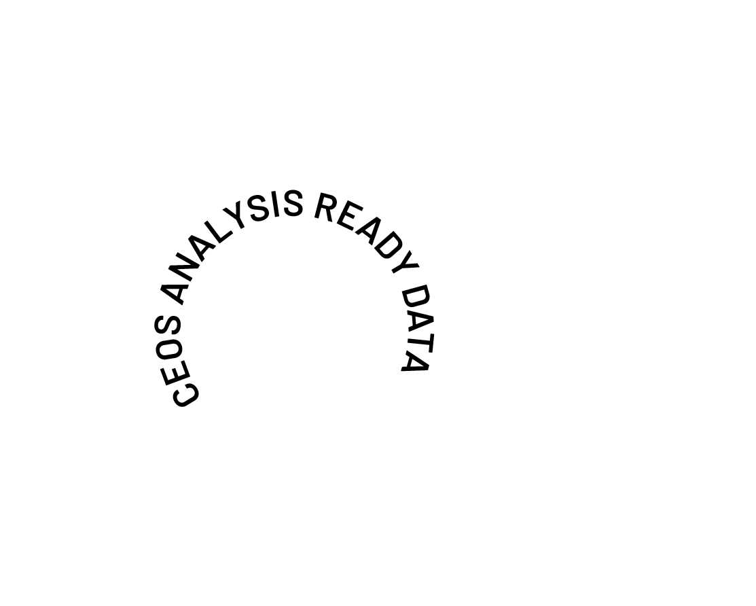
The Future of CEOS Analysis Ready Data
Ferran Gascon
ESA, CEOS-ARD Oversight Group Lead
Shaping the future of CEOS-ARD
SIT TW 2025

Slide 2
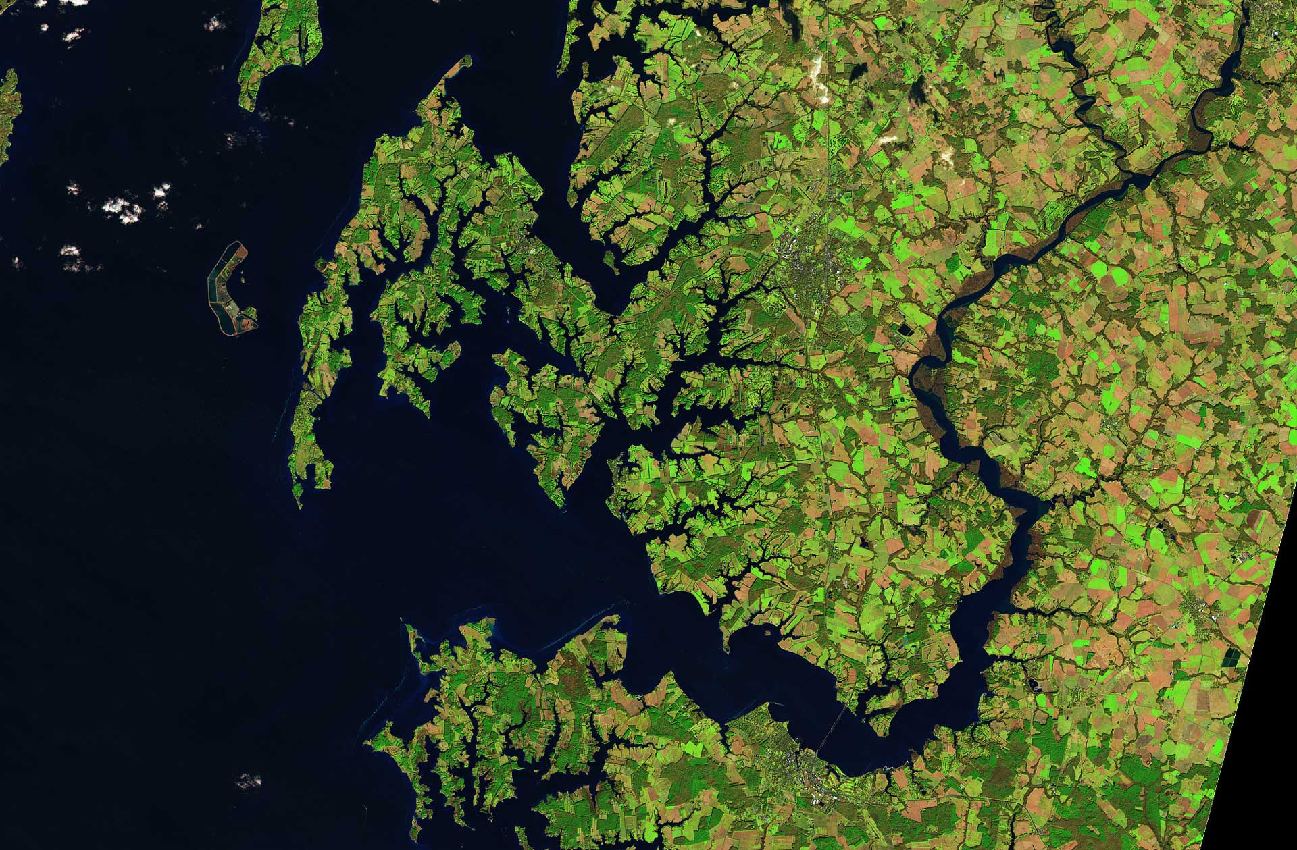
Background
CEOS Analysis Ready Data (CEOS-ARD) caused a significant and positive paradigm shift in the Earth observation community
Making data more transparent and easy to use
Basis for improved interoperability.
Critical benchmark for non-CEOS data providers
Encouraged a more thoughtful approach to data provision
Ensuring non-experts can benefit alongside the scientific community
Democratising EO
SIT TW 2025

Slide 3



Impact
For our Global Mangrove Watch (GMW) data workflow where we process thousands of images, the CEOS-ARD standard used for the JERS-1/ALOS/ALOS-2 SAR data from JAXA has simplified our processing chains with data now provided as GeoTIFFs and with standardised metadata. The specified pre-processing, including geometric rectification and radiometric terrain correction, has also been a significant help and reduced our internal data processing effort.
Dr Pete Bunting, Global Mangrove Watch Product Lead, Aberystwyth University, UK
By adopting CEOS Analysis Ready Data (CEOS-ARD) specifications, Digital Earth Africa is ensuring that satellite data is available, findable, accessible, and suitable for use by as many users as possible. Using CEOS-ARD, DE Africa is providing a rich source of information to better understand and address challenges of sustainable development in Africa. This information tells a story over time to support decision-making by governments, private sector and civil society.
Dr Adam Lewis PSM, Senior Advisor on the Global Team for Digital Earth Africa
Landsat Collection 2’s compliance with CEOS-ARD standards has been a game changer for the global Earth observation community. Users gain faster, more dependable insights for diverse applications from land cover change and agricultural monitoring to natural resource management and disaster response. CEOS-ARD compliance has truly unlocked the analytical power of the 50+ year Landsat archive, significantly enhancing USGS's contribution to our understanding and stewardship of the planet.
Dr. Christopher Barnes (KBR), Sustainable Land Imaging Partnerships, USGS EROS Center, USA
SIT TW 2025

Slide 4





Since 2016, CEOS has developed nine CEOS-ARD Product Family Specifications (PFS)
SIT TW 2025
* Combined SAR PFS includes: Normalised Radar Backscatter, Polarimetric Radar, Ocean Radar Backscatter, Geocoded Single-Look Complex, Interferometric Radar

Slide 5
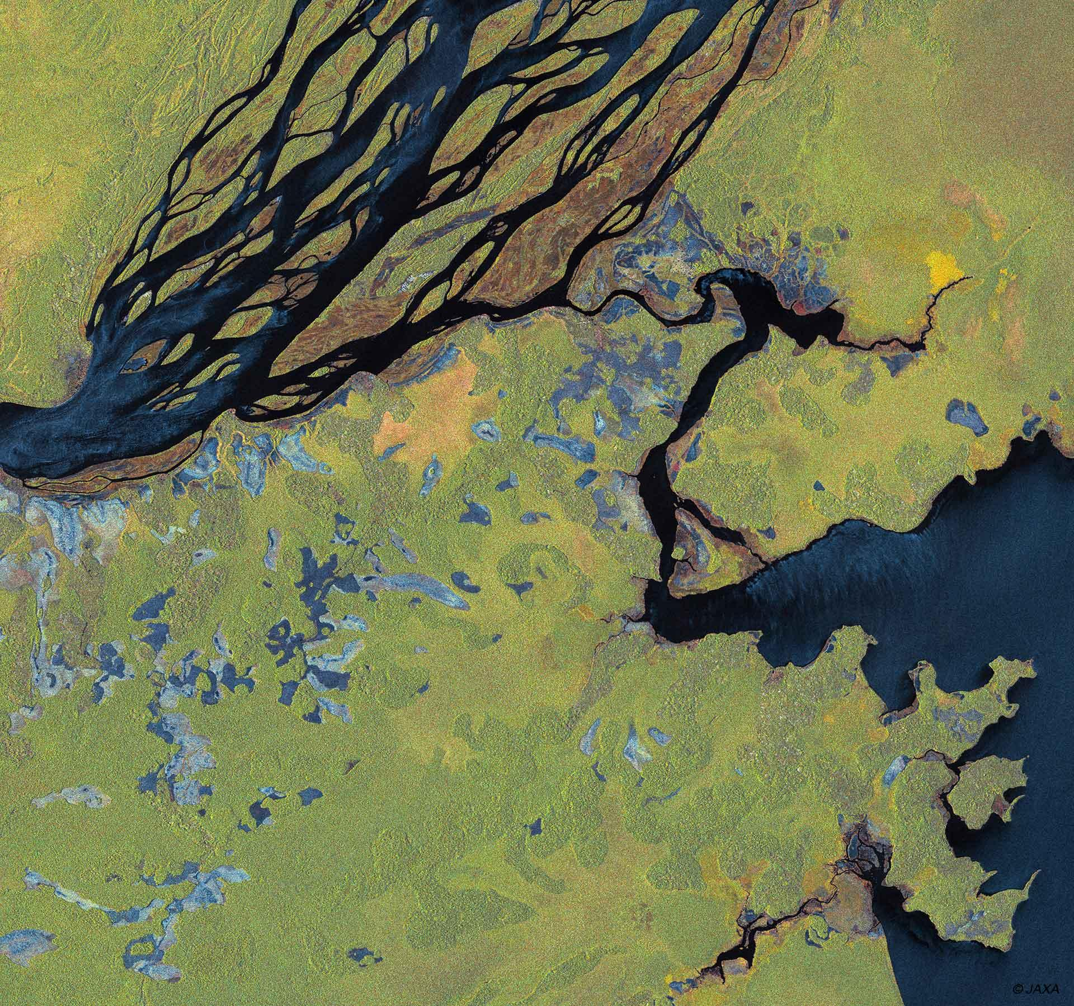


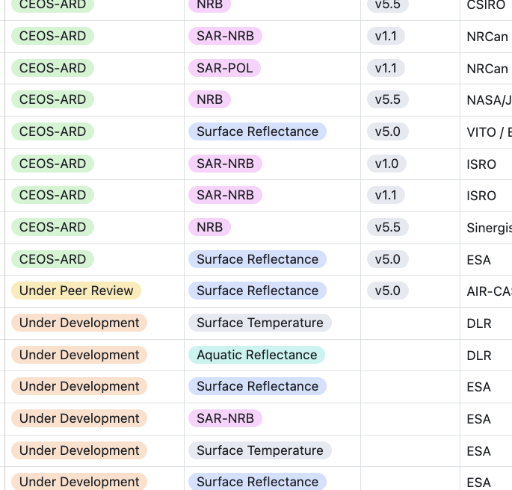
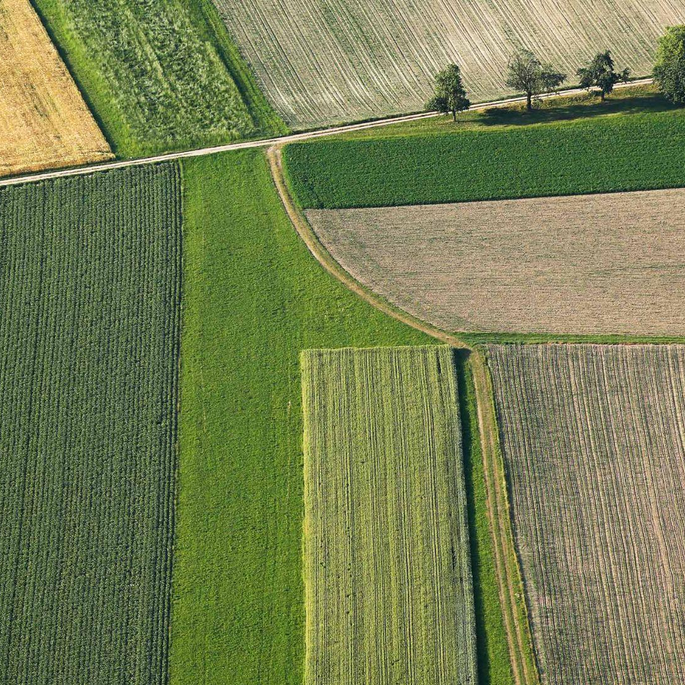
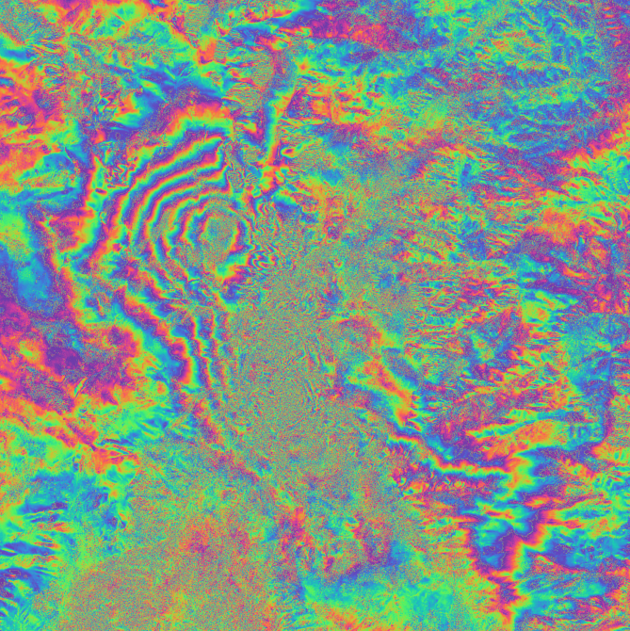
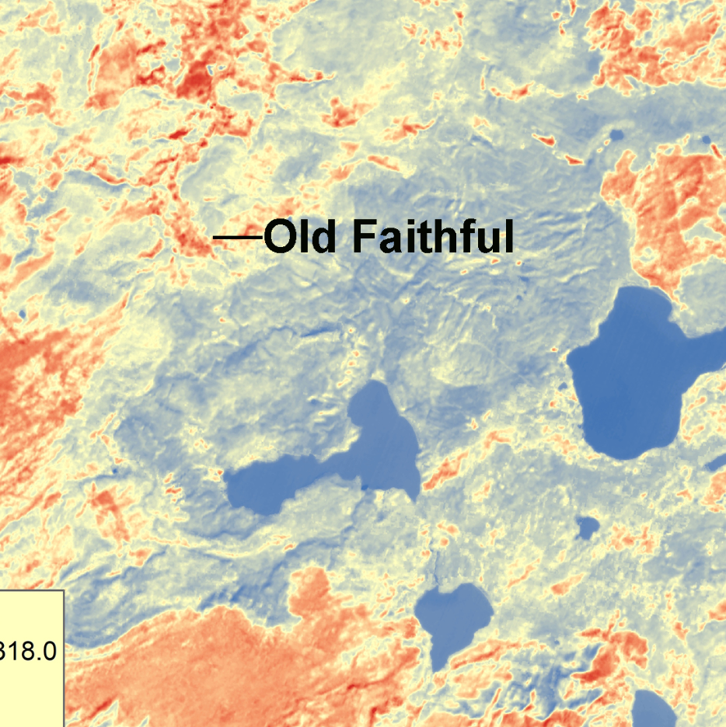

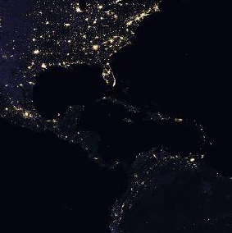
Where are we now?
CEOS-ARD Specifications have been powerful catalysts for progress:
USGS Landsat Collection 2
Copernicus Sentinel-2 Collection 1
ALOS-2 PALSAR-2 ScanSAR NRB and Global Mosaics
DLR EnMAP
ISRO RISAT-1A
And many more… See all datasets on ceos.org/ard
CEOS-ARD Product Family Specifications
Synthetic Aperture Radar
Normalised Radar Backscatter, Polarimetric Radar, Ocean Radar Backscatter, Geocoded Single-Look Complex, Interferometric Radar
Surface Reflectance
Nighttime Lights Surface Radiance
Surface Temperature
Aquatic Reflectance
SIT TW 2025

Slide 6
Some updates since SIT-40
2025 has been pivotal for CEOS-ARD community engagement (LSI, LPS, WGCV-55, IGARSS …)
EarthDaily, Ororatech, Planet, SatVu, Constellr, Aistech Space, Marble Imaging AG, SatSure, Catalyst, Synspective, Esri, Hyspace, SkyServe, Pixxel, SatSure, Synspective, and more
From the news: SatSure has been selected to build India’s PPP-led EO constellation. KaleidEO will deliver two wide-swath multispectral imaging payloads (~1–2 m GSD, 8 MS bands, >65 km swath) and ARD data to CEOS-ARD standards to the consortium
New Aquatic Reflectance, INSAR PFS
Next: multi-source SAR mosaics, VHR SAR
CEOS and industry agreement to co-develop updated Surface Temperature Specification
LST, SBT, SST?
NASA (CSDA) and ESA (EDAP) Joint Earth Observation Mission Quality Assessment Framework engagement – seeking synergies and efficiencies
CEOS-ARD GitHub to increase transparency, consistency, community participation, version control, software alignment, etc.
Agreed new CEOS-ARD typology and product level categorisation
SIT TW 2025

Slide 7
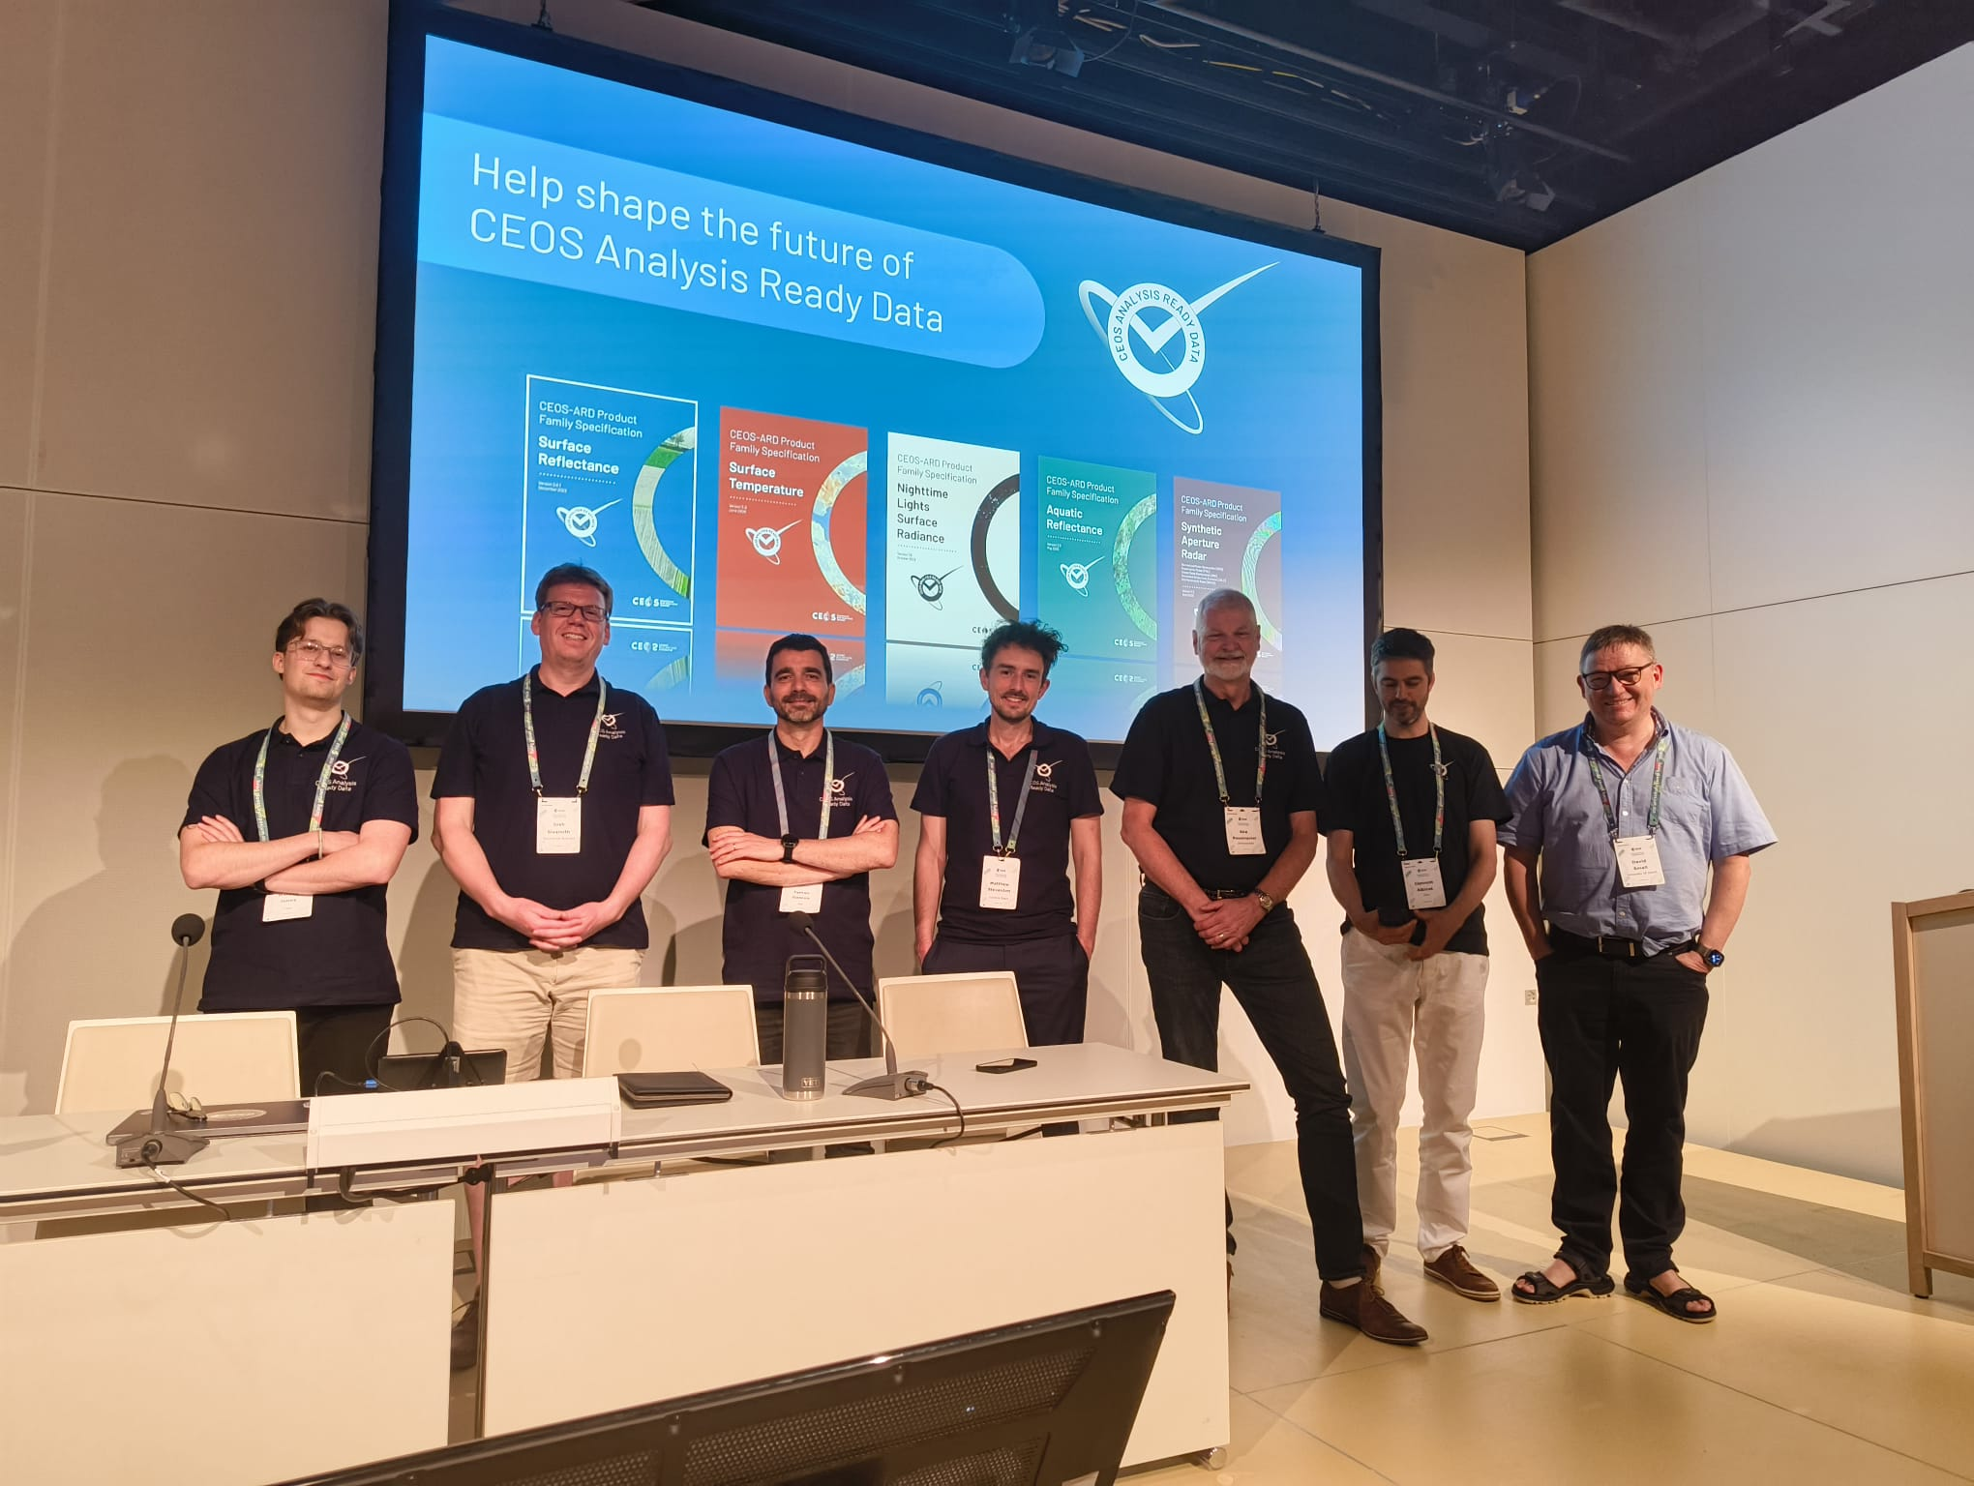
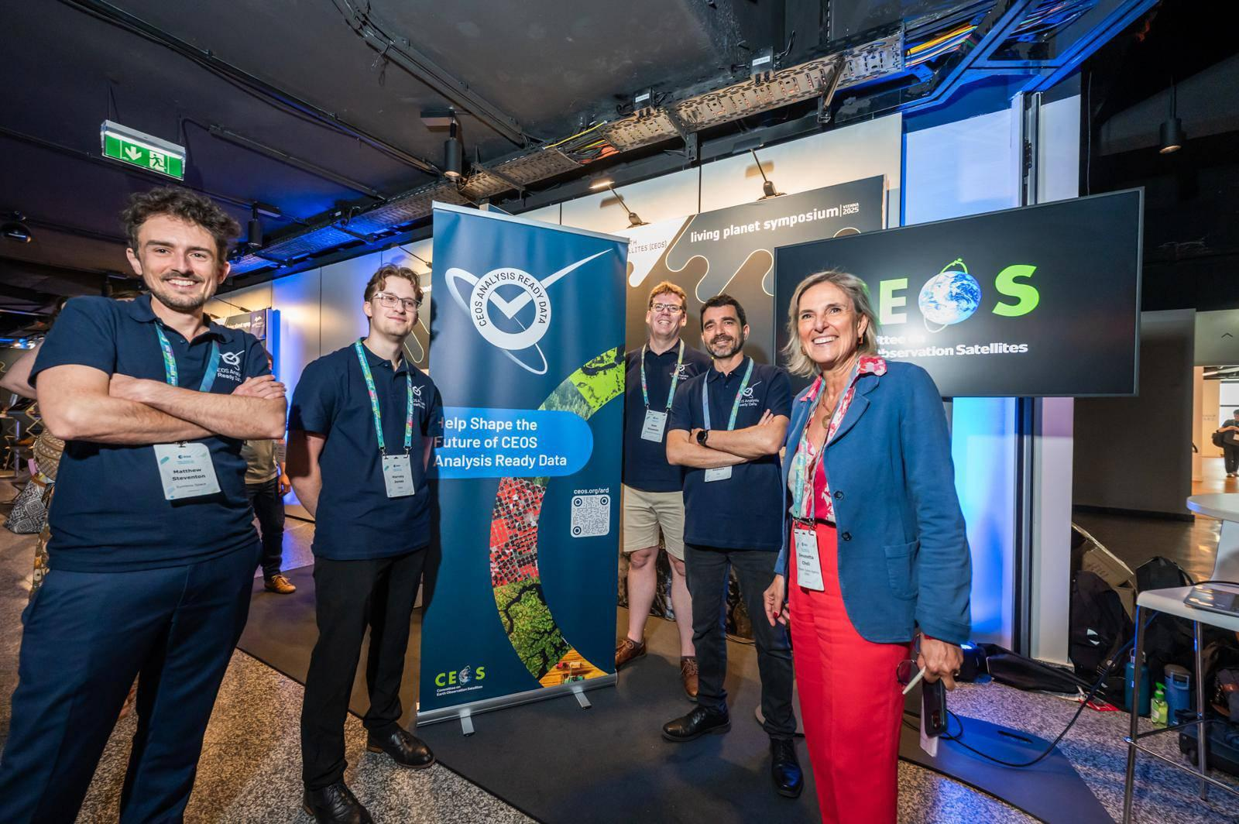
CEOS-ARD
@ ESA LPS 2025

Slide 8
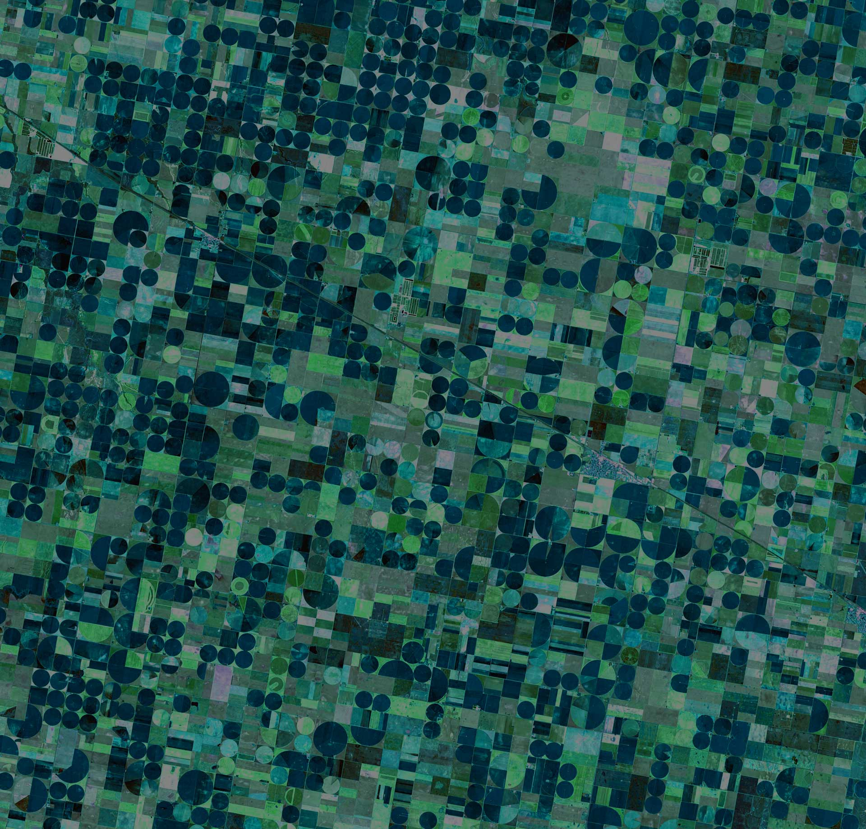
Can we do more?
The Earth observation sector has come a long way since CEOS-ARD was first conceptualised:
Changing technology, including AI/ML, cloud-native
Evolving user base and expectations
Increasing demands for interoperability
Need CEOS-ARD to continue evolving
Ensure CEOS-ARD remains consistent with and relevant to the evolving user base and their expectations
Where are the opportunities to make CEOS-ARD better?
SIT TW 2025

Slide 9
Future of CEOS-ARD
Goals for 2025:
Gather community feedback on the current state of CEOS-ARD
Understand priorities for future development
Present concept note for CEOS-ARD Strategy 2026 at CEOS Plenary 2025
Overall Aim: Ensure CEOS-ARD is working for the broadest group of stakeholders
SIT TW 2025

Slide 10

Approach
CEOS-ARD Oversight Group tasked with maintaining CEOS-ARD Strategy
Updated every two years
In 2025 we have undertaken a community engagement campaign to understand needs
Particular focus on those outside of CEOS
Understand exactly how CEOS-ARD needs to evolve
Presence at key events such as ESA’s LPS, IGARSS, IAC, WGCV-55
Survey to gather feedback to “Help Shape the Future of CEOS-ARD” ceos.org/ard/survey
Social media campaign
LinkedIn particularly valuable
SIT TW 2025

Slide 11
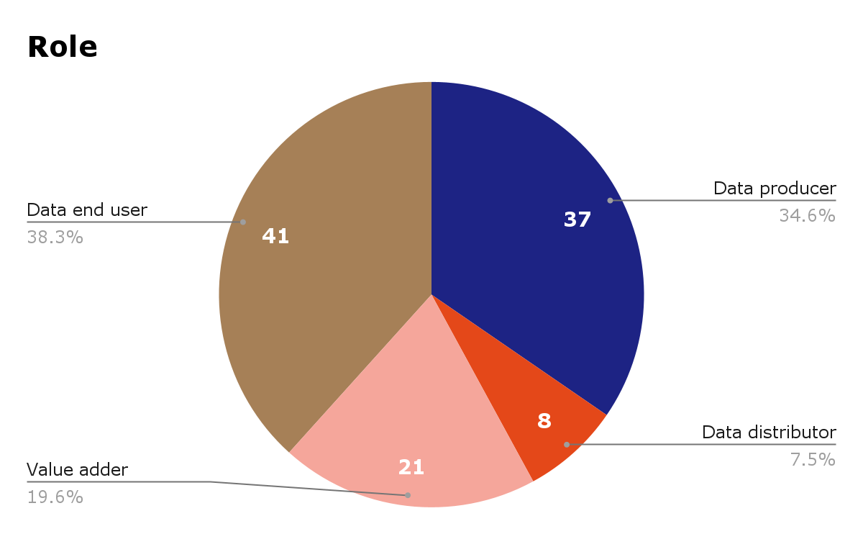
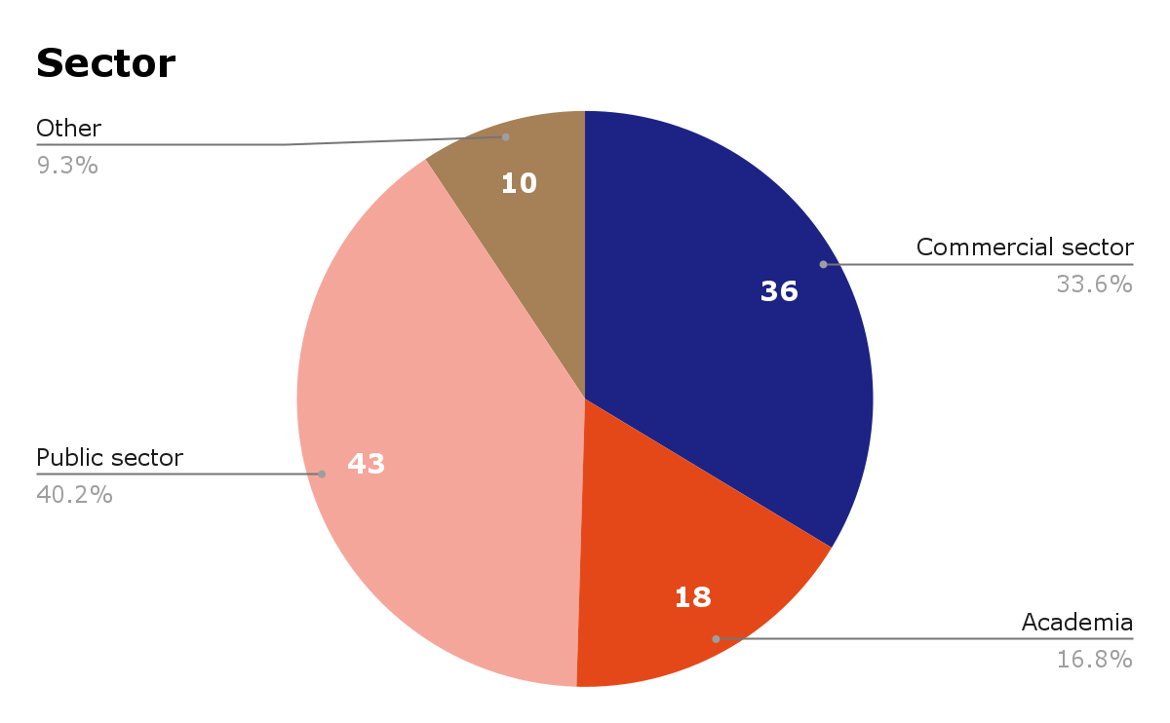
Survey Respondents
107 responses! 🎉
SIT TW 2025

Slide 12
Preliminary Findings
From survey results, discussions within CEOS, and workshops with the broader community
Topics that a Future CEOS-ARD Strategy Should Consider:
Consistent and Enhanced Metadata Specifications
Data and Metadata Quality
Ongoing Quality Assurance and Integrity Monitoring
Fitness for Purpose Metrics
Increased Support to Scientific Applications and Environmental Adaptation and Resilience
Stability, GCOS ECVs
Tools for ​​Automated Compliance Assessments and Reviews
SIT TW 2025

Slide 13
Preliminary Findings
Topics that a Future CEOS-ARD Strategy Should Consider:
Increased Commercial Relevance
Business case related but also technical: VHR, mosaic products (constellations)
Supporting Opportunities and Reducing Risks Related to AI / ML
Garbage-in, garbage-out?
CEOS-ARD datasets as the ‘gold-standard’ training data for Geospatial Foundation Models (GFMs) and other AI/ML applications?
​Measurand Consistency to Promote Application Resilience
Multi-source applications
Alignment with the Software Ecosystem
ARD Standards
​​Thematic and Higher-level ARD Products
Training and Outreach
Capturing Use and Impact
SIT TW 2025

Slide 14
Timeline
Findings will be presented at the 2025 CEOS Plenary to:
Present a clear statement of what a future CEOS-ARD needs to look like according to the community.
Support request for CEOS Principal decision to develop the CEOS-ARD Strategy 2026 (for endorsement at CEOS Plenary 2026) that would delve deeper into what is needed to address these findings and resource the specific tasks needed to achieve this step change in ambition.
CEOS-ARD Strategy 2026 would be developed throughout 2026 by the CEOS-ARD Oversight Group in collaboration with various CEOS entities and in consultation with external stakeholders.
Initial outline to be presented at SIT-41 (April 2026)
Near complete draft then prepared for discussion at SIT Technical Workshop 2026
Presentation for endorsement at CEOS Plenary 2026 (hosted by Australia, Hobart)
Joint WGCV-56 and LSI-VC-19 meeting a critical and timely milestone for data quality topics
SIT TW 2025

Slide 15
Closing
Thank you to everyone for supporting this effort!
Community reception has been extremely positive and encouraging
107 survey responses and counting
Numerous valuable inputs through interaction at events
2025 has been pivotal for CEOS-ARD community engagement
SIT TW 2025

Slide 16
Shaping the future of CEOS Analysis Ready Data

Slide 17
Appendix: Future of CEOS-ARD Survey Preliminary Results
Matt Steventon
CEOS-ARD Oversight Group
Shaping the future of CEOS-ARD
SIT TW 2025

Slide 18
Future of CEOS-ARD Survey
ceos.org/ard/survey
Core questions + tailored questions for data producers, users, distributors, etc.
Characteristics needed to make an EO dataset 'Analysis Ready'
What do you value most in the CEOS-ARD Framework
What should be prioritised for future development?
Do you see a need for formal EO ARD standards or is a ‘community standard’ approach like CEOS-ARD sufficient?
Characteristics needed to make an EO dataset 'AI/ML ready'
Barriers to use of the CEOS-ARD Framework / products
Specific datasets you would like to see assessed and endorsed as CEOS-ARD
Opportunities to accelerate the uptake and impact of CEOS-ARD
CEOS-ARD self-assessment plans
SIT TW 2025

Slide 19
Some Food for Thought
Could we be more ambitious?
Is the value proposition of CEOS-ARD clear and could it be better communicated?
The potential role of CEOS-ARD as a common benchmark for space agency / governmental data procurement processes.
Do we need to introduce minimum requirements for data quality? And what is the correct approach?
Can we better support users to find products that are fit for a specific purpose?
Supporting application resilience by increasing consistency and equivalence of CEOS-ARD products?
How might CEOS-ARD be made more interoperable and interchangeable? Do we need to be stricter in certain areas to drive practical interoperability?
SIT TW 2025

Slide 20
Respondents
107 responses! 🎉
SIT TW 2025

Slide 21
Survey responses
CEOS / Space Agency | Commercial | Other
Australian Bureau of Meteorology ASI CONAE CSIRO DLR ESA Geoscience Australia GISTDA ISRO NASA NOAA SANSA UNOOSA | Airbus Defence and Space GmbH AISTECH SPACE, S.L. Arlula Pty Ltd Auspatious CATALYST (PCI Geomatics) Common Space Constellr EarthDaily ENVEO IT GmbH EOIntelligence Esri First Street GeoInsight GRASP Earth Marble Imaging AG Pixalytics Ltd Pixxel Planet Labs Riscognition GmbH Sarmap SA SatSure India Analytics Pvt Ltd SatVu Sparkgeo SpectralEO Telespazio UK USACE-AGC World from Space | Aberystwyth University Anna University Conicet Curtin University Kasetsart University KTH Royal Institute of Technology Landgate Natural Resources Canada OGC STFC Trier University UK Met Office UK Ordnance Survey Univ. Colorado, Boulder University of Maryland University of Tartu University of the Free State University of Venda
SIT TW 2025

Slide 22
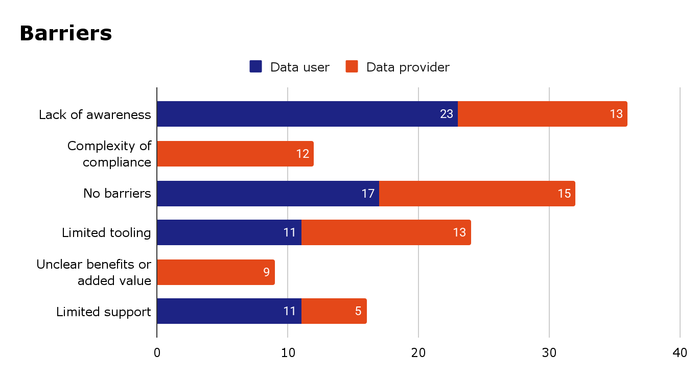
Future of CEOS-ARD
SIT TW 2025

Slide 23
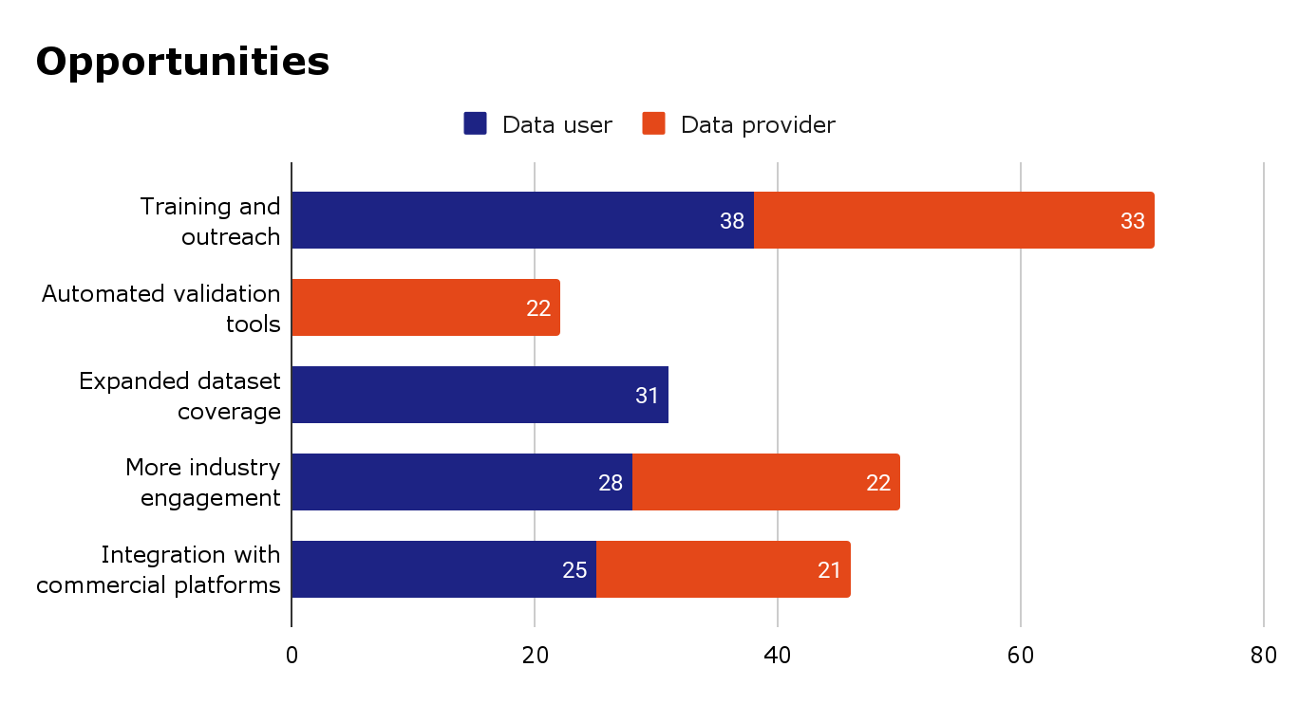
Future of CEOS-ARD
SIT TW 2025

Slide 24
Top 10 Characteristics for Analysis Ready Data (multiple choice)
Rank | Characteristics sorted by ranking
1 | Consistent metadata specifications
2 | Machine-readability
3 | Interoperability through time (relative geolocation)
4 | Findable, Accessible, Interoperable, Reusable (FAIR) compliance
5 | Consistency (data has temporal and spatial consistency)
6 | Consistent terminology
7 | Accessibility
8 | Interoperability with other datasets
9 | Geometric correction using DEM (ortho-rectified)
10 | Fitness for purpose indicators (that the product fulfills the requirements of a specific application, e.g., land cover mapping, precision agriculture, etc.)
Respondents were also asked to provide additional characteristics and comments in a free text field. Feedback has been integrated into concept note.
Notably, quality characteristics were mentioned six times.
SIT TW 2025

Slide 25
Top 10 Characteristics for AI/ML Ready Data (multiple choice)
Rank | Characteristics Sorted by Ranking
1 | Machine-readable formats
2 | Rich, consistent, useful and interpretable metadata
3 | Easy access via APIs or cloud providers
4 | Rigorous definition of data values/content (no ambiguities)
5 | High-quality data and continuous QA/QC
6 | Large-scale accessibility
7 | Temporal consistency
8 | Supply of training datasets that are consistently and accurately labelled
9 | Automated pre-processing
10 | Standardised acquisition parameters
Respondents were also asked to provide additional characteristics and comments in a free text field. Feedback has been integrated into concept note.
SIT TW 2025

Slide 26
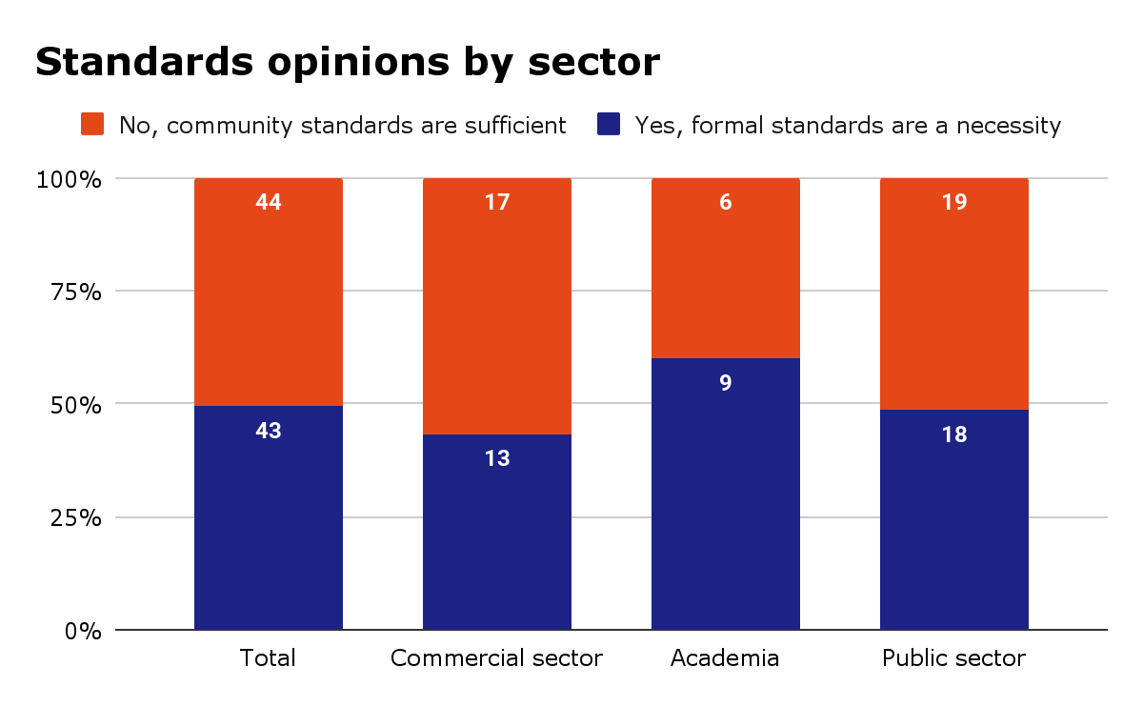
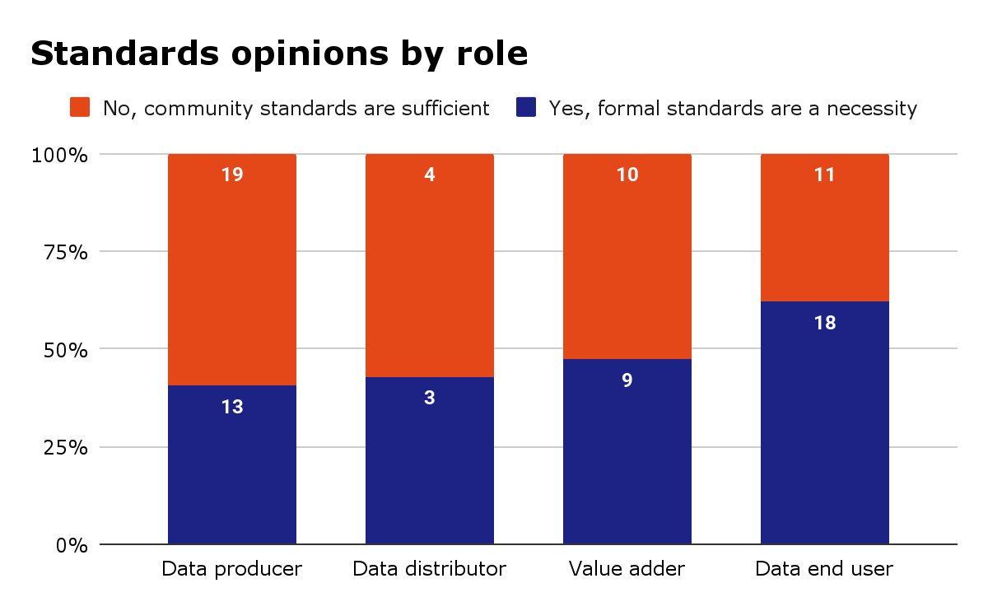
Opinions on ARD Standards
Respondents were divided on the topic of formal vs community standards
In the additional comments box, respondents advocated for free and open community standards – noting the need to be flexible
SIT TW 2025

Slide 27
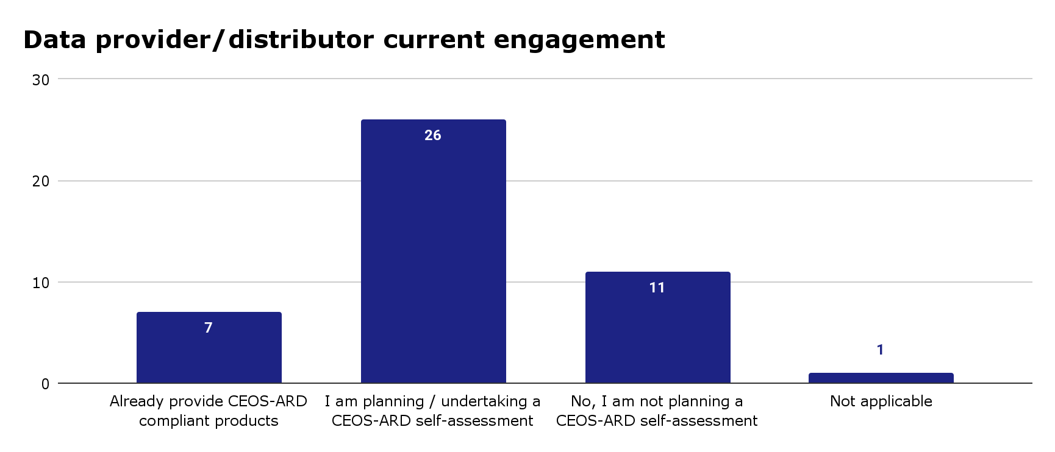
SIT TW 2025

Slide 28
Are there specific datasets you would like to see assessed and endorsed as CEOS-ARD?
Commercial data sources
SAR datasets with consistent radiometric calibration performed, using the same DEMs
Copernicus data
MODIS and all ESA Sentinel products
Thematic products for vegetation biomass SAR
Planetscope
PACE
All EO data that are licensed by National Govts and are either public or commercial
The data from the EO workshorses such as Landsat, Sentinels, PACE, VIIRS etc.
Reanalysis model data such as ERA-5
NovaSAR-1
High resolution datasets
Sentinel-1,2,3
Global elevation models like AW3D, COP30 or COP90
Low level (e.g. surface reflectance) products that invovle multi-sensor integration
NISAR
SIT TW 2025

Slide 29
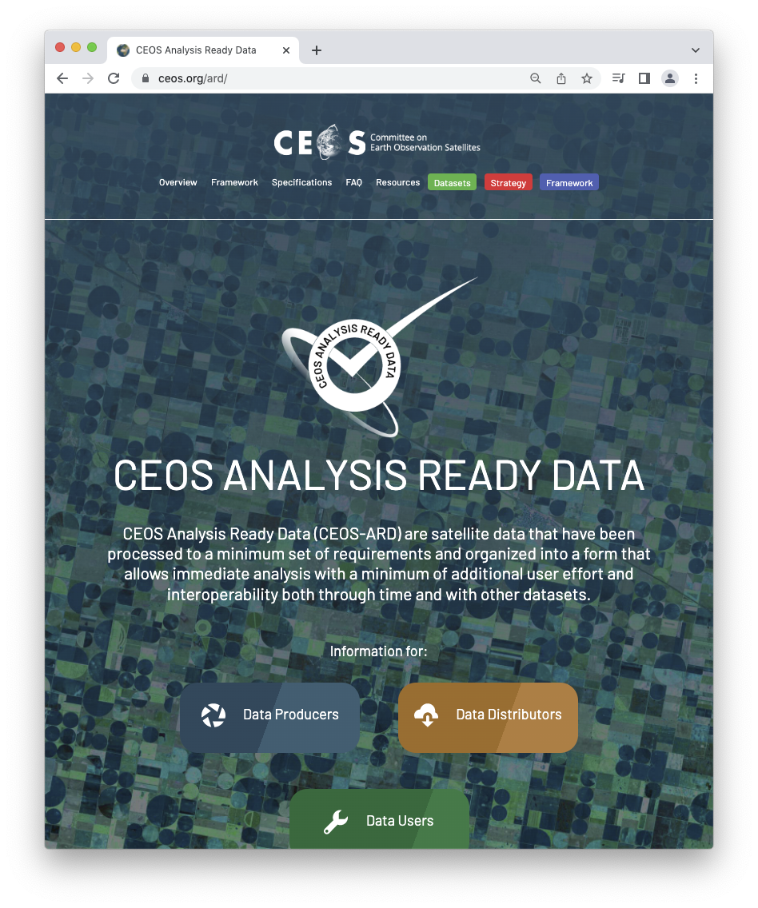
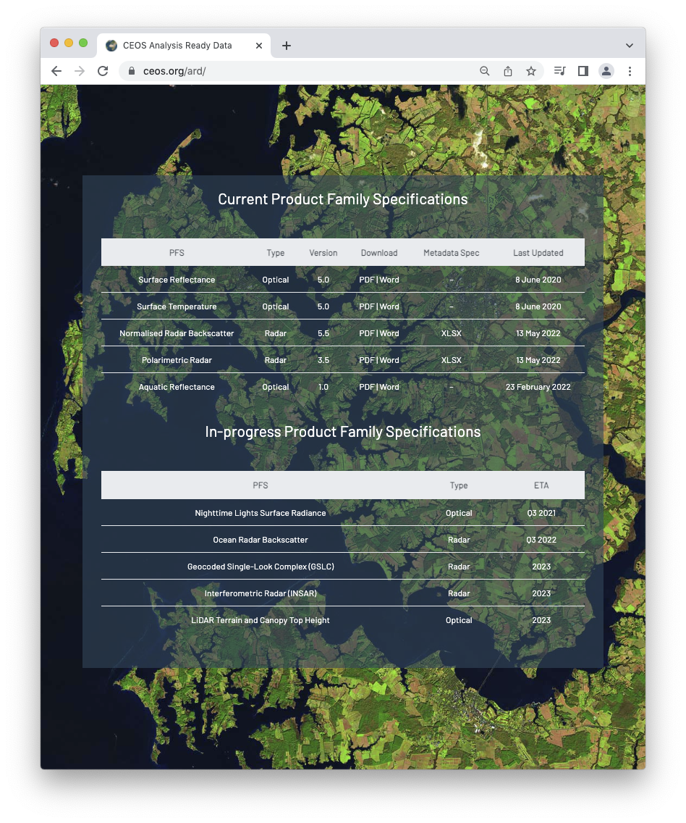
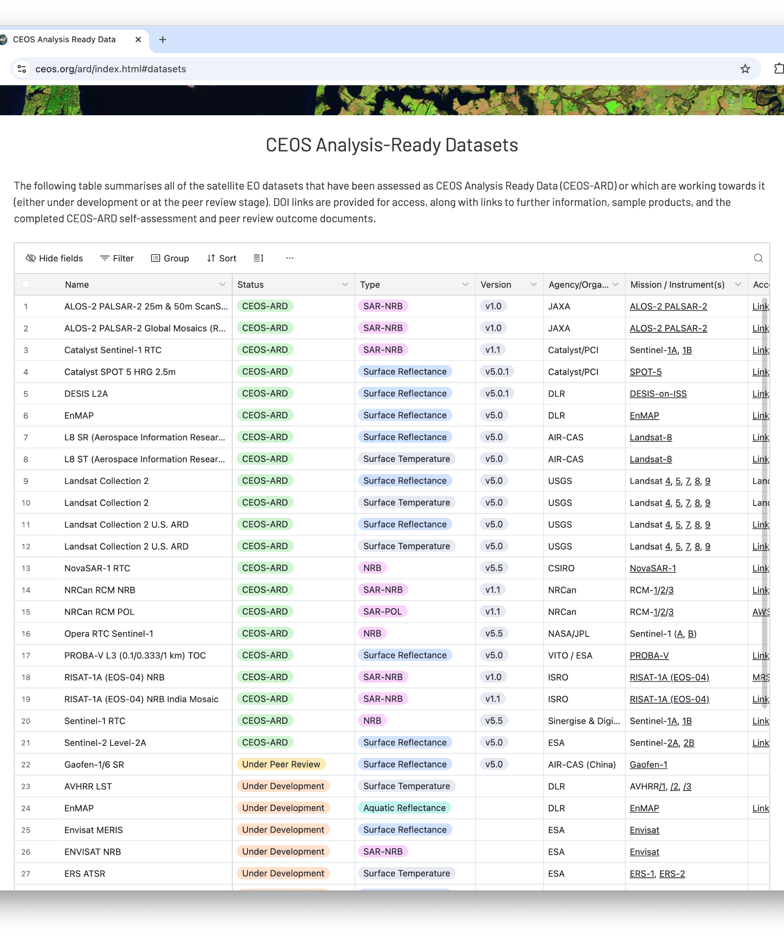
Connect
ceos.org/ard
Contact form on page
Or directly:
Ferran.Gascon@esa.int
matthew@symbioscomms.com
SIT TW 2025

Slide 30
Help shape the future of CEOS Analysis Ready Data

