Slide 1
CEOS SIT TW
CEOS Analytics Lab (CAL)
David Borges, SEO
Agenda Item 5.5
SIT TW 2025
Darmstadt, Germany
10 September 2025

Slide 2
CAL Topics
Overview & Capabilities
Technical Developments & Platform Improvement
CEOS SARCalNet Support
Commercial SAR Tasking / Analysis (Umbra, ICEYE, Capella)
Case Study: ALOS-2 Forested Wetlands Inundation Mapping

Slide 3
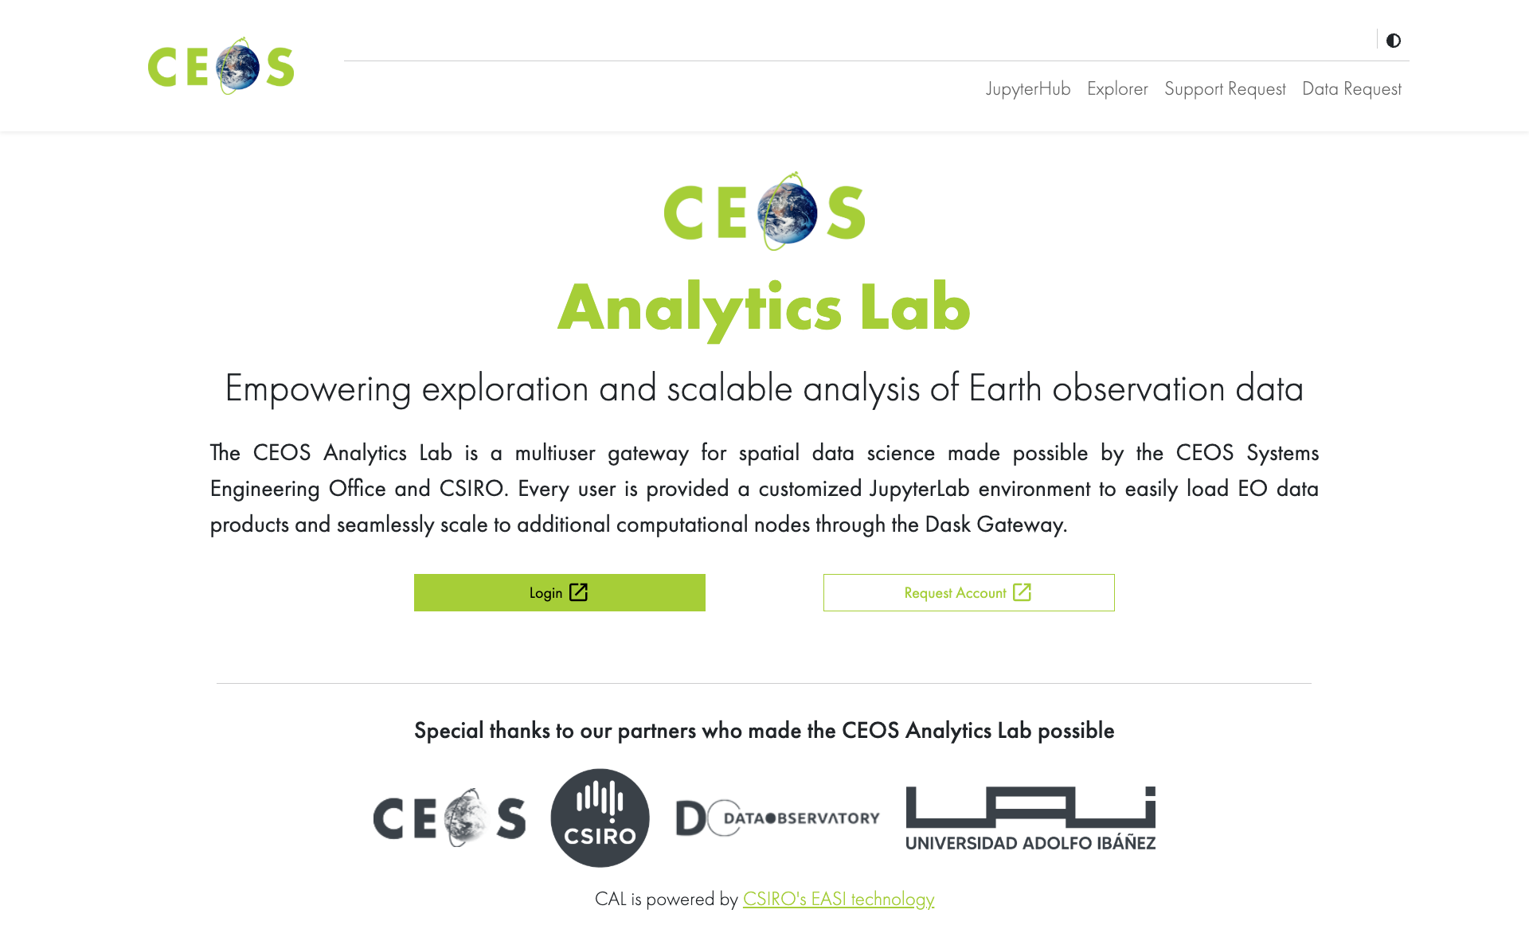

CEOS Analytics Laboratory (CAL) (Formerly known as EAIL)
cal.ceos.org

Slide 4
























Elastic Kubernetes Service
Analytics Laboratory
OGC Web Services
Data visualisation
https://cal.ceos.org
WMS, WMTS and WCS
Horizontal Pod Autoscaler (HPA) adjusts to user demand
Customisable, on-the-fly functions and calculations
Handles OGC, ESRI, other map services and geospatial files
2D, 3D and 4D visualisations
Above and below ground
Charting and time-series
OWS
Storage
Data for visualization
Public
Amazon S3
Amazon EC2 Auto scaling
Amazon EC2 Auto scaling
Dask Worker
ARCO data formats
(e.g. COG/Zarr)
Dask Worker
Metadata queries
Analytics environment
Flexible, scalable workers
Metadata
(eo3/STAC)
32GB, 8CPU default capacity
>500 pre-installed python libraries
Optional extra CPU/RAM
Optional GPU
Metadata and data response
Powerful parallel processing
Optional GPU, extra CPU or extra RAM (per worker)
Amazon S3
Amazon RDS
Argo Workflows
Powered by:
Data updates and new product generation
(ARCO data formats and eo3 metadata)
Powerful workflow engine
Hugely scalable
Automated data and product updates
Customised, on-demand data workflows
In addition to:
Automation and orchestration with:
Amazon Cognito
Amazon EFS
Amazon DynamoDB
Amazon CloudFront

Slide 5

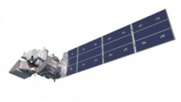

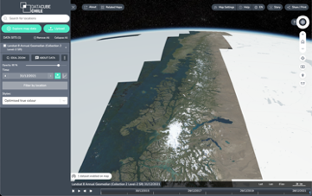

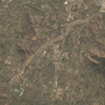
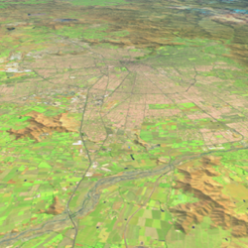
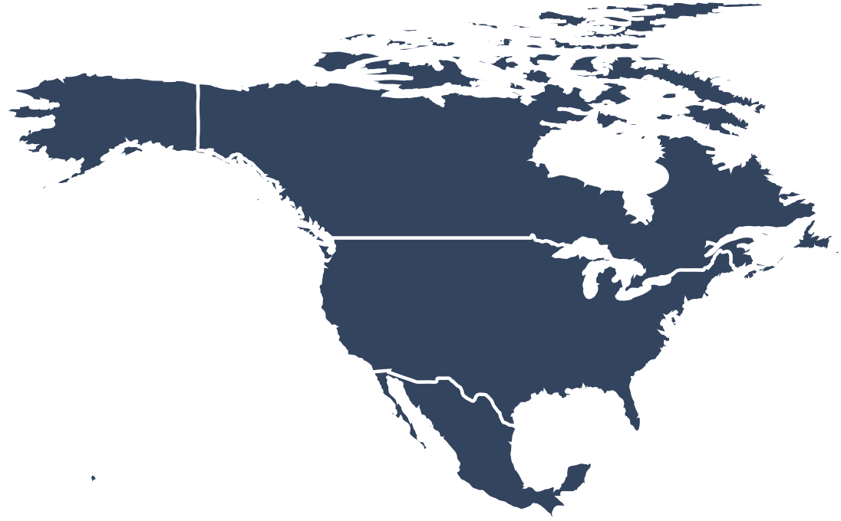


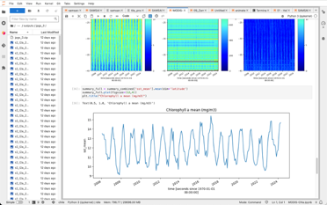

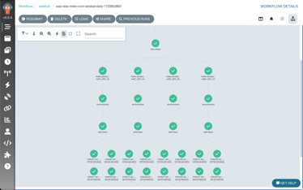
CEOS Analytics Laboratory
Analytics Laboratory
from pilot or project
to national or continental
ARD & ARCO
Visualisation
Analysis Ready:
Landsat 5/7/8/9
Sentinel 1/2/3
MODIS
VIIRS
ALOS
Elevation
Small sats
Commercial
…
Exploratory analysis
1 computer or 200
30GB RAM or 6TB
8 CPU or 1600
Scalable workflows
ARCO = Analysis Ready, Cloud Optimized

Slide 6
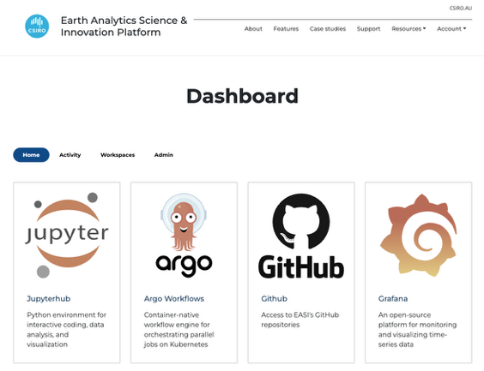
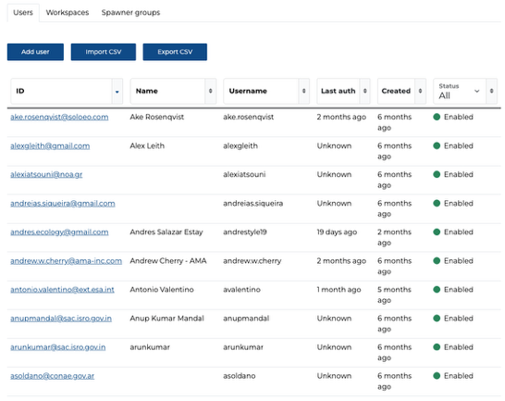
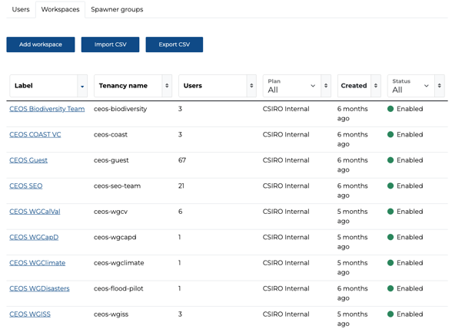
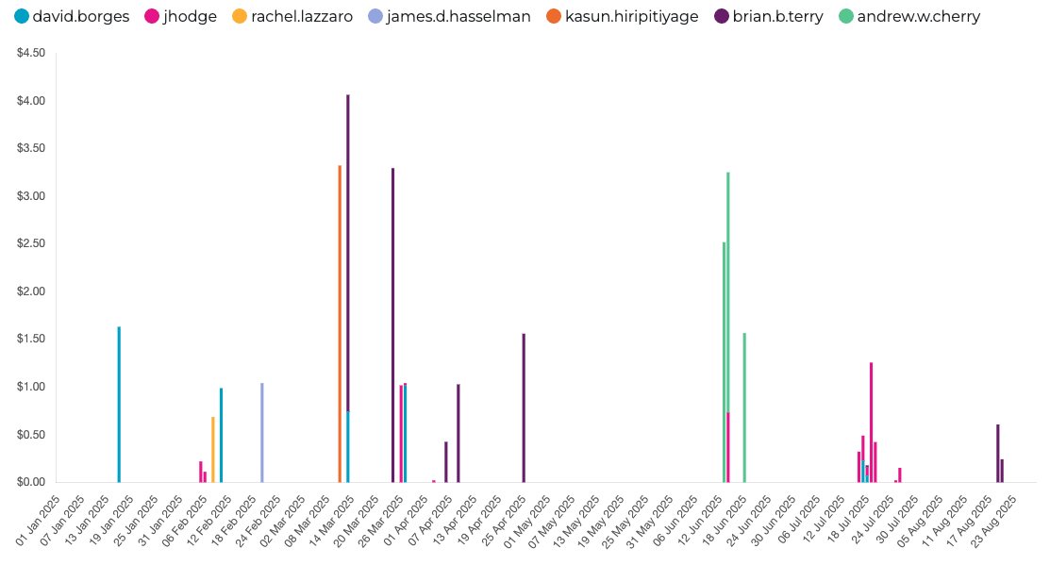
CAL - New Features
Improved user management dashboard
Centralized dashboard for users to access CAL components
Simplified control of shared workspaces and compute options
Self-service information about a user’s own usage and efficiency
Administrator-level summaries of overall usage

Slide 7
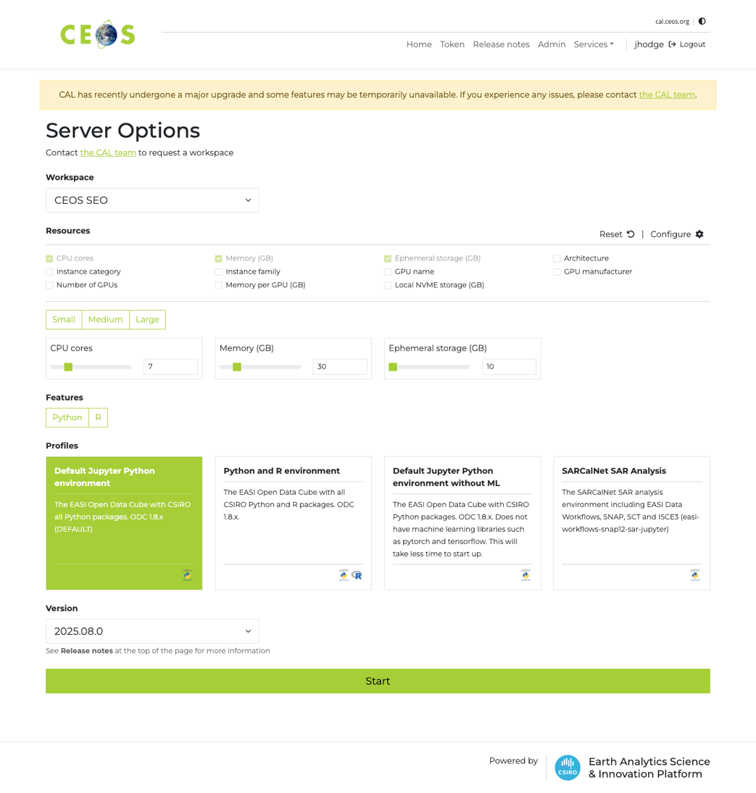
CAL - New Features
New JupyterLab styling and options
Flexible machine options
New GPU options
New architecture selections (arm64)
Selections for specific instance types if required (AWS instance types)
New option of on-node SSD storage for fast access to local data

Slide 8
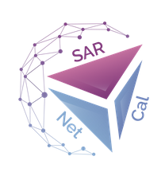
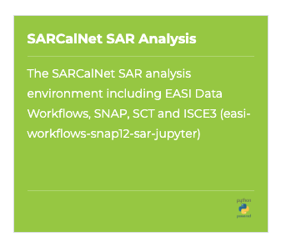
CAL support to WGCV-SAR & SARCalNet
New custom CAL environment for WGCV-SAR & SARCalNet users
Includes a range of SAR-specific tools and libraries for processing and analysis, including:
Can be expanded on request
Demo at WGCV SAR 2025 ws (Oct 2025)
Sardem
NISARQA
KARIOS
S1etad
SNAP
ISCE3
SAR Cal Toolbox (SCT)
PolSARPro

Slide 9

Commercial SAR data access through NASA CSDA
SEO evaluation of CSDA opportunity:
Access to commercial SAR (ComSAR) data
NASA application procedure
Responsiveness of ComSAR operators
Relevance of acquired data (target coverage, timeliness, formats, …)
ComSAR systems available through the CSDA Program:
Capella Space (X-band, single-pol, SAR)
ICEYE US (X-band SAR)
Umbra (X-band SAR)
Key point: CSDA accommodates new tasking requests (a prerequisite for meaningful use as ComSAR Open Data global archives found to be fragmented and of limited general use)
ICEYE (Stripmap)
Capella Space (Stripmap-50)
Umbra (Spotlight)
GA Corner Reflector array (QLD, Australia)

Slide 10
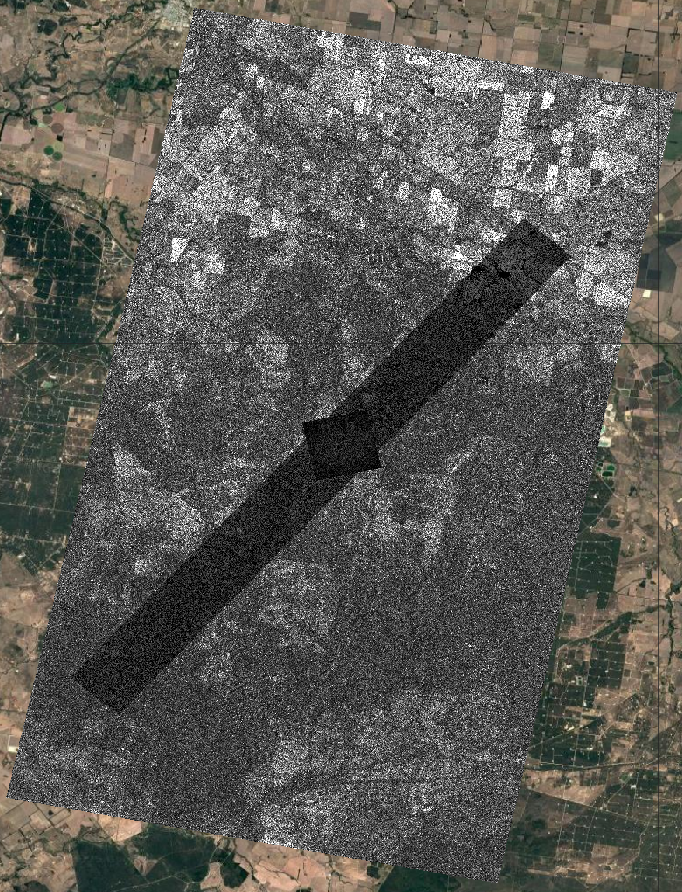
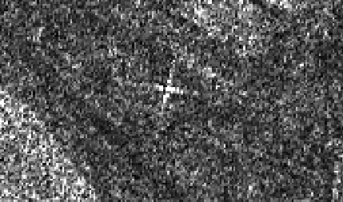

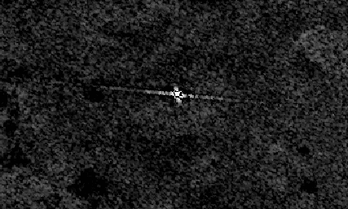
Commercial SAR data access through NASA CSDA
Request #1
Geoscience Australia Corner Reflector array (QLD, Australia)
ICEYE + Capella + Umbra
Stripmap + Stripmap + Spotlight
Target: Corner Reflector (SB16)
Time window: May/June 2025
Outcome
All vendors on target (CR OK!)
Within temporal window OK
Modes & viewing geometry OK
Data provided at two proc. levels: GRD (SIDD) & SLC (SICD) OK
Latency: Delivery >2 months after obs. NG
This work utilized data made available through the NASA Commercial Satellite Data Acquisition (CSDA) Program and U.S. Geological Survey – CAC. ©2025 ICEYE, Capella, Umbra.
ICEYE (Stripmap)
Capella Space (Stripmap-50)
Umbra (Spotlight)
ICEYE 2025-06-05
Target
CR-SB16
Capella 2025-06-06
GA Corner Reflector array (QLD, Australia)
Umbra 2025-06-16

Slide 11
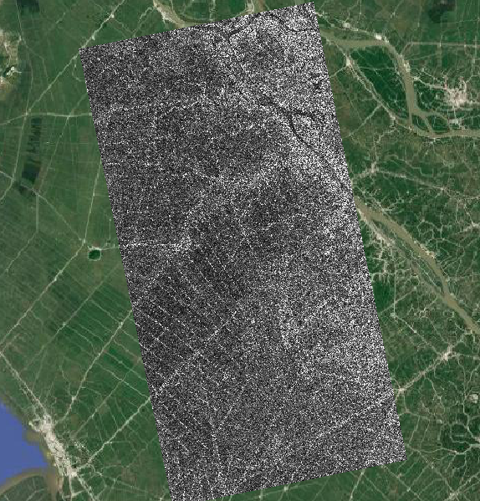
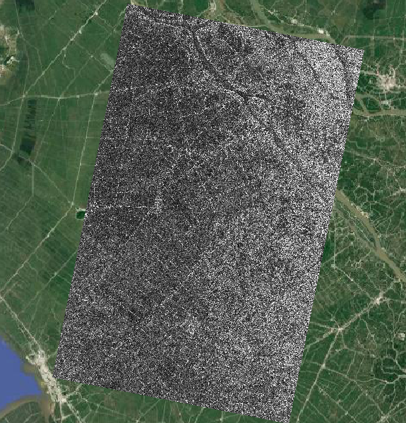
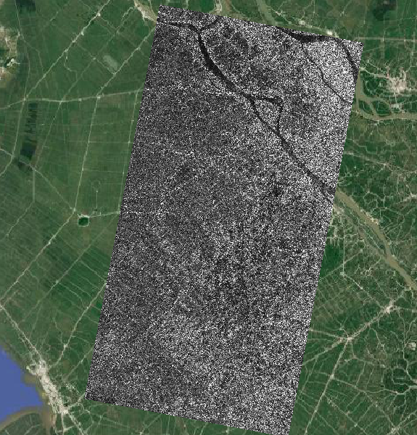
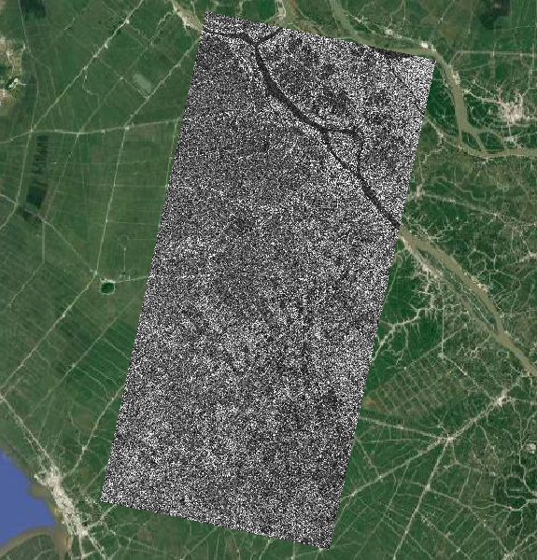
Commercial SAR data access through NASA CSDA
Request #2
Mekong delta (Vietnam)
ICEYE stripmap time-series
Every 6-days, May–Sept 2025 (~20 obs)
Consistent viewing geometry though time-series
Outcome
Target location OK
Observation mode OK
4/20 observations (22 May – 19 Jun) delivered (still ongoing? - no info) NG
Mix of ascending/descending passes NG
All data provided at two p. levels: GRD (SIDD) & SLC (SICD) OK. But no DEM corrected level NG (→ Good case for CEOS-ARD!)
Latency: 2-3 months after observations NG
This work utilized data made available through the NASA Commercial Satellite Data Acquisition (CSDA) Program and U.S. Geological Survey – CAC. ©2025 ICEYE, Capella, Umbra.
ICEYE 2025-05-22
ICEYE 2025-06-05
ICEYE 2025-06-17
ICEYE 2025-06-19

Slide 12
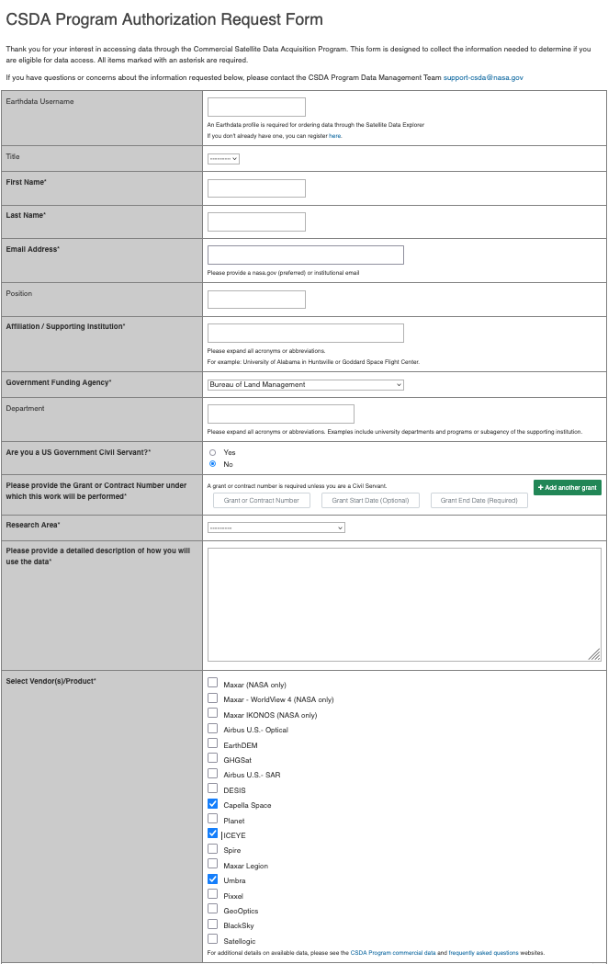
Commercial SAR data access through NASA CSDA
SEO evaluation of CSDA opportunity
Access to commercial SAR (ComSAR) data
3 US-based SAR vendors
Limitation to selected US users
NASA application procedure
Online form. Simple application.
Responsiveness of ComSAR operators.
Very high. First acquisitions within days of submission.
Relevance of acquired data
In general, acquired as requested.
Own processing & analysis software required
Positive outcome but some room for improvement:
CEOS-ARD product levels and formats desired
ICEYE (Stripmap)
Capella Space (Stripmap-50)
Umbra (Spotlight)
GA Corner Reflector array (QLD, Australia)

Slide 13
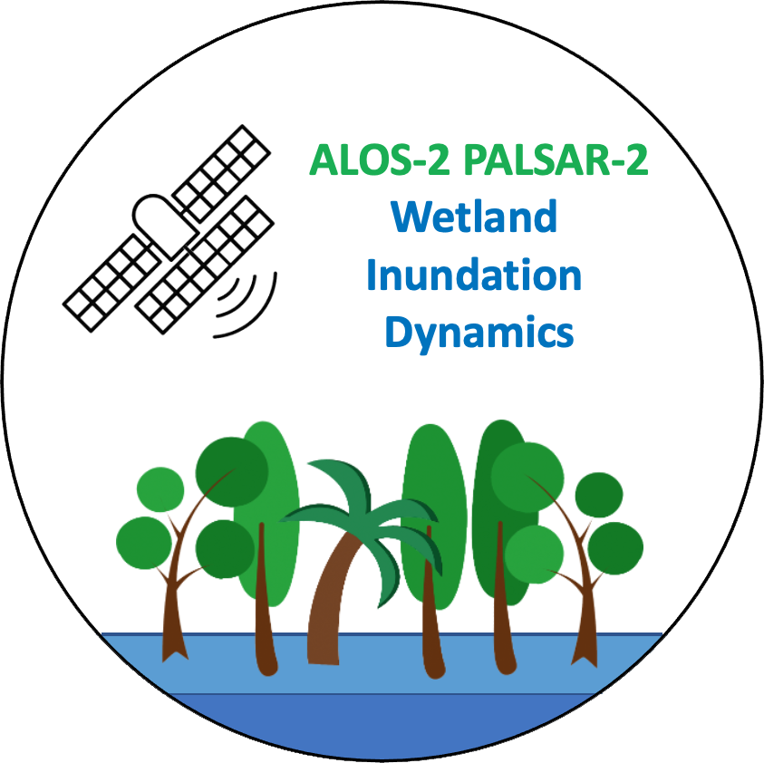
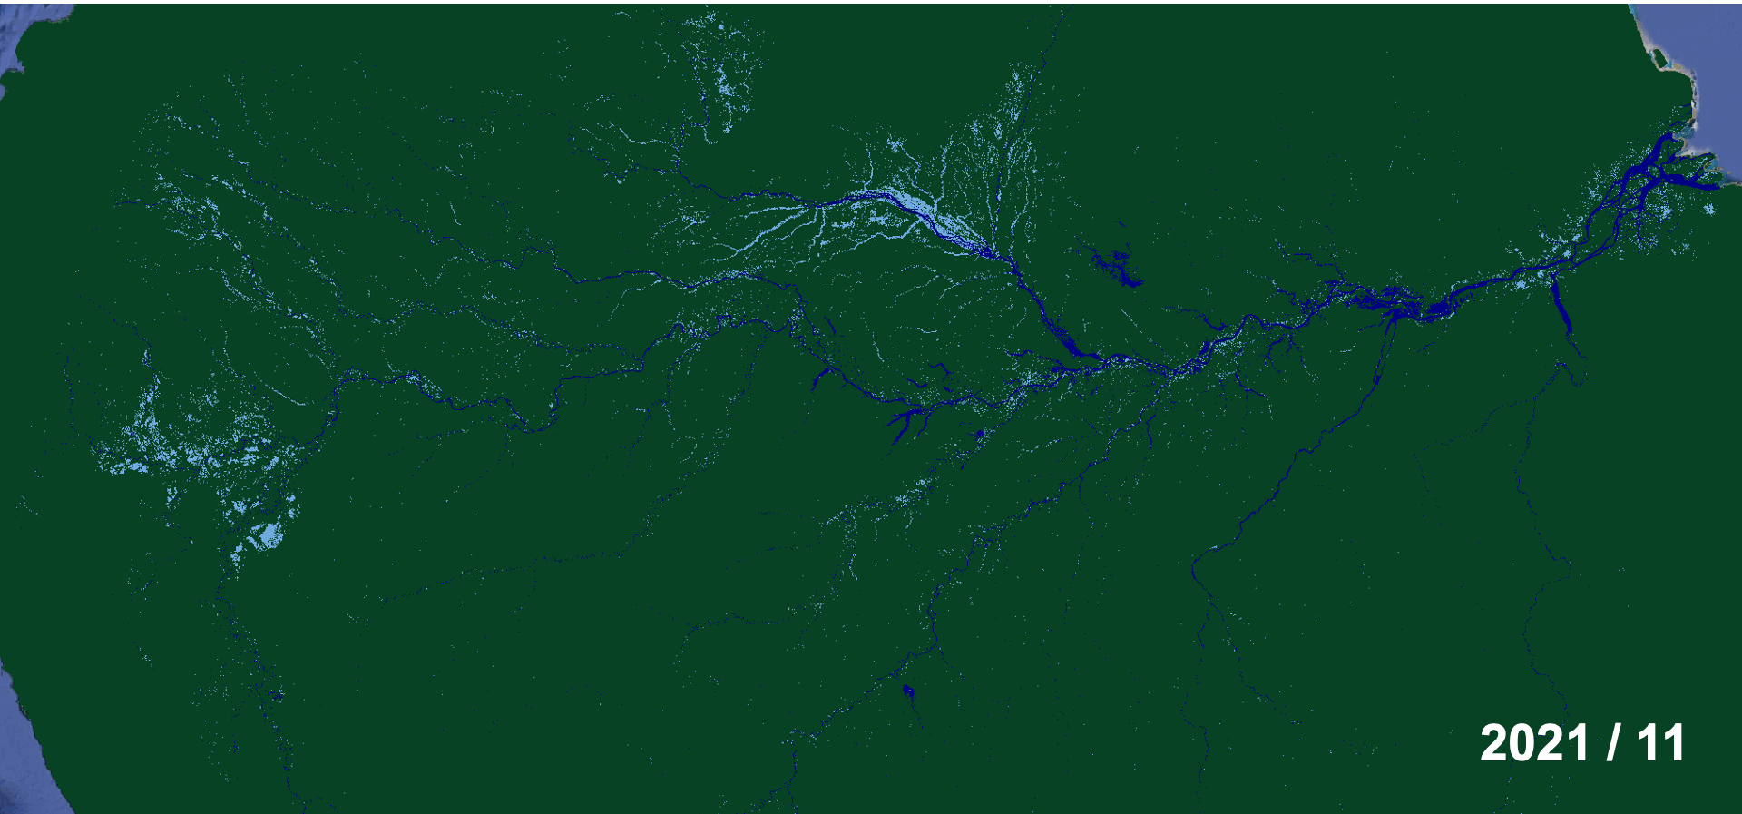
CAL Case Study:
ALOS-2 Forested Wetlands Inundation Mapping
Project supporting, e.g. LSI-VC EO & Wetlands, AFOLU Roadmap & GEO4SDG, GEO-Wetlands & Ramsar Convention
JAXA, soloEO, Aberystwyth Uni. & Wetlands Int’l collaboration with CEOS SEO.
Aim: Classification of ALOS-2 time-series data to characterise wetland inundation extent & changes across global tropical wetlands.
SDG Indicator 6.6.1: “Change in the extent of water-related ecosystems over time”
← Seasonal variations in flooding extent (cyan) across the Central Amazon basin 2022-2024. Classification (RadWet) of ALOS-2 ScanSAR L-band time-series.

Slide 14
CAL Case Study:
ALOS-2 Forested Wetlands Inundation Mapping
Processing intensive:
Prototype area: Amazon basin (8 Mkm²)
Number of PALSAR-2 ScanSAR observations (2014–2025): 101 w2w coverages
Input data: >3 TB zipped tile-based GeoTiff stored on local computer
Processing time using local desktop (8 CPU, 48 GB RAM): ~800 h
Local approach time-consuming and labour intensive.
→ Collaboration with SEO for a scalable cloud-based solution using the CAL.

Slide 15
CAL Case Study:
ALOS-2 Forested Wetlands Inundation Mapping
CAL demo phase 2 (Q4/2025 ~)
Making full use of the CAL cloud-based environment:
JAXA provision of global archive of CEOS-ARD NRB (unzipped) ALOS-2 ScanSAR data* to the AWS Open Data Registry. (← THANK YOU JAXA!)
CAL access input data directly from the JAXA AWS s3 bucket
→ No copying or unzipping required → Significant further increases in processing speed anticipated.
→ Scalability: CAL workflow applicable to tropical forested wetlands globally.
* Compliant with CEOS Interoperability Handbook>Architecture Factor>Publish #3/#4

Slide 16
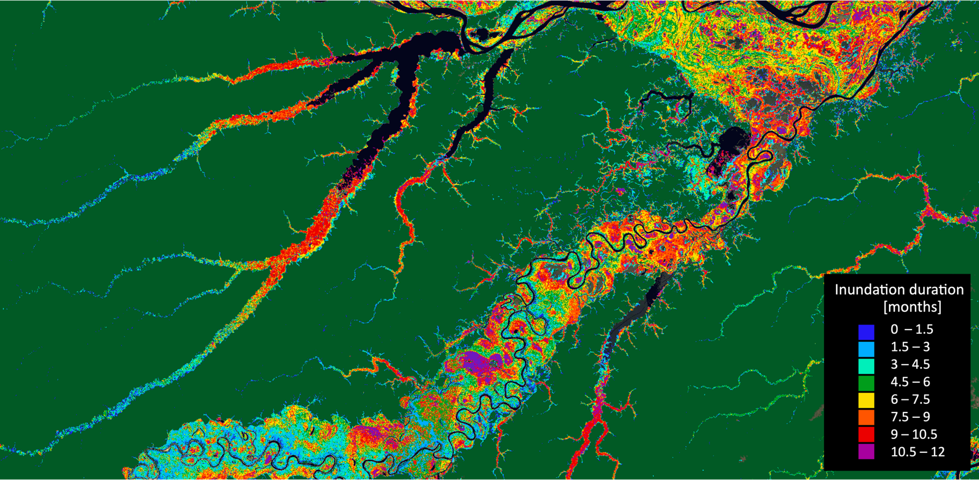
CAL Case Study:
ALOS-2 Forested Wetlands Inundation Mapping
First CAL demo (Q3/2025):
CEOS Analytics Lab used to parallelise the existing workflow:
Employing n scalable CPU cores simultaneously.
Processing speed increased x80. Processing time for the 10-year time series reduced from 800 h to less than 10 h.
← Inundation duration map for 2022.
Colours indicate the number of times a pixel has been classified as “flooded” in the 2022 time-series.

Slide 17
CEOS Analytics Laboratory
cal.ceos.org

