Slide 1
Update on Canada's WildFireSat Mission Expansion
Towards a group to better coordinate global EO fire monitoring
Joshua Johnston
Natural Resources Canada
Agenda Item 6.2
SIT TW 2025
Darmstadt, Germany
9-11 September, 2025

Slide 2
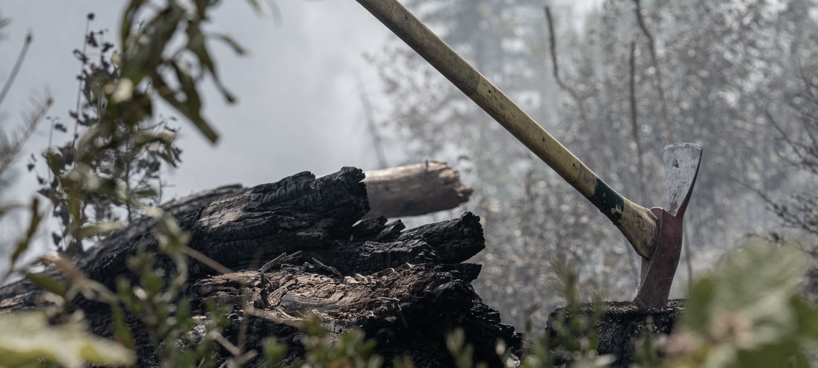
Contents
What we suggest
Context
CEOS WG Disasters Wildfire Pilot
WildFireSat Expansion & Global Coordination
Next Steps
Contributors:
NRCan: M. De Jong, C. McFayden, M. Crowley, E. Hope, A. Magistrale, L. MacPherson, J. Dobbin
CSA: D. Dufour, L. Philpott, M. Patel, F. Fournier
NASA: D. Morton

Slide 3
Our proposal to CEOS
Aim: to establish a group to better coordinate global EO-based wildfire monitoring
  Proposed members: space agencies, product developers, commercial/philanthropic NGO missions
Can/should this be under CEOS?

Slide 4
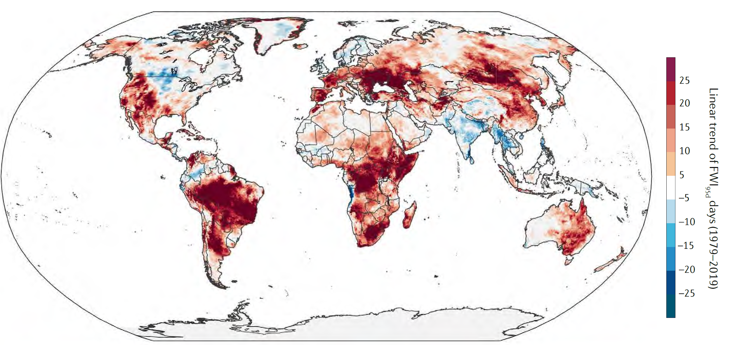
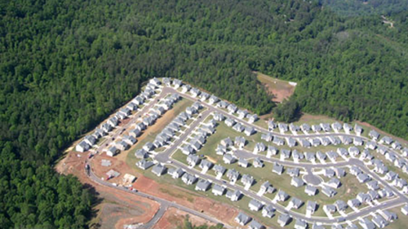
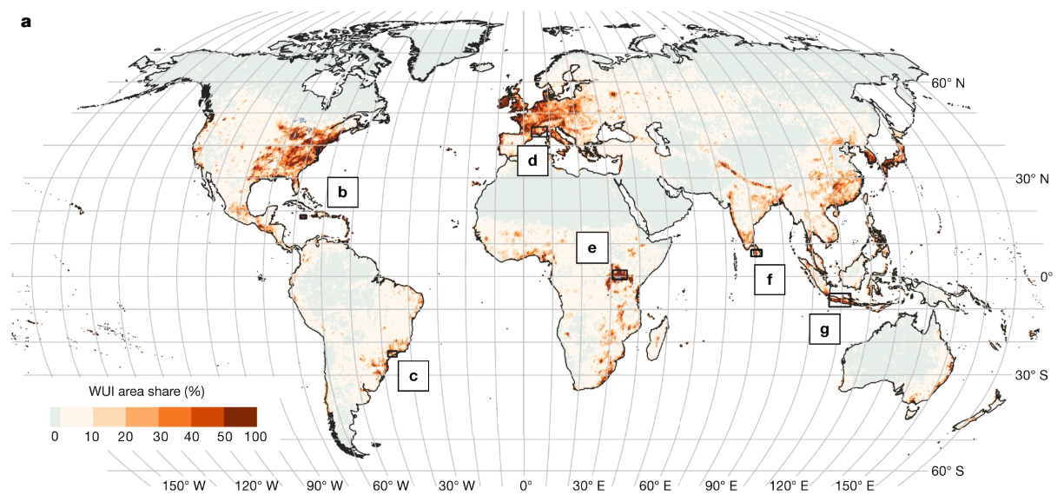
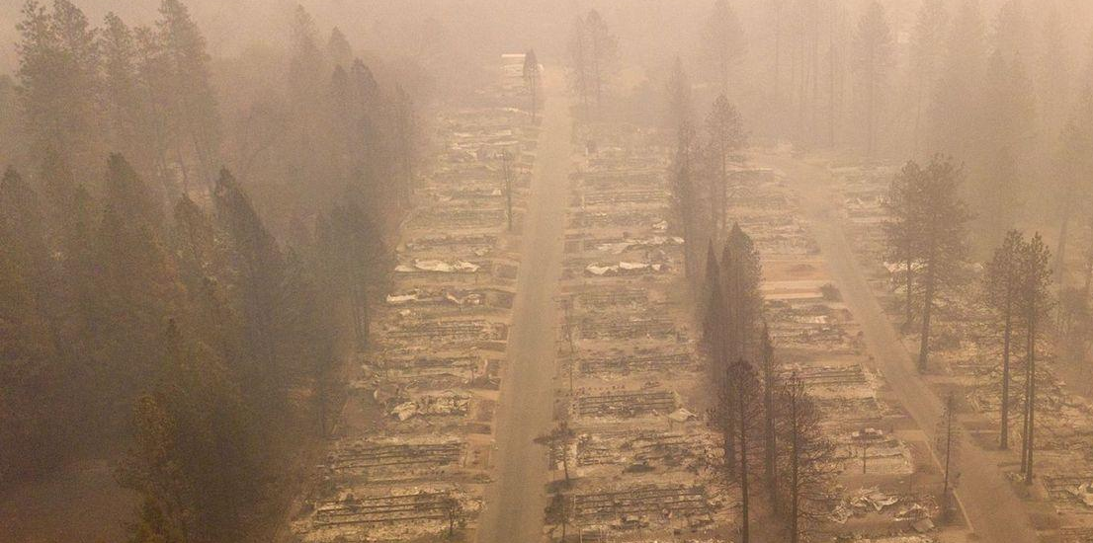
Context – Global fire challenges
Fire is an essential natural disturbance agent, but poses management challenges
management challenges are being exacerbated by:
  climate change: longer fire seasons, more extreme weather conditions
  Land use change: increasing wildland urban interface,
  Human behaviour: influences ignitions and suppression
Trend in extreme fire weather conditions in recent decades (1980s-2010s) Bowman et al., (2020)
Wildland Urban Interface texaswildfirerisk.com
Paradise Fire, USA 2018 (cnn.com)
Area share (%) of the Wildland-Urban Interface, 2020
Schug et al (2023) https://doi.org/10.1038/s41586-023-06320-0

Slide 5
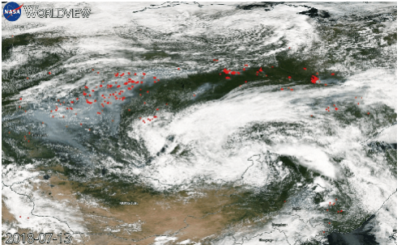
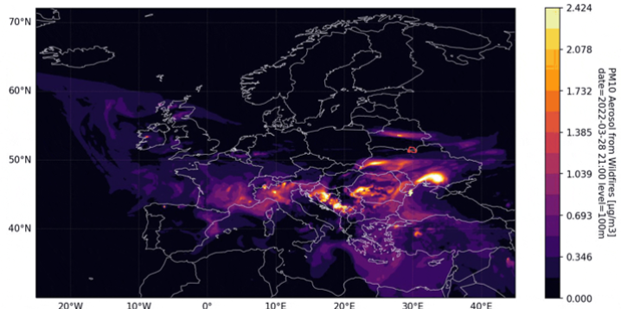
Context – Active Fire EO
Short (2.2µm) to mid-wave (3.9µm) IR Earth observation is widely used for active fire (AF) monitoring
Many operational fire management tools are in use around the world that are built on AF data for:
  Detecting new fires
  Landscape-scale strategic fire monitoring
  NRT smoke emissions modelling
Problems:
  operational tools built on science missions with uncertain continuity (e.g. MODIS)
  trade offs with other mission objectives: orbit and sensor characteristics are not optimal for fire monitoring
Siberia, 2018. MODIS active fires overlaying a true colour composite, with clearly visible smoke plumes. Data from NASA Worldview
Wildland Urban Interface texaswildfirerisk.com
Atmospheric concentration of PM10 from wildfires, March 2022 (data from GFAS CAMS)

Slide 6
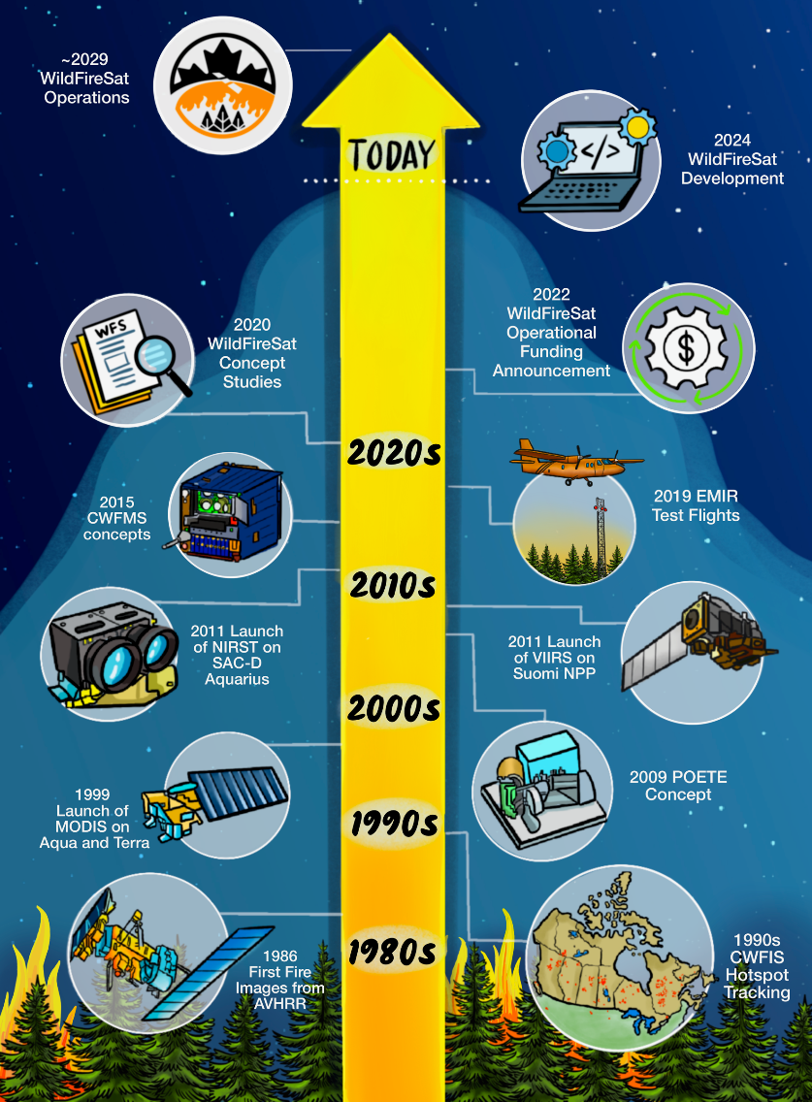
Context – WildFireSat & WGD Wildfire Pilot
Canada has been working on a dedicated fire monitoring mission for many years
WildFireSat – a purpose built, government funded fire monitoring mission will provide free and open global fire monitoring data
  launch date ~2029
Canada co-led the CEOS WG Disasters Wildfire Pilot, set up in 2021
  Pilot co-leads: NRCan, CSA, NASA, FAO
Wildland Urban Interface texaswildfirerisk.com

Slide 7
CEOS WGD Wildfire Pilot
Aim: to provide a comprehensive gap analysis for active-fire earth observation
‘Supply’ side analysis:
Gap analysis of existing and future
active fire monitoring systems
‘Demand’ side analysis:
who is using active fire
products for management?
What influences this?
Wildland Urban Interface texaswildfirerisk.com
Recommendations:
Define user requirements for
active fire missions
How can we better coordinate global active fire monitoring?

Slide 8
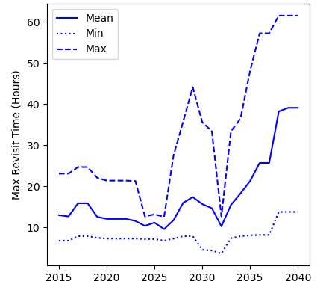
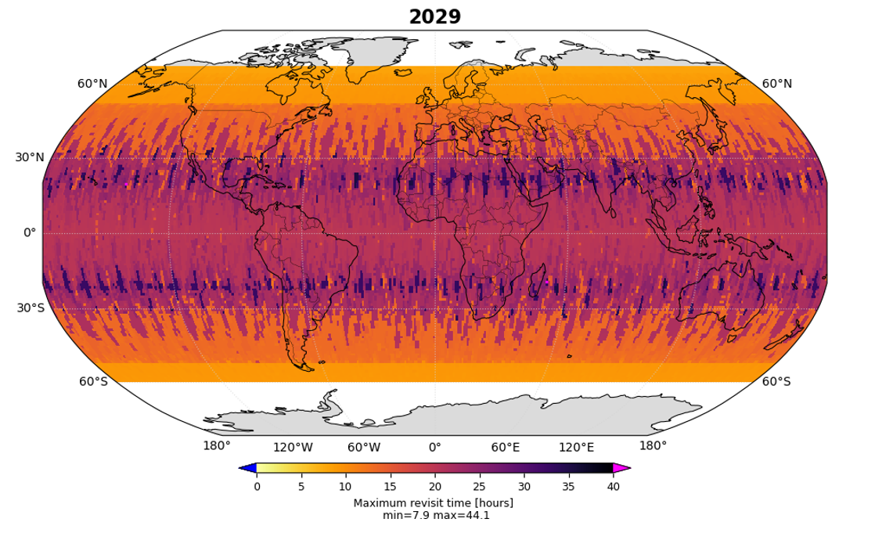
CEOS WGD Wildfire Pilot – Findings (1)
‘Supply’ side analysis
Gap analysis of existing and future active fire monitoring systems using the CEOS MIM database and STK modelling
Primary findings:
Global monitoring capabilities are unstable out to the mid-2030s (e.g. Figure 1)
Revisit times do not get better in future (Figure 1), but more spatially detailed observations appear likely for a period in the early 2030s (not shown)
Revisit times would be improved if existing/committed capabilities of additional space agencies were to be leveraged for AF monitoring (not shown).
Worst EO monitoring capabilities in the (sub)tropics (Figure 2); climate change is driving more extreme fire weather in some of these areas (but not all).
Figure 1. Maximum revisit time (global aggregation)
baseline scenario for fire monitoring/detection
Wildland Urban Interface texaswildfirerisk.com
Figure 2. Maximum revisit time in 2029
baseline scenario for fire monitoring/detection

Slide 9
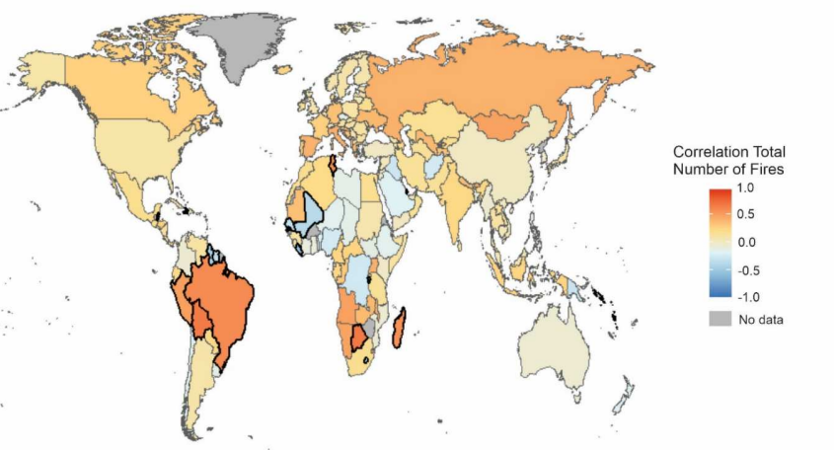
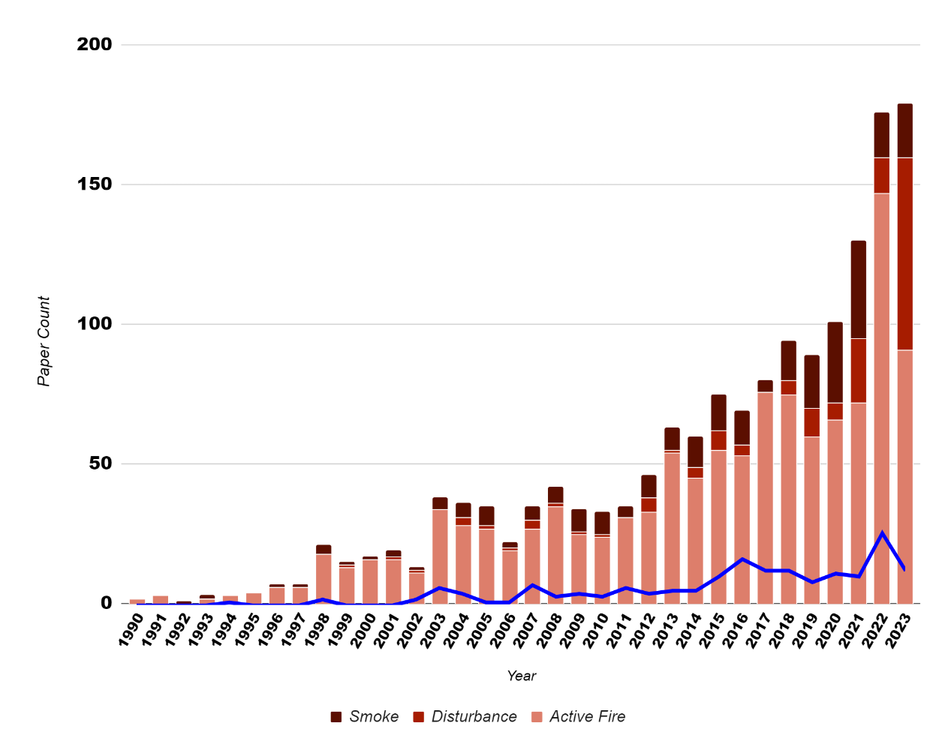
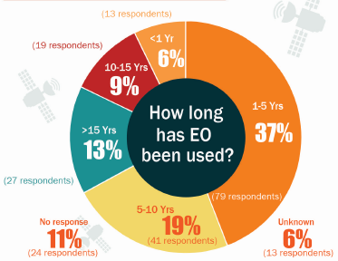
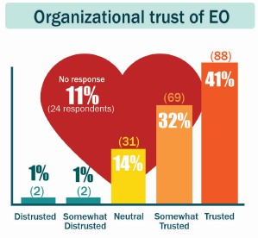
CEOS WGD Wildfire Pilot – Findings (2)
‘Demand’ side analysis
who is using active fire products for management? What influences this? Taking a “3-pronged” approach using:
  Global fire management user survey
  Active fire web platform user traffic analysis
  Bibliometric analysis
Primary findings:
Relationships between use of EO fire platforms & fire activity were found in a diverse range of countries (GDP & geography) suggesting that a variety of hotspot data use situations exist (Fig. 1; Hope et al., 2024)
Bibliometric analysis & global user surveys show that there has been a recent explosion of active fire EO usage (Fig. 2) both for science and fire management applications. Fire managers also have a high degree of trust in this data (Fig. 3., McFayden et al., 2024)
Figure 2. Number of
publications per year, active fire EO (Crowley et al., in prep.)
Figure 1. total weekly use counts vs. # fires. Outliers with strong or weak relationships are bolded (Hope et al., 2024)
Wildland Urban Interface texaswildfirerisk.com
Figure 3. Global end user survey outcomes (M^{c}Fayden et al., 2024)
Hope et al., (2024) https://doi.org/10.1080/17538947.2024.2420821
McFayden et al. (2024) https://ostrnrcan-dostrncan.canada.ca/handle/1845/275072

Slide 10
Synthesis – a perfect storm?
High use of EO active fire systems in operational fire management workflows around the world, with evidence of increasing uptake
Not guaranteed that globally coverage over the next decade will continue at the level we are accustomed to in terms of data products that are accessible, transparently produced, cal/val’d
Coverage and reliability might get worse during some time periods. This has implications for end user uptake, trust and the loss of important intelligence informing fire management activities
Better coordination, access and interoperability of data from existing and future missions could help alleviate these issues
Wildland Urban Interface texaswildfirerisk.com

Slide 11
Global coordination
At the G7 Leaders Meeting in June 2024, the Prime Minister of Canada announced the signing of the Kananaskis Wildfire Charter
  The WildFireSat Mission was expanded from Canadian -> Global scope
G7 announcement also included a mandate to improve global coordination, explicitly to address findings of the Wildfire Pilot, and provided funds to support it
WildFireSat has a vested interest in preserving/expanding public access to fire data – our products are partially interdependent on existing active fire monitoring satellite data
Wildland Urban Interface texaswildfirerisk.com

Slide 12
Global coordination – two aspects
Support the GOFC-GOLD Fire Implementation Team
https://gofcgold.umd.edu/
A global network of fire product developers & experts
1) Fund expanded activities: research surrounding independent validation of new fire products and end-user applications
2) Provide ongoing funding to support existing meetings and activities
Establish a new international wildfire monitoring coordination group
Aim: ensure coordination between the various agencies producing EO data used to generate wildfire products (and those that could be used, but aren’t currently) and the downstream community
Proposed members:
1 ) Space agencies
2) Downstream users (e.g., GOFC-GOLD Fire IT, GWIS)
3) Commercial & philanthropic NGO providers

Slide 13
Next steps
Could/should the international wildfire monitoring coordination group live under CEOS in some form?
Aware that CEOS has a strong governance structure and formal approach for creating new Initiatives, VCs etc (process papers)
We hope to host a side meeting at Plenary in November (TBC) - looking for questions and perspectives on this idea with the aim of shaping a formal proposal to CEOS
  Views can be shared now, or offline prior to Plenary
Wildland Urban Interface texaswildfirerisk.com

