Slide 1
Virtual Constellation Reporting to CEOS Leadership
Yuko Nakamura, JAXA
Agenda Item #7.10
SIT TW 2025
Darmstadt, Germany
9-11 September, 2025

Slide 2
Observations
CEOS lacks consistency in reporting from the VCs on the state of the observing system.
  To CEOS leadership
  To the community generally
Where does someone look for a status of the 'state of the observing system' from CEOS VCs ?
Variety of VC outputs – all a bit different and on different timescales
VC outputs hosted in various locations and formats - no one point of reference
CEOS could be more coordinated and systematic in this regard
Consistency would strengthen the CEOS ‘brand’ and affirm coordination

Slide 3
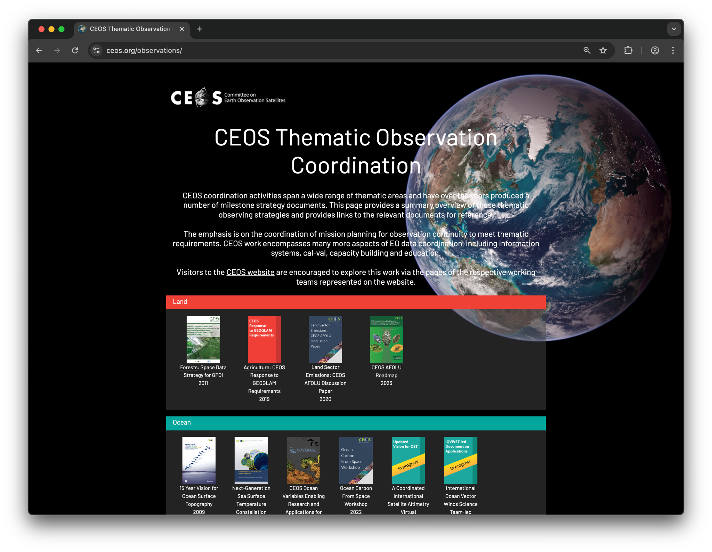
We’ve taken some steps
A good start
Scope a little fuzzy - not specific to VCs
Not required, systematic, or consistent
Solely focused on reports / strategies
https://ceos.org/observations

Slide 4
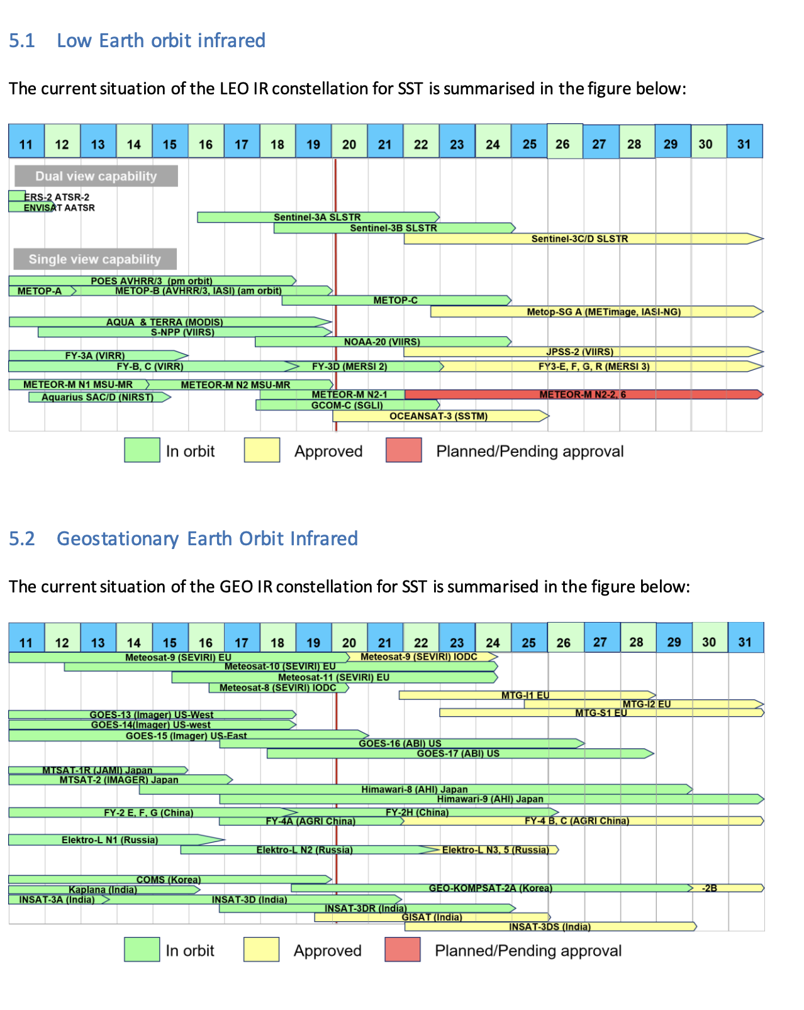
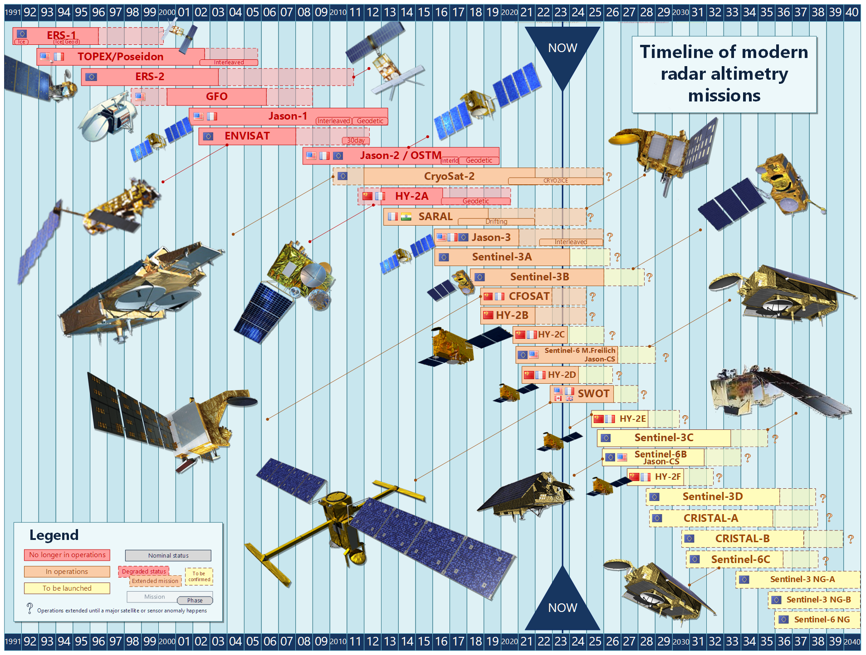
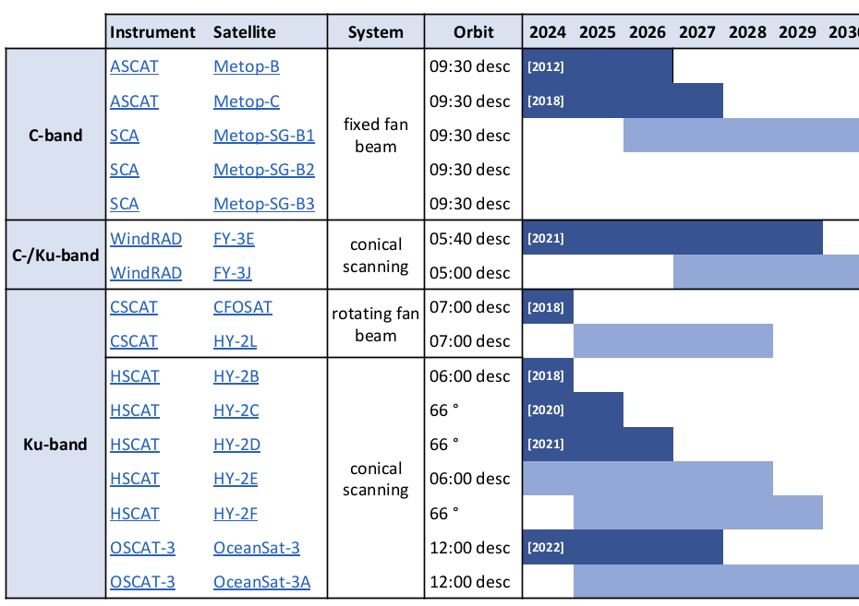
VC Timelines
Some are clearly published, others not
Variety in styles and content

Slide 5
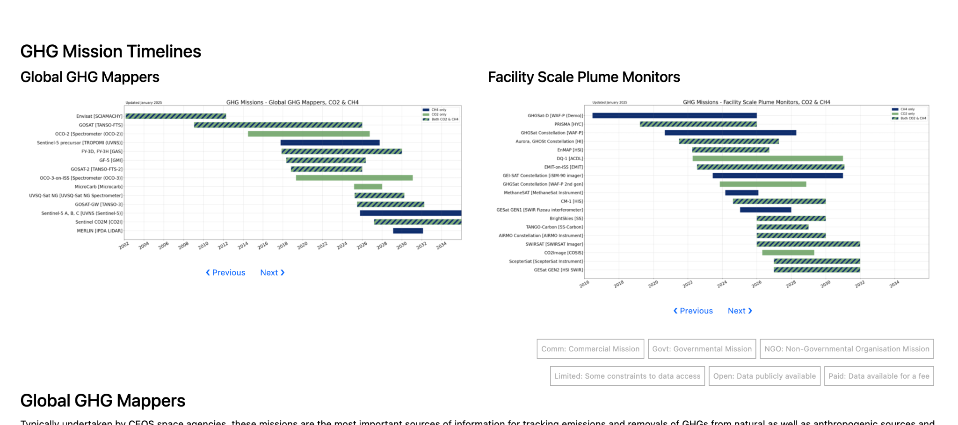
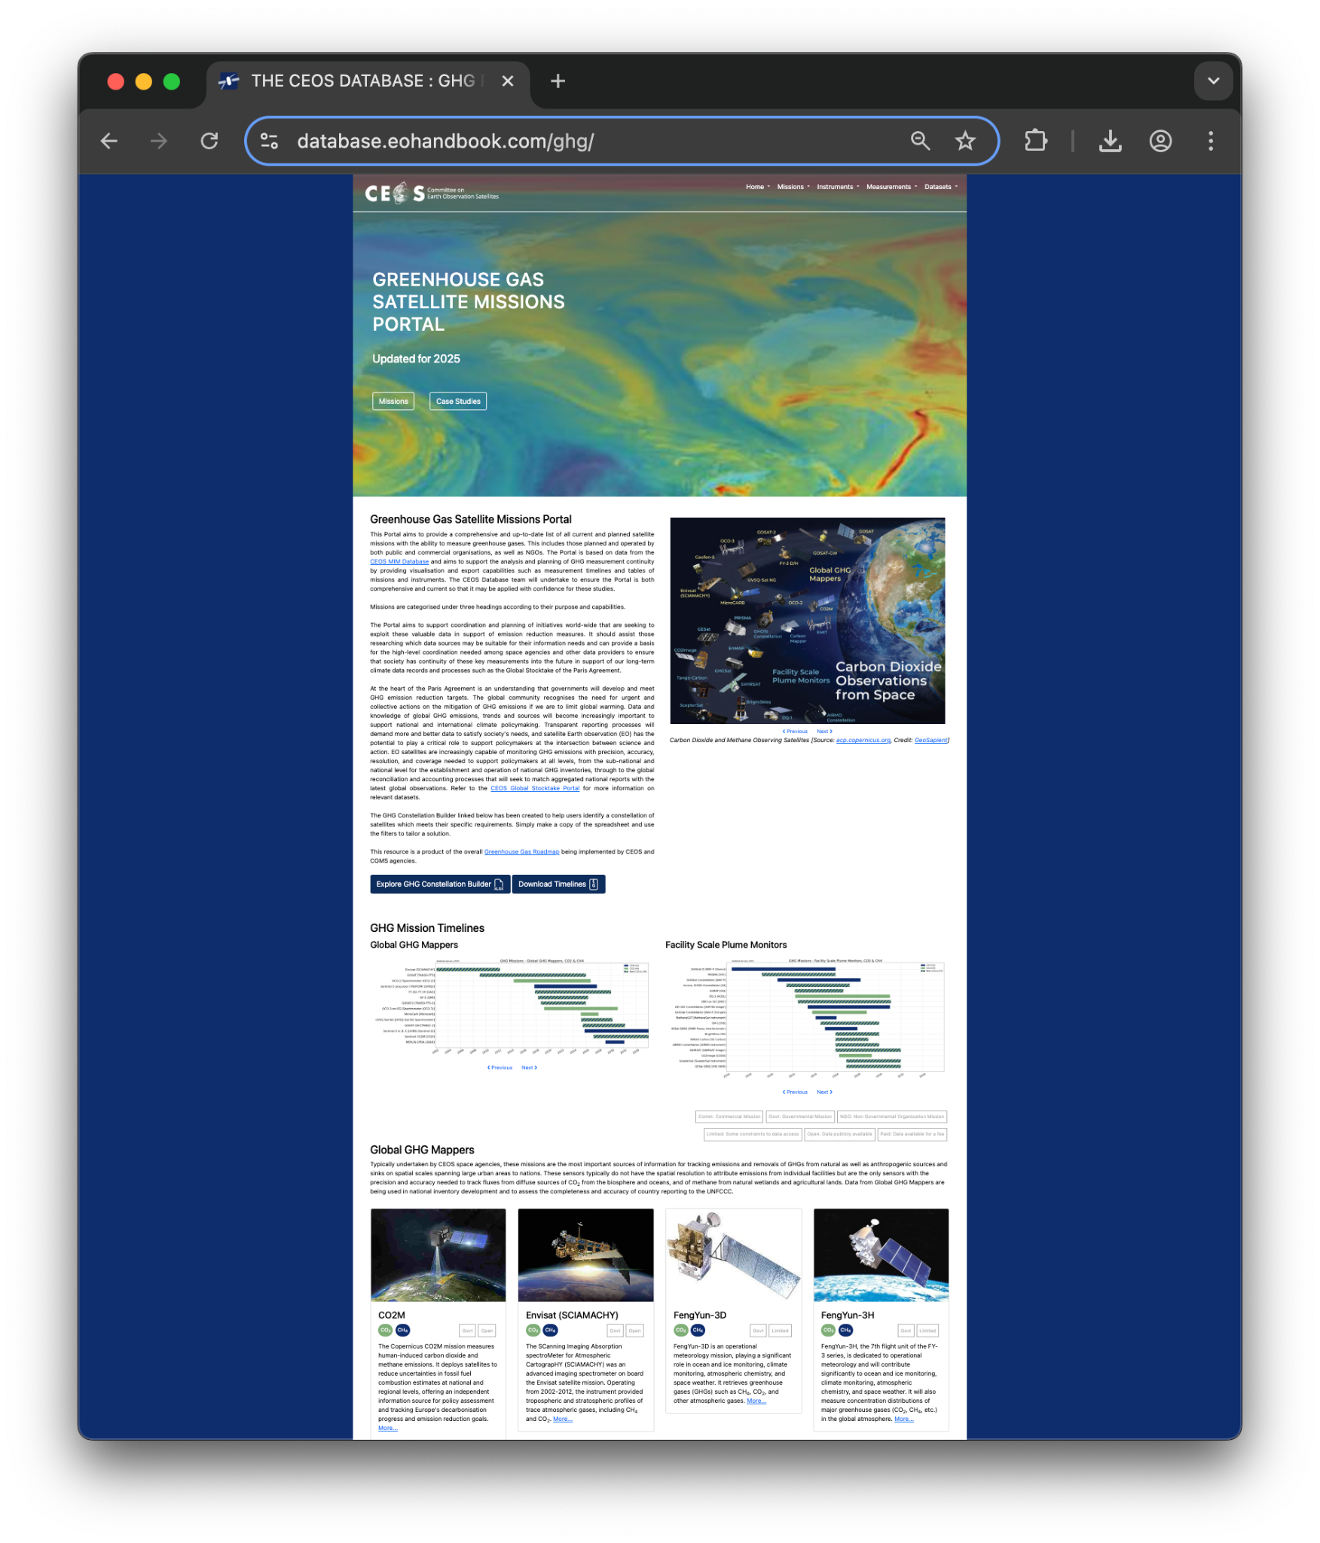
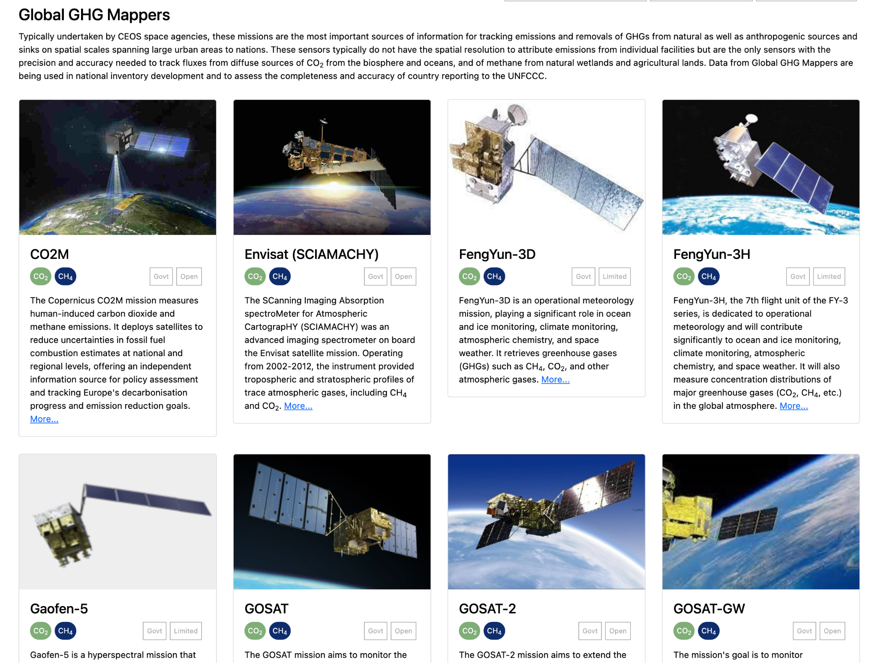
Mission Overviews
GHG Portal demonstrates the missions that make up the ‘constellation’ alongside timelines
Could be a model for similar VC pages?

Slide 6
Considerations
Don’t want to create large amounts of work for VCs
Can we leverage existing systems like the MIM Database to automate this (noting the GHG Portal example)
Needs active and engaged VC representatives
Aware there is overlap with various external science teams
Shouldn’t seek to replace existing work, just organise and present better

Slide 7
Furthermore
Have seen confusion recently regarding the way VCs should report findings to CEOS Principals, how their findings should be framed, and whether they should be ‘endorsed’
  OST-VC White Paper on a Coordinated International Satellite Altimetry Virtual Constellation
  SST-VC and COAST-VC Joint Statement Regarding Ultra High Resolution Infrared Measurements
Coming back to this later…

Slide 8
Discussion
Should CEOS establish a common reporting format and schedule, so that we can regularly achieve a systematic and consistent overview of gaps and opportunities.
  SIT TW 2025 VC Session a taster / trial run – feedback?
  Consistent reports to SIT and Plenary
  Harmonised reporting templates for the Virtual Constellations?
Furthermore, should we seek to implement more comprehensive and consistent reporting on VC timelines and mission information?
  Via CEOS website / MIM DB / etc.
Can we formally clarify the approach for reporting VC recommendations to CEOS Principals to avoid future confusion - e.g., definition of endorsement

Slide 9
SST-VC and COAST-VC Community Request Regarding Recommended Coverage of Future Missions for Coastal Ocean Observations

Slide 10
SST-VC and COAST-VC Community Request Regarding Recommended Coverage of Future Missions for Coastal Ocean Observations
Statement originally presented at SIT Tech Workshop 2024
  Some issues with content and framing
Update presented at SIT-40, with another decision and action recorded:
DECISION 05 | CEOS Agencies acknowledged the requests and recommendations from SST-VC and COAST-VC to: Consider the acquisition of coastal SST in GHRSST format with enough coverage up to minimum 100 km from the coast when planning new ultra high resolution TIR missions. Additionally consider coastal coverage distances for features listed on page 4 and 7 of the statement, which are based on the justifications detailed in the appendices. Rationale: Following these recommendations will make data from emerging missions significantly more valuable and usable to the scientific coastal ocean communities, and increase the likelihood of breakthrough science and improved information for decision making and societal benefits.
SIT-40-11 | SST-VC is asked to refine the statement presented at SIT-40 regarding extended observation coverage from new ultra-high-resolution thermal infrared instruments to reflect feedback from CEOS Agencies at SIT-40. It will also work with the SIT Chair Team to accomplish virtual endorsement by CEOS Principals. | May 2025
 | Rationale: The statement was well received by CEOS Agencies at SIT-40. However, the SIT-40 discussion yielded feedback that should be taken into account before final endorsement.

Slide 11
SST-VC and COAST-VC Community Request Regarding Recommended Coverage of Future Missions for Coastal Ocean Observations
Post SIT-40 virtual endorsement was not concurred
  “endorsement” implies an impact on mission planning/requirements that would not be suitable in the frame of CEOS
Further updates following SIT-40 (in response to action SIT-40-11) and latest document circulated last week.
The final statement will be presented at the CEOS Plenary as a “recommendation” from the science community, giving CEOS Principals the opportunity to acknowledge the paper and take it under advisement.
The statement is also presented at SIT TW 2025 for information and discussion, as a preparatory step towards CEOS Plenary.
Presented for information only at both TW and Plenary. Not for endorsement.
Looking for acknowledgement of receipt and consideration of the recommendation

