Slide 1
Missions, Instruments and Measurements Database
Utilising the Database for Improved
Virtual Constellation Observation
Continuity Reporting
Marie-Claire Greening, ESA
Agenda Item 7.11
SIT TW 2025
Darmstadt, Germany
9-11 September, 2025

Slide 2
MIM Database as a CEOS Service
database.eohandbook.com
Provided by ESA as a CEOS service since 1990s
As per CEOS Work Plan Section 3.12 (CEOS Services), part III
Consolidated statement of CEOS Agency EO satellite-based programmes and plans.
CEOS Members surveyed annually to understand their current and future missions, as well as the instruments and what they measure
The database is a service that all CEOS Agencies and entities are welcome to take advantage of
Some other information exists in the backend database beyond what is presented online - including some commercial capabilities and mappings to the WMO OSCAR database
Contact the team for more information: ceosmim@gmail.com
Notes:
‘What they measure’ is critical - highlight this. Some agencies seem to overlook the measurements tab of the survey - but it is critical for gap analyses to correctly understand what each mission can measure

Slide 3
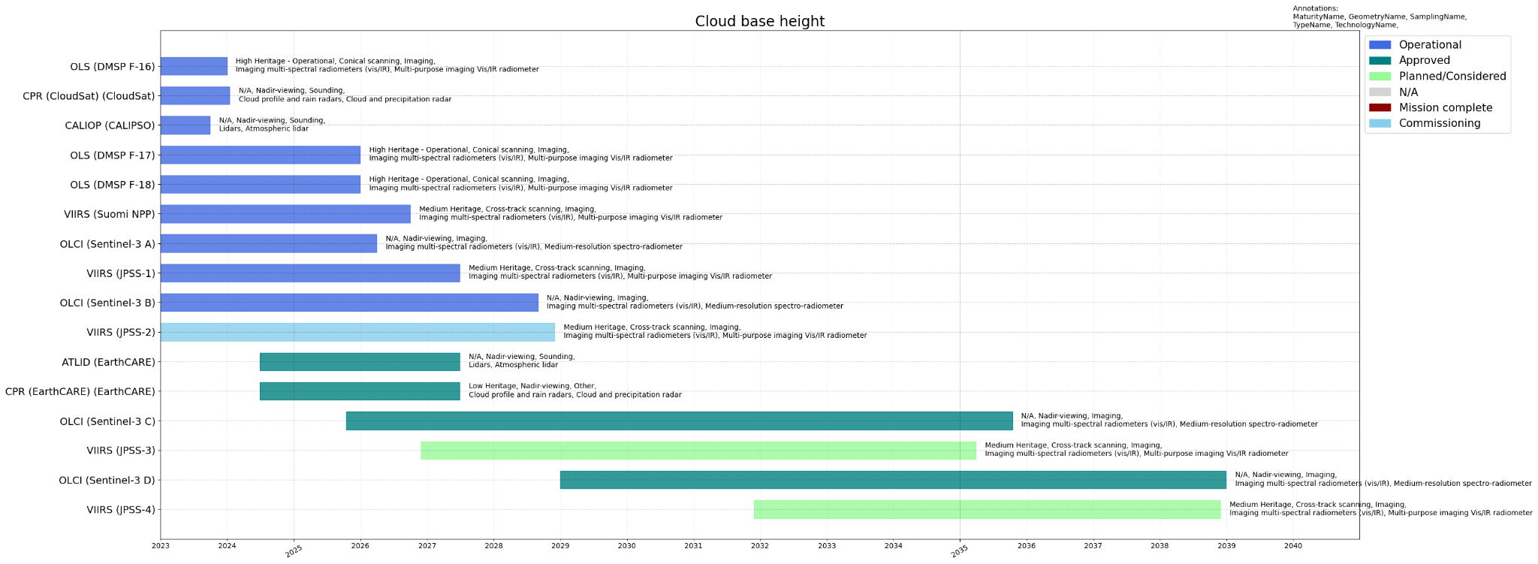
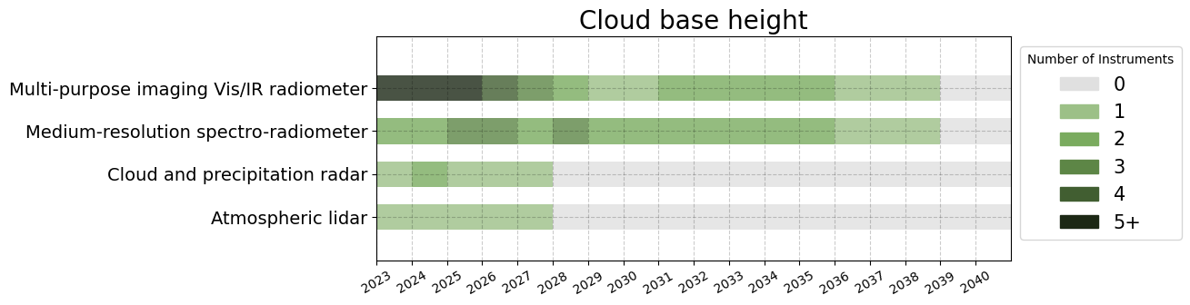
The Database for Gap Analyses
Example Gap Analysis charts developed for ESA Science Strategy Foundational Study in 2024
Full timeline with instrument details
Heatmap of instrument types
Notes:
The Mission-Instrument-Measurement mappings available allow for traceability between geophysical variables and what sensors can measure them
Used frequently for various Gap Analyses - Including the ESA Science Strategy Foundational Study & NASA Decadal Survey

Slide 4
Information the Database Provides
All agency-verified, and updated annually
Mission specs - e.g. orbit details, launch & EOL dates
Instrument specs - e.g. type, resolution, swath, accuracy, data access
Can filter by any of these parameters to meet requirements
Develop a custom list of missions and sensors which can respond to the needs of a VC
Can customise the legend and categorisation

Slide 5
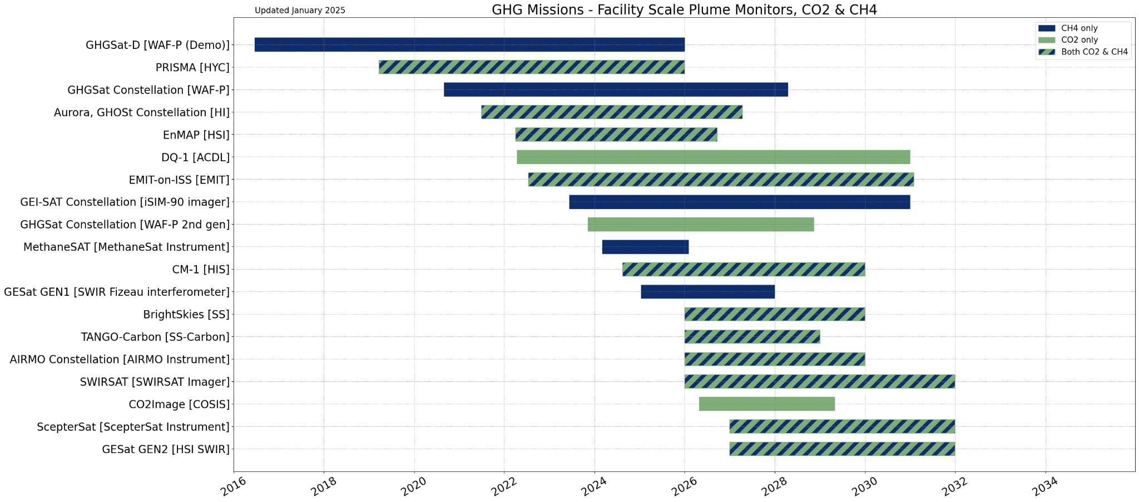
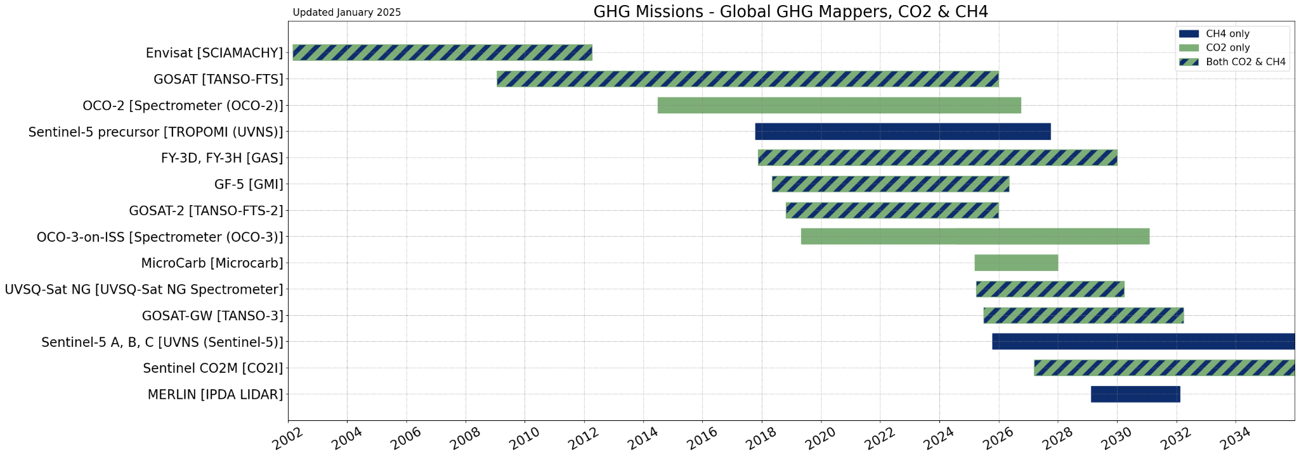
GHG Example
Drawn programmatically - once the list of missions and categories are defined, it is very easy to regenerate
Done annually for GHG Portal, following survey updates

Slide 6
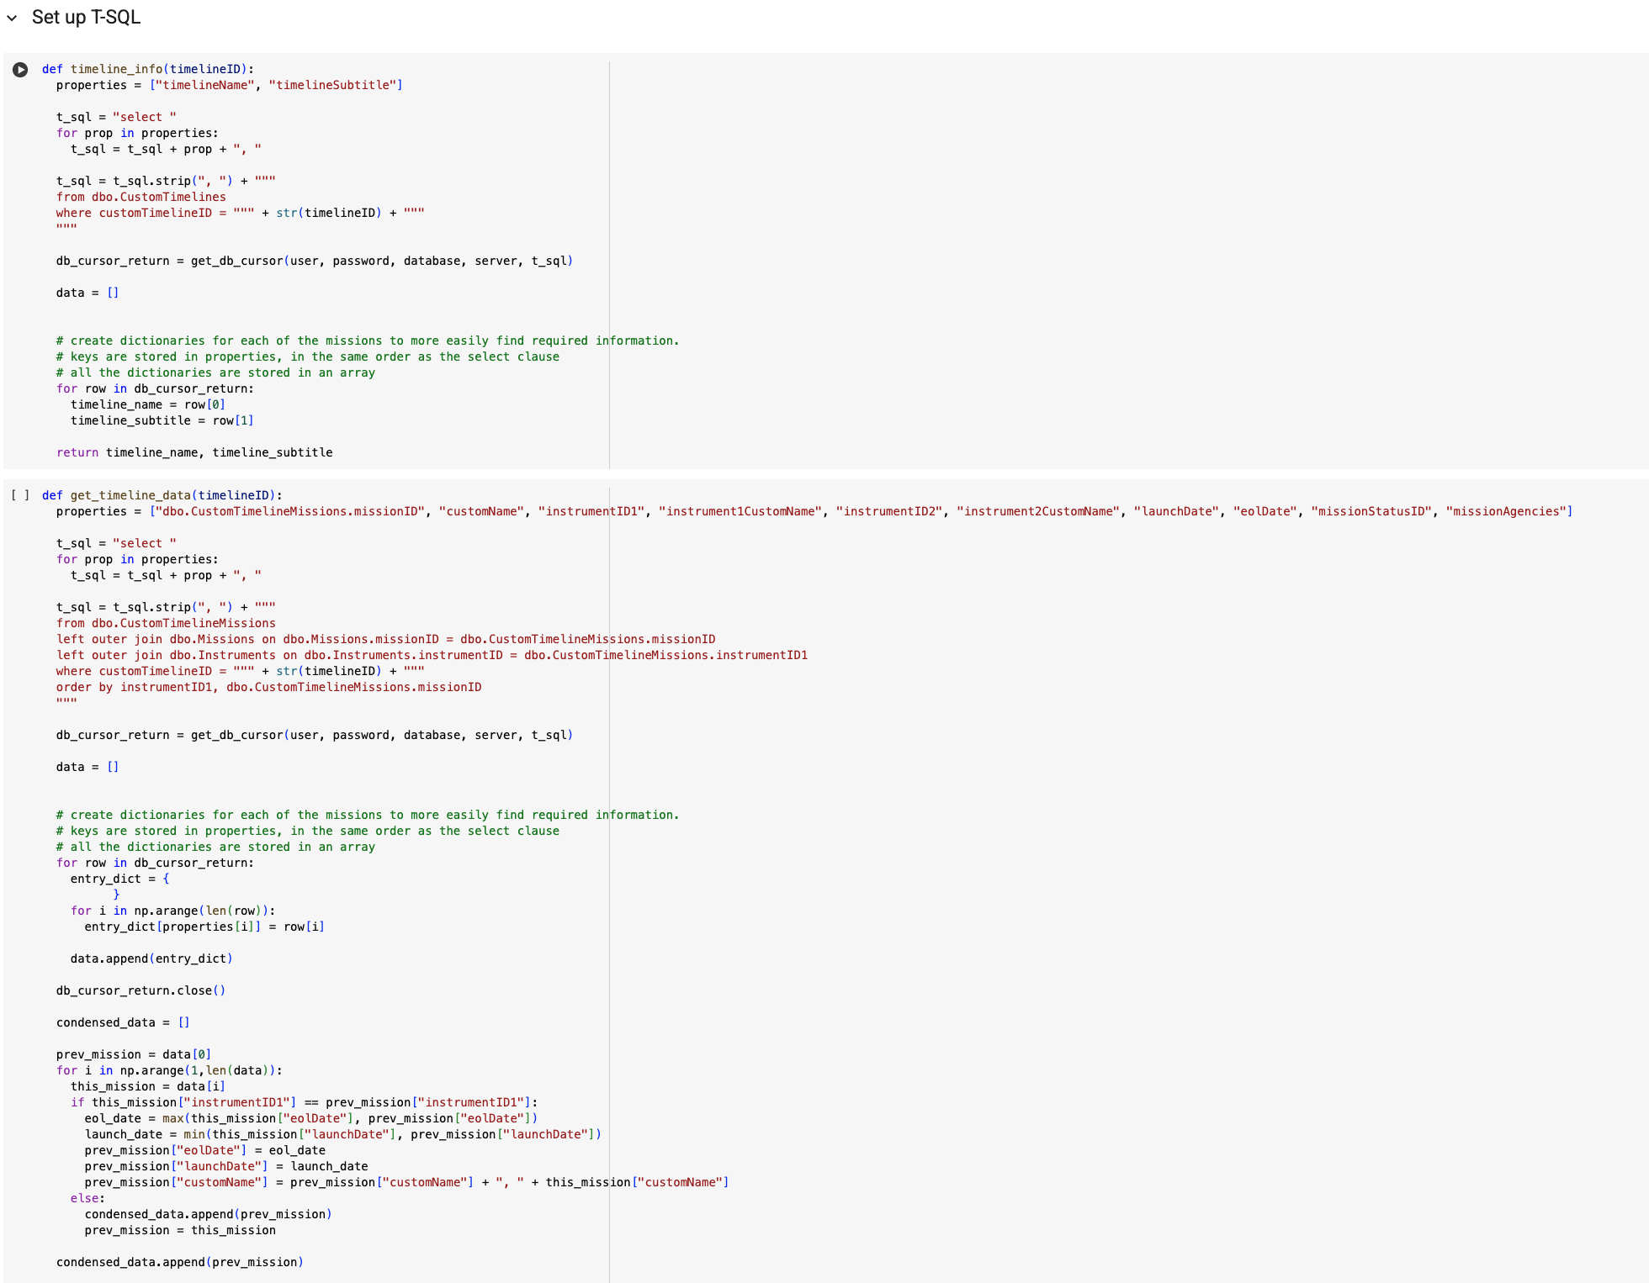
Enabling VC Collaboration
Timelines are generated using a Jupyter Notebook
Data pulled directly from database
Can work with the VCs to enable the systematic generation of new timelines customised to their needs

Slide 7
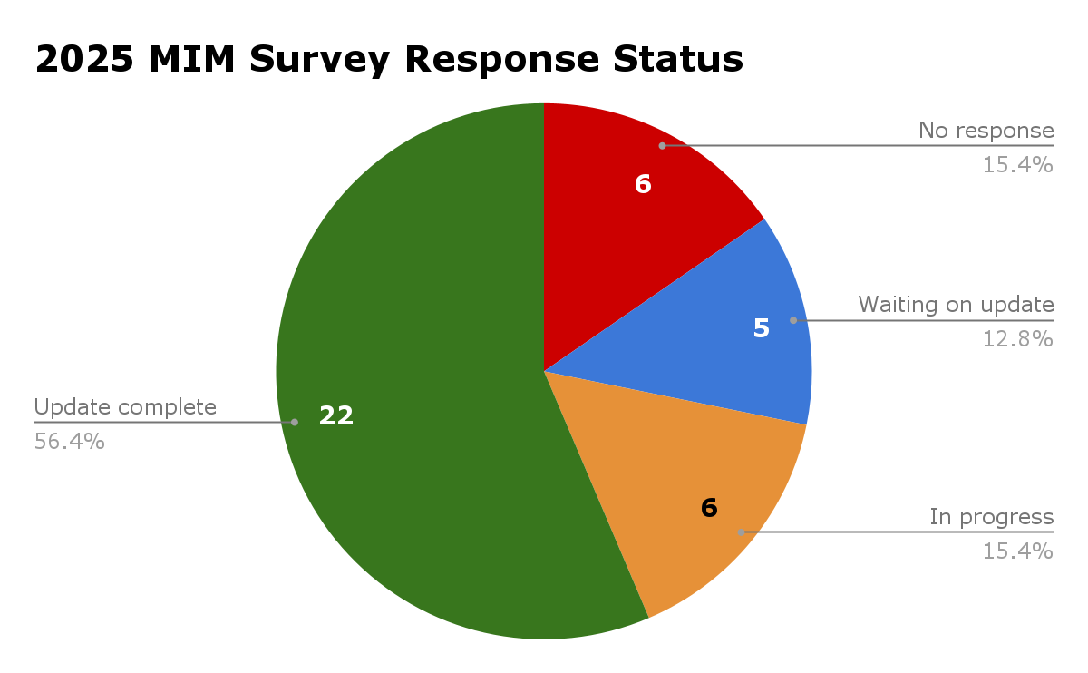
Update on the 2025 Survey
Thank you to all agencies and contacts for the survey updates!
Finishing off the updates now
AIS Measurement now included
Timeline:
Remainder of September: QA Checks and final updates
Early October: Publish 2025 CEOS MIM Database

