Slide 1
SST VC Virtual Constellation
State of the Global Observing System
Misako Kachi, JAXA Christo Whittle, SANSA
Agenda Item 7.3
SIT TW 2025
Darmstadt, Germany
9-11 September, 2025

Slide 2
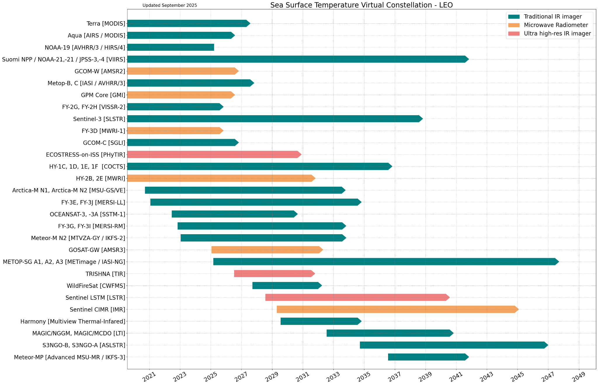
Summary of Current & Planned Missions (1) LEO SST missions
IR and Microwave (MW) imagers in LEO satellites from 2020 to 2048.
Green: Traditional IR imager (~1-km res.) *SLSTR is the only reference dual-view sensor
*SGLI has 250-m resolution
Orange: MW imager
Pink: Ultra high-resolution IR imager
There are gaps in MW SST beyond 2032.
*
*
2030
2035

Slide 3
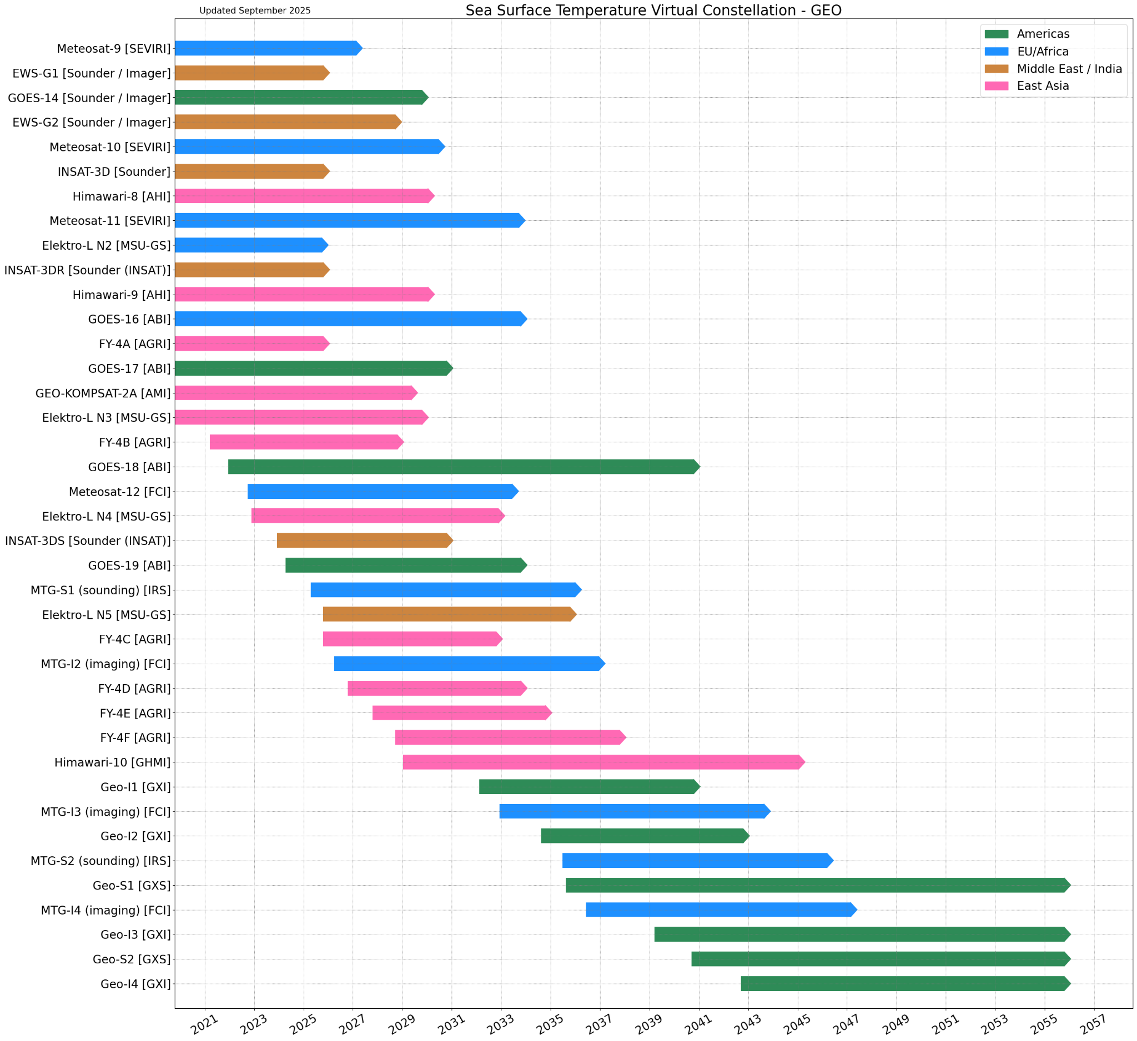
Summary of Current & Planned Missions (1) GEO SST missions
IR imagers on board the geostationary satellites from 2020 to 2057.
Green: Americas
Blue: Europe
Brown: Middle East/India
Pink: East Asia
It seems no gaps of IR SSTs in 2030 or 2035.
2030
2035

Slide 4
Planning highlights
Highlight any issues e.g.
Developed SST- & COAST-VCs joint statement on recommended coastal coverages of future ultra high-resolution IR sensors (agenda item 7.10)
GHRSST Data Specification (NetCDF4) V2.1/2.2 (https://doi.org/10.5281/zenodo.6984989) is routinely produced and we are planning future V3.0 (started discussion among GHRSST community)
New products – SST, IST (Sea ice surface temperature), ultra high-resolution SST (<100m)
CEOS-ARD PFS development – how to collaborate between GDS and ARD?
Discussion & inputs to CEOS Biodiversity Study team in June 2025
Topics of potential interest (coastal areas, seascapes, coral reef, heat wave, etc.), input to & review of user needs spreadsheet
Any potential gaps in product availability – MW SST
How does data supply look in 2030? – AMSR3 (2025-2032), HY-2E (2025-2028), CIMR-A (2029-2037)/-B(2034-2042)
How does data supply look in 2035? – Potentially CIMR-A & -B will be in operation. No confirmed successor for HY-2 nor AMSR – continuation needed

Slide 5
GDS (GHRSST Data Specification)
GHRSST Data Specifications = describes the format and content of L2/L3/L4 SST datasets recommended by GHRSST : variables to put in the products, convention for flags and quality information, ancillary information, attributes, unique vocabulary and associated definitions, …
A common format for SST products adopted by about 20 agencies, more than 150 datasets and many more every year
Providing interoperability between GHRSST datasets and services:
less hassle for users : all datasets can be used in the same way, no code change, easy to merge or swap data sources in user applications (among a constellation of tens of missions now available)
Latest release is GDS 2.1r0 (2021) : https://doi.org/10.5281/zenodo.6984989
Currently planning
GDS 2.2 : short fixes and clarifications, no breaking change
GDS 3.0 : changes requiring online discussion, breaking changes

Slide 6
Discussion started toward GDS 3.0
Unused NetCDF4 features that would make format clearer or more optimal : groups, chunking, significant number of digits, …
Volume limitations are not so important as they used to be => some requirements could be relaxed (scaling, number of variables,...)
GDS was ahead of its time 10 years ago but a lot of activities on format improvement by various agencies or communities
New cloud optimized format (COG, NetCDF5, Zarr) => some rules for conversion and interoperability (e.g. ensure traceability of metadata attributes)
Provide recommendations for cloud access to NetCDF4 : chunking strategies, internal metadata aggregation, virtual datasets, and machine oriented metadata to allow for optimized subsetting and distributed access

Slide 7
Issues for attention of SIT
Any gaps
Continuation of MW SST
Issues with engaging satellite operators
Test & validate ultra high-resolution SST of upcoming missions to analyze value of resolving significant features in coastal area
Commercial sector engagement in your domain
Some commercial sector (ororatech, Germany) joined GHRSST26 in June 2025 and interested in engagement with the community for possible ultra high-resolution SST from their satellite
Whatever would benefit from Principal attention
Coordination between parameter-focused & area-focused VCs

