Slide 1
Land Surface Imaging Virtual Constellation
State of the Global Observing System
Jonathon Ross (GA)
Takeo Tadono (JAXA)
Agenda Item #7.4
SIT TW 2025
Darmstadt, Germany
9-11 September, 2025

Slide 2
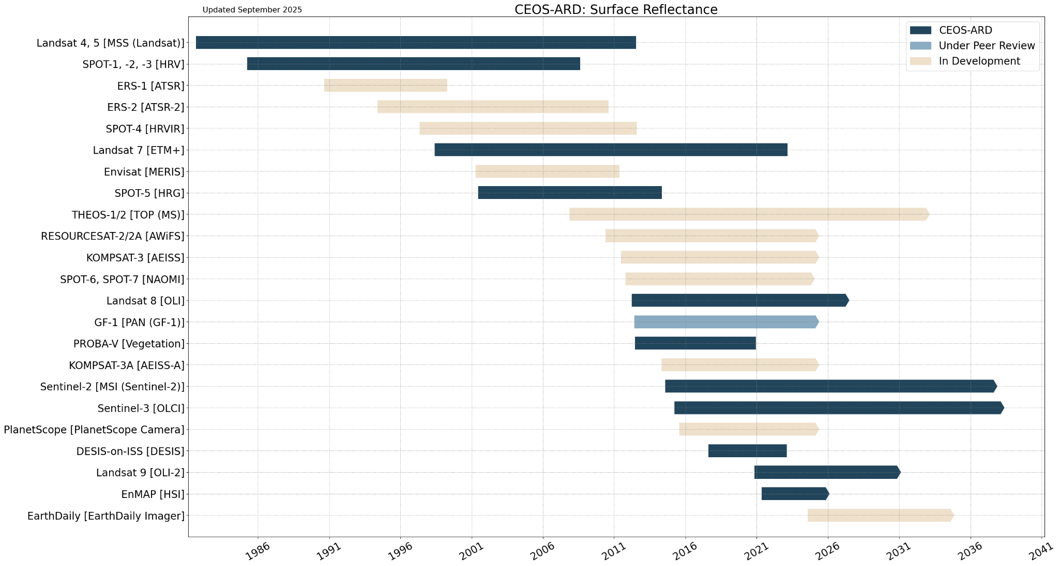
Summary of Current & Planned Missions
CEOS-ARD Surface Reflectance Continuity

Slide 3
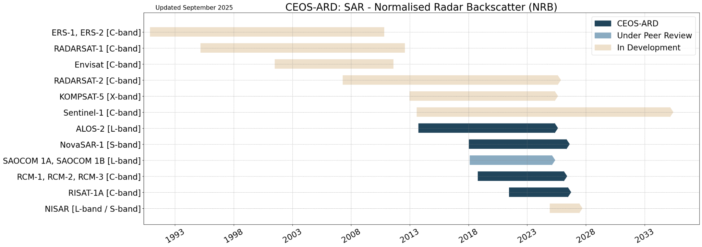
Summary of Current & Planned Missions
CEOS-ARD SAR NRB Continuity

Slide 4
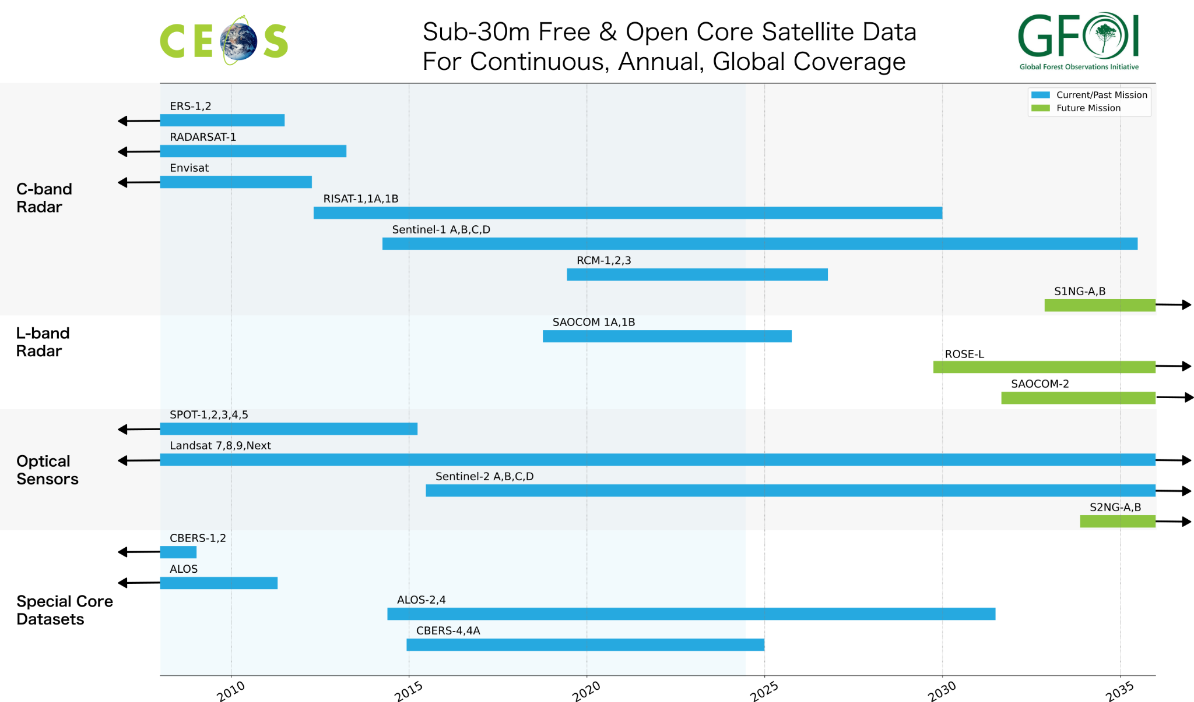
Summary of Current & Planned Missions
GFOI Core Coverage

Slide 5
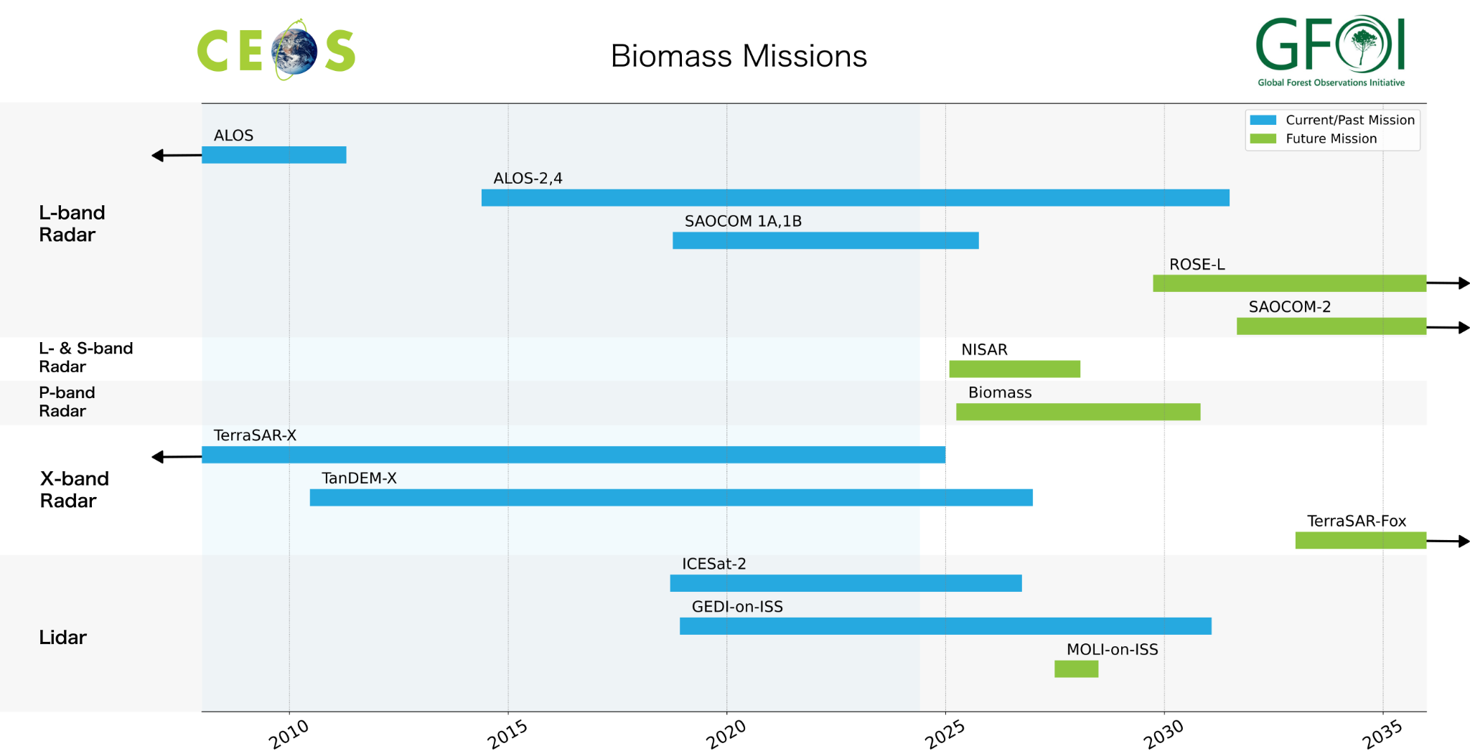
Summary of Current & Planned Missions
Biomass Observation Continuity

Slide 6
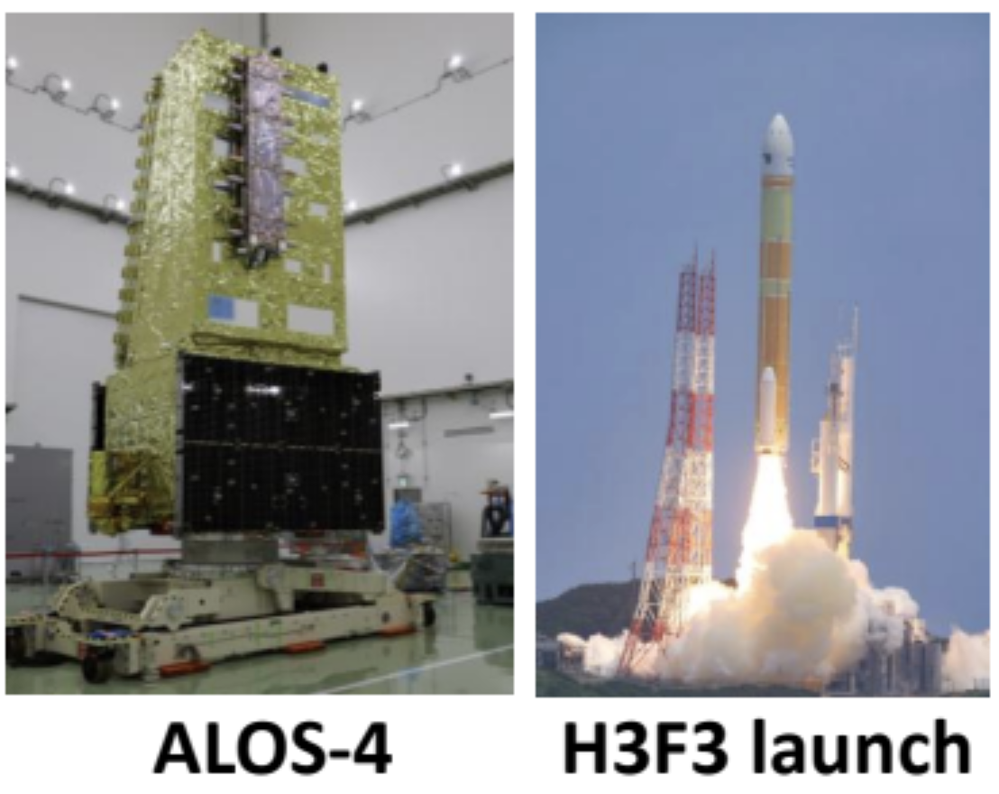
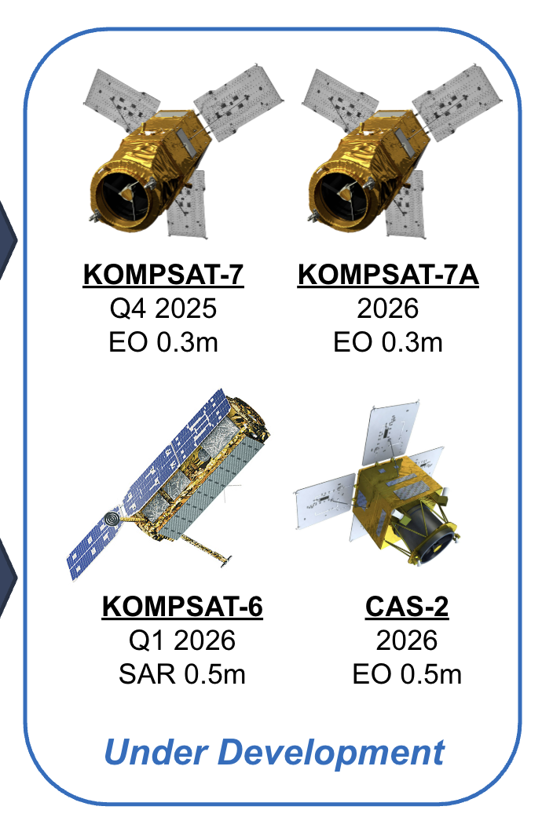
Planning highlights
JAXA: ALOS-4 Nominal Observations operation from April 1; Data distribution from July 2025.
ESA: BIOMASS successfully launched in April, 2025.
NASA & ISRO: NISAR successfully launched in July, 2025.
  NASA (JPL): NISAR(L) CEOS-ARD under development.
  ISRO: RISAT-1 CEOS-ARD compliant; NISAR(S) under development.
CONAE: SAOCOM-1A/B CEOS-ARD assessment ongoing. SABIA-Mar also targeting CEOS-ARD.
USGS/NASA: future Landsat and Landsat Collection 3 development ongoing
GISTDA: Strong THEOS continuity – THEOS-3 (VNIR & SWIR) , 4 (SAR) and 5 (high res). CEOS-ARD development underway. THEOS-1 (2008) and THEOS-2 series active.
KARI: KOMPSAT-6 (SAR) and KOMPSAT-7/7A under development; Korean ARD development:
CEOS-ARD PFS development:
Multi-Source Backscatter, VHR SAR
Need to update PFS to enable high res (VHR) and commercial sector participation
CEOS and industry co-development of updated Surface Temperature Specification (LST, SBT)
  TRISHNA, SBG, LSTM, S-3 – need additional CEOS mission representation
  OroraTech, Constellr, SatVu, EarthDaily, others
  SST-VC co-development?
Supportive of developing an official LSI-VC recommendation for DGGS (Discrete Global Grid System).

Slide 7
Issues for attention of SIT
Land Degradation Neutrality (GEO-LDN, UNCCD)
  Data needs: more long term time series (2000 - present); consistent global land cover datasets; additional hyperspectral; data harmonisation
  SAR priorities: Coverage of small islands (high res, cloudy); Biomass; Land cover structure, disturbance; Moisture – aridity; Vertical profile (band integration)
AFOLU Roadmap actions need to identify more activities beyond NASA, ESA, JAXA
Need to map GEOGLAM EAVs to existing agency products / activities – stocktake of CEOS agency contributions to agriculture
Wetlands/Ramsar: Support for closer collaboration with EO community at Ramsar COP15; EO key to enabling more reporting.
  EO included in Resolution COP15 23.10: “working with Earth observation organizations, including the Group on Earth Observations (GEO), for putting Earth observation data and monitoring tools at the disposal of Contracting Parties”
CEOS-ARD survey:
  Community calling for additional CEOS-ARD from MODIS, PACE, NISAR, NovaSAR-1, Sentinel-1 and 3, among others
  Availability of open DEMs at higher resolution to support RTC of increasingly high resolution SAR datasets
Commercial sector is keen to engage and learn from CEOS agencies
  Active engagements with EarthDaily, OroraTech, Planet, SatVu, Constellr, Aistech Space, Marble Imaging AG, SatSure, Catalyst, Synspective, Esri, Hyspace, SkyServe, Pixxel, SatSure, Synspective, and more
Review agency participation in LSI-VC: ASI, CSA, CNES (note Surface Temp topic), DLR, INPE, NASA, NOAA, VAST

