Slide 1
SIT Technical Workshop 2025
Ocean Colour Radiometry Virtual Constellation (OCR-VC) (For Information)
Ewa Kwiatkowska
Marie-Helene Rio
Jeremy Werdell
Agenda Item 7.5
SIT Technical Workshop 2025
EUMETSAT, Darmstadt, Germany
09 - 11 September 2025

Slide 2
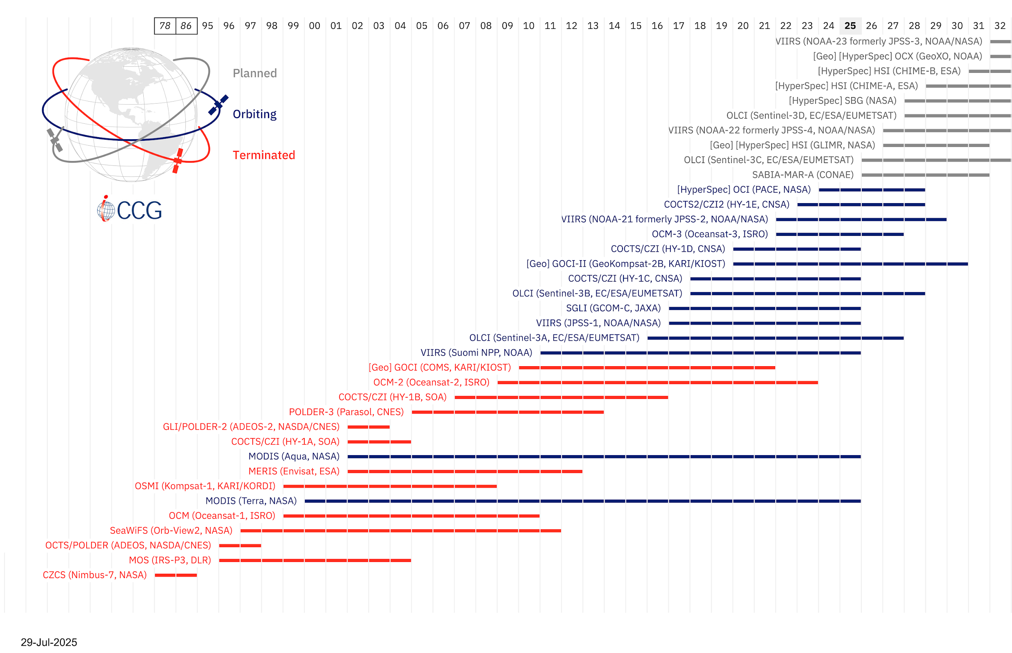
OCR-VC timeline of missions
Operational recurrent missions from 2010s
Hyperspectral missions from 2020s, NASA PACE >Feb 2024
Geostationary pioneering missions, KIOST GOCI-I&II >2010, but no plans for OCR GEO-ring yet
Application advances
Coastal and inland waters in addition to open oceans and seas
Water quality, HABs, ecosystem health, biodiversity, water resources, fisheries, aquaculture, coastal management, primary production, aquatic carbon, climate
Link to IOCCG graphic

Slide 3
OCR-VC key planning highlights
Progress on the Aquatic Carbon Roadmap
Wednesday, Sep 10: agenda item 6.1 presented by Marie-Helene Rio, ESA
Dec 2025: a dedicated keynote, panel discussion, and breakout session at the International Ocean Colour Science Meeting (IOCS); preceded by the Ocean Carbon From Space 2025 Workshop
SIT-41 in early 2026: current target for completion
May 2025 endorsement of the CEOS-ARD Aquatic Reflectance PFS that covers all aquatic ecosystems, oceans, seas, coastal and inland waters
Other OCR-VC deliverables: System Vicarious Calibration in BAMS 2025; in situ measurement protocols, FRM4SOC2; IOCCG training & scholarships, FRM4SOC2 FICE
IOCS 2025 in Darmstadt, Germany, 1-4 Dec, IOCCG meeting co-hosted by EUM & ESA
Current IOCCG working groups and task forces
WGs: Benthic Reflectances, Primary Production, Optical Water Types, Lidar Applications
TFs: Marine Litter & Debris, Hyperspectral, Carbon, Long-Term Records, Sensor Calibration, SVC

Slide 4

OCR-VC issues for attention of SIT
Current and future of OCR
Geo: GEO-XO mission may lose the ocean colour sensor
Hyperspectral: continuity of hyperspectral measurements into the future
Consistent long-term time series: IOCCG is tackling this OCR requirement, but it is complex and needs guidance
Support for high quality in situ measurements - Fiducial Reference Measurements
System Vicarious Calibration: vulnerability around funding for the SVC infrastructures and their measurements (MOBY, MarONet) and the risk for missions
Validation: sustainment of investment
Coordination with in situ instrument manufacturers, calibration labs, metrology institutes
End-to-end uncertainty budget for OCR products and the OCR quality label
Aquatic carbon roadmap: working on interfaces across the three carbon roadmaps and implementing aquatic carbon in global carbon stock assessments
Developing water quality data products: roadblocks for using EO by water quality reporting agencies, and the private and commercial sector

