Slide 1
Ocean Surface Topography Virtual Constellataion (OST-VC)
E. Obligis, EUMETSAT
Y. Faugère, CNES
OST-VC co-chairs
Agenda Item 7.6
SIT TW 2025
Darmstadt, Germany
9-11 September, 2025

Slide 2
Presenter Guidelines
Presenters should name their file using the following convention:
AgendaItemNumber_LastName_Subject (e.g., 1.1_Maejima_Welcome)
Documents and presentations should be uploaded to the shared folder to allow for streamlined self service
Shared Presentation Folder (default view only, ask for upload/edit permission as required)
For support contact the SIT Chair Team: jaxa-sit-chair-2024-25@googlegroups.com
Presentations and documents for information should be submitted by 2 September 2025
Reporting to engage discussion or decision is encouraged, but detailed reporting should be provided as pre-meeting reading material or in background slides.
Please explicitly highlight the decisions, outcomes, or actions you are seeking. The more explicit you are, the better. i.e., feel free to provide text for a proposed action – it may be revised later, but this approach will help with the efficient preparation of the actions record of the SIT meeting.

Slide 3
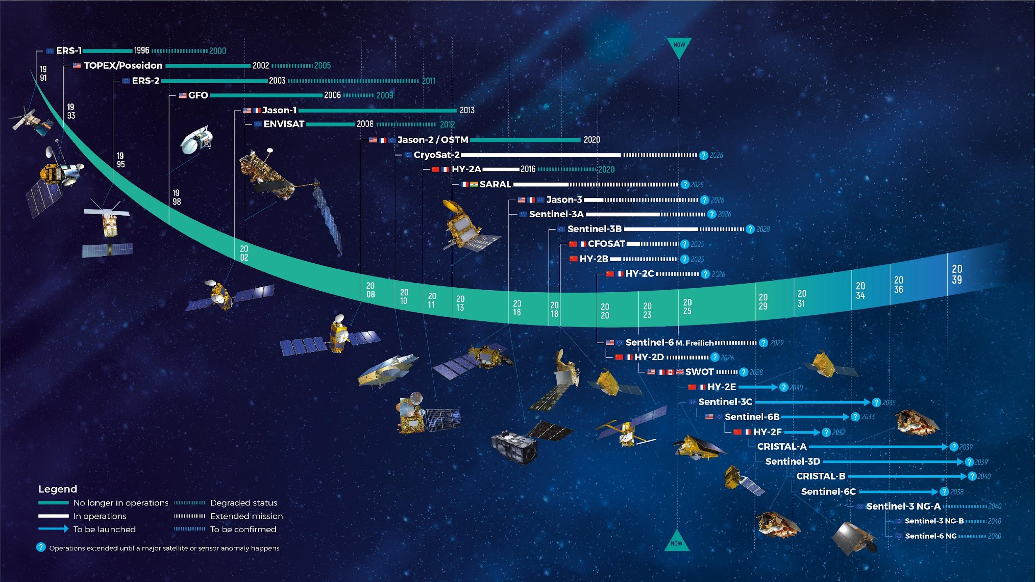
Current constellation
11 missions in flight
11 missions to come
And regular and consistent reprocessing of old missions
Courtesy of CLS

Slide 4
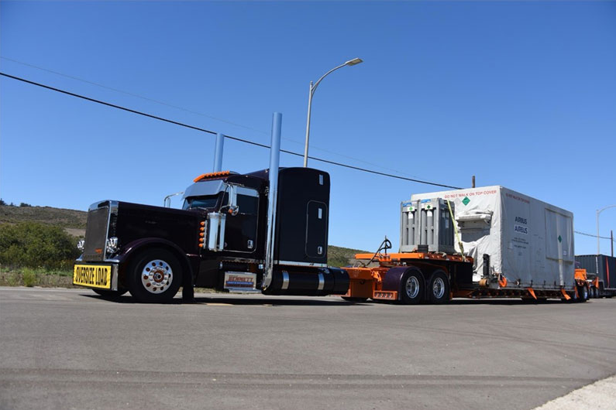
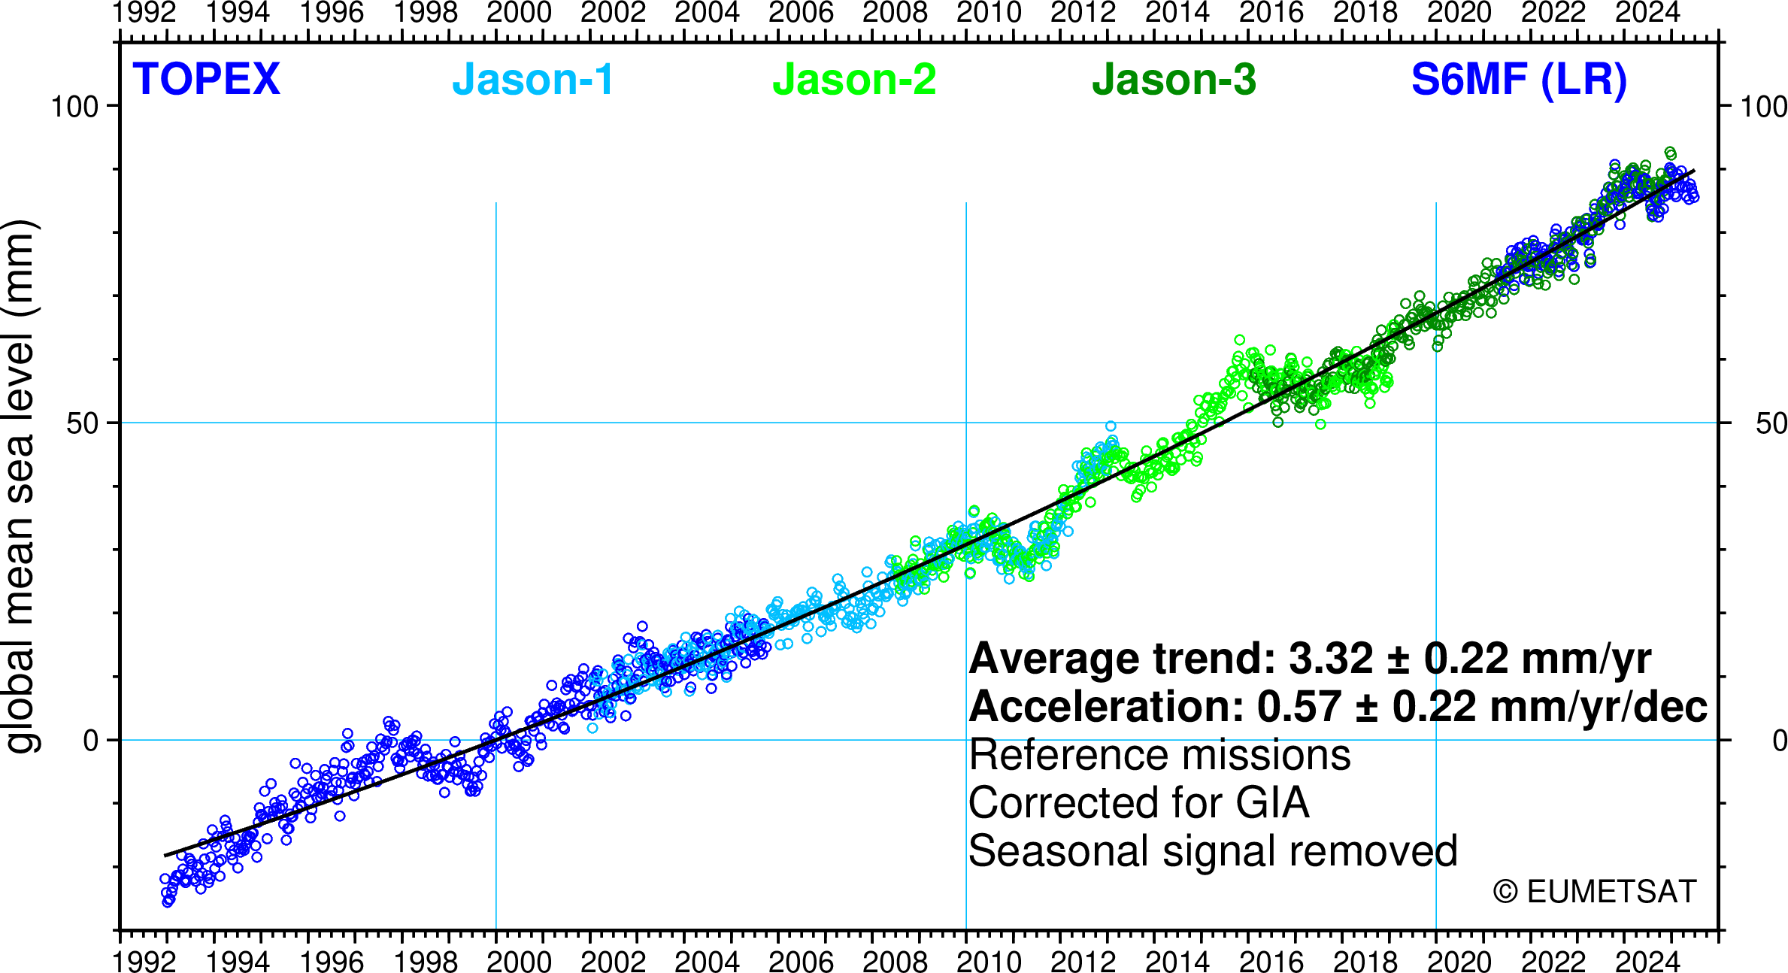
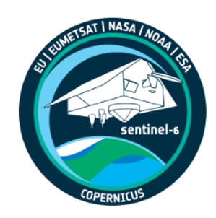
Breaking news – Sentinel-6B
Sentinel-6B satellite arrived on a truck bed at Vandenberg Space Force Base in California on 18 August. It will be unpacked from its climate-controlled shipping container in the next weeks to begin final preparations for launch in November.
Launch to take place from Vandenberg Air Force Base, with a Space X Falcon 9, on Sunday November 16, 2025, at 9 pm PT.
Will guaranty the continuity of the Mean Sea Level record which started in 1992 with Topex-Poseidon.

Slide 5
Missions status
AltiKa (CNES/ISRO): Still operational, extended until 2025
CRYOSAT (ESA): Still operational, extended until 2028
Jason-3 (CNES/NASA/EUMETSAT/NOAA/EU): now definitely in interleaved Long Repeat Orbit after the second tandem with Sentinel6-MF, extended until 2027
SWOT (NASA/CNES/CSA/UKSA): fully operational
Sentinel-3 (ESA/EUMETSAT/EU):
A and B: fully operational, compliant with mission requirements
C: launch expected in Fall 2026, commissioning activities (including tandems) in preparation
HY (CNSA/CAST/NSOAS)
HY-2B, HY-2C, HY-2D are fully operational
HY-2E and HY-2F will be launched in 2026
CFOSAT (CNSA/CNES):
Still operational, extended until 2026

Slide 6
Missions status
Sentinel-6 (EUMETSAT/ESA/NOAA/NASA/EU/CNES):
S6-MF : fully operational, compliant with mission requirements
S6-B: will be launched on 16th November
S6-C: mission identified in the EC Copernicus Long Term Scenario but risk associated to US contribution
CRISTAL (ESA/EUMETSAT/NASA/EU): currently in phase D, launch expected in 2027
Sentinel-3 Next Generation Topography: phase B2/C/D has started, ESA procurement on-going, implementation of two dedicated satellites carrying Wide-Swath and Nadir altimeters, together with radiometer and POD instruments
Sentinel-6 Next Generation: ad-hoc expert group in place to define user requirements. Studies under way to determine the impact of a potential newly selected non-sunsynchronous orbit on the long-term record of altimetric mean sea level rise

Slide 7
Future OSTST meetings
OSTST 2025
16 November 2025, in Buellton, CA, USA, to coincide with the launch of Sentinel-6B
OSTST 2026
22 – 26 June 2026, Wiesbaden, Germany

Slide 8
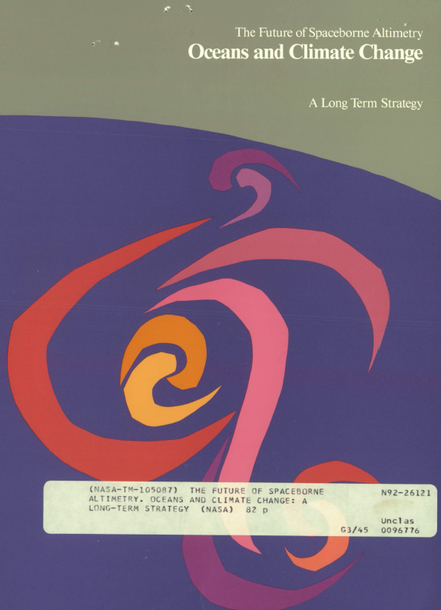
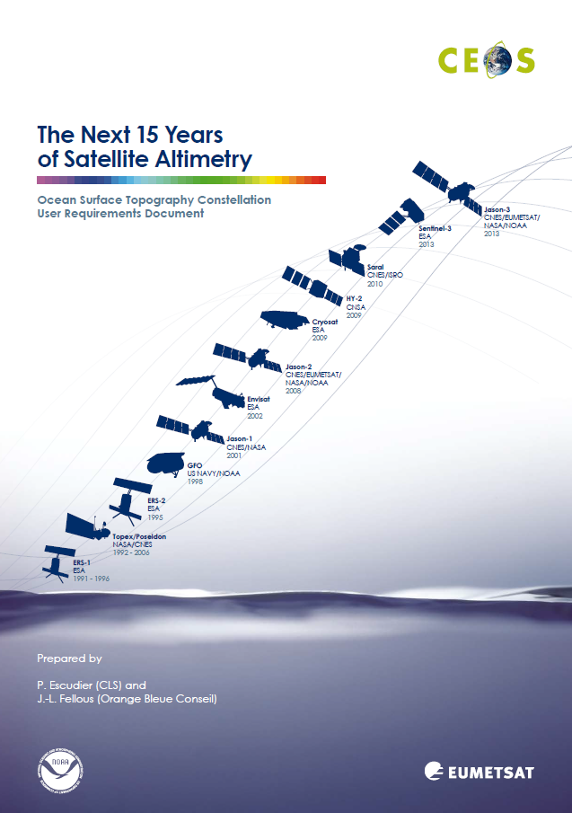
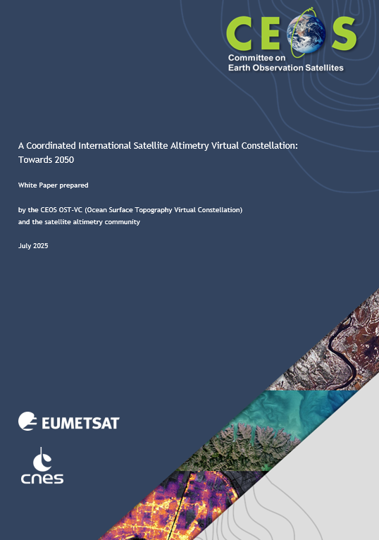
White Paper
1992
2009
2025
New OST-VC white paper
“A Coordinated International Satellite Altimetry Virtual Constellation: Toward 2050”
🡪 Dedicated Presentation item 8.1

Slide 9
Issues for attention of SIT
Key role of Chinese missions (HY2) in the Virtual Constellation 🡪 participation of Chinese agencies in the VC would be welcome.

Slide 10
Thank you

