Slide 1
Precipitation Virtual Constellation
State of the Global Observing System
Chris Kidd NASA/UMD
Takuji Kubota JAXA
Agenda Item 7.8
SIT TW 2025
Darmstadt, Germany
9-11 September, 2025

Slide 2
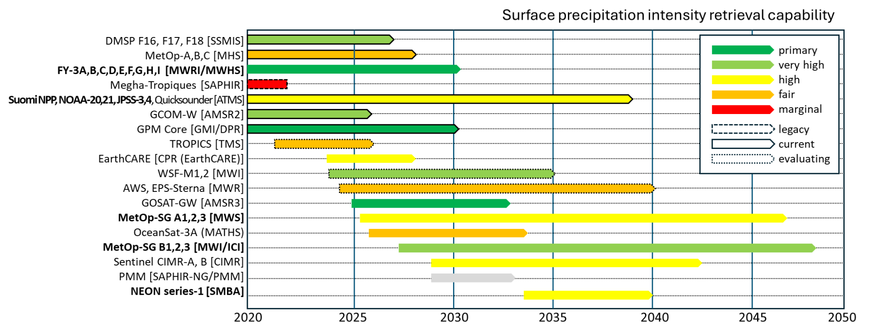
Summary of Current & Planned Missions

Slide 3
Planning highlights
Current product status:
Agency/organisation products generally freely available in HDF5/netCDF formats.
New products based upon AI/ML are being developed (e.g. GPROF V08 precipitation retrieval product for release in 2026).
CEOS-ARD PFS for precipitation under development (primary agency/organisation products already in ARD-type formats).
Potential gaps in product availability
Products heavily dependent on the suitability and availability of data.
To 2030 - continued operations of core sensors (with some loss/gains).
Commercial (high frequency) data available (at a not insignificant cost).
Post 2030 - GPM EoL, some new missions, but dominated sounding instruments which are less capable for surface precipitation estimation.
No precipitation radar beyond GPM DPR (EoL ~2031).

Slide 4
Issues for attention of SIT
Satellite data provides key observations for mapping, monitoring and measuring global precipitation:
❖Critical gaps: possible (likely) lack of low inclination radar(s) and suitable low frequency radiometers for precipitation is now critical. (Precipitation-focused missions have been largely ‘research’ missions).
❖Coordination required: the continuation of a core set of precipitation-capable agency missions is vital - commercial missions are an added extra (albeit with reduced capability).
❖Societal impact: a reduction in the accuracy of satellite precipitation estimates impacts many aspects of our society from natural hazard mitigation to water resource planning.

