Slide 1
COAST Virtual Constellation
Paul DiGiacomo, NOAA
Agenda Item 7.9
SIT TW 2025
Darmstadt, Germany
9-11 September, 2025

Slide 2
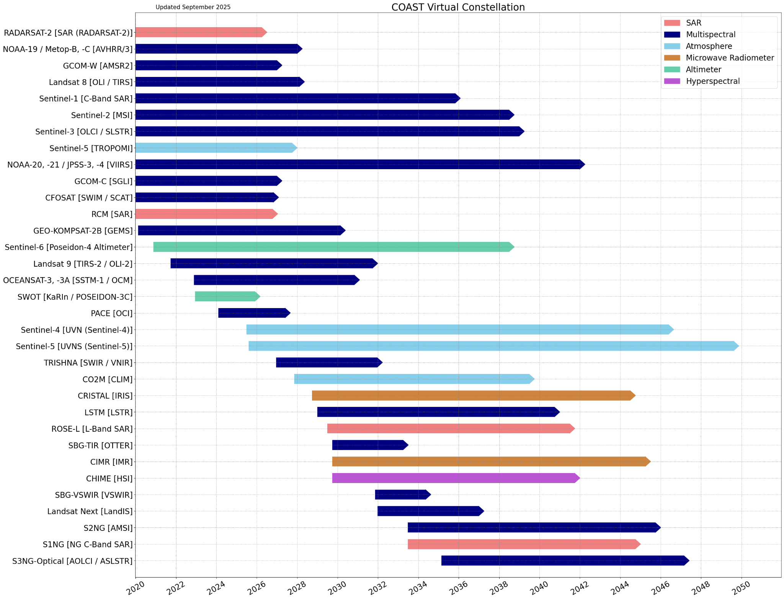
Summary of Current & Planned Activities

Slide 3
Planning highlights
Current status: product development & internal-external communications
Products/Tools/Services - Application Knowledge Hub (AKH) Improvements released; improved Geoscience Australia intertidal bathymetry and NOAA Marsh Mapping tool
CoastPredict collaboration - Co-chairing special session at AGU 2025
IOCCG and GOOS – introductory outreach completed, in conjunction with OCR-VC discuss future collaboration areas.
SST-VC - coastal masking recommendation joint statement
Responsive to call from Biodiversity Study Team, WGISS Interoperability Handbook Review, and OCR-VC Aquatic Carbon Roadmap contributors
Now participating in the CEOS Analysis Ready Data (ARD) Group Meetings
Product Availability and Gap Analysis (Commencing soon)
COAST-VC (in conjunction with other CEOS entities) shall lead subject matter experts in a gaps and limitations analysis of existing mission data for the coastal ocean. This will be a CEOS contribution to the Space4Ocean Alliance. Report due to SIT Chair Q2 2027
Notes:
Application Knowledge Hub (AKH) Improvements released
Geoscience Australia intertidal bathymetry
Successful Outreach and Training at One Ocean Science Conference/UNOC3 and ESALPS
Hopefully you saw some of the new products in our Side Event demo Tuesday before this SIT-Technical Workshop
CoastPredict collaboration - Co-chairing special session at AGU 2025 (New Orleans) OS021 - Satellite and In Situ Observations in Support of the Prediction of Coastal Hazard Impacts for Enhancing the Resilience of Coastal Communities
IOCCG and GOOS - Aurelien Carbonniere attended a meeting with IOCCG to introduce COAST to the members, and IOCCG leadership were also invited to a special meeting (alongside OCR-VC) with COAST-VC to discuss future collaboration areas.
SST-VC: Successfully completed cross VC collaborations for coastal masking recommendation joint statement
Responded on time to Biodiversity Study Team, WGISS Interoperability Handbook Review, and OCR-VC Aquatic Carbon Roadmap calls for contributors
Now participating in the CEOS Analysis Ready Data (ARD) Group Meetings
2026-27 - COAST-VC (in conjunction with other CEOS entities) shall lead subject matter experts in a gaps and limitations analysis of existing mission data for the coastal ocean (e.g. within 100km of the shoreline) and prepare for the SIT chair a summary report with detailed appendices. This will be a CEOS contribution to the Space4Ocean Alliance. The report would ideally document what products are not operationally achievable with current data and which future missions should target to fill in terms of science requirements, stakeholder and model needs. Examples are salinity, ocean color, SST less than 30m resolution. There is also a consideration of data access and latency of data processing that will be operational concerns. Principle: CEOS COAST-VC Due Date: Quarter 2 of 2027.

Slide 4
Items for attention of SIT
COAST welcomes discussion on the future hosting of the COAST Application Knowledge Hub as CEOS considers how/where to manage final VC products.
COAST announces the Open Recruitment of COAST-VC members, including to support the Gap Analysis Effort that requires Subject Matter Experts CEOS wide - meetings to start in October
COAST welcomes expressions of interest in COAST-VC co-leads as NOAA plans its natural transition back to membership status in mid-2026, in alignment with our initial VC proposal timeline.
Notes:
COAST welcomes discussion on the future hosting of the COAST Application Knowledge Hub as CEOS considers how/where to manage final VC products.
COAST announces the Open Recruitment of COAST-VC members, including to support the Gap Analysis Effort Subject Matter Experts CEOS wide - meetings to start in October"
COAST welcomes expressions of interest in COAST-VC co-leads as NOAA plans its natural transition back to membership status in mid-2026, in alignment with our initial VC proposal timeline.

