Slide 1
SIT Technical Workshop 2025
GEOGLAM
Sven Gilliams Alyssa Whitcraft
GEOGLAM Secretariat
Agenda Item # 8.2
SIT TW 2025
Darmstadt, Germany
9-11 September, 2025

Slide 2
Proposed SIT-TW Action + Most Recent Actions
Action # | Proposed or Original Deadline | Action Text | Update/Comment
SIT-TW-40-? | Plenary-39 | CEOS agencies without confirmed PoCs are asked to formally appoint a PoC to the GEOGLAM LSI-VC Subgroup Note: commitment can be incremental starting with short-term support for first 6 variables of the stocktake | Already Confirmed: ESA, ISRO, CSIRO, SANSA, Geoscience Australia, CONAE
SIT-TW-40-? | Plenary-39 | WG Cal-Val asked to work with GEOGLAM PoCs to scope “Joint Workshop on Good Practices for ET Validation”
SIT-40-12 | 9 May 2025 | CEOS Agencies are asked to review the submitted “LSI-VC Subgroup on GEOGLAM Terms of Reference” and provide a response to GEOGLAM points of contact… | Feedback welcome, but not required. LSI-VC will approve.
Plenary-38-08 | 29 Nov 2024 | CEOS agencies to identify points of contact to contribute to an 18-month Essential Agriculture Variables (EAV) stocktake and LSI-VC Subgroup on GEOGLAM scoping effort. | Requesting movement to SIT-TW-40 Action for agencies without confirmed reps.
SIT-39-05 | June 2024 | CEOS Agencies to identify points of contact to contribute to the LSI-VC Subgroup on GEOGLAM. | Requesting movement to SIT-TW-40 Action for agencies without confirmed reps.
Notes:
Points →
These are the actions we will ask for today, I’ll describe them later
We are absorbing the old actions into the new actions

Slide 3
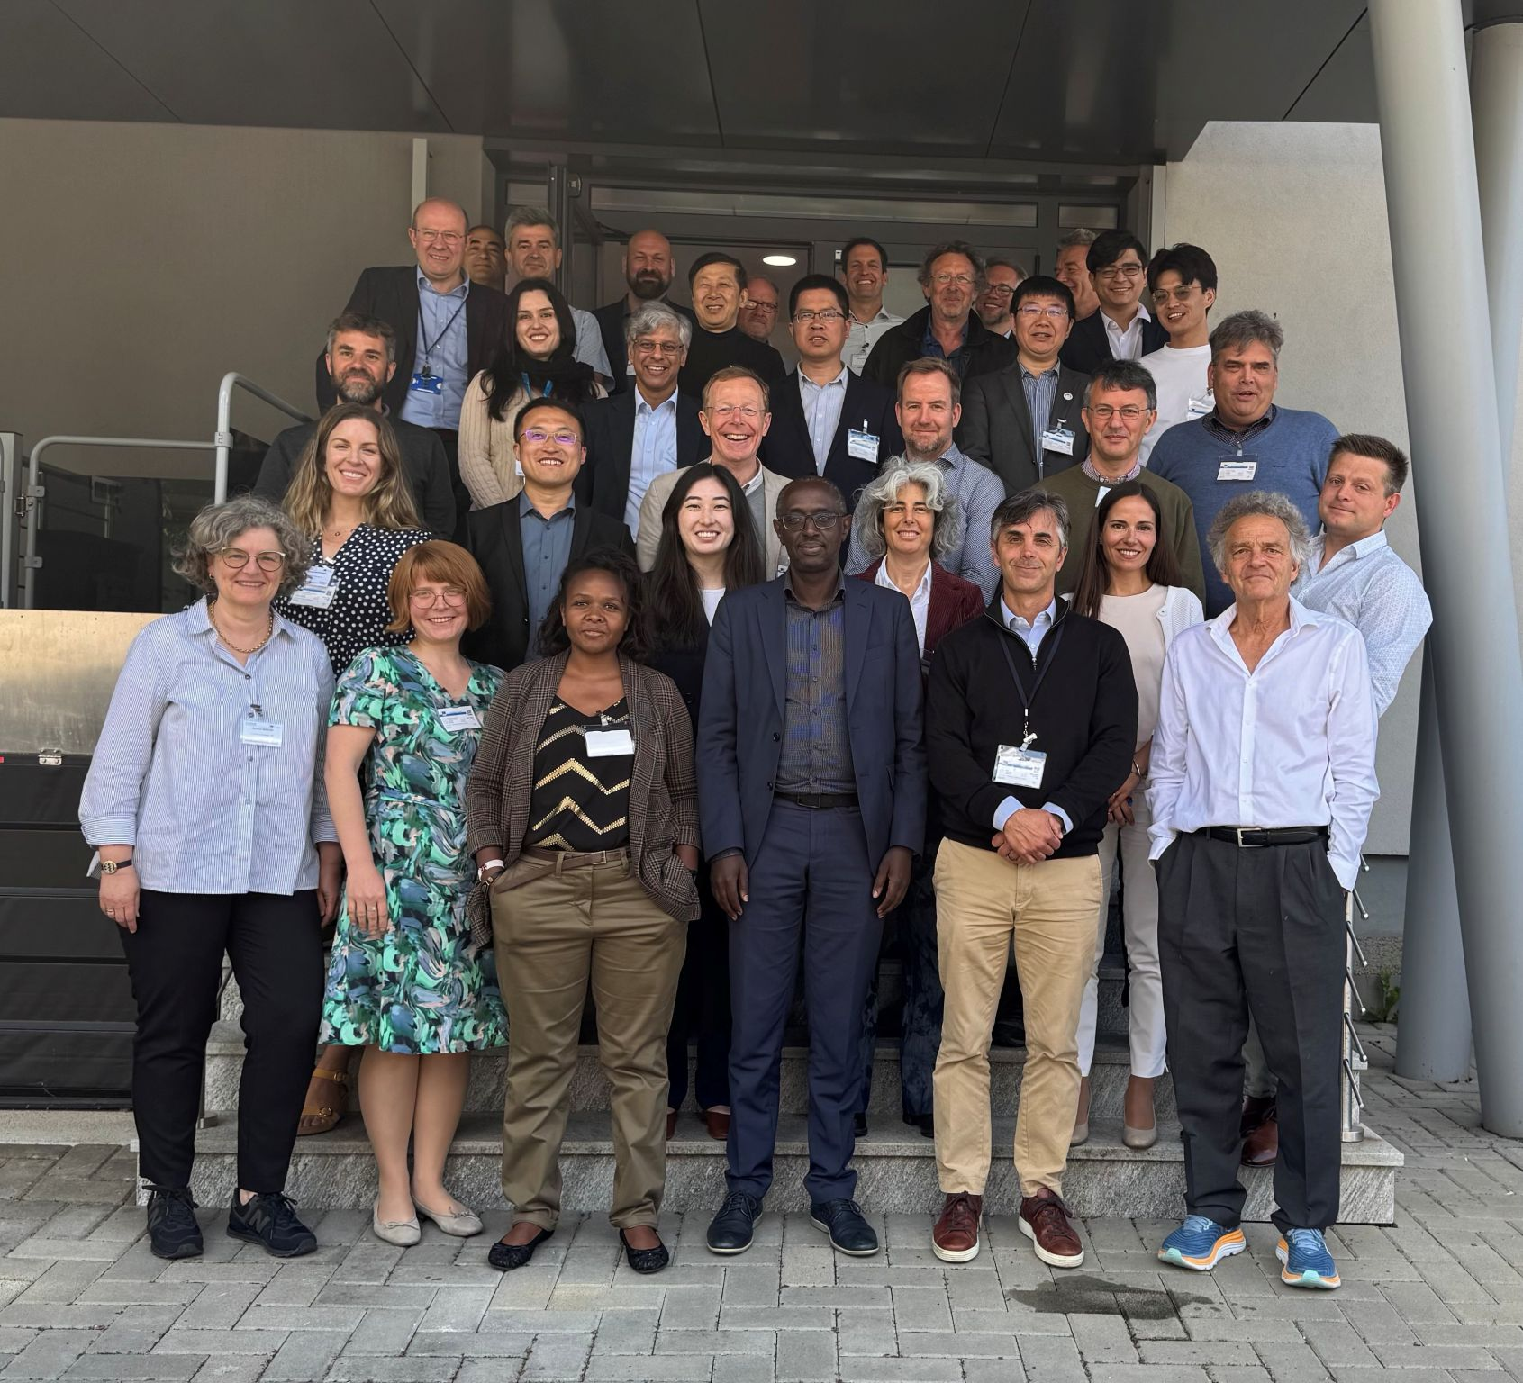
GEOGLAM EAV Workshop 13-15 May 2025, EC JRC
34 in-person attendees, inc:
UKSA, NASA, ESA, EC
18 virtual attendees, inc:
JAXA, SANSA, Geoscience Australia, ISRO
2 new EAV WG Co-Leads join Alyssa + Sven
Laurent Tits (VITO)
Michael Marshall (U Twente)
Unifying Rationale:
Proliferating uses for EO in agriculture creates inefficiency, inconsistency (scale, definition), and quality issues.
There is a very clear need for guidance for multiple audiences (inc. CEOS) that transcends application, scale, and border on definitions and typologies around agricultural land use, productivity, and change.
GEOGLAM is best suited to do this.
Notes:
Points →
Well attended
Participation in-person and online by CEOS orgs
This is really a valuable thing for increasing efficiency for CEOS agencies to support ag

Slide 4
Key Outcomes: GEOGLAM EAV Workshop
Agreements:
The scope & objectives of GEOGLAM’s EAV effort →
Audiences for the EAV Effort (and what to show them - in appendix)
CEOS / agencies
Agriculture decision makers
Agriculture information product generators
Input variable product generators
Funders/donors
Present a unified and authoritative approach to defining and implementing systematic agricultural assessments.
Provide consensus, use-agnostic definitions for measurements and quality assessments of agriculture state, change, and forecast.
Create a path to concretely embed satellite observations within agriculture decisions.
Provide a communication tool for bridging gaps with non-satellite communities so that they adopt satellite data for their applications.
Maintain (and grow) GEOGLAM as the international EO-for-ag authority
Set requirements tightly linked to use for space agencies to consider in current data provision and future missions and data systems.
Direct feed into CEOS
Notes:
Points →
What CEOS gets out of it
What agencies get out of it

Slide 5
Key Outcomes: GEOGLAM EAV Workshop
Agreements:
The list of uses of satellite-based EAVs that are within GEOGLAM’s scope
AMIS
Early warning
Quantitative production forecasting
SDGs / UNFCCC (AFOLU) / UNCCD (LDN) etc.
National statistics
Compliance / regulatory applications
Disaster response
Water district management and conservation planning
Insurance
Voluntary markets (GHG)
Supply chain traceability
Risk mitigation
Precision management
Land management
The framework for thinking about and documenting EAVs
“Steps” in the GEOGLAM’s EAV Effort
Plus timeline May 2025 - April 2026
Phase 1 → 6 Initial Variables to “Pressure Test” Framework:
Crop type; crop yield; field boundaries; irrigated cropland; cover crop ET
Now “on the record” as within scope of GEOGLAM EAVs - reduces duplication from other communities
Notes:
Points →
Expansion of GEOGLAM “on the record” scope - but it has always been in the community
This is why the distillation/unified-voice function of the EAVs is important
6 Initial variables means incremental effort opportunity for agencies and getting process right before doing everything

Slide 6



SINGLE SET FOR ALL USES
Reduce Complexity
Create Consistency
DISTINCT SETS FOR EACH USE
Representative of breadth of applications
Allows unpacking of sources of gaps
PRIORITISATION
Identifying most important gaps that can support the most improvement for each use and distilled for the most uses
Use 1
Product Requirements
“Threshold” and “Goal” Spatial, Spectral, Temporal, Accuracy, Latency
Stocktake - Products
List & Specifications of Past, Current, & Planned Products
Gap Analysis - Products
Performance of Products vs. Threshold & Goal Requirements
EAV Name
Definition
Units
Guidance: Typologies, Hierarchies, Accuracy Assessment etc.
Correspondence with Other EVs
Per Use Priorities
Stocktake - Missions
List & Specifications of Past, Current, & Planned Missions
Gap Analysis - Missions
Performance of Missions vs. Threshold & Goal Requirements
Distilled Priorities
Use …n
Product Requirements
“Threshold” and “Goal” Spatial, Spectral, Temporal, Accuracy, Latency
Stocktake - Products
List & Specifications of Past, Current, & Planned Products
Gap Analysis - Products
Performance of Products vs. Threshold & Goal Requirements
Per Use Priorities
Stocktake - Missions
List & Specifications of Past, Current, & Planned Missions
Gap Analysis - Missions
Performance of Missions vs. Threshold & Goal Requirements
Notes:
Points:
Single set = consensus
Multiple sets for uses = a realistic picture of how EO data are used
But at the end, we narrow and distill down
Missions piece is where we really need agency help - products are good too

Slide 7
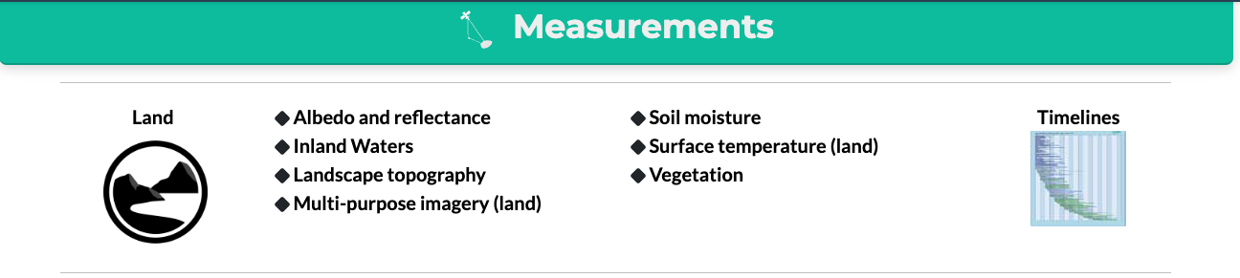
May 2025
Sep 2025
Nov 2025
April or Sept 2026
Fall or Winter 2026
Agencies Do SIT-TW-41 Actions
CEOS Does Plenary-39 Action #2-3
13-15 May 2025
GEOGLAM EAV Workshop
SIT-TW-40
Report:
- Progress on EAVs
Discuss:
- “Roadmap” for EAVs over next 6 months
Actions:
Agencies appoint PoCs to LSI-VC or stocktake
Scoping of Joint ET Workshop with Cal-Val
Plenary-39
Documents: - Phase 1 EAV Report for 1st Set of EAVs
Report:
- Key findings of Phase 1
- Proposed Cal-Val Workshop for ET
Actions:
Agencies Work on Stocktake for 1st 6 Variables
CEOS MIM Ag Component Database Design Scoping
WG Cal-Val Workshop “Green-light”
SIT-41 or SIT-TW-41
Documents:
- Phase 2 Report
- Agency feedback on level of interest in remaining EAVs
Report:
- EAV Req’s
- Agency Foci for next phase of EAV Stocktake
Action:
Agencies continue Stocktake based on their foci
Fall or Winter 2026
GEOGLAM EAV WG + LSI-VC Subgroup Joint Workshop to Distill Priorities
Agencies Do Action #1
Agencies Do Action #1
Asynchronous work on Phase 1 EAVs
Completes + Submits Phase 1 EAV Report
Asynchronous Work on Phase 2 Def’s + Req’s for Other Variables
Legend
Boxes = Events
Arrows = Work
GEOGLAM
CEOS/Agencies
Shared
Notes:
By Plenary-39 → Review SIT-41 action - and set some deadline after which the ToR simply is assumed endorsed (?)
By Plenary-39 → Agencies to fill in the blanks on LSI-VC group
Beginning in the context of the stocktake support for the 6 actions
We could name the individual agencies who have been active in the past (see right pane)
April 14-16, 2026 - NASEM Beckman Center in Irvine, CA - https://www.nationalacademies.org/beckman-center
→ Agencies work on prioritized stocktake for 2 months (?)
→ More MIM
→ June-July period… GEOGLAM Prioritisation workshop (because full req’s + stocktake (as much as agencies want) + gap analysis can be complete) … outcome of this = prioritisation plan
Sept. 8-10, 2026 - NASEM in Washington, D.C. → review prioritisation plan
→ Plenary 2026… present final stocktake and operationalised MIM
April 20-22, 2027 - NASEM in Washington, D.C.
Sept. 7-9, 2027 – NASEM Beckman Center in Irvine, CA

Slide 8
Look ahead → Plenary-39
May 2025
Sep 2025
Nov 2025
Crop type
Crop Yield
ET
Irrigated Cropland
Cover Crop
Field Boundaries
What will have been completed for 1st 6 Variables:
Definition + Descriptions
Product Requirements
GEOGLAM community’s “accounting” of current and past products and related satellites
GEOGLAM community’s assessment of gaps and prioritisation
Agencies Do SIT-TW-41 Actions
SIT-TW-40
Report:
- Progress on EAVs
Discuss:
- “Roadmap” for EAVs over next 6 months
Actions:
Agencies appoint PoCs to LSI-VC or stocktake
Scoping of Joint ET Workshop with Cal-Val
Plenary-39
Documents: - Phase 1 EAV Report for 1st Set of EAVs
Report:
- Key findings of Phase 1
- Proposed Cal-Val Workshop for ET
Actions:
Agencies Work on Stocktake for 1st 6 Variables
CEOS MIM Ag Component Database Design Scoping
WG Cal-Val Workshop “Green-light”
13-15 May 2025
GEOGLAM EAV Workshop
Legend
Boxes = Events
Arrows = Work
Asynchronous work on Phase 1 EAVs
Completes + Submits Phase 1 EAV Report
GEOGLAM
CEOS/Agencies
Shared

Slide 9
Look ahead → Plenary-39
May 2025
Sep 2025
Nov 2025
Crop type
Crop Yield
ET
Irrigated Cropland
Cover Crop
Field Boundaries
What will have been completed for 1st 6 Variables:
Definition + Descriptions
Product Requirements
GEOGLAM community’s “accounting” of current and past products and related satellites
GEOGLAM community’s assessment of gaps and prioritisation
Planned Decisions & Actions, Plenary-39:
Action → Agency participants on LSI-VC GEOGLAM Subgroup work on stocktake for 6 variables
Action → CEOS SEO / Symbios (?) + GEOGLAM → scoping of ag component of MIM
Action → Green-light / commitment to WG Cal-Val Workshop
Agencies Do SIT-TW-41 Actions
SIT-TW-40
Report:
- Progress on EAVs
Discuss:
- “Roadmap” for EAVs over next 6 months
Actions:
Agencies Appoint PoCs to LSI-VC or stocktake
Scoping of Joint ET Workshop with Cal-Val
Plenary-39
Documents: - Phase 1 EAV Report for 1st Set of EAVs
Report:
- Key findings of Phase 1
- Proposed Cal-Val Workshop for ET
Actions:
Agencies Work on Stocktake for 1st 6 Variables
CEOS MIM Ag Component Database Design Scoping
WG Cal-Val Workshop “Green-light”
Missing = Agency’s accounting
13-15 May 2025
GEOGLAM EAV Workshop
Legend
Boxes = Events
Arrows = Work
Asynchronous work on Phase 1 EAVs
Completes + Submits Phase 1 EAV Report
GEOGLAM
CEOS/Agencies
Shared
Notes:
Points →
We will take the first 6 variables as far as we can - but we need the insight on missions

Slide 10
Between Plenary-39 and SIT-41 or SIT-TW-41……
Actions from Plenary-39:
Agencies Work on Stocktake for 1st 6 Variables
In parallel, GEOGLAM EAV Working Group continues undertaking EAV Framework for other EAVs.
CEOS MIM Ag Component Database Design Scoping
Eventual home for the EAV Framework
Continued planning, possible execution of WG Cal-Val Workshop
There are many dependencies in this plan, so SIT-41’s report could become SIT-TW-41’s:
Finding engaged EAV Stewards for next tranche of variables
Adequate agency engagement and buy-in
Green-light of Cal-Val Workshop + travel availability of participants
April or Sept 2026
Fall or Winter 2026
CEOS Does Plenary-39 Action #2-3
SIT-41 or SIT-TW-41
Documents:
- Phase 2 Report
- Agency feedback on level of interest in remaining EAVs
Report:
- EAV Req’s
- Agency Foci for next phase of EAV Stocktake
Action:
Agencies continue Stocktake based on their foci
Fall or Winter 2026
GEOGLAM EAV WG + LSI-VC Subgroup Joint Workshop to Distill Priorities
Agencies Do Action #1
Agencies Do Action #1
Asynchronous Work on Phase 2 Def’s + Req’s for Other Variables
Legend
Boxes = Events
Arrows = Work
GEOGLAM
CEOS/Agencies
Shared
Notes:
Points:
This is the idea, but we need sustained agency commitment and involvement… SIT-41 will be a chance to renew that

Slide 11

SIT-TW-40 → 2 Requested Actions
1. By Plenary-39, CEOS agencies are asked to formally appoint a PoC to the GEOGLAM LSI-VC Subgroup (from Plenary-38-08)
Confirmed: ESA, ISRO, CSIRO, SANSA, Geoscience Australia, CONAE
Historically-engaged agencies without formal PoC: NASA, DLR, CSA, JAXA, UKSA, USGS, NOAA, CNES
All other agencies are very much welcome!
Effort can be incremental → short-term commitment to support for first 6 variables of the stocktake (from SIT-39-05)
2. WG Cal-Val asked to work with GEOGLAM PoCs to scope “Joint Workshop on Good Practices for ET Validation”
UN FAO (ET & Irrigated Cropland Lead Steward) is able to host
Then, we will report workshop proposal at Plenary-39
View PoC List here: https://go.umd.edu/GEOGLAM-LSIVC-LIST
Recap:
We are making good progress toward EAV Objectives
There was solid agency participation in the EAV Workshop
We need ongoing communication and effort from several key agency collaborators for successful implementation of the EAVs

Slide 12
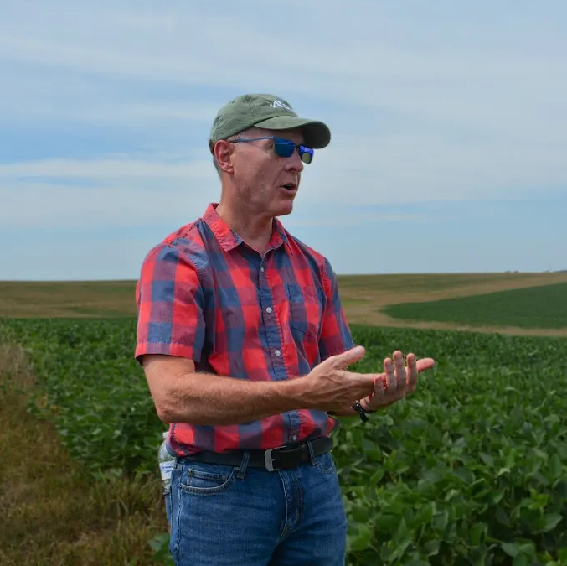

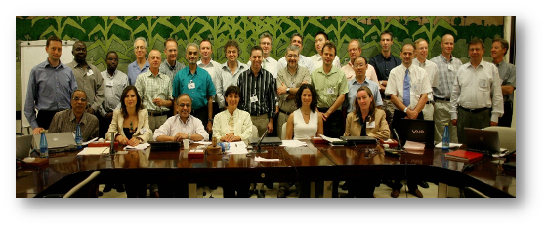
Thanks
With Gratitude to Dr. Bradley Doorn
Brad Doorn retired from NASA in July 2025 after 40 years of government service
Highlights:
He started NASA’s Agriculture Applied Sciences Program in 2017, managed Water Resources 2008-2023
He served as (co-)lead of GEOGLAM Subgroup / AHWG from 2012 (far right, 2012)
He was one of GEOGLAM’s largest supporters (even when it was GEO Ag Task 07-03) (bottom, 2007)
What’s next? → he will continue teaching at Penn State University

Slide 13
Appendix
Appendix

Slide 14

GEOGLAM Priorities for CEOS LSI-VC Subgroup on GEOGLAM ToR Excerpt
SIT-TW-40 + Plenary-39 Ask → Scoping the breadth of activities, roles, and responsibilities between GEOGLAM and CEOS (SIT-39-06)
Confirming ToR for LSI-VC Subgroup on GEOGLAM (SIT-40-12)
Identifying communication modalities and procedures for GEOGLAM collaboration with other CEOS Working Groups and activities, including the AFOLU initiative, where EAVs already feature.
This was an objective of the GEOGLAM EAV Workshop that was not resolved
SIT-TW-40 Ask → Identifying engaged/active points of contact for each agency to serve on the LSI-VC Subgroup on GEOGLAM (SIT-39-05)
View ToR here: https://go.umd.edu/GEOGLAM-LSIVC_ToR
Embedded within SIT-TW-40 + Plenary-39 Ask → Undertaking a “stocktake” of (and formally documenting) past, current, and future EAV-related projects, activities, and missions/instruments, with CEOS agency participation.
Embedded within SIT-TW-40 + Plenary-39 Ask → Reflect on the stocktake to create a robust gap analysis related to the EAVs toward identifying 2-3 of the highest-priority gaps, their source (e.g. observation, method, product…), and opportunities to address them.
SIT-TW-40 Ask → Progressing the work already initiated with CEOS WG Cal/Val Land Product Validation.

Slide 15
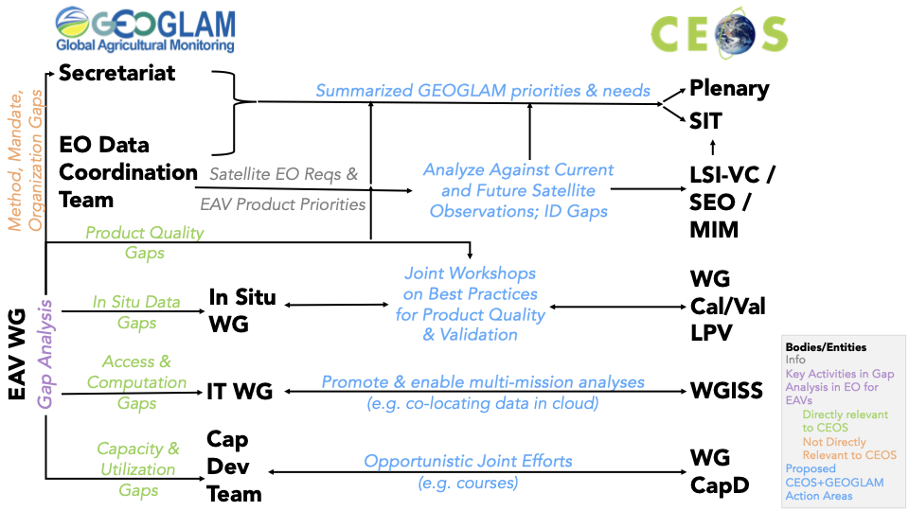
A sketch of logical GEOGLAM-CEOS interactions

Slide 16

MIM Database - We need to scope
Can add another Category “Agriculture” or add “Agriculture” under “Land”
Agriculture
Agriculture

Slide 17
GEOGLAM EAV Audiences & What to Show Them
Audience for GEOGLAM’s EAV Efforts | What GEOGLAM wants from them | What they want to know from GEOGLAM’s EAV efforts | What GEOGLAM EAV WG shows them
Funders / donors | Money for innovation research and in-situ data collection | What agriculture decision makers need (products, training, and underpinning materials) in order to achieve a desired impact | Constrained/time-limited funding ask which clearly link to impact that can be achieved from the innovation/in-situ data collection research in terms of human and environmental benefit.
Agriculture decision-makers | To serve them - which justifies the entirety of agriculture monitoring | Which decision-relevant, satellite-derived agriculture information products are available to them, where to find them, and how to use them | A list of the agriculture information products. Where the decision-makers are also funders, we show them the above as well.
Agriculture information product generators | Common definitions for the agriculture information products that agriculture decision-makers need | GEOGLAM itself - we want to collectively benefit from our varied perspective and expertise facilitated through the convening power of GEOGLAM. | The framework and clear boundaries/guidance for their efforts
Bio/geo/physical and hydrological product generators | Basic variables that are necessary for the agriculture information product generators to create the decision-relevant products | Which "input EAVs" to produce and with which specifications | The list of measurements and their requirements.
CEOS / Agencies | Suitable satellite observations | Spatial, spectral, temporal requirements that have a clear tie to what the agriculture decision-makers need. | Spectral, spatial, temporal, radiometric, accuracy, continuity, and latency requirements, with an indication of what concrete improvements will be achieved through their provision of satellites with the specified requirements.

Slide 18
Example: Field Boundaries
(still in progress)
Definition: Field boundaries are the borders of an agricultural field, which are contiguous area of land used for specific agricultural purposes, such as one crop with common phenology for one season (sub-field) that may be contained within a larger field block (primary field) that is defined by land ownership or permanent or natural boundary features such as trees, roads, water courses, etc.
Observability Comments:
Commonly relies upon object-oriented classification.
Permanent and natural boundaries are easier to distinguish.
Sub-field boundaries are meaningful but can be more difficult to distinguish using EO unless very different management (e.g. different crops)
Product quality contingent upon reference data quality and desired objective (e.g. exact boundary location vs. area within boundaries)
Measurement Unit: Unitless Vector
Overlap with Other EVs: None
Recommended Typology: Land Use Typology
Accuracy Assessment Guidelines:
Object-based accuracy metrics (over segmentation, under-segmentation, intersection over union, commission/omission errors)
Good practices guidelines needed
Lead Steward: Catherine Champagne, AAFC
Participants: Bahram Daneshfar, Yuval Sadeh, Lin Yan, Rakhesh Devadas, Mykola Lavreniuk, Miao Zhang, Alyssa Whitcraft
Uses Identified (means 4 potetnail sets of reqs, inventory, gap analysis):
Production forecast or estimation (combine with yield)
Landscape monitoring
Parcel identification (e.g. reporting)
Current-season monitoring / rapid analysis

Slide 19
Example: Field Boundaries
(still in progress)
Use: Production forecast or estimation (combine with yield)
Product Requirements | Temporal |  | Spatial |  | Accuracy |  | Latency
 | Threshold | Goal | Threshold | Goal | Threshold | Goal | Threshold | Goal
 | Annual | Seasonal | Unit = Field Highly-variable globally. Corresponding spatial resolution would be 1-30m with precise geometric registration between images. |  | Above 80% overlap with each reference field | Above 90% overlap with each reference field | End of year | Early/mid season prior to harvest
Relevant Satellite Instruments
List | Specs & Performance (Red = Full Gap; Yellow = Goal not met; Green = Goal Met)
 | Temporal |  | Spatial |  | Accuracy -> interpreted as limiting factors |  | Latency |  | Availability
 | Spec | Performance | Spec | Performance | Spec | Performance | Spec | Performance | Spec | Performance
Sentinel-2 | 5 days | Goal | 10m | Threshold | issues with geometric registration with default processing - particular issues for small fields | Threshold / not adequate for small fields | 3-4h | Goal | free | Goal
Planet | Daily | Goal | 5m | Threshold to Goal (TBC) | georeferencing issues, limited spectral bands, limited time series, radiometric mosaics not consistent | Not Met | n/a | Goal | commercial | Not Met
Landsat | 8 days | Goal | 30 m | Threshold | spatial resolution suitable for large fields (North America) | Threshold |  | Not Yet Analyzed | free | Goal
There is MUCH more information… but take home messages are:
1) the satellite observation component are pretty good except for small fields, where geometric accuracy + insufficiently fine spatial resolution leads to many fields being missed.
2) We are definitely not documenting all satellites and products - and need agency input to do that…

Slide 20
Key Outcomes: GEOGLAM EAV Workshop
Agreements:
The list of uses of satellite-based EAVs that are within GEOGLAM’s scope
AMIS
Early warning
Quantitative production forecasting
SDGs / UNFCCC (AFOLU) / UNCCD (LDN) etc.
National statistics
Compliance / regulatory applications
Disaster response
Water district management and conservation planning
Insurance
Voluntary markets (GHG)
Supply chain traceability
Risk mitigation
Precision management
Land management
Now “on the record” as within scope of GEOGLAM EAVs - reduces duplication from other communities

Slide 21
Key Outcomes: GEOGLAM EAV Workshop
Agreements:
The framework for thinking about and documenting EAVs
Input EAVs:
Usually need additional analysis before user-ready, feed into Agriculture Information EAVs
Generally will need to be produced at 2 levels (~field-level; ~administrative)
Agriculture Information EAVs:
User-facing
More diverse product requirements
“Steps” in the GEOGLAM’s EAV Effort →
Plus timeline May 2025 - April 2026
Phase 1 → 6 Initial Variables to “Pressure Test” Framework:
Agriculture Information EAVs → Crop type; crop yield; field boundaries; irrigated cropland; cover crop
Input EAV → ET
Agree upon a list and single set of definitions & descriptions
Need to be consistent regardless of scale
Descriptions also include guidelines for typologies, hierarchies, good practices for validation etc.; cross-cut with ECVs/EWVs/EBVs
2. Articulate EAV product requirements by use
Temporal, spatial, latency, accuracy
3. As they correspond with use, take stock of past, current, and planned:
Methods, projects, systems, and satellite instruments satellite instruments
State of use/uptake where relevant
4. As they correspond with use, analyse gaps...
Simply, this "stocktake - requirements = gaps" ...
But not all gaps are equally important, closeable, etc.
5. Prioritise what to do next...
6. Do it!

Slide 22
May 2025
Sep 2025
Nov 2025
Spring 2026 or Summer 2026
April or Sept 2026
Agencies Do SIT-TW-41 Actions
CEOS Does Plenary-39 Action #2-3
SIT-TW-40
Report:
- Progress on EAVs
Discuss:
- “Roadmap” for EAVs over next 6 months
Actions:
Agencies appoint PoCs to LSI-VC or stocktake
Scoping of Joint ET Workshop with Cal-Val
Plenary-39
Documents: - Phase 1 EAV Report for 1st Set of EAVs
Report:
- Key findings of Phase 1
- Proposed Cal-Val Workshop for ET
Actions:
Agencies Work on Stocktake for 1st 6 Variables
CEOS MIM Ag Component Database Design Scoping
WG Cal-Val Workshop “Green-light”
SIT-41 or SIT-TW-41
Documents:
- Phase 2 Report, inc. Workshop Results
Report:
- EAV Req’s
- Agency Foci for next phase of EAV Stocktake
Action:
Agencies continues Stocktake based on their foci
Spring or Summer 2026
GEOGLAM LSI-VC Subgroup Variable Focus Workshop
13-15 May 2025
GEOGLAM EAV Workshop
Agencies Do Action #1
Legend
Boxes = Events
Arrows = Work
Asynchronous work on Phase 1 EAVs
Completes + Submits Phase 1 EAV Report
Asynchronous Work on Phase 2 Def’s + Req’s for Other Variables
GEOGLAM
CEOS/Agencies
Shared
Notes:
By Plenary-39 → Review SIT-41 action - and set some deadline after which the ToR simply is assumed endorsed (?)
By Plenary-39 → Agencies to fill in the blanks on LSI-VC group
Beginning in the context of the stocktake support for the 6 actions
We could name the individual agencies who have been active in the past (see right pane)
April 14-16, 2026 - NASEM Beckman Center in Irvine, CA - https://www.nationalacademies.org/beckman-center
→ Agencies work on prioritized stocktake for 2 months (?)
→ More MIM
→ June-July period… GEOGLAM Prioritisation workshop (because full req’s + stocktake (as much as agencies want) + gap analysis can be complete) … outcome of this = prioritisation plan
Sept. 8-10, 2026 - NASEM in Washington, D.C. → review prioritisation plan
→ Plenary 2026… present final stocktake and operationalised MIM
April 20-22, 2027 - NASEM in Washington, D.C.
Sept. 7-9, 2027 – NASEM Beckman Center in Irvine, CA

