Slide 1
Capacity Development Updates
WGCapD
Agenda Item 8.3
SIT TW 2025
Darmstadt, Germany
9-11 September, 2025

Slide 2
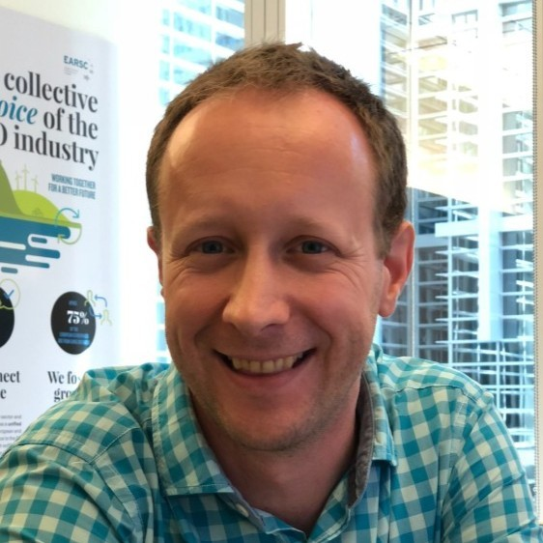
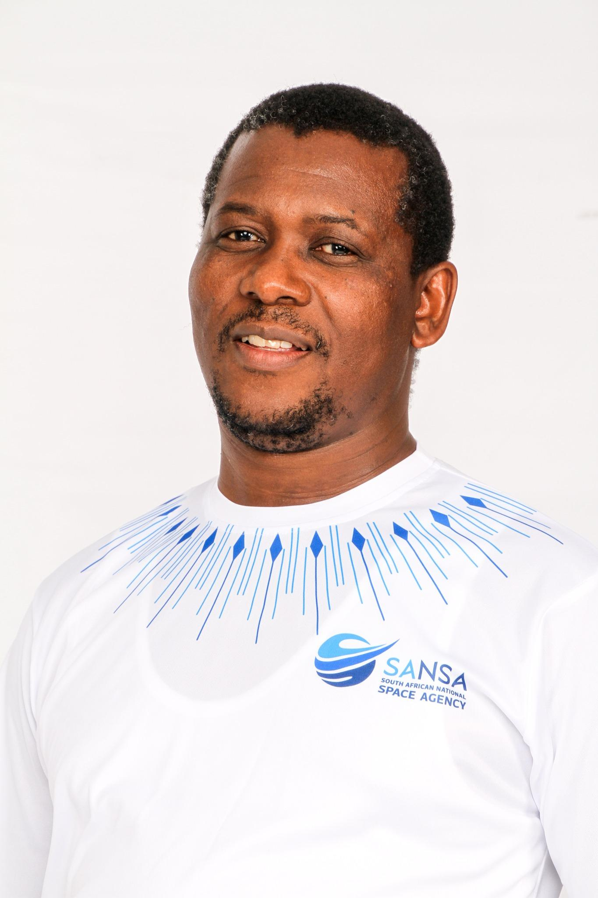

WGCapD Leadership Update
Christoph Aubrecht (ESA) nominated as a WGCapD Vice Chair, expected to serve as Chair starting in 2026
Dan Matsapola (SANSA) staying on as WGCapD Chair for one more year to support smooth transition
WGCapD will be looking for a Vice Chair in 2026

Slide 3
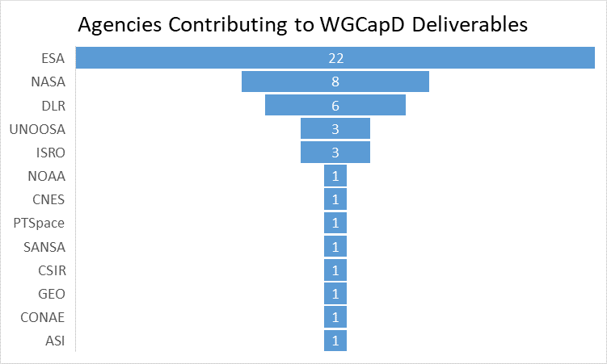
WGCapD Deliverables
WGCapD member agencies are currently working to execute 29(!) deliverables
12 deliverables will be implemented in CY25
17 are expected to be completed in CY26
Examples include:
Copernicus User Uptake in Africa (DLR, UNSPIDER, NASA)
Hyperspectral Remote Sensing Training (ESA, DLR, ASI, NASA)
Polarimetric SAR Training Course (ESA, ISRO)
PUMAS training on the joint utility of Sentinel-1 and SAOCOM-1 (ESA, CONAE)
Guidance for Conducting Needs Assessments for Capacity Building (NASA, UNOOSA)

Slide 4
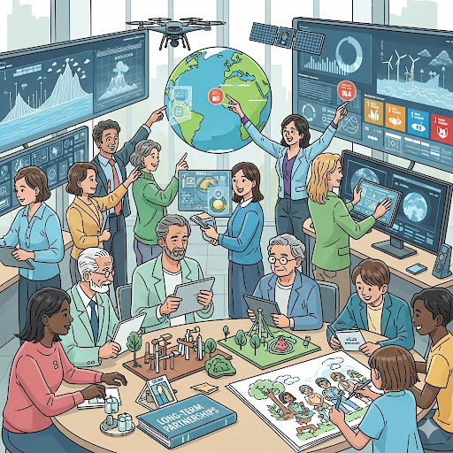
WGCapD Priorities
Shift from one-time joint trainings or webinars to sustained long-term collaborations, i.e. ESA-NASA Transatlantic Trainings
Focus on capacity building of underrepresented communities, i.e. Indigenous Mapping Workshops and Engaging Youth to use EO for Economic Empowerment
Promoting cross-cutting deliverables that involve more than just two agencies, i.e. SDG MOOC
Strengthen collaborations with Working Groups on Disasters, Climate, SDGs, and others
Engaging more CEOS members who are not yet involved in WGCapD
Prioritize capacity development of decision- and policy-makers for greater impact
Incorporate new AI tools and best practices to support capacity building efforts

Slide 5
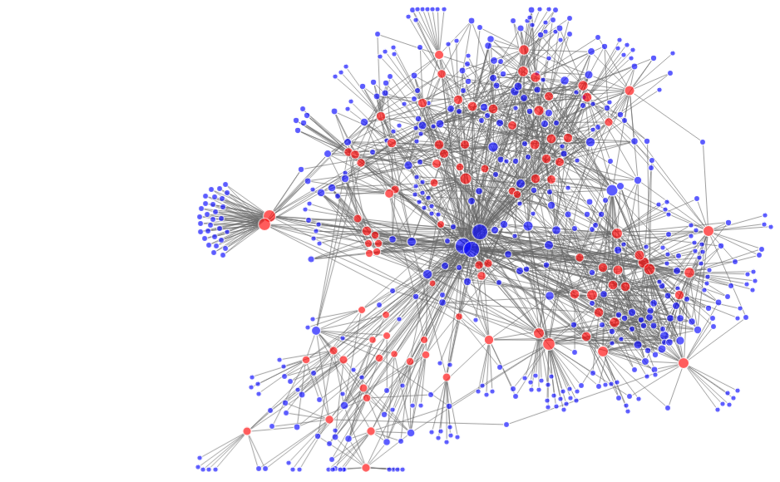
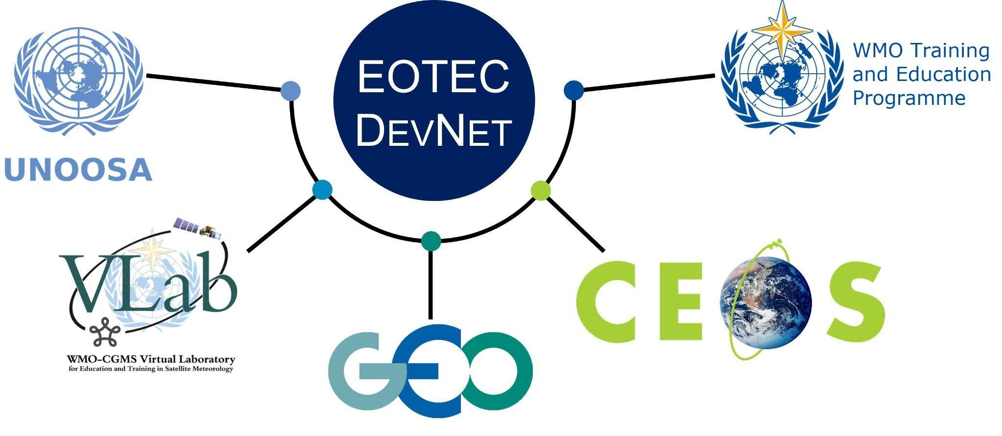
EOTEC DevNet Extends WGCapD Impact
Earth Observation, Training, Education, and Capacity Development Network (EOTEC DevNet) grew out of WGCapD deliverable in 2021 with a mission of extending the reach of Earth observation capacity building globally.
2022-2025 milestones:
Vibrant regional and thematic CoPs hosted meetings for 1,500+ participants with 50–70% repeat attendance
130+ spotlight sessions on government, private sector, international agency, and NGO EO capacity building and research
500+ attendees of five webinars conducted with partners
Notes:
EOTEC DevNet grew out of WGCapD members realizing the need to coordinate efforts with EO Training providers beyond CEOS members
It has since grown significantly and serves as an important connective tissue across partner networks
The chart on the right which came out of EOTEC network analysis and represents the state of EOTEC DevNet in 2024 with each blue dot representing an individual participant and red dots marking specific collaboration/learning opportunities.

Slide 6
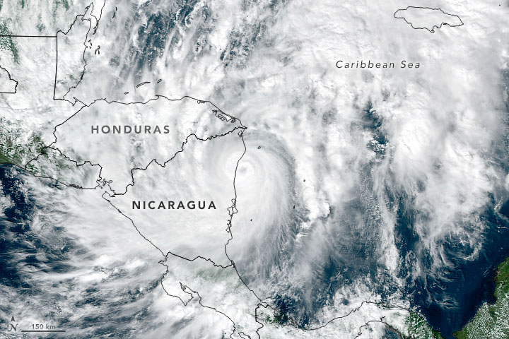
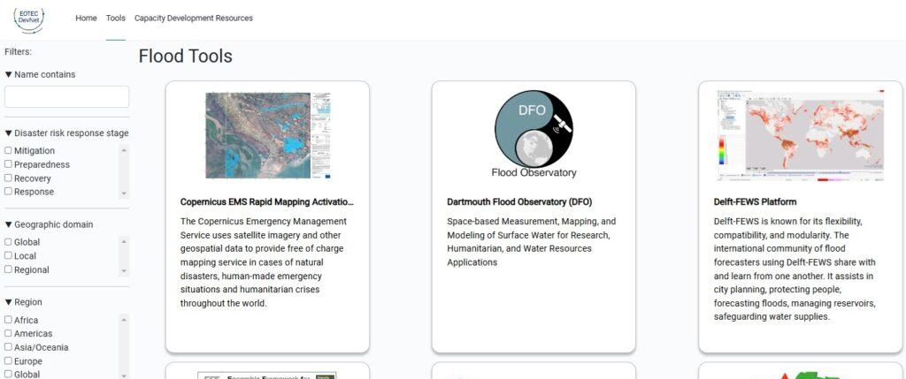
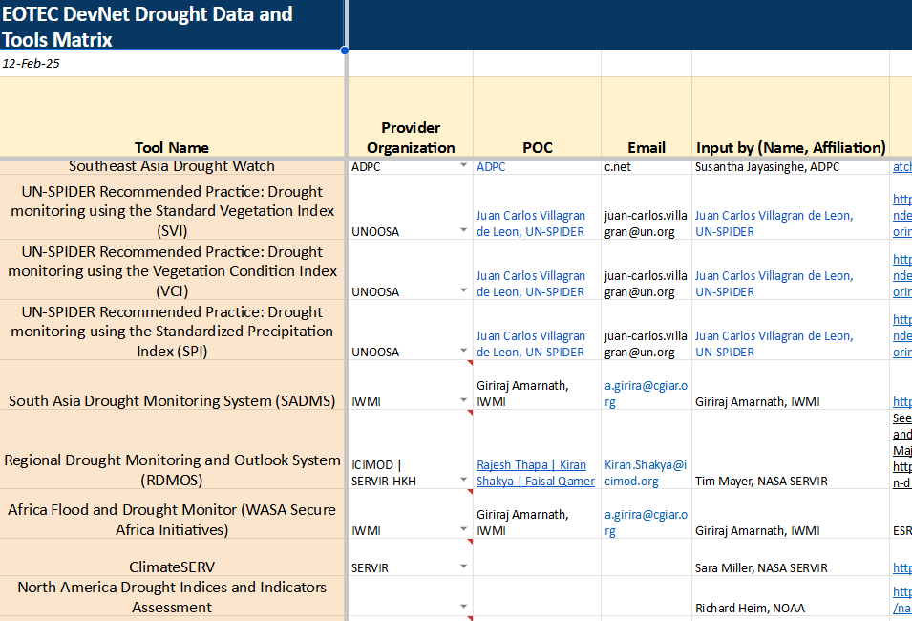
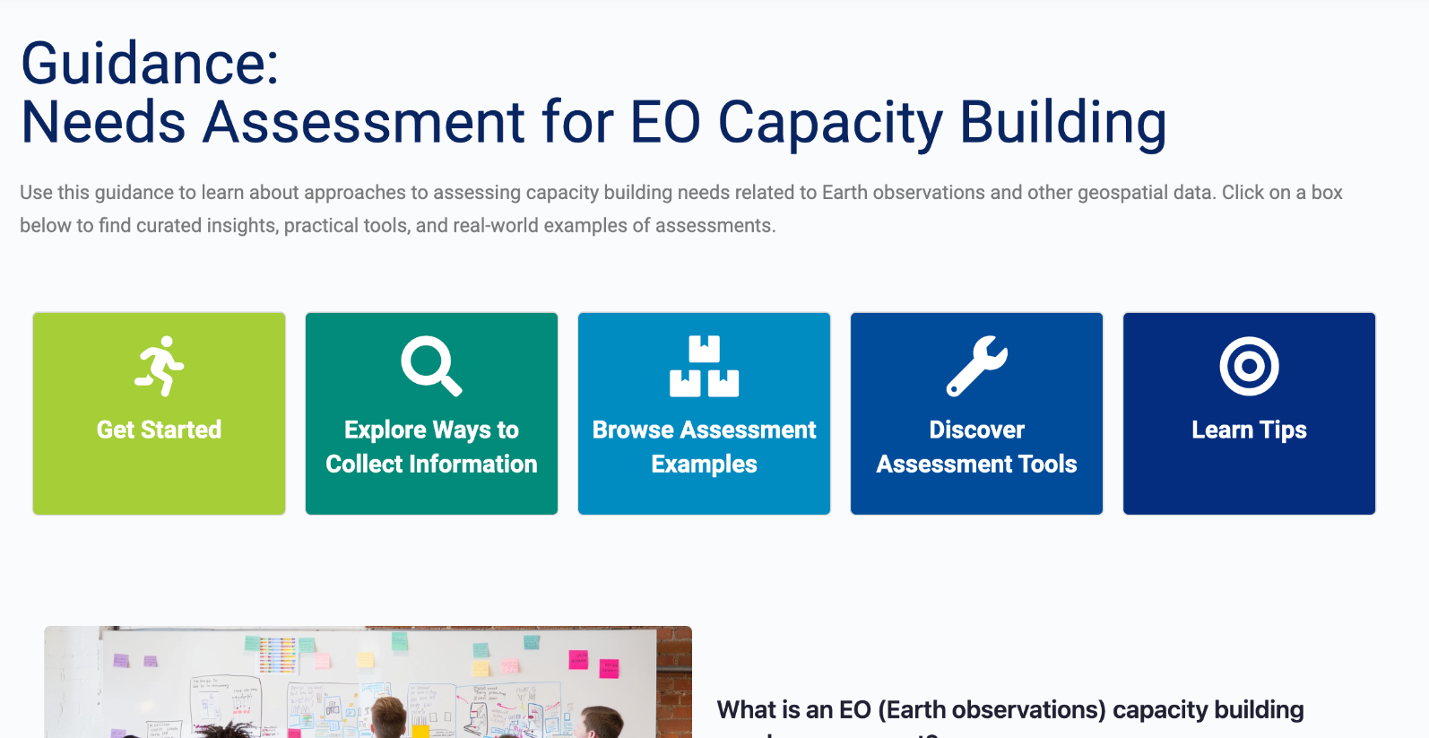
EOTEC DevNet Products
Global case on flood extent tools
Flood Tools Tracker built in partnership with CEOS SEO
Drought Tools Tracker
EO Needs Assessment Guidance
Notes:
A key part of EOTEC DevNet’s work is helping users navigate what's already available. EOTEC is not building new tools, but helps people find the right ones for their context.
For instance, the Flood Tools Tracker and Drought Tools Tracker simplify navigation through existing EO resources, making it easier for decision-makers and practitioners to identify the tools and training materials they need. The Global Flood Extent Use Case, which includes five regional event analyses that demonstrate the practical application of EO data in addressing flood risks and offers a replicable model for others to enhance disaster preparedness and response.
Another effort is the ongoing development of EO Capacity building Needs Assessment Guidance, designed to help stakeholders systematically identify and address gaps in EO capacity building.

Slide 7

EO Needs Assessment Guidance
Notes:
This short screen recording demonstrates the Needs Assessment section of the EOTEC website including introduction to needs assessment methodology. It details the steps of needs assessment cycle and explores many ways to collect information.
Users can also browse past EO Needs Assessment examples and dive deeper into how various assessment tools were used in different context.The site also features lessons learned and tips for those embarking on their own assessment.
And like with its other products EOTEC used both WGCapD and other CEOS resources such as as GEOGLAM Capacity Development Toolkit and then augmented it with materials from across the partner networks.

Slide 8
EOTEC DevNet Strategy 2026-27
Focus on EOTEC’s role as an accelerator of existing knowledge and information sharing, and leveraging its convening power - and that of our global and regional leadership - to add value and deepen reach.
Key Objectives:
Strengthen and build communities of practice
Solidify the network’s role as an EO capacity-building information and knowledge-sharing hub
Collaborate with partners to accelerate the discoverability of and access to data, tools and training
Collaborate with EOTEC leadership partners to leverage and support their networks
Seek to sustain EOTEC operations and diversify funding sources
Strengthen Secretariat operations
Full strategy document, lessons learned and planned tasks and activities are available HERE.
Feedback and engagement by CEOS members is most welcome!
Notes:
After 3 years of piloting various approaches and growing the community of both capacity builders and users, EOTEC recently went through strategic planning exercise.
You can see on this slide what EOTEC plans to focus on as it looks towards its next two year - it is mostly about accelerating the sharing of existing knowledge across the network of networks by strengthening both the regional and thematic communities of practice, as well as bringing more value to the global founding partners including CEOS. You are welcome to read the entire strategy document and all the planned activities but as an example, the next slide focuses on the objective related to collaboration with global partners.

Slide 9
EOTEC DevNet Strategy 2026-27
Collaborate with EOTEC leadership partners to leverage and support their networks | For all: Quarterly Global Task Team meetings, with one in-person meeting annually Share info via their websites, social media, newsletters, etc. Participate in relevant partner events | WMO: CONECT, CalMet, Vlab meetings GEO: GEO Forums, regional GEO meetings; ODOK, GIDTT meetings CEOS: monthly and annual WGCapD meetings; meetings of other WGs UNOOSA: UN-SPIDER and UNOOSA conferences, SPACE4WATER meetings
 | CEOS: Deepen collaboration with WGCapD and increase engagement with relevant working groups, eg Disasters Pending 2025 deliverables: Network analysis EO capacity needs assessment guidance | Participate in WGCapD monthly and annual meetings Link to WGCapD training calendar Collaborate with SEO on tool trackers New deliverables Joint activities (webinars) Drought tools tracker EO Training Providers Forum SIT updates as needed Support WGCapD in convening annual training providers’ strategy meeting Connect partnerships into the WGCapD network
Full strategy document, lessons learned and planned tasks and activities are available HERE.
Notes:
As a chair of WGCapD I try to stay apprised of other capacity building efforts, but with my day-to-day portfolio at SANSA, I can’t keep up with everything. Yet somehow EOTEC secretariat team which is comprised of 3 part time members is able to attend nearly all the relevant meetings, webinars and conferences and then bring the learnings back to WGCapD.
They disseminate information via their website and social media, collaborate with CEOS SEO on adding information in relevant trackers and now are an integral part of how WGCapD engages with the larger universe of EO training providers.

Slide 10
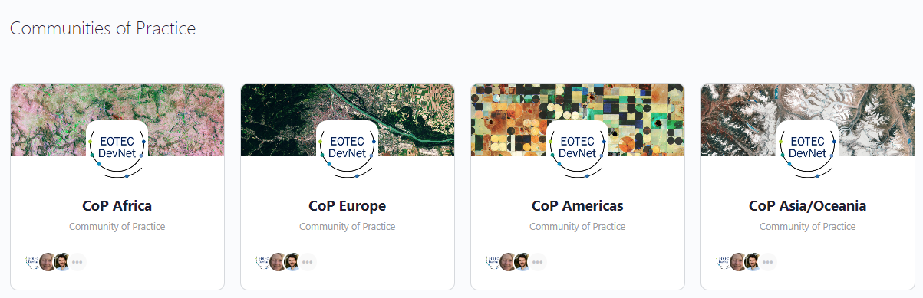
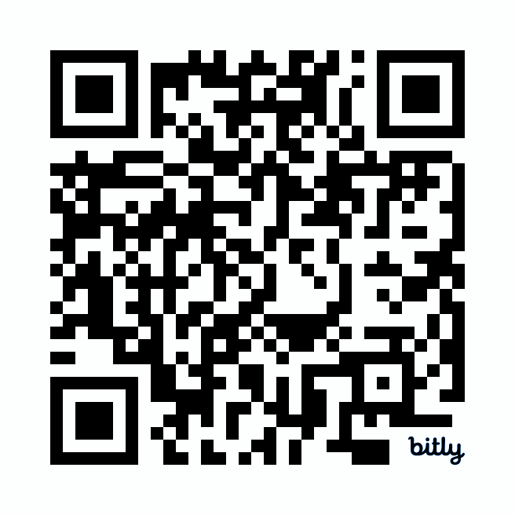


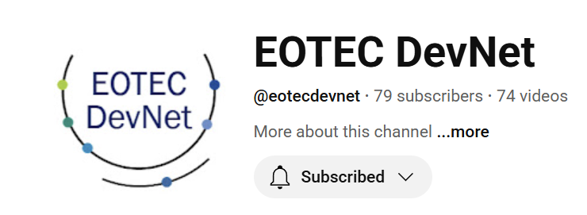
Call to Action
Join the capacity building efforts of WGCapD and EOTEC DevNet
Take advantage of our resources, such as CEOS Training Calendar and Flood/Drought Tools Trackers
Let us know how we can best support other efforts across CEOS with the expertise of our members and community
Connect with experts in our online communities
JOIN US!
Visit
www.eotecdev.net
@EOTEC DevNet #EOTECDevNet
Add tools and resources to our Flood/Drought
Trackers and EO Needs Assessment
‹#›
Notes:
In conclusion:
We are grateful to NASA and DLR (via EO College) for supporting EOTEC DevNet efforts
We are pleased to have ESA taking on the WGCapD Vice-Chair role
We invite others to join our efforts

