Slide 1
CEOS Youth programme: Update
CEOS Chair Team
Agenda Item 9.3
SIT TW 2025
Darmstadt, Germany
9-11 September 2025

Slide 2
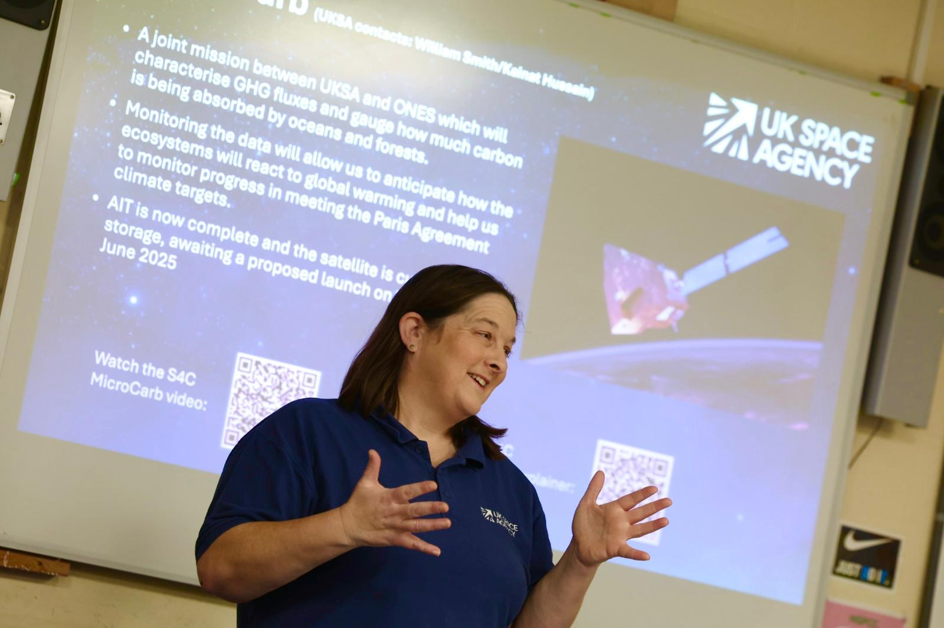
Recap: CEOS Youth Programme
Aim: Pilot a CEOS programme to inspire global youth collaboration in Earth Observation.
Educate: Create a low-cost, potentially repeatable pilot programme that can educate and inspire young people on the benefits of EO for Society.​
Collaborate: Provide opportunities for students to work collaboratively across borders using the platform of CEOS. ​
Engage: Facilitate a dialogue between CEOS principals and youth representatives on key CEOS topic areas. ​

Slide 3
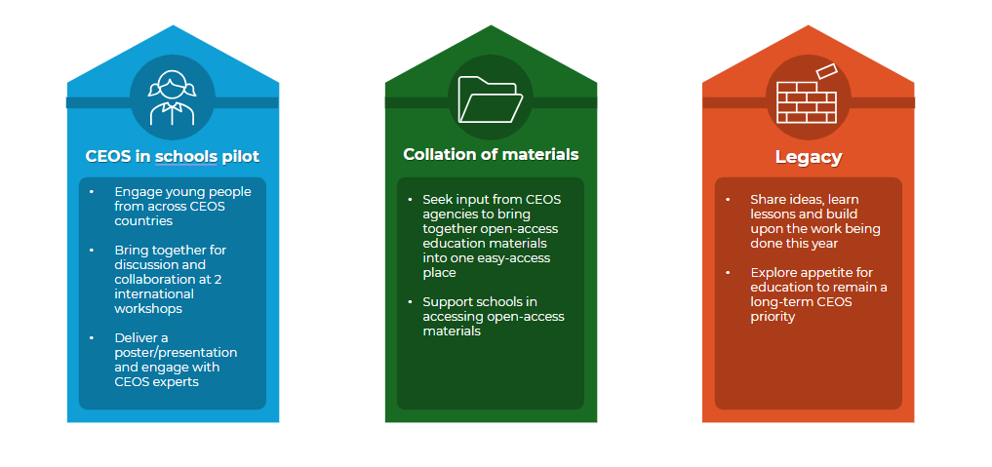
CEOS Youth programme overview

Slide 4
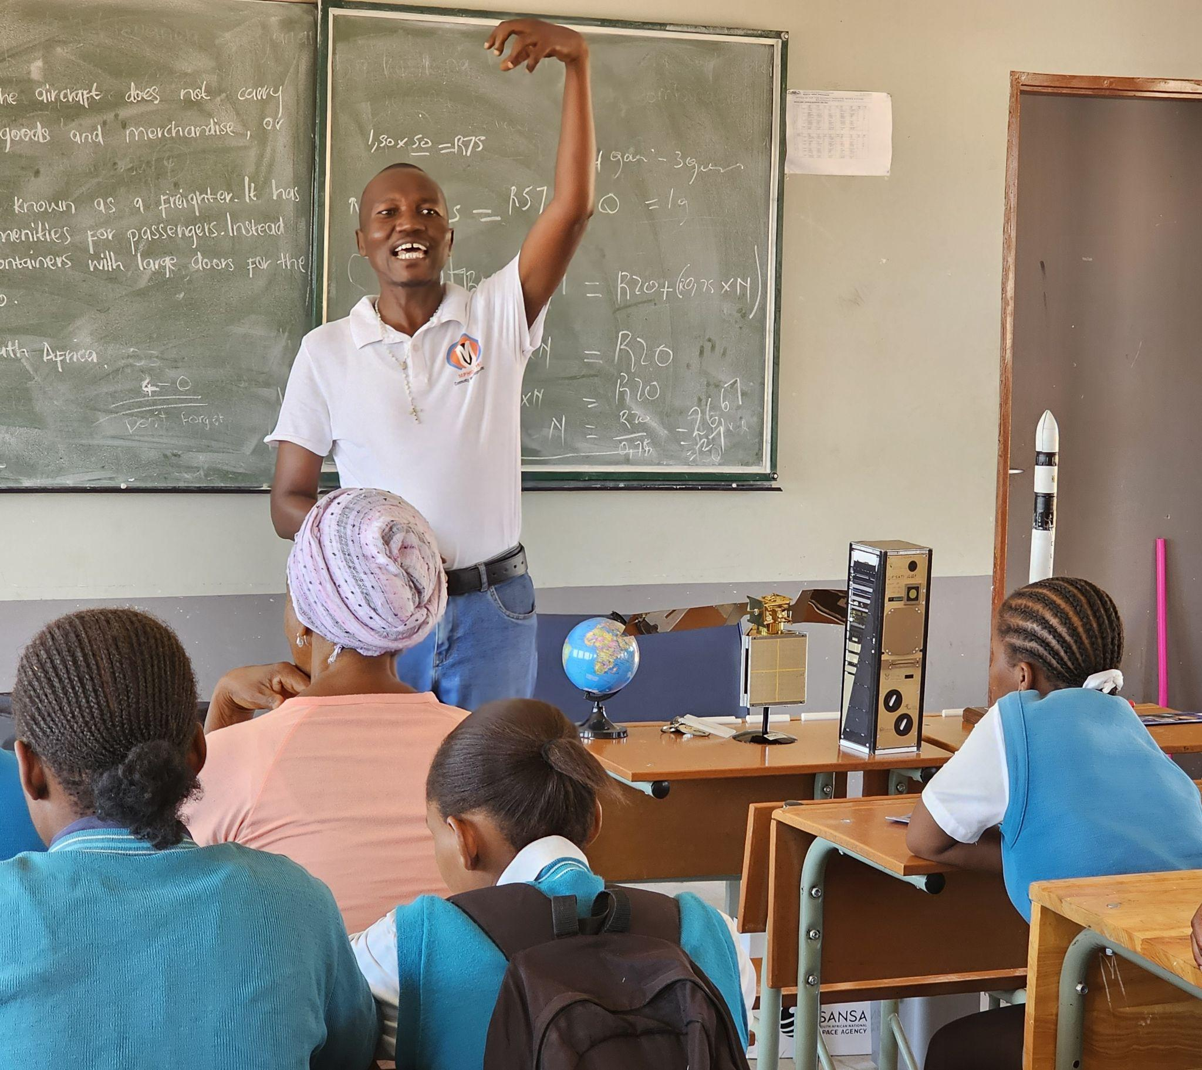
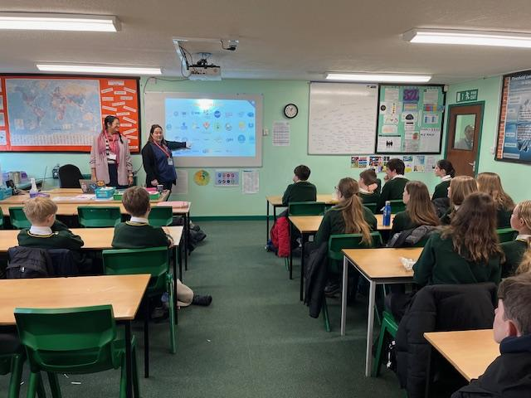
CEOS in Schools: 2 International Webinars
Schools had material and a visit from an expert/ Agency to begin to look at EO and the topics and then came together to discuss:
First international webinar: 26 February 2025, ‘EO for the Urban environment’
  125 students across six countries (Australia, Canada, Thailand, Japan, South Africa and the United Kingdom)
  Each student got to speak in small virtual breakout groups
Second international webinar: 26 March 2025, ‘EO for biodiversity’
  Featured a speaker from ESA’s Biomass mission

Slide 5


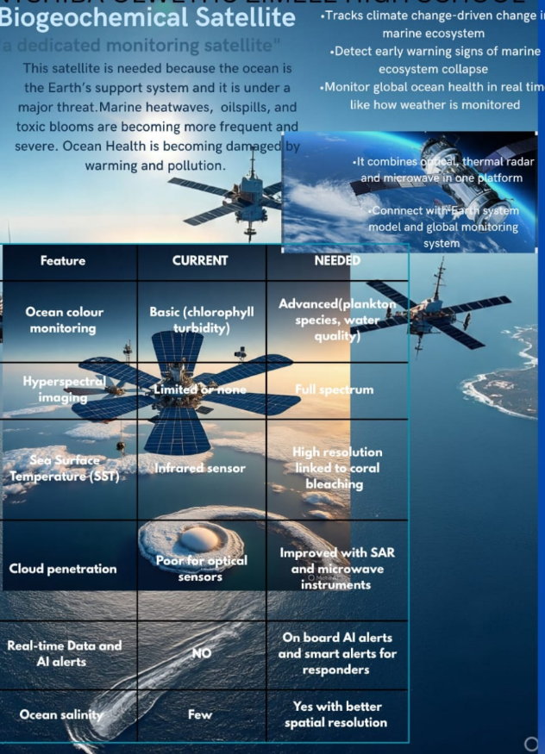
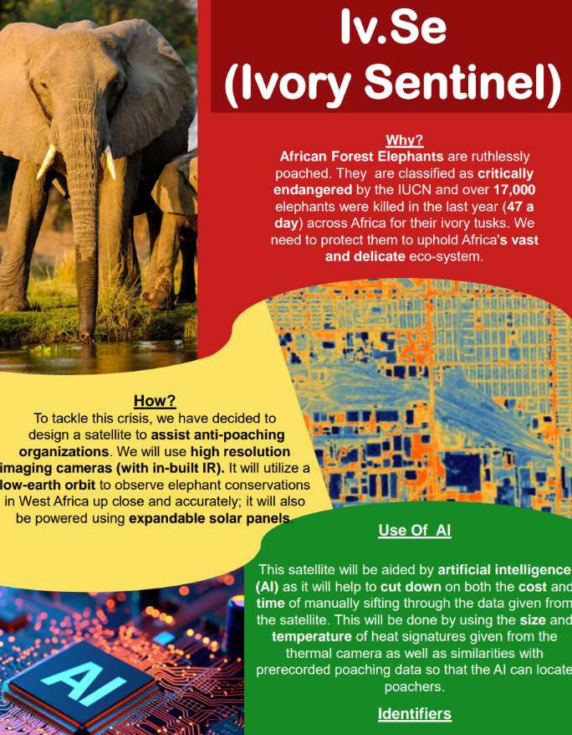



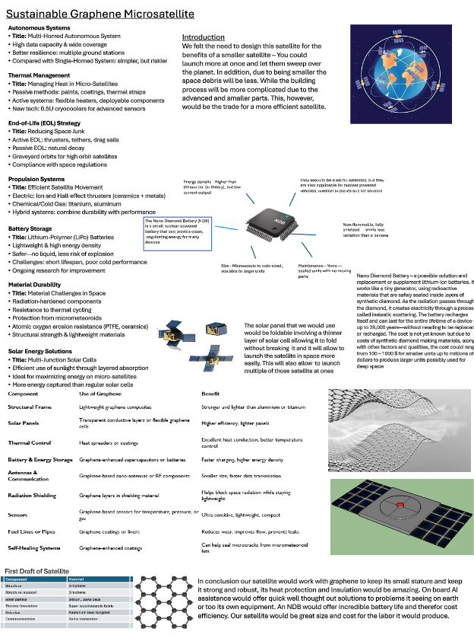
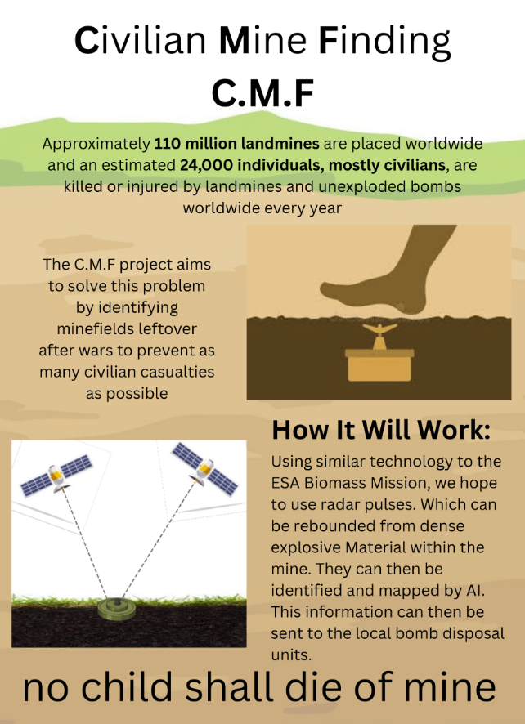

Posters project and Youth summit
Youth Event will take place on morning of side meeting day at Plenary 2025 (Tuesday 4th)
Opportunity for students to present posters and take part in a Q&A with participating CEOS Principals
Posters will be on display throughout CEOS Plenary
Looking to foster a two-way dialogue between the youth voice and CEOS principals

Slide 6

Youth Hub: Improving access to open-source material
CEOS Youth Hub | CEOS | Committee on Earth Observation Satellites

Slide 7

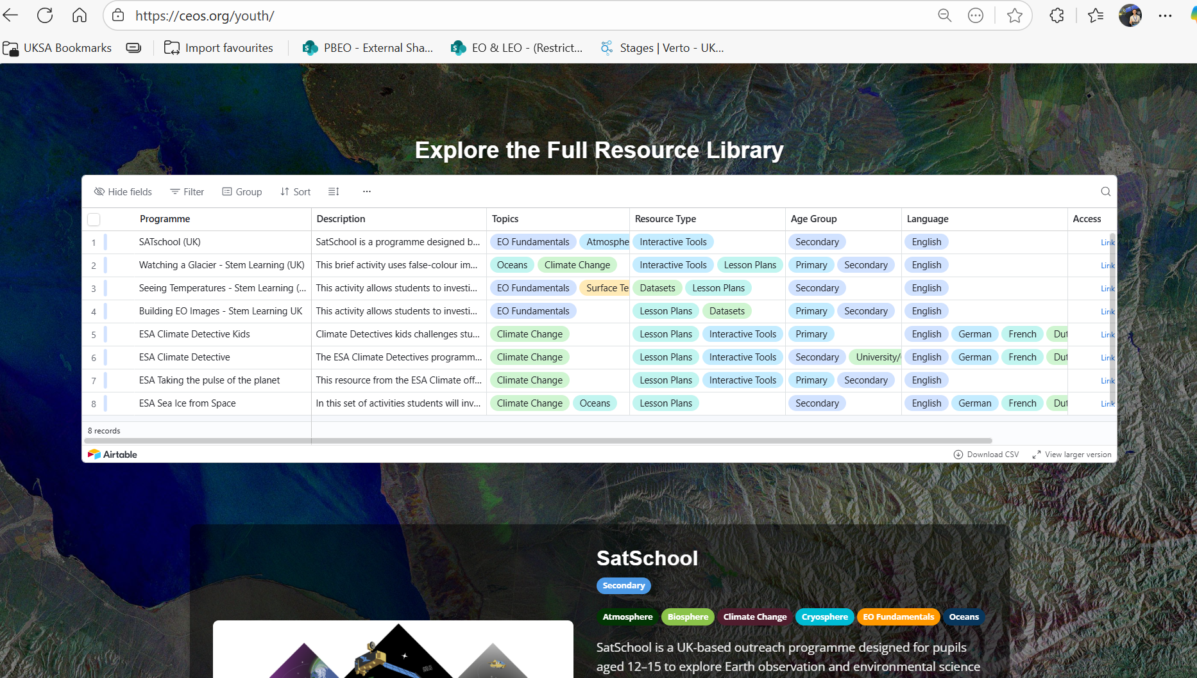
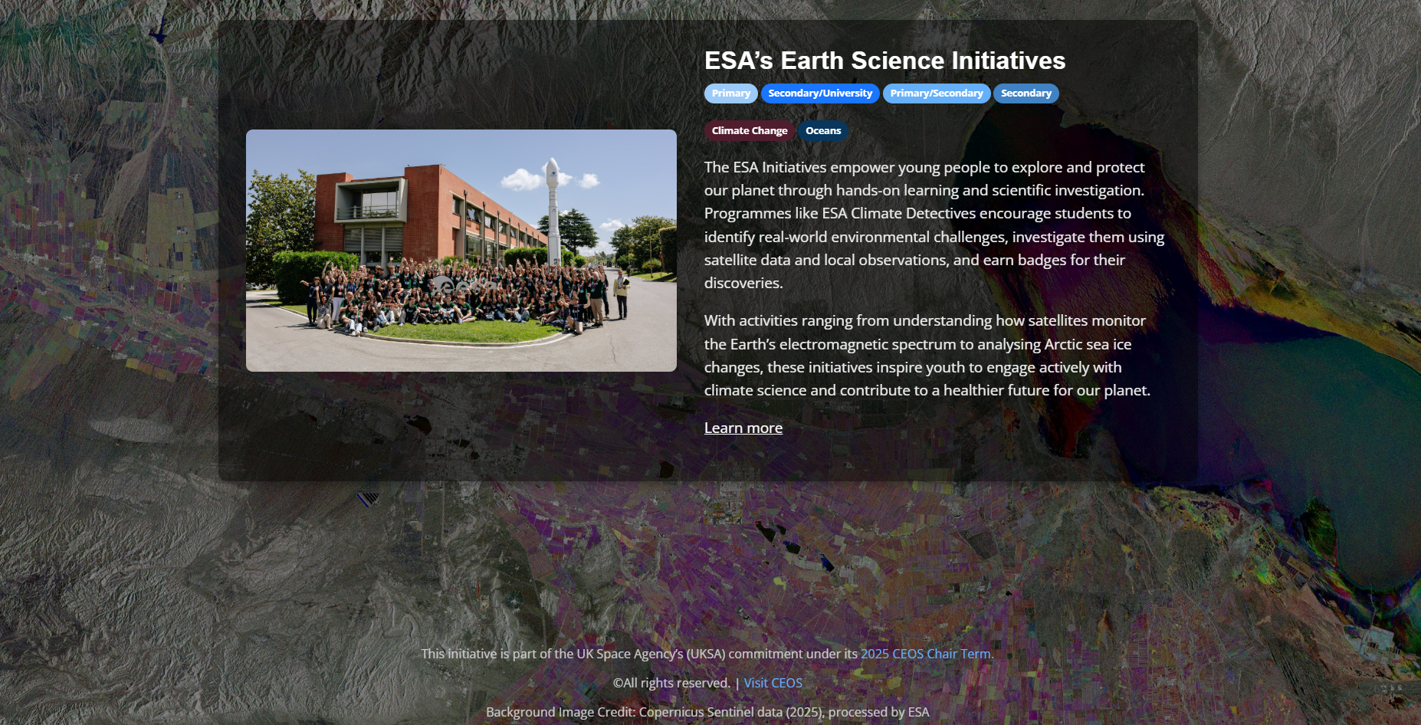
Youth Hub: Improving access to open-source material
CEOS Youth Hub | CEOS | Committee on Earth Observation Satellites

Slide 8
Challenges and suggestions
Onboarding: Initial set up and finding the schools / teachers to take part started in June to December and programme ran Jan to November :
Facilitators: Webinar facilitators for the break-out rooms need experience working with students in hybrid format to encourage all to participate. Education teams have these skills.
Early engagement: Engaging with teachers/educators early is important as programme required students to have time to review background information
Number of students: Active decision to have only 125 students over 6 counties to maximise opportunity for each student to speak with each other. With the intention to open to wider cohort, the practicalities would need to be worked through
Time zone challenges: Ensuring the international exchange across multiple time zones at suitable times for 14 yr olds meant running 2 webinars on the same day. Some students liked being at home in the early morning and evenings so this worked well.
Notes:
which students to choose and how? This is not a one way transmit to 1000s type of programme
Need to get the next set of students onboard asap so teachers can plan into their time.

Slide 9






Successes and feedback
Global Participation: Over 125 Students from 6 CEOS countries engaged in cross-cultural learning and collaboration.
Interactive Format: The opportunity for each student to engage and speak directly with students from other countries was consistently praised as unique and the most important aspect.
Real-World Relevance: Activities centred on practical applications of EO data in disaster response and biodiversity conservation
Open to all: Support for the approach that is open to students across globe regardless of school curriculum – its an 'extra' to be done in clubs or school lunch time.
Notes:
The teachers local facilitation is key

Slide 10
Forward look
2026 programme: We are pleased that Team Australia have included the continuation of the programme into their Chair Year. UKSA will be on hand to support wherever needed.
Legacy: Ongoing discussions with WG Capacity development Chair, who is keen to support and embed the programme as a future activity
Pilot review document: UKSA will be producing a summary document prior to CEOS plenary summarising the activities from this pilot year , lessons and suggestions.
Youth Summit and posters – to come!

Slide 11
Discussion and feedback

