Slide 1
2026 CEOS Chair Period
Positioning CEOS for Success in a Rapidly Changing Context
Credit: USGS/NASA Landsat 9

Slide 2
CEOS Chair 2026
Team Australia - “three for the price of one”
  CSIRO - Chair Team Lead, CEOS Chair: Dr Alex Held
  With Geoscience Australia and the Bureau of Meteorology
Chair Term focused on ensuring delivery of current activities while also enabling Principal-level strategic discussion on key topics
  Focus on issues/topics with relevance across the CEOS organisation
  Respectful of Agency resourcing
  Dedicated Chair Team capacity for proposed activities
  Ensuring complementarity to NASA SIT Chair
This session is to inform you of our plans and:
  Gather your input to refine before CEOS Plenary
  Identify additional contributors/participants from Agencies and Entities

Slide 3
Structure of CEOS Chair 2026 Work
Two Focus Activities under the headline theme:
    Information Products on Satellite EO and CEOS Support to Environmental Change Adaptation and Resilience
    Updated CEOS ARD Strategy - Ensuring CEOS ARD is Fit for the Future
Finite activities to be concluded within the 2026 Chair Term
  No expectation of ongoing investment/support from CEOS organisation
  Open to input and contributions from all Agencies and Entities
  Information to support strategic Principal-level discussions as well as to help communicate CEOS’s value proposition and relevance
Three Highlight Topics - focused, standalone events
All complementary to NASA SIT Chair

Slide 4
Headline Theme
“Positioning CEOS for Success in a Rapidly Changing Context”
Environmental change adaptation and resilience as a lens to explore and communicate CEOS’s positioning, role and unique value as an organisation
  Change is happening and will continue - satellite Earth observations have great potential to add value and support tangible impact that changes lives
  Action required at global/national level, but critical at regional/local scales - even at the level of individual businesses.
  The EO sector itself is changing rapidly - how do we capitalise on this potential?
  What might this mean for CEOS in terms of opportunities and challenges? positioning and partnerships?
CEOS, as the leading global coordination body, can be a powerful factor in ensuring satellite EO data plays its part:
  Making the increasing volume of data - government and commercial - easier to use, for more purposes, by more people - empowering action at increasingly local levels
  Facilitating satellite EO integration into decision support products that enable practical action on adaptation at all scales - where local relevance is key
  Ensuring data and information is generated and used in a way that builds trust and protects the reputation of the satellite EO community in the eyes of stakeholders

Slide 5
Activity 1: CEOS Support to Environmental Adaptation and Resilience
Prepare information products that support Principals at the 2026 Plenary to strategically consider the role CEOS is playing, and can play, in supporting societal adaptation and resilience in the face of environmental change
  Multiple drivers of such change
  Applications rely on access to, and ability to integrate, multiple datasets at different spatial scales
    In particular at local scales.
  A lens through which to explore CEOS’s role in the EO ecosystem and value chain, including threads around commercial sector engagement and scalability
  Relevant across many parts of CEOS, as evidenced by efforts to date
Product 1 - Outward focus
  Captures case studies and exemplars of current impact and value
  Highlight demonstrators, resources, tools and examples (e.g. code)
  Online, dynamic, multi-media (where possible)
  Opportunity for thematic views - small islands, polar, biodiversity, water, etc
  An asset to support communication of value at major events

Slide 6
Activity 1: CEOS Support to Environmental Adaptation and Resilience
Product 2 - Inward focus
  Collation and analysis of challenges and opportunities that support Principals to consider strategic topics such as:
    Where can CEOS get the greatest ‘bang for buck’ and add the greatest unique value?
    Do we have the right partnerships? Are we leveraging existing partnerships effectively?
    Are existing CEOS activities/efforts connected and aligned to support greatest impact?
  Key sources:
    CEOS’s efforts and experiences, e.g. WGDisasters, COAST-VC, GST Strategy, Biodiversity Study Team, Agriculture, etc
    Synthesis of issues and themes arising from the case study capture and analysis process
Writing Team - open from Plenary; express interest now
Coordinators: Alex Held (CSIRO) and Mark Dowell (EC)

Slide 7

Activity 2: Future CEOS ARD Strategy
Provide additional capacity and attention to support the CEOS-ARD Oversight Group in their effort to prepare the next iteration of the CEOS-ARD Strategy ready for Plenary 2026
Purpose: Ensuring CEOS-ARD is Fit for the Future
  Building on significant interest and momentum from Principals and stakeholders - including pull from the commercial sector
  Ensure CEOS-ARD remains consistent with and relevant to the evolving user base and their expectations
  Maximise the societal benefits of satellite EO – including for adaptation and resilience to a changing environment (CEOS-ARD is a key enabler)
Driven by evidence:
  Engagements with the community at key events such as ESA’s LPS, IGARSS, IAC, WGCV, LSI-VC (more to come)
  Survey to gather feedback to “Help Shape the Future of CEOS-ARD” (open: ceos.org/ard/survey)

Slide 8
Themes to explore (provisional)
Ongoing quality assessment procedures
Measurement equivalence
Standardisation
Linkages to agency purchasing frameworks
Commercial engagement geometry
Continued relevance beyond land
Alignment to / implementation of interoperability handbook
Implications of “AI Ready” data
Higher-level products
Specification change management
Writing Team established - additional contributions welcome
Lead: Ferran Gascon (ESA), Chair Team Contact: Matthew Adams (GA)

Slide 9
Highlight Topics
Antarctica Plenary Experience
  Opportunity to deepen the CEOS community’s connections with polar issues through in-person engagement with leading experts with lived experience
  Leverage Plenary in Hobart, Australia’s gateway to Antarctica
Water Quality Workshop
  Demonstration of EO based methodologies for water quality, with a focus on how these methodologies could fill the gaps identified in the Adaptation and Resilience chair theme.
  How to transform EO archives into actionable water quality insights to support adaptation strategies.
CEOS in Schools Sessions
  Continue legacy of the 2025 UKSA CEOS Chair

Slide 10
Timeline
2026 SIT
ARD Strategy - Principal-level Review of Progress and Discussion of Emerging Issues; Side Event
Adaptation and Resilience Product - Principal-level Discussion of Key Themes and Findings to Date; Side Event
2025 Bath Plenary
ARD Strategy - Concept Note Presentation
Adaptation and Resilience Product - Writing Team Launch
2026 SIT TW
ARD Strategy - Review for Plenary
Adaptation and Resilience Product - Review for Plenary
2025 SIT TW
Chair Plan Presentation
2026 Hobart Plenary
ARD Strategy - Discussion and Acceptance
Adaptation and Resilience Product - Discussion and Acceptance
Antarctica Experience
CEOS in Schools Side Event
UNFCCC COP31
CBD COP18
etc
UNFCCC COP30
CEOS Statement
Water Quality Workshop
CEOS in Schools Virtual Workshop
ARD Strategy Engagements -JACIE (Reston) and Joint WGCV/LSI-VC/ARD OG
(USGS, Sioux Falls)

Slide 11
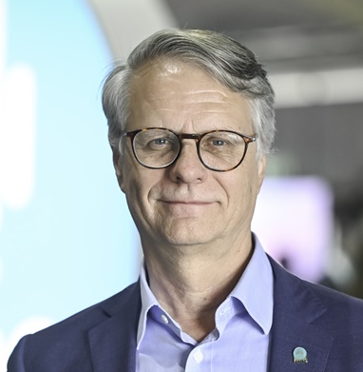
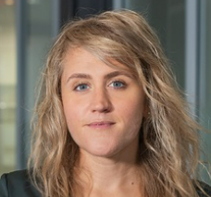



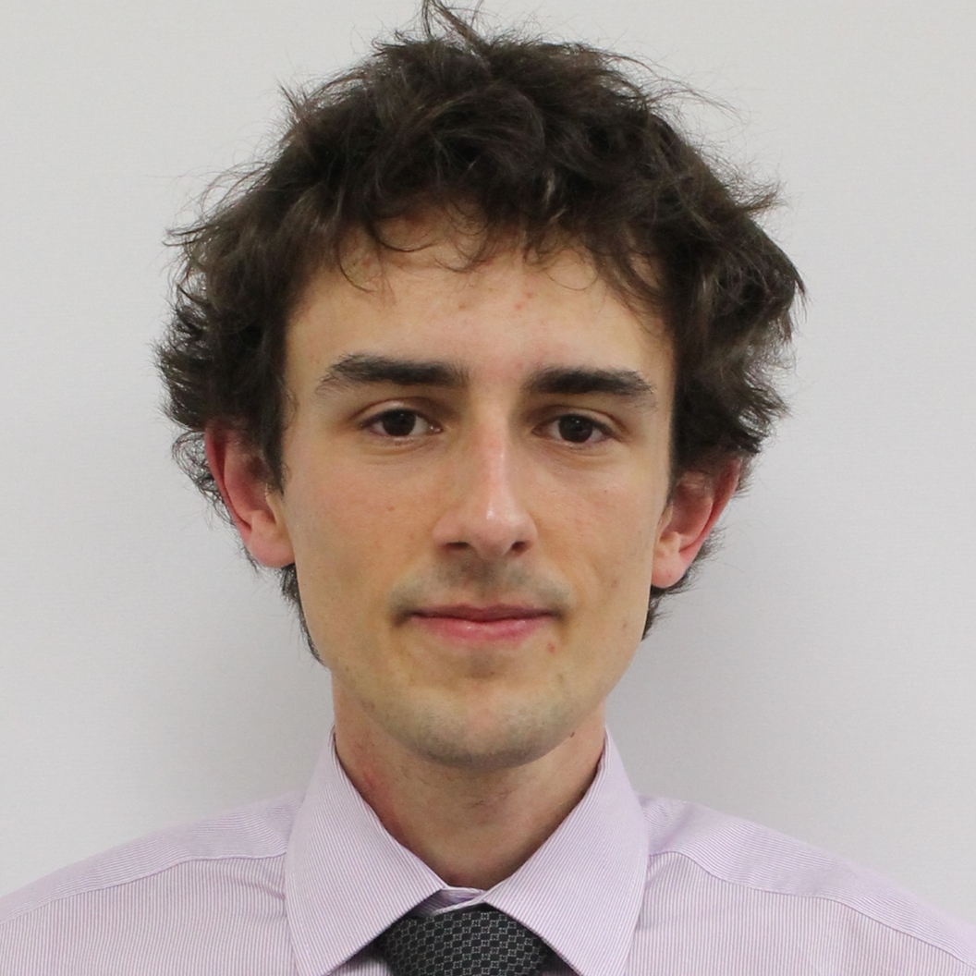
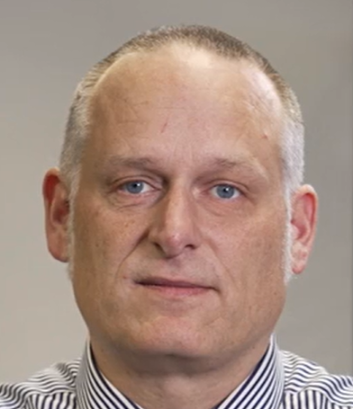

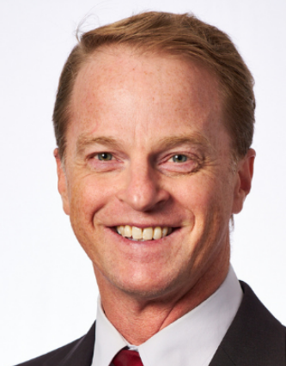
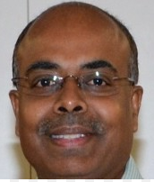
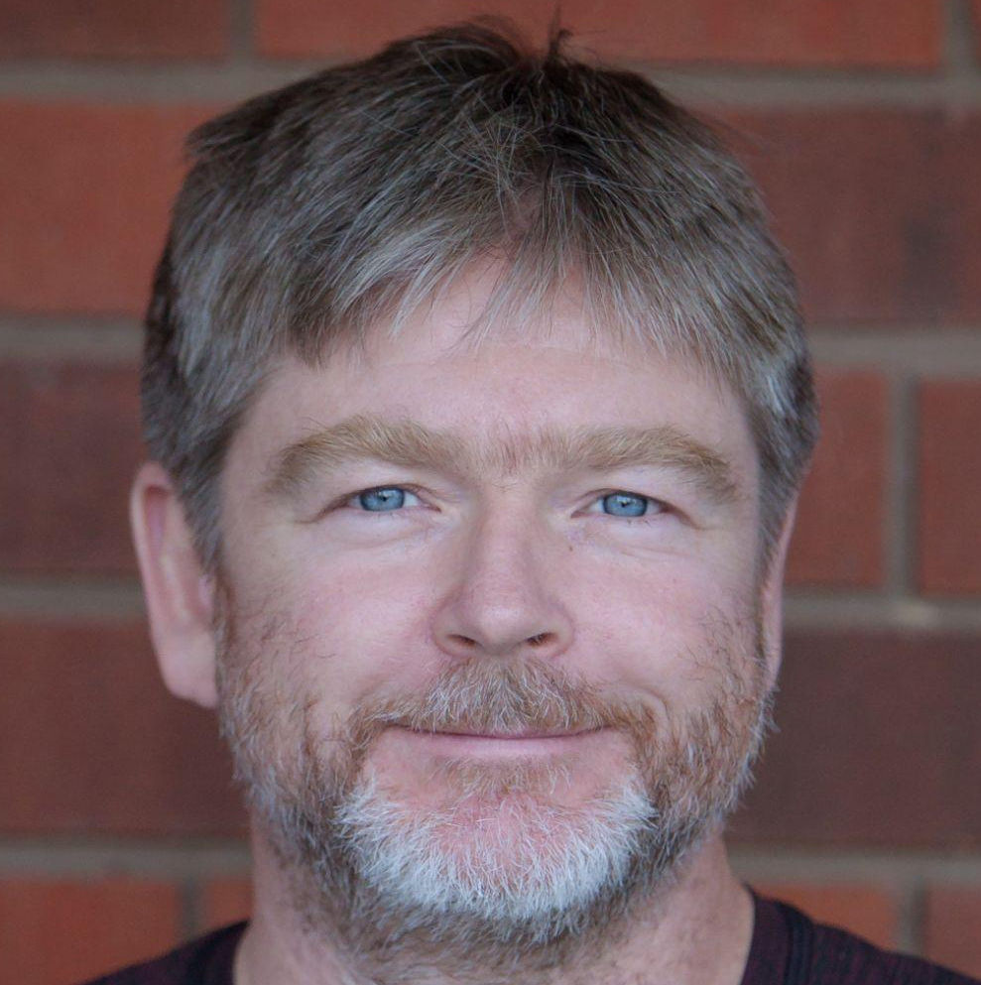
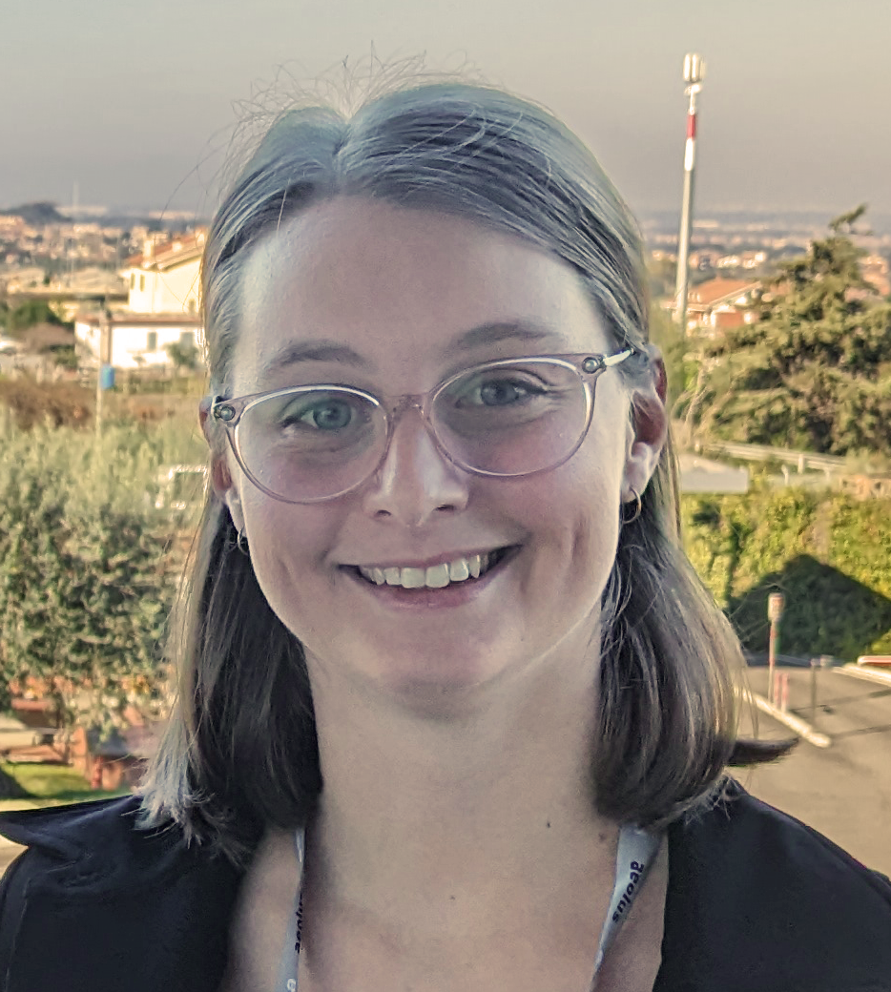
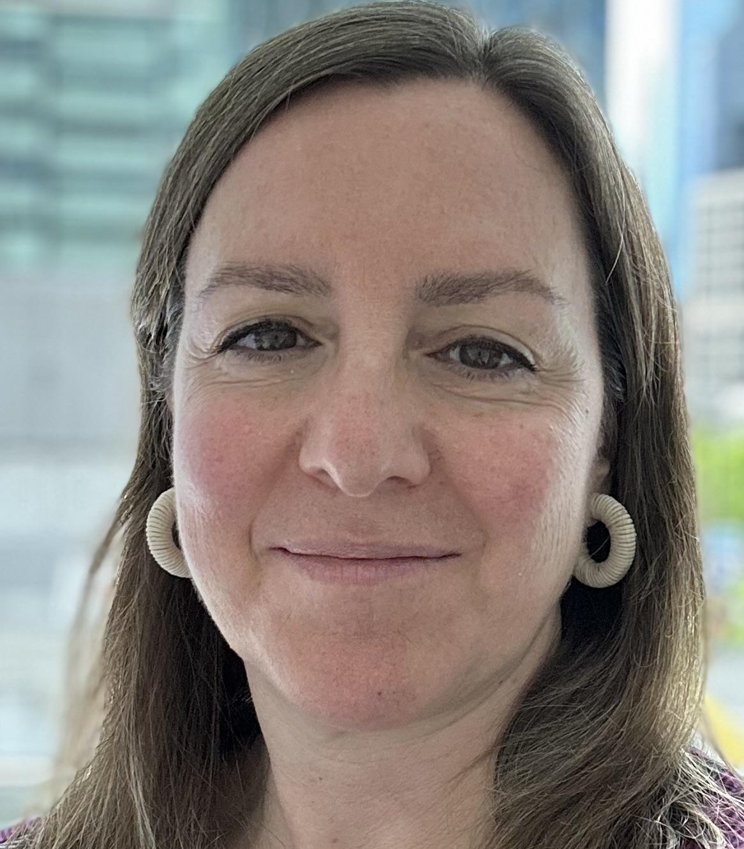
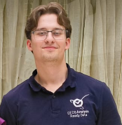
Chair Team Members
CSIRO
CEOS Chair Support
Alex Held
CEOS Chair
Adaptation and Resilience PoC
Amy Parker Agency Contact
Antarctica Co-PoC
Shaun Levick
Biodiversity Expert
Zandria Farrell
Water Quality PoC
Geoscience Australia
Stephen Ward
Matt Steventon
Jonathon Ross
GA Principal
LSI-VC Co-Lead
Maggie Arnold
Agency Contact
Antarctica Co-PoC
Matt Adams
CEOS-ARD PoC
Medhavy Thankappan
WGCV Vice-Chair
George Dyke
Libby Rose
Bureau of Meteorology
Supported by experts from GA, CSIRO and BOM
Agnes Lane
Bureau Principal
CEOS in Schools PoC
Harvey Jones

Slide 12
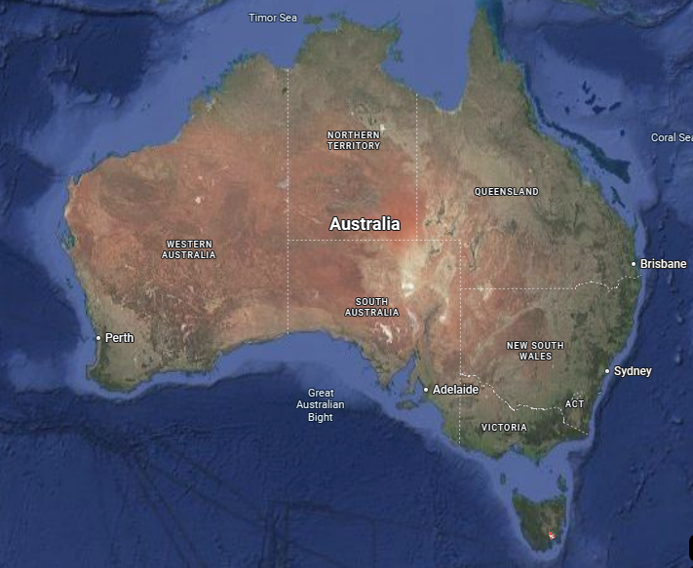
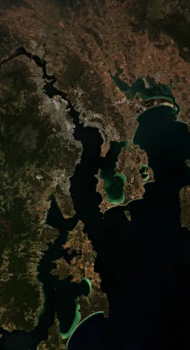

40th CEOS Plenary
3-6 November 2026
Hobart, Australia
Antarctica
Credit: European Union Sentinel-2
BREAKING NEWS!!! Venue: Hotel Grand Chancellor

Slide 13

CEOS at IAC
CEOS Selfie?

Slide 14
Context
Ongoing role for Earth observing satellite programmes in delivering data for society relies on:
  Complementary roles of government and commercial missions
  Assuring trust in information and insights
  Ensuring robust supply chains
Environmental change will continue to happen
  Whatever the cause
  EO is fundamental to support adaptation and resilience
  National, regional and local scales
  Volume and variety of data increasing
  Importance of making data easy to use and integrate

Slide 15
CEOS Chair Organisations
CSIRO
Australia’s National Science Agency and member of CEOS since 1989. Multi-disciplinary science organisation with broad expertise in Earth observation applications, data systems, cal/val and sensor design.
Geoscience Australia
Australia’s public sector geoscience organisation and associate member of CEOS since 2013. Unlocking satellite imagery of lands and coasts for economic and community benefit along with PNT and Geodesy.
Bureau of Meteorology
Associate member of CEOS since 2015 and Australia’s weather, climate, water, ocean and space weather information agency.

Slide 16
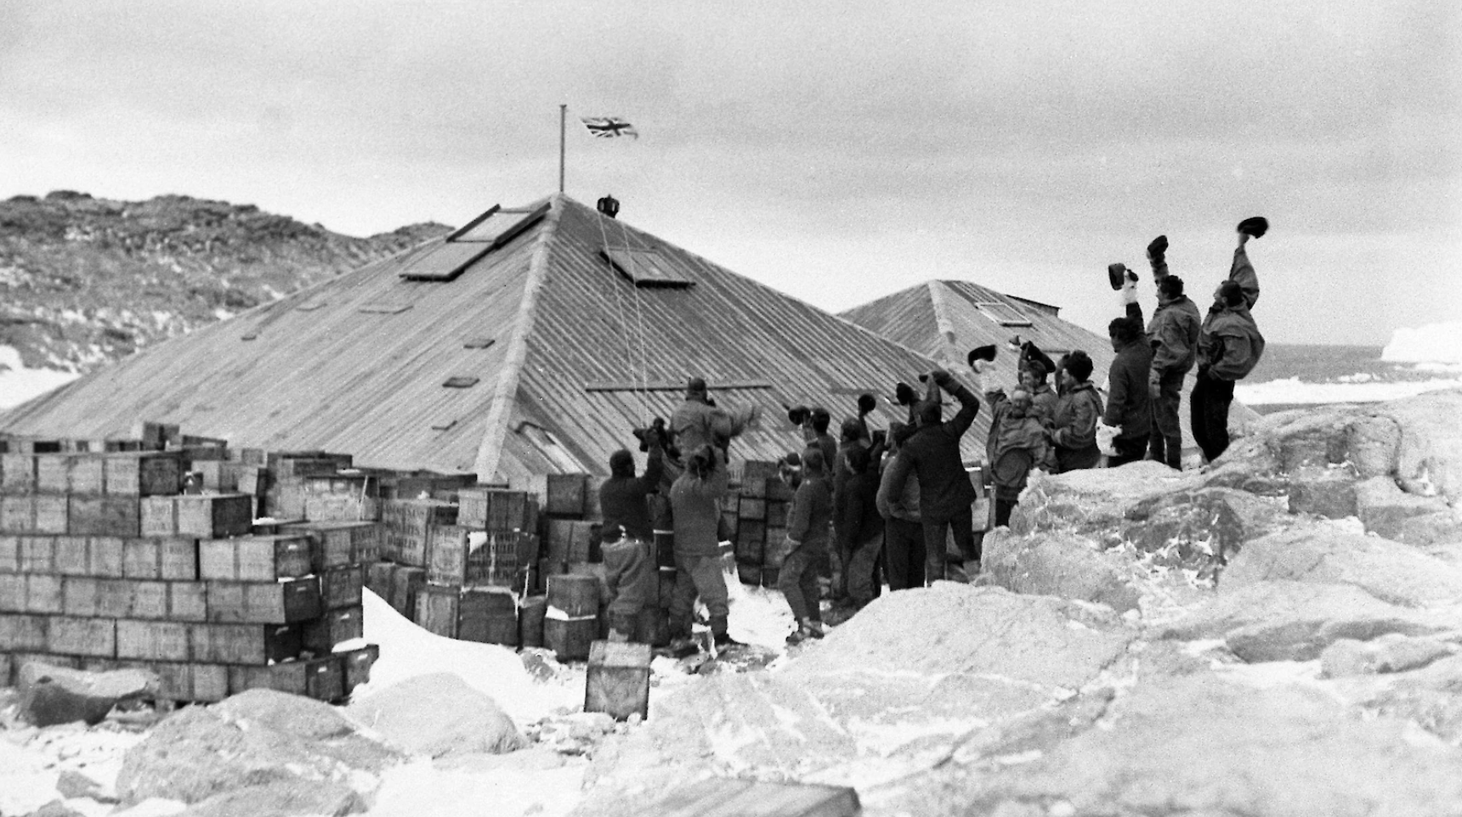


Highlight Topic: Antarctica Plenary Experience
Hobart: Gateway to Antarctica
Engage with those working at the heart of Antarctic matters - the Australian Antarctic Division.
Showcases the current role Earth observation plays in Antarctic matters and gaps in available data, science and products.
Opportunity to deepen CEOS’s connections with polar issues.
Antarctica’s Mawson’s Huts in 1912 and replicated today in Hobart
Credit: Mawson’s Huts Foundation
Sentinel-1A radar backscatter over the Publications Ice Shelf, East Antarctica.
Credit: Digital Earth Antarctica

Slide 17
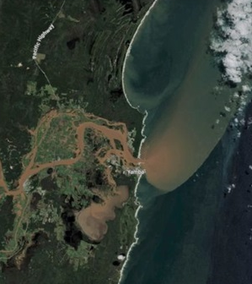
Highlight Topic: Water Quality Workshop
Theme:
How to transform Earth observation archives into actionable water quality insights to support adaptation strategies
Objectives:
Share knowledge on the use of Earth observation for water quality to identify gaps and successes
Progress CEOS support to Environmental Adaptation and Resilience (Chair Theme 1)
Interactive session :
Participants will contribute insights based upon the current EO capability within their own area of expertise/country, to identify gaps in knowledge or particular strengths. The group explore whether gaps can be filled through collaboration/knowledge sharing.
The workshop will use existing case studies to demonstrate methodologies:
  AquaWatch4Lakes tech Demonstrator (Indonesia)
  AquaWatch California Site (US)
Credit: Sentinel-2A

Slide 18
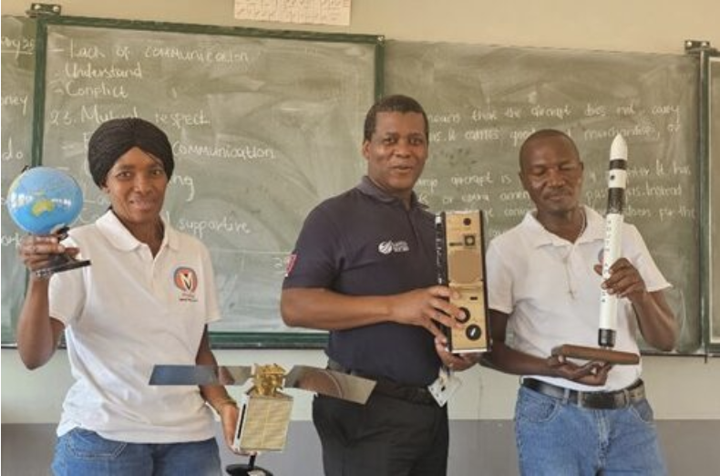
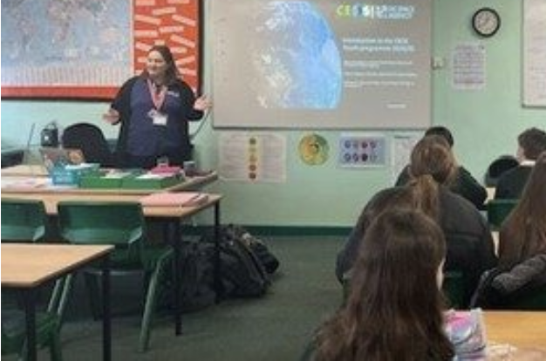
Highlight Topic: CEOS in Schools
Format: 2 events
Virtual Workshop: March/April 2026
Potential event at Plenary:
Panel session on EO in Schools with Australian education experts
Poster presentation
Continue legacy of the 2025 UKSA CEOS Chair
UKSA and SANSA visiting participating schools in the UK and South Africa during the 2025 UKSA CEOS Chair

