Slide 1
Biodiversity
Proposal for the sustained presence of the topic of biodiversity within CEOS
Shaun Levick, CSIRO
Marc Paganini, ESA
Gary Geller, NASA-JPL
Agenda Item 9.7
SIT TW 2025
Darmstadt, Germany
9-11 September, 2025

Slide 2

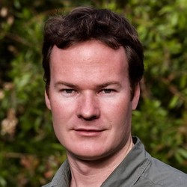
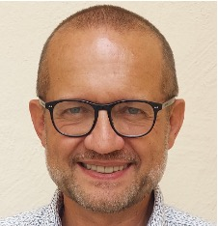
Biodiversity Study Team
Established at CEOS Plenary 2024
Co-leads: Gary Geller (NASA-JPL), Shaun Levick (CSIRO), and Marc Paganini (ESA)
Members: CNES, CSA, CSIRO, EC, ECCC, ESA, ISRO, JAXA, NASA, NOAA, UKSA, USGS
Road to here
~2012: “Biodiversity Activity” initiated
~2020: Informal discussions on increasing engagement
Triggered by biodiversity crisis;
Convention on Biological Diversity (CBD)
Global Biodiversity Framework (GBF)
2021: Biodiversity “Discussion Group” initiated
2022-2024: Ecosystem Extent Task Team
Whitepaper
Demonstrator studies
2024: CSA Chair theme
Long-term engagement
Gary Geller
NASA-JPL
Shaun Levick
CSIRO
Marc Paganini
ESA

Slide 3
The BST Mandate
Overall task: Assess the options for sustainable support for biodiversity in CEOS and make a recommendation at Plenary 2025
Phase 1: Conduct a stakeholder assessment (identify end user needs)
Phase 2: Consult across CEOS entities and agencies (assess potential to address user needs)
Phase 3: Develop recommendation for sustainable CEOS support for biodiversity and associated documentation

Slide 4
Stakeholder Assessment
GEO BON | GEO Biodiversity Observation Network
IOC/UNESCO | Intergovernmental Oceanographic Commission of UNESCO
IPBES | Inter-governmental Platform on Biodiversity and Ecosystem Service (analogous to IPCC)
Ramsar Convention on Wetlands | International treaty on Wetlands (signed in 1971 in Ramsar, Iran)
TNFD | Taskforce on Nature-related Financial Disclosures (other “nature finance” organizations were also considered)
UNCBD | UN Convention on Biological Diversity
UNCCD | UN Convention to Combat Desertification
UNSEEA | UN System of Environmental-Economic Accounting

Slide 5
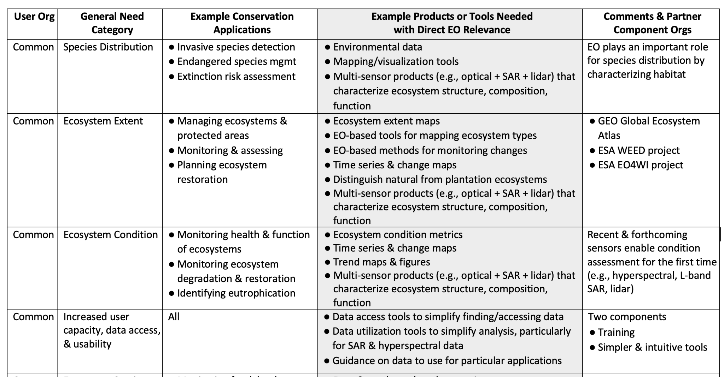
User needs

Slide 6
Options considered
Working Group
Virtual Constellation
Subgroup under the LSI-VC
Ad Hoc Team
Federated Approach
No action

Slide 7
Options comparison
Option | Benefits | Challenges
CEOS Working Group | Strong ties to international conventions (CBD, Ramsar, UNCCD) High institutional visibility & influence Long-term commitments from Agencies Structured leadership model ensures continuity | Heavy mandate and reporting across CEOS High resource requirement (sustained commitment from at least 4-5 Agencies) Demanding governance and reporting Heaviest coordination burden Heaviest travel burden
CEOS Virtual Constellation | Flexible and scalable membership Flexible leadership transitions Provides a concentration of expertise Manageable reporting and leadership responsibilities | No unique challenges were identified that could not be addressed Still needs Agency commitments and support for leadership and expertise
New Subgroup in LSI-VC | Avoids creation of new WG or VC Simplifies startup Synergies with existing LSI-VC work Supports coordination with other CEOS terrestrial activities | Land domain focus: lacks comprehensive biodiversity approach that must include marine & coastal ecosystems Diluted biodiversity visibility within CEOS Increased management demands on LSI-VC

Slide 8
Options comparison cont.
Option | Benefits | Challenges
Ad Hoc Team | Effective for addressing a specific topic or target task Useful for some External Requests Clear focus, outputs, and outcomes | Narrow focus on a single topic; limited impact Finite duration Lacks long-term relationship with users
Federated Approach | Avoids creating a new entity Could leverage existing entities and experts Offers Agencies the opportunity to sponsor outside biodiversity expertise | Lack of biodiversity expertise in existing entities Entities have their own, original focus Lack of strategic focus risks being fragmented and reactive Coordination complexity across entities to align scattered efforts Weaker CEOS identity and visibility
No action | None | Fails to address major societal need

Slide 9
Recommendation
The Biodiversity Study Team recommends the establishment of a Biodiversity Virtual Constellation as the most effective and sustainable option for ensuring a long term and impactful CEOS engagement in support of Biodiversity.
A Biodiversity Virtual Constellation (B-VC) would offer the flexibility to tailor the VC with the expertise needed to address identified user needs and activities for which the ensemble of CEOS Agencies is ideally suited
A Virtual Constellation can accommodate a range of contributions, from sustained Agency leadership to smaller or targeted inputs, allowing broad participation across CEOS
The B-VC model also supports the possibility for agencies to sponsor external biodiversity experts for defined periods, useful for Agencies that may not have in-house biodiversity programmes
The B-VC is envisioned as a dynamic and evolving structure, capable of adjusting its composition and priorities over time.

Slide 10
Biodiversity Study Team
Initial proposal for a Biodiversity Virtual Constellation

Slide 11
CEOS Virtual Constellation
(from the CEOS Virtual Constellation Process Paper, Oct 2019)
A CEOS Virtual Constellation is a set of space and ground segment capabilities operating together in a coordinated manner, in effect a virtual system that overlaps in coverage in order to meet a combined and common set of EO requirements.
Primary Goal is to demonstrate the value of a collaborative partnership in addressing key observational gaps and sustain the routine collection of critical observations.
2 types of CEOS Virtual Constellations:
Single Property with single/multiple satellite measurement techniques OR
Multiple Property / Domain based with multiple satellite measurement techniques
Specific Goals from the CEOS Virtual Constellation Process Paper (addressed in Annex 3 of the BST Report & Recommendation for a B-VC)
CEOS agency mission coordination at multiple level: space segment, ground segment, products/services.

Slide 12
B-VC Mission Statement
Advance biodiversity understanding, monitoring, and conservation for the benefit of society, by strengthening the community’s use of space-based Earth observations and data products.

Slide 13
B-VC Objectives
Maximize Impact
Maximize the societal benefit of space-based EO & derived data products
Focus: biodiversity understanding, monitoring, and conservation
Engage Users
Maintain active dialogue with biodiversity stakeholders
Support continued understanding of evolving user needs
Adapt activities accordingly
Leverage CEOS collective Capabilities and Resources
Alignment & connectivity across CEOS Agency missions, observations, data products, & services
Coordination with activities of other CEOS entities

Slide 14
B-VC Activities
Identify priority gaps in biodiversity observations and data products (including EBVs and biodiversity indicators) and facilitate development of solutions to fill critical gaps.
Facilitate enhancement of data processing and utilization tools needed to increase utilization of EO for biodiversity applications.
Enhance existing CEOS biodiversity demonstrators, and explore possibilities for new ones, to provide useful exemplars and facilitate development and testing of needed EO capabilities.
Prioritize and implement Capacity Building initiatives through close collaboration with CEOS WGCapD.
Actively seek to increase biodiversity community engagement with EO and its applications for biodiversity understanding, monitoring, and conservation.
Coordinate with GEO BON and its Global Biodiversity Observing System (GBiOS) concept to facilitate the wider use of space-based EO.

Slide 15
B-VC Membership & Leadership
Membership
Primarily CEOS Agency personnel, including support from other CEOS entities
Where needed, augmented with outside expertise
Goal for geographic diversity, and range of expertise
Leadership
Two and no more than three Co-Leads
Provided by CEOS Agencies
Co-Lead positions will be reviewed every two years
Decision of leadership resides with the Constellation

Slide 16
B-VC Resources
B-VC team members
In-kind support by CEOS Agencies (with participation from CEOS entities)
Invited external experts sponsored by CEOS agencies (on a voluntary basis)
Existing Agency Research and Development Programs
Proposals for projects with specific deliverables, submitted by B-VC team members or external experts
Algorithm and product development
Demonstrator development
External support via proposals to outside entities
National government agencies, institutions, philanthropic orgs…
Submitted by B-VC team members or outside experts (e.g., at universities)
Support to B-VC specific activities
Notes:
BST membership was supported by 12 Agencies, including three co-leads

Slide 17
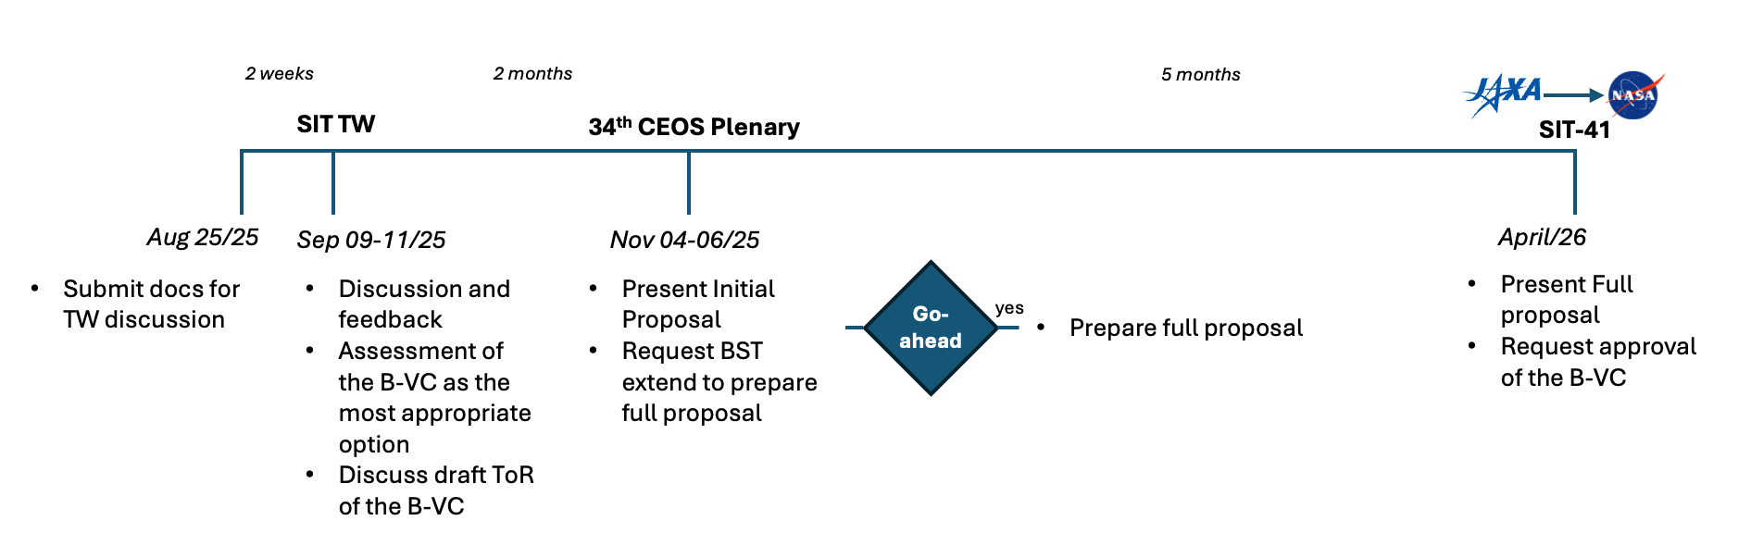
Timeline to SIT-41
Documents available for review
Report from the Biodiversity Study Team: Recommendation for a CEOS Biodiversity Virtual Constellation
Initial Proposal and Terms of Reference for a CEOS Biodiversity Virtual Constellation (submitted to SIT Chair Team)
Implementation Plan for the CEOS Biodiversity Virtual Constellation (draft)

Slide 18
Request to Principals at Plenary
Acknowledge that the Biodiversity Study Team has fulfilled its assigned tasks
Agree that a CEOS Biodiversity Virtual Constellation (B-VC) is the leading option for sustainable support
Extend the BST’s duration to provide time to develop a Full Proposal for consideration and decision at SIT-41 in April 2026

Slide 19
Thank you

