Slide 1
Atmospheric Composition Virtual Constellation (AC-VC)
State of the Earth Observation System
Charles Miller, JPL/NASA
Agenda Item 1.2.1
SIT TW 2026
Washington DC, USA
8-10 September, 2026

Slide 2
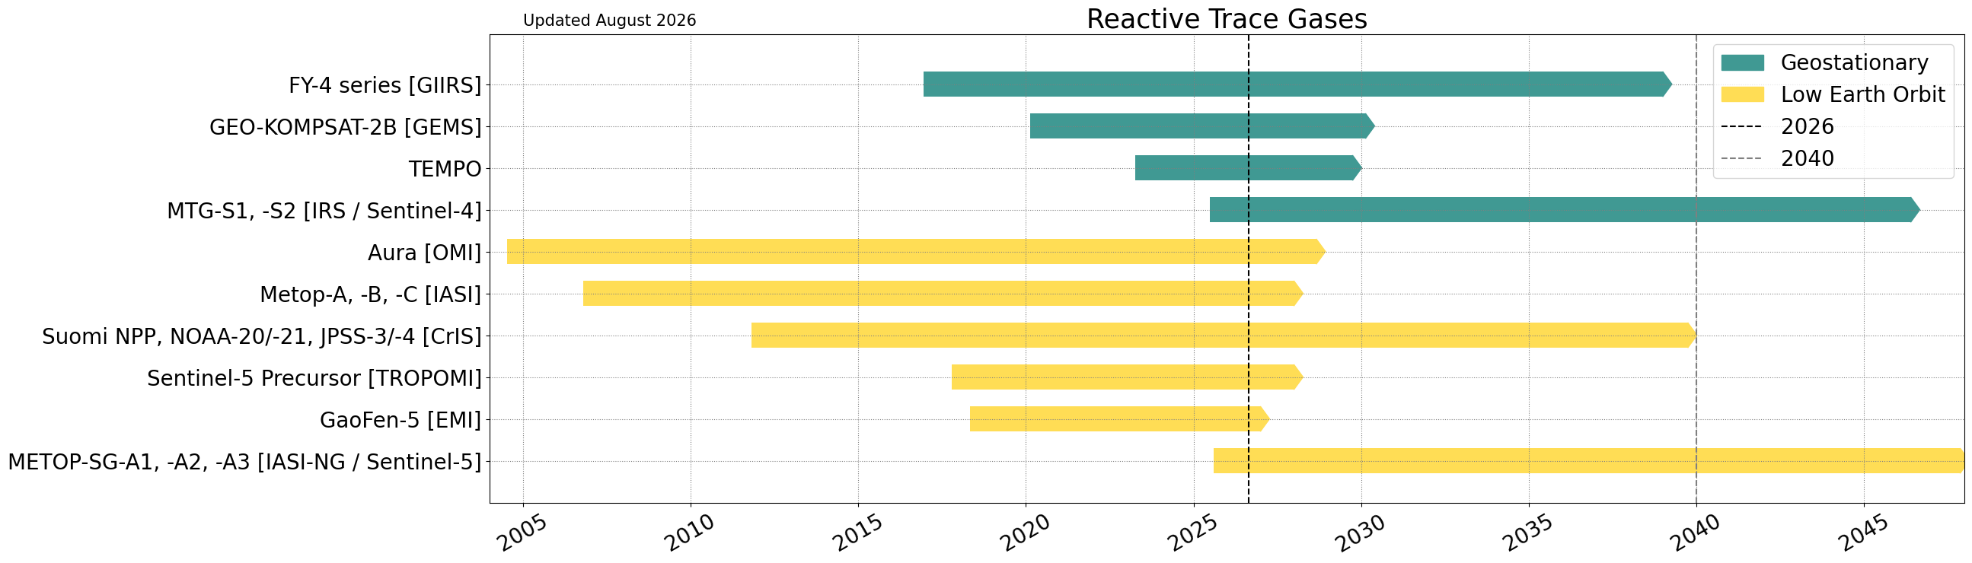
Summary of Current & Planned Missions: Reactive Trace Gases

Slide 3
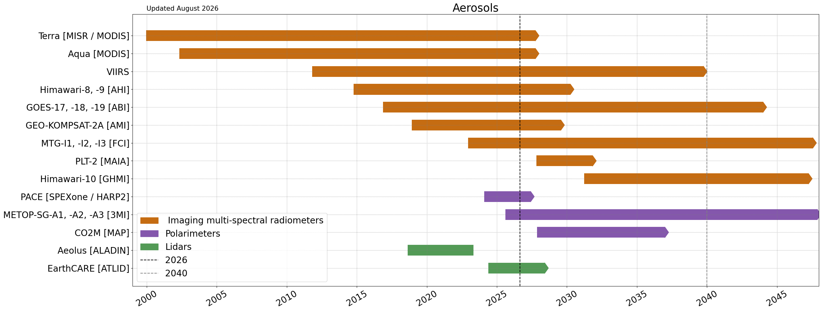
Summary of Current & Planned Missions: Aerosols

Slide 4
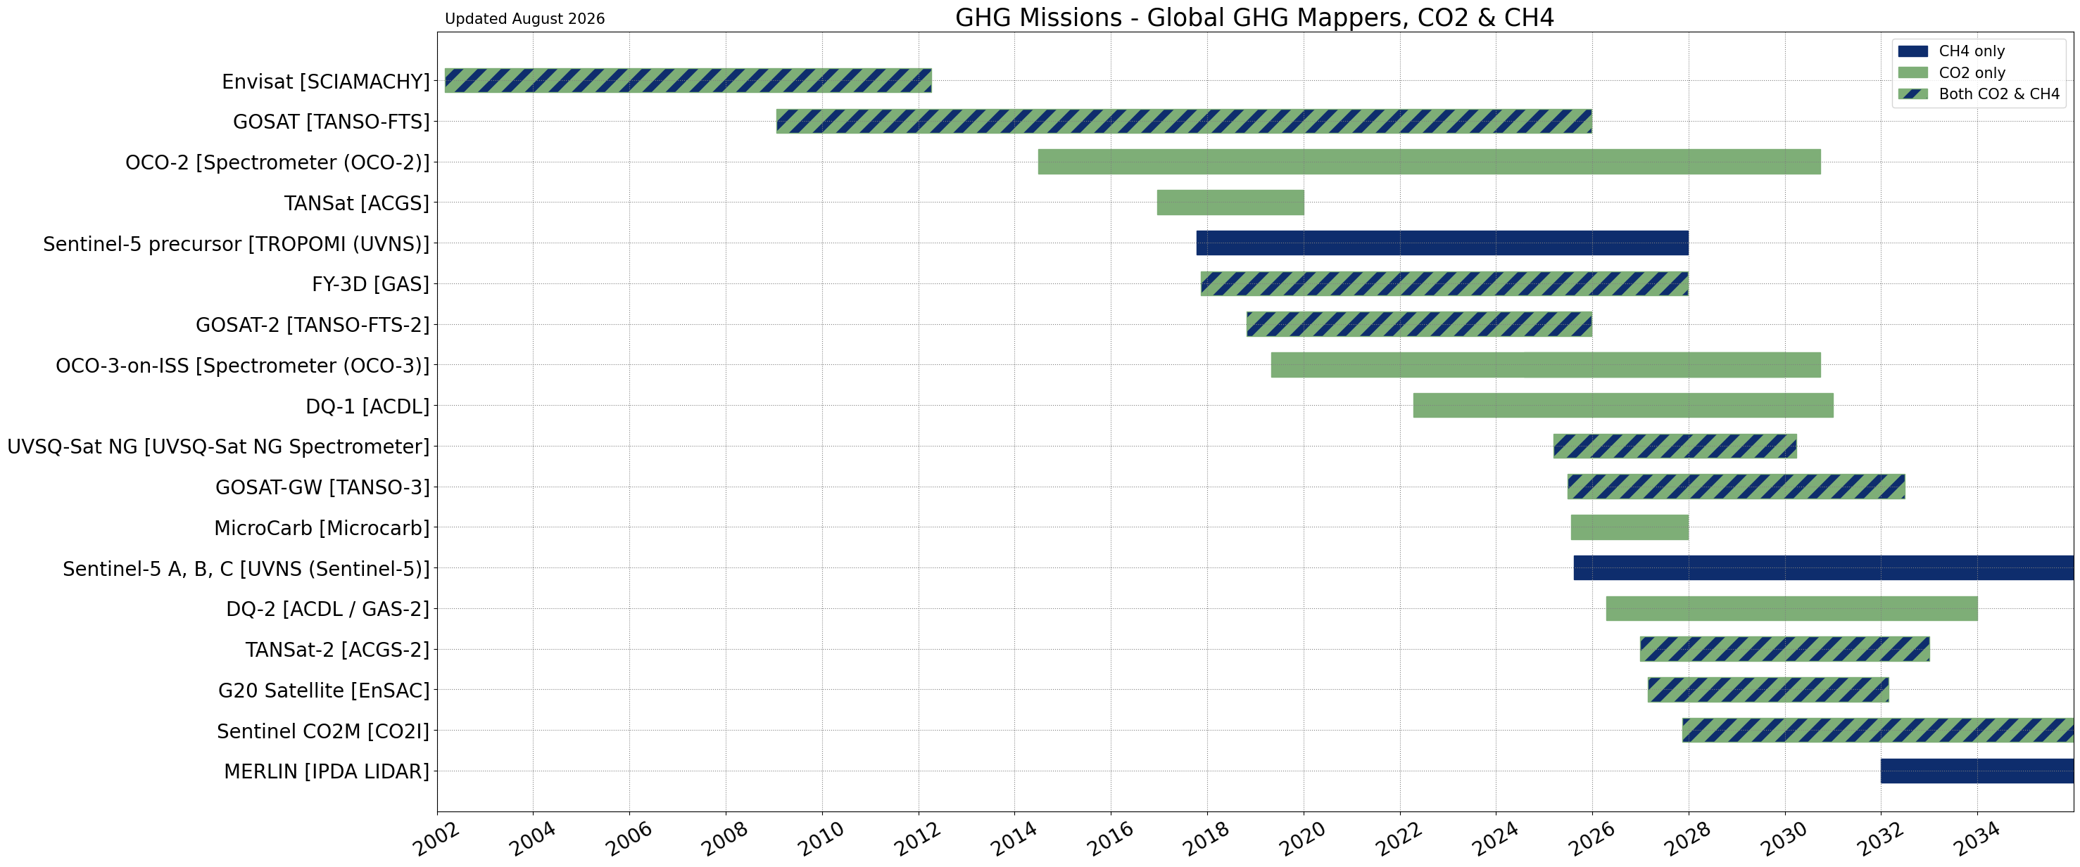
Summary of Current & Planned Missions: Greenhouse Gases – Global Mappers

Slide 5
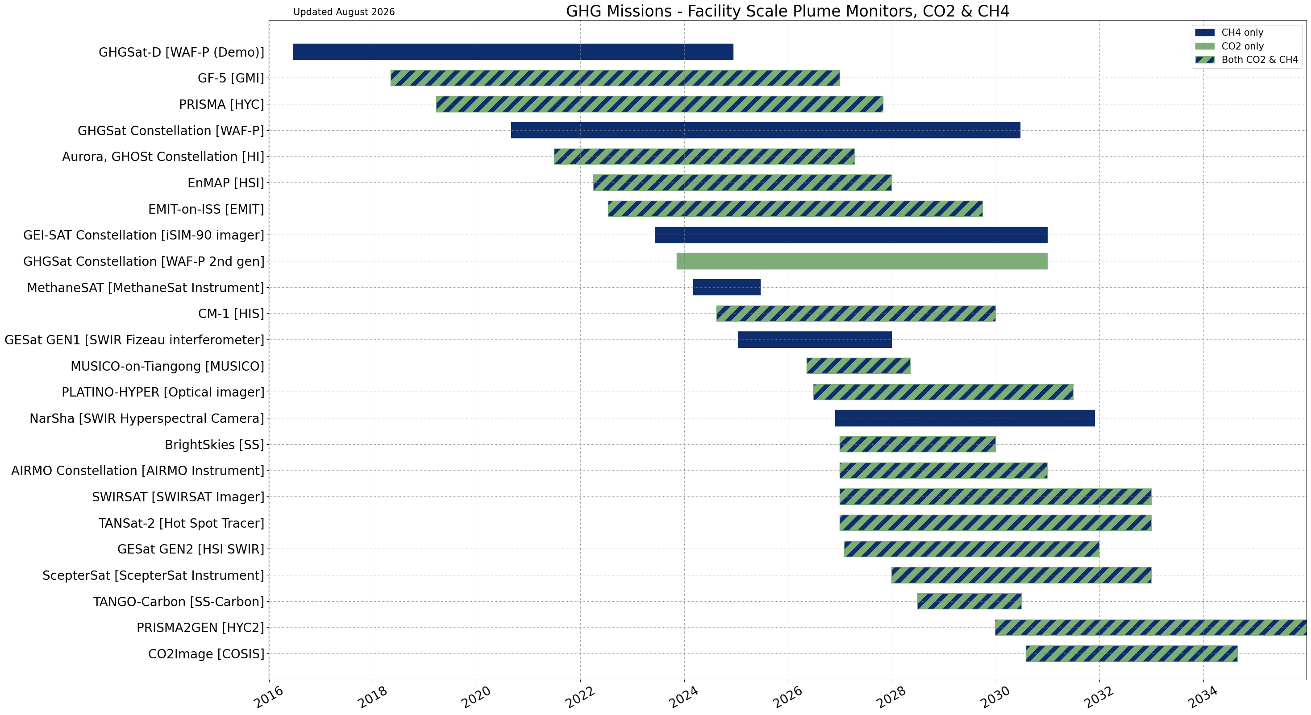
Summary of Current & Planned Missions: Greenhouse Gases – Facility Scale

Slide 6
Planning highlights
Sentinel-4 (S4), Sentinel-5 (S5), IRS, IASI-NG launched in summer 2025 are in commissioning
Harmonization and exploitation of total column water vapour
AC-VC GEO White Paper
  Global need for hourly AQ data
  Four (4) geostationary instruments with current technology could possibly cover observation gaps in the tropics and Southern Hemisphere not observed by GEMS, TEMPO, and S4

Slide 7
Issues for attention of SIT:
AC-VC Recommendation on Sentinel-5P
The AC-VC community recommends extending the Copernicus Sentinel-5 Precursor (S5P) mission with the TROPOMI instrument on board as long as possible, aiming at operations until 2035 for the following reasons:
  1. S5P is in excellent condition and fit for another 10 years (through 2035)
  2. S5P is the standard for the CEOS AQ-VC and GEO cross-calibration.
  3. S5P contributes to diurnal variability observations worldwide.
  4. S5P extends the long-term afternoon data record
  5. S5P offers higher spatial resolution than S4 and S5
  6. S5P is an important reference for commissioning and verifying S5 and CO2M

