Slide 1
SST Virtual Constellation
VC Report on activites
Christo Whittle, CSIR
Misako Kachi, JAXA
Agenda Item 3.3
CEOS SEC 350
8-10 September 2026

Slide 2
SST-VC Annual Meeting
CEOS SST-Virtual Constellation 2026 Annual Meeting on 9 June 2026
Members (online/absence) on 9 June 2026
  Christo Whittle (SANSA/CSIR, co-lead)
  Misako Kachi (JAXA, co-lead)
  Ed Armstrong (NASA)
  Sheekela Baker-Yeboah on behalf of Kenneth Casey (NOAA)
  Anne Reed (EUMETSAT)
  Paolo Cipollini (ESA)
  Pradeep Thapliyal (ISRO)
  Miao Zhang (CMA)
  Han-Cheol Lim (KMA)
  Pallavi Govekar (BoM)
  Natália de Moraes Rudorff (INPE)
  Facundo Eduard Godoy (CONAE)
  Cristina González Haro (GHRSST PO)
  Evald Alin Artene (GHRSST PO)
  Chris Merchant (GHRSST ST Chair)
Guests
  Jean-Francois Piolle (Ifremer, for CEOS-ARD & GDS3 engagement)
Observers
  Sheekela Baker-Yeboah

Slide 3
NASA SIT Chair Priorities
Meeting with SIT in January 2026
Priority 1: Water Planet- Seeing Earth's Water from Space
  Advance understanding of Earth's water cycle by monitoring terrestrial waters, coastal regions, and oceans from space. Transform this knowledge to actionable insights to enhance water use efficiency, improve water quality, and enhance resilience to water-related hazards such as droughts, floods, and storms.
Priority 2: Connected Data for Community Resilience
  Advance community-level resilience by leveraging CEOS disaster risk reduction successes and partnerships to enhance cross-collaboration, data interoperability, and actionable information.

Slide 4
Meeting Discussion Points
New SIT Chair Initiatives
Aquatic Carbon Roadmap (circulated, comments by end of Jun.)
Water Quality WS (Ed Armstrong)
  Ed attended. PACE & water-quality groups. Feedback of survey. Ocean color sensors. SST by ECOSTRESS. Ultra-high-resolution TIR missions (TRISHNA, SBG->EAGLE, ). Climate & coastal resilience.
  (Update after the meeting) Next WS (Sep. 8) in Washington DC; Sheekela Baker-Yeboah will attend on behalf of SST-VC.
  Combining VCs for coastal resilience… Possible topic to next meeting.
CEOS-ARD (Ed Armstrong, Jean-Francois Piolle)
  Surface temperature Product Family Specifications (PFS); mostly LST; added ocean temperature (and ice?). Mapping with GDS attributes (first spreadsheet by Ed). Gap/differences exist. -> could be inputs to GDS3.0. CEOS ARD compliant format.
COAST-VC (Christo Whittle)
  No notice of new meeting at the time;
  Last meeting attended in January to discuss gap analysis.
  NOAA reorganization since then…
  New contacts: Elliot Matthews (elliott.matthews@noaa.gov); Oriana Villar (oriana.villar@noaa.gov)
Biodiversity-VC (Misako Kachi & Christo Whittle)
  Established in Apr. 2026
  Coast-water quality aspect & ultra high-res. TIR SST
  Nominate SST-VC to be PoC to B-VC → Pradeep Thapliyal volunteered (To check with support from ISRO)
  Targets of SST-VC … ultra high res. SST will be next focused area .. applicable to COAST- & B-VC
  Need to evaluate ultra high-res. SST / in-situ observation. May be related to new SIT priority. focusing on in-situ validation and cal/val for coastal areas.
  Contribute to White paper: “Coastal and inland water bodies: the next frontier for global thermal infrared observations”
GDS (GHRSST Data Specification) 3.0 update timeline (Jean-Francois Piolle)

Slide 5
GHRSST GDS 3.0
Objectives
Discussed over 2024-2026 time frame
Outline of main evolutions presented at GHRSST meeting (June 2026) - agreement within Science Team
Draft GDS v3 by Fall 2026
Main evolutions
Revising uncertainties (led by O. Embury)
Including Sea Ice Temperature (led by G. Corlett)
Revised time and space coordinates and dimensions
Regridding rules (for L3)
Scaling / quantization / data types
Cloud optimization of NetCDF4/HDF5 (led by Ed Armstrong)
Conversion rules to other formats (Zarr, COG)
Revised file and variable naming
Ancillary and optional fields
Constraints for UHR SST (water/land mask and temperature separation, geolocation, …)
Account for ARD requirements (CRS, Metadata machine readability, Algorithms, Solar and viewing geometry (not mandatory), Saturation, Atmospheric corrections, Geometric accuracy) => need for ARD and GDS specs to converge together

Slide 6
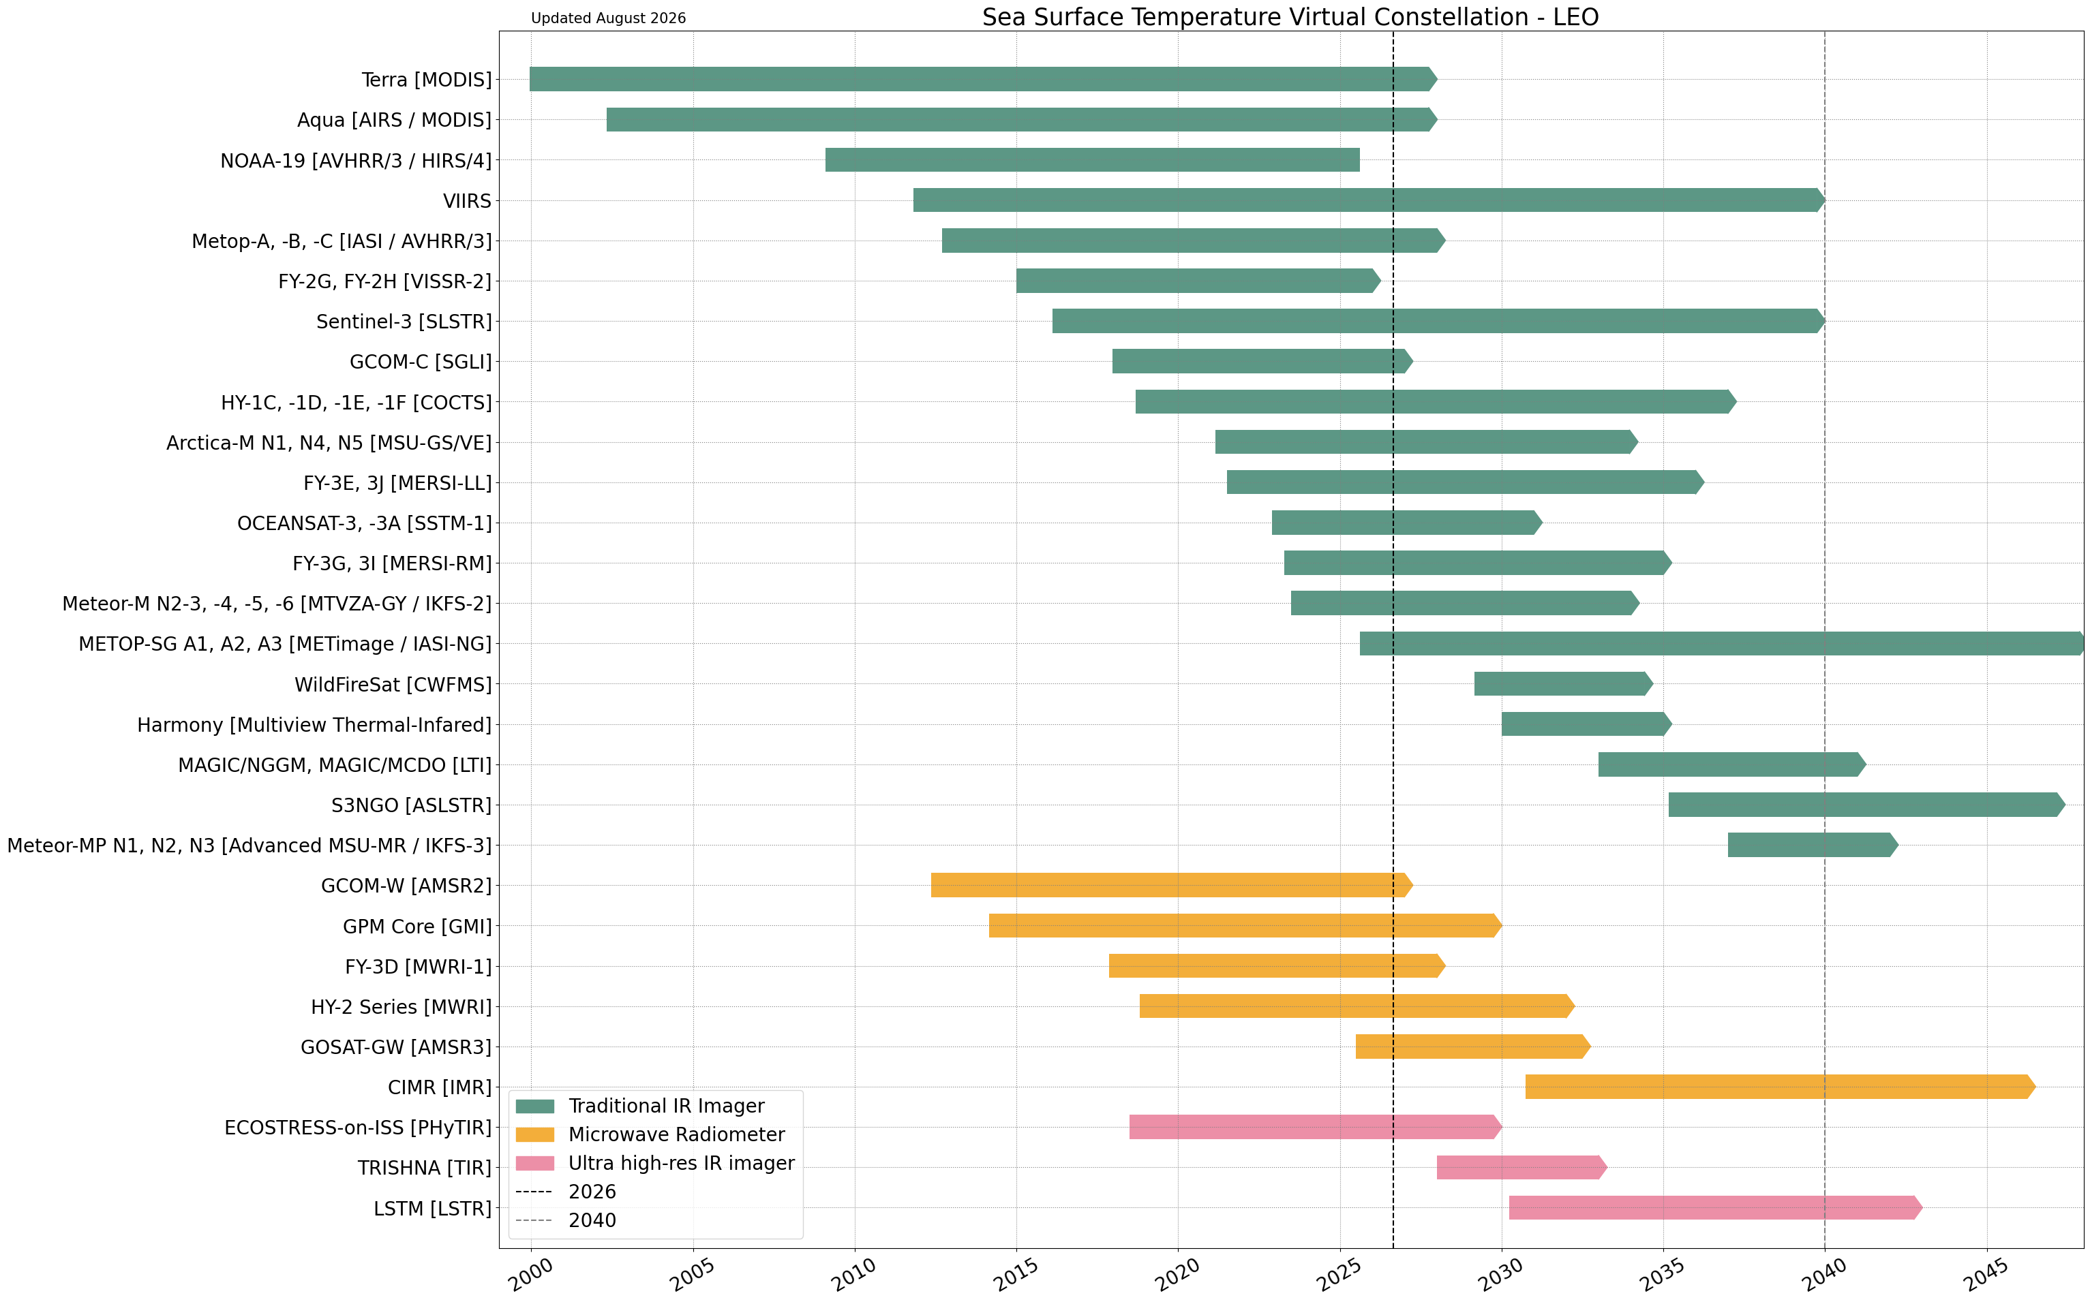
SST timelines (as of Aug. 2026): LEO SST
From MIM Database

Slide 7
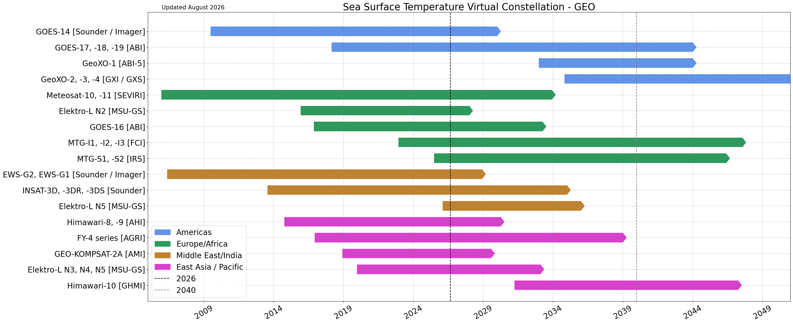
SST timelines (as of Aug. 2026): GEO SST
From MIM Database

