Slide 1
Biodiversity Virtual Constellation
B-VC
State of the Earth
Observation System
Yoseline Angel (NASA),
Lucie Viciano (CSA), and Marc Paganini (ESA)
Agenda Item 1.2.3
SIT TW 2026
Washington DC, USA
8-10 September, 2026

Slide 2
Outline
Summary of Current & Planned Missions
Planning highlights:
- Activities
- CEOS Statement to CBD COP-17
- Team building
Next steps
Concluding remarks

Slide 3
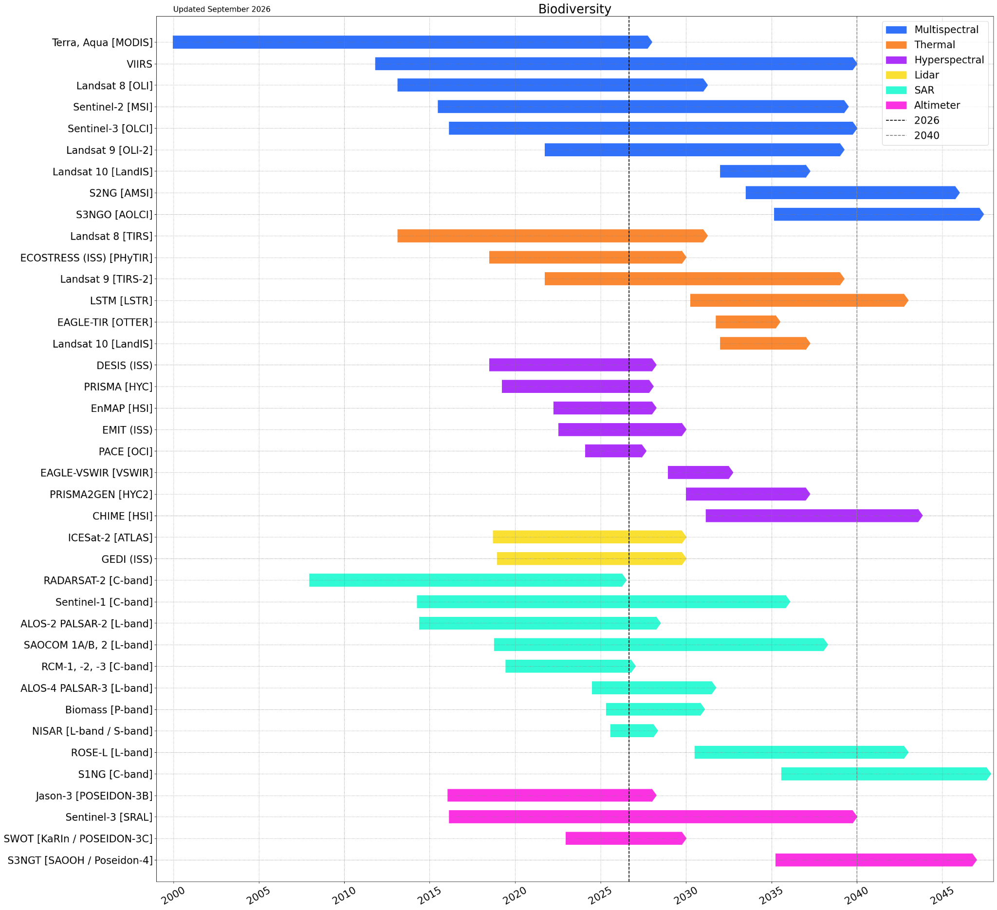

Summary of Current & Planned Missions
Essential Biodiversity Variables
(EBVs)
Ecosystem Function
Ecosystem Structure
Species traits
GBF Indicators and Targets
MIM Database generated (contact libby@symbios.space)

Slide 4
Planning highlights
Activities under discussion
CEOS Statement to CBD COP-17
Team building

Slide 5
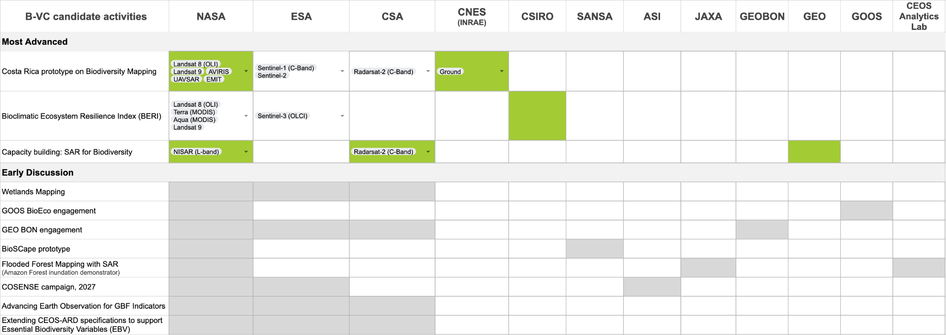
Activities under discussion
Core Activities
Users
Identify priority gaps in EO products.
Facilitate improved EO data processing and utilisation.
Explore prototypes for develop/test EO products.
Implement capacity building activities with WGCapD.
Actively seek greater biodiversity community engagement with EO.
Coordinate with GEO BON/GBiOS.
GEO BON
GOOS BioEco
IPBES
Ramsar Convention on Wetlands
UNCBD
UNCCD
UNSEEA
Nature Finance
National agencies
Notes:
(From Marc) A few comments on the B-VC activities
ESA in the GEO BON engagement. We have connected GEOBON BON-in-a-Box with ESA OpenEO/CDSE and will now develop jointly with GEO BON (McGill and WCMC) some data pipelines for biodiversity indicators (including BERI). That is a strong engagement with GEO BON because it will allow to easily integrate biodiversity workflows with EO data workflows
I would add in the “early discussions” also a line/row on “Earth Observation for GBF indicators”. The idea is to do an in-depth analysis of the relevance of Earth Observation for biodiversity indicators (headlines, component and complement)
We can put as a title “Advancing Earth Observation for GBF Indicators”
here follows a short description of the activity:
Advancing Earth Observation for GBF Indicators
(in relation to objective 1 - Identify priority gaps in EO products)
Conduct an in-depth assessment of the relevance and potential contribution of Earth Observation to the monitoring and reporting of the Kunming–Montreal Global Biodiversity Framework (GBF), covering headline, component, and complementary indicators. The activity will identify and prioritise indicators for which satellite EO can provide direct measurements, derived variables (EBVs), or complementary information, and assess associated observation requirements, methodological maturity, data availability, limitations, and opportunities for further development.
(in relation to objective 3 - Explore prototypes for develop/test EO products)
For selected priority indicators, the activity will support the development and demonstration of reproducible EO-enabled workflows, building on existing methodologies and datasets and leveraging GEO BON’s BON-in-a-Box and ESA’s openEO/CDSE environments. The work will promote interoperability, scalability, and uptake of EO-based approaches and strengthen coordination between CEOS Agencies, GEO BON, the CBD community, and other relevant partners.
We will initiate the analysis with the ESA project and then further develop it (especially the upstream part) with CEOS agencies.
“Marc discussed a potential CEOS-ARD Strategy initiative to develop product family specifications for EBVs, such as ecosystem extent “
As a title of the activity I would propose “CEOS-ARD Specifications for Essential Biodiversity Variables (EBVs)” or “Extending CEOS-ARD to Essential Biodiversity Variables”
here follows a short description of the activity:
Extending CEOS-ARD to Essential Biodiversity Variables
Contribute to the implementation of the CEOS Analysis Ready Data (CEOS-ARD) Strategy 2026–2031 by extending the ARD approach towards higher-level biodiversity-relevant L4 data products, with a focus on Essential Biodiversity Variables (EBVs).
The B-VC will work with the CEOS Land Surface Imaging Virtual Constellation (LSI-VC), and in particular its CEOS-ARD coordination activities, to develop Product Family Specifications (PFS) for selected terrestrial EBVs. The activity will initially explore Ecosystem Extent as a priority candidate, building on the work and expertise developed through the former CEOS Ecosystem Extent Task Team, while considering other EBVs where appropriate.
The activity will also engage with the CEOS Working Group on Calibration and Validation (WGCV), particularly its Land Product Validation (LPV) subgroup, to ensure that validation requirements, quality assessment, uncertainty characterisation, and fitness-for-purpose considerations are appropriately addressed within the ARD specifications.
By bringing together the biodiversity expertise of the B-VC, the CEOS-ARD expertise of LSI-VC, and the cal/val expertise of WGCV/LPV, the activity will establish a coordinated approach for defining interoperable, traceable, scalable, and fit-for-purpose higher-level biodiversity products. It will directly contribute to the Fitness for Purpose pillar of the CEOS-ARD Strategy 2026–2031, while also supporting its strategic objectives related to standards and interoperability; quality, authenticity and provenance; automation and scalability; AI enablement and foundation models; and adoption and impact.

Slide 6
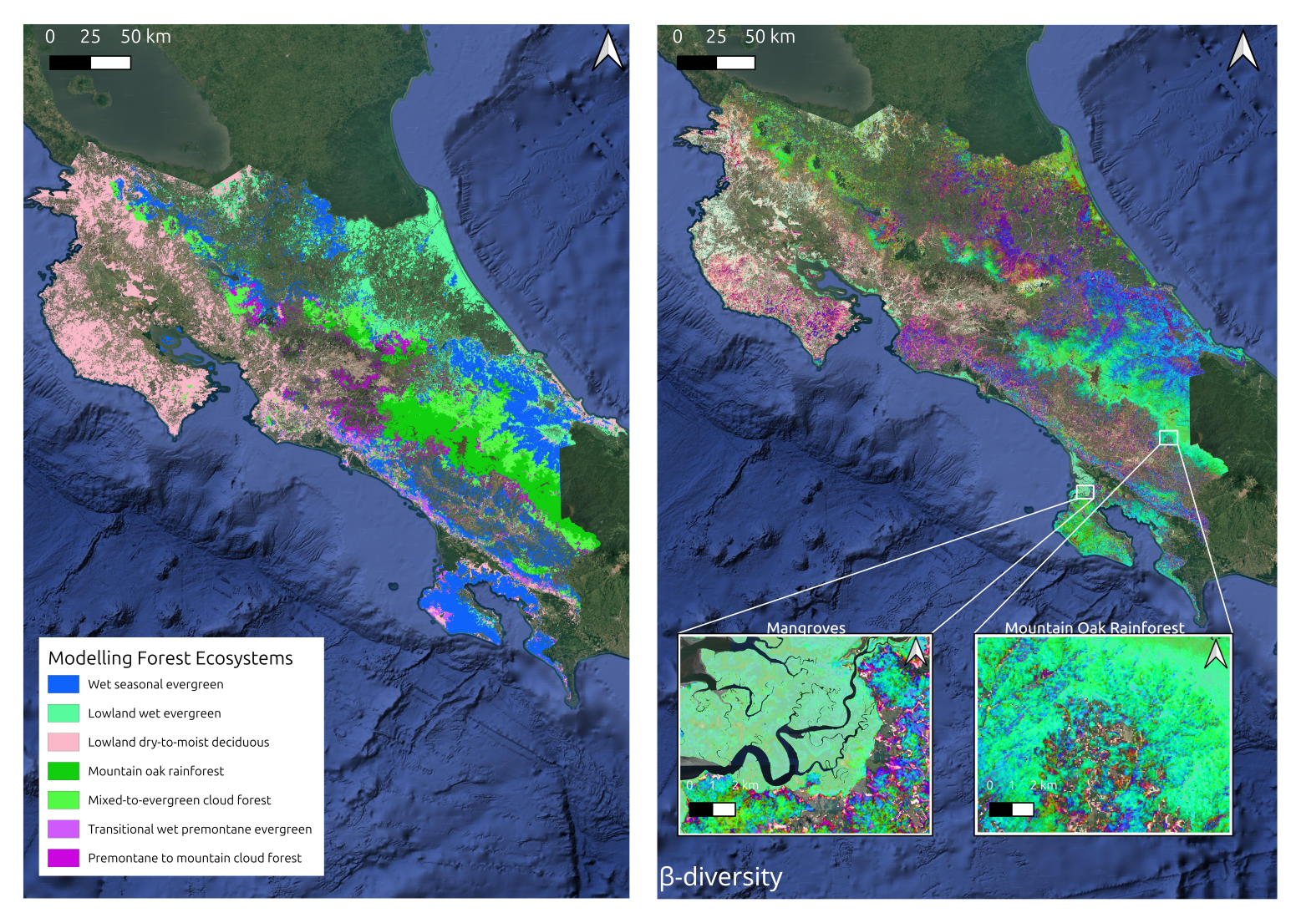


Biodiversity Mapping - Costa Rica
BiodivmapR: Sensor-agnostic approach to mapping forest diversity:
Applied across Costa Rica.
Annual β-diversity maps.
Ongoing validation with in situ & GBIF data.
Forest ecosystems classification adapted to the IUCN Typology.
Next steps:
Validate with NASA AVUELO data (AVIRIS, UAVSAR, in situ).
Expand to Panama.
Integrate SAR.
Cube Operational Data for Ecosystem Extent and Condition
CODEX-CEOS
Credits: Sandra Luque, Jean Baptiste Ferrer (INRAE)

Slide 7
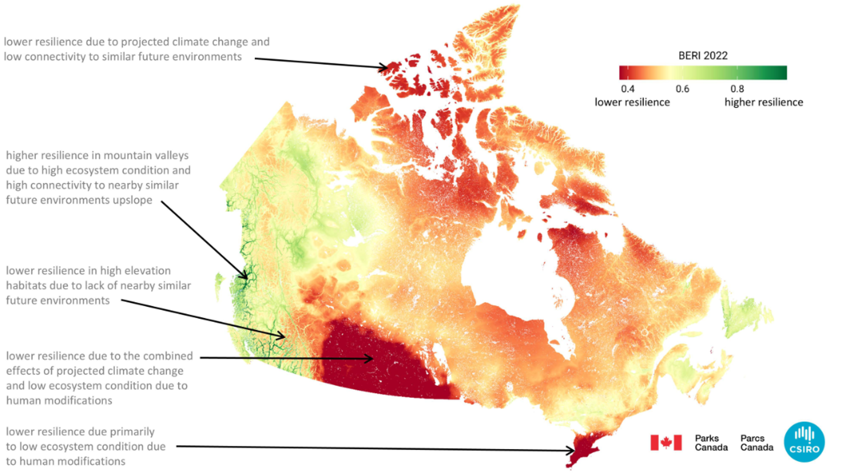


Bioclimatic Ecosystem Resilience Index (BERI)
BERI is an official “voluntary” component indicator of the GBF Monitoring Framework
(Component indicator 8.CT.2 for GBF Target 8 “minimize the impact of climate change on biodiversity and increase resilience”)
Supported by new ESA project:
“ EO For Essential Biodiversity Variables and GBF Indicators”:
Development of BERI end-to-end workflows on GEO BON BON-in-a-Box and ESA OpenEO/CDSE cloud platforms
CEOS ARD
Training data
Climate scenarios
End-user
Calibrated and Derived EO
Ecosystem condition change
BERI
DSS
Protection and Restoration
Source: CSIRO report to Parks Canada, Simon Ferrier
Species data
Environ. data
BERI measures the capacity of natural ecosystems to retain species diversity in the face of climate change, as a function of ecosystem area, connectivity and integrity.
Notes:
Already implemented globally at 1km resolution, with publicly-accessible results generated annually from 2000 onwards.
Also implemented using best-available national data, at finer spatial resolution, for Australia, Canada and South Korea.

Slide 8

Pre-event Training/Outreach opportunity
Topic: SAR for Biodiversity and applications overview
B-VC is proposing a webinar that will follow on from NASA’s in-depth NISAR training
at the AmeriGEO week, Nov. 30- Dec. 4, 2026
Goal: Showcase the broader potential of satellite SAR observations for biodiversity applications, while using the session as an outreach opportunity to identify institutions interested in applying SAR for biodiversity and better understand their needs and priorities.
We expect institutions leading biodiversity efforts to participate, particularly the UNCBD Technical Support Centres (TSCs) in the region.
Formal proposal currently under discussion.

Slide 9




Early discussion: Wetlands Mapping
Support the Ramsar Convention on Wetlands and GEO-Wetlands (led by Ramsar Scientific and Technical Review Panel - STRP) on:
Wetlands Inventories (wetland extent mapping and typology classification)
Essential Wetland Variables (EWVs)
Wetland Condition Indicators (for wetland conservation and restoration)
Contribution to the Ramsar STRP workplan 2025-2028
STRP Task 2.2: Advance the development and use of EO technology for dynamic wetland mapping and inventory, assessment and conservation
Possible B-VC activities:
Leverage ongoing/new ESA projects on wetland extent, EWVs and wetland condition indicators.
Leverage NASA’s emerging Biodiversity and Ecological Conservation (BDEC) “Wetlands Observatory”.
Strengthen connections with LSI-VC (AFOLU Road Map).
Support to GEO-Wetlands Capacity Building activities (further discussion with WGCapD).

Slide 10
CEOS Statement to CBD COP-17
CEOS Statement to the 17th Conference of the Parties of the Convention on Biological Diversity
(CBD COP-17) referred to as the 2026 UN Biodiversity Conference at Yerevan, Armenia on 19-30 October 2026
SIT-41-09 action: B-VC to work with the CEOS Chair Team to develop a CEOS statement for UN CBD COP-17
Purpose: to introduce CEOS to the Contracting Parties to the CBD and reaffirm CEOS commitment to work closely with the CBD to ensure that the collective capabilities of the world's civil space agencies contribute effectively to achieving the goals of the Global Biodiversity Framework (GBF) and support biodiversity conservation, restoration and nature-positive actions through the best available EO science and technology.
Delivery: written statement (2 pages) and oral statement (2-3 min) delivered by ESA (accredited as an intergovernmental observer organization to the Conferences of the Parties to the CBD).
COP17 Agenda Items: Item 9(b) “Monitoring framework for the Kunming-Montreal Global Biodiversity Framework” or Item 17 “Scientific and technical needs to support the implementation of the Kunming-Montreal Global Biodiversity Framework and matters related to the work programme of IPBES”
Status: Draft statements (written and oral) delivered to CEOS Chair and CEOS SIT Chair for review.

Slide 11
B-VC Team Building
NASA
(Yoseline Angel)
CSA
(Lucie Viciano)
ESA
(Marc Paganini)
Co-Leads
(Until Aug 2026: Gary Geller)
(2027: Federica Marando)
CSIRO
USGS
ISRO
CNES (INRAE)
SANSA
GISTDA

Slide 12
Next Steps
Build out B-VC membership and establish ways of working, including the creation of B-VC sub-groups.
Strengthen coordination with relevant CEOS entities and key external biodiversity partners, identifying activity leads and contributors.
Complete the B-VC Work Plan and roadmap.
Prioritise and launch the first activities and collaborations.

Slide 13
Concluding remarks
We welcome opportunities to engage with CEOS agencies and groups as we move forward with these activities.
Looking forward to supporting NOSA’s 2027
CEOS Chair priorities, True Green and True Blue.

