Slide 1
Land Surface Imaging Virtual Constellation
State of the Earth Observation System
Ake Rosenqvist, JAXA
Agenda Item 1.2.4
SIT TW 2026
Washington DC, USA
8-10 September, 2026

Slide 2
LSI-VC highlights
CEOS-ARD strategy (covered during yesterday’s TW workshop)
USGS continues to advance Collection 3 development, targeting a public release in late 2029; Landsat 10 will hold its Mission Definition/Requirements Review in late Sept, with a 2031 launch targeted.
Ongoing self-assessments for CEOS-ARD compliance:
  Harmonized LS-S2 (NASA), ResourceSat-2/2A LISS (ISRO), THEOS (GISTDA)
  NISAR (NASA JPL), JERS-1 & ALOS-1 heritage mosaic data (JAXA)
New CEOS-ARD compliances since SIT-41:
  RADARSAT-1 (CSA), SkyBee (Constellr), StriX (Synspective)
Update of CEOS-ARD PFSs to enable high res (VHR) to facilitate commercial sector participation (solution expected at LSI-VC-20)

Slide 3
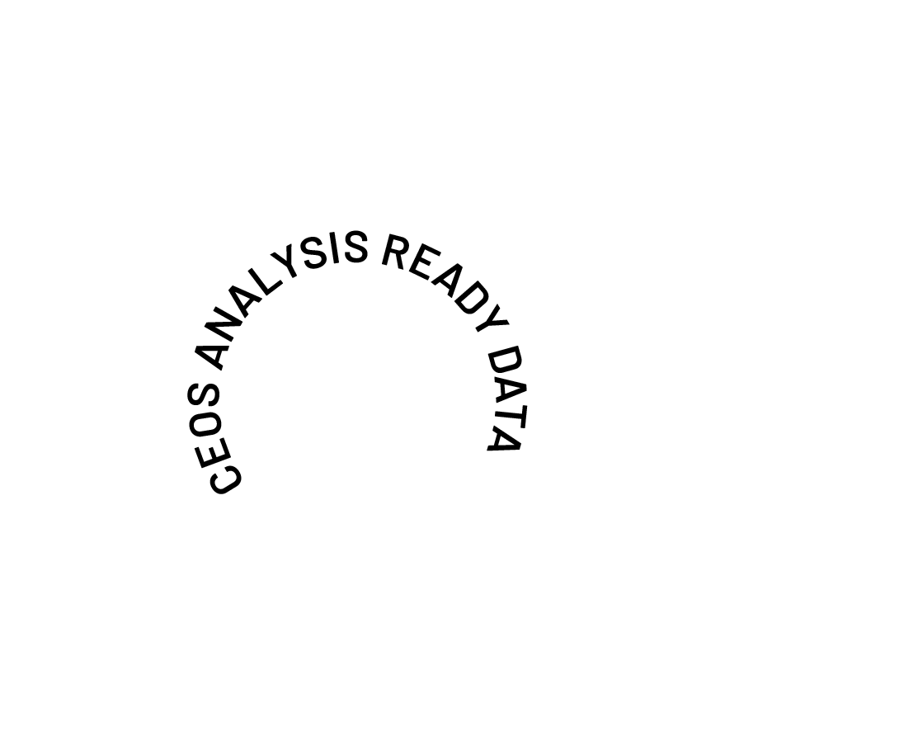
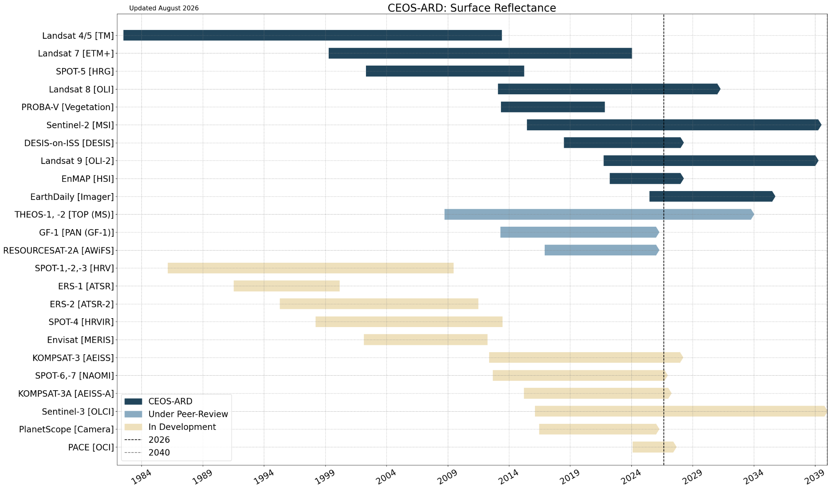
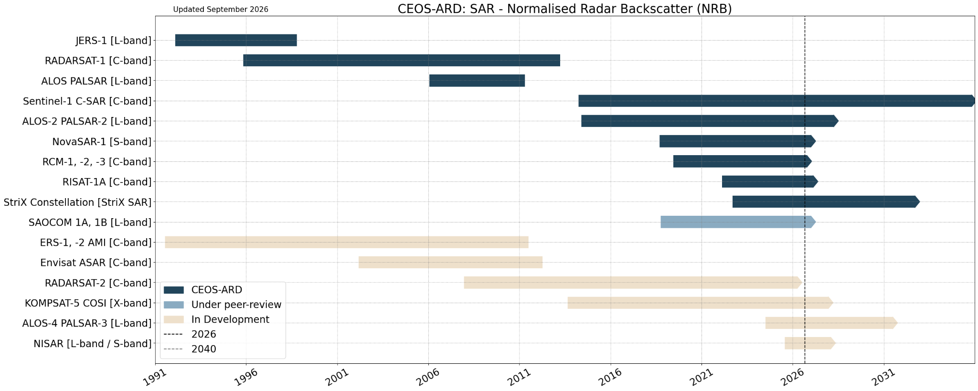
Missions supporting CEOS-ARD Products:
Surface Reflectance and Synthetic Aperture Radar
See datasets table at ceos.org/ard

Slide 4
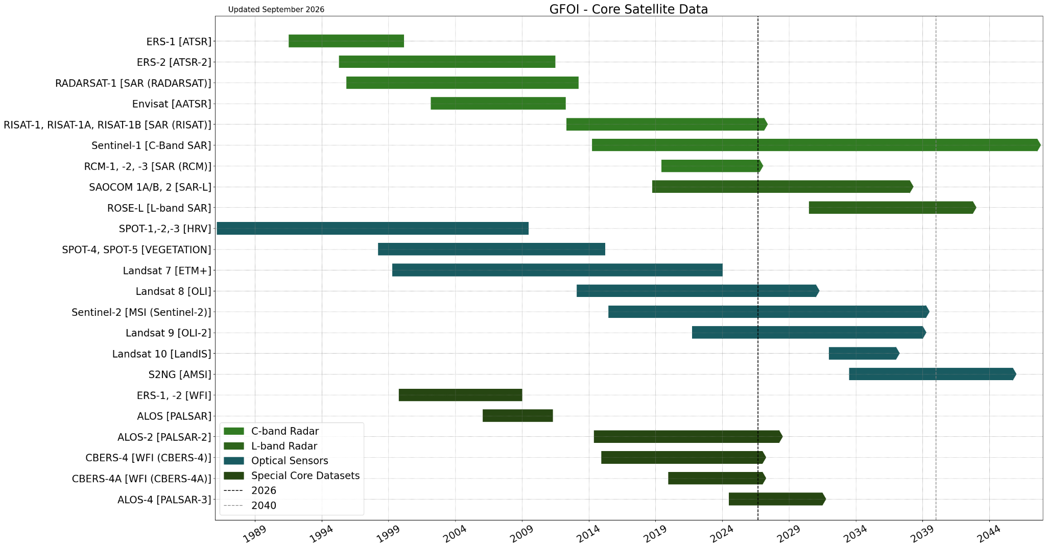

Global Forest Observations Initiative (GFOI) Core Satellite Data
Add: Lidar missions

Slide 5
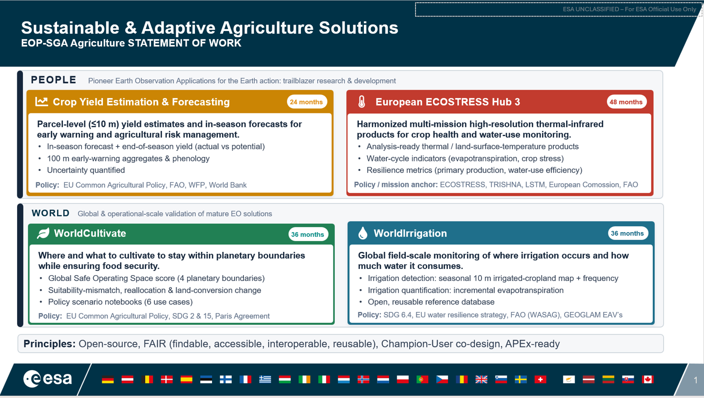
GEOGLAM Essential Ag Variables
Adopted a new framework for documenting EAVs, incl:
  Definition + Descriptions
  EAV Product Requirements
  “Stocktake” of current and past products and related satellites
  Assessment of gaps and prioritisation
EC-JRC contract
  Consolidation of EAV table
    Add required metadata
    Assess user needs -> measurable? ->
-> if not input to Space Agencies
  Prep of phase 2
    Next EAV’s
    Refinement of approach
ESA Invitation To Tender in support of EAV’s

Slide 6
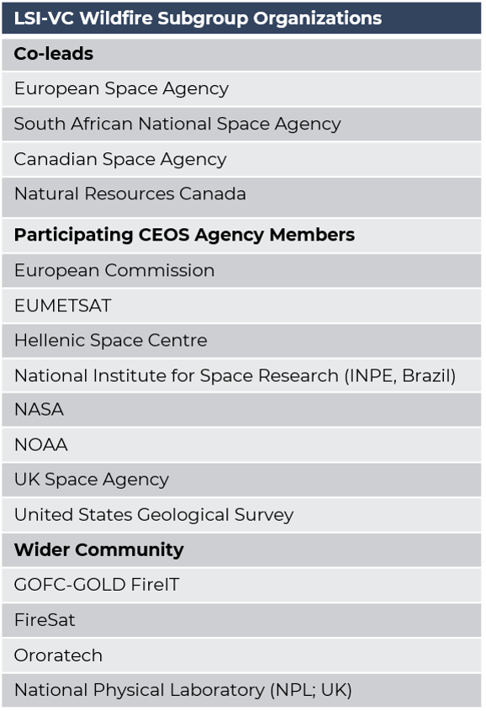
Wildfire Subgroup Updates
Wildfire subgroup Terms of Reference finalised
16 organisations engaged with the subgroup
  12 CEOS members
  2 commercial / non-profit
Initial focus activities:
Work towards best practice guidelines for fire monitoring products
Support validation of fire products through coordination & facilitation of collaborative validation activities
Support development of CEOS-ARD PFS for fire products

Slide 7
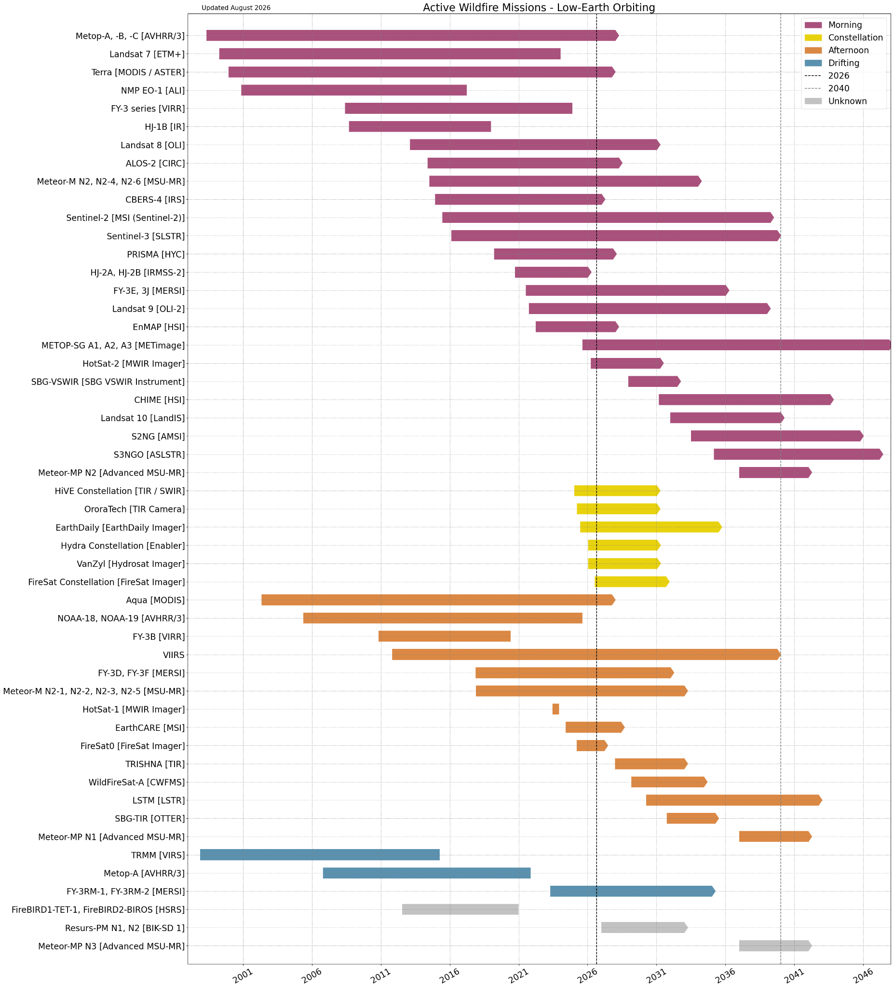
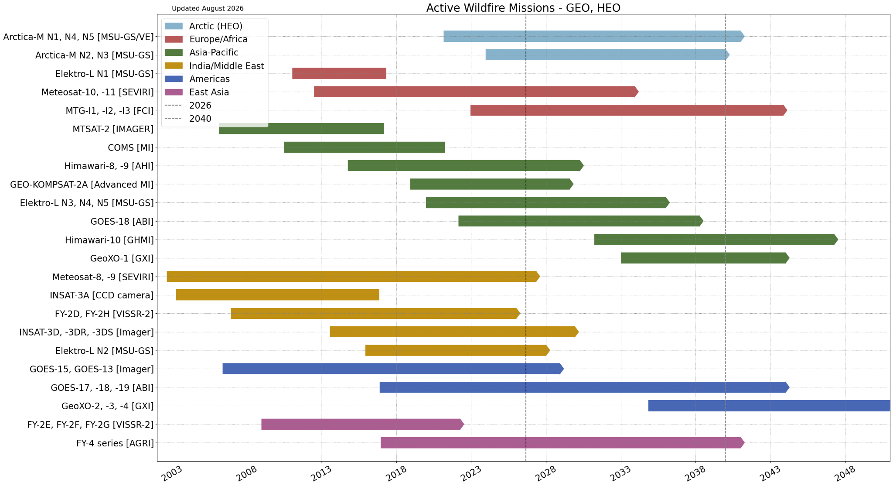
Wildfire Missions
Missions potentially capable of active fire observations; support to develop active fire products unconfirmed
Widely used space agency supported operational active fire products
  LEO: VIIRS, MODIS, Landsat, S3-SLSTR
  GEO: GOES, MSG/MTG, Himawari
See https://database.eohandbook.com/wildfire/

