Slide 1
Ocean Colour Radiometry (OCR)
State of the Earth Observation System with Ewa Kwiatkowska (EUMETSAT) and Marie-Helene Rio (ESA)
Jeremy Werdell
NASA GSFC
Agenda Item 1.2.6
SIT TW 2026
Washington DC, USA
8-10 September, 2026

Slide 2
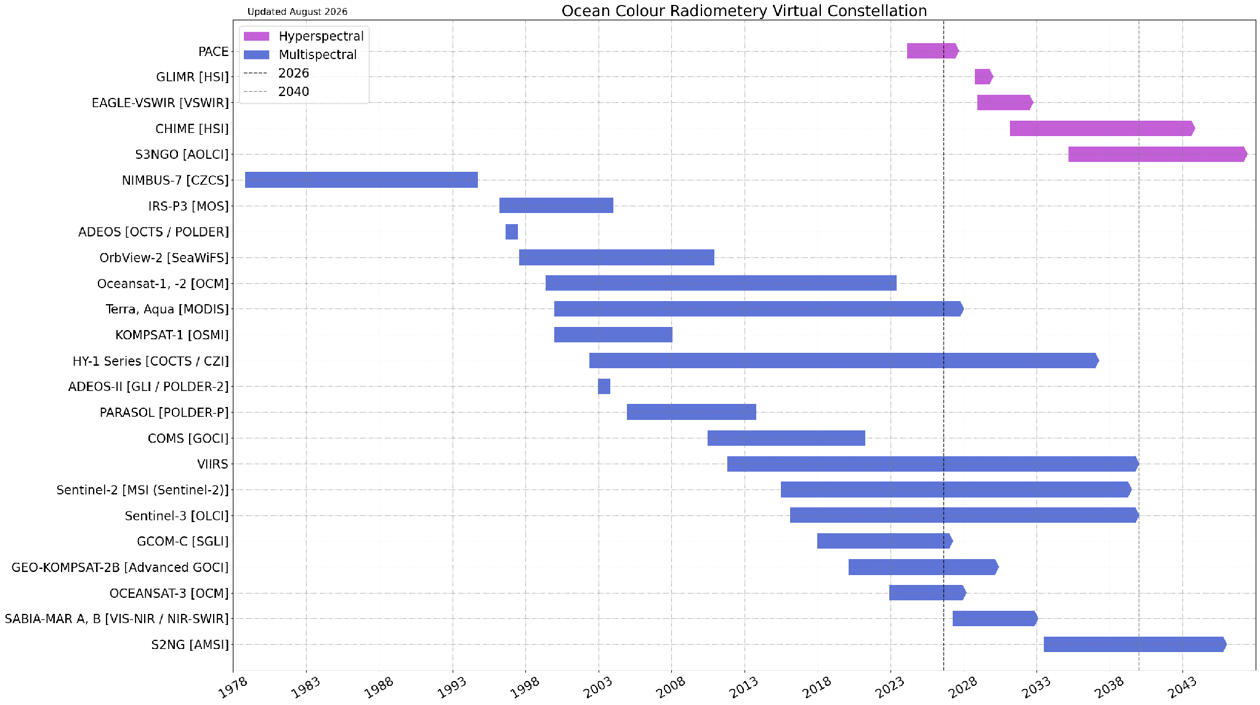
Summary of Current & Planned Missions
global (1-2 day coverage)

Slide 3
Planning highlights
Highlight any issues e.g.
  New products
    Complete: Aquatic Carbon Roadmap; to be presented today @ 14:00
    Published: “A scientific roadmap of aquatic hyperspectral remote sensing: Overview of status, challenges, and future perspectives”, IOCCG Report 22; https://doi.org/10.25607/OBP-2066; update due in late 2027
  CEOS-ARD PFS development
    PACE ARD self-assessment complete (update provided on Wed, Sep 9)
    Review of Water Annex in progress (discussed yesterday)

Slide 4
Planning highlights
Any potential gaps in product availability
  How does data supply look in 2030?
    PACE OCI will be 6 (3 year design life).
    No other global (1-2 day) hyperspectral missions planned.
    Few regional (7+ day coverage) missions available (e.g., ESA CHIME, NASA Eagle)
  How does data supply look in 2035?
    PACE OCI will be 11 (3 year design life).
    A-OLCI possibly on orbit, possibly hyperspectral.
    No other global (1-2 day) hyperspectral mission planned.
The threat of this gap is real. What can be done?
  Met with CEOS SIT Chair leadership on Sep 3

Slide 5
Issues for attention of SIT
Any gaps, challenges, risks
  Gap likely in global (1-2 day) hyperspectral between PACE OCI and A-OLCI
  No emergent network of / collaboration on geostationary ocean colour
Other items which would benefit from Principal attention
  Biweekly contact with lead of SIT Priority #1 Water Planet I Seeing Earth’s water from space
  Considering more direct engagement with the WGCV (AERONET-OC, SVC sites, others)
Engagement of the commercial sector in the VC
  Ongoing at agency levels
  Per recommendation of CEOS SIT Chairs, will likely add generation of an (open-ocean) applications traceability matrix (ATM) to the VC work plan to document the gap identified

Slide 6
Backup

Slide 7
Definitions
global, hyperspectral ocean colo(u)r radiometry
  1-2 day global coverage (via orbit, swath width; ignoring cloud cover)
  UV (~350 nm) continuous to NIR (~900 nm) at a minimum
  spectral steps of ~5 nm or less

Slide 8
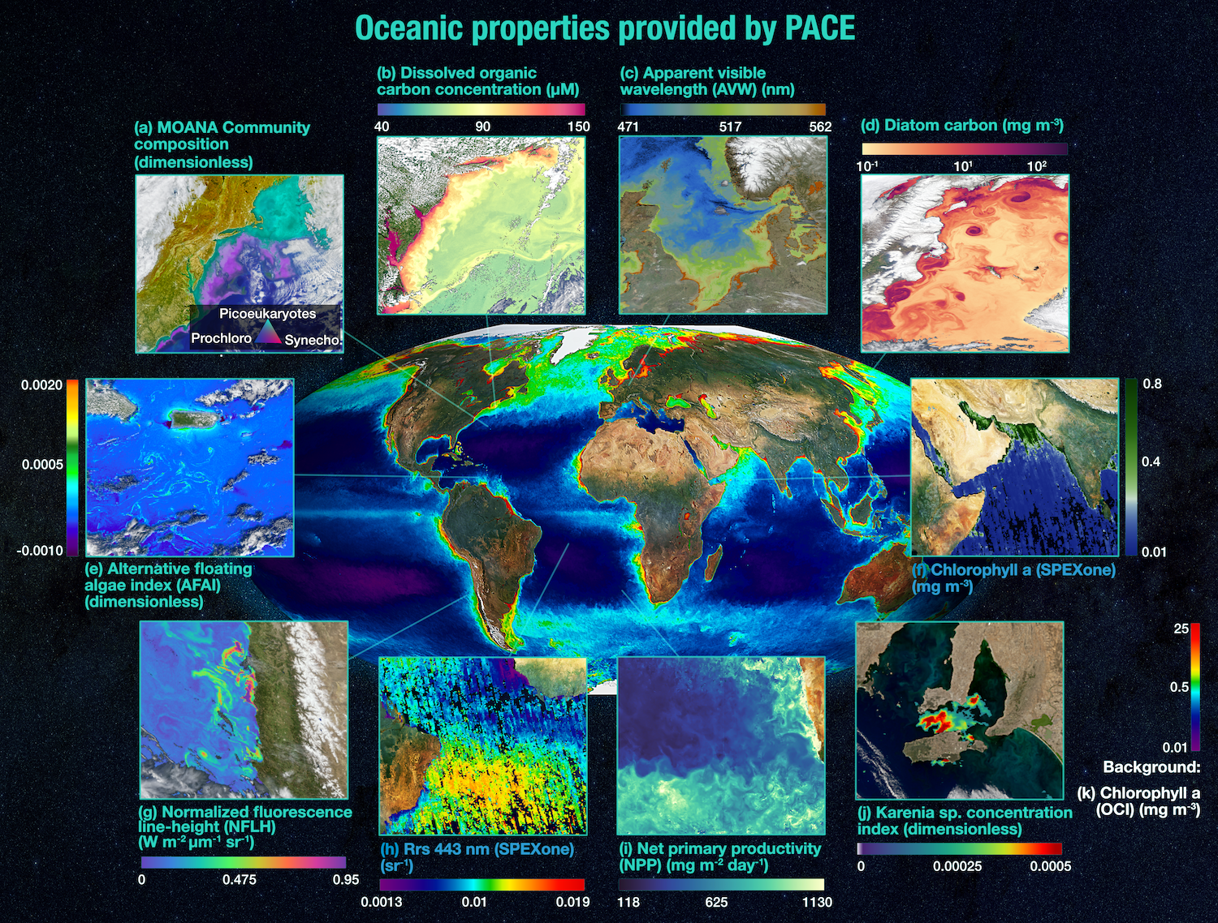
Why hyperspectral?
example parters (non-academics)
  federal fishery line offices
  state, regional, private (shell)fisheries managers
  water quality managers
  military
returning to multi-spectral observations only will undo years of investment

Slide 9
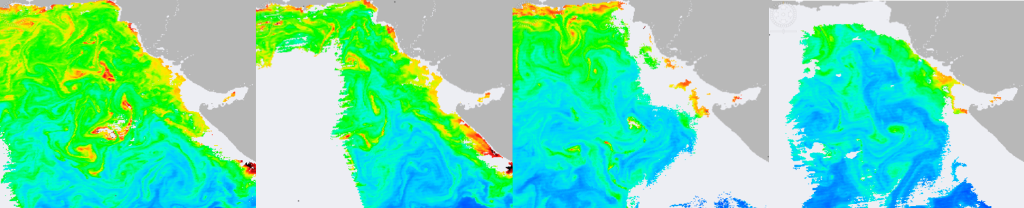
Why 1-2 day global coverage?
global oceanic phytoplankton biomass turns over (renews or replace itself) between 60-150 times per year
  in sunlit, nutrient rich water, doubling rates vary from 0.5 to 2 doublings/day
  phytos live in a dynamic 3-D fluid on a rotating ellipsoid
  “Life moves pretty fast. If you don’t stop and look around once in a while, you could miss it” (F. Bueller)

