Slide 1
Ocean Surface Topography (OST-VC)
State of the Earth Observation System
E. Obligis, EUMETSAT
Y. Faugere, CNES
Agenda Item 1.2.6
SIT TW 2026
Washington DC, USA
8-10 September, 2026

Slide 2
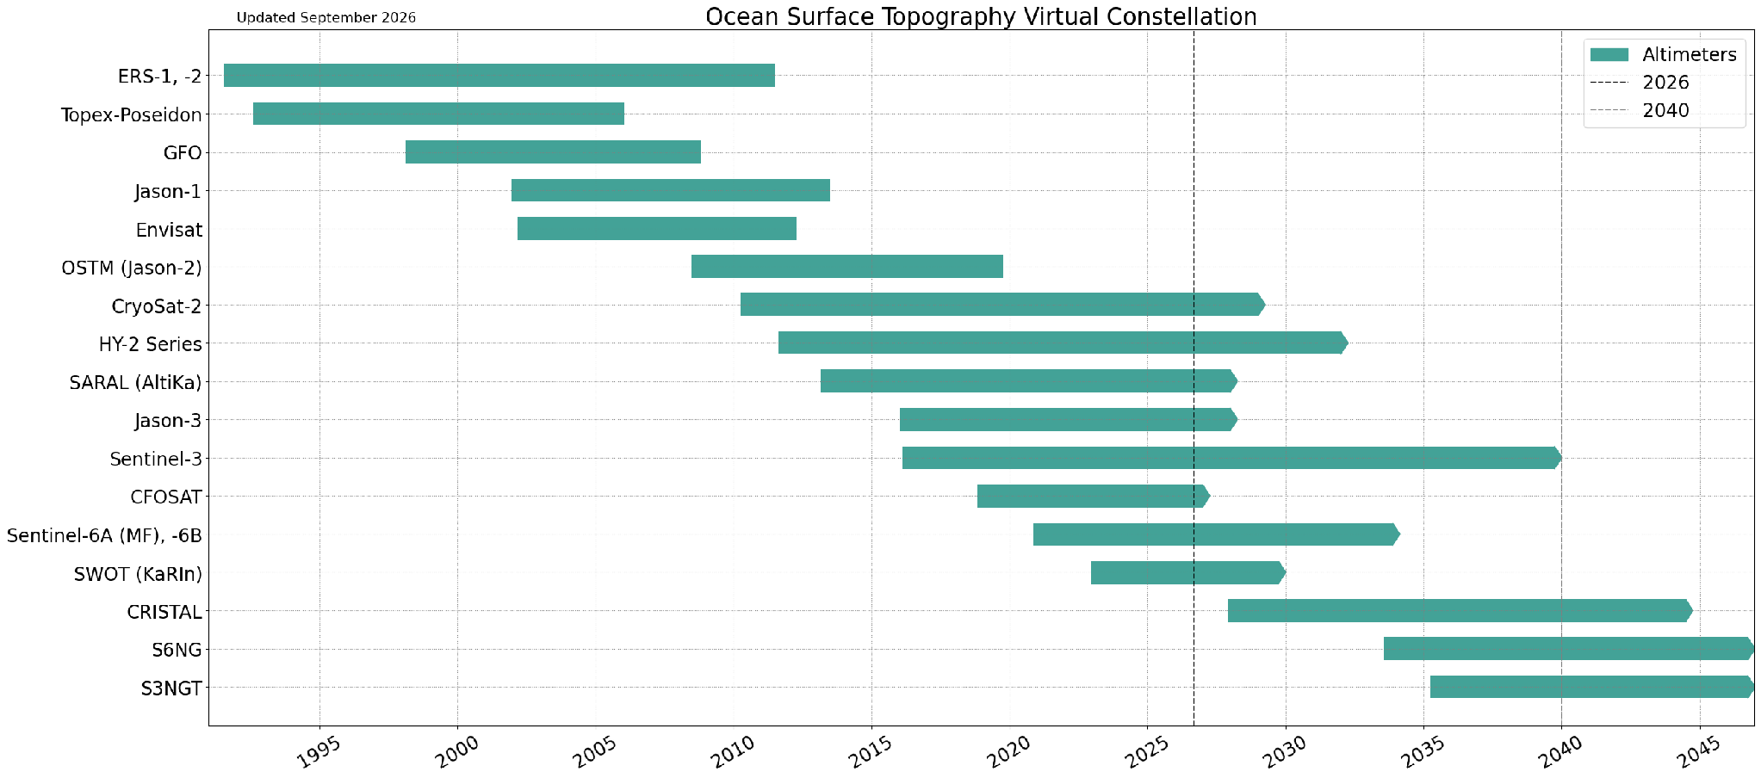
Summary of Current & Planned Missions
MIM Database

Slide 3
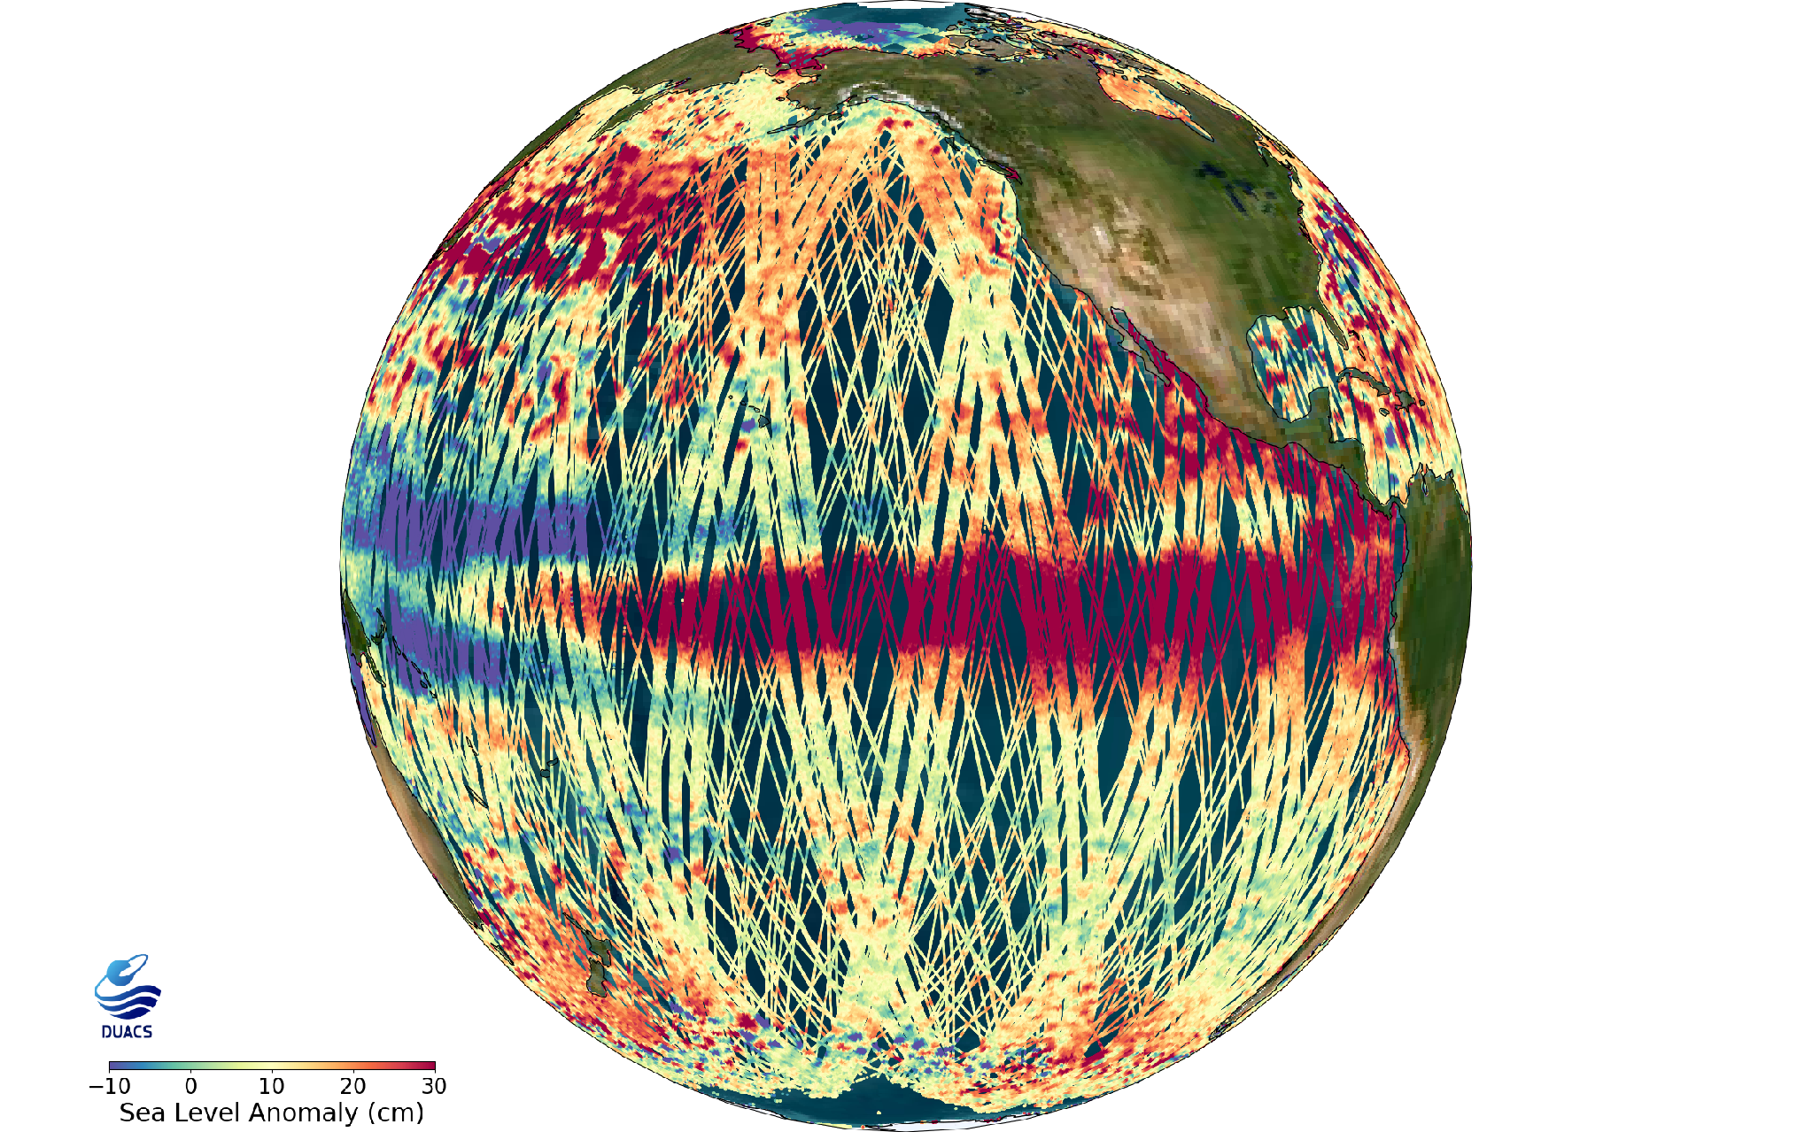
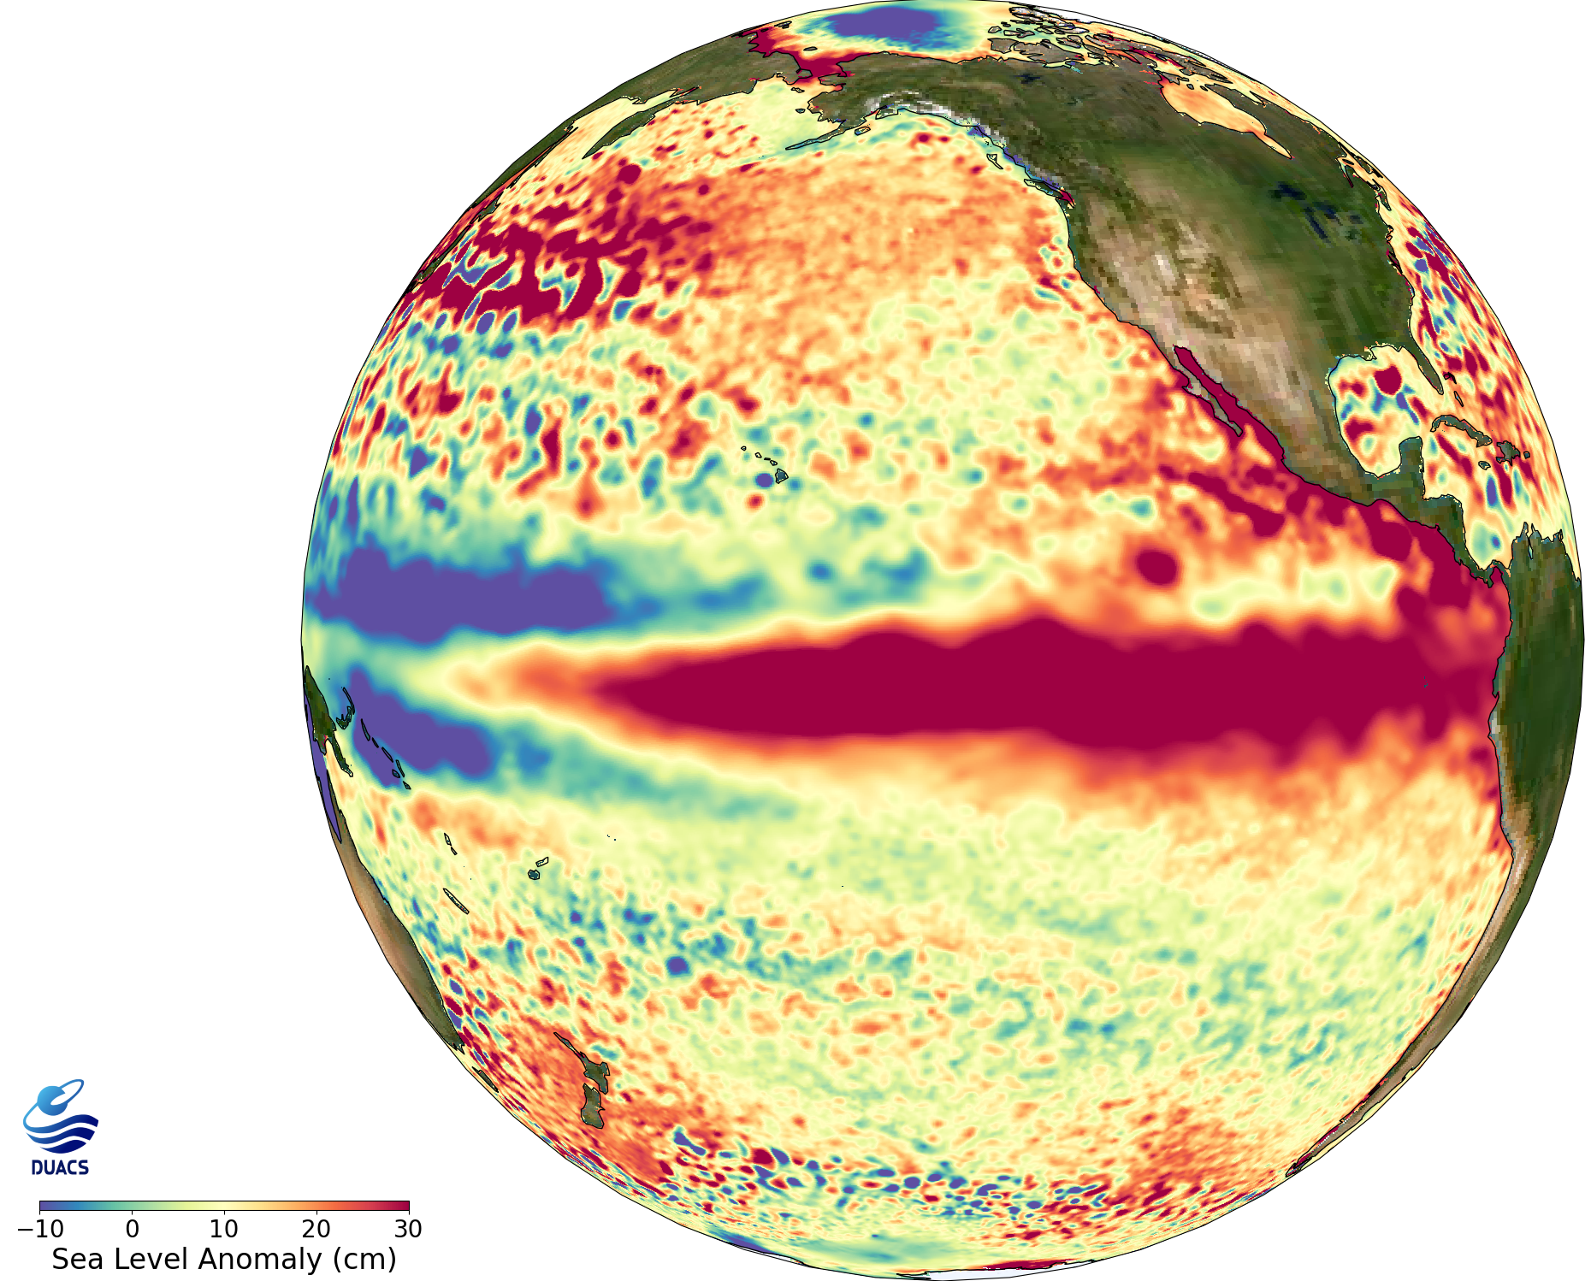
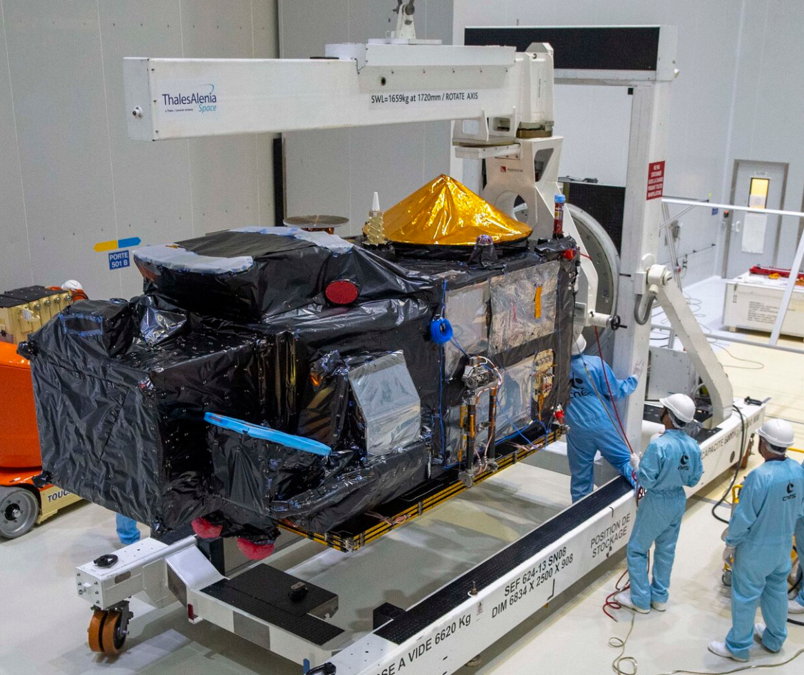
MISSION STATUS (1/4)
Sentinel-6B commissioning in nominal progress => IOCR end of October => expected to become the new reference mission by end of 2026
Sentinel-3C launch planned next week, on September 14th 2026 => commissioning with tandem phases with S3B then S3A => expected to be operational in June 2027
EL NINO MONITORED BY THE ALTIMETRY CONSTELLATION - AUGUST 2026 (SOURCE AVISO)
Sentinel-3C unpacked from its container at Europe’s Spaceport in French Guiana

Slide 4
MISSION STATUS (2/4)
CRYOSAT (ESA): Still operational, extended until 2028
Jason-3 (CNES/NASA/EUMETSAT/NOAA/EU): now in interleaved Long Repeat Orbit from 2026/06/26 to address geodesy applications additionally to operational oceanography
SWOT (NASA/CNES/CSA/UKSA): fully operational, extension process still in progress (CNES/NASA/CSA)
Sentinel-3 (ESA/EUMETSAT/EU):
  A and B : fully operational
  C launch expected September 14th , will replace Sentinel-3 A which will stay on the same ground track with a delay of 7 days (TOPO+ scenario)
Sentinel-6 (EUMETSAT/ESA/NOAA/NASA/EU/CNES):
  MF (S6-A): launched in Nov 2020, currently the reference for all other altimeter missions
  S6-B: launched in Nov 2025, currently being commissioned, expecting to take over the role of reference altimeter satellite by the end of 2026;
  S6-C: originally planned to continue the series but procurement not approved by the EC

Slide 5
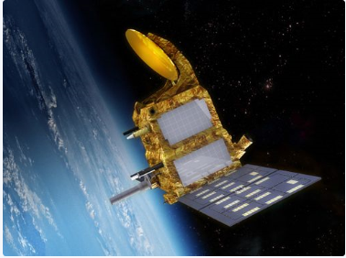
MISSION STATUS (3/4)
SARAL/AltiKa (CNES/ISRO): Still operational, discussion in progress on a potential orbit change
AltiKa : first altimeter in Ka band provides from 2013 unprecedented measurement of topography over the ocean (as well as wind and waves), inland water, sea and land ice
SARAL in OST-VC
    Key contribution to altimetry-topo
    High latitude coverage
    Filling the critical Gap between ENVISAT and Sentinel-3
    New capacities of the Ka Band: coastal, inland, ice
    Asset for future missions : SWOT, CRISTAL, S3NG, SKIM/STREAM/ current mission, SMASH …
Extension in 2027 today under discussion between CNES and ISRO -> decision expected by the end of the year
Importance of SARAL/Altika measurements, notably to monitor high latitudes and huge interest to have AltiKa flying with CRISTAL (launch window starts 1st Oct 2027) for its Cal/Val Phase
Final decision depending also on satellite's conditions. Need to minimize the risk of loosing the platform and making SARAL/AltiKa a space debris

Slide 6
MISSION STATUS (4/4)
CRISTAL (ESA/EUMETSAT/NASA/EU): currently in phase C, launch expected between Q4 2027 and Q4 2028
Sentinel-6 Next Generation: accelerated scenario to launch S6NG-A asap (2033), but risk of disruption in the climate times series because of inconsistency between the end of S6B nominal life time and S6NG-A launch.
Sentinel-3 Next Generation Topography: under development, implementation of two dedicated large-satellites carrying Wide-Swath and Nadir altimeters, together with radiometer and POD instruments.

Slide 7
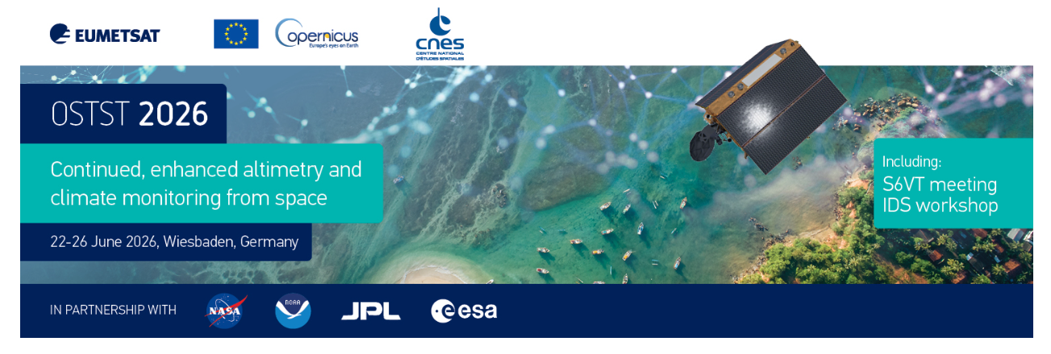
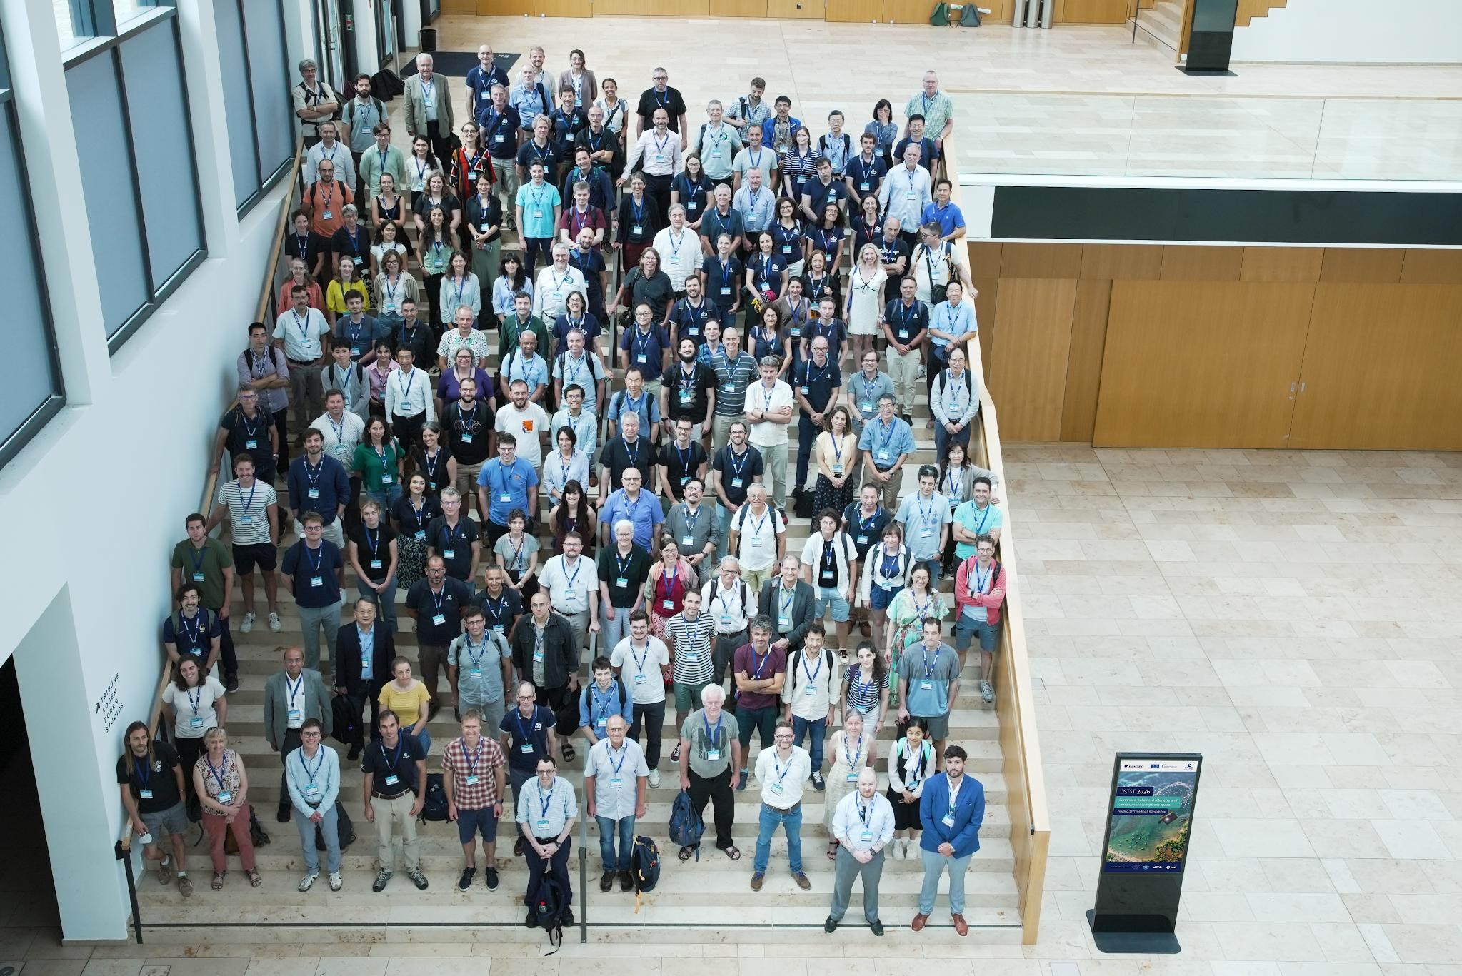
OSTST 2026
Co-organized by EUMETSAT and CNES

Slide 8
THANK YOU

