Slide 1
OSVW-VC
State of the Earth Observation System
Dr Stefanie Linow, EUMETSAT
Agenda Item 1.2.7
SIT TW 2026
Washington DC, USA
8-10 September, 2026

Slide 2
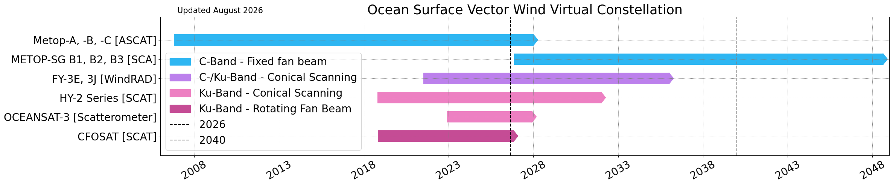
Summary of Current & Planned Missions

Slide 3
Planning highlights
  Contributions to the OSVW-VC from NSOAS, EUMETSAT, ISRO and CMA
High-quality wind vector field observations are provided several times a day
Global constellation allows intercalibration, optimization and standardisation of wind and ocean stress products
Coordination of the development of a coordinated multi-mission global wind product to improve temporal resolution, particularly for capturing high-frequency extreme weather events
Global timeliness requirements currently the most difficult to meet for forecasting applications
Mission highlights
  New winds products from ISRO: scatterometer, SAR and GNSS-R
  EUMETSAT: upcoming launch of EPS-SG scatterometer (SCA): improved high-winds capabilities
  NSOAS: launch of HY-2E in July 2026, plans for HY-2F in 2027, with improved payloads such as upgraded altimeters and dual-frequency scatterometers

Slide 4
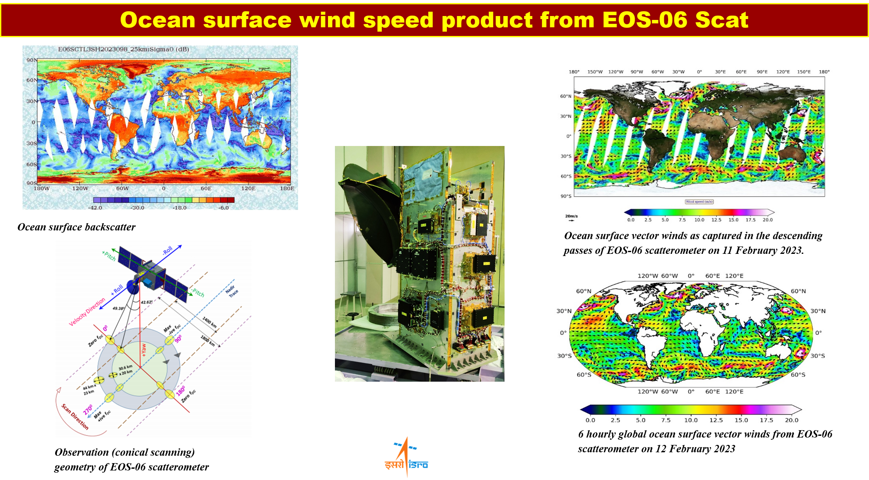
Planning highlights

Slide 5
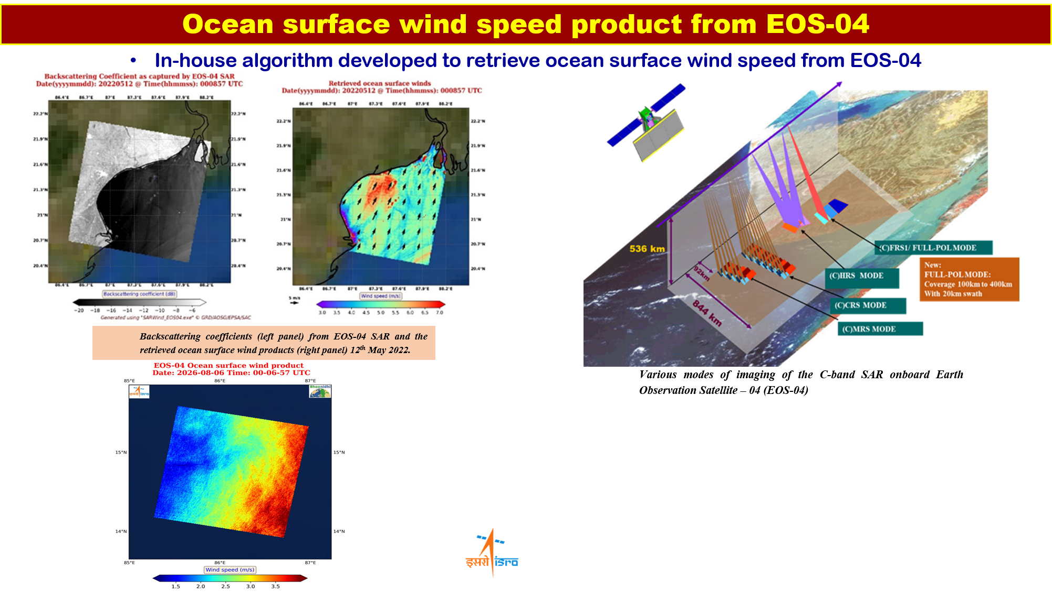
Planning highlights

Slide 6
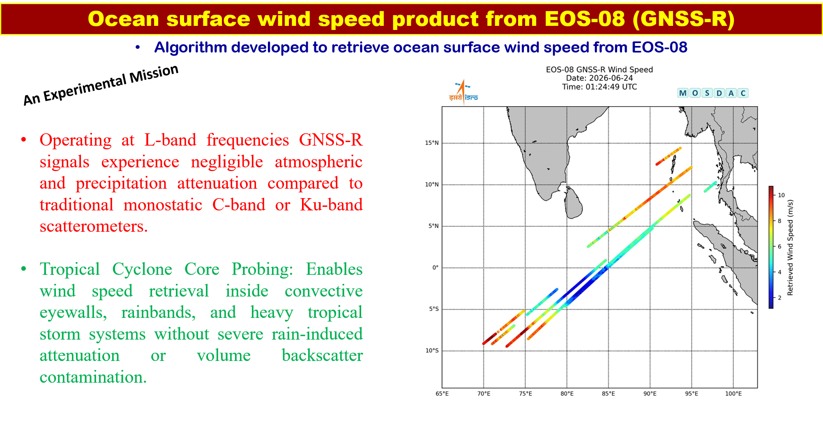
Planning highlights

Slide 7
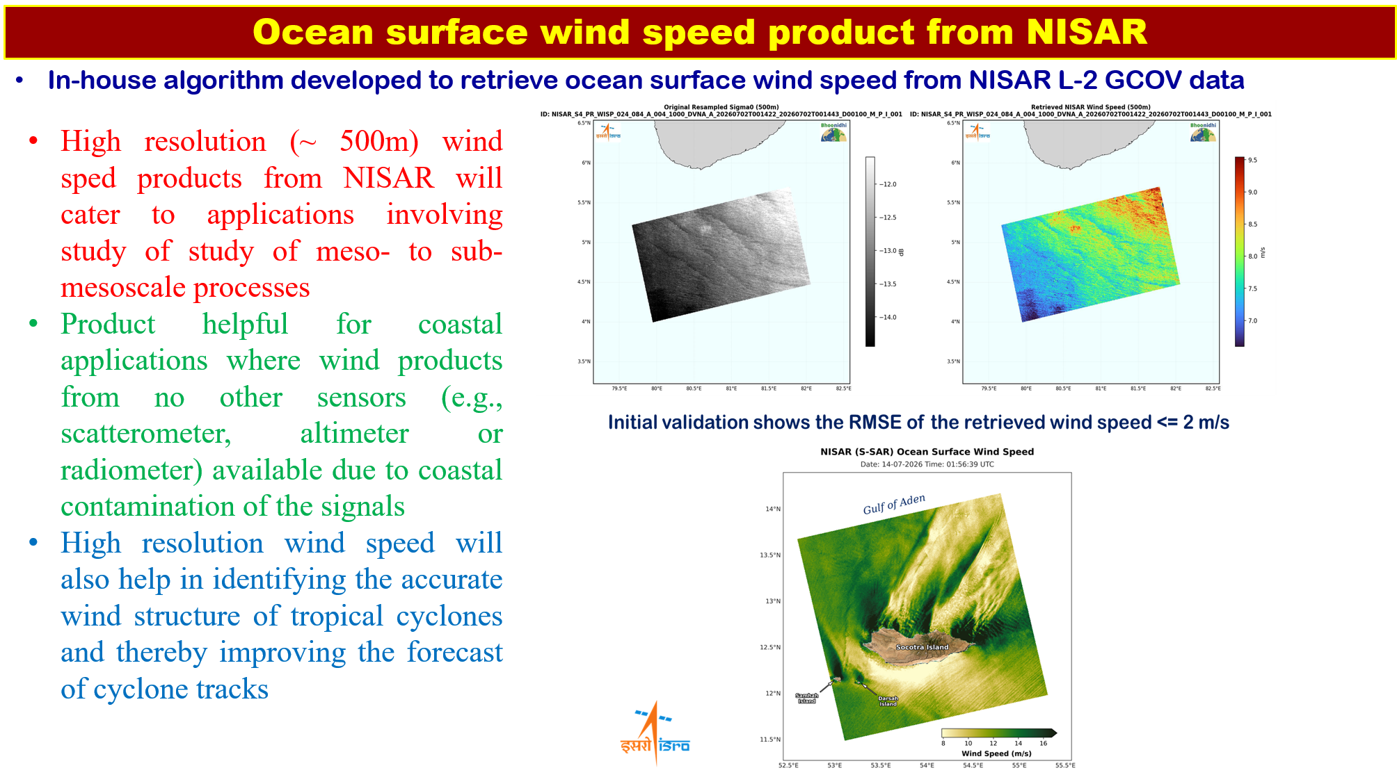
Planning highlights

Slide 8
Issues for attention of SIT
Free and open exchange of data on a global scale
Continuity of wind vector measurements, and the evolution of the next generation of instruments beyond 2035

