Slide 1
Precipitation Virtual Constellation
(P-VC)
Will McCarty (NASA),
Agenda Item 1.2
SIT TW 2026
Washington DC, USA
8-10 September, 2026

Slide 2
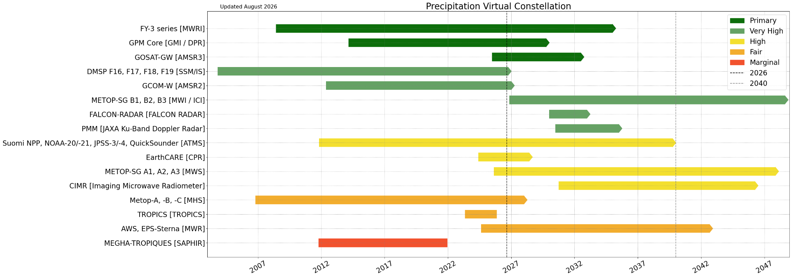
Summary of Current & Planned Missions

Slide 3
P-VC Updates
First kick-off meeting for new co-lead on 21 July 2026 (Will McCarty of NASA, succeeding Chris Kidd)
Precipitation observing system is expanding, with increasing Doppler, microwave, and commercial capabilities.
GPM DPR/GMI: Version 8 products released in March 2026.
AMSR3: Data publicly available since June 2026.
EarthCARE: Now being operationally integrated into ECMWF NWP systems, demonstrating the direct contribution of science missions to operational forecasting.
GSMaP: Version 9 planned for October 2026, incorporating additional NWP information and AI/ML techniques to improve passive microwave precipitation retrievals.
FALCON: Planned atmospheric constellation consisting of radars, lidar, and radiometers targeting global, continuously updated observations and multi-mission algorithms and AI applications.

Slide 4
Key Gaps & Challenges
Various types of gaps – coverage and continuity of existing measurements; surface reference observations; and gaps created by challenging precipitation regimes.
  Spaceborne precipitation radar observations: Need to assess future continuity and coverage of spaceborne precipitation radar measurements.
  Surface/reference data: Sparse ground observations in the Himalayan and northeastern regions of India, limited reference observations for precipitation retrieval and validation.
  Snowfall: Need for improved, validated surface snowfall/precipitation products.
  Complex terrain: Retrieval challenges in accurately retrieving precipitation over mountainous regions; need further algorithm development and validation using high-quality surface observations.
  Latency: : Lower-latency observations are needed for rapid applications. Direct Broadcast and DBNet could improve timeliness, although coverage remains limited.

Slide 5
Emerging & Commercial Data Sources
New data sources
  NASA: Purchase of Tomorrow.io precipitation radar data.
  NOAA: Tomorrow.io + WeatherStream microwave sounder data.
  Role of Commercial Data: Provide additional and complementary observations to existing satellite capabilities.
Key gap & considerations
  Data quality are currently below core satellite sensors
  Need methodology for consistent assessment of quality, calibration, coverage and interoperability
  Increasingly heterogeneous observations require consistent quality metrics
  Commercial data can fill sampling gaps, but their value needs to be demonstrated against established reference observations

