Slide 1
COAST-VC
State of the Earth Observation System
Neeraj Agarwal (ISRO)
Aurelien Carbonniere (CNES)
Nima Pahlevan (NASA)
Supported by Alex Christensen
Agenda Item 1.2.9
SIT TW 2026
Washington DC, USA
8-10 September, 2026

Slide 2
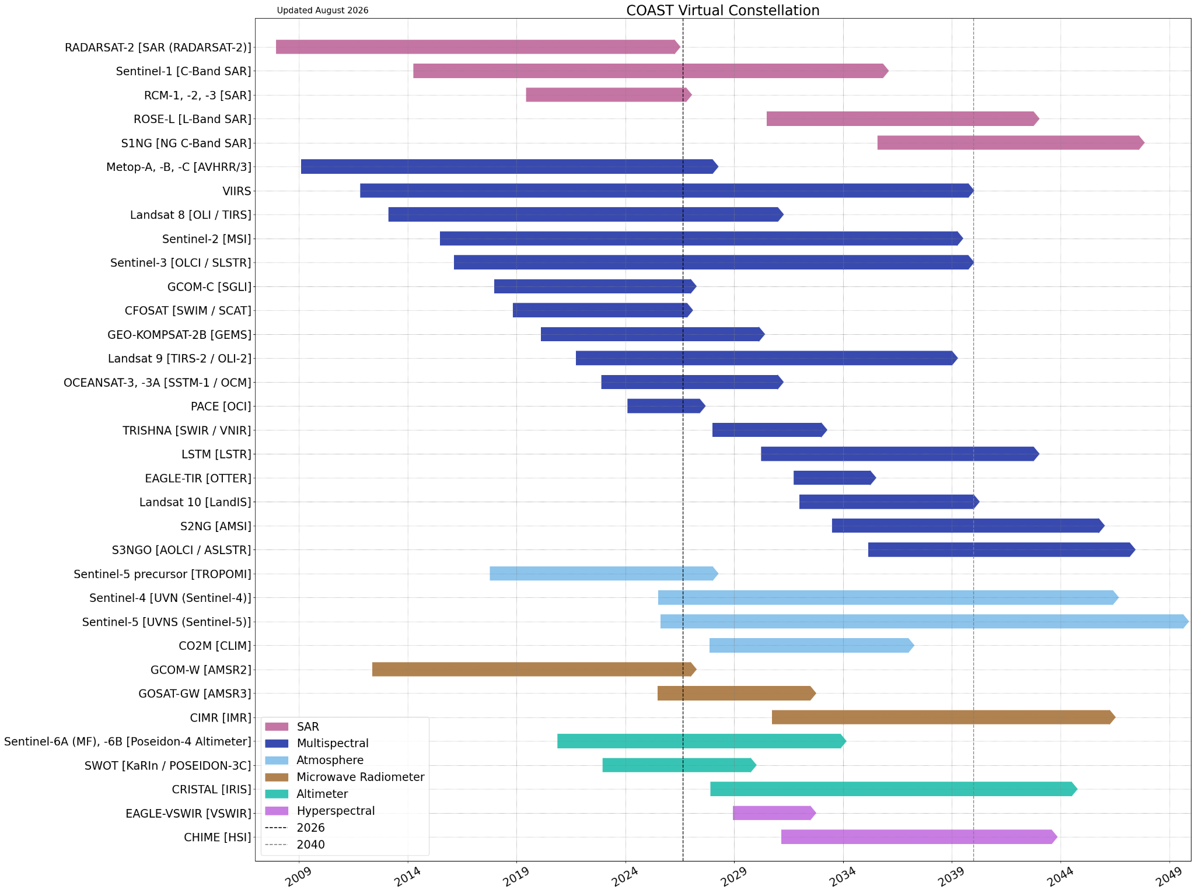
Summary of Current & Planned Missions

Slide 3
Planning highlights
Recent presentations on COAST-VC
  COSPAR 1-9 August | Florence, IT (Jerome Benveniste)
  CoastPredict General Assembly and GlobalCoast Network Assembly. 21-24 April | Mérida, Mexico (Aurelien)
  Introduction to CEOS COAST – meeting with the Philippines Space Agency in 26 January (Aurelien)
  GHRSST meeting (Neeraj)
  Gap Analysis Strategy was presented in CEOS Water Quality Side Event on April 13th, 2026.
Gap Analysis
  COAST-VC (in conjunction with other CEOS entities) leads SMEs in a gaps and limitations analysis across coastal regions. This is a CEOS contribution to other international initiatives such as the Space4Ocean Alliance.
  80+ SMEs are participating in four sub-groups: In Situ Validation, Products and Algorithms, High Latitudes, Tools
  Report due to SIT Chair Q2 2027

Slide 4
Gap Analysis: In Situ Validation
Goals and Objectives:
  Quantify the in-situ reference and validation gap that limits confidence in coastal products.
  Treat data access and processing latency as first-class operational concerns.
Approach:
  Assess 25 coastal biophysical and biogeochemical variables against their principal observing technique.
  Classify each variable as operational, semi-operational, research, or not achievable inside the 100 km band.
  Assess every sensing family (optical, thermal, radar altimetry, SAR, scatterometry, GNSS-R, L-band, lidar), not colour and SST alone.
  Test coastal validation quantitatively from satellite-in situ match-ups, using an uncertainty-aware fidelity assessment.
Leads:
  Suhyb Salama (University of Twente, ITC), Chandanlal Parida (IOW), Arjun Adhikari (Goa University)

Slide 5
Gap Analysis: Products and Algorithms
Goals and Objectives:
  Define gaps and limitations on coastal products
  Separate evaluation of near-shore vs coastal (shelf) areas
  Include recommendations
Approach:
  Finding consensus among the group in terms of definitions/concepts
  Construction of a Table with main applications (i.e. climate, pollution, biodiversity, and water quality) to link products and algorithms to gaps and limitations
  Literature review and expert knowledge
Leads:
  Victor Martinez-Vicente, Michelle Gierach, Punya Ravichandran, Erich Hochberg

Slide 6
Gap Analysis: High Latitudes
Goals and Objectives:
  Summarise the observation challenges at high latitudes.
  Review novel and emerging observational capabilities.
  Identify critical observational gaps and data user needs.
  Evaluate the availability and readiness of existing satellite derived products.
  Establish a strategic framework for complementary advanced in-situ observations.
Approach:
  Initially met as a sub-group of the chairs to gather ideas/content.
  Now organising telecons with the larger group to gather feedback.
  Bringing the gathered content together as the draft.
Leads:
  Samantha Lavender, Daniel Carlson, Lian Feng, Sushil Kumar Singh, and Maria Tzortziou.

Slide 7
Gap Analysis: Tools
Goals and Objectives:
  Consolidate inventory of coastal data portals and tools
  Identify geographies with utmost need for satellite-based capabilities
  Document adoption challenges and barriers to entry
  Strategize approaches for EO integration into coastal economies
Approach:
  Engaged via virtual meetings
  Literature review based on existing inventories, adoption barriers, and underserved regions
Leads:
  Violeta Sanjuan Calzado, Dani Varghese, Nima Pahlevan, Salamimoses Adelakun

Slide 8
Issues for attention of SIT
Any gaps, challenges, risks
  Community participation
Other items that would benefit from Principal attention
  High-Latitude —> Arctic Focus group in close collaboration with NOSA
  Tools —> challenges identified in commercial use and adoption of EO
Engagement of the commercial sector in the VC
  Optical: Bathymetry products appear mature
  SAR: Flood mapping method assessment through NASA CSDA

