Slide 1
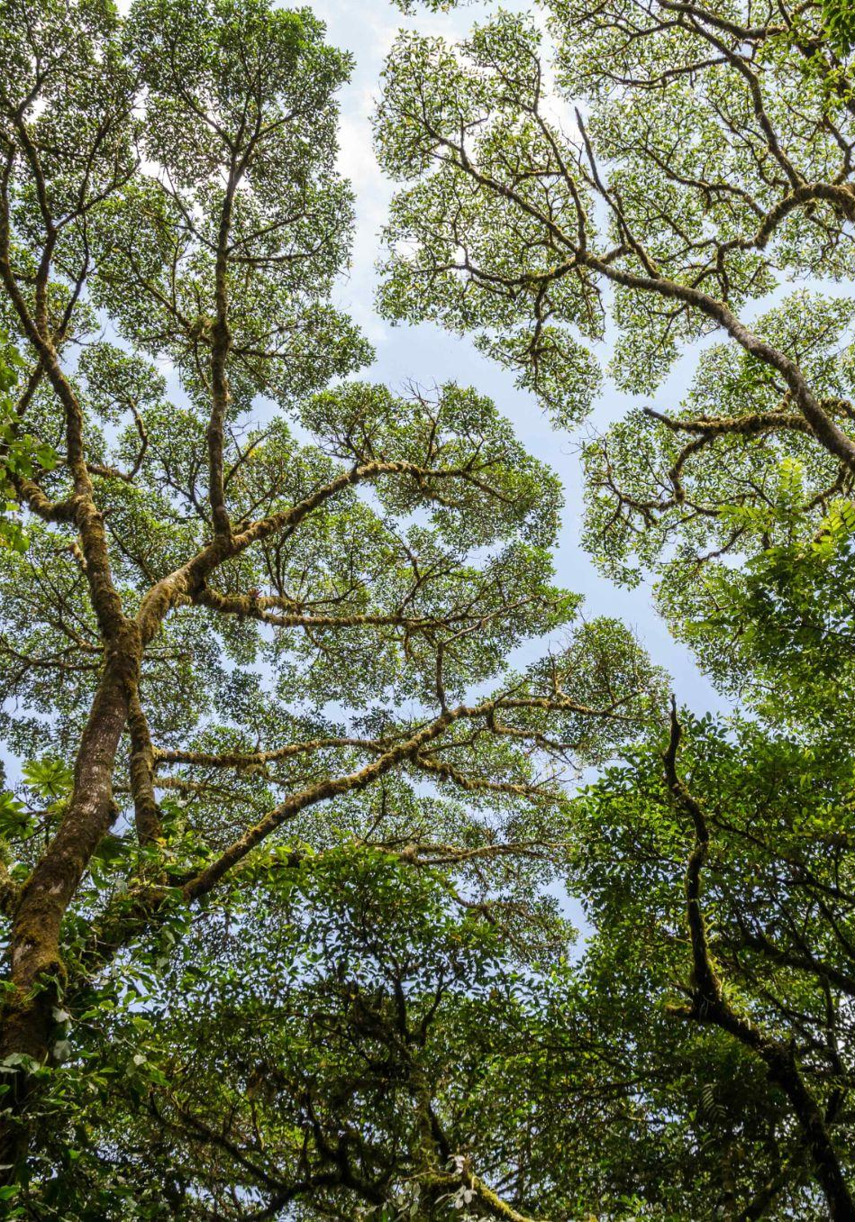
AFOLU Roadmap
Update
LSI-VC Forests and Biomass Subgroup
Clement Albergel, ESA
Matt Steventon, JAXA
Agenda Item #1.3
CEOS SIT TW 2026
Washington D.C., USA
10 September 2026

Slide 2
LSI-VC Forests and Biomass Subgroup Update
Thank you to INPE and CSA for nominating representatives to the subgroup since SIT-41
CSA: Laurent Giugni
INPE: Mariane Reis
Thrilled to see and support the 2027 NOSA CEOS Chair priority True Green, leveraging long Global Forests Observations Initiative (GFOI) heritage
Current implementation of the CEOS AFOLU Roadmap:
Ongoing CEOS agency AFOLU activities
Bolstering participation in the subgroup
Stocktaking agency outputs that contribute to realisation of the Roadmap

Slide 3
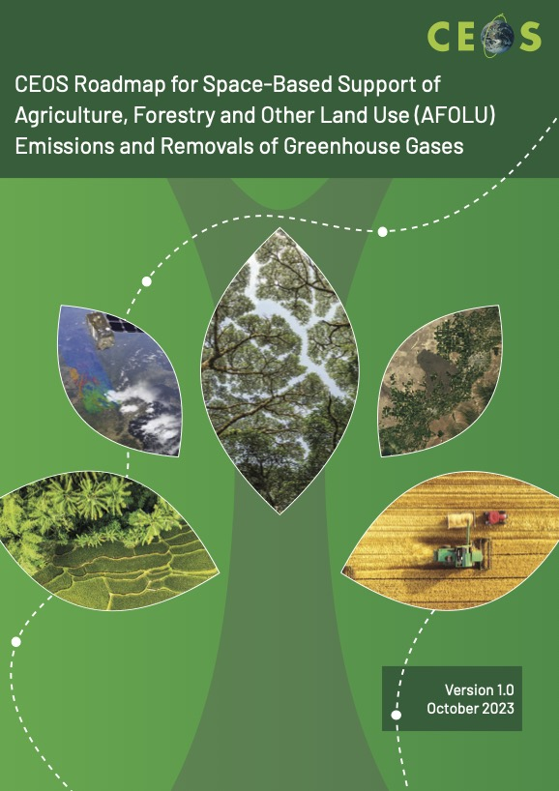
CEOS AFOLU Roadmap
Framework for long-term (+15 years) coordination of CEOS agency observing programmes in support of the needs of society for Agriculture, Forestry and Other Land Use (AFOLU)-related information
Overseen by the LSI-VC Forests and Biomass Subgroup
Co-Leads: Takeo Tadono (JAXA), Neha Hunka (ESA), Clement Albergel (ESA)

Slide 4
2026 Goal: CEOS AFOLU Portal
Objective: Provide a public-facing means to stocktake and present CEOS Agency contributions to the AFOLU Roadmap
Breadth of CEOS Agency contributions to AFOLU Roadmap not well documented to date
To facilitate identification of collaboration opportunities, gaps, progress
Communicate CEOS Agency work and achievements for AFOLU
Show progress on implementation of the AFOLU Roadmap

Slide 5
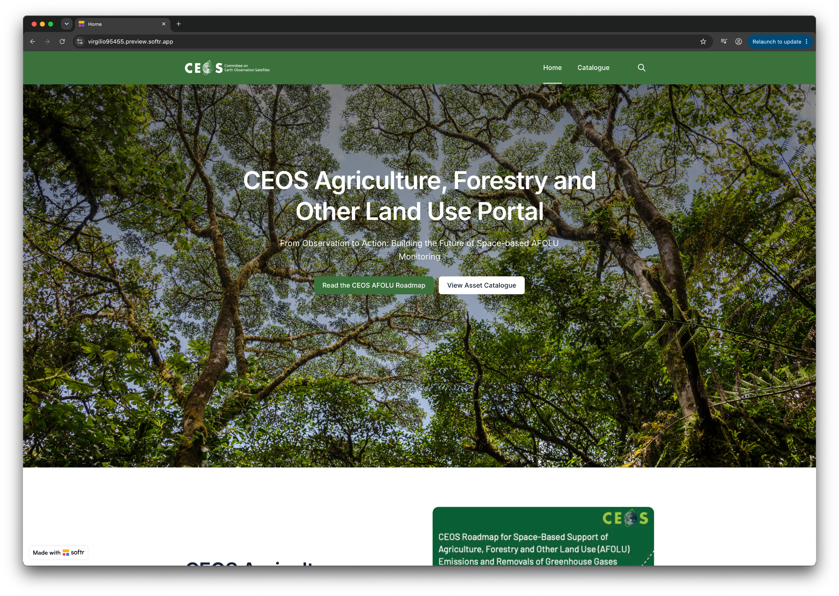
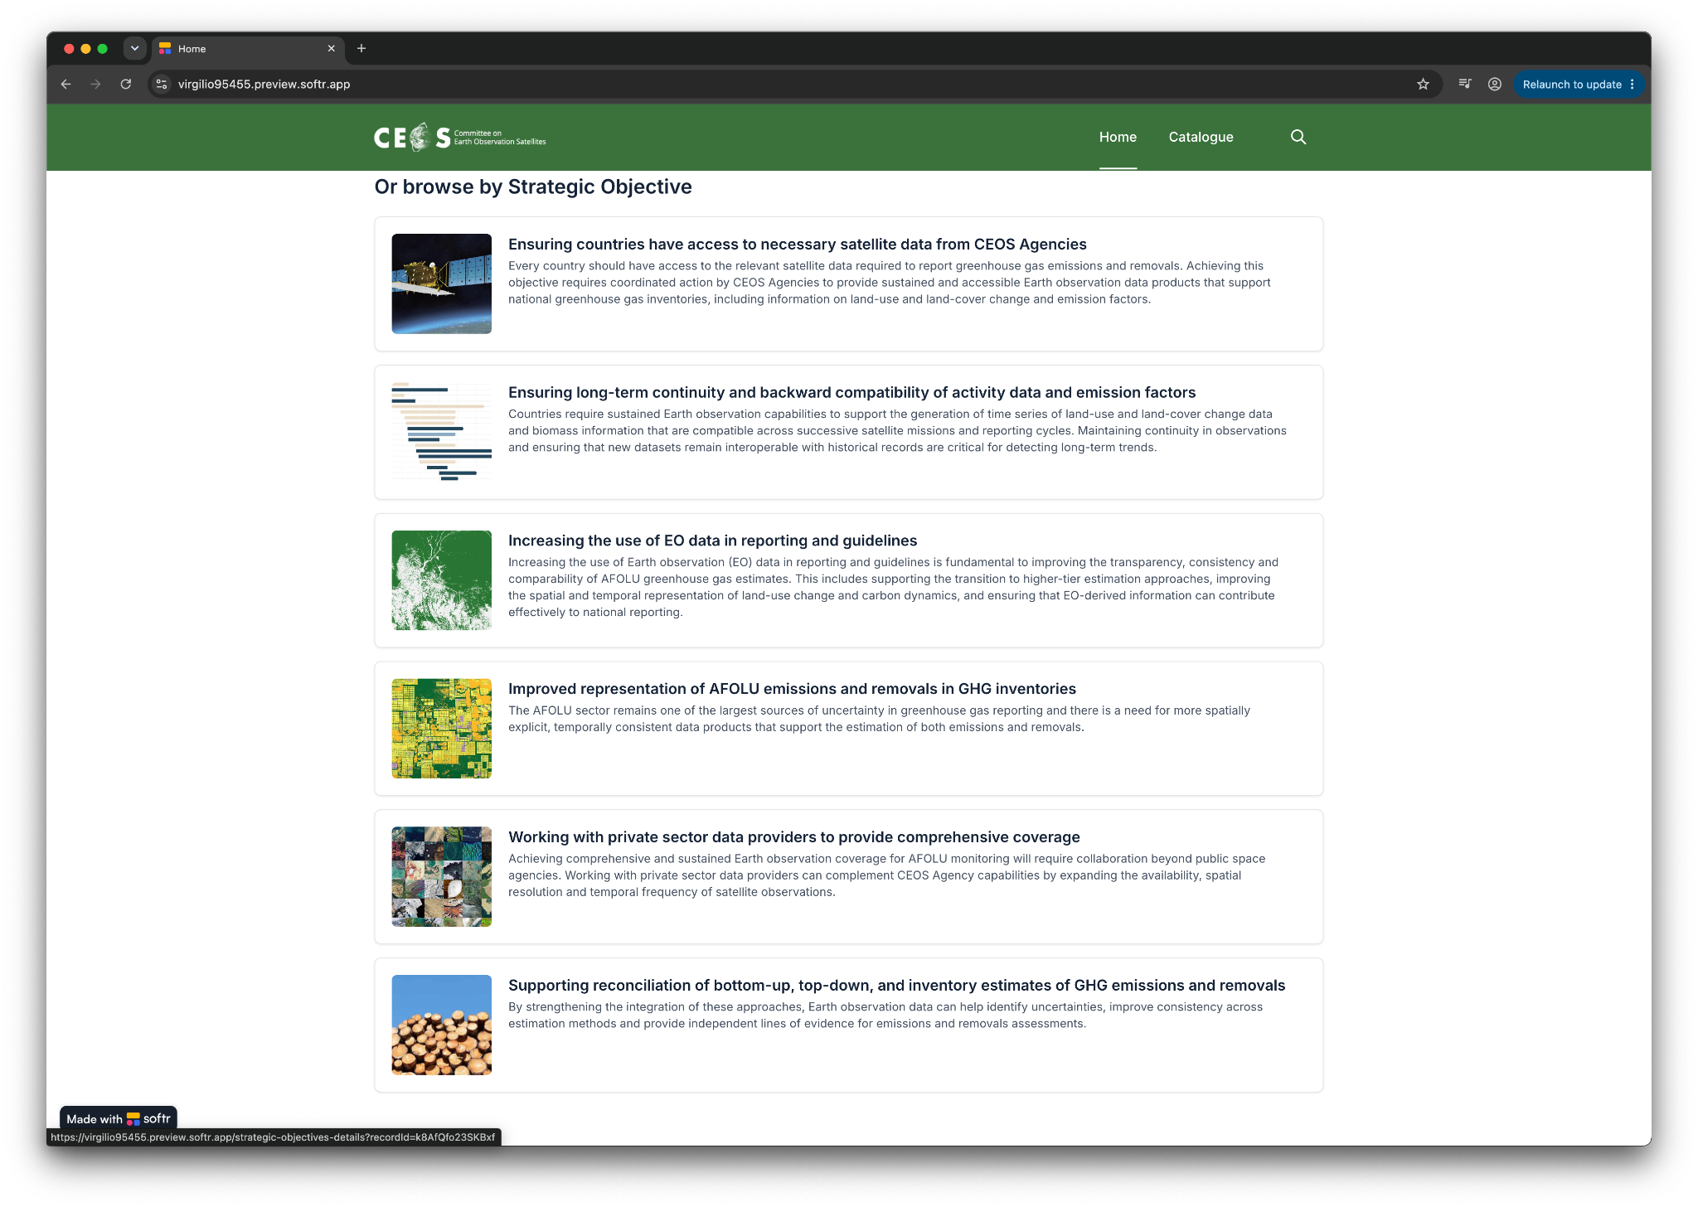

Slide 6
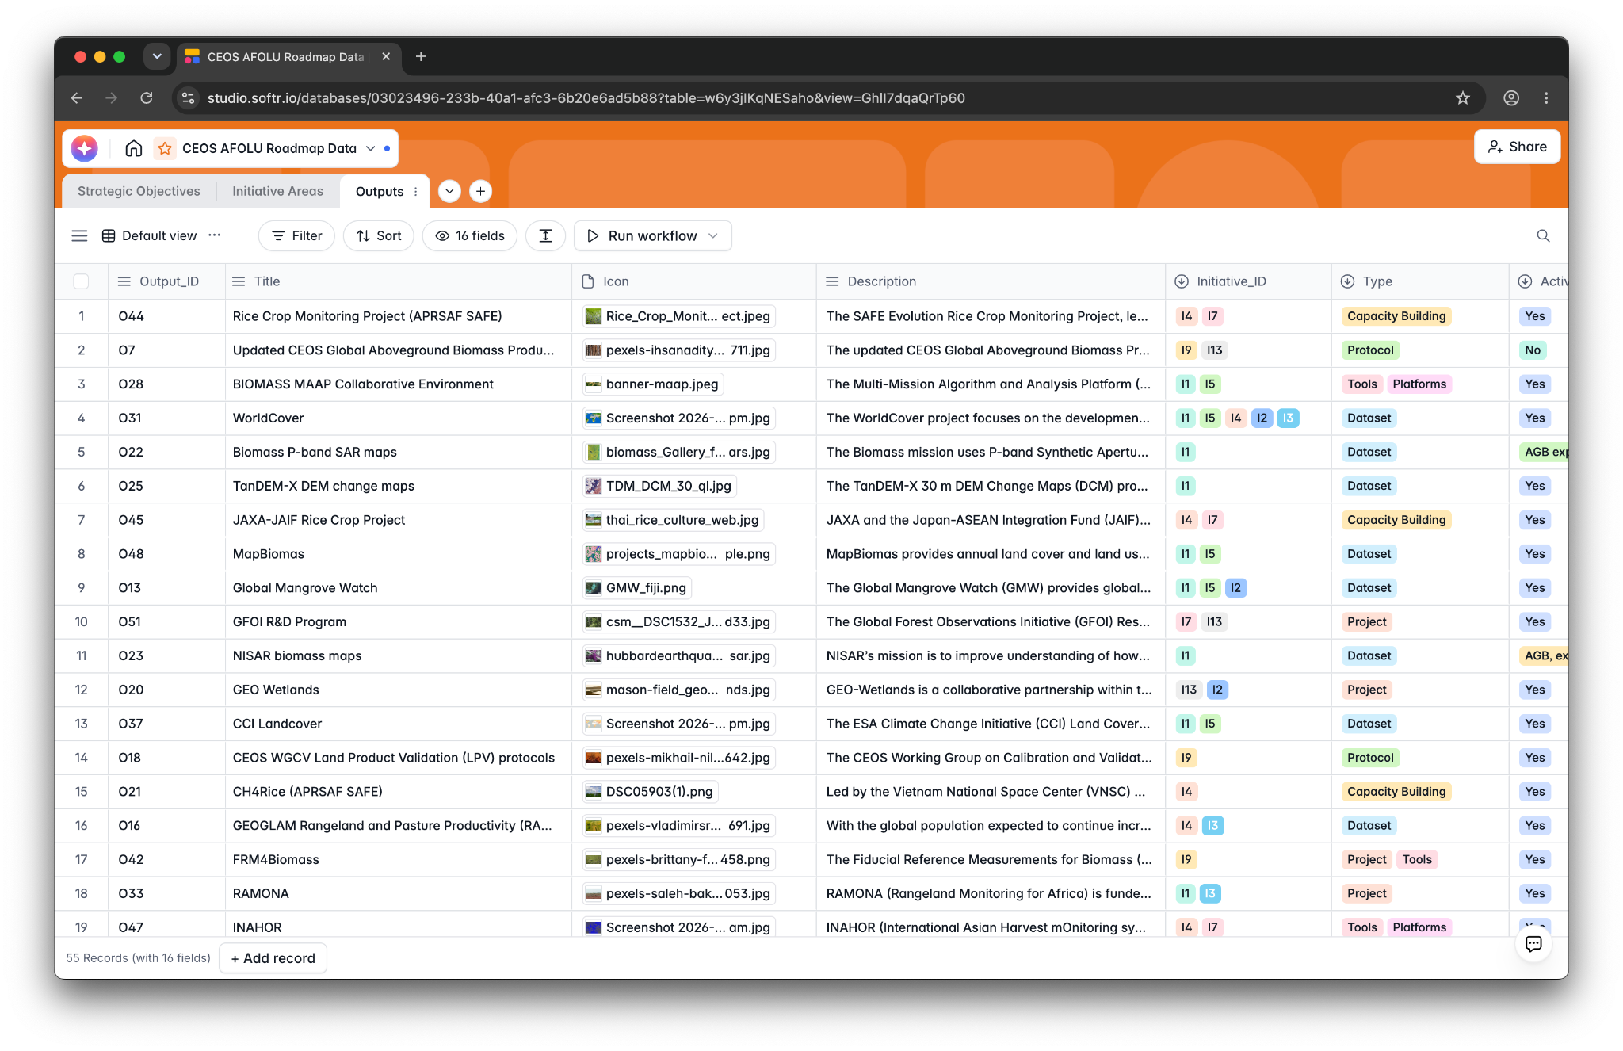
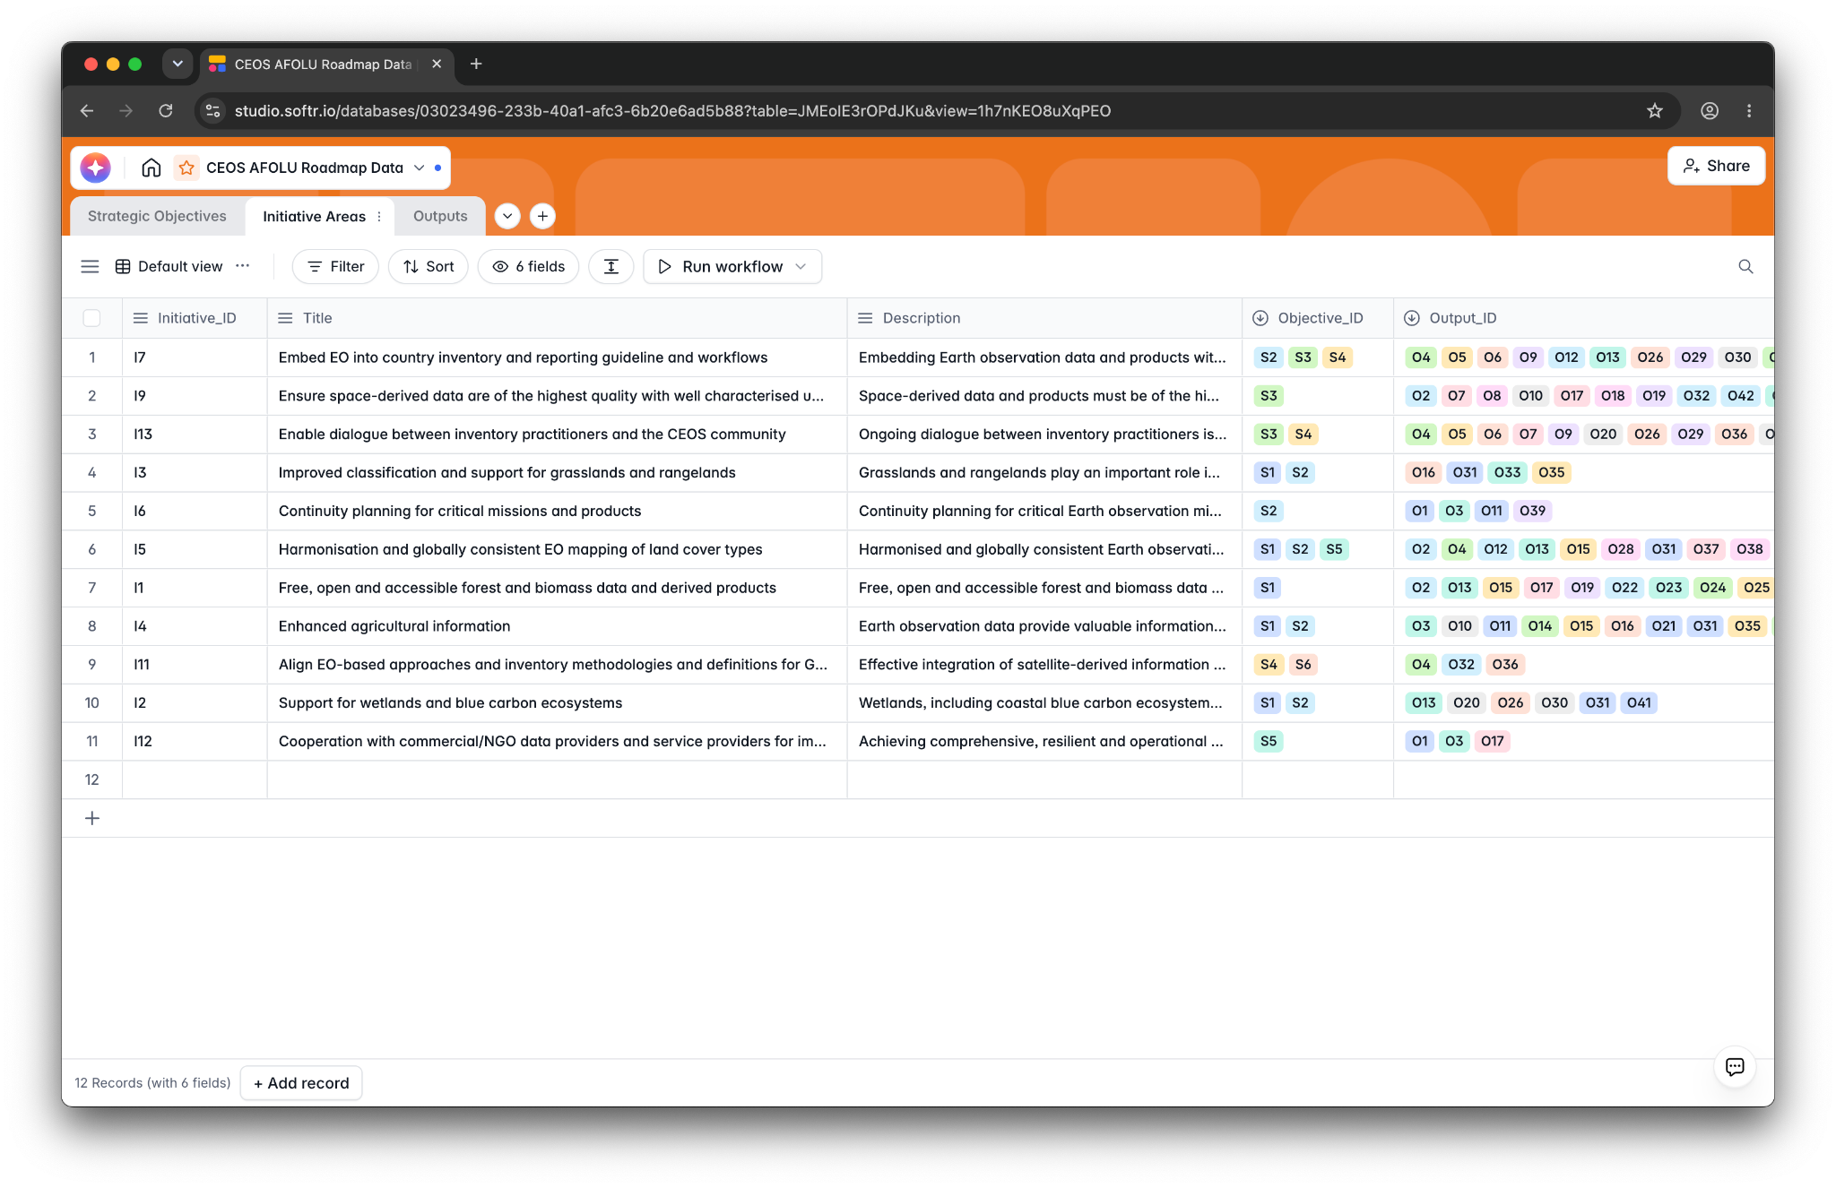

Slide 7
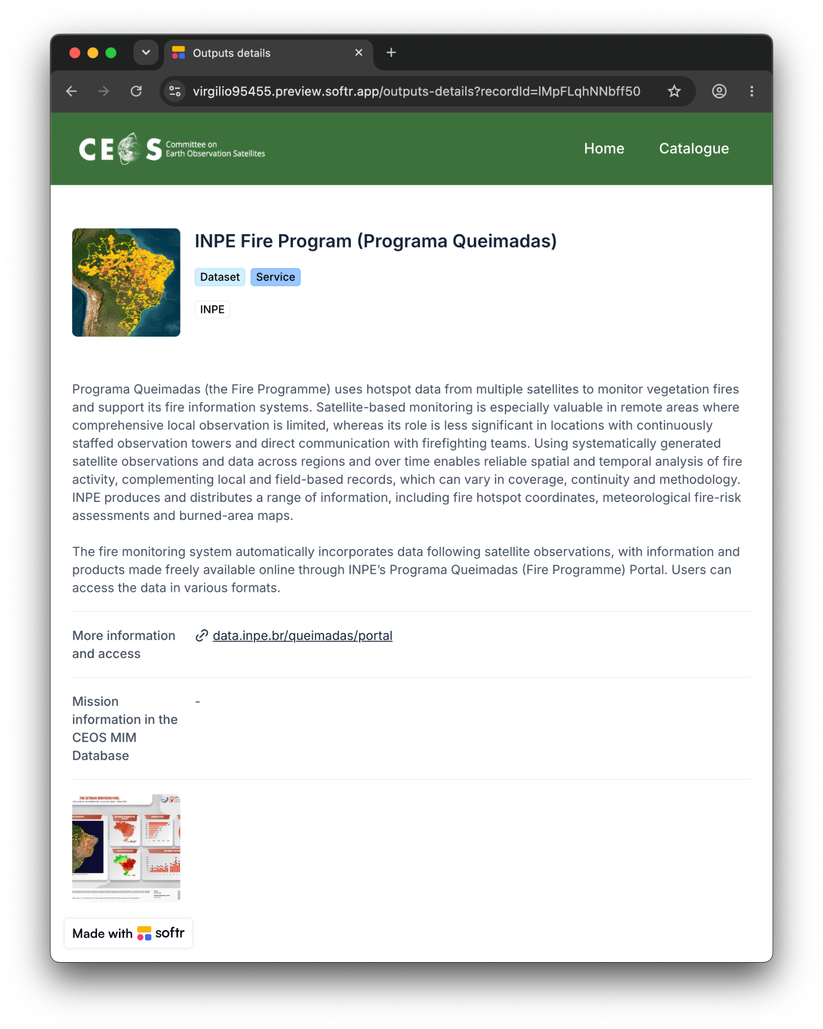
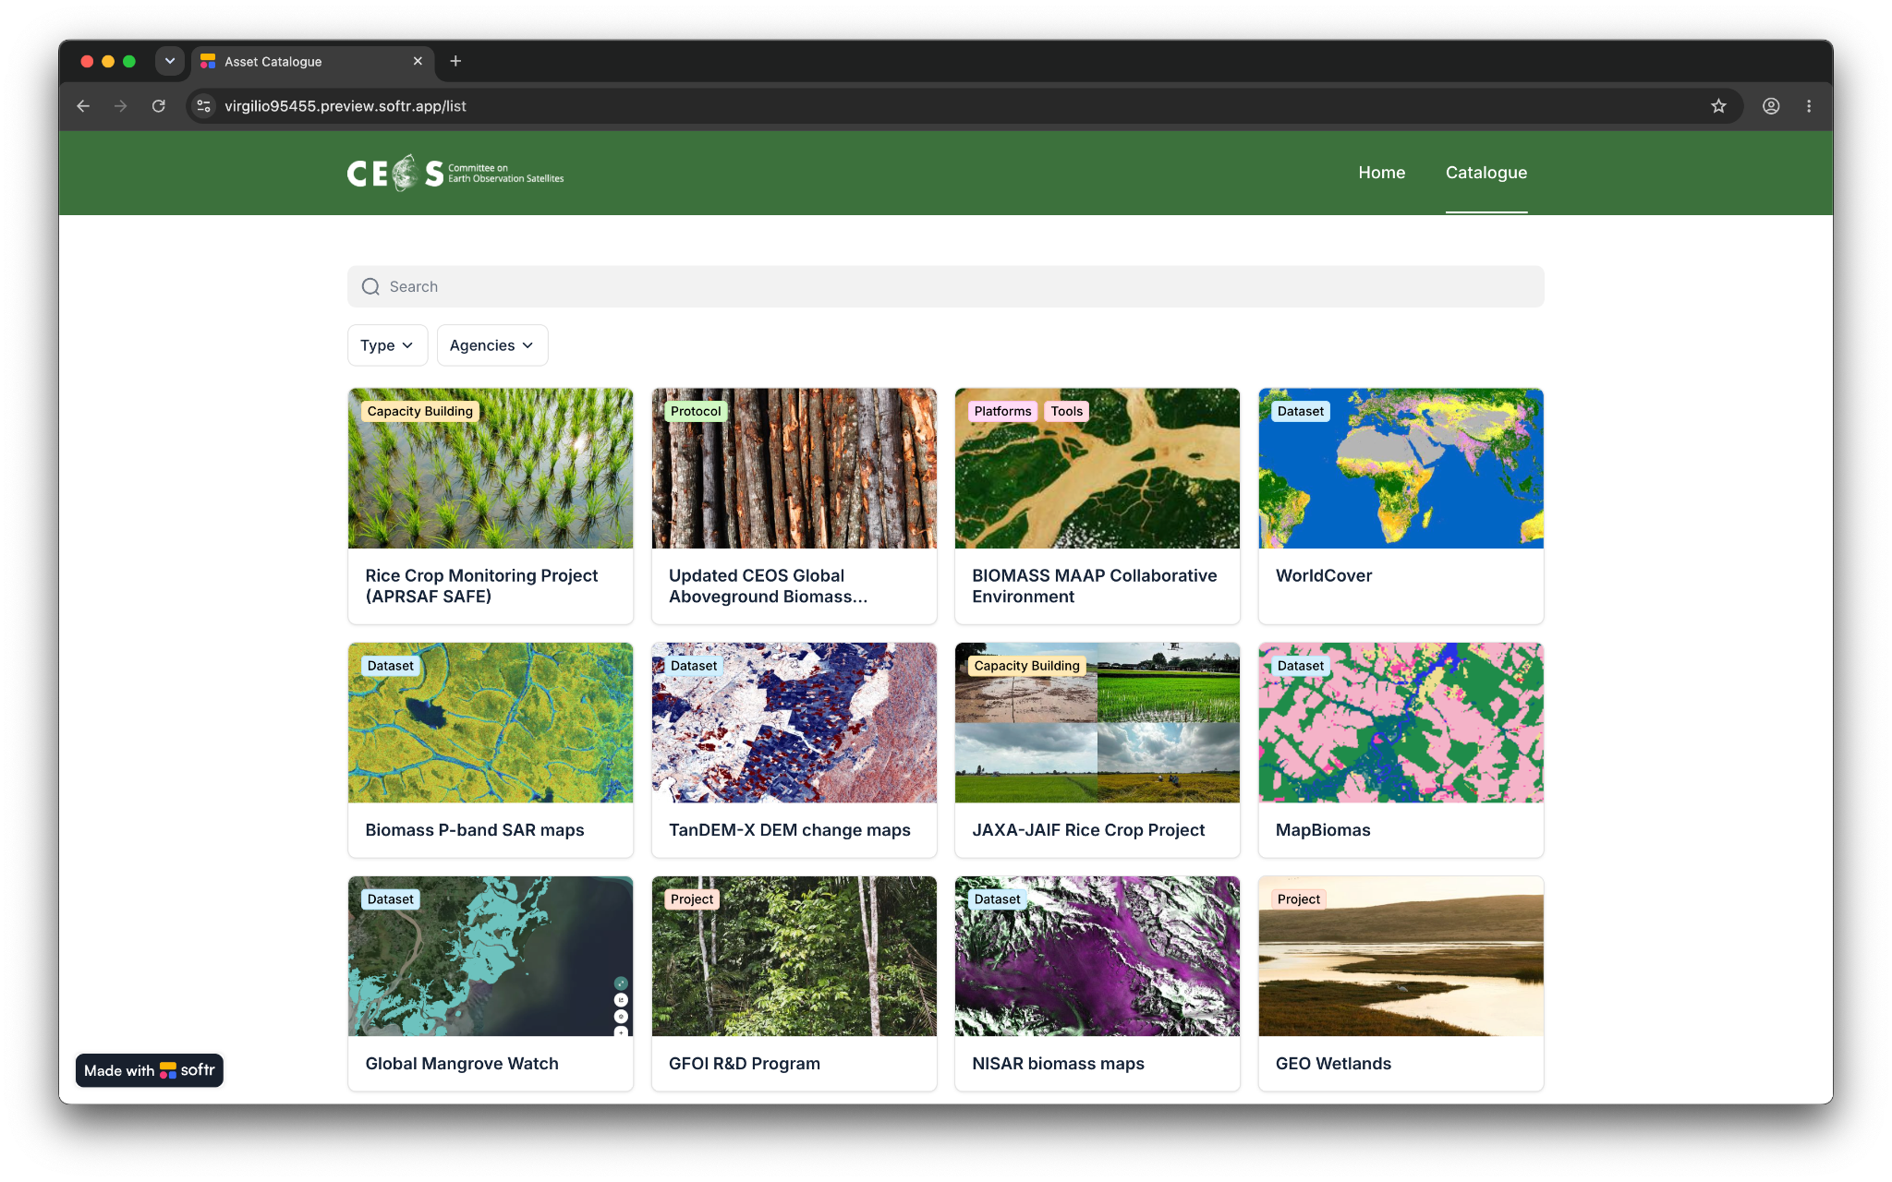

Slide 8
Work in progress
Still working to catalogue what already exists
And determining the correct level of asset
Need CEOS Agency attention to provide assets for the catalogue to ensure it is a complete picture
Agency representatives needed for the LSI and subgroups
Build out a comprehensive catalogue
Add database references to Roadmap actions annex
Then we can look at gaps and opportunities for collaboration across the activities
Aim: Using catalogue to assess progress on implementing the Roadmap recommendations; use Portal to communicate status holistically

Slide 9
Project Updates

Slide 10
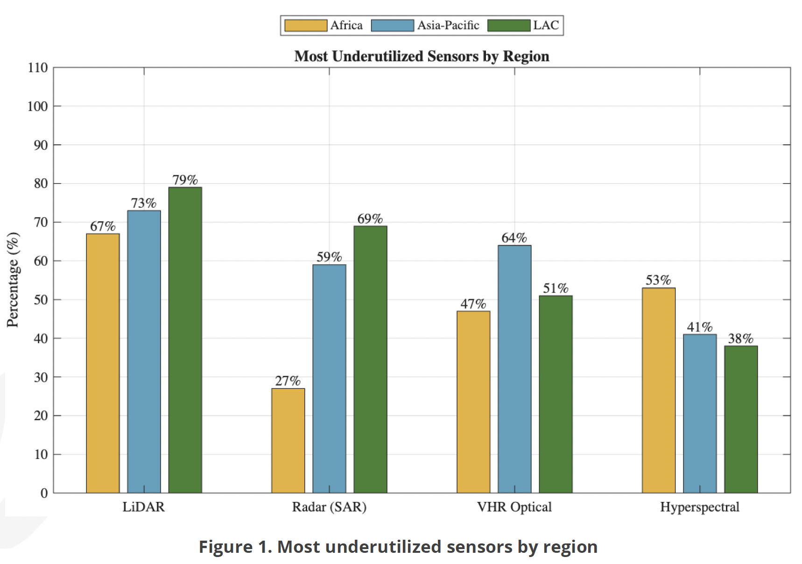
Global Forest Observation Initiative (GFOI)
ESA’s Support to the R&D Coordination for the GFOI Initiative : strengthening country engagement to enhance the use of Earth-Observation data in national decision-making related to the AFOLU sector.
Country-identified R&D Needs
Chronosequence guidance: Develop GFOI-endorsed operational guidance for removal factors. (Medium–long term)
Country case studies: Document practical approaches to removals accounting and reporting. (Short term)
Common field standards: Define minimum data standards across IPCC Tier 2, ART-TREES and FCPF. (Medium term)
Priority ecosystem research: Advance methods for agroforestry and dry-forest recovery. (Medium term)
Peatland CH₄ monitoring: Link SAR wetland mapping with methane estimates in key tropical regions. (Medium–long term)
Uncertainty guidance: Promote practical, transparent approaches to communicating uncertainty. (Short–medium term)
https://gfoi-rd.gfz.de/fileadmin/gfoird/documents/2026_06_RDExchange_CountryRDNeeds/2026_GFOIRD_CountryEngagementReport.pdf
1: Ensure continuity and long-term backward compatibility of CEOS missions providing activity data and emission factors
1.1: Track CEOS agency data continuity provision for the key AFOLU measurement groups and report outlook to SIT meetings for gaps, overlaps and interoperability actions. Provide guidance as needed to new missions (and related Mission Advisory Groups/Science teams).

Slide 11
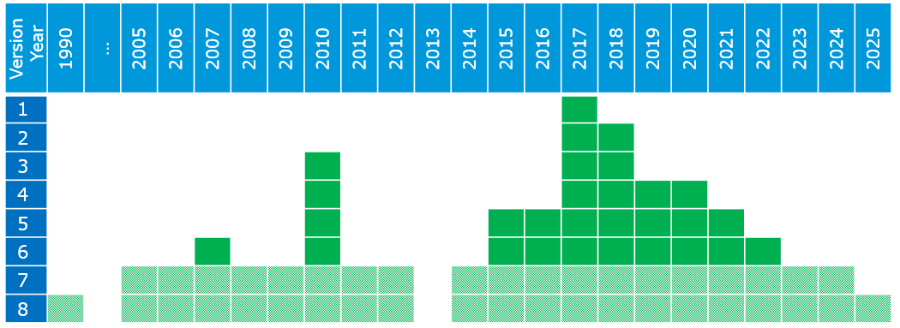
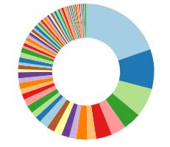



CCI Biomass
The current release of the CCI BIOMASS data products (v7) consists of global maps of AGB for each of the years 2005-2012 and 2015-2024, together with per-pixel standard deviation with a pixel size of 1 ha, i.e., for a 100 m x 100 m large area.
Software tool to compute the AGB change product (including SD and quality flag) based on comparisons of estimates between any 2 years
Over 400 download by >75 countries since spring already
Nine additional years released in v7! Before 2015, ALOS PALSAR and Envisat ASAR are used, then ALOS-2 PALSAR-2 & Sentinel-1. Close collaboration and special processing by
V8 tested ERS-1/2, JERS-1 (backward compatibility) and new sensors BIOMASS, NISAR
Will provide the global PALSAR data for 2025
1: Ensure continuity and long-term backward compatibility of CEOS missions providing activity data and emission factors
1.2: Explore harmonization and integration activities that generate temporal continuity and provide complete and consistent spatial coverage of Activity Data and biomass estimates.

Slide 12

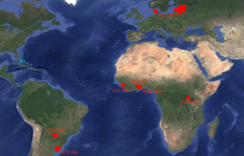
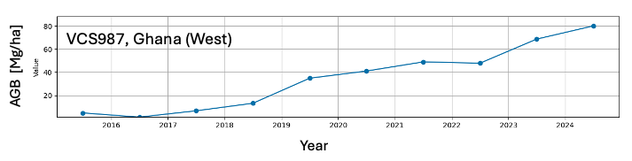

CarbonEYE
The use of Global Biomass Maps methodologies (e.g. CCI Biomass) in local-scale Carbon Markets
CarbonEye is funded under the Future EO-1 EO SCIENCE FOR SOCIETY permanently open call. Currently at mid-term.
Aim: to harness the synergies between carbon markets and remote sensing technologies by developing tailored carbon data products based on profound expert knowledge
How: combination of satellite SAR time series (S1, ALOS, SAOCOM) and LiDAR data in a physics-based framework (CCI Biomass)
Where: seven Verra Verified Carbon Standard (VCS) project sites (user requirements defined, data collected, carbon estimation algorithm developed and tested)
Main lessons learnt: 1) carbon estimation method is robust, 2) an accurate data product requires site-specific tailoring, including knowledge of tree species and forest management
1: Ensure continuity and long-term backward compatibility of CEOS missions providing activity data and emission factors
1.2: Explore harmonization and integration activities that generate temporal continuity and provide complete and consistent spatial coverage of Activity Data and biomass estimates.

Slide 13
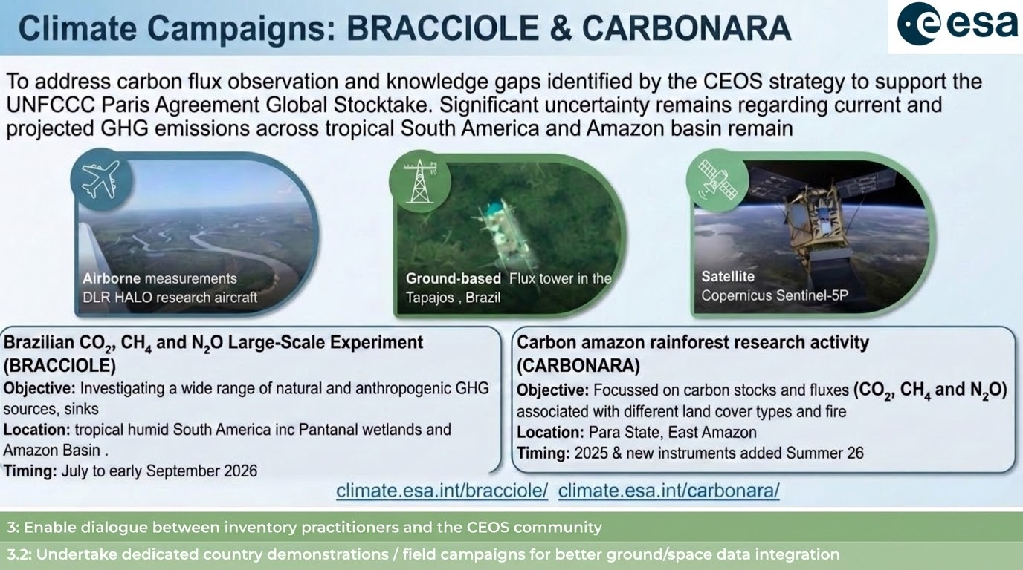

Slide 14

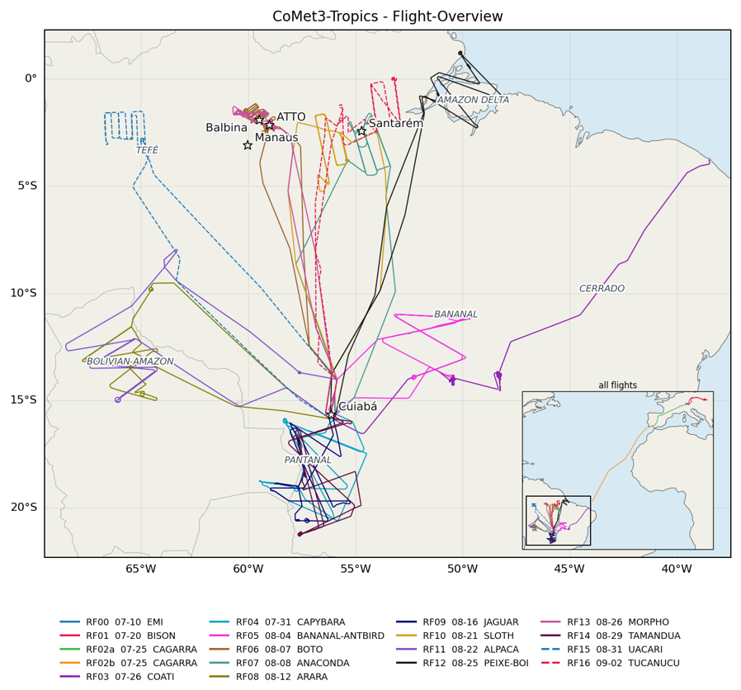
CoMet 3.0 Tropics mission on HALO
supported by ESA‘s BRACCIOLE project
Airborne campaign on German research aircraft HALO
Sophisticated multi-instrument greenhouse gas payload
Remote Sensing and in-situ
Period: 25 July – 6 Sept. 2026, Campaign base: Cuiabá, MT
Successfully conducted 14 Research flights
= 123 Flight hours in Brazil (+ transfers)
Main targets:
Wetlands: Amazon, Pantanal, Llanos de Moxos (Bolivia)
Overflights over ATTO, Santarém Supersite (3x), Flux Towers
Tropical CO2 & SIF over different biomes (primary &
secondary forest, disturbed forest, tropical savanna)
Anthropogenic GHG sources: agriculture, feedlots, hydropower dams, ..
GHG Satellite validation and mission preparation
University Bremen - Institute of Environmental Physics - DLR Institute of Physics of the Atmosphere.
3: Enable dialogue between inventory practitioners and the CEOS community
3.2: Undertake dedicated country demonstration / fields campaigns for better ground / space data integration

Slide 15
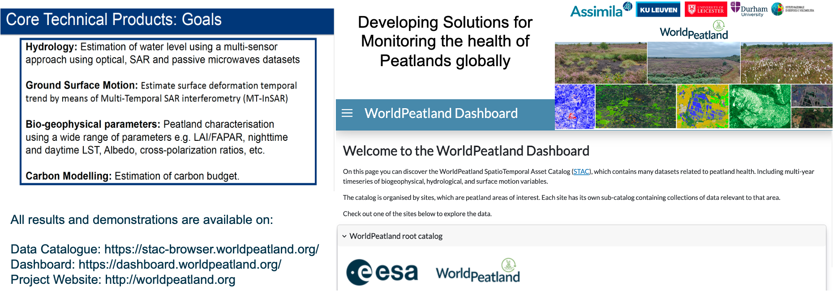
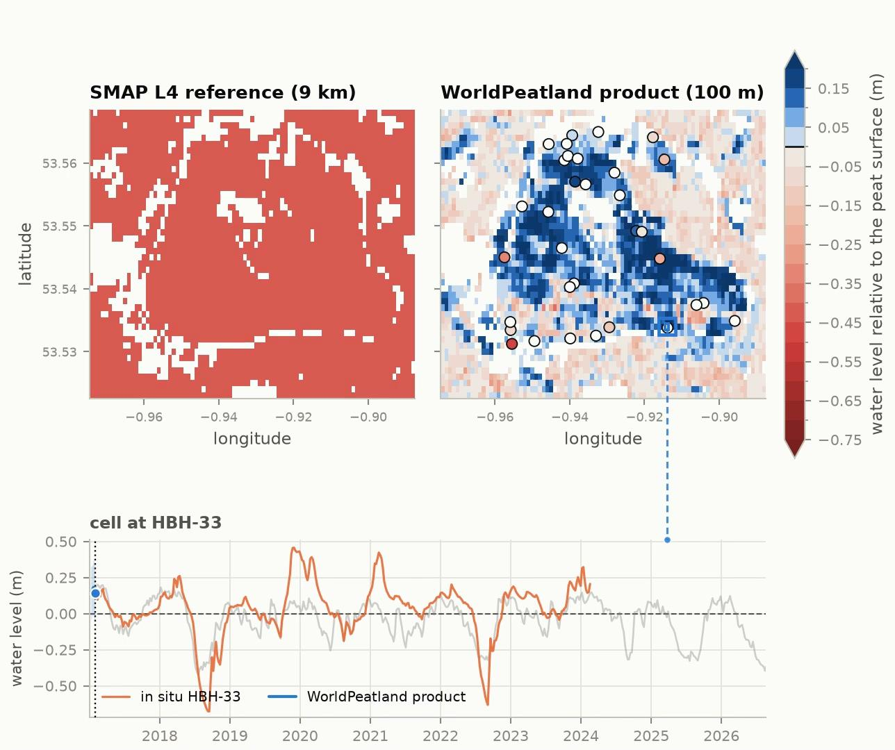
ESA WorldPeatlands
Peatlands, as high carbon ecosystems, are a priority for development of EO applications
Peatland Water Level Monitoring
3: Enable dialogue between inventory practitioners and the CEOS community
3.3: Support NFI teams and review experts accessing independent estimates derived from satellite EO in the context of the Enhanced Transparency Framework

Slide 16
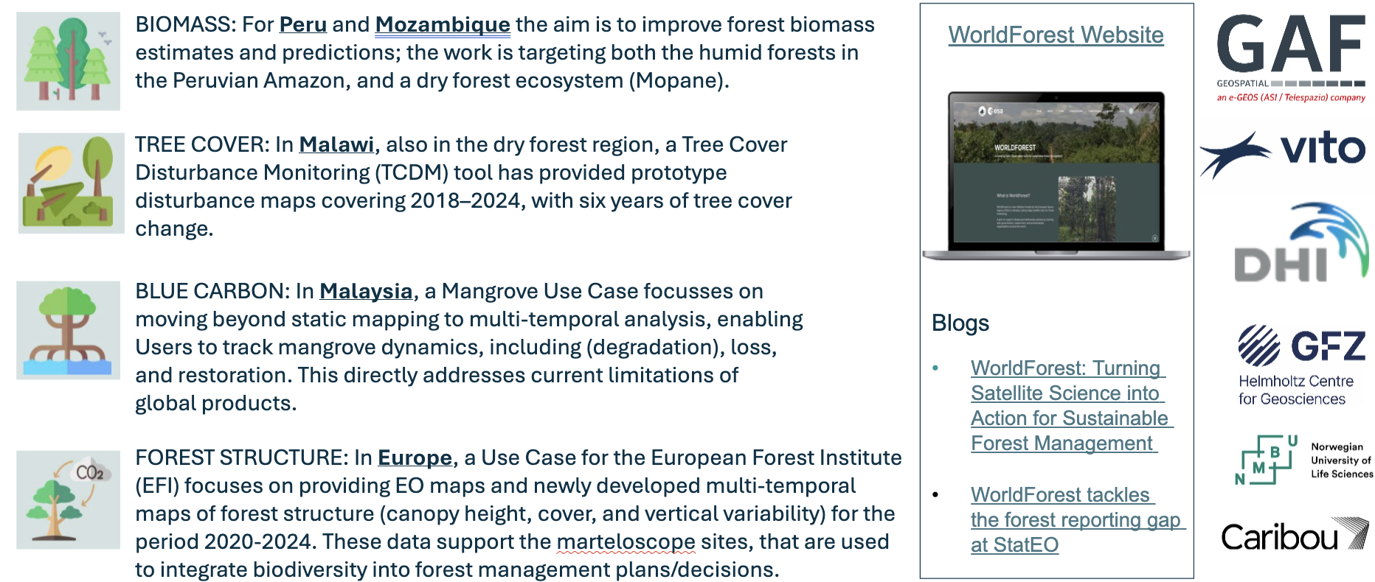
ESA World Forests
Bringing EO-based solutions for forests to operational use
3: Enable dialogue between inventory practitioners and the CEOS community
3.3: Support NFI teams and review experts accessing independent estimates derived from satellite EO in the context of the Enhanced Transparency Framework

Slide 17

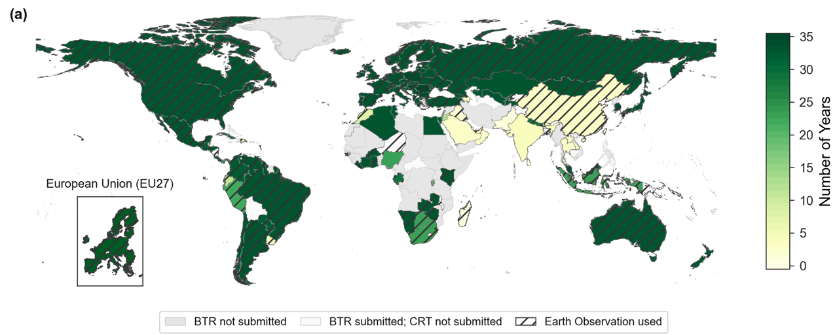
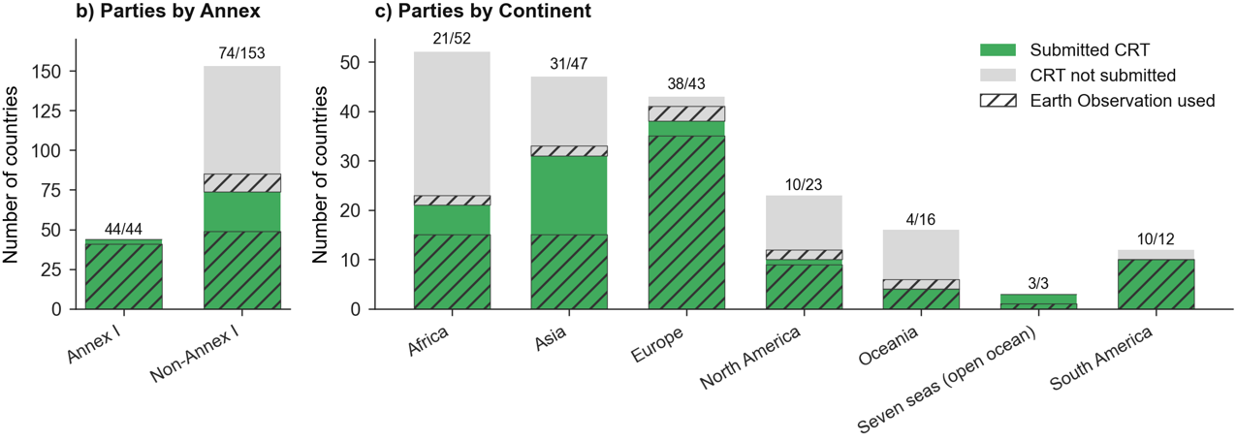
GHG budget reconciliation
a. Number of inventory years covered by each country’s Common Reporting Table (CRT) submission in the first round of Biennial Transparent Report (BTR1). Grey areas denote countries that have not submitted BTR1 yet. “Zero” value represent countries that only submit BTR without any CRT.
b. CRT submission status by Annex group and c. continent.
⇒ Hatched areas indicate the use of Earth Observation (EO)*
*EO use was identified from each country’s BTR1/NID reports by using LLM. A country was classified as using EO when the report explicitly stated that satellite data, aerial imagery, LiDAR, or other remotely sensed data were used to prepare the GHG inventory, with at least one verified piece of evidence reaching a confidence score of 0.90 or higher. Future plans, general programs, and citations alone were not counted.
Australia uses EO for Activity-data generation; Biomass estimation; Carbon-stock estimation; Land representation/land-area matrix; Land-use change detection; Land-use classification; Spatial stratification
France uses EO for Activity-data generation; Burned-area estimation; Deforestation monitoring; Land representation/land-area matrix; Land-use change detection; Land-use classification; Model input; Spatial stratification
…
As of Aug 27, 2026
Deng et al., 202X, in prep
4: Support efforts to reconcile bottom-up, top-down, and inventory estimates of GHG emissions and removals
4.1: Develop guidance and datasets to support the consistent comparison and assessment of bottom-up and top-down methodologies with national GHG inventories.

Slide 18
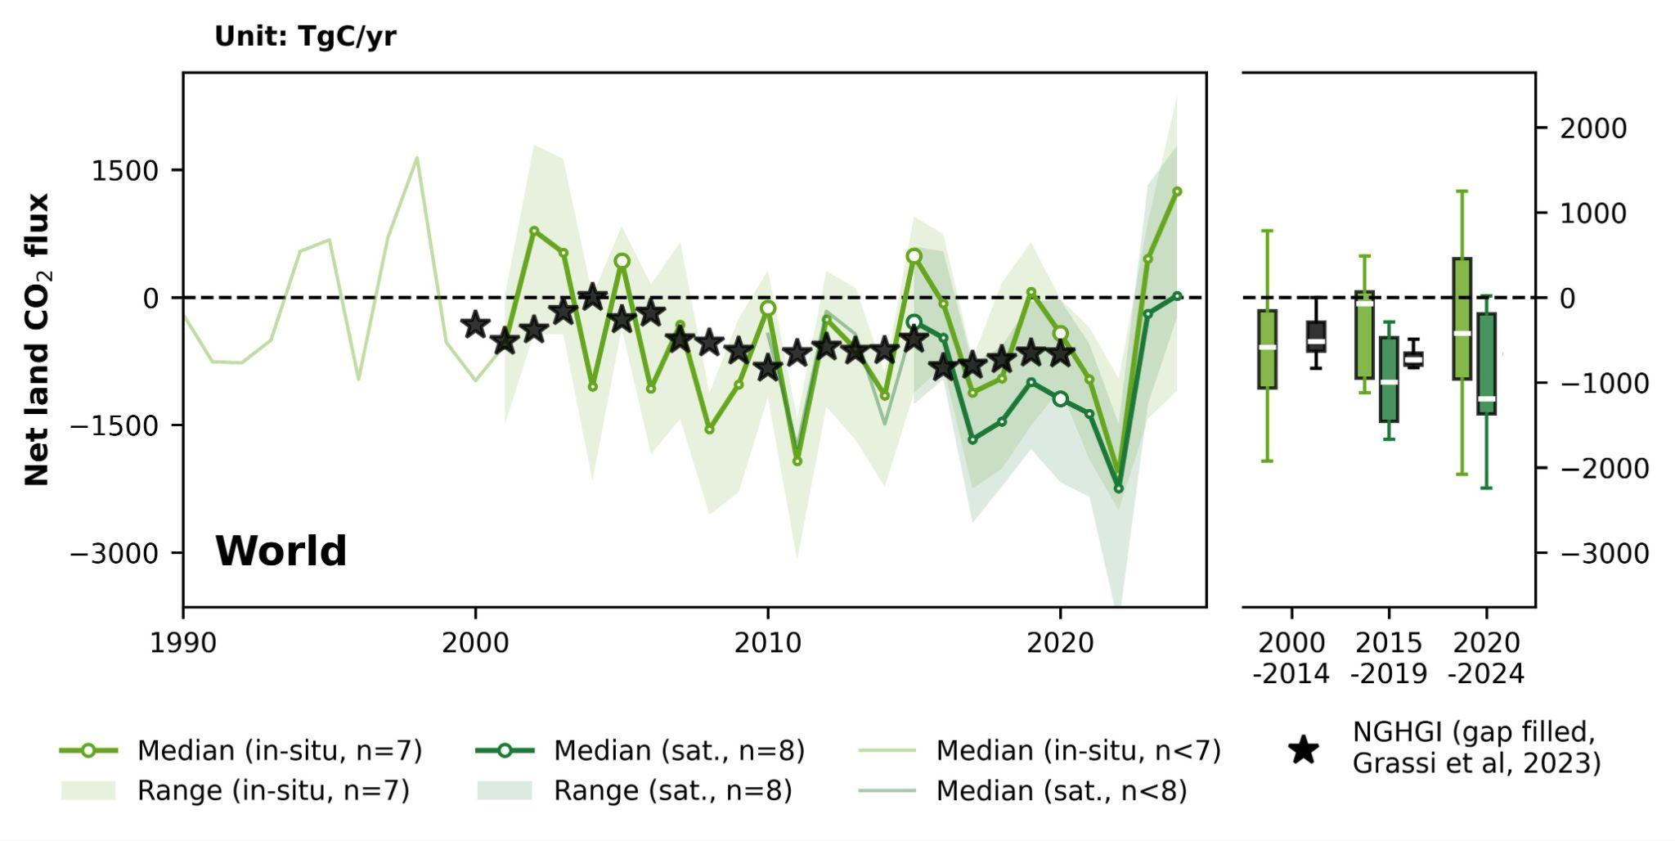
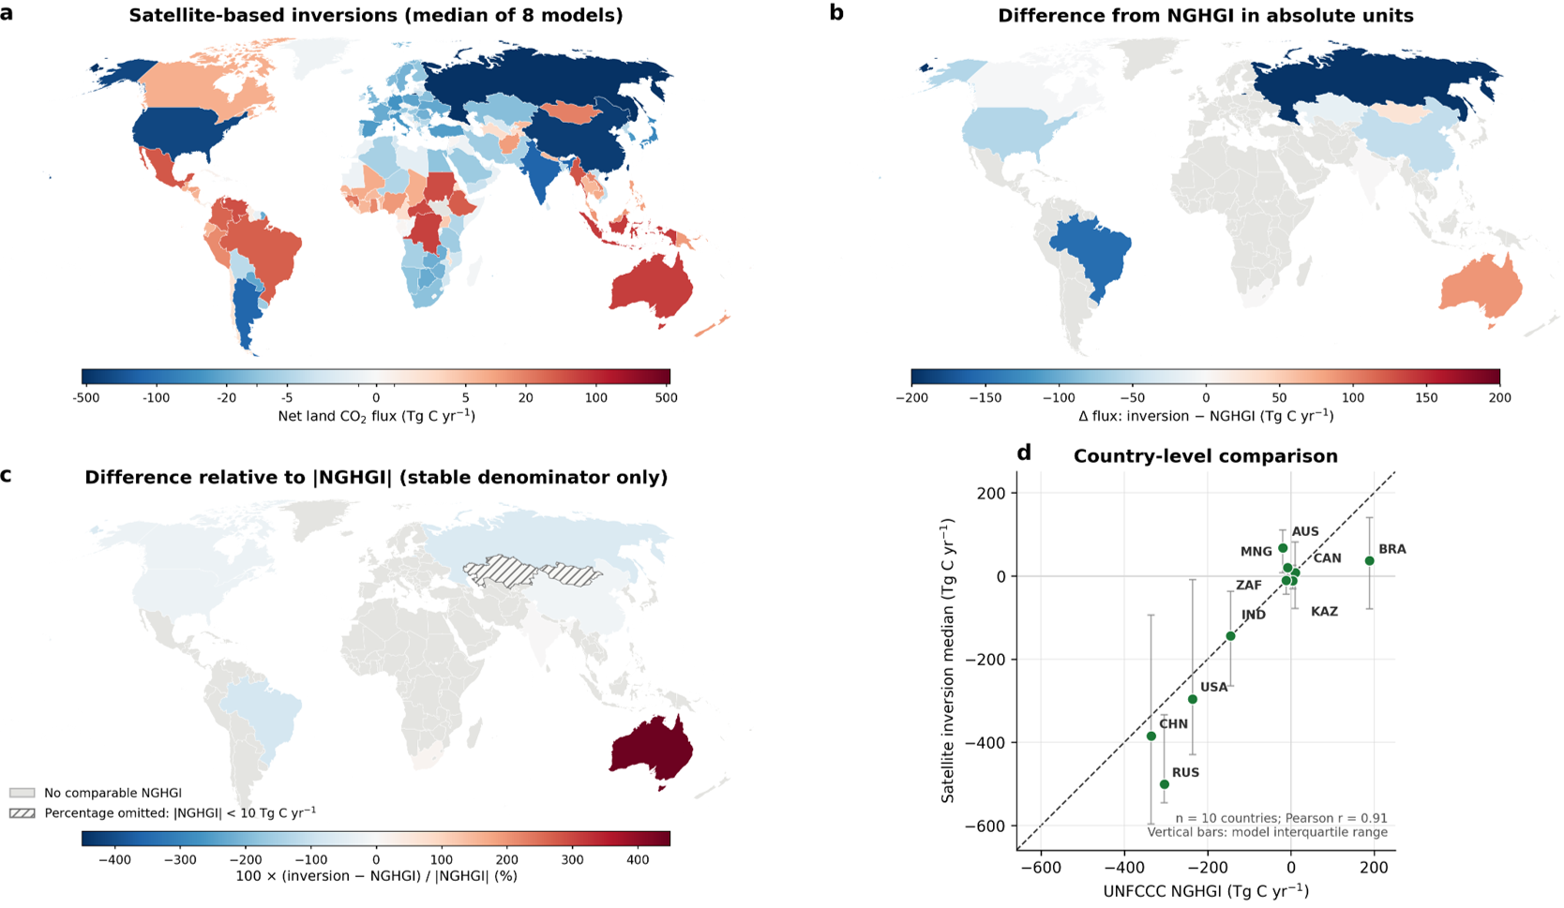
GHG budget reconciliation
Comparisons of land CO2 sink between National GHG Inventories (NGHGI) and Top-down satellite-inversions in 2020 across a selected group of countries from Deng et al (in prep)
Global net land CO2 fluxes (unit: TgC yr-1) during 1990-2024.
Median sink from in-situ inversions (after lateral-flux correction) is very comparable to the global LULUCF sink from inventories while the satellite inversions show a slightly stronger managed-land sink than inventories.
4: Support efforts to reconcile bottom-up, top-down, and inventory estimates of GHG emissions and removals
4.1: Develop guidance and datasets to support the consistent comparison and assessment of bottom-up and top-down methodologies with national GHG inventories.

Slide 19
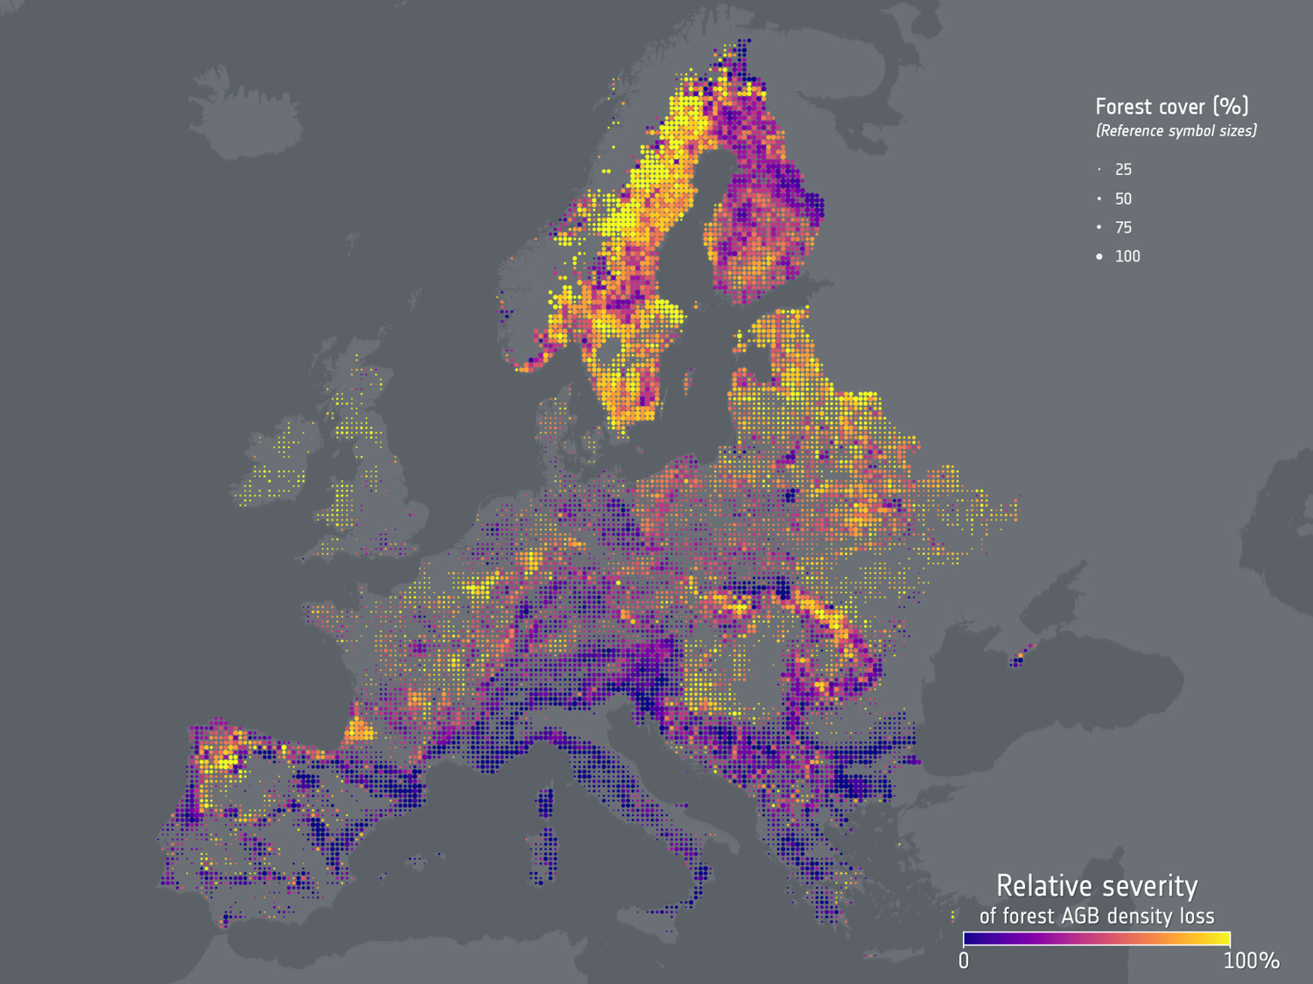
European forest biomass declining
Europe’s forests are losing more biomass than previously thought, with disturbances such as drought and pests causing increasingly large losses from some of the oldest forests in Europe
Using Landsat archive - this study is the first to measure not just where Europe’s forests were lost but how much biomass disappeared along with them (for each hectare of disturbed forest, 46% more biomass is being lost since 2018)
Forest recovery can no longer keep pace with disturbance
By combining National forest reports with satellite maps of disturbance & biomass, the study projected how Europe’s carbon sinks is likely to evolve to 2030
European forest’s capacity to absorb and store carbon is likely to have decrease by 39% in 2010-2023
Implications if EU is to meet 2030 forest carbon targets
ESA - Europe’s forests losing more biomass since 2018
4: Support efforts to reconcile bottom-up, top-down, and inventory estimates of GHG emissions and removals
4.1: Develop guidance and datasets to support the consistent comparison and assessment of bottom-up and top-down methodologies with national GHG inventories.

Slide 20
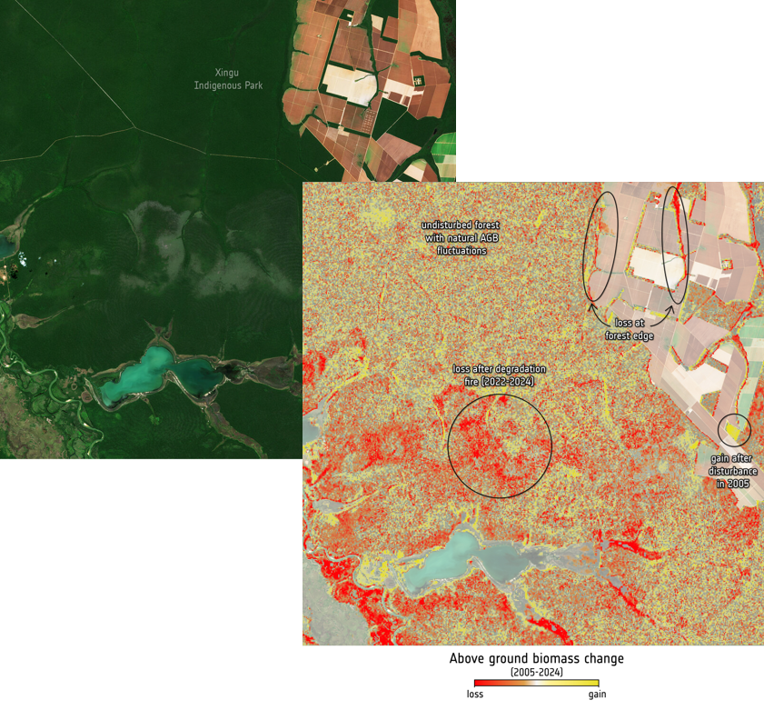
Improved reporting needed on forest carbon emissions
New meta-analysis of 146 studies (1988-2026) found that tropical forest degradation, including wildfire, selective logging and fragmentation, is a major but often under-reported source of carbon emissions.
Forest fires increase carbon emission by almost 50%, selective logging by 34%, and edge effects by 31% compared with undisturbed forest.
Partially degraded forests recover more effectively than completely degraded forests. Recovery is enhanced when degraded forests remain connected to healthy forests.
The study highlights the need to better account for degradation and recovery processes in carbon models and national GHG reporting.
ESA CCI Biomass record helps to distinguish between degradation from deforestation and track forest recovery
ESA - Improved reporting needed on forest carbon emissions
Forest degradation: Xingu Indigenous Park, Brazil from Sentinel -2 2005 v 2024
4: Support efforts to reconcile bottom-up, top-down, and inventory estimates of GHG emissions and removals
4.1: Develop guidance and datasets to support the consistent comparison and assessment of bottom-up and top-down methodologies with national GHG inventories.

Slide 21

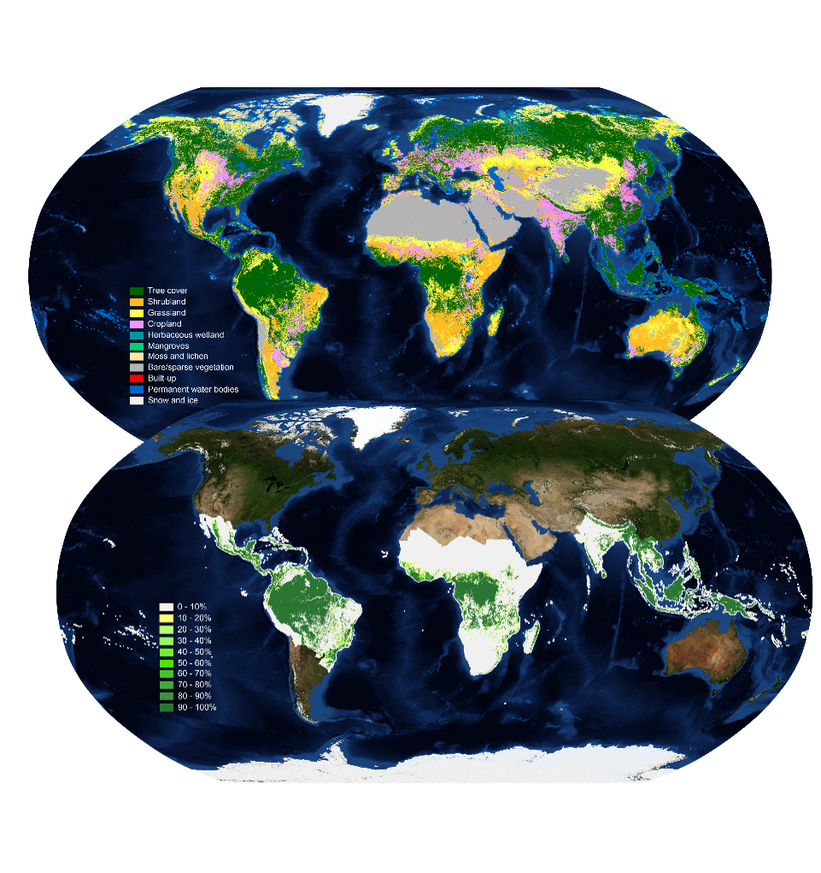
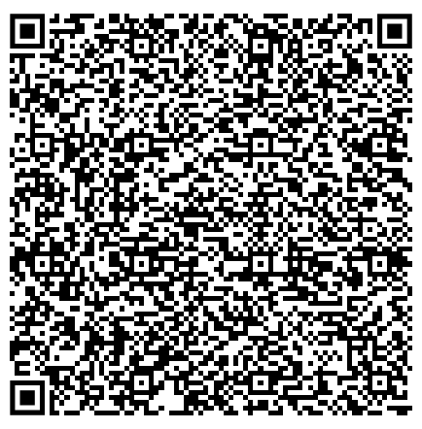
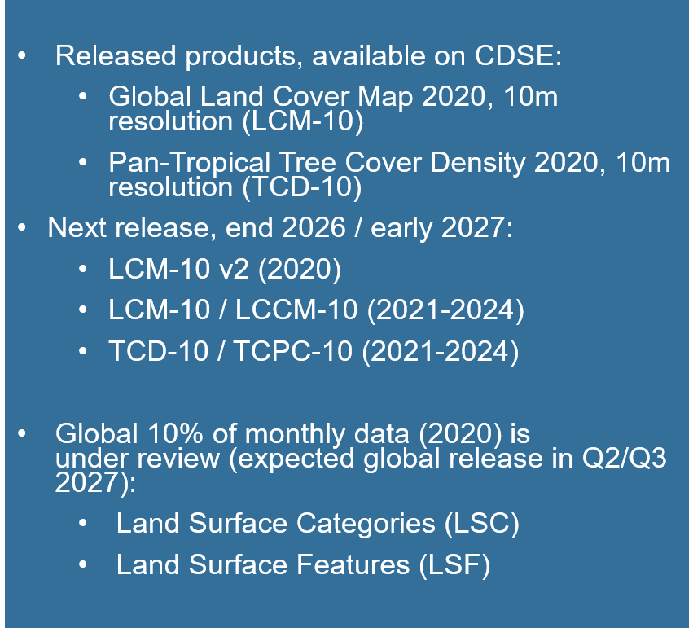
GFOI Core Satellite Data Continuity
Implementation – Copernicus Land Monitoring Service (CLMS) Land Cover and Forest Monitoring (LCFM) new product release
10m global Land Cover Map (LCM-10)
10m pan-tropical Tree Cover Density (TCD-10)
5: Systematically target activities to support IPCC Land Cover classes

Slide 22

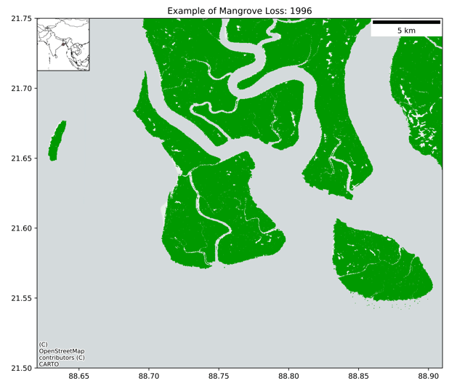
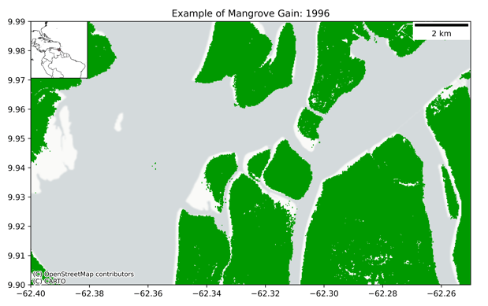
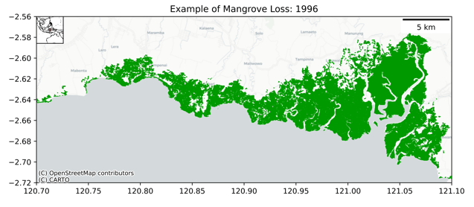

GFOI Core Satellite Data Continuity
Global Mangrove Watch
The Global Mangrove Watch – Version 4 released on July 26, 2026. A consistent global dataset at 30 m of mangrove extent and changes over 4 decades (1985–2025) generated from a combination of optical (Landsat, S-2) and SAR (JERS-1, ALOS, ALOS-2) data.
Activity Data: Annual layers of mangrove gains and mangrove losses.
Non-anthropogenic losses: Erosion
Gains:
Sedimentation
Anthropogenic losses: Land conversion
5: Systematically target activities to support IPCC Land Cover classes
5.3: Review and consolidate current approaches to characterising, mapping and monitoring Blue Carbon Ecosystems.
5.4: Explore development of new CEOS initiatives on wetlands mapping and monitoring.
5.5: Establish closer collaboration with the Ramsar Convention Secretariat and Scientific and Technical Review Panel (STRP).

Slide 23
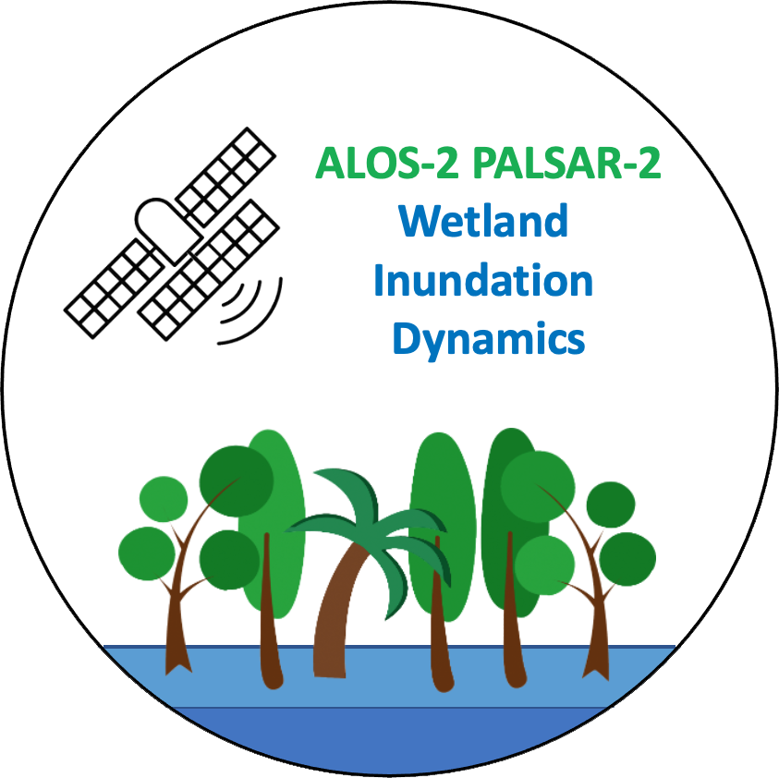
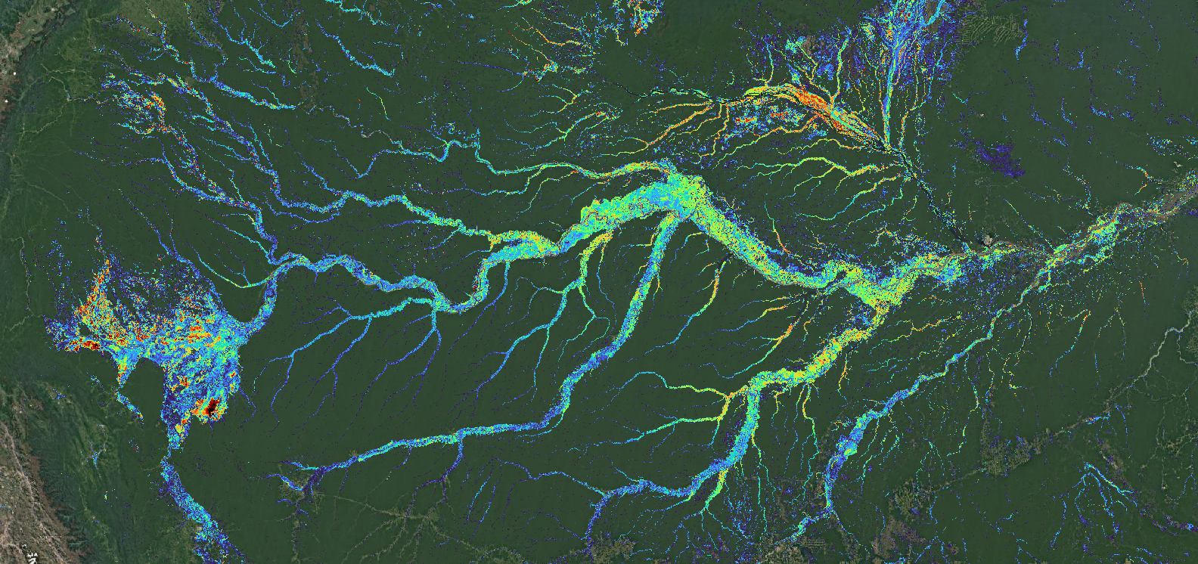
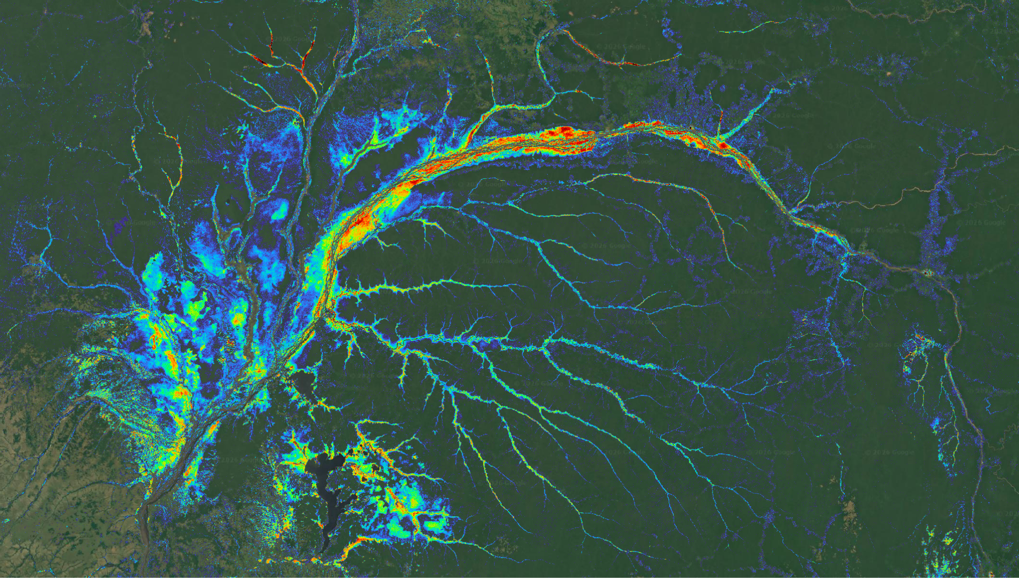
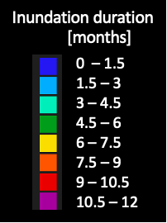
GFOI Core Satellite Data Continuity
Wetland Inundation Dynamics
Forested wetlands recognised as as information gap by the Ramsar Convention. Mapping wetland inundation extent and duration under the forest canopy by L-band SAR. Annual inundation maps for 2015-2026. Public release Oct 2026.
Input data: Public open ALOS-2 PALSAR-2 CEOS-ARD [NRB] on AWS. Downstream automated processing workflow in the CEOS Analytics Lab (CAL).
Amazon river basin - Annual inundation extent and duration
Congo river basin
5: Systematically target activities to support IPCC Land Cover classes
5.3: Review and consolidate current approaches to characterising, mapping and monitoring Blue Carbon Ecosystems.
5.4: Explore development of new CEOS initiatives on wetlands mapping and monitoring.
5.5: Establish closer collaboration with the Ramsar Convention Secretariat and Scientific and Technical Review Panel (STRP).

Slide 24


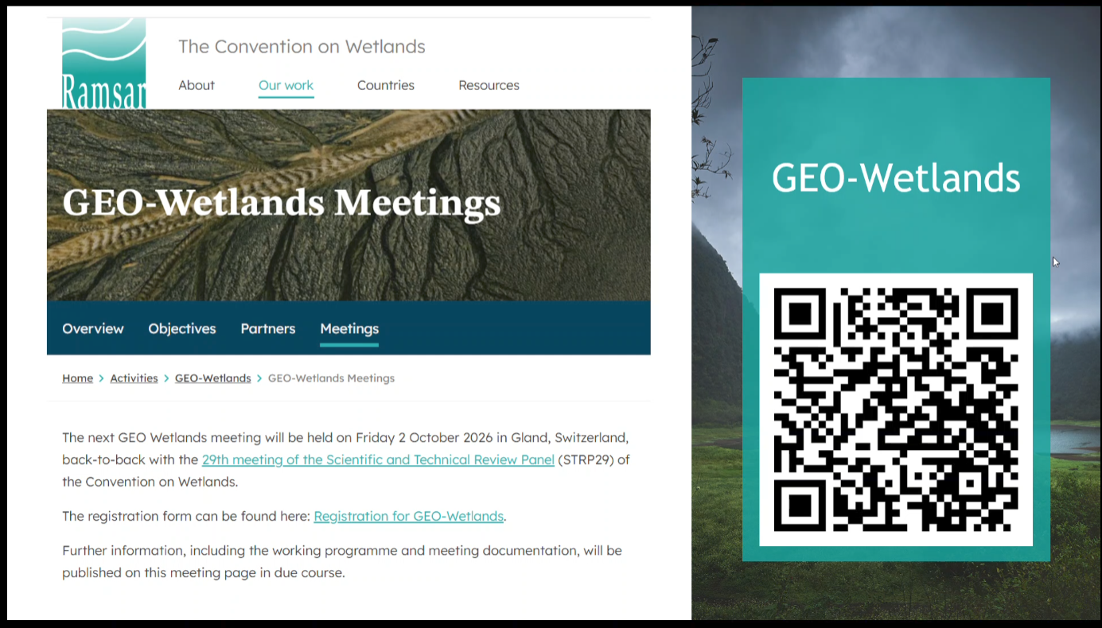
GFOI Core Satellite Data Continuity
GEO-Wetlands
Chairs:
  Ramsar STRP Chair, Wetlands Int’l
Co-leads & collaborators:
  Ramsar Secretariat,
  ESA, JAXA
  GEO Sec, UNEP/DHI, Aberystwyth Univ.
GEO-Wetlands collaborator agreement & ToR developed in Q1/2026.
JAXA and ESA long-term Observer Organisations to the Ramsar Scientific and Technical Review Panel (STRP)
Bilateral agreements with Ramsar Secretariat: ESA (2025) and JAXA (2026)
5: Systematically target activities to support IPCC Land Cover classes
5.3: Review and consolidate current approaches to characterising, mapping and monitoring Blue Carbon Ecosystems.
5.4: Explore development of new CEOS initiatives on wetlands mapping and monitoring.
5.5: Establish closer collaboration with the Ramsar Convention Secretariat and Scientific and Technical Review Panel (STRP).

Slide 25
Thank you!

Slide 26
Extra Slides

Slide 27
GHG budget reconciliation
Comparisons of land CO₂ sink between National GHG Inventories (NGHGI) and Top-down satellite-inversions in 2020 across a selected group of countries from Deng et al (in prep)
4: Support efforts to reconcile bottom-up, top-down, and inventory estimates of GHG emissions and removals
4.1: Develop guidance and datasets to support the consistent comparison and assessment of bottom-up and top-down methodologies with national GHG inventories.

Slide 28
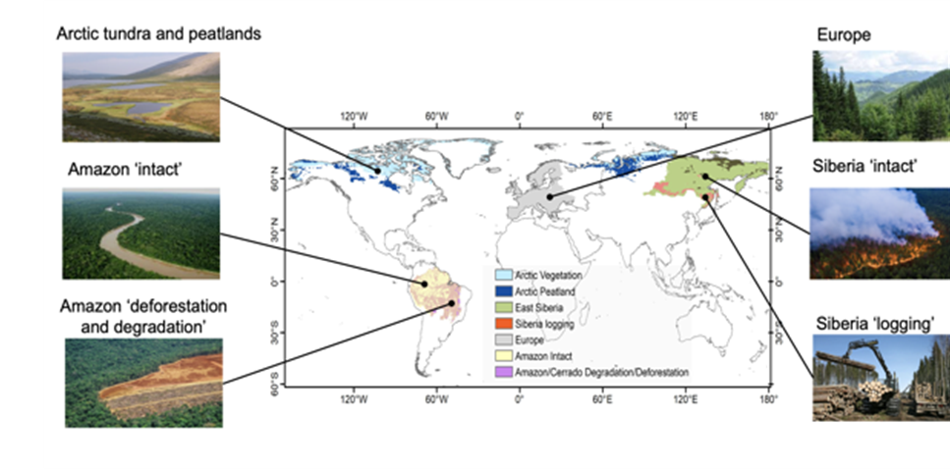
4.1 / 7.1: Engagement with GCP & RECCAP-2
Harness satellite based ECV for reducing the uncertainty on the emissions and sinks of CO₂, and CH₄ over key land regions, and attributing them to anthropogenic and global change drivers.
The project proposes to integrate bottom-up and top-down methods and compare their results with inventories for case study land regions that are of key importance for global budgets and where uncertainties on current CO₂, and CH₄ fluxes remain very large: Europe, Siberia, Amazon and Arctic.
The project also keeps a global perspective by developing a global framework to make EO-based estimates of bottom-up and top-down CO₂, and CH₄ fluxes comparable with national inventories.
4: Support efforts to reconcile bottom-up, top-down, and inventory estimates of GHG emissions and removals
4.1: Develop guidance and datasets to support the consistent comparison and assessment of bottom-up and top-down methodologies with national GHG inventories.

Slide 29


Actions 5.3/ 5.4/ 5.5: Wetlands
❖ Action 5.3: Consider best practice for including Blue Carbon Ecosystems (BCEs) in national inventories
GFOI/MGD: Blue Carbon Guidance for REDD+ reporting published in 2025
Global Mangrove Watch (JAXA) – 1985-2025 annual time-series for release in 2026
Coastal Blue Carbon Project (ESA) – seagrass, saltmarshes, mangroves
❖ Action 5.4(a): Explore the development of new CEOS initiatives on wetlands mapping and monitoring
LSI-VC “EO & Wetlands” theme initiated
GEO-Wetlands in GEO Work Programme. Led by Ramsar, Wetlands Int’l, ESA and JAXA
Wetland Inundation Dynamics mapping (JAXA) - Tropical wetland temporal dynamics
❖ Action 5.4(b): Ensure that CEOS missions consider wetlands amongst their mission goals
Wetlands science objectives in ALOS-2, ALOS-4, NISAR, ROSE-L, CHIME, LSTM (others?...)
❖ Action 5.5: Establish closer collaboration with the Ramsar Convention
JAXA & ESA long-term Ramsar STRP Observer Organisations
EO Side Event and GEO-Wetlands exhibition at Ramsar COP15
EO in the 2025-2028 Ramsar STRP Work Plan (Task 2.2: “Advancing the development and use of technology, especially through an initiative on Earth observation, for dynamic wetland mapping and inventory, assessment and conservation”.
5: Systematically target activities to support IPCC Land Cover classes

Slide 30

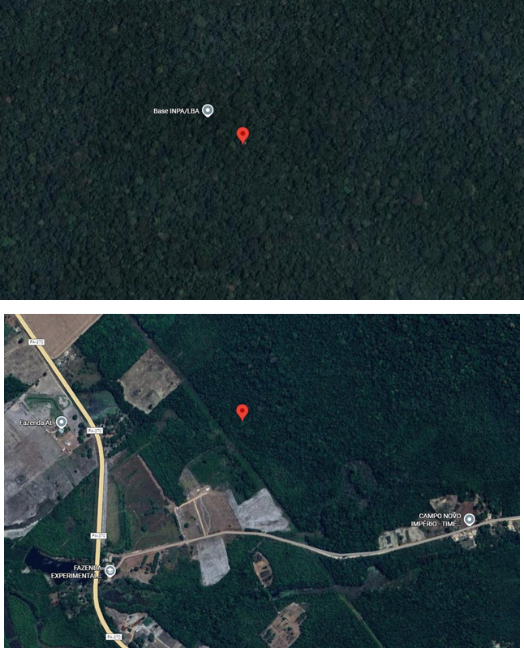

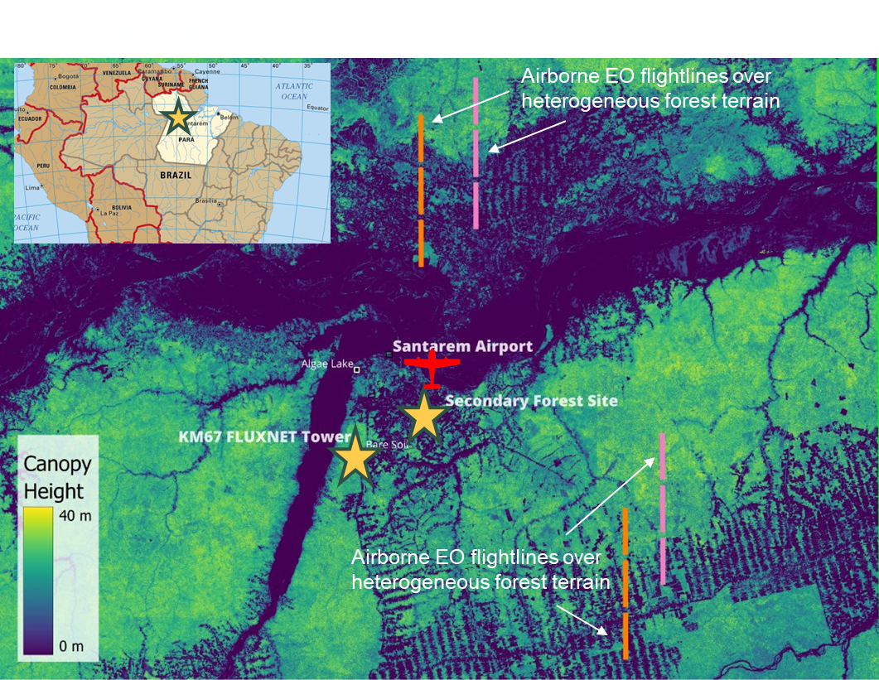

Action 3.2/6.1: ESA-INPE Campaign
Location of primary & secondary towers
3: Enable dialogue between inventory practitioners and the CEOS community
3.2: Undertake dedicated country demonstrations / field campaigns for better ground/space data integration

Slide 31
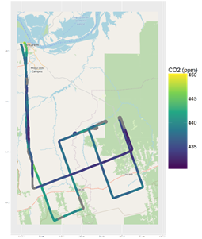

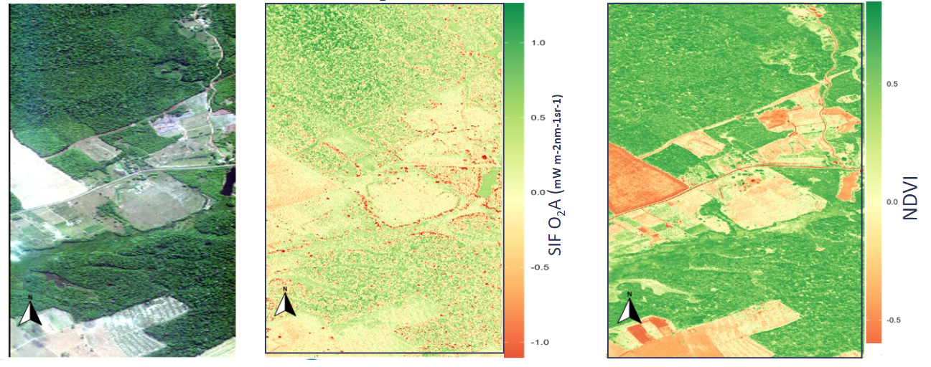
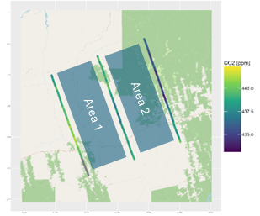
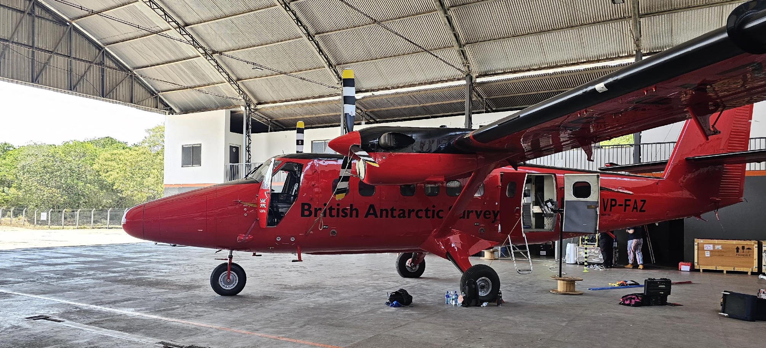
Action 3.2/6.1: ESA-INPE Campaign
Airborne landscape scale GHG fluxes
Solar Induced Fluorescence
Airborne CO₂
Mixing Ratio
Landscape Scale GHG Fluxes
Area 1: +2374 mg m⁻² h⁻¹
Area 2: +4070 mg m⁻² h⁻¹
Solar Induced Fluoresence :
Tower O₂A SIF @761 nm [13:29 UTC] 1.46 ± 0.33 mWm⁻²nm⁻¹sr⁻¹
Airborne O₂A SIF @761 nm [13:29 UTC] 1.71 ± 0.82 mWm⁻²nm⁻¹sr⁻¹
3: Enable dialogue between inventory practitioners and the CEOS community
3.2: Undertake dedicated country demonstrations / field campaigns for better ground/space data integration
Notes:
Landscape scale GHG Fluxes
Airborne CO₂ mixing ratios assessed during ~ 3 - 4 hr flights show clear contrasts over different land-covers, centred on early-afternoon time when fluxes should change relatively slowly.
Decrease in CO₂ downwind of primary forest, consistent with net carbon uptake, while over disturbed and secondary forest CO₂ mixing ratios increase downwind, potentially consistent with net CO₂ emission (tbc).
Very early CO₂ flux estimates suggest positive net fluxes (2374 and 4070 mg m⁻² h⁻¹) over the disturbed and secondary forest respectively, demonstrating the capability to resolve landscape-driven carbon dynamics.
SIF
Solar induced fluorescence (SIF) O₂A and NDVI maps retrieved from AisaIBIS and AisaFENIX1K airborne EO over contrasting land-cover types
Preliminary comparison of continuous tower (FLoX) and airborne (IBIS) SIF retrievals show consistency.

Slide 32
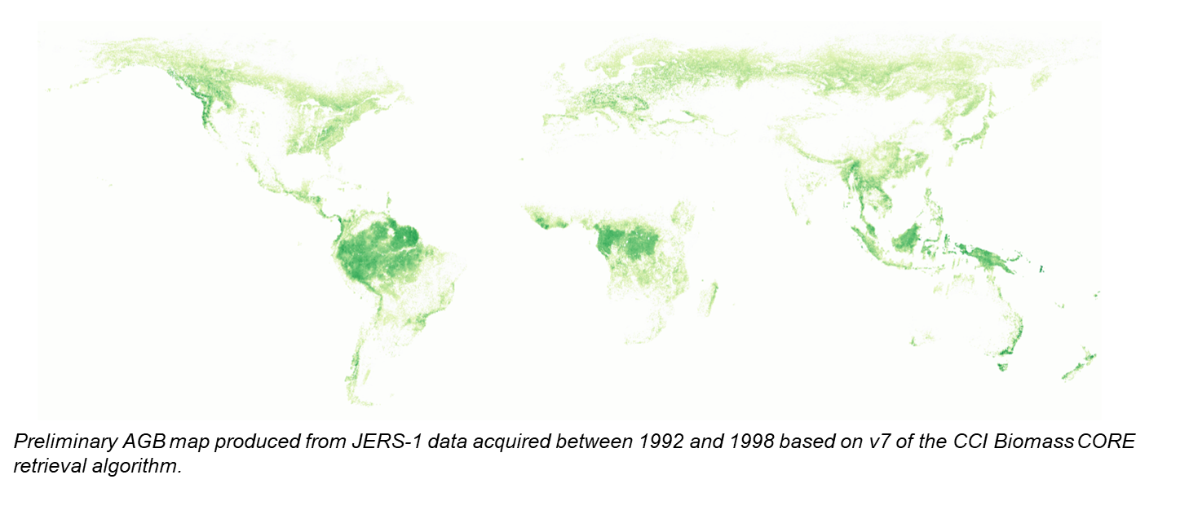
Recommendations 0 / 1 : CCI Biomass
1: Ensure continuity and long-term backward compatibility of CEOS missions providing activity data and emission factors
1.2: Explore harmonization and integration activities that generate temporal continuity and provide complete and consistent spatial coverage of Activity Data and biomass estimates.

Slide 33
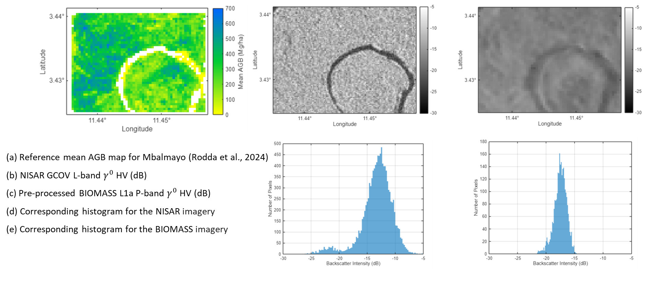
Recommendations 0 / 1 : CCI Biomass
1: Ensure continuity and long-term backward compatibility of CEOS missions providing activity data and emission factors
1.2: Explore harmonization and integration activities that generate temporal continuity and provide complete and consistent spatial coverage of Activity Data and biomass estimates.

Slide 34
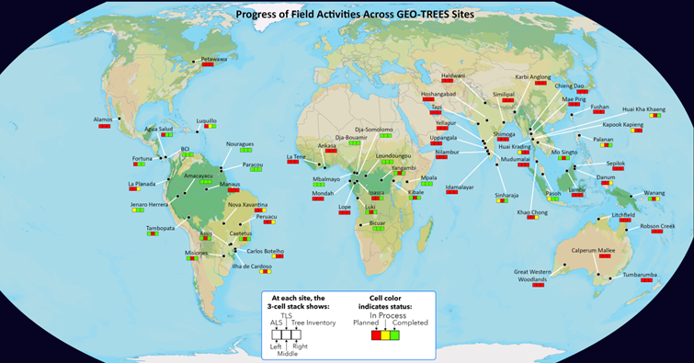
Action 2.5 - GEOTREES
Action 2.5 : Biomass harmonisation group to work with GEO-TREES to implement validation of CEOS biomass products with GEO-TREES data.
Data acquisition has been started for 38 sites
(of which 10 sites are complete)
Integration of national sites
(India, Australia, Canada) is ongoing
Geo-Trees technical workshops
  on Terrestrial Laser Scanning,
Chiang Mai, Nov 2025
  on Data Processing Pipeline
Harmonisation, Panama, March 2026
Awarding 6 research grants to GT site researchers in March 2026

Slide 35
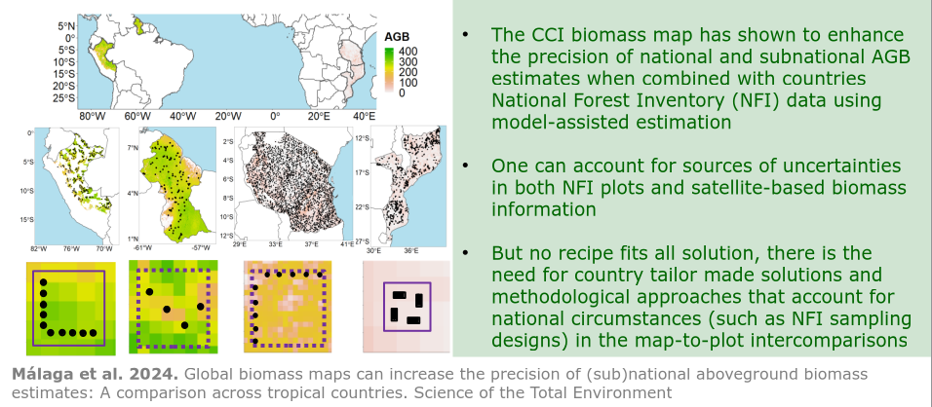
Action 2.6 / 2.8 / 3.1 R&D efforts on informed uptake of space-based biomass products

Slide 36
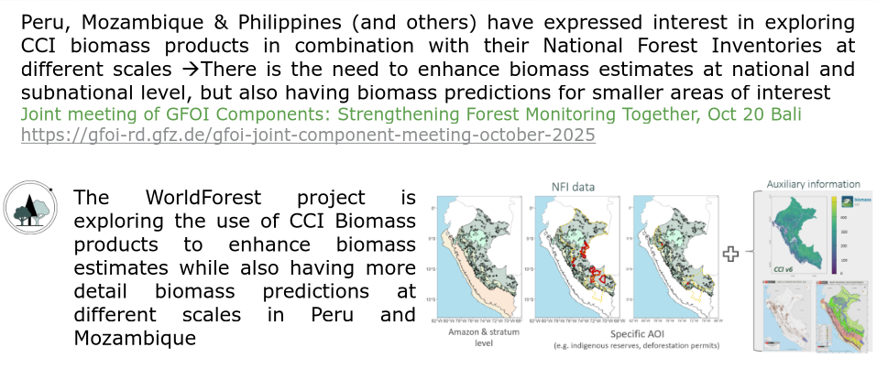
Action 2.6 / 2.8 / 3.1 R&D efforts on informed uptake of space-based biomass products

Slide 37
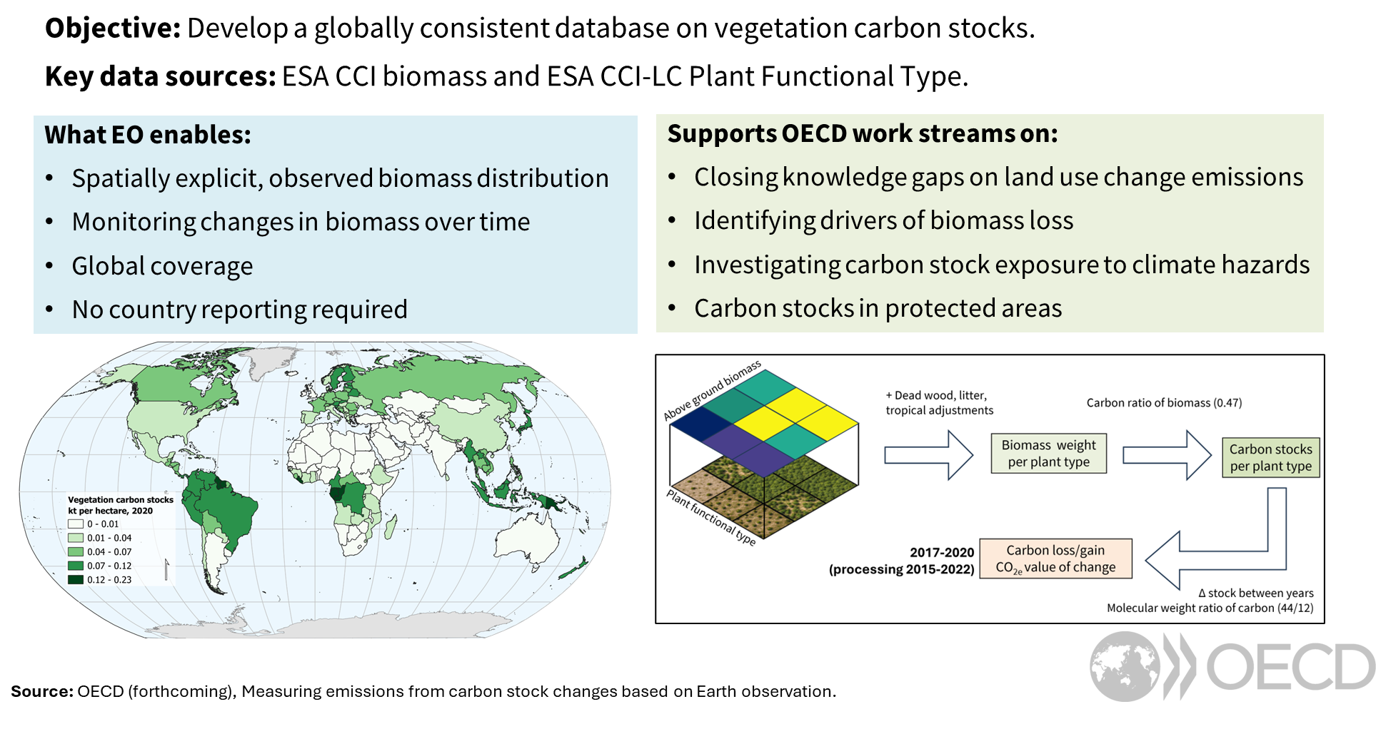
Action 2.6 / 2.8 / 3.1 R&D efforts on informed uptake of space-based biomass products - OECD exploring EO’s potential to monitor carbon stock

Slide 38
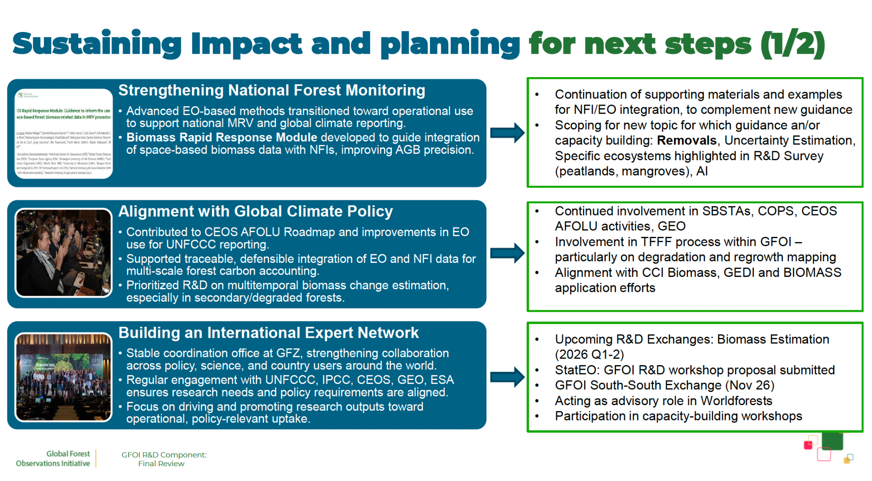
Action 2.6 / 2.8 / 3.1 R&D efforts on informed uptake of space-based biomass products - ESA support to GFOI R&D

Slide 39
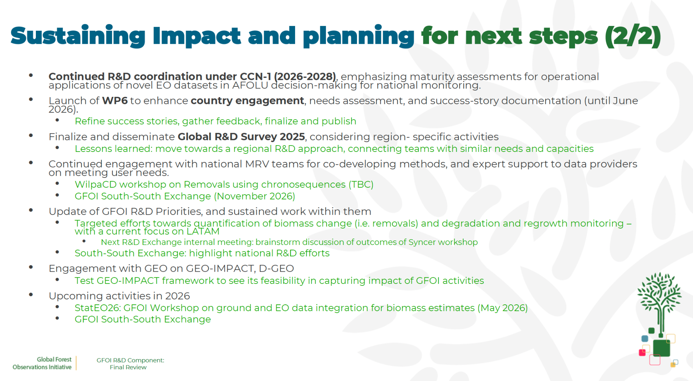
Action 2.6 / 2.8 / 3.1 R&D efforts on informed uptake of space-based biomass products - ESA support to GFOI R&D

Slide 40

Action 2.6 / 2.8 / 3.1 Guidance efforts on informed uptake of space-based biomass products - JAXA support to GFOI MGD
JAXA support to the GFOI Methods & Guidance Document (MGD) Advisory Group.
Guidance Documents released in 2025:
The use of space-based forest biomass-related data in MRV procedures
Advice on the inclusion of Blue Carbon in Greenhouse Gas Inventories and relationship with REDD+ reporting

Slide 41




Action 2.d ESA CarbonEYE Project
ESA’s CarbonEYE project brings forest carbon / biomass maps to the carbon markets

Slide 42




Action 2.d Earth Observation in support of Carbon Markets
Planting of trees on degraded land
Soil Carbon in Mineral Soils and Agroforestry
Rewetting of Peatlands

Slide 43






CEOS-ARD Directly Supporting AFOLU Goals
“For our Global Mangrove Watch (GMW) data workflow where we process thousands of images, the CEOS-ARD standard used for the JERS-1/ALOS/ALOS-2 SAR data from JAXA has simplified our processing chains with data now provided as GeoTIFFs and with standardised metadata. The specified pre-processing, including geometric rectification and radiometric terrain correction, has also been a significant help and reduced our internal data processing effort.”
Dr Pete Bunting, Global Mangrove Watch Product Lead, Aberystwyth University, UK
0: Ensure countries have access to satellite data from CEOS Agencies to report to UNFCCC following IPCC guidance
0.2: Ensure all relevant data are accessible through web portals plus physical media where necessary. Promote wider adoption of CEOS-ARD, within and beyond CEOS

Slide 44



Recommendation 5: Systematically target activities to support IPCC Land Cover classes. Actions 5.6: Rangelands
❖ Action 5.6: Improve rangeland mapping including via better classification of grasslands and rangeland (Continental, Africa) & linkage with other organisations
Global Pasture Watch (World Resources Inst.):
  Annual grassland class and extent maps at 30-m spatial resolution (2000—2024)
  Part of Land & Carbon Lab consortium

Slide 45



L-band SAR Annual Global Mosaics and Forest/Non-Forest maps
“For our Global Mangrove Watch (GMW) data workflow where we process thousands of images, the CEOS-ARD standard used for the JERS-1/ALOS/ALOS-2 SAR data from JAXA has simplified our processing chains with data now provided as GeoTIFFs and with standardised metadata. The specified pre-processing, including geometric rectification and radiometric terrain correction, has also been a significant help and reduced our internal data processing effort.”
Dr Pete Bunting,
Global Mangrove Watch Product Lead,
Aberystwyth University, UK
0: Ensure countries have access to satellite data from CEOS Agencies to report to UNFCCC following IPCC guidance
0.1: Ensure data policies remain open and free and that all relevant satellite Level 1b data are available to Parties as needed.

Slide 46



Radarsat-2 Tropical Forests Dataset
Free access to processed RADARSAT-2 data over tropical forests archive datasets for science and research.
CSA in collaboration with Natural Resources Canada’s Canada Centre for Mapping and Earth Observation (CCMEO) and MDA Space.
High-resolution C-band Synthetic Aperture Radar (SAR) data available through the Earth Observation Data Management System (EODMS) platform, spans over a decade – from 2014 to 2024.
24-day revisit over four main regions: Africa, Central and South America and South-East Asia with Indonesia and additional areas expected to be available in 2026
0: Ensure countries have access to satellite data from CEOS Agencies to report to UNFCCC following IPCC guidance
0.1: Ensure data policies remain open and free and that all relevant satellite Level 1b data are available to Parties as needed.

Slide 47








Biomass Harmonization Past Activities
Objectives:
FAO supported NASA effort to use GEDI Biomass Data toward national reporting in West Africa.
5-year collaborative product ‘Global Transformation of Forests for People and Climate: a focus on West Africa’ between UN FAO, SIDA, ECOWAS
Little forest biomass data are available in the 15 participating West African countries – can we use GEDI to gap-fill?
Collection of regional reference data critical to calibrate / validate GEDI
GEDI Biomass not used for national reporting yet, but FAO working with countries to uptake data
Showcase how EO-based estimates can be used to fill gaps in current guidance in the policy domain, such as biomass estimates in lands outside ‘forests’ and EO-based estimates for refining IPCC Tier 1 defaults.

