Slide 1
Proposal: Annual Report on the State of the CEOS Virtual Constellations
Libby Rose
Agenda Item 1.3
SIT TW 2026
Washington DC, USA
8-10 September, 2026

Slide 2
Current Issues
Mission timelines as generated by MIM don’t always tell the full story
  Add commentary by experts in the domain
Gaps in the observing system aren’t succinctly and consistently reported
  A written report is more easily shareable and digestible rather than a series of presentations
How these gaps are filled isn’t tracked
  Annual report, produced in the same format each year, with commentary on how gaps previously reported are now filled

Slide 3
State of the CEOS Virtual Constellations Report
Compiled by the SIT Chair Team and presented for information to CEOS Principals at Plenary each year
Provides timelines for key observables, alongside a paragraph of text explaining any nuances, and gaps and opportunities highlighted
Agencies are invited to consider the gaps and opportunities in their mission planning
Complements CGMS & WIGOS analyses

Slide 4
Scope
Scope limited to Virtual Constellations:
  CEOS has identified these observables and domains as key areas requiring coordination
  Propose to include SAR preemptively
Can consider adding other relevant thematic observables in the future

Slide 5
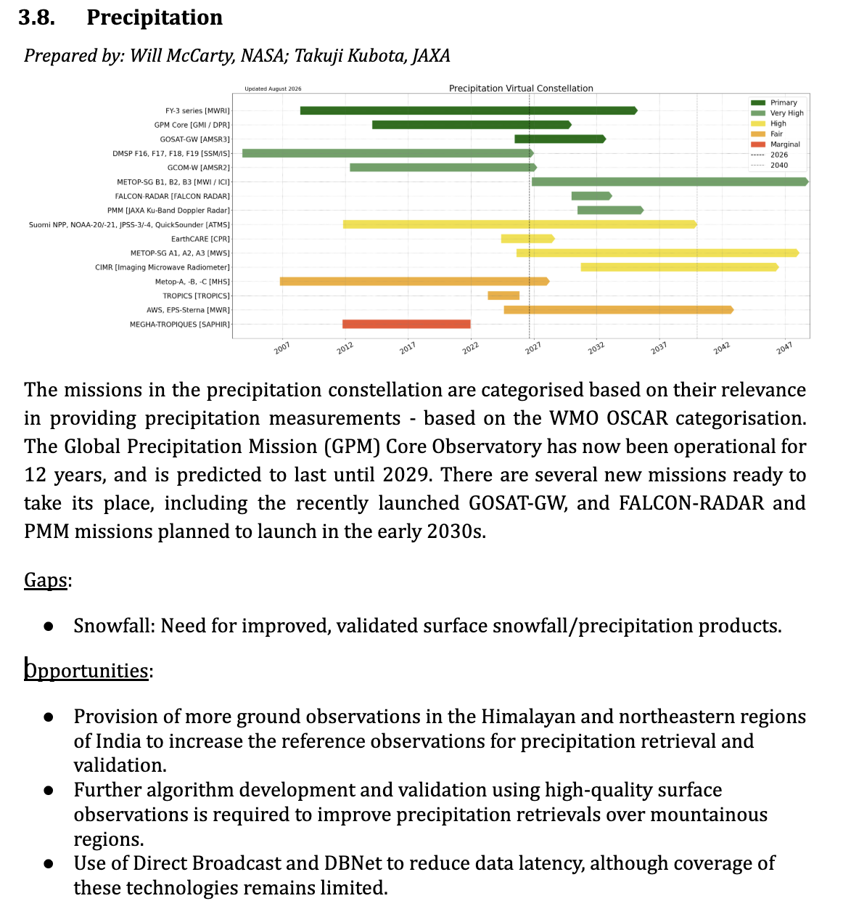
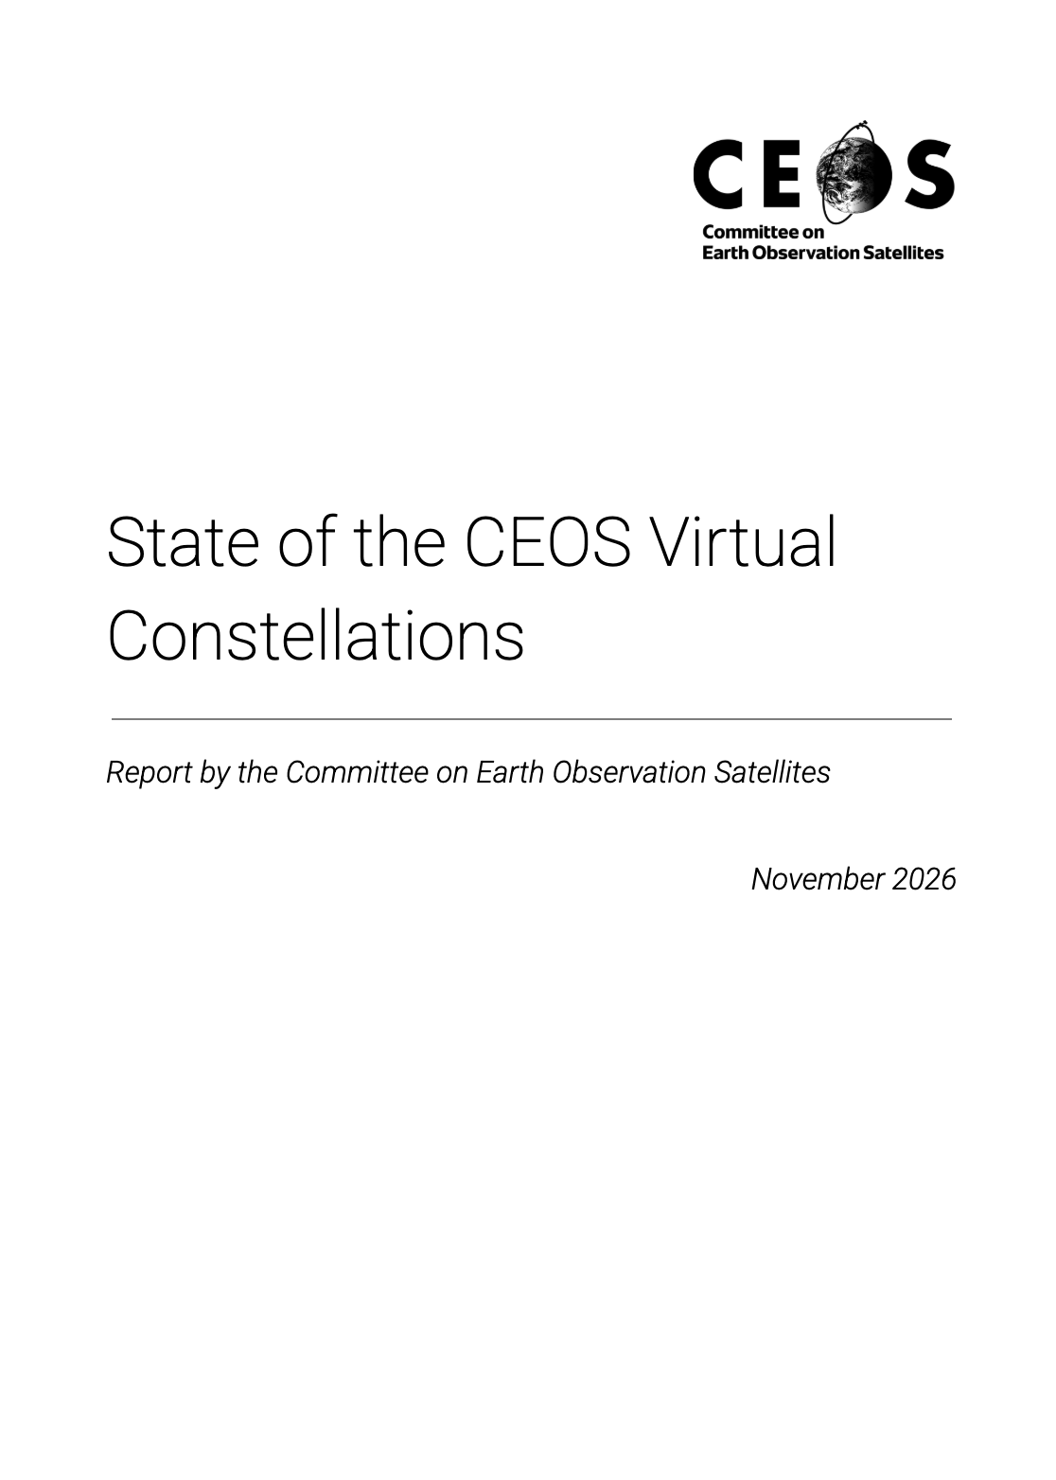
Example:
DRAFT

Slide 6
Next Steps
VCs to provide inputs based on their presentations in item 1.2
  All inputs to be received by 9 October 2026 (four weeks from now)
Report will be circulated to CEOS Members and Associates ahead of the 2026 CEOS Plenary

