Slide 1
DOI
Process Paper
Dave Borges, SEO
Agenda Item 2.2
SIT TW 2026
Washington DC, USA
8-10 September, 2026

Slide 2
DOI Process Paper Motivation
CEOS documents and papers have lacked persistent identifiers
Multiple CEOS groups requested SEO create a standardized mechanism to assign Digital Object Identifiers (DOIs)
CEOS had no formal process for assigning DOIs
Defines a formal process for the assignment of DOI to eligible CEOS documents and papers
Serves to create a public record specifying that a version of a document holds a specific CEOS status

Slide 3
Benefits of DOIs
Persistent Access
  A DOI resolves permanently, so a CEOS document remains reachable after websites are reorganised or links change
Increased Discoverability
  Standardized metadata means CEOS outputs appear in global research indices (DataCite, OpenAIRE, Google Search), making them findable by the broader EO community.
Citation Tracking
  DOIs enable formal citation of CEOS work in peer-reviewed literature, allowing measurement of the reach and impact
Open Access Alignment
  DOI registration is open by default and consistent with CEOS's open-data commitments and FAIR principles.

Slide 4

Platform for Assigning DOIs
Why Zenodo is the Right Platform
CEOS Implementation Approach
Free, open-source platform operated by CERN and funded by the European Commission through OpenAIRE. No cost to CEOS and no vendor lock-in; data remains exportable.
Community curation model CEOS maintains a dedicated collection space with admin/curator controls. Only approved content appears in the CEOS community.
Flexible content types a single platform handles reports, datasets, software tools, presentations, and standards documents. All receive DOIs through DataCite.
Built-in review workflow Zenodo's 'Submit for Review' feature allows draft submissions to remain private until curator-approved. All review comments are tracked, providing a transparent audit trail.
Community Management: SEO will serve as Technical Coordinator to manage the CEOS Zenodo Community, metadata standards, and publication execution.
Standardized metadata requirements: mandatory CEOS keywords, author affiliations with CEOS agency identification, Earth observation context, and related identifier linkages.
Complements agency DOI practices: the CEOS process is for collaborative CEOS outputs. Member agencies may continue to assign DOIs through their own repositories for agency-specific work.

Slide 5
Relationship to Governance
Governance and Processes Document decides how documents reach Principals and what statuses are eligible for DOIs
The process paper defines only the mechanism for DOI assignment
Covers how to submit, review, and publish, not whether a document should be published
No role in the process may interpret, extend or waive Governance requirements
If the Governance is updated (e.g., the status of a decision type changes), the DOI Process Paper's applicability criteria will update accordingly without requiring significant amendment (specific status is mentioned for clarity)

Slide 6
Two Status are Eligible
Document Status | DOI Treatment | Decision Required
Endorsed | Assigned Automatically | At Endorsement
Acknowledged | Elective, by submitting entity | At Submission, or any later time (Section 2.1)
For Endorsement submission is taken as the DOI decision. No separate election later
For Acknowledged documents the election belongs to the submitting entity
All other statuses are not eligible

Slide 7
Roles and Responsibilities
Three roles execute the process. None holds authority to interpret, extend or waive the Governance requirements; each verifies against the record or executes a technical step. The Secretariat sits outside the process as the authoritative source of that record.
Submitter: Creates Zenodo account, prepares draft submission with complete metadata, submits for review, responds to feedback, performs post-publication verification. Submitters are typically Working Group or Virtual Constellation members preparing documents on behalf of their CEOS entity.
CEOS CEO as Documentation Lead
CEOS SEO as Technical Coordinator
Strategic coordination & governance verification
Technical implementation & platform management
Verification: Confirms that submitted documents have completed the Document Approval by examining meeting minutes and formal communications.
Coordination: Works with submitters and CEOS Secretariat to gather endorsement documentation.
Referral: For unclear or contested governance status, refers the matter to CEOS leadership
Completion: Ensures DOI assignment completes once status is conferred, following up with the Submitter where it has not concluded within 30 days
Technical Review: Reviews submissions against CEOS metadata standards for completeness, resource type selection, mandatory keywords, related identifiers, professional presentation.
Platform Administration: Manages CEOS Zenodo community space, user permissions, community curation, and quality oversight.
Publication Execution: Publishes approved submissions after both technical compliance and governance verification are confirmed.
Support: Assists submitters with Zenodo interface and metadata requirements.

Slide 8
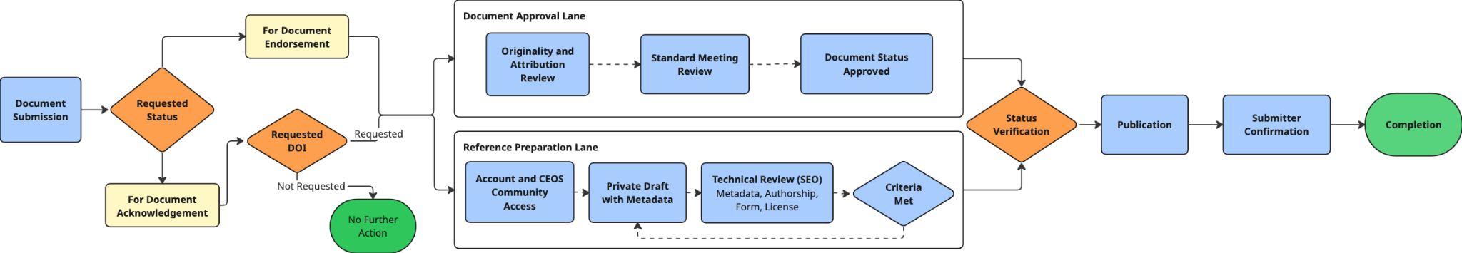
DOI Workflow
Two lanes, the Document Approval and Reference Preparation, may proceed independently and come together at status verification
Nothing public before publication. Any draft withdrawn or retained privately leaves no public trace

Slide 9
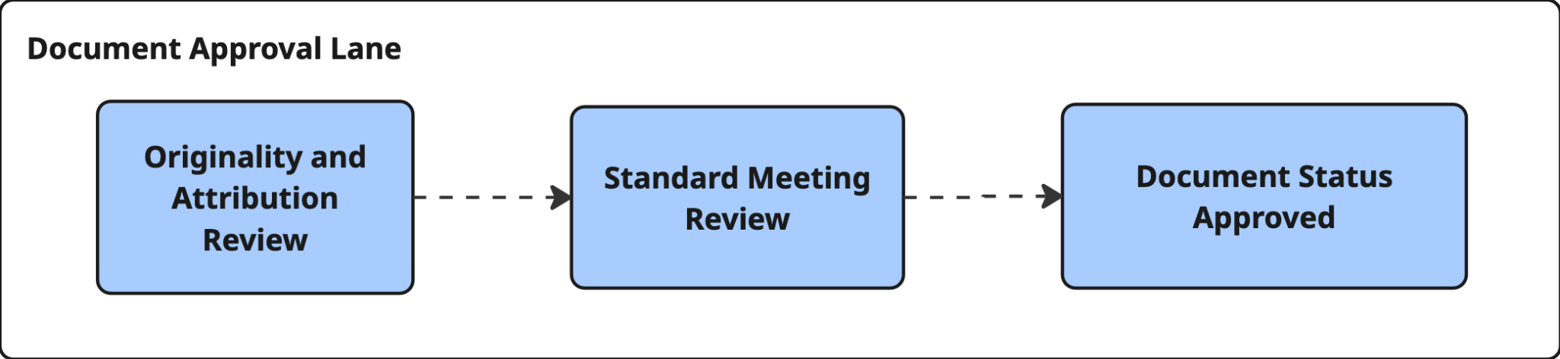
Document Approval
Originality and Attribution Review
All authors confirm final text
Correct cover page based on status
Acknowledgement packages should indicate the election for DOI assignment within 30 days
Submitted to Principal meeting with time to review
Once approved, status is confirmed by CEOS CEO

Slide 10
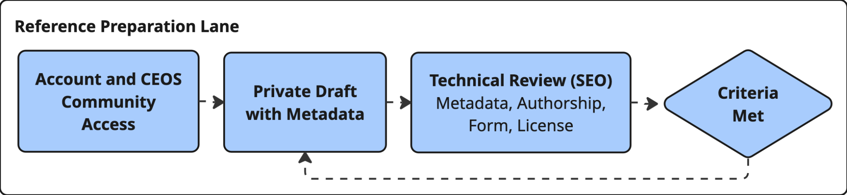
Reference Preparation
Zenodo Account creation and CEOS community access
Draft is prepared with metadata outlined in the Zenodo Submission Guide
Four Acceptance Criteria:
  Metadata complete
  All authors agree
  Files final and submitted
  Licence is appropriate

Slide 11
After Confirmation and Publication
Publication Confirmation: After SEO publishes, Zenodo mints via DataCite. Submitter's will check that the DOI resolves, the record visible in community, metadata is correct
Version Rule: DOI attaches to the version that received status. Any change needs fresh status before a new version is published
Hosting: DOI resolves to the Zenodo landing page; canonical copy lives on the CEOS publications page with Zenodo metadata pointing there

Slide 12
Status and Next Steps
Current Status
Next Steps
Process Paper v1.0 (Aug 2026) finalised and circulated. Redesigned since SIT-41 to sit entirely beneath CEOS Governance and Processes Rev 2.0: eligibility follows document status, two-lane workflow
Governance Rev 2.0 now names the DOI Process Paper as the mechanism by which publication and branding align with status. The two documents are designed to be endorsed together
Roles assigned: CEOS Executive Officer as Documentation Lead; SEO as Technical Coordinator. CEOS Zenodo community established and ready to receive submissions on endorsement.
Submission of DOI Process Paper for endorsement, alongside Governance and Processes Rev 2.0. Final version provided to for review.
Zenodo Submission Guide: the operational companion to the paper is being prepared by SEO and will be published on the website
Retroactive assignment: prepare list of existing CEOS key documents to receive DOI and confirm status record for legacy documents before first batch.
Path to Plenary 2026
SIT-41 (Apr 2026)
SIT Technical Workshop
Plenary 2026 (Nov)
Update and discussion.
Solicit feedback on approach,
scope, and governance alignment.
Final draft circulated by CEO prior to TW. Virtual Endorsement secured Friday, 04 September 2026.
Updated Governance and Processes Paper & DOI Process Paper in place, guiding Principal decisioning.

Slide 13
Existing Publications
Key documents will retroactively be assigned a DOI
Monitoring Surface PM2.5: An International Constellation Approach (2022)
Greenhouse Gas Roadmap Issue 1 (2020)
Greenhouse Gas Roadmap Issue 2 (2024)
Geostationary Air Quality Constellations Validation Strategy (2019)
Greenhouse Gas White Paper (2018)
Geostationary Air Quality Constellation (2011)
Common Practices for Quantifying Methane Emissions from Plumes Detected by Remote Sensing (2025)
CEOS Strategy for Carbon Observations from Space (2014)
CEOS Global Stocktake Strategy (2021)
Lessons Learned and Recommendations from Space Agencies' Support for the First Global Stocktake (2025)
Essential Climate Variable Inventory Analyses (2018)
Space Agency Response to GCOS IP (2018)
Space Agency Response to 2022 GCOS IP v1.2 (2026)
ECV Inventory Gap Analysis Report (2024)
WGClimate Coordinated Action Plan (2024)
Sustainable Development Goals Data Supply Analysis and Strategy (2020)
CEOS Ecosystem Extent Task Team White Paper v1.1 (2023)
WGDisasters Strategy Paper: Promoting Space Data for Disaster Risk Management (2020)
CEOS AFOLU Roadmap (2023)
Land Sector Emissions: CEOS AFOLU Discussion Paper (2020)
Agriculture: CEOS Response to GEOGLAM Requirements (2019)
Forests: Space Data Strategy for GFOI (2011)
A Coordinated International Satellite Altimetry Virtual Constellation: Towards 2050 (2025)
Next-Generation Sea Surface Temperature Constellation (2020)
15 Year Vision for Ocean Surface Topography (2009)
Global Satellite Precipitation Constellation: Status & Requirements (2021)
Feasibility Study for an Aquatic Ecosystem Earth Observing System (2018)
CEOS Strategy for Water Observations from Space (2015)
And many other publications...

