Slide 1
Expanding Geostationary Atmospheric Composition Satellite Constellation: Towards Global Coverage
Emma Knowland
Ali Omar, NASA
Agenda Item 2.4
SIT TW 2026 Washington, DC
8-10 September, 2026

Slide 2
Outline of White Paper and this Presentation
01
At the beginning
02
The Volunteer Team
Genesis of this activity
Orgs/Disciplines/Regions
03
The Problem
04
Gaps in Observations
Geostationary Solution
The case for a Geo-Belt Constellation
05
Ground Measurements
06
Closing high latitude gaps
Strengthening and standardizing
Inclined Geo Solution
07
Benefits
08
After the White Paper
Integrated Observations Modeling, Forecasting, Transport
Continue efforts to inform, build capacity and explore opportunities

Slide 3
Expanding Geostationary Atmospheric Composition Satellite Constellation: Towards Global Coverage
GENESIS
In 2024, CEOS AC-VC commissioned a new White Paper to expand GEO coverage to unmonitored regions
The goal was to complement GEMS, TEMPO, and Sentinel-4 with additional satellites for global air quality and greenhouse gas observations
A dedicated team has been meeting bi-weekly from October 2024 to draft the document
The initial plan was presented at the October 2025 CEOS SIT TW Meeting
Following this meeting, the scope was reduced to focus exclusively on air quality
A final Geo Expansion White Paper will be ready for the 2027 SIT 42 meeting for review by the Principals.

Slide 4
White Paper Authors
Betsy Farris
University of Colorado
Jonathan E Hickman
NASA GISS (Columbia University)
Eloise Marais
University College London
Dylan Millet
University of Minnesota
Ray Nassar, Christopher Sioris
Environment and Climate Change Canada (ECCC)
Marloes Penning DeVries
University of Twente, Netherlands
Rob Ryan
University of Melbourne, Australia
Raid M Suleiman
Harvard-Smithsonian Astronomical Observatory
Ben Veihelmann
European Space Agency (ESA)
Karn Vohra
University of Birmingham, UK
Jun Wang
University of Iowa
Ali Omar, Emma Knowland, Barry Lefer
NASA
James Hannigan, Pieternel Levelt, Shima Shams, Helen Worden
National Center for Atmospheric Research (NCAR)
Owen Cooper, Shobha Kondragunta
National Oceanic and Atmospheric Administration (NOAA)
Ana Andries
Surrey University, UK
Paulo Artaxo
University of Sao Paolo, Brazil
Sara Basart
World Meteorological Organization (WMO)
Dominika Cyzewska
European Org. for the Exploitation of Meteorol. Satellites (EUMETSAT)
Arlindo daSilva
Asticou-Earth Systems LLC USA)
Sebastian Diez
Universidad del Desarrollo, Chile
Omar Emam
Intospass, UK
Notes:
28 Co-authors from Universities, Agencies and Industry in the US, Europe, Canada, Australia, Middle East and South America

Slide 5
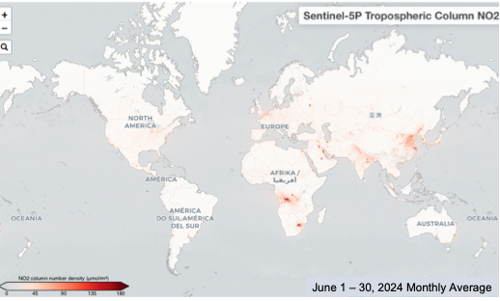
The Challenge – Addressing the Gap in Observations
Human activities drive rapid atmospheric changes.
The fast pace of change requires hourly observations.
These shifts directly impact air quality and human health.
Accurate measurements are vital to guide actions and evaluate the success of current strategies
Tropospheric Nitrogen dioxide (NO₂ ) column concentration retrieved by Sentinel 5P for the month of June 2024. High column densities ( denoted by bright red colors ) over the South Africa are associated with high power plant and industrial emissions in the region. Elevated column densities over south equatorial Africa are associated with dry season biomass burning activity

Slide 6
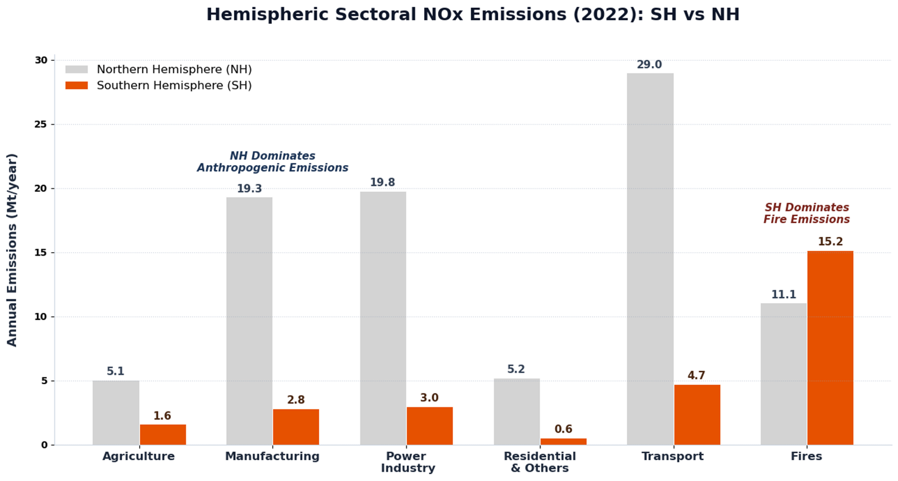
No_{x} Emissions : A tale of two hemispheres
NH - NOx emissions from different source sectors are higher than fire emissions in the NH
SH - fire emissions are are the main source of NOx
Source: EDGAR database for anthropogenic emissions and Zhu and Kondragunta (2026) for fire emissions.

Slide 7
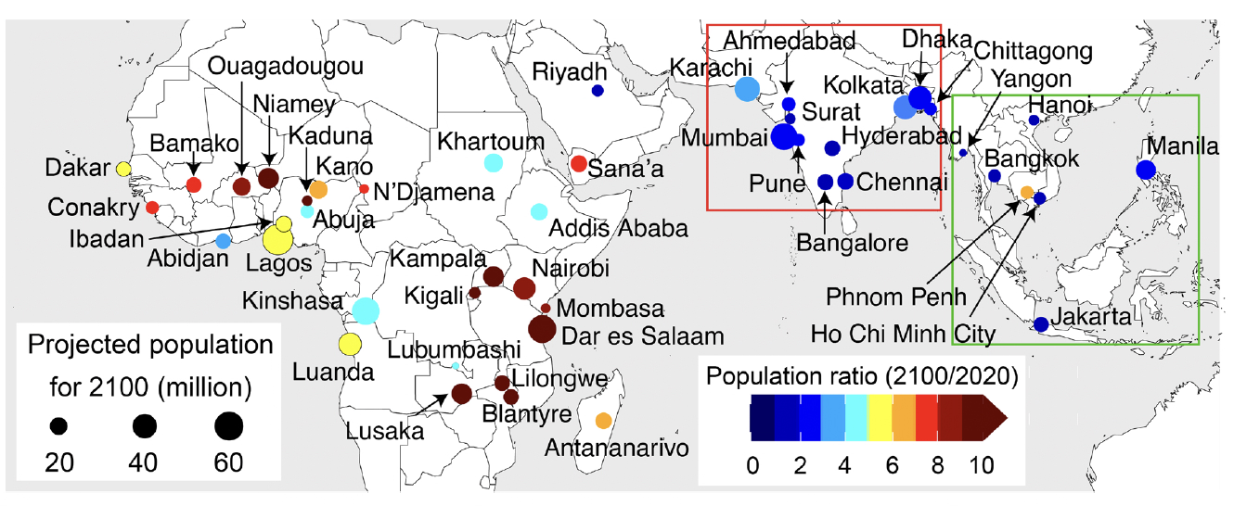
Projected population growth for the fastest-growing cities in the tropics (25°S to 25°N) by 2100
Source: Vohra et al. (2022)
Notes:
Projected to be megacities (population ≥ 10 million) by 2100. Only 12 are megacities now, mostly in India. Forecast population
growth rates from 2020 to 2100 range from 3 to 31% per year in Africa, 1% per year for Riyadh and 8% per yr for Sana’a in the
Middle East, 0.8 to 3% per year in South Asia, and 0.5 to 7% per year in Southeast Asia. The largest cities, predicted to surpass 50 million
inhabitants by 2100, include Lagos (80 million) in Nigeria, Dar es Salaam (62 million) in Tanzania, Kinshasa (60 million) in the
Democratic Republic of the Congo, and Mumbai (58 million) in India

Slide 8
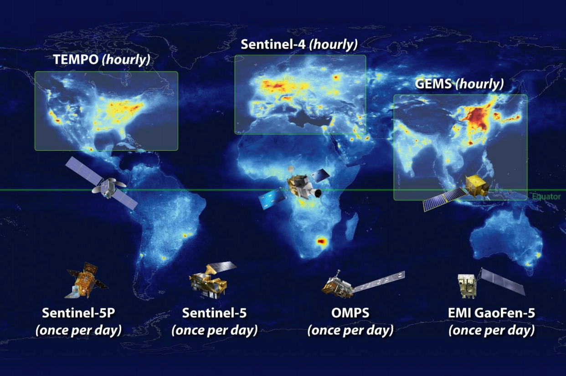
The Current Landscape
  The CEOS Atmospheric Composition Virtual Constellation (AC-VC) partners provide valuable data
  Gaps remain in observing diurnal cycles, rapidly changing events, and specific pollutants in the SH and populated NH regions
  Polar-orbiting satellites offer global coverage, but limited temporal resolution

Slide 9
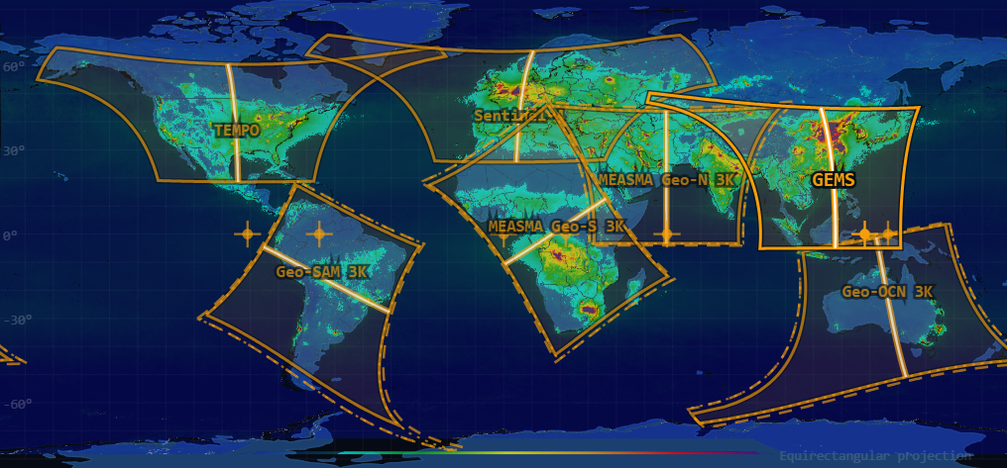
Closing the Gap: The Global Geostationary Satellite Solution (Geo-Belt)
  Notional geostationary satellite concepts for coverage of gaps
  Continuous, wide-area coverage over currently undermonitored regions
  Complementing and enhancing existing constellation
  Significant ownership and participation at the regional level to build capacity
  Leverage the Analysis Ready Data (ARD) concepts for Geo
The benefits of investing in geostationary atmospheric composition monitoring extend far beyond the science. By improving our ability to predict and respond to environmental challenges, we can realize significant economic savings in areas such as healthcare, agriculture, and resource management

Slide 10
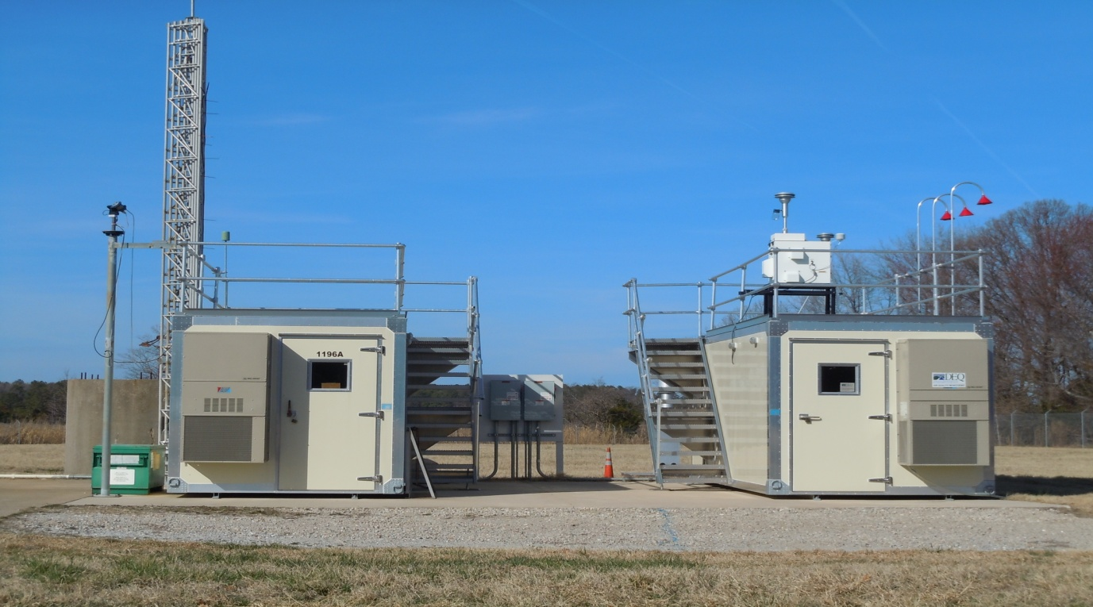
Strengthening Ground-Based Measurements for Calibration/Validation
Leverage existing ground-based networks (e.g., AERONET, Pandonia, NDACC).
Establish strategically located collection of instruments at relevant sites
Focus on comprehensive instrumentation and local capacity building.
Engage diaspora scientists to reach local institutions (e.g., AMS Townhall Jan 2025) in developing countries
Credit: Ali Omar
  The disparity in atmospheric composition ground-based measurements around the globe creates an issue, as unmonitored regions are often disproportionately impacted by pollution but lack the resources to monitor and mitigate the impacts effectively.

Slide 11
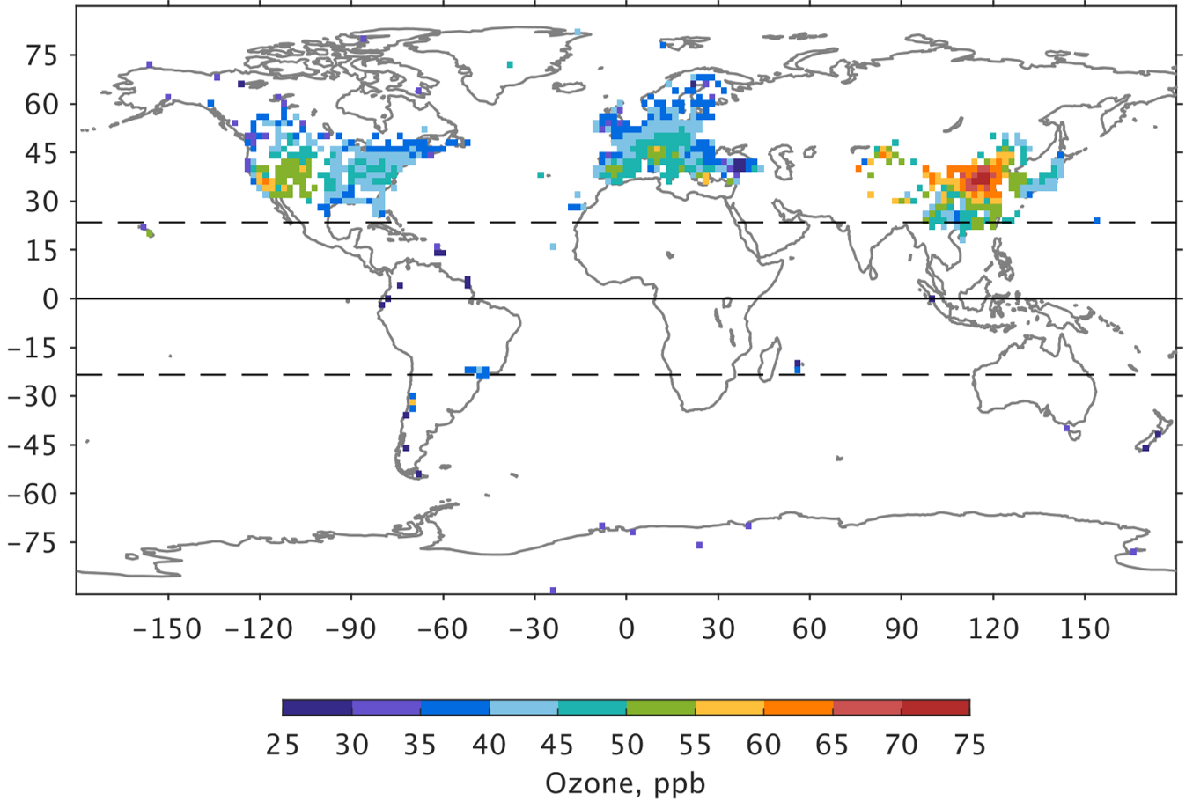
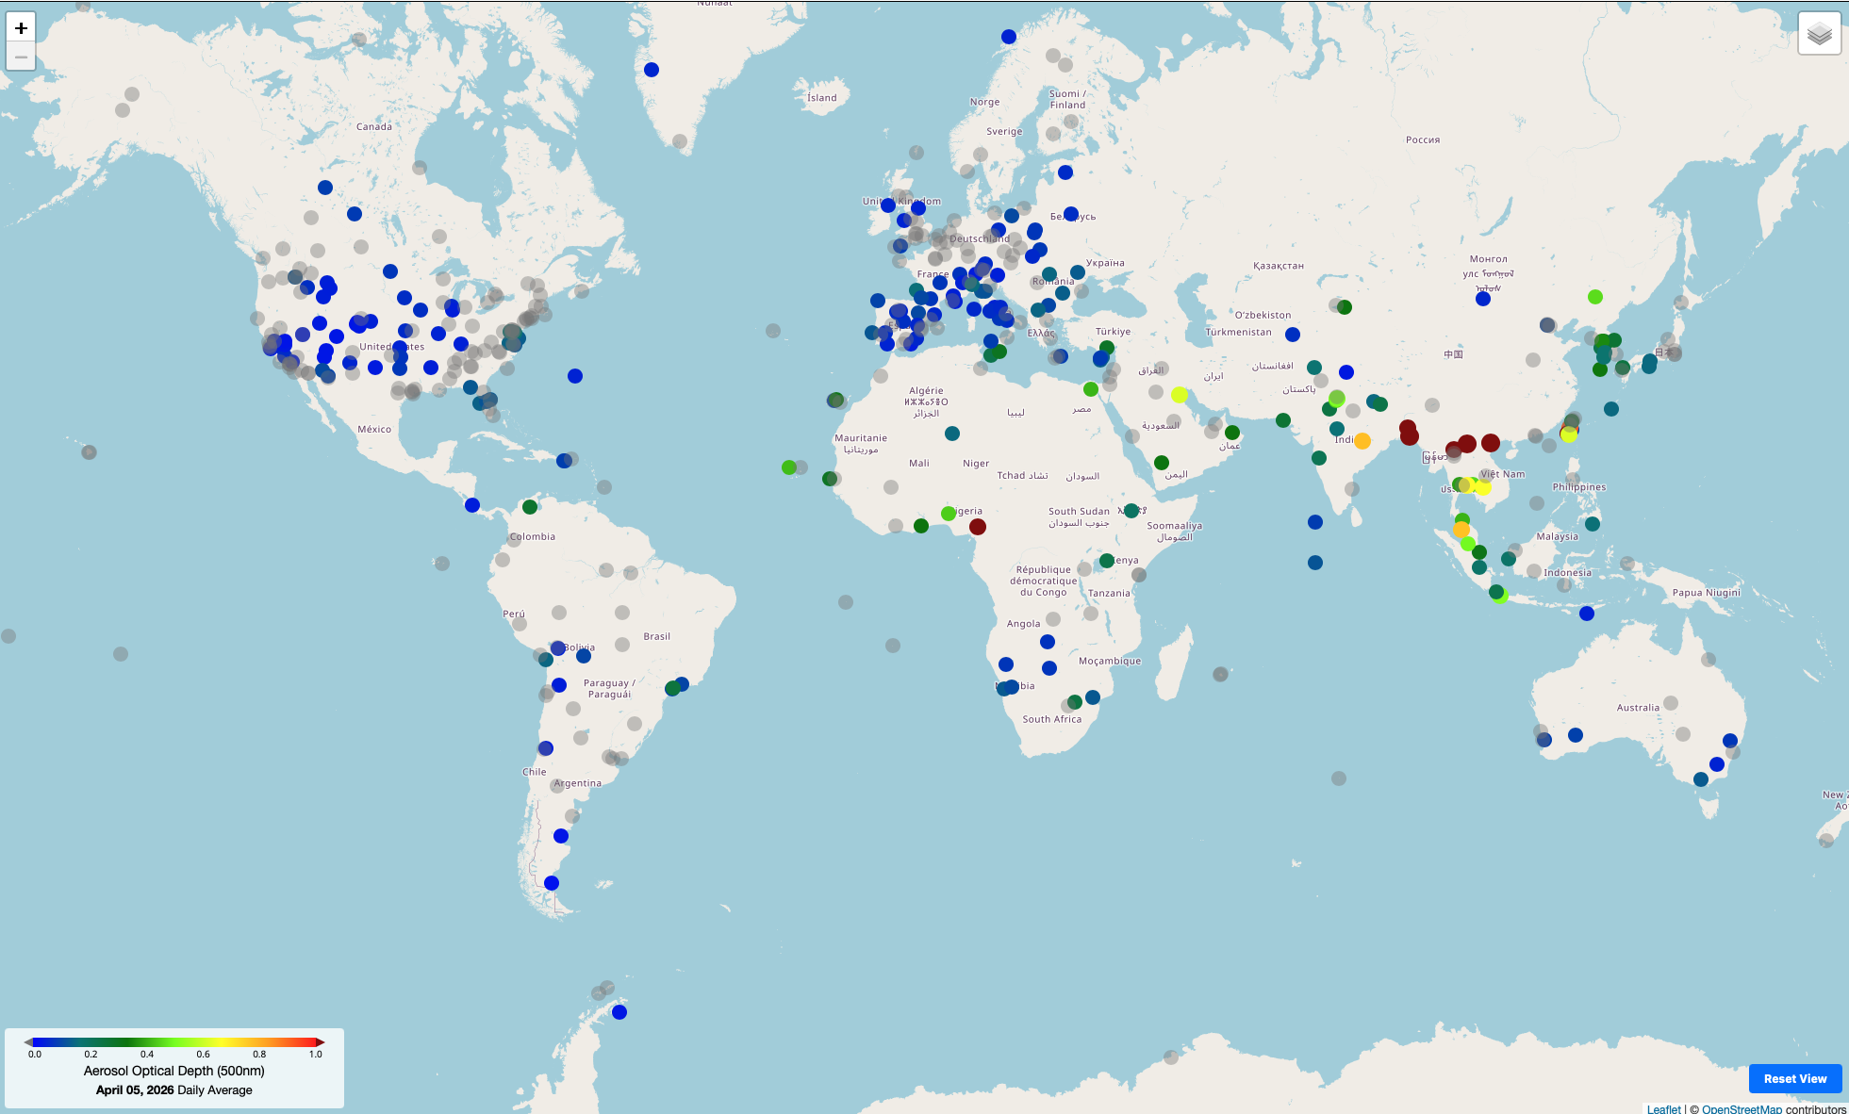
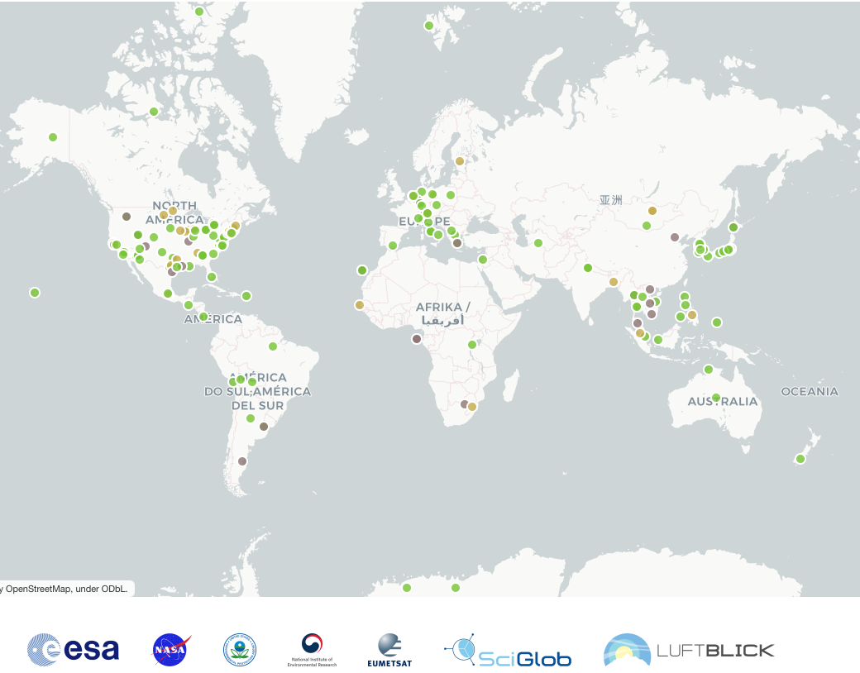
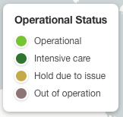

Ground Stations for Monitoring Ozone, Nitrogen dioxide, and Particulate Matter
All available surface ozone (O₃) observations from the Tropospheric Ozone Assessment Report (TOAR). Note that Ozone monitors exist in Australia but are not yet in the open-access TOAR-II database (Szopa et al., 2026)
Pandonia Global Network (PGN) – Trace gases NO₂, O₃, HCHO, etc
AERONET – Optical Depth (proxy for PM)
TOAR-II
AERONET
Strengths
Uniform and standardized
Algorithms /data processing
Instrument operating routines
Quality control
Real-time data processing
Data archiving
PANDONIA
Geostationary observations will provide data in regions not covered by ground networks

Slide 12
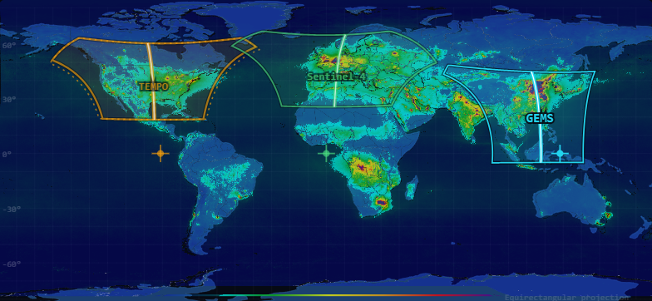
Geo-Belt Constellation – Notional Maps
GeoAQ Constellation – TEMPO, Sentinel-4, GEMS
Geo-Belt Constellation : GeoAQ Constellation +4
High latitudes are not covered the the Geostationary Platforms

Slide 13
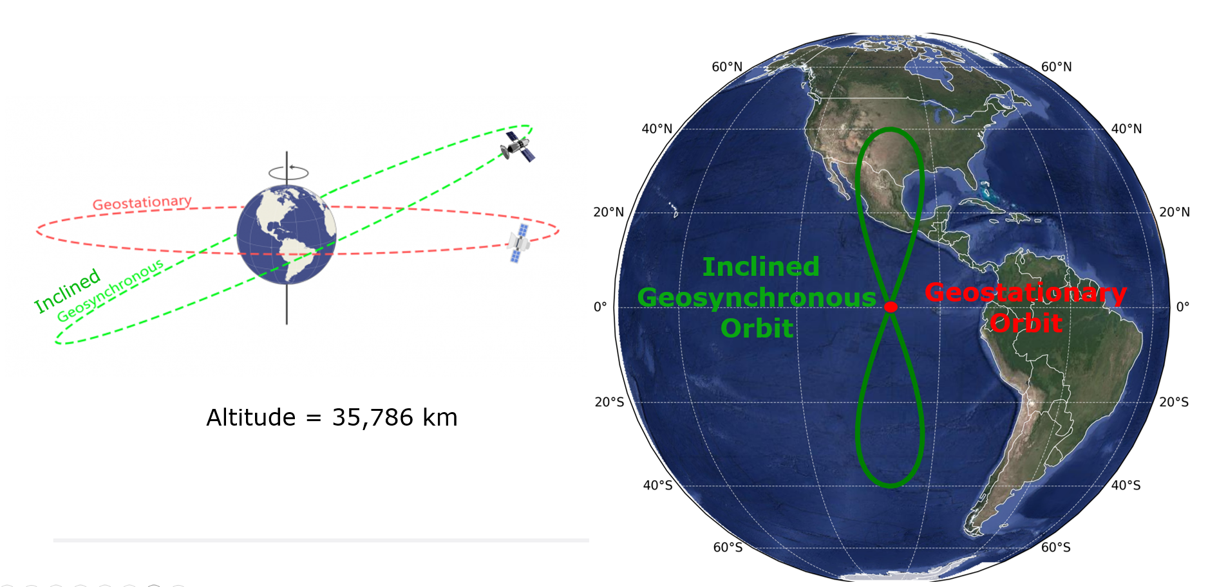
Inclined Geosynchronous Orbits (IGOs)
ECCC has proposed the use of Inclined Geosynchronous Orbits (IGOs) to observe under monitored regions at high northern latitudes

Slide 14
Summary and Path Forward: Towards Global Air Quality Coverage
The Geo-Belt Solution: Four new geostationary satellites and inclined orbits address critical diurnal air quality coverage gaps across unmonitored regions.
Notional Concepts: The proposed orbital configurations and satellite solutions within the white paper are strictly notional ideas for collaboration and consideration.
Integrated Strategies: The white paper synthesizes CEOS ARD, Validation, and Geostationary AQ document recommendations to ensure robust ground-based calibration, and data access and interoperability.
Actionable Benefits: This integrated, analysis-ready approach improves predictive modeling and supports epidemiological research, potentially saving lives and driving global economic savings in healthcare and resource management.
Path Forward: Socialize the white paper with the broader science community, integrate CEOS capacity building concepts and submit to the next CEOS meeting.

Slide 15
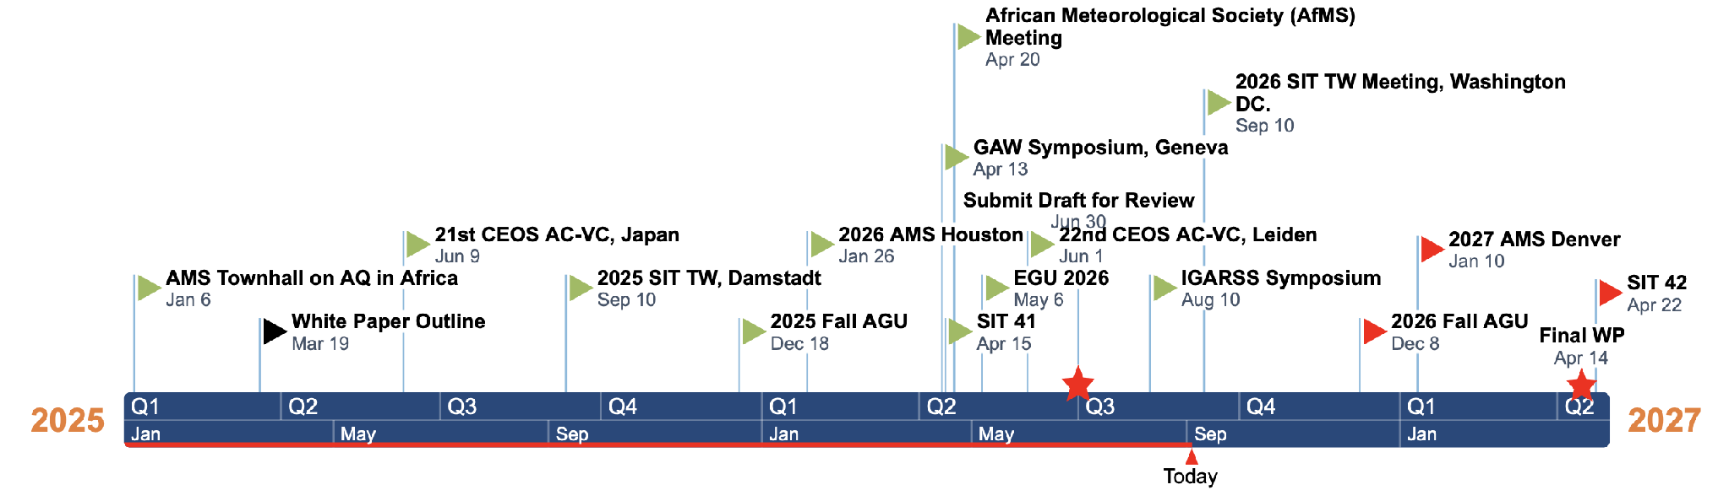


Schedule
not today
Major Milestone/Deliverable
Completed Task
Future task
Author inputs completed (pens down) June 30, 2026
Synthesis of inputs and writing July 1 – July 15, 2026
Review by international experts July 16 – Aug 5, 2026
Revisions, Reviews, Revisions Aug 6, 2026- April 12, 2027

