Slide 1
Norwegian Space Agency (NOSA) 2027 CEOS Chair Themes
Christian Hauglie-Hanssen
NOSA, 2027 CEOS Chair
Agenda Item 2.6
SIT TW 2026
Washington DC, USA
8-10 September, 2026

Slide 2

2027 CEOS Chair Theme:
Trusted Satellite Data for a Better Future

Slide 3

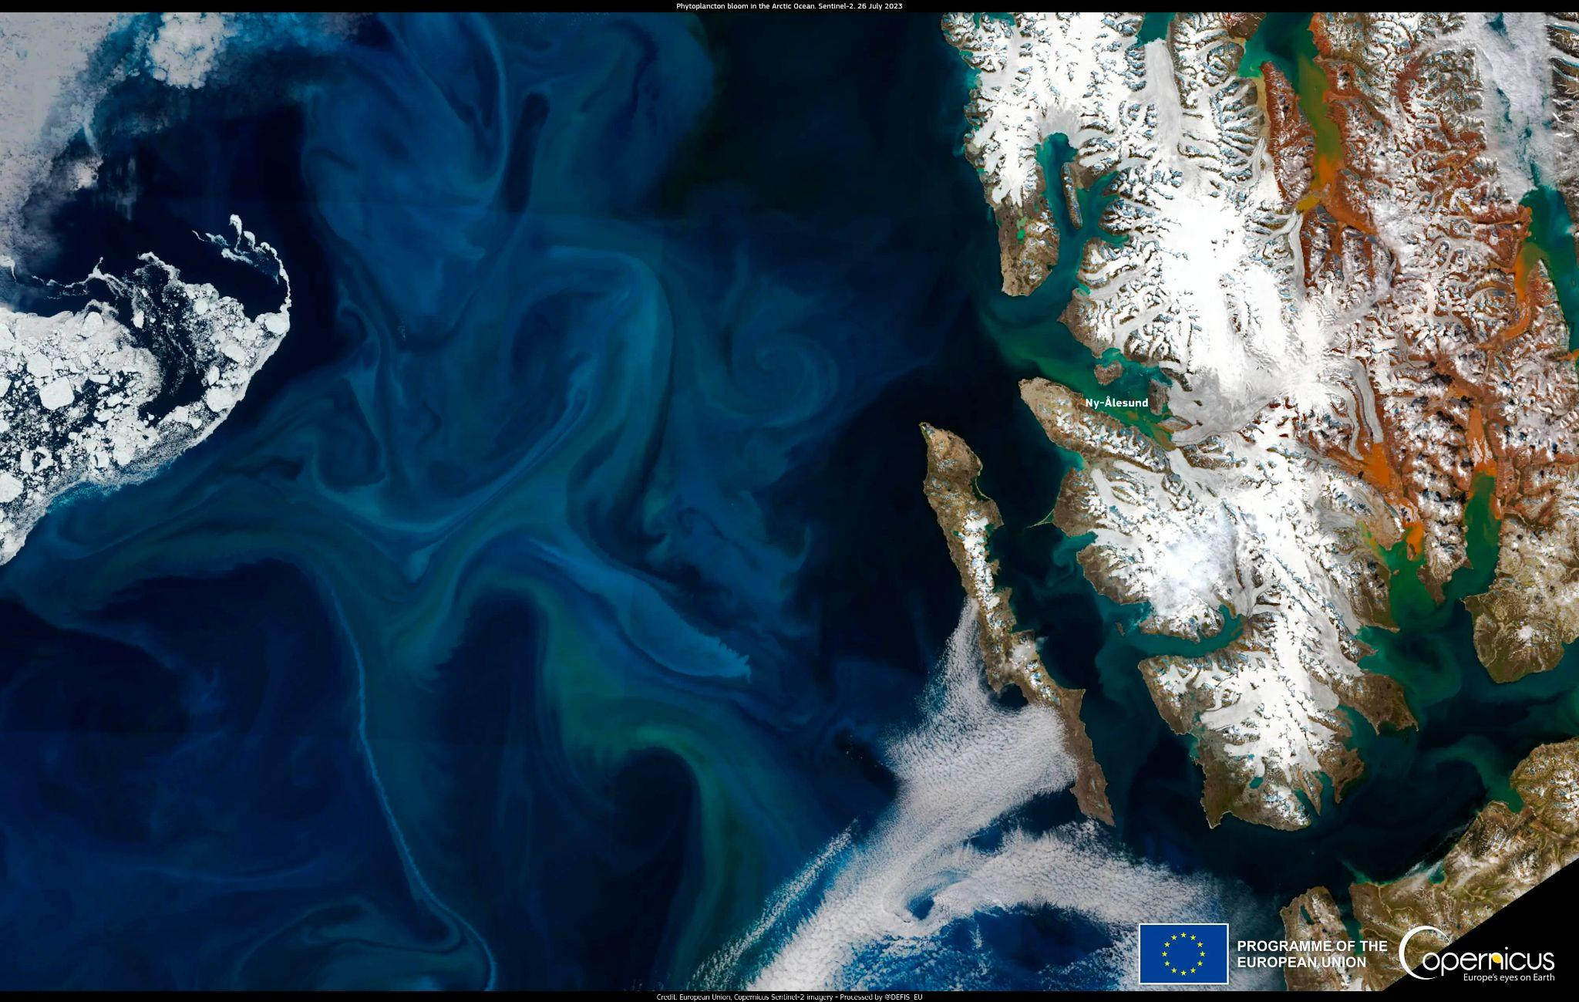
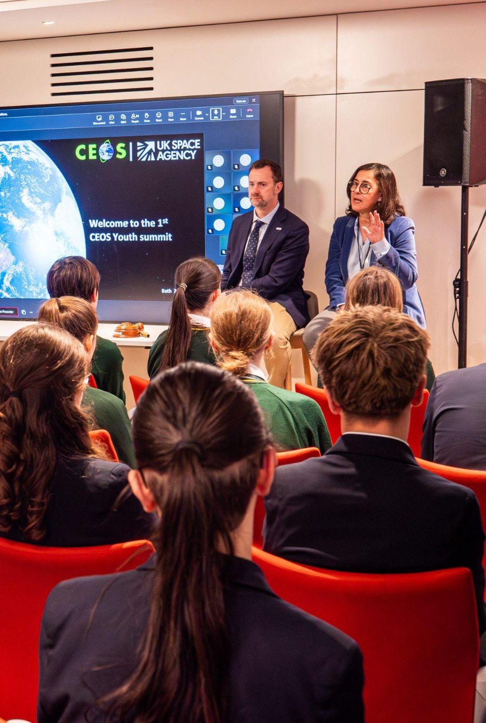
Three Interlinked Priorities
True Green
True Blue
True Future
Tropical Forests
Ocean and Polar
Youth Engagement

Slide 4
Three Interlinked Priorities
Without the blue, there is no green, and without the future generation, there is no lasting impact
True Green
True Blue
True Future
Tropical Forests
Ocean and Polar
Youth Engagement

Slide 5

Central / Shared Theme
Delivery of trustworthy, interoperable, and analysis-ready satellite EO data to support global decision-making.
Norway will build upon the strong foundations of CEOS-ARD and seek to elevate activities aimed at increasing the quality, trust, interoperability, and scalability of CEOS-ARD:
Leveraging and implementing CEOS Interoperability Handbook principles
Using and promoting world-leading WGCV Cal/Val resources

Slide 6

Focus Activity #1: True Green
Connected Stakeholders:
Norway’s International Climate and Forest Initiative (NICFI)
  Priority: transparency and accountability in the protection of forests, biodiversity and high-value ecosystems.
Global Forest Observations Initiative (GFOI)
  Longstanding CEOS priority and GEO Flagship
Food and Agriculture Organization (FAO) Forestry Programme
  CEOS Associate and operator of System for Earth Observation Data Access, Processing and Analysis for Land Monitoring (SEPAL)
  Capacity building for countries and NFMS/MRV
Notes:
Working to protect the world’s tropical rainforests by building upon well-established relationships and push for the increased provision of open, trustworthy and harmonised satellite-based data products for tropical forests

Slide 7
Focus Activity #1: True Green
The NOSA CEOS Chair team commits to supporting implementation of the anticipated 2026-2031 CEOS-ARD Strategy, and based on user knowledge focus on two key areas:
Increasing representation of cloud-native approaches in the CEOS-ARD Framework, increasing the discoverability, accessibility and usability of satellite EO data;
Improving data quality and facilitating discussion on broader adoption of a common quality assessment framework by CEOS-ARD, and potentially more broadly across CEOS.
Notes:
Increasing representation of cloud-native approaches in the CEOS-ARD Framework, in direct response to feedback from users in the forestry community, with a view to increasing the discoverability, accessibility and usability of satellite EO data;
Improving data quality and facilitating discussion on broader adoption of a common quality assessment framework by CEOS-ARD, and potentially more broadly across CEOS.

Slide 8
Focus Activity #2: True Blue
Highlighting the importance of the oceans and polar regions, and working towards building a resilient and comprehensive ocean observing system through enhanced international cooperation, harmonised approaches and improved access to data.
Engaging with established initiatives:
Ocean-Eye International Alliance
WMO’s Task Team on the Cryosphere and Polar Observation from Space (TT-CPOS)
International Polar Year (IPY)

Slide 9
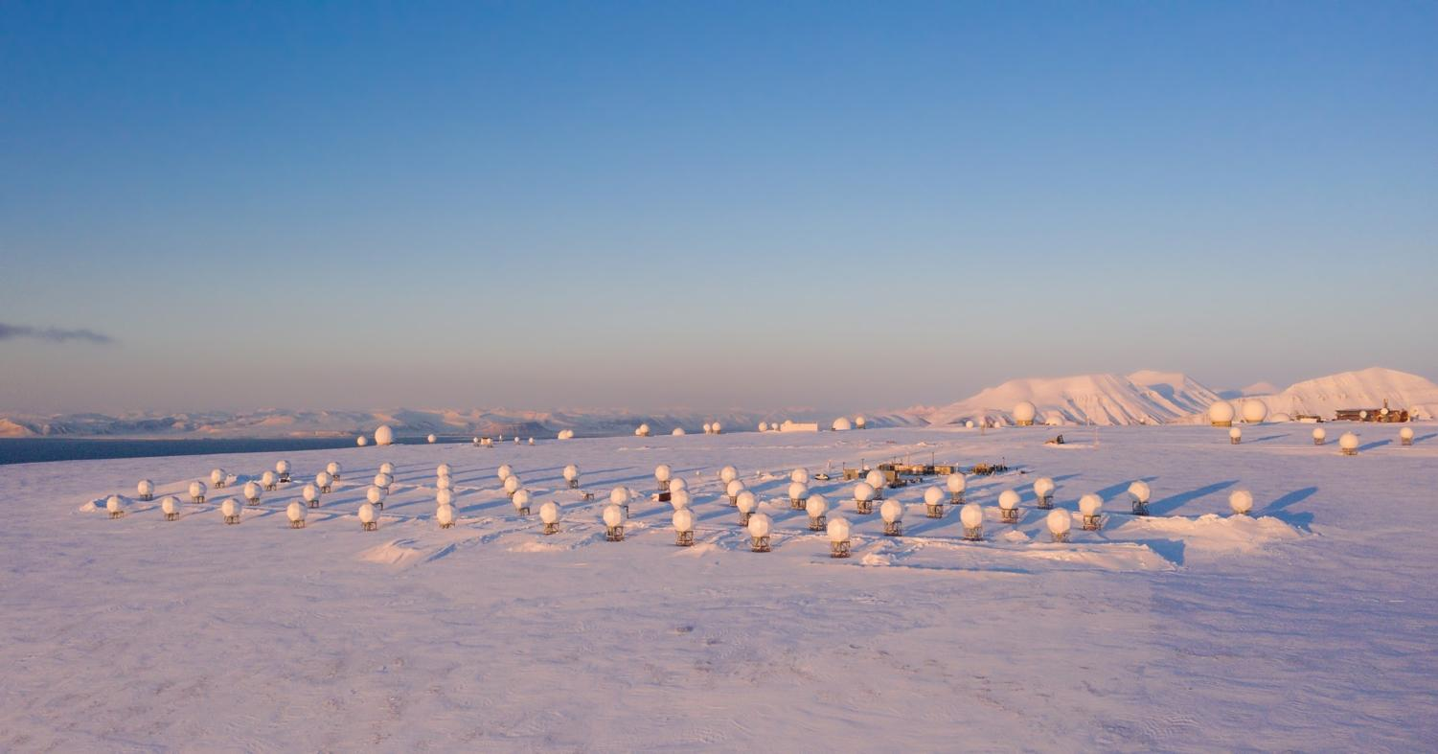
Image Credit: KSAT

Slide 10
Focus Activity #2: True Blue
The NOSA CEOS Chair team will focus on two key areas:
Increasing the visibility of ocean and polar issues:
  Encouraging early dialogue with space agencies in support of the upcoming International Polar Year (IPY). CEOS-ARD for IPY.
  Supporting WMO TT-CPOS in coordinating with space agencies
  Promoting the importance of satellite data as the backbone of environmental monitoring for polar and ocean regions
Enhancing in situ and ground-based observation networks in polar regions, collaborating with WGCV as part of their initiative to define cal/val supersites.

Slide 11
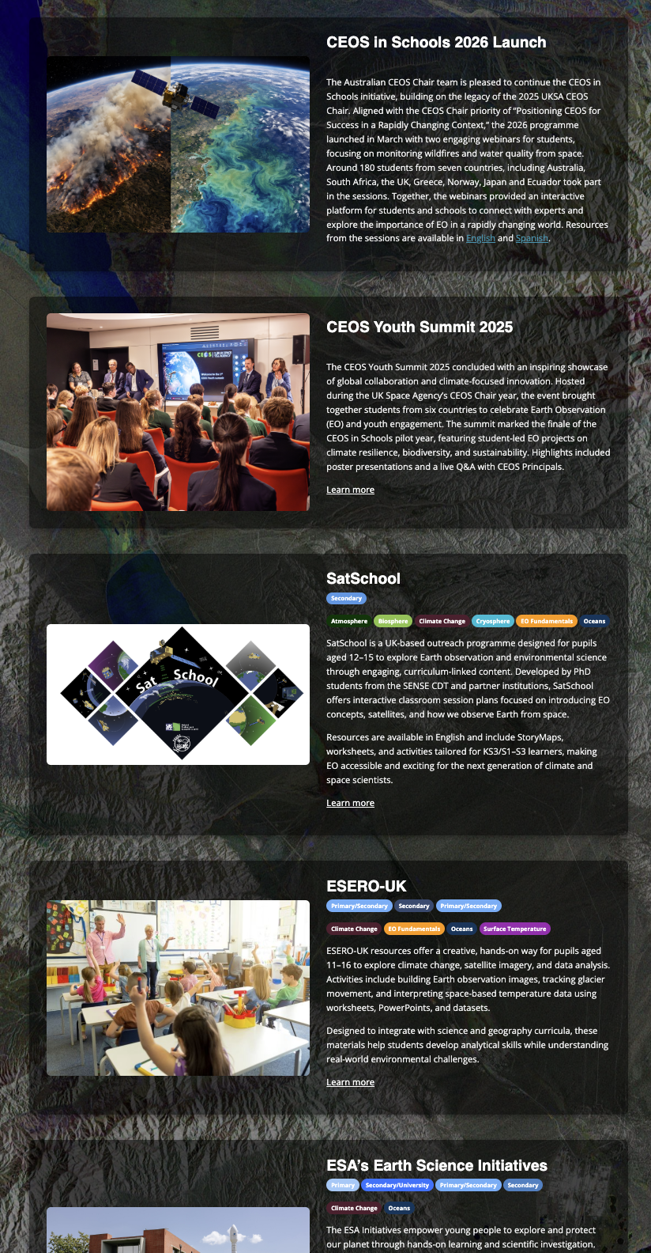
Focus Activity #3: True Future
Recognise the critical importance of inspiring and engaging the next generation of Earth observation professionals
Continue legacy of the UK and Australia on the CEOS Youth Engagement Programme.
Two international webinars, one for each of the True Blue and True Green priorities.
CEOS Youth Summit at the CEOS Plenary in Bergen
Reminder! Please suggest additional resources for https://ceos.org/youth/ (shown right)

Slide 12



CEOS Plenary 2027
Save the date!
CEOS Plenary in Bergen, Norway
1 - 5 November 2027
Fløyen. Foto: Sverre Hjørnevik

Slide 13
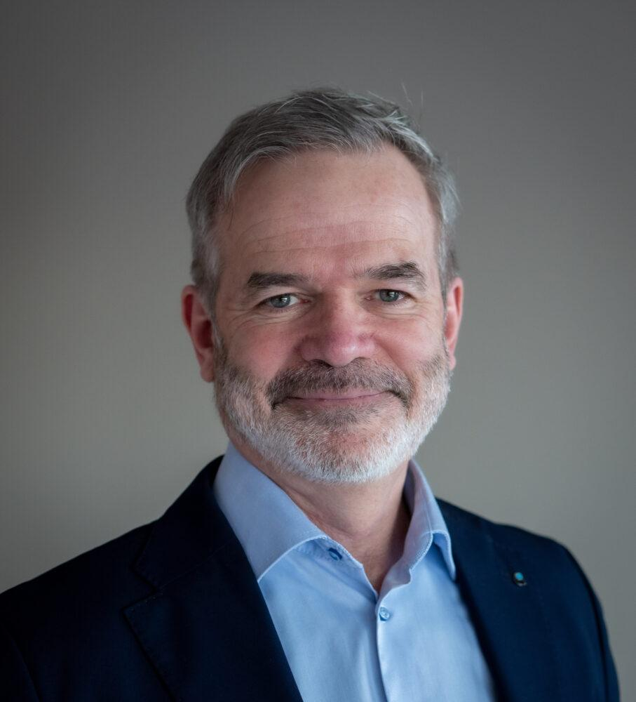
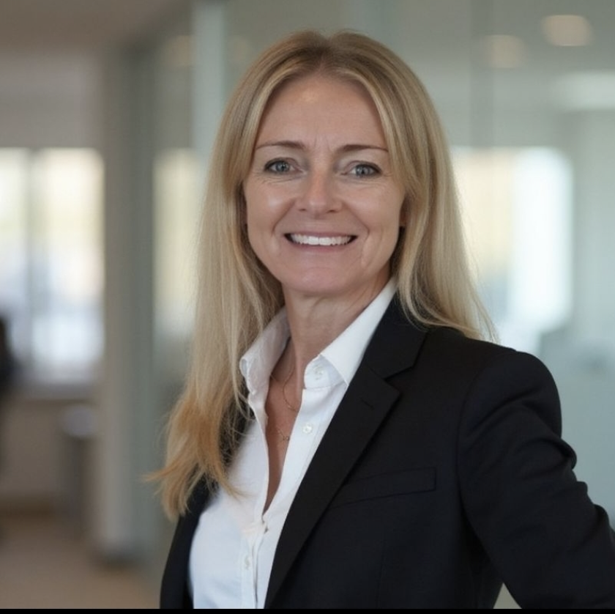
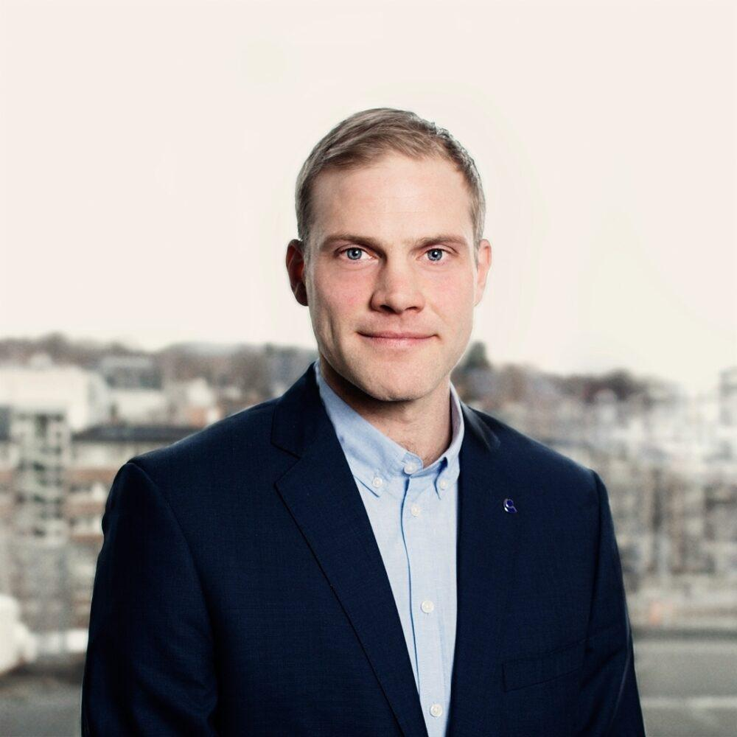


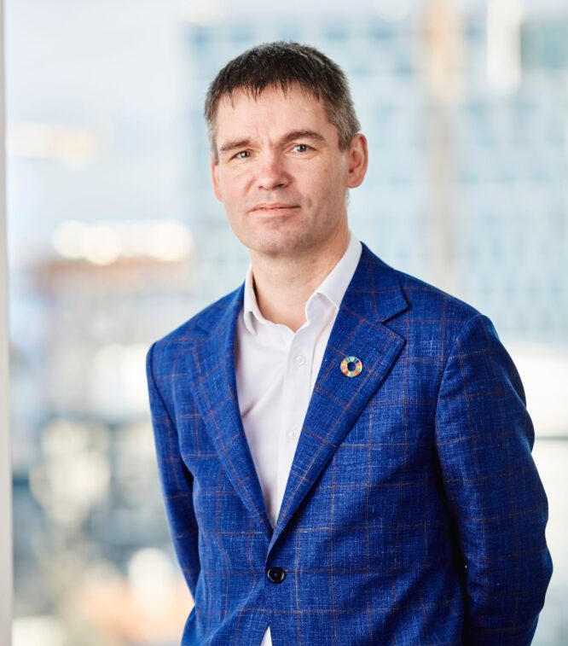



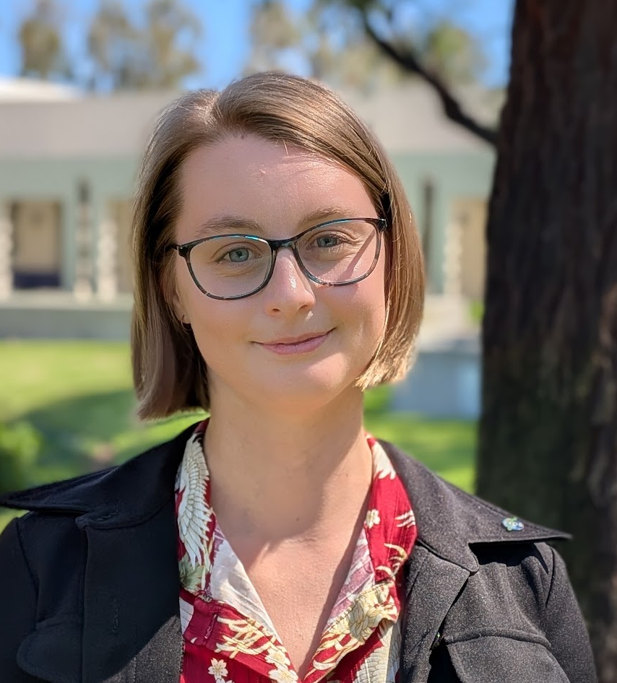
NOSA CEOS Chair Team
CEOS Chair Support
Stephen Ward
Christian Hauglie- Hanssen
Ann Mari Fjæraa
Ola Nordbeck
Matt Steventon
Ole Morten Olsen
Dag Anders Moldestad
Maria Høegh Berdahl
Libby Rose
Vigdis Lonar

Slide 14
Thank you!

