Slide 1
Working Group Vice Chair Nominations for CEOS Plenary Endorsement
CEOS Chair Team
Agenda Item 2.7
SIT TW 2026
Washington DC, USA
8-10 September, 2026

Slide 2
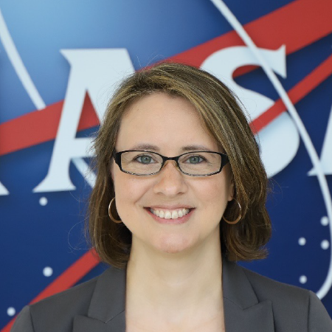
WGCapD
Dr. Melanie Follette-Cook, NASA
Research scientist in the Mesoscale Atmospheric Processes Laboratory at NASA Goddard Space Flight Center
Project Scientist of the NASA Applied Remote Sensing Training (ARSET) Program

Slide 3
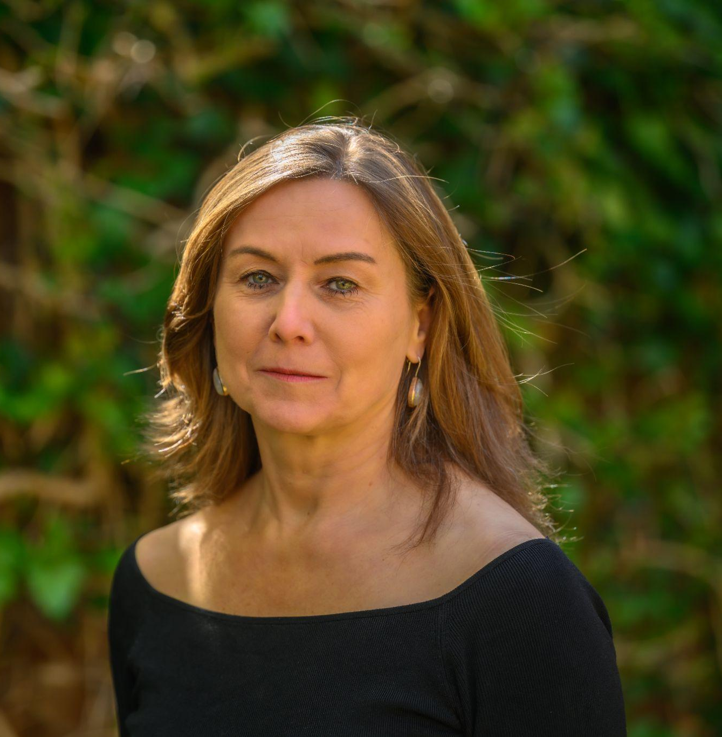
WGClimate
Dr. Susanne Mecklenburg, ESA
Head of Division on Climate and Long-Term Action
Member of WGClimate since 2019
Nomination has been confirmed by CGMS

Slide 4
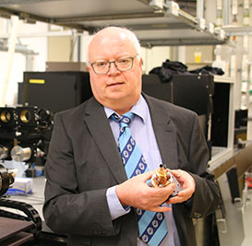
WGCV
Dr. Nigel Fox, UK NPL (on behalf of USKA)
Long time Infrared and Visible Optical Sensor subgroup lead
FRMSat (formerly SITSat) Task Team co-lead
TRUTHS mission PI

