Slide 1
Reflection on Earth Observation Data Providers Collaboration Forum
Eleanor Pierel, NASA
Agenda Item 2.9
SIT TW 2026
Washington DC, USA
8-10 September, 2026

Slide 2
Strategic Leadership Priority Trend
2022 ESA SIT Chair Priority
  CEOS New Space Task Team (NSTT)
2023 GISTDA Chair Theme
  Supporting the Exploration of New Geometries for CEOS with New Space
2024 CSA Chair Theme
  Encouraging Commercial Sector engagement across CEOS Priorities
2025 UKSA Chair Theme
  Unlocking Earth Observations for Public Services
2026 Australia Chair Theme
  Positioning CEOS for Success in a Rapidly Changing Context
2026 NASA SIT Chair Priority
  Updating CEOS Value Chain to reflect current Earth observation ecosystem

Slide 3
Agenda Overview
8:30 - 9:30 | Coffee and Networking
9:30 - 9:45 | Opening Remarks and CEOS Organizational Context
9:45 - 10:30 | Session 1: CEOS and Commercial Sector Institutional Perspectives Overview of existing CEOS-commercial collaborations (WG, VC) CEOS Partnerships activity
10:30 - 10:50 | Coffee Break and Networking
10:50 - 11:50 | Session 2: CEOS Member Agency and Company Exchange International CEOS agency perspectives on commercial sector cooperation Q + A session with agencies
11:50 - 12:30 | Session 3: Calibration and Validation Overview of CEOS cal/val activities Commercial perspective on cal/val opportunities Opportunities in cal/val activity
12:30 - 1:30 | Lunch | West Court
1:30 - 3:10 | Session 4: Data Interoperability and Analysis Ready Data Topics: Overview of CEOS Interoperability Handbook and CEOS- ARD opportunities OGC Satellite Tasking API Presentation Private sector perspective and opportunities presentation ESA-NASA Joint EO Mission Quality Assessment Framework Presentation Interoperability and ARD opportunities activity
3:10 - 3:40 | Coffee Break and Networking
3:40 - 4:30 | Session 5: Interactive Needs and Opportunities Discussion Integrate gaps and challenges collected throughout the day to identify opportunities for future collaboration
4:30 - 5:30 | Workshop Conclusion
5:30 - 7:30 | Hive Rooftop No-Host Social

Slide 4
Reflections & Learnings
Private sector IS using CEOS information, networks, and ARD
There is still an awareness and communication gap
  Commercial providers would like to find CEOS guidance information more easily - potentially on member agency websites
There were requests from companies for more organized outreach, similar to how CEOS Agencies have designated Contacts and Principals
Private sector would like to be involved earlier to help co-create CEOS outputs

Slide 5
Next Steps & Thoughts?
Feedback survey sent to participants
Consider future engagement opportunities
Continue and highlight WG/VC engagements
What are your takeaways from the Forum?
What other next steps should CEOS take for private sector engagement? (E.g. annual collaboration forum, engagement area topic plan, MIM database, etc.)

Slide 6
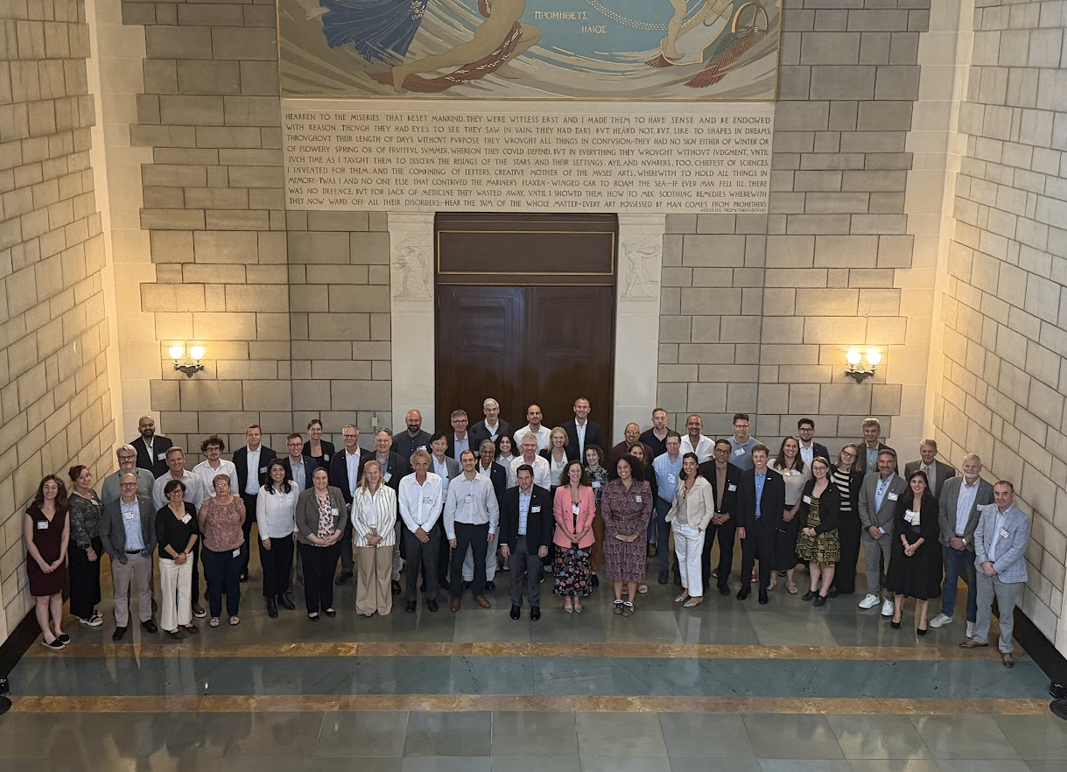
Thank you!

