Slide 1
Closing Remarks
Julie Robinson, NASA
Alex Held, CSIRO
Agenda Item 3.2
SIT TW 2026
Washington DC, USA
8-10 September, 2026

Slide 2
3-6 November 2026
Hobart (Nipaluna), Australia
2026 CEOS Plenary
Credit: USGS/NASA Landsat 8

Slide 3
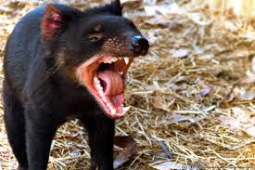
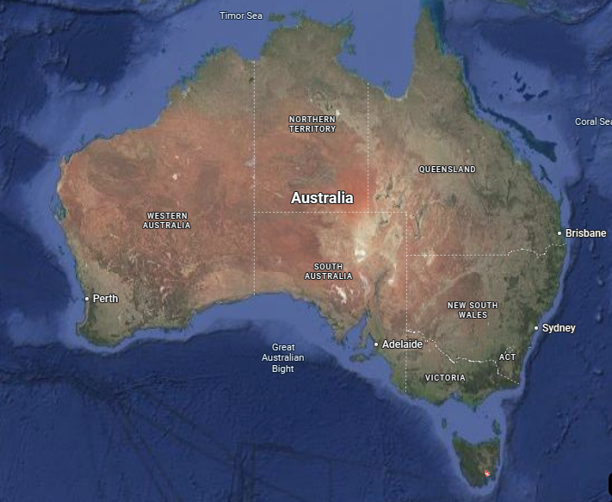
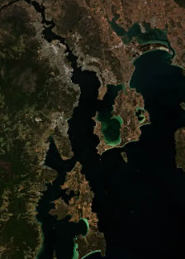
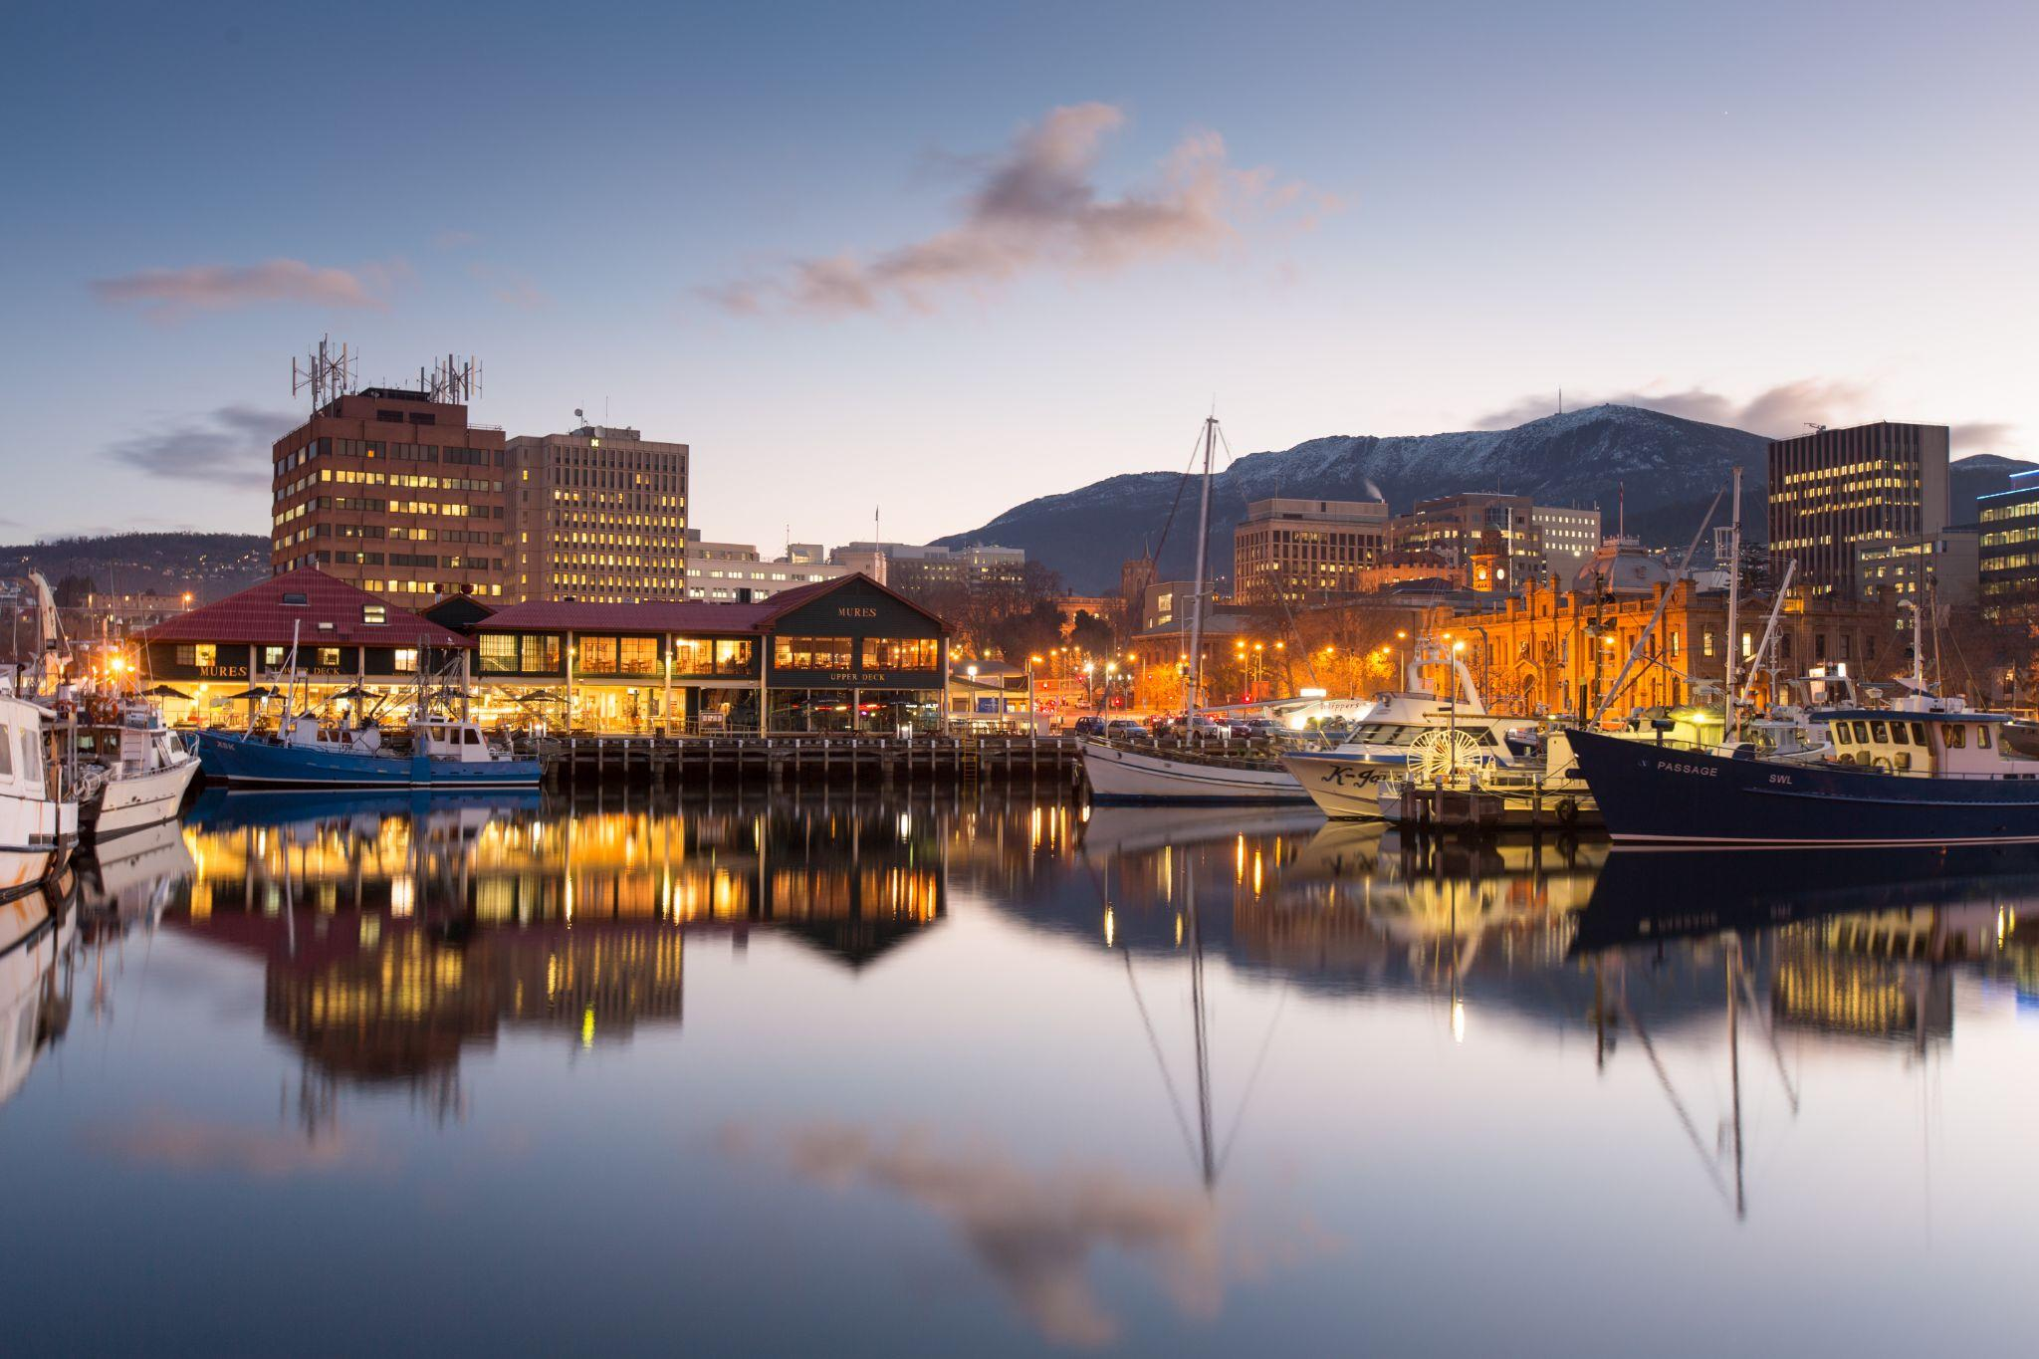
40th CEOS Plenary
3-6 November 2026
Hobart, Australia
Antarctica
Venue: Hotel Grand Chancellor
Credit: European Union Sentinel-2

Slide 4
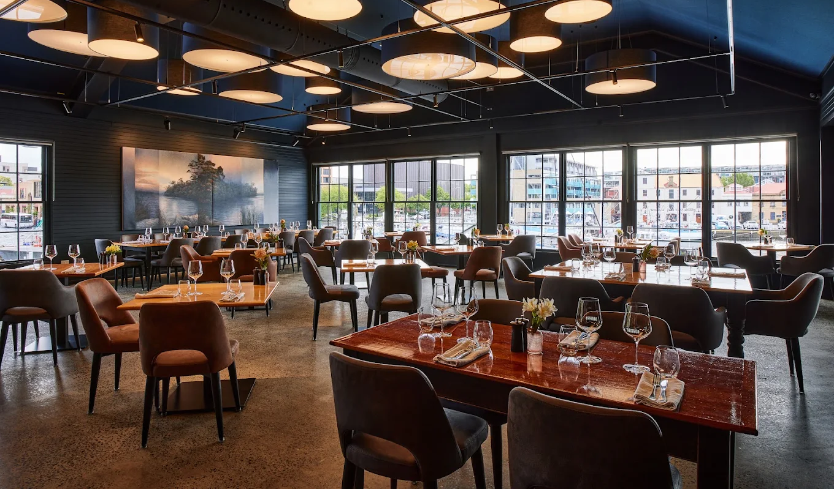
Week-at-a-glance
Tuesday, 3rd November:
  CEOS Youth Event
  Side Meetings
  Welcome Reception at the Tasmanian Museum and Art Gallery
    Including Islands to Ice Exhibition
Wednesday, 4th November:
  CEOS Plenary Day 1
  Hosted dinner at Mures Upper Deck
Thursday, 5th November:
  CEOS Plenary Day 2
Friday, 6th November:
  Antarctic Plenary Experience at the Australian Antarctic Division
Australia’s national EO conference (‘Advancing Earth Observation Forum’) will take place in Hobart the following week 9-12 November
Notes:
Welcome reception at the Tasmanian Museum and Art Gallery - where your journey to Antarctica starts, and access to the Islands to Ice exhibit for self guided tours on bringing the wonders of the Southern Ocean and Antarctica region to the shores of Tasmania.
Antarctic Plenary experience - technical tour at the Australian Antarctic Division providing an opportunity to deepen the CEOS community connections with polar issues through in person engagement with leading experts with lived experience.

Slide 5
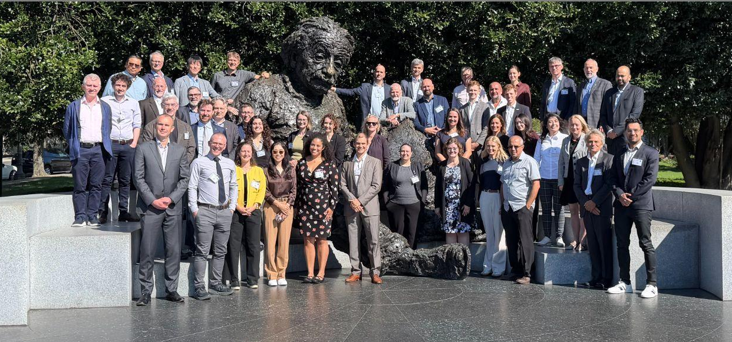
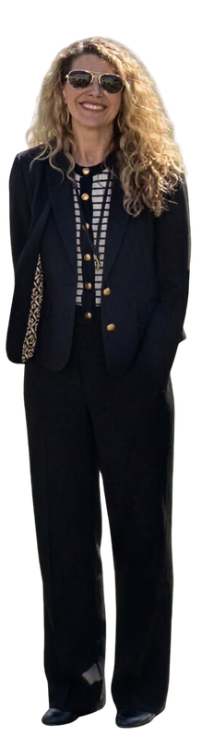
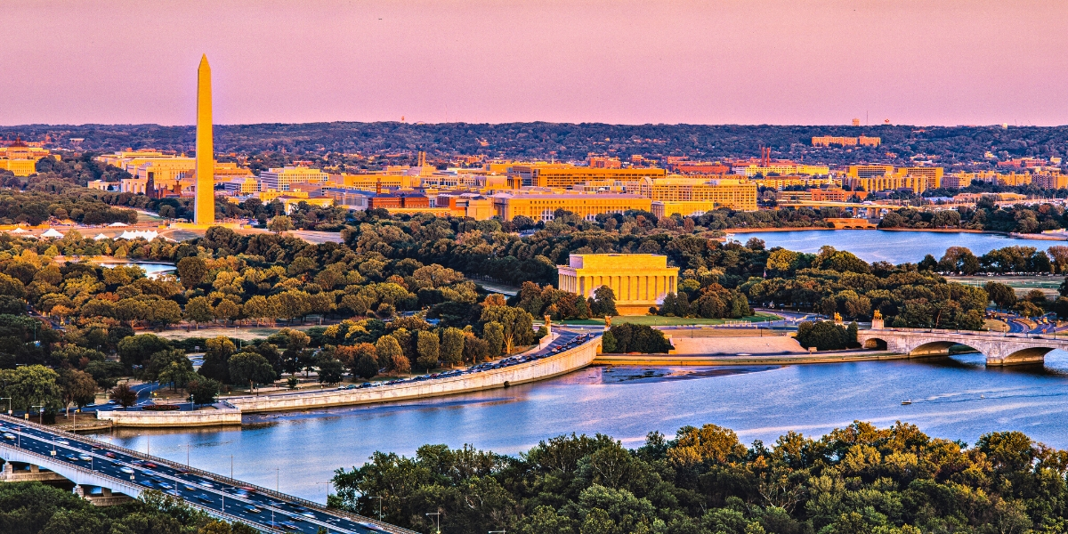
Further on… SIT-42
April 20-22, 2027
  Side meetings: Tuesday 20th
  SIT-42: Wednesday 21st & Thursday 22nd
Back here, at the National Academy of Sciences Washington D.C.

Slide 6
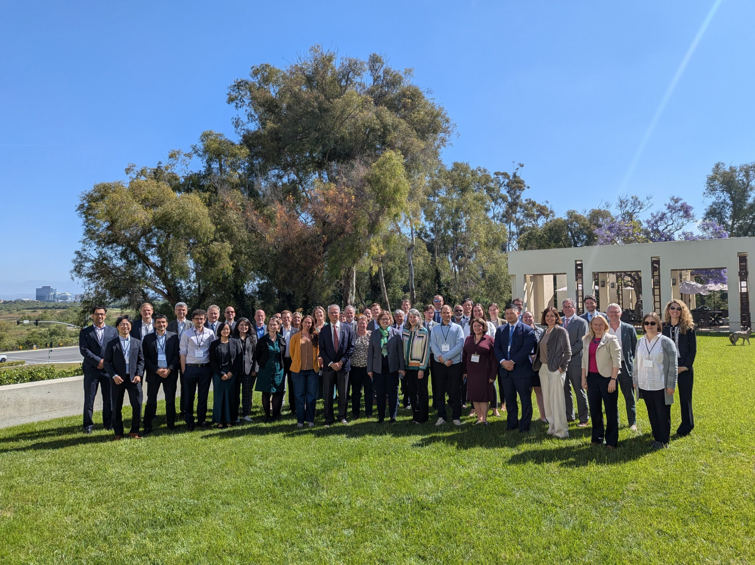
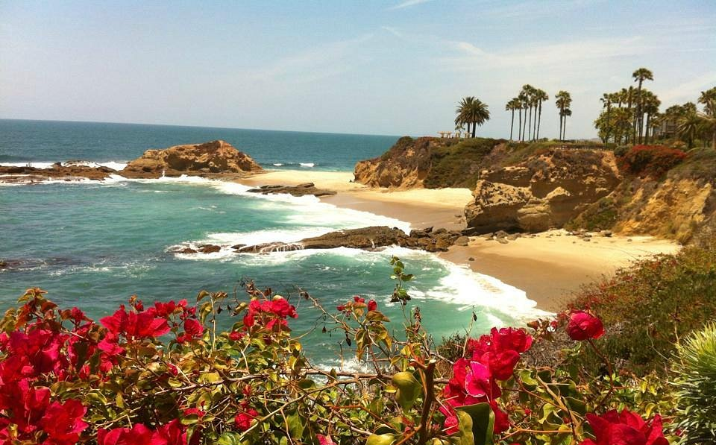
SIT TW 2027
September 7 - 9, 2027
At the Beckman Center, Irvine, California
  Same location as SIT-41

Slide 7
Remote Sensing of Water Quality
Requirements for Comprehensive Catchment-to-Coast Observation
TOMORROW: September 11, 2026
Arrive 08:30 for 09:00 start

Slide 8
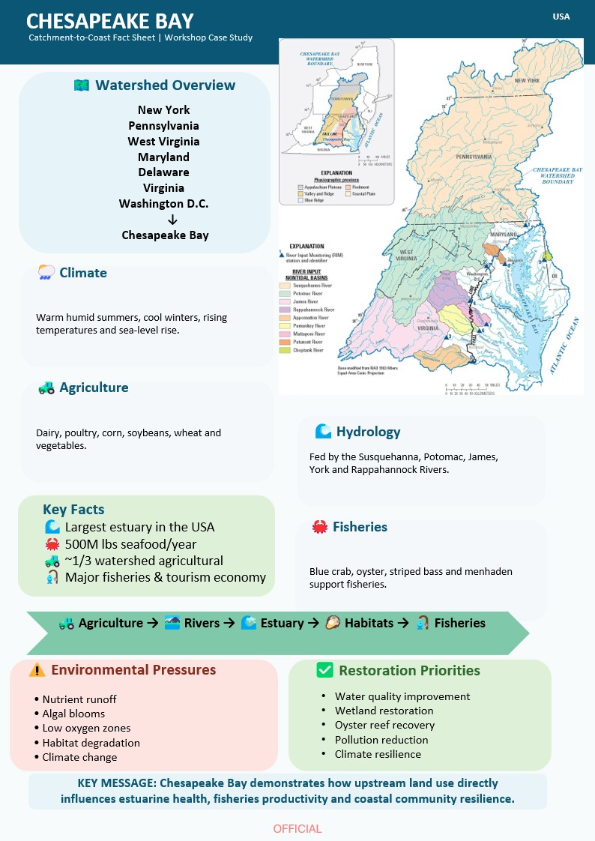
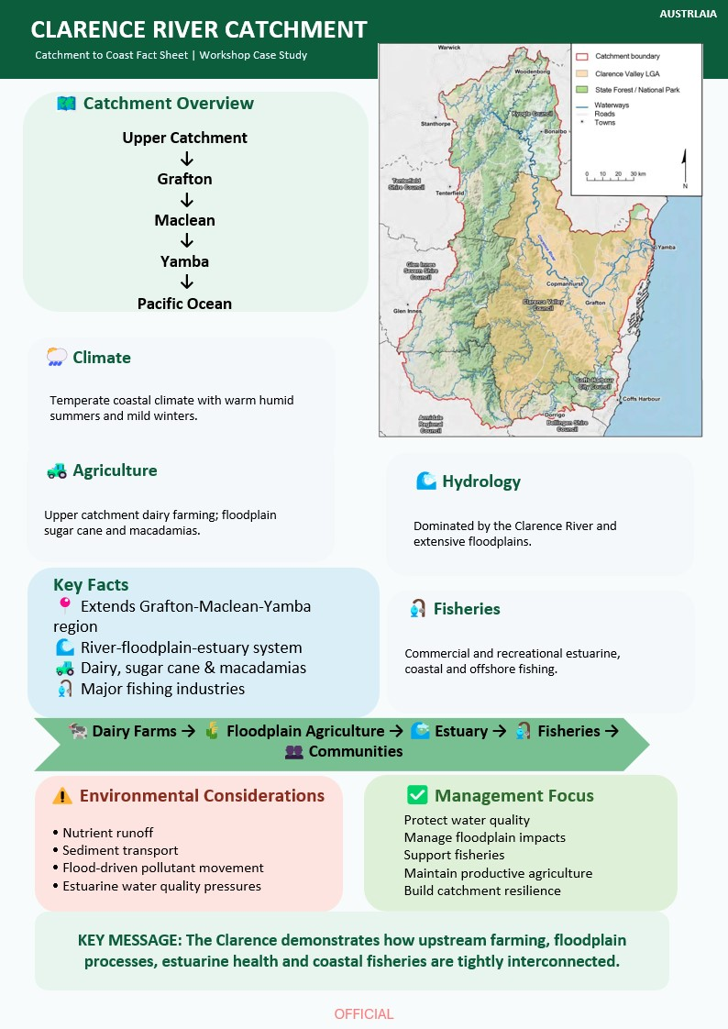
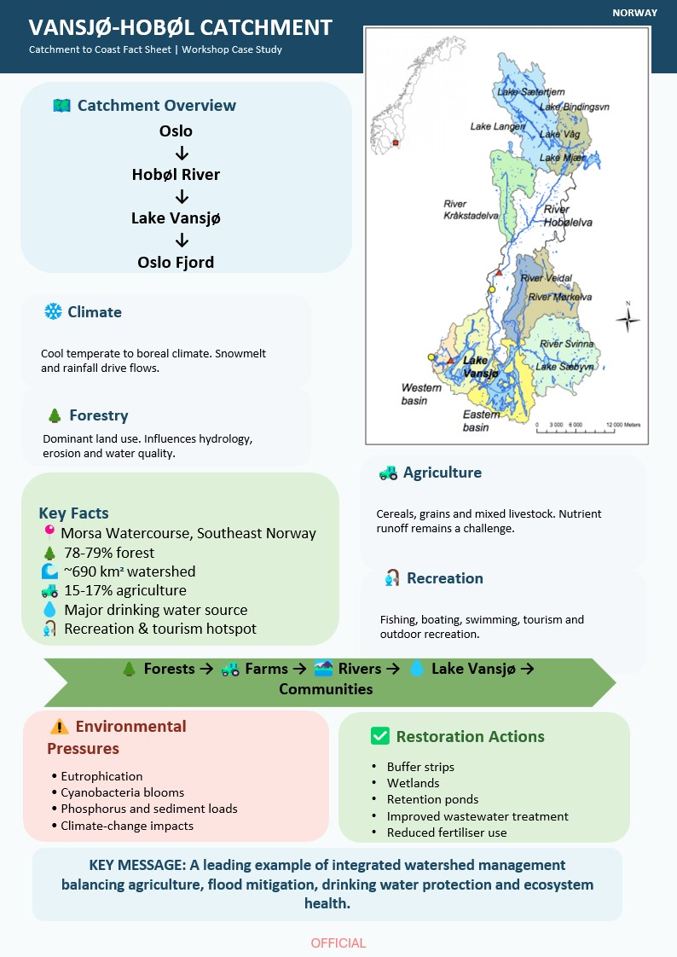
Key Objectives
Advance conceptual alignment, by bringing together terrestrial hydrology and water quality communities.
Explore the essential variables for water quality and integration of requirements across the system, and how this translates to end users.
Extend understanding and identification of issues through the application of “catchment to coast” thinking to real life use cases.
Notes:
Erin (and at end introduce Ayia)

