Slide 1
CEOS Value Chain
Robert Cheetham,
NASA SIT Chair Team
W1.1: Data Value Chain
SIT TW 2026
Washington DC, USA
8-10 September, 2026

Slide 2
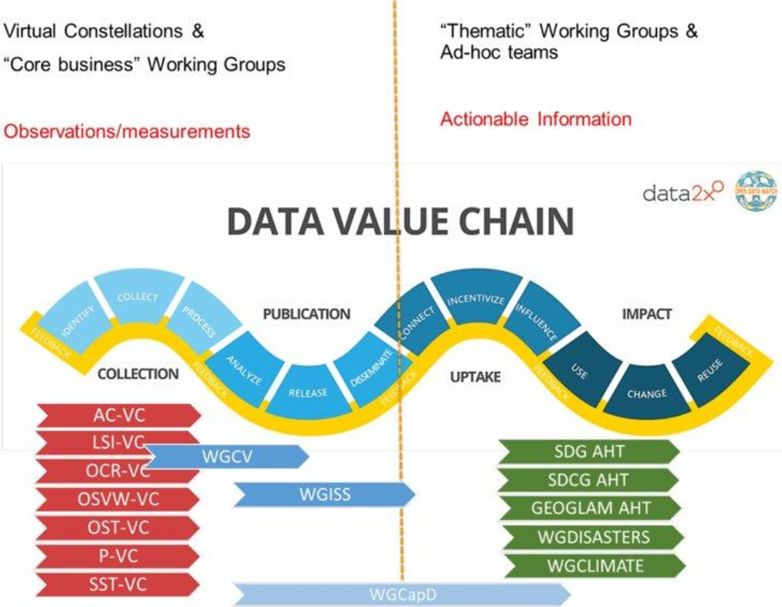
CEOS Value Chain
Strengthen internal organizational resilience
Understand where new activities (biodiversity, wildfire, etc.) align
Understand gaps and roles where commercial engagement could be increased or improved
Realize and increase capture of downstream impact

Slide 3
CEOS Value Chain
No longer accurate
Emphasize impact
Ecosystem has changed

Slide 4
Who did we talk to?
CEOS Internal
2026 Chair
2027 Chair
SIT Chair
Secretariat
CEO
SEO
CEOS ARD OG
WGISS
WGDisasters
WGCapD
LSI-VC
CEOS Agencies
ASI
GA / CSIRO
European Commission
ESA
EUMETSAT
ISRO
JAXA
NASA
NOSA
NRCAN
SANSA
UK Space Agency
CEOS External
AWS
Cesium
Clark University
Climate Spark
Common Space
EarthDaily Analytics
Esri
GEO Secretariat
LGND AI
moreGeo
OGC
Pixxel
Synspective
Terrawatch
Umbra
WGIC

Slide 5
CEOS Value Chain
Not a lot of consensus
  Some reference a value chain regularly
  Some rarely do so
Linear construct is inadequate (but everyone fell back to it when speaking)
Feedback loops and value circles

Slide 6
Value Chain Skepticism
Context-dependent
  Research vs. Operations
  Science vs. Commercial
  Data flow vs. Stakeholder priorities
Multitude of partners and contributors can't be represented
Multiple time scales
Focus on data and information production but at the expense of long-term archival maintenance and other data collection modes

Slide 7
No Common Scope of Value Chain
Some members avoid downstream activities in order to avoid competing with commercial activity
Some members have a service delivery mandate and are active across the entire value chain with significant attention to applications
WGs and VCs have developed organically based on member agency interest - no systematic coverage of the entire value chain

Slide 8
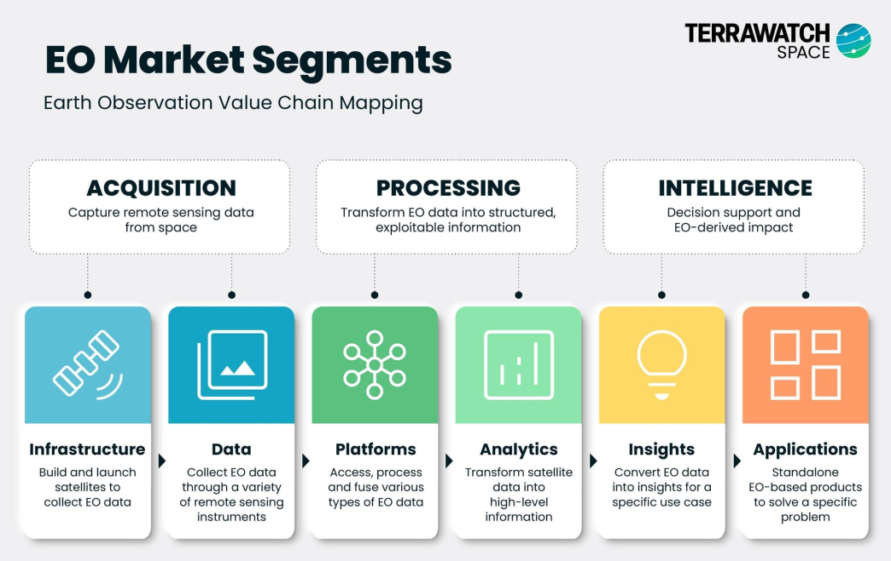
Terrawatch EO Value Chain

Slide 9
Value Chain: Targets & Indicators for Decision Making
Fitness for Purpose
European Commission (EC) Perspective
Decide
Apply
Data Production
Sense
Needs identified for Policy and Decision Making
Resulting requirements for applications, indicators, models and Services
Resulting requirements for Data Products
Resulting requirements for observations
Data/Information
Service
Evolution
Ground Segment
Evolution
Space Segment
Evolution
Evolution

Slide 10
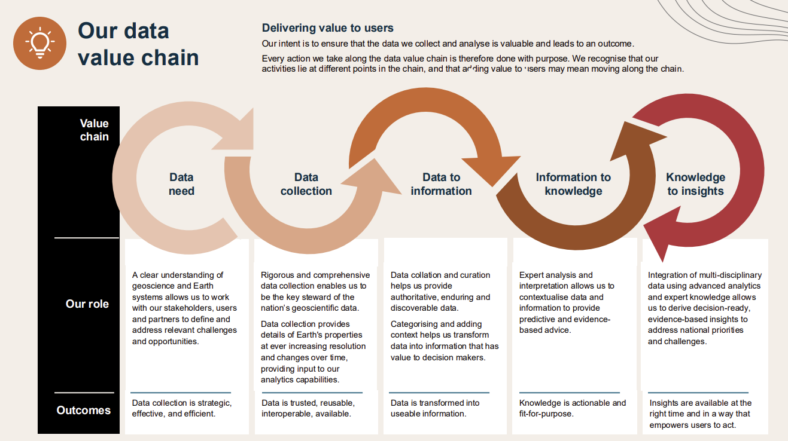
Geoscience Australia

Slide 11
CEOS Roles with greatest impact
Pre-Acquisition
Community needs assessment
Outreach and support to emerging market agencies
Coordinating multiple national agencies
Visibility into coverage gaps
MIM survey
COVE
Upstream
Cal/Val Portal
Calibration Networks
  RadCalNet
  SARCalNet
  HyperNet
  TIRCalNet
Virtual Constellations

Slide 12
CEOS Roles with greatest impact
Midstream
CEOS-ARD
Promoting standards adoption by national agencies
WGISS/OGC Common Metadata Model
AVHRR data archive recovery efforts
Downstream
Thematic Working Groups
GSNL Supersites

Slide 13
CEOS Role - Intangibles
Coordination and collaboration
Relationship-building through dinner and corridor conversations
Knowledge transfer and best practices
GitHub org - glossary, etc.
Lends authority to collaborative efforts - a CEOS recommendation is more trusted than a bilateral effort
Cultivating trust

Slide 14
Value Chain Discussion Activity
Work together as a table
Each table has a couple of sets of printouts of the value chain options
Together discuss 4 questions:
  1) What tradeoffs does each value chain representation offer?
  2) If you had to pick one option to publish on the CEOS web site, which one would you choose? Why?
  3) Would it make sense to publish a second value chain? If so which one would you choose?
  4) Would it be helpful to consider publishing an interactive value chain on the CEOS web site based on the Context Value Chain approach?

Slide 15
Generic Linear Value Chain
Notes:
Tasking is a feedback loop as well as User Needs
Focused on roles and activities CEOS is engaged in
Interviews
Needs to be a pre-evaluation area where needs are identified
Examples of where actors fit
Two feedback loops
User needs but ALSO tasking (e.g. mid-res to high-res after change detection)
Interviewees emphasized that the value chain needs to be adaptable to representing their use/needs-
ADD
“Cloud” to Distribution
Embed CEOS Trust Building more prominently - perhaps extend across Pre-Acqu to Midstream

Slide 16
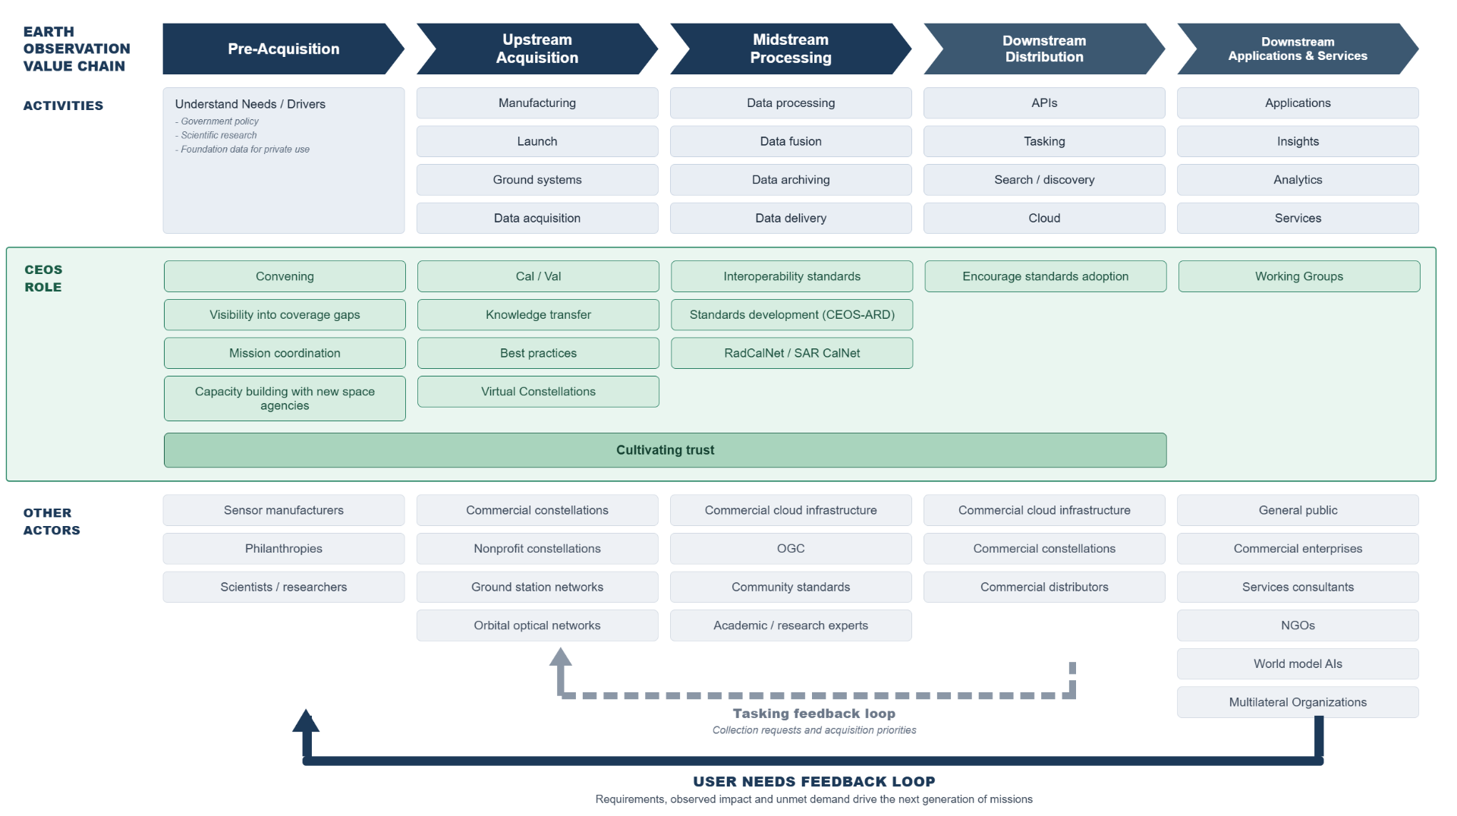
Generic EO Value Chain
Notes:
Focused on roles and activities CEOS is engaged in
Interviews
Needs to be a pre-evaluation area where needs are identified
Examples of where actors fit
Two feedback loops
User needs but ALSO tasking (e.g. mid-res to high-res after change detection)

Slide 17
2. Context-specific Value Chain
Notes:
Tasking is a feedback loop as well as User Needs
Focused on roles and activities CEOS is engaged in
Interviews
Needs to be a pre-evaluation area where needs are identified
Examples of where actors fit
Two feedback loops
User needs but ALSO tasking (e.g. mid-res to high-res after change detection)
Interviewees emphasized that the value chain needs to be adaptable to representing their use/needs-
ADD
“Cloud” to Distribution
Embed CEOS Trust Building more prominently - perhaps extend across Pre-Acqu to Midstream

Slide 18
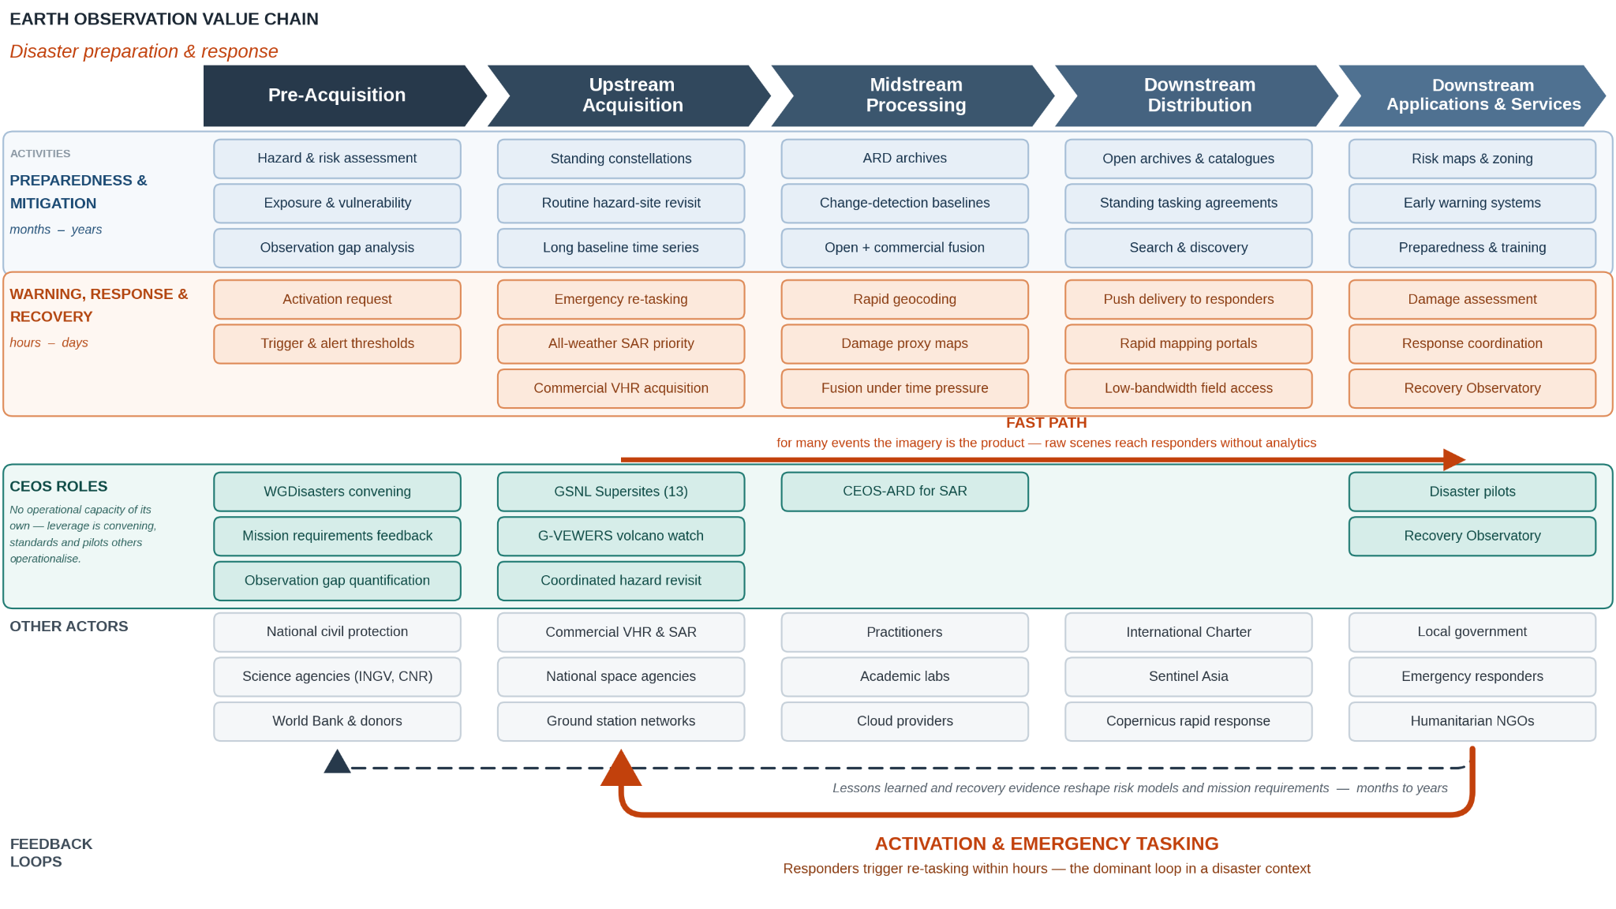
2a. Context: Disaster Planning/Response
Notes:
Disaster Context: There are 2 time frames - preparedness and mitigation that operates on years; and warning/response that operates on hours and days
Interviewees emphasized that the value chain needs to be adaptable to representing their use/needs-

Slide 19
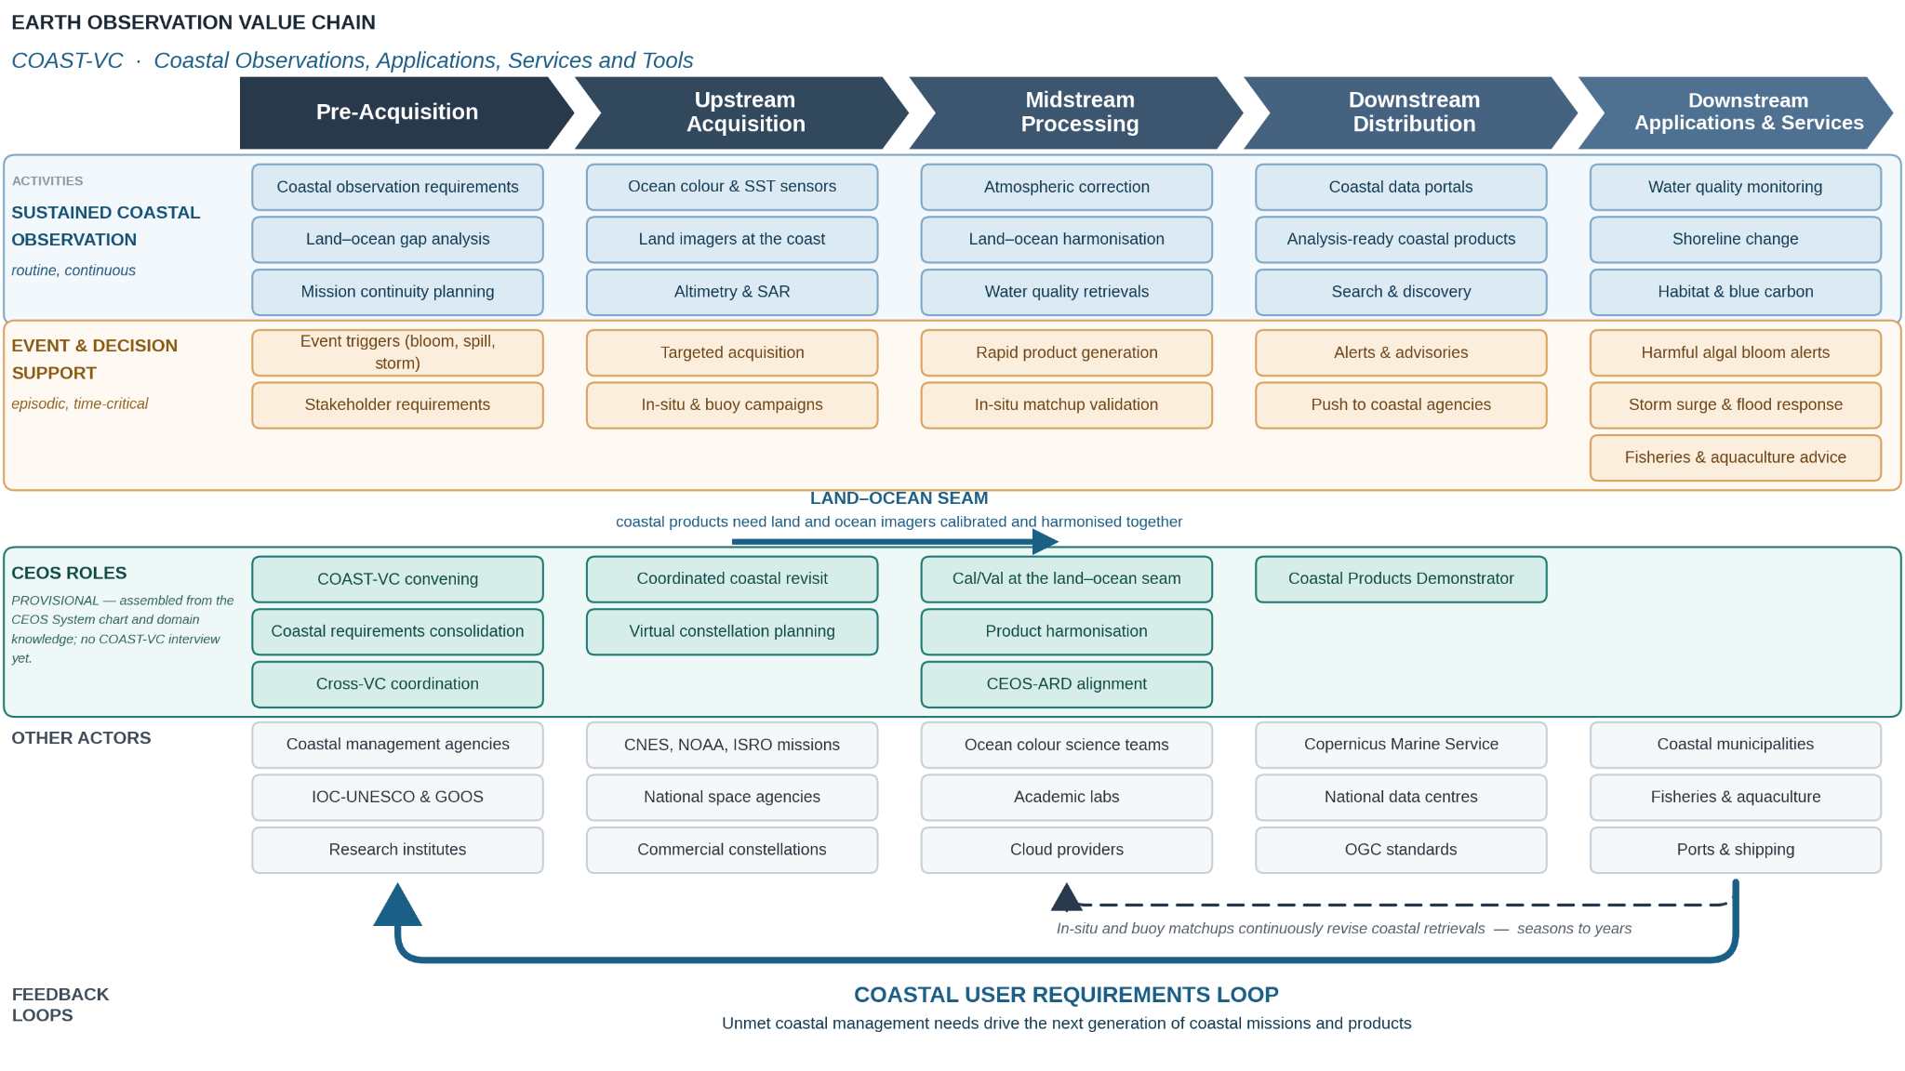
2c. Context: Coast VC

Slide 20
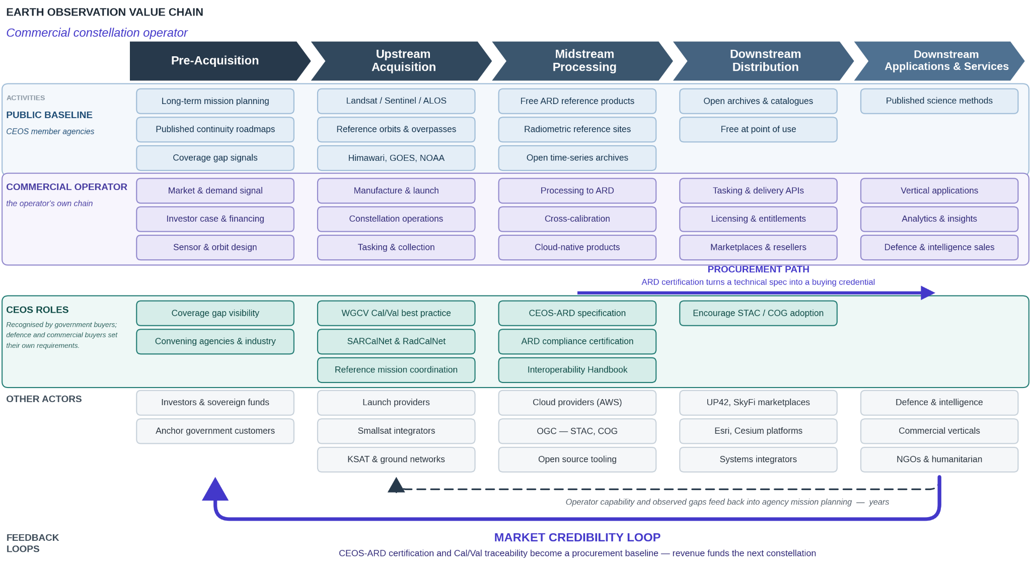
2b. Context: Commercial Constellations

Slide 21
3. EO Value Cycle
Notes:
Tasking is a feedback loop as well as User Needs
Focused on roles and activities CEOS is engaged in
Interviews
Needs to be a pre-evaluation area where needs are identified
Examples of where actors fit
Two feedback loops
User needs but ALSO tasking (e.g. mid-res to high-res after change detection)
Interviewees emphasized that the value chain needs to be adaptable to representing their use/needs-
ADD
“Cloud” to Distribution
Embed CEOS Trust Building more prominently - perhaps extend across Pre-Acqu to Midstream

Slide 22
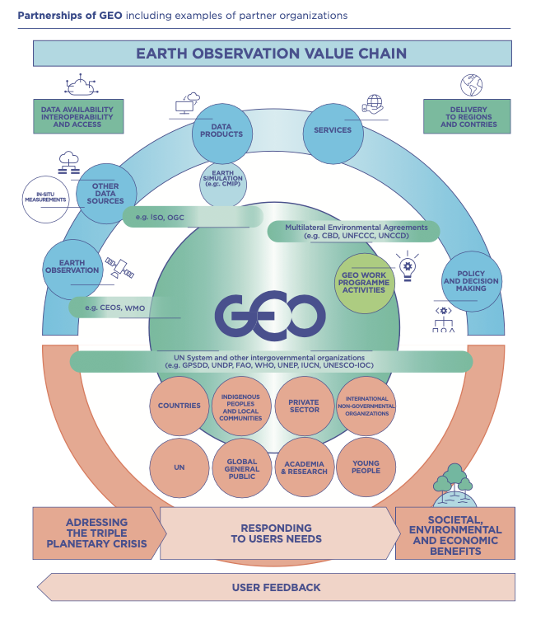
Circles

Slide 23
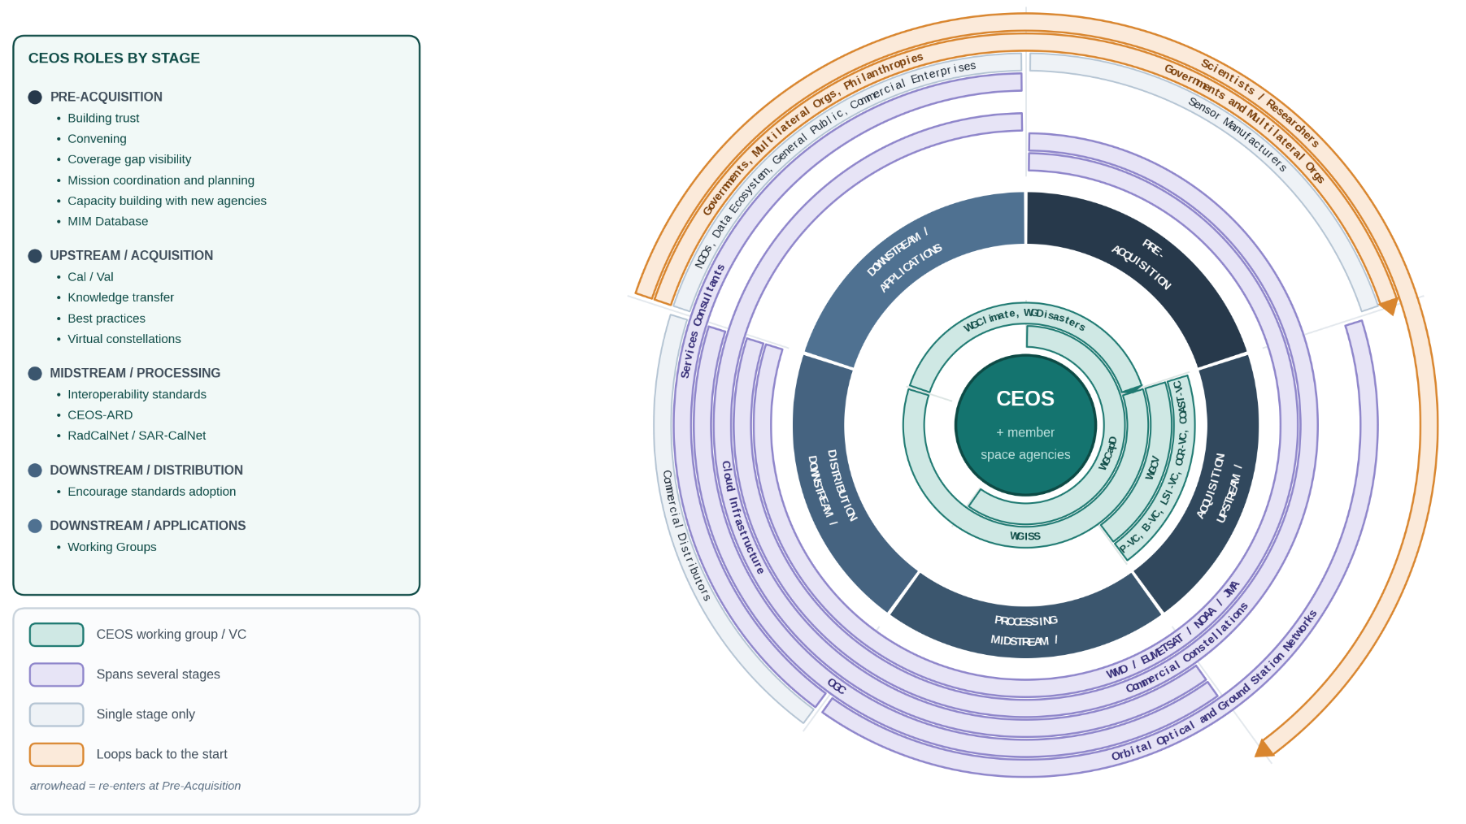
4. Value Cycle

Slide 24
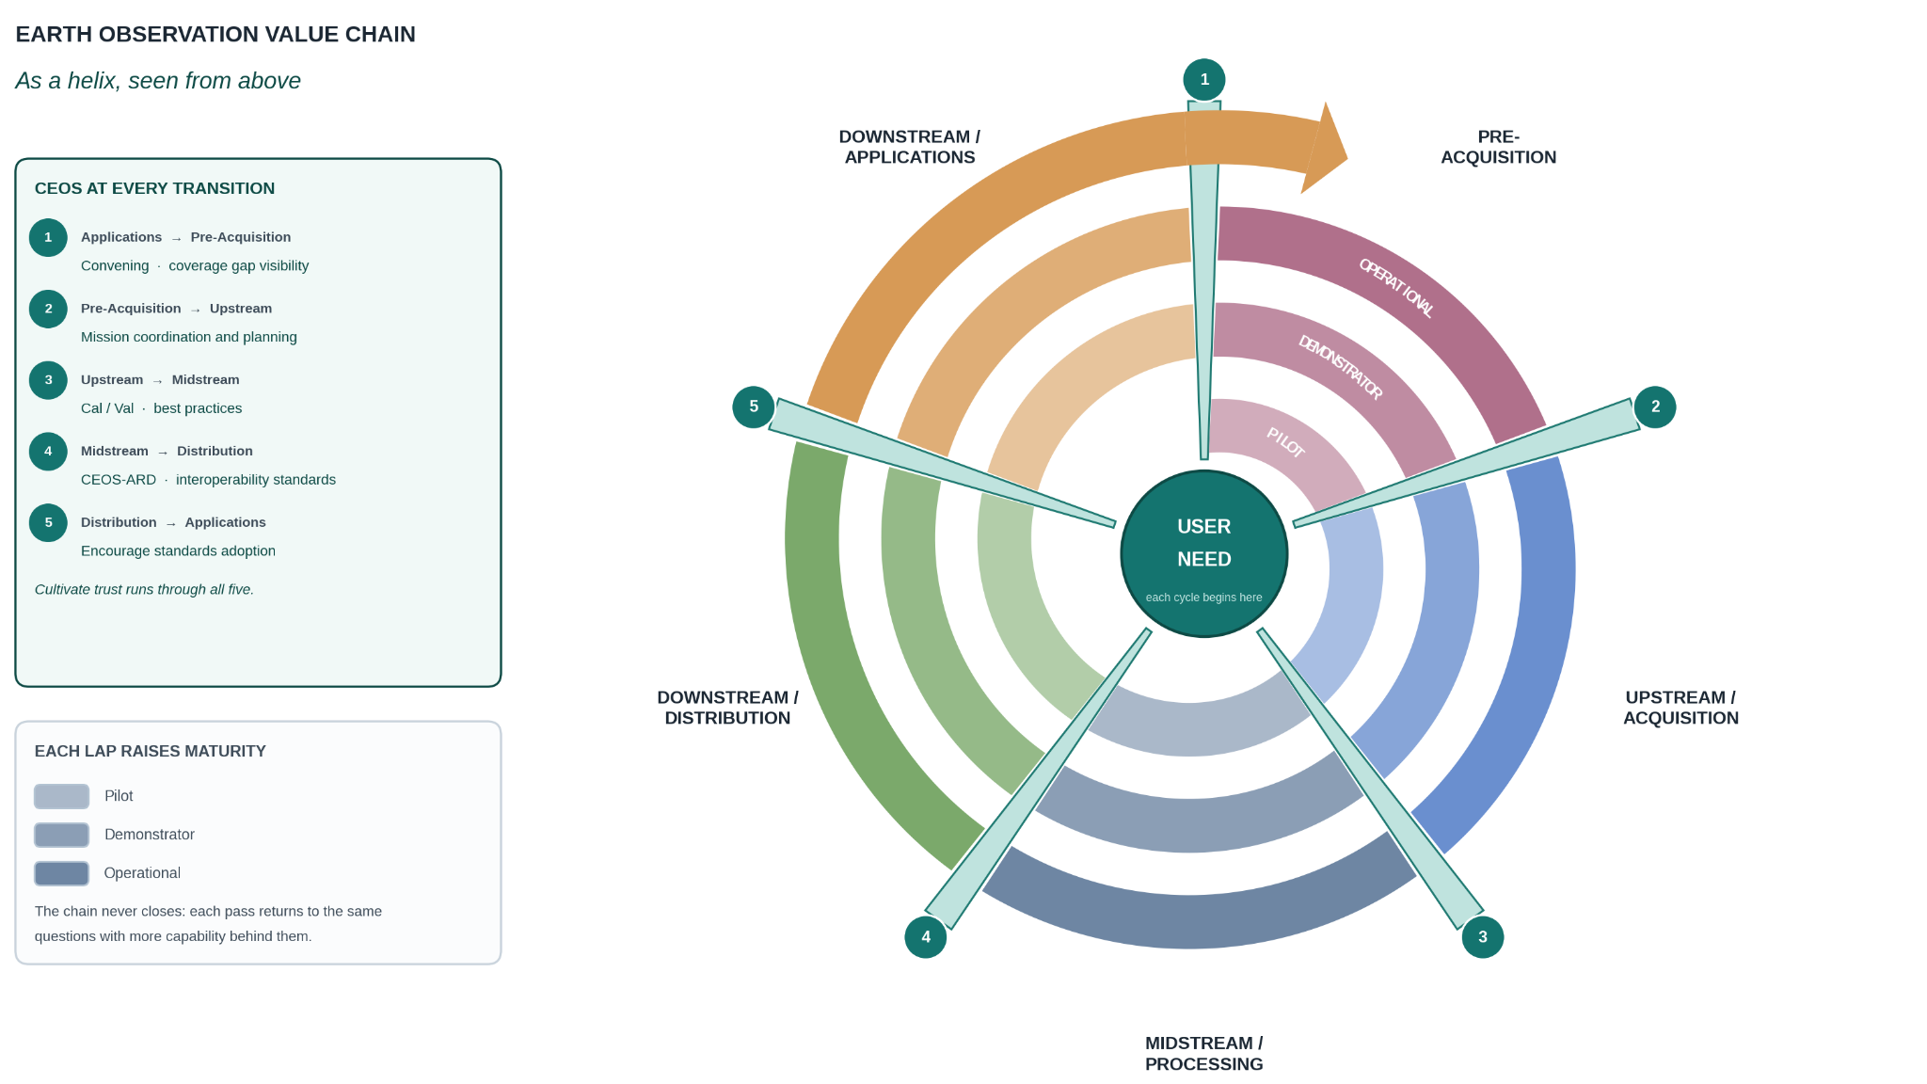
Helical
Notes:
Highlights the fact that many activities actually cycle thorugh a process multiple times, maturing as they go. For example, a pilot that becomes a demonstrator that then becomes an element of core observation infrastrcuture

Slide 25
4. Future with AI Value Chain
Notes:
Tasking is a feedback loop as well as User Needs
Focused on roles and activities CEOS is engaged in
Interviews
Needs to be a pre-evaluation area where needs are identified
Examples of where actors fit
Two feedback loops
User needs but ALSO tasking (e.g. mid-res to high-res after change detection)
Interviewees emphasized that the value chain needs to be adaptable to representing their use/needs-
ADD
“Cloud” to Distribution
Embed CEOS Trust Building more prominently - perhaps extend across Pre-Acqu to Midstream

Slide 26
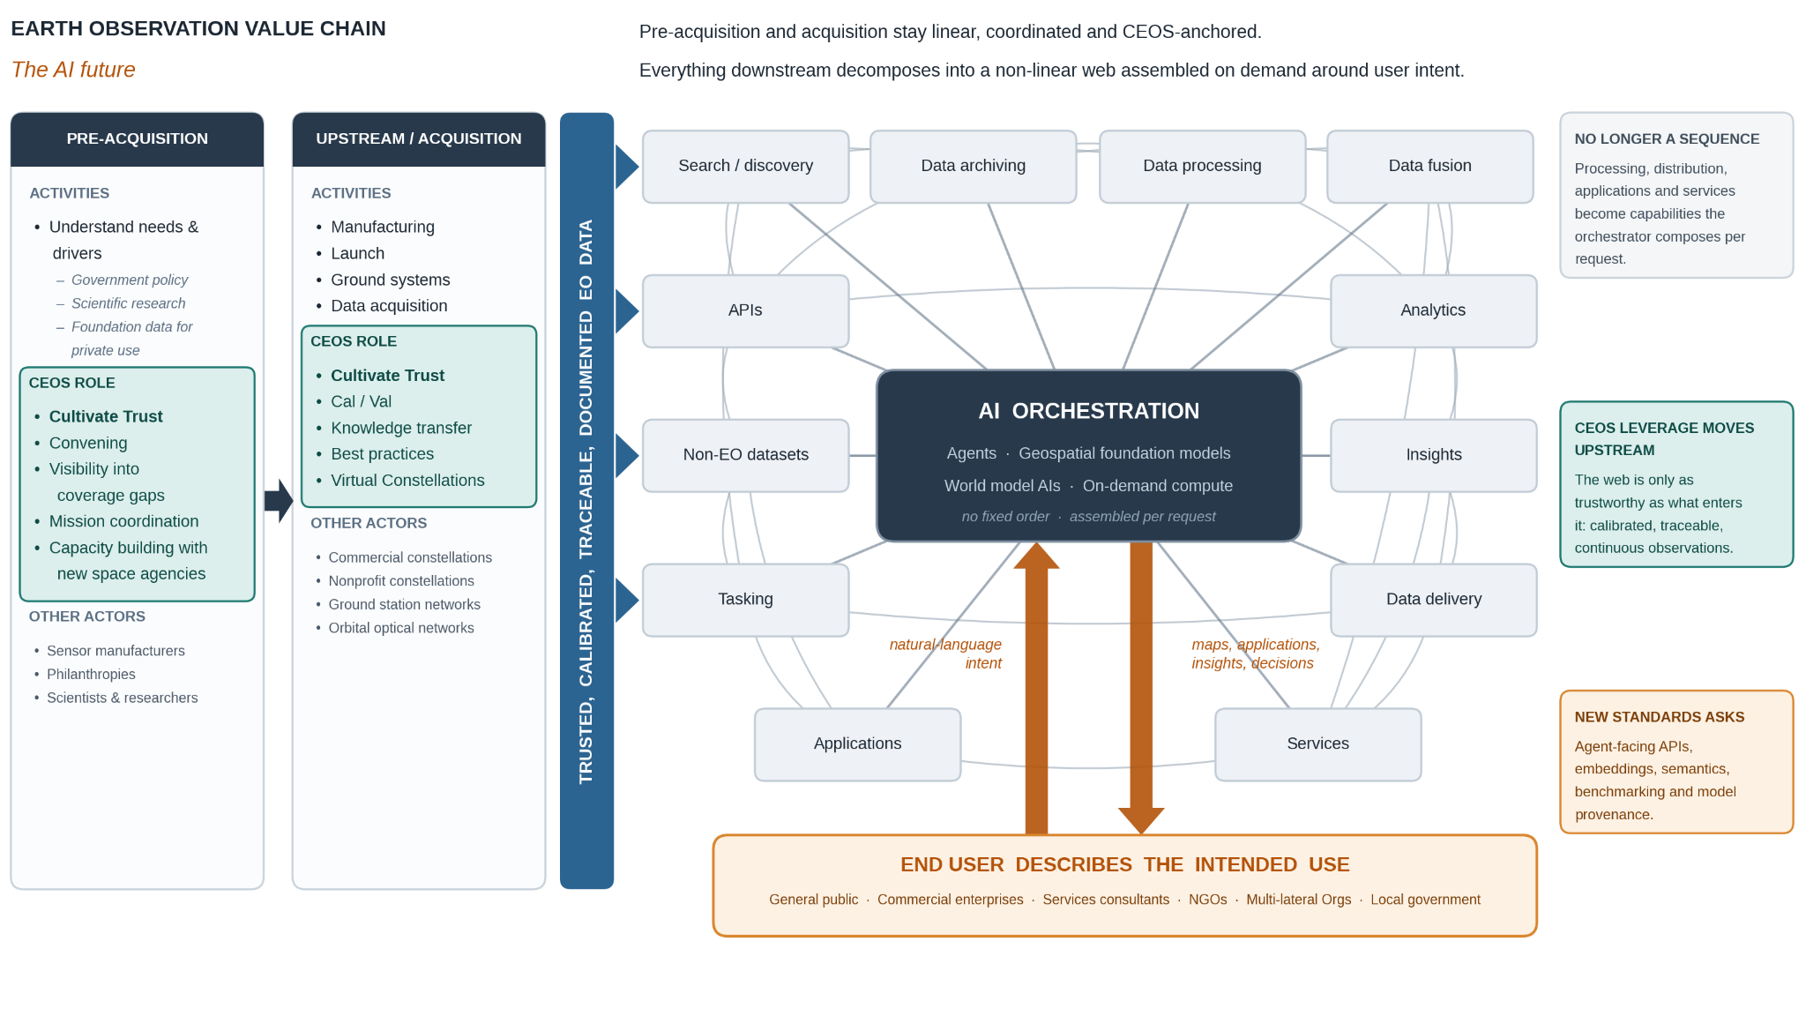
3. Future with AI as Consumer

Slide 27
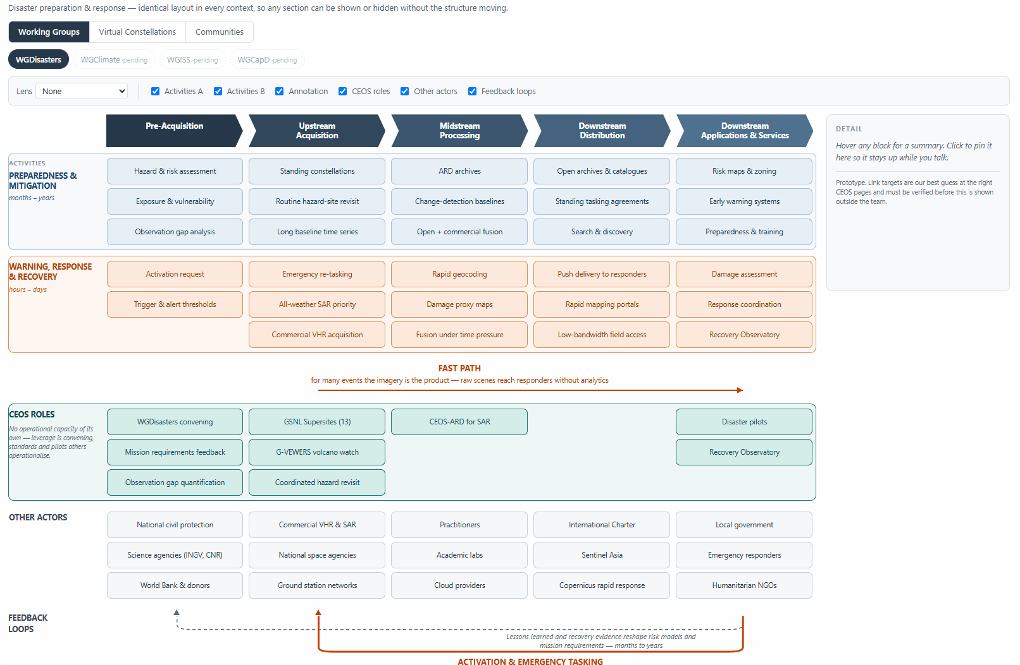
3. Future with AI as Consumer

Slide 28

Submit your responses
1) What tradeoffs does each value chain representation offer?
2) If you had to pick one option to publish on the CEOS web site, which one would you choose? Why?
3) Would it make sense to publish a second value chain? If so which one would you choose?
4) Would it be helpful to consider publishing an interactive value chain on the CEOS web site based on the Context Value Chain approach?
https://bit.ly/4cceTu2

Slide 29
Thank you!
Interested in being a beta tester
for the new CEOS web site?
david.borges@nasa.gov
Notes:
Interviews
Needs to be a pre-evaluation area where needs are identified
Examples of where actors fit
Two feedback loops
User needs but ALSO tasking (e.g. mid-res to high-res after change detection)
Interviewees emphasized that the value chain needs to be adaptable to representing their use/needs-
ADD
“Cloud” to Distribution
Embed CEOS Trust Building more prominently - perhaps extend across Pre-Acqu to Midstream

Slide 30
Socio-Economic Impact Assessment
Zachary Vinyard
NASA SIT Chair Team
Agenda Item W1.3
SIT TW 2026
Washington DC, USA
8-10 September, 2026

Slide 31
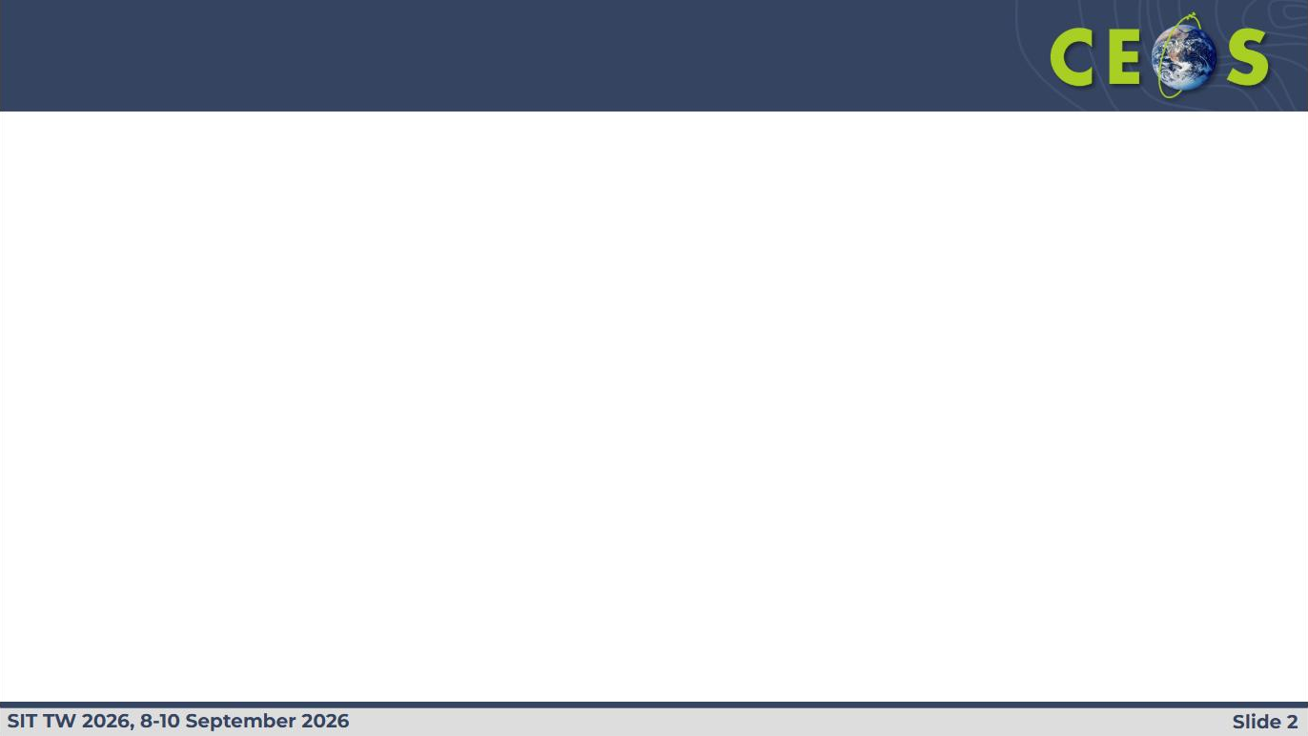
Shaping what CEOS measures
INTRODUCTION
Ongoing work
This session
Radiant Earth is assessing the socioeconomic impact of CEOS, using water and resilience activities for NASA's SIT Chair Priority 2 as pilot areas, with two outputs: (a) an assessment of the impact CEOS has today, and (b) a framework for building impact measurement into future CEOS work.
Input from this session will inform both outputs. The session is structured as a working discussion.
Project timeline
Sept 2026
Nov 2026
April 2027
September 2027
Nov 2027
SIT TW, Washington, D.C.
CEOS Plenary, Hobart
SIT-42, Washington, D.C.
SIT TW, California
Plenary, Norway
Final analysis & Framework
Slide 2

Slide 32
Resilience
WORKING DEFINITIONS · 1 OF 2
COMMUNITY AND DATA SYSTEMS RESILIENCE
Resilience refers to the capacity of systems - natural, built, economic, and social - to withstand disturbances, maintain essential functions, and recover efficiently under conditions of stress. Resilience strengthens the underlying robustness and flexibility of interconnected systems across local, national, and global scales.
From: 2026 CEOS Earth Observation Handbook on Adaptation and Resilience.
Slide 3

Slide 33
Impact
WORKING DEFINITIONS · 2 OF 2
The change that CEOS creates: outcomes, data creation, and decisions that would not have happened (or would have happened differently) without CEOS.
Slide 4

Slide 34
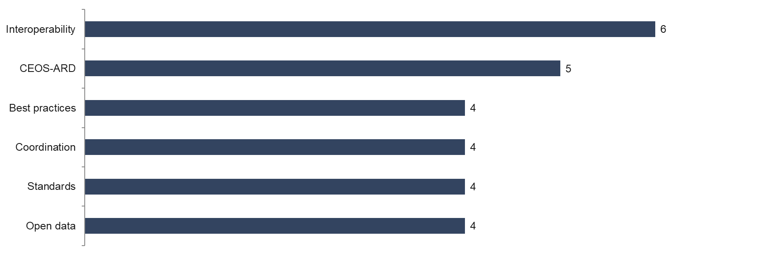
What the community reported at SIT-41
COMMUNITY INPUT · SIT-41, SPRING 2026
Where is CEOS having its greatest impact?
Source: live audience polling conducted during the SIT-41 value chain session, spring 2026. Counts reflect the number of participants giving each answer.
Slide 5

Slide 35
The state of impact measurement at CEOS
EMERGING FINDINGS
1
Tracking
Interviews to date indicate no structured impact monitoring at CEOS today: appreciation of the work, but little systematic evidence.
2
Impact
ARD, interoperability, calibration/validation, coordinated missions: clear candidates where CEOS changes outcomes.
3
Characterization
Characterize impact thoroughly before quantifying it. Qualitative evidence is valid; quantification follows where it is meaningful.
Six dimensions of value against which impact will be assessed (GEO Impact Assessment Toolkit, GIAT v2.0):
Economic
Environmental
Regulatory
Societal
Scientific
Innovation
Slide 6

Slide 36
Impact at CEOS today
INTERACTIVE DISCUSSION
Identify one CEOS activity you are confident has real impact, and describe how you know.
Slido: #1890314
Slide 7

Slide 37
Looking ahead
INTERACTIVE DISCUSSION
The year is 2030.
CEOS has massive, globally recognized impact.
How is this impact measured?
How is it communicated?
All ideas are welcome. What is tracked? Who sees it? What changes as a result?
Slido: #1890314
Slide 8

Slide 38
Thank you
Zachary Vinyard
Radiant Earth · NASA SIT Chair Priority 2
zachary.vinyard@radiant.earth
To discuss further, or to suggest a case for examination, please get in touch.
Slide 9

Slide 39
Socio-Economic Impact Assessment
Presenter, Organization
Agenda Item W1.3
SIT TW 2026
Washington DC, USA
8-10 September, 2026

