Slide 1
Workshop 2:
Water Planet
Erin Urquhart, NASA
Agenda Item W2
SIT TW 2026
Washington DC, USA
8-10 September, 2026

Slide 2
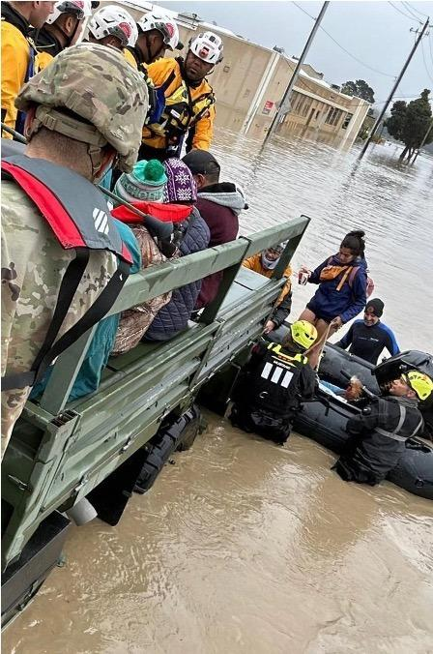

NASA SIT Chair Priorities
Priority 1: Water Planet- Seeing Earth's Water from Space
Advance understanding of Earth's water cycle by monitoring terrestrial waters, coastal regions, and oceans from space. Transform this knowledge to actionable insights to enhance water use efficiency, improve water quality, and enhance resilience to water-related hazards such as droughts, floods, and storms.

Slide 3
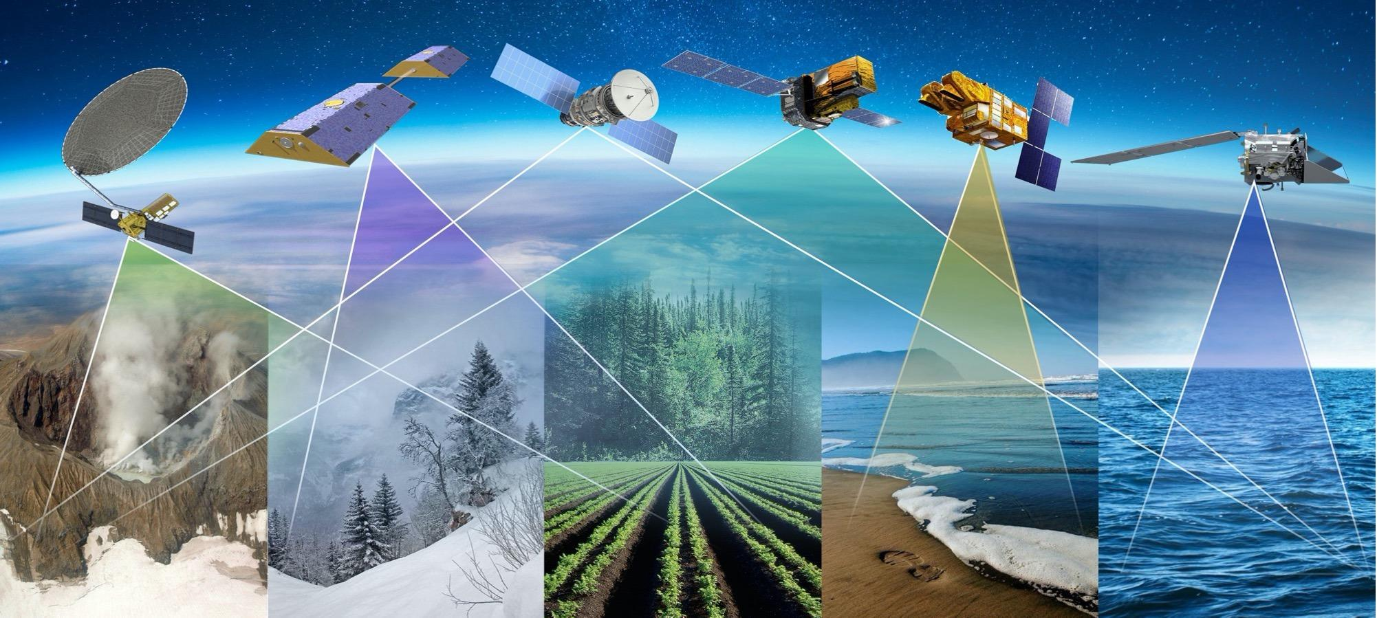
Priority 1: Key Objectives
Coordinated Water Observations
Accessible and Interoperable Water Data Products
User-Center Solutions for Water Challenges
Assessment of Benefits & Impact

Slide 4
Priority 1: Deliverables Timeline
Seeing Earth’s Water from Space
Plenary
2025
SIT-41
SIT TW
2026
Plenary
2026
SIT-42
SIT TW
2027
Plenary
2027
Objectives
Coordinated Water Observations
Gap analysis of water variables
Best practice guidance for integrating multispectral (optical + SAR) data for water
Coordinate and promote multisource integrated water products
Accessible & Interoperable Water Data Products
Define application specific requirements for water variables
CEOS-ARD Self Assessments
CEOS-ARD for Water
Encourage and contribute CEOS ARD Water products related to water resources & quality
Align and promote user-driven tools for water management and resilience
User-centered Solutions for Water Challenges
Water Quality Workshop Series
Advancing EO data for water resources solutions (TBD)
Assess data needs for water resources / water quality management
Assess Impact & Benefits
Impact assessment of existing CEOS activities related to water/resilience (w/ Priority 2)
Use cases on the benefits of EO for water

Slide 5
Water Planet Workshop
Workshop objectives:
Confirm the CEOS-ARD Strategy Water Annex initiatives and identify additional contributions and opportunities. Discuss the relation of the annex as a follow-up to the 2015 CEOS Strategy for Water Observations from Space.
Review progress on CEOS-ARD Self-Assessments for PACE and SWOT
Review progress on the SIT Chair’s Best Practice Guidance for Integrating Multiplatform and Multispectral Data for Water Science and Applications, including the integration use cases submitted by the CEOS community. Identify additional contributors.
Discuss opportunities and connections to the NOSA 2027 CEOS Chair theme: True Blue

Slide 6
2026 CEOS-ARD Strategy Water Annex
Perry Oddo, NASA
Agenda Item W2.1
SIT TW 2026
Washington DC, USA
8-10 September, 2026

Slide 7
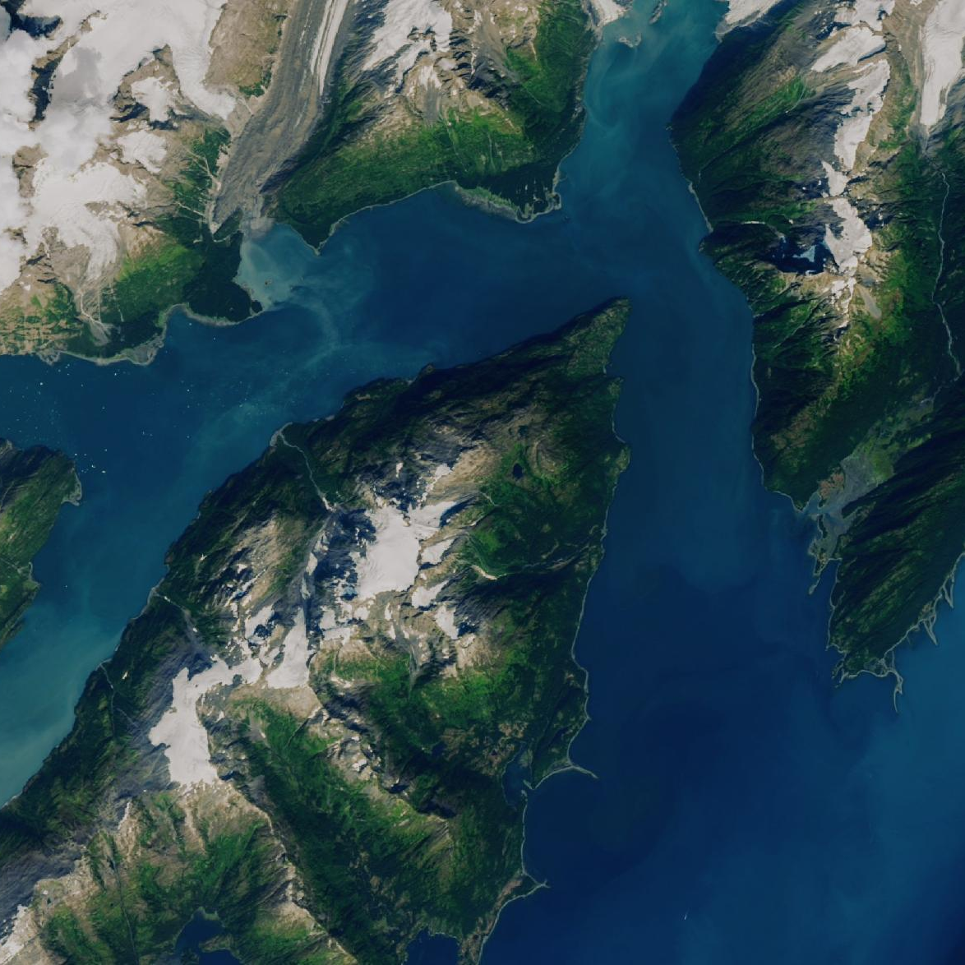
CEOS-ARD Strategy for Water
Session Overview
Provide context for the CEOS-ARD Strategy for Water
Review and confirm annex initiatives
Identify additional areas for contribution
Putting things into practice:
CEOS-ARD Self-Assessments for recent water-relevant missions
  Surface Water and Ocean Topography (SWOT)
  The Plankton, Aerosol, Cloud, and ocean Ecosystem (PACE)

Slide 8
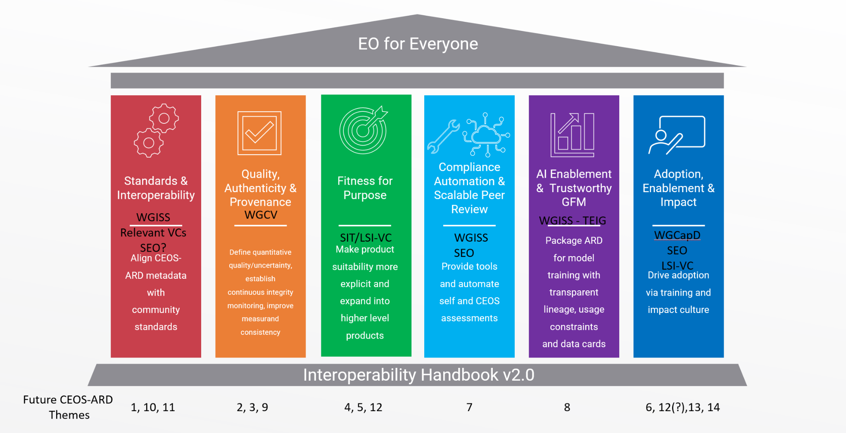
Context: CEOS-ARD Strategy
CEOS Analysis Ready Data (CEOS-ARD)
CEOS-ARD are satellite data that have been processed to a minimum set of requirements and organized into a form that allows immediate analysis with a minimum of additional user effort and interoperability both through time and with other datasets.

Slide 9
CEOS-ARD Strategy for Water
Water Annex Objectives:
Close the usability gap between data collection and use in decision making
Shift the burden of fundamental data processing away from user
Guide framework for delivering user-centric water products
Move beyond foundational data to deliver the specific thematic variables that water managers require.
Enable Seamless Multi-Mission Integration
Support common standard so observations from different institutions can be readily combined.
Water Planet
“Seeing Earth’s Water from Space”
Water
Annex
CEOS-ARD
“Earth Observation for Everyone”
NASA ES2A
“Trusted Information to Drive Earth Resilience Activities”
Notes:
In doing so, these also satisfy three of the Water Planet Key objectives:
Coordinated Water Observations
Accessible and Interoperable Water Data Products
User-Center Solutions for Water Challenges

Slide 10
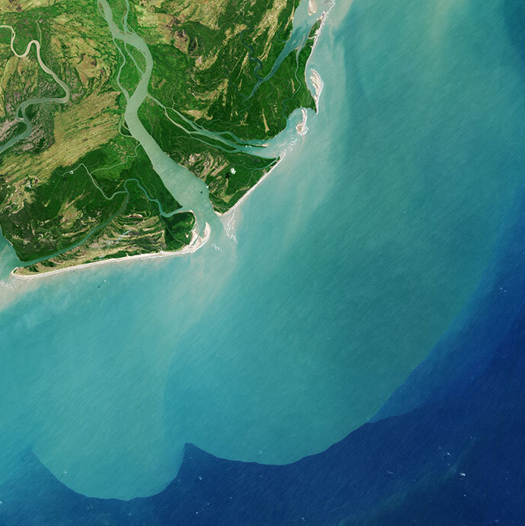
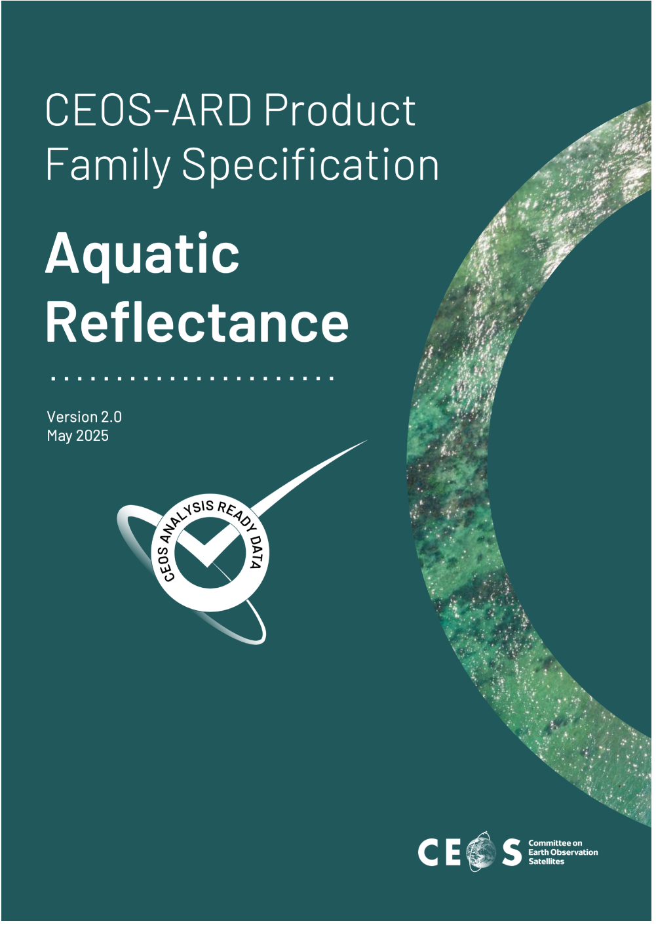
Prior Work: CEOS in the Aquatic Realm
Aquatic Reflectance PFS
Provides guidance for satellite data products focused on inland and nearshore coastal, and optically-shallow waters
2025 update expanded coverage to all aquatic domains, including open oceans
Established key metadata requirements, as well as products, algorithms, and geometric corrections
Despite providing a critical baseline, community feedback indicates that more work is needed to meet water practitioners where they are

Slide 11
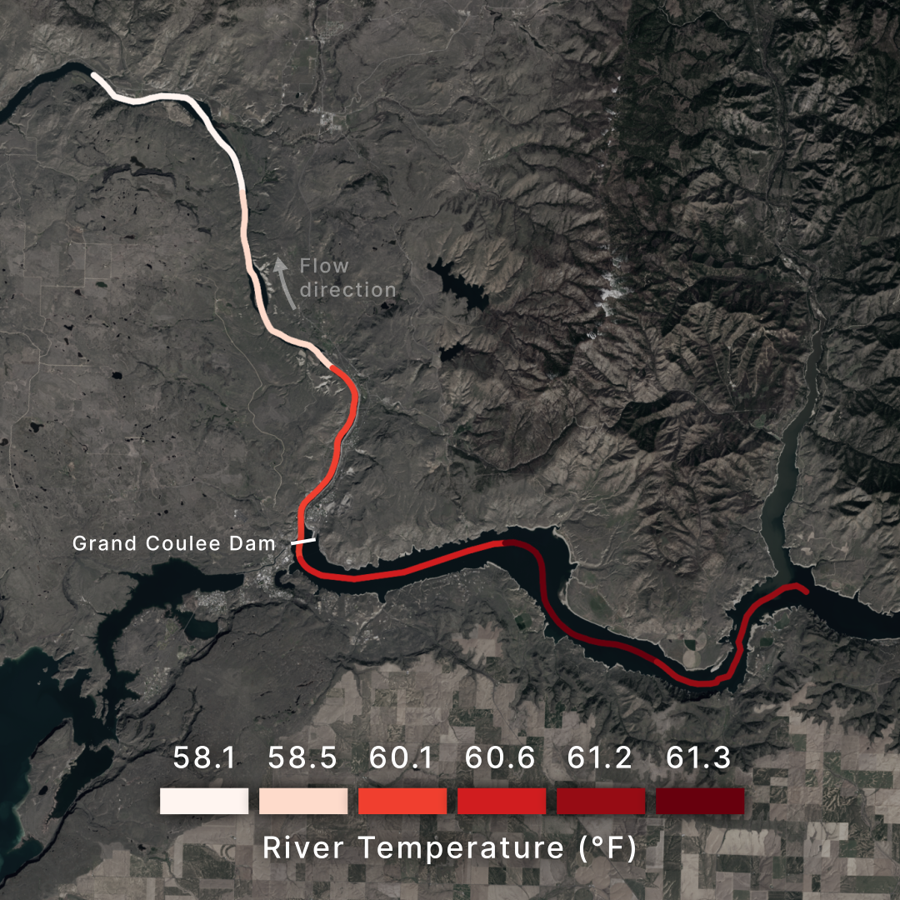
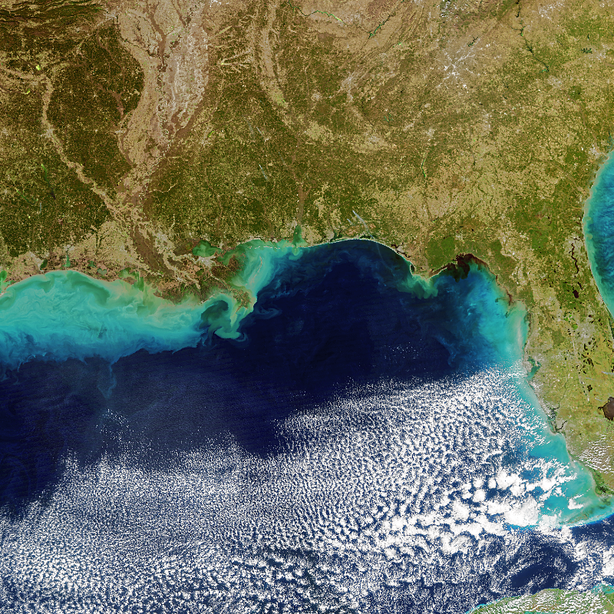
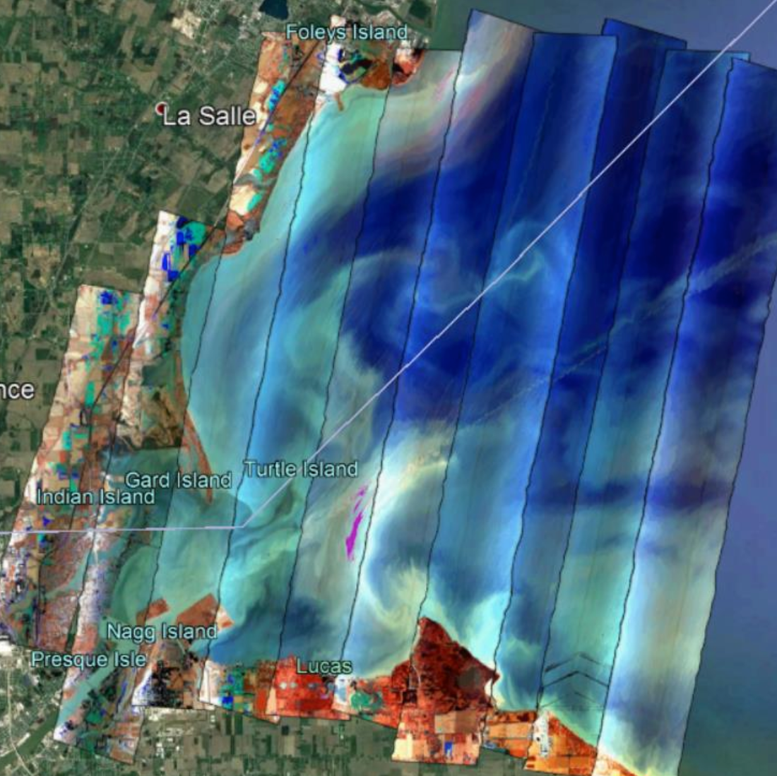
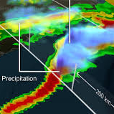
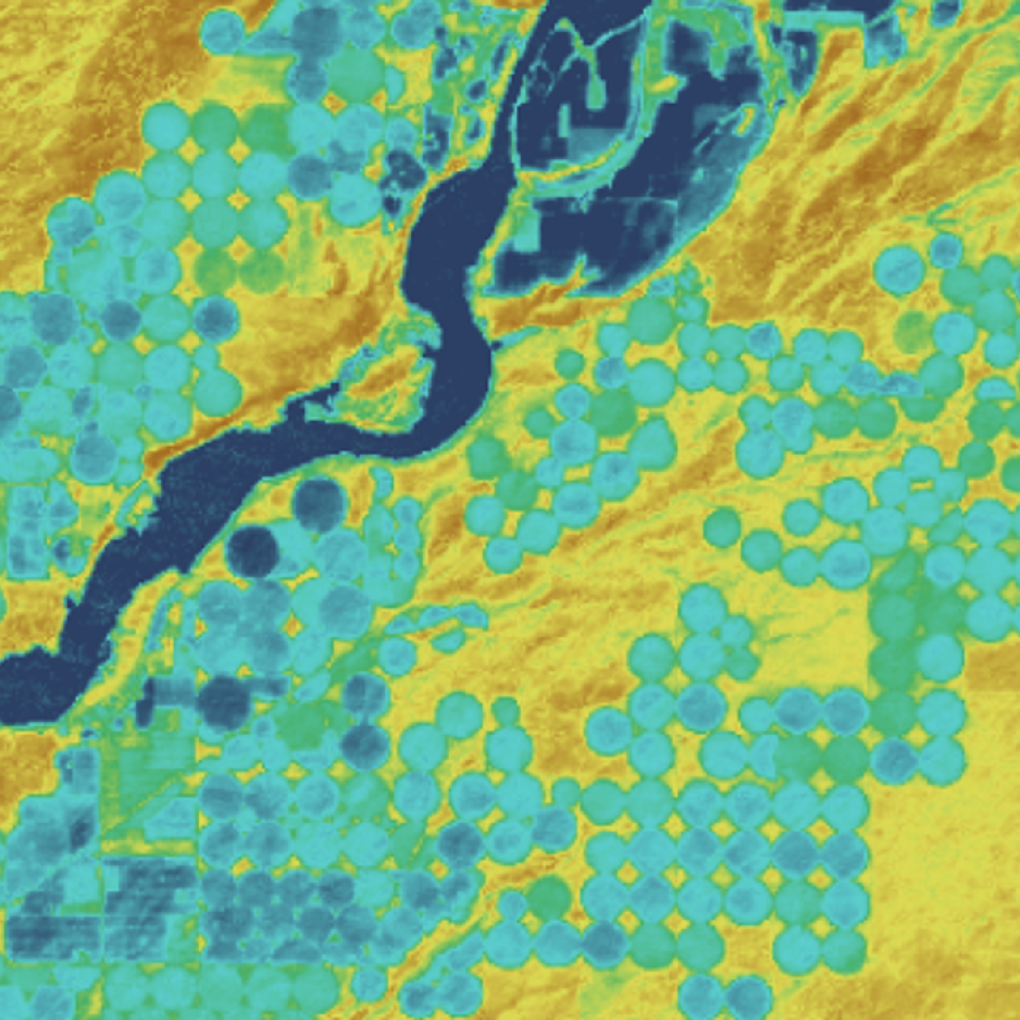
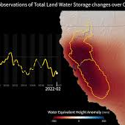
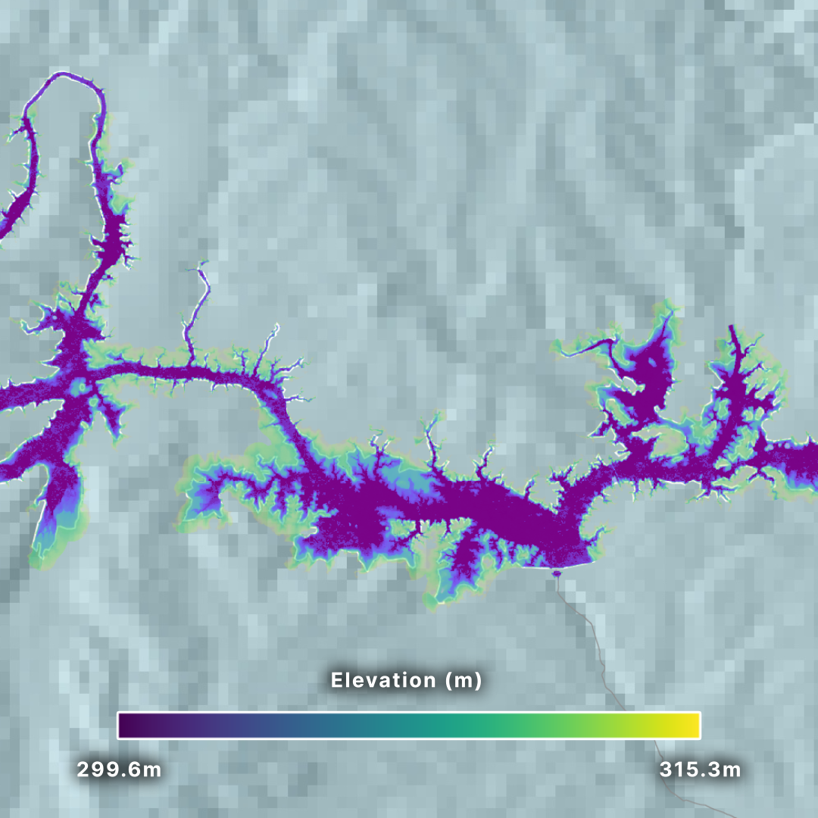
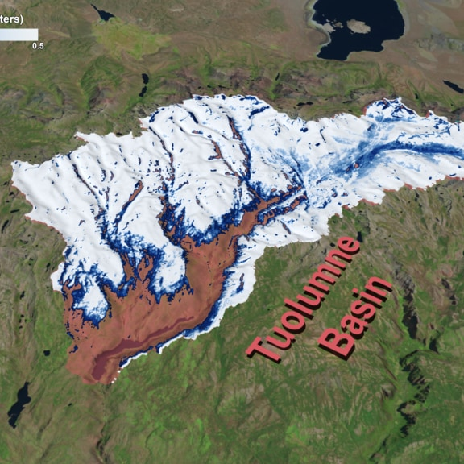
Establishing a Need for Higher-Level Products
Thermal Infrared
Brightness Temperature
Aquatic Reflectance
Cloud Top Temperature
LS Reflectance / Temperature
Gravity Anomalies
Radar Backscatter
Microwave Radiometry

Slide 12
Establishing a Need for Higher-Level Products
Water Temperature
Salinity
Chlorophyll
Precipitation
Crop Water Use
Groundwater Storage
Reservoir Extent
Snowpack
Notes:
Therefore, to fulfill the "User-Centric Solutions" outcome of the Water Planet priority, this annex seeks to establish a roadmap to expand the CEOS-ARD Framework for the water domain, with the goal of expanding beyond strictly foundational data to define PFS for higher-level, thematic products. This annex outlines the steps required to bridge the gap between data producers and the water management community, ensuring that CEOS-ARD is fundamentally "fit for purpose" from catchment to coast.

Slide 13

Recent Updates: Future of CEOS-ARD
Future of CEOS-ARD Priority Themes
Consistent and Enhanced Metadata Specifications Data and Metadata Quality Ongoing Quality Assurance and Integrity Monitoring Fitness for Purpose Increased Support to Scientific Applications and Environmental Adaptation and Resilience Solidifying the Business Case and Increasing Commercial Relevance Tools to Aid Compliance Assessments and Peer Reviews | Supporting Opportunities and Reducing Risks Related to AI Measurand Consistency and Algorithm / Application Resilience Alignment with the Software Ecosystem Analysis Ready Data Standards Thematic and Higher-level CEOS-ARD Products Training and Outreach Capturing Use and Impact

Slide 14
Recent Updates: Future of CEOS-ARD
Future of CEOS-ARD Priority Themes
Consistent and Enhanced Metadata Specifications Data and Metadata Quality Ongoing Quality Assurance and Integrity Monitoring Fitness for Purpose Increased Support to Scientific Applications and Environmental Adaptation and Resilience Solidifying the Business Case and Increasing Commercial Relevance Tools to Aid Compliance Assessments and Peer Reviews | Supporting Opportunities and Reducing Risks Related to AI Measurand Consistency and Algorithm / Application Resilience Alignment with the Software Ecosystem Analysis Ready Data Standards Thematic and Higher-level CEOS-ARD Products Training and Outreach Capturing Use and Impact

Slide 15

Recent Updates: Future of CEOS-ARD
12. Thematic Products
Respondents suggested starting to apply CEOS-ARD criteria to higher-level products. They called for more predefined thematic indicator products and more diversity of data and sensor types. It was suggested that accessibility could be improved for non-experts with thematic, pre-processed products. Closer alignment of specifications with the application needs of users was encouraged to drive adoption.

Slide 16
Framing for Water Annex:
Essential Water Variables
Essential Water Variables (EWVs)
Parameters that address user-defined critical requirements for:
Observational monitoring of key elements of the global, regional, and local water cycle
Inputs required by land surface/ hydrological models to generate derived products
Variables required by users for interdisciplinary decision support systems and tools

Slide 17
Framing for Water Annex:
Essential Water Variables
Essential Water Variables (EWVs)
Proposed in the 2014 The Global Earth Observation System of Systems (GEOSS) Water Strategy Report
Partial adoption through initiatives like the Group on Earth Observations Global Water Sustainability (GEOGLoWS) and the Global Energy and Water Exchanges (GEWEX)
Limited support for water quality, which is aggregated as single variable

Slide 18
Framing for Water Annex:
Essential Water Variables
Essential Water Variables (EWVs)
Proposed in the 2014 The Global Earth Observation System of Systems (GEOSS) Water Strategy Report
Partial adoption through initiatives like the Group on Earth Observations Global Water Sustainability (GEOGLoWS) and the Global Energy and Water Exchanges (GEWEX)
Limited support for water quality, which is aggregated as single variable
Primary EWVs | Supplemental EWVs
Precipitation | Surface Meteorology
Evaporation | Surface and Atmospheric Radiation Budgets
Evapotranspiration | Clouds
Snow | Aerosols
Soil Moisture | Land Cover
Soil Temperature | Vegetation
Groundwater | Land Use
Runoff/Streamflow/River Discharge | Elevation/Topography
Lake/Reservoir Levels and Aquifer Volumetric Change, Terrestrial Water Storage | Geological Stratification
Water Use/Demand
Water Quality

Slide 19
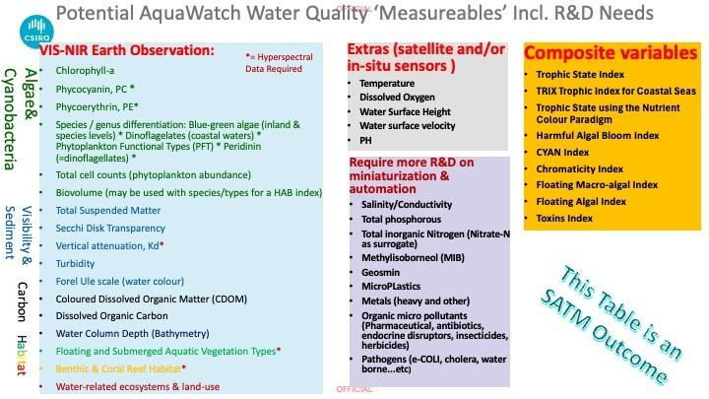
Framing for Water Annex:
Essential Water Quality Variables
Notes:
Throughout 2026, NASA and CSIRO have collaborated on a shared priority of Water Quality, seeking to understand the requirements for comprehensive catchment-to-coast satellite Earth observations. Past work by CSIRO under the Aquawatch program has yielded a candidate set of Essential Water Quality Variables – achieved through a comprehensive Science and Applications Traceability Matrix assessment, intended to ensure the AquaWatch program is driven by end user requirements informed by science.
While this should be considered a preliminary step towards formal Essential Water Quality Variables, these findings provide a useful first deconstruction of the singular ‘Water Quality’ Primary EWV noted above.
Identifying Essential Water Quality Variables (EWQVs) will provide a scientifically agreed and user-focused set of measurements critical for monitoring water quality along the catchment-to-coast system. These are characterised as the most important indicators of water quality, which have significant impact on ecosystem health, water security and human well-being. Improving consistency, interoperability and comparability of water quality observations will enable more effective tracking of water conditions, support development of early warning and forecasting systems, as well as guide future mission planning, technology development and investment in observation systems to ensure that the most important water quality information remains available, consistent and fit for purpose over the long term. Aligning CEOS-ARD with EWQVs will further enable this.

Slide 20
CEOS-ARD Water Annex: Initiatives
Initiatives by Pillar
9
2
2
2

Slide 21
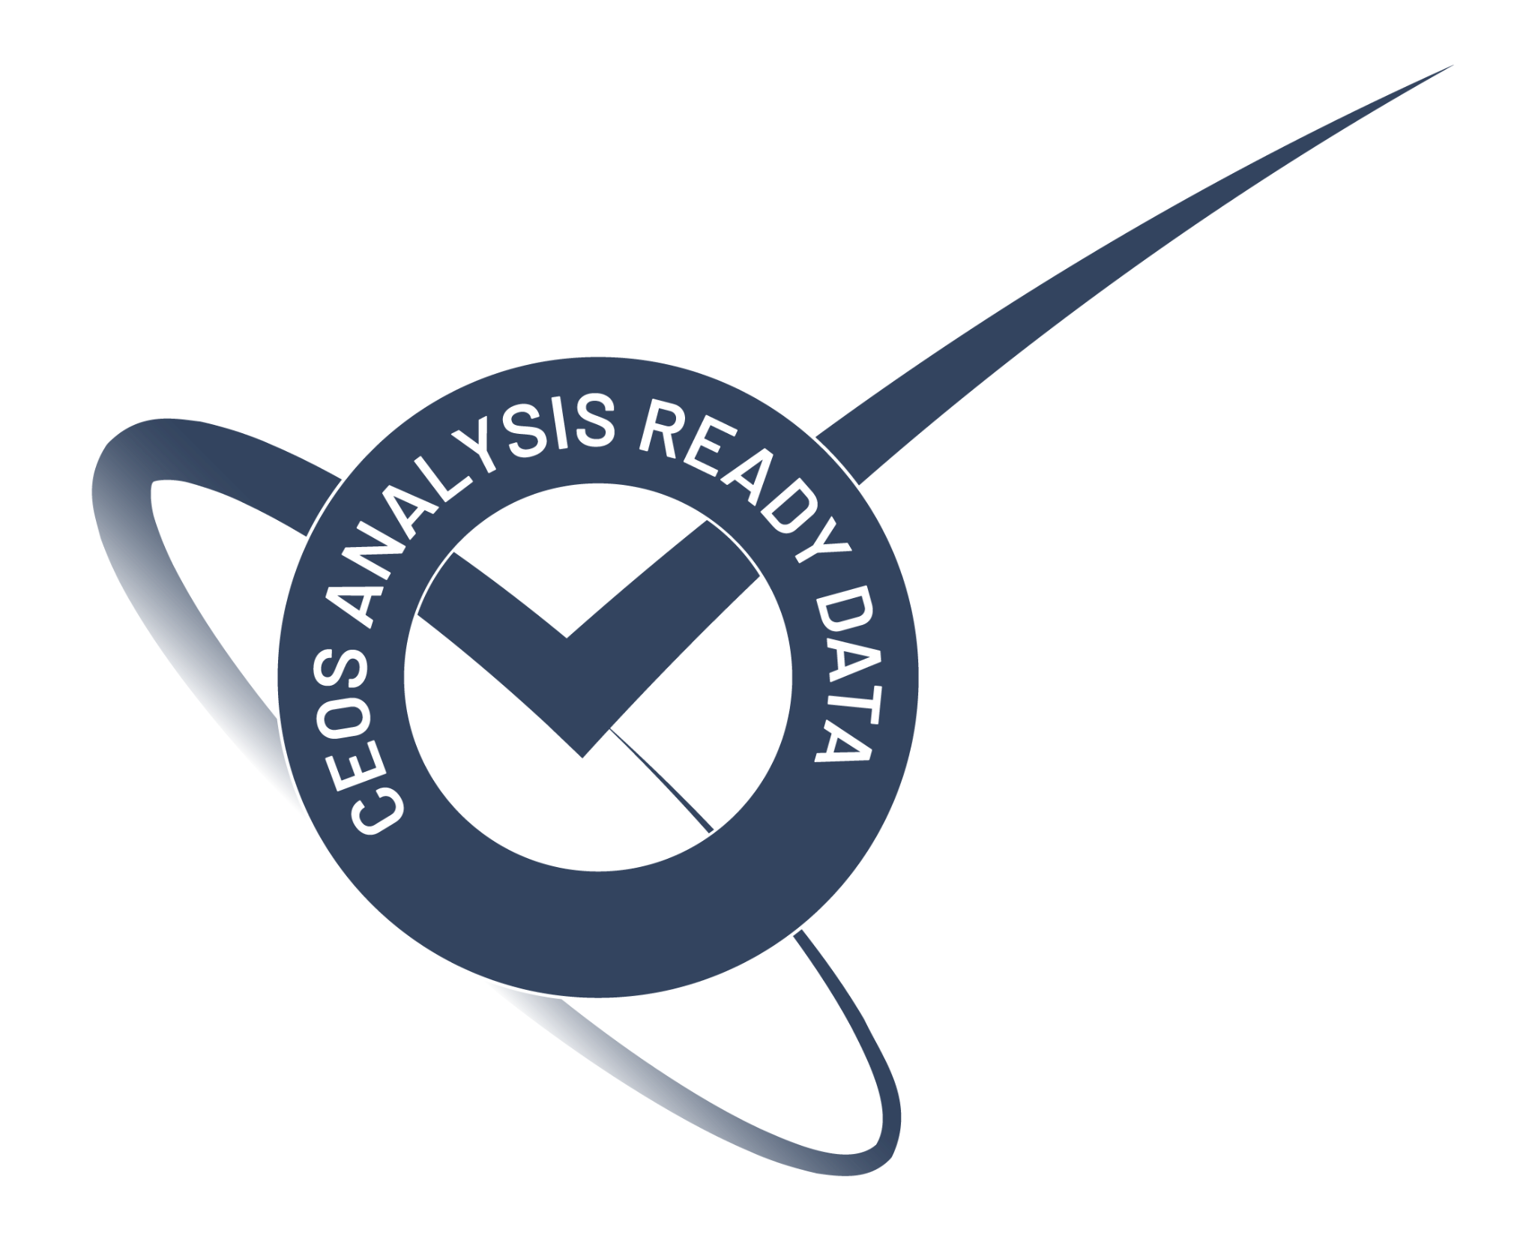
CEOS-ARD Water Annex: Initiatives
Standards and Interoperability
Update Product Family Specifications (PFS) based on ARD Self-Assessments:
  SWOT Self Assessment ➟ Synthetic Aperture Radar (SAR) PFS
  PACE Self-Assessment ➟ Aquatic Reflectance (AR) PFS
Explore new derived PFS as water-specific test cases
  Updated AR PFS ➟ Derived Chlorophyll PFS
  Derived Soil Moisture PFS
Identify common building blocks across necessary PFS to address EWVs
  Leverage the CEOS-ARD modularization approach to identify foundational elements that can be shared across multiple water-thematic specifications.

Slide 22
CEOS-ARD Water Annex: Initiatives
Quality, Authenticity & Provenance
Ensure appropriate representation of the water domain in CEOS WGCV
  Explore the current lack of a dedicated water group in the Working Group on Calibration and Validation (WGCV) that might be needed to support peer review of water-focused self-assessments
Fitness for Purpose
Develop water-specific guidance for dataset selection
  Create documentation to help users select appropriate datasets for specific tasks, including guidance on the use of multiple integrated datasets
Contribute water-thematic profiles to the CEOS-ARD Product Selection Framework
  Integrate water-specific variables into the broader framework to improve discoverability of relevant CEOS-ARD for end-users.

Slide 23
CEOS-ARD Water Annex: Initiatives
Adoption, Enablement & Impact
Engage stakeholder communities to capture case studies and impact metrics
  Work with relevant communities to document and demonstrate the operational value of CEOS-ARD for water management.
Continue CEOS water quality workshops
  Utilize ongoing workshops to elicit community requirements and collaboratively develop PFS and compliant products.

Slide 24
Next Steps
CEOS-ARD Strategy for Water
CEOS-ARD Strategy for Water will be included as Annex I in the 2026 CEOS-ARD Strategy, which will be presented for endorsement at the 2026 CEOS Plenary
Feedback from community on the draft strategy and initiatives is requested
Incorporate additional takeaways from CEOS Water Quality Workshop #2

Slide 25

CEOS-ARD Strategy for Water
Discussion
How does the framing around Essential Water Variables (EWVs)—and related frameworks like EWQVs or EWetVs—align with your agency's strategic priorities? Do you find this a valuable lens for defining future CEOS-ARD products?
What is your reaction to the proposed distribution of responsibilities across the Water Annex initiatives?
Recognizing that many agencies are already generating higher-level water products in some capacity, how can we best align those existing efforts?

Slide 26
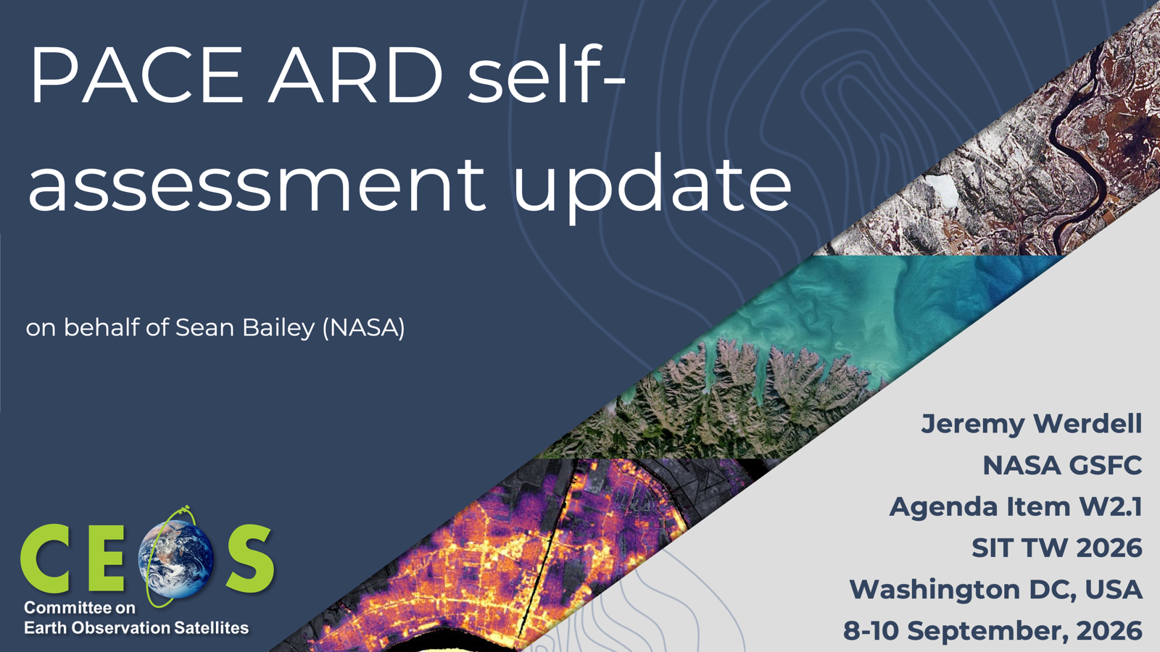

Slide 27
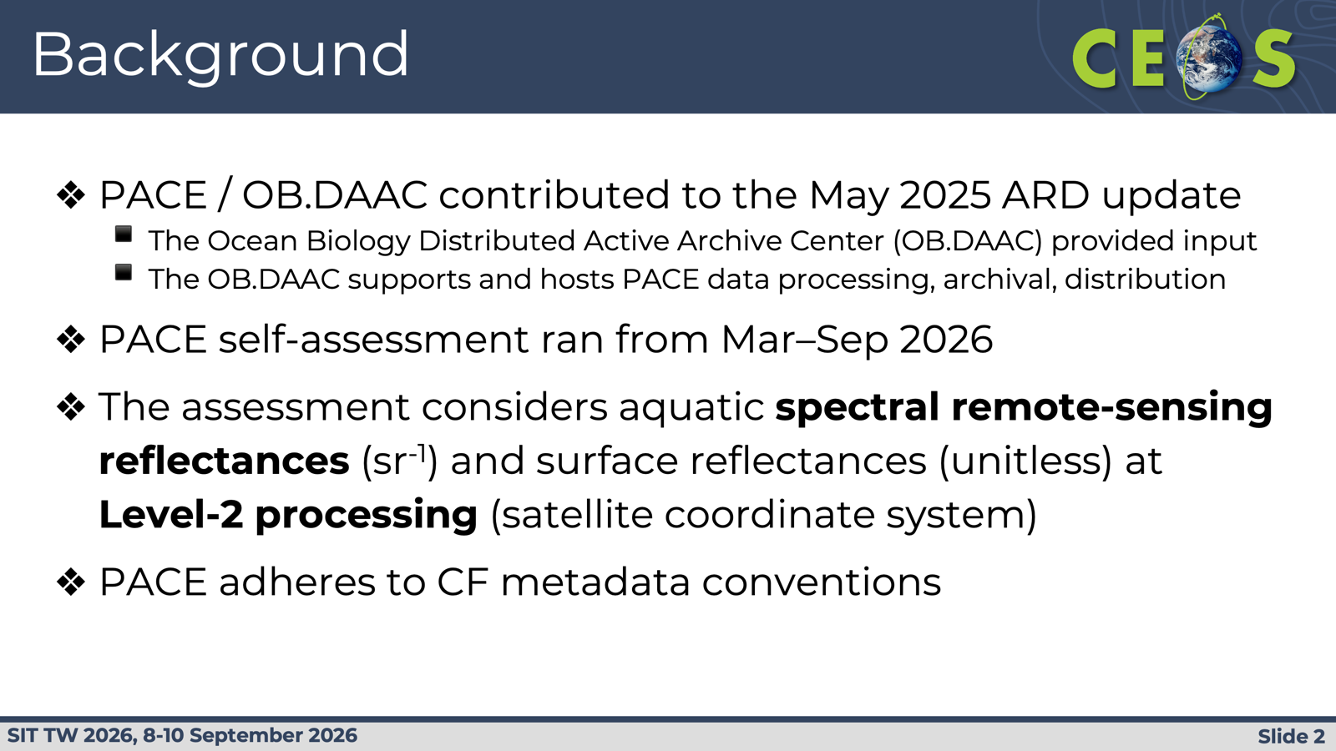

Slide 28
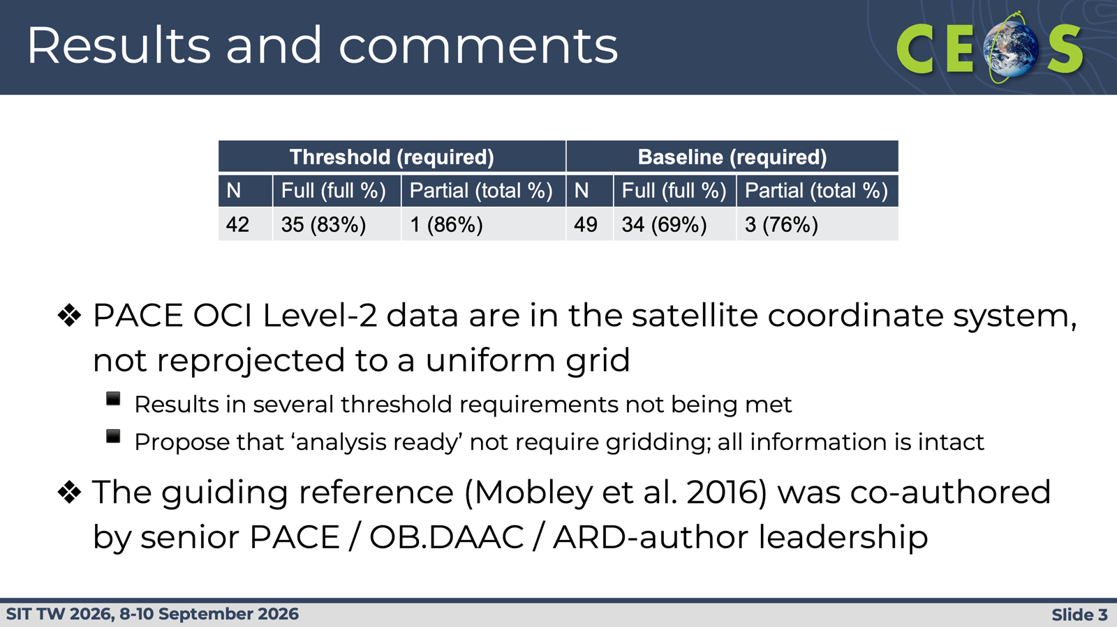

Slide 29
SWOT ARD self-assessment update
Matt Bonnema, NASA JPL
Agenda Item W2.1
SIT TW 2026
Washington DC, USA
8-10 September, 2026

Slide 30
InSAR ARD Self Assessment
Completed initial self assessment of SWOT L1 low-rate interferogram product and preparing submission of results.
Many required metadata fields relegated to product documentation
Source radar products unavailable
SWOT user community would benefit more from water thematic ARD assessment of higher level products
 | General Metadata | 2. Per-Pixel Metadata | 3. Radiometrically Corrected Measurements | 4. Geometric Corrections | Total
Threshold | 7/28 (8 partial) | 1/3 | 0/3 | 0/3 | 8/37 (8 partial)
Goal | 7/36 (9 partial) | 2/16 (1 partial) | 0/12 (2 partial) | 0/5 | 9/69 (12 partial)

Slide 31
Best Practice Guidance for Integrating Multiplatform and Multispectral Data for Water Science and Applications
John Bolten, NASA
Agenda Item W2.2
SIT TW 2026
Washington DC, USA
8-10 September, 2026

Slide 32
Best Practice Guidance: Purpose & Scope
What This Document Is
Who It Serves
Why Now
Community-driven best practice guide for combining optical, SAR, passive microwave, altimetry, and gravity data for water applications
A living resource hosted on GitHub, contributable by all CEOS agencies
Covers the land-to-ocean continuum: availability, use, extremes, quality
Scientists and practitioners needing guidance on multi-sensor integration
Proposal writers and early-career researchers designing multi-mission studies
CEOS agencies planning missions and assessing CEOS-ARD compliance
Water managers seeking actionable satellite-derived information
Since 2015: a new generation of water-relevant missions has launched across the intergovernmental and commercial space sectors
New EO is available. The integration guidance did not follow.
This document fills the gap between available missions and practical applications

Slide 33
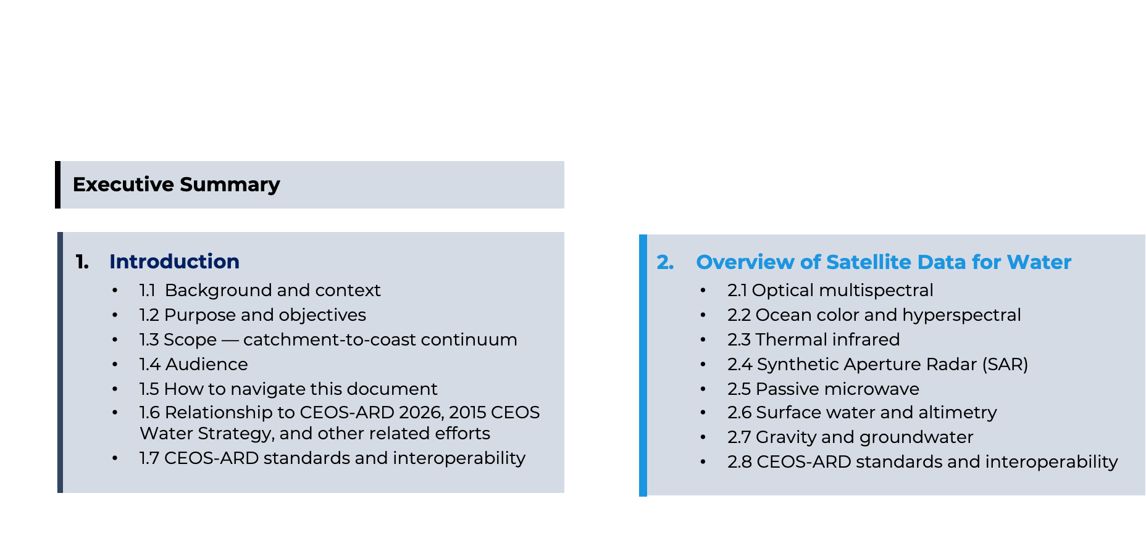

Slide 34
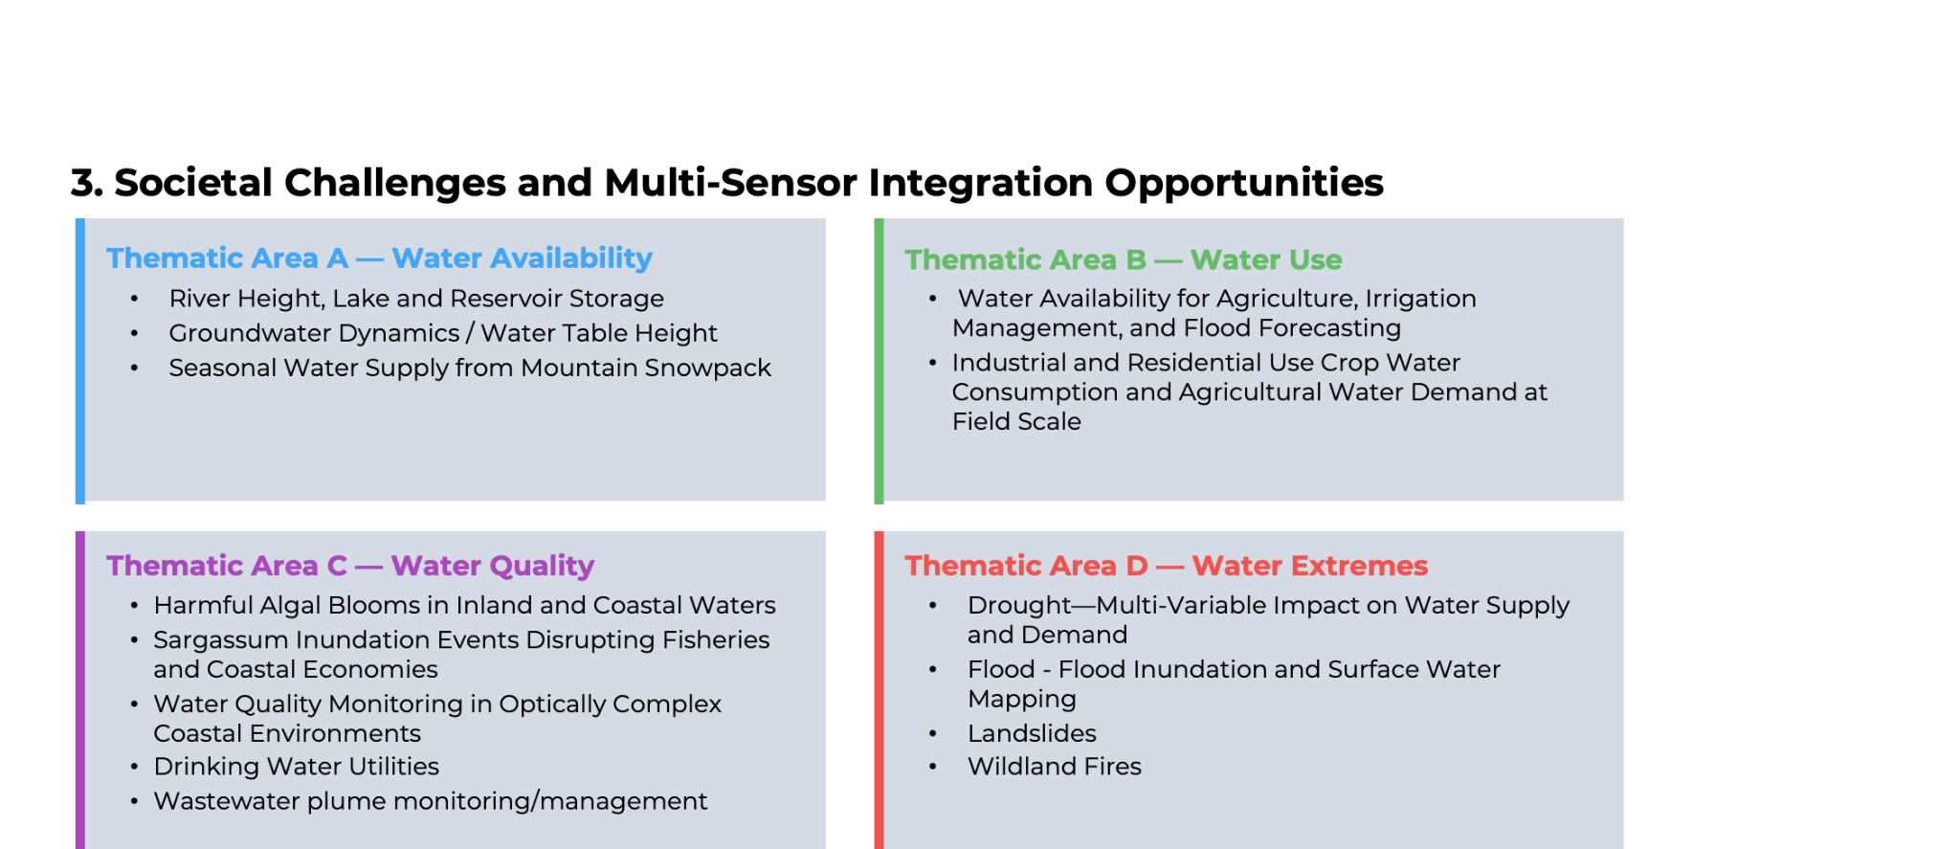

Slide 35
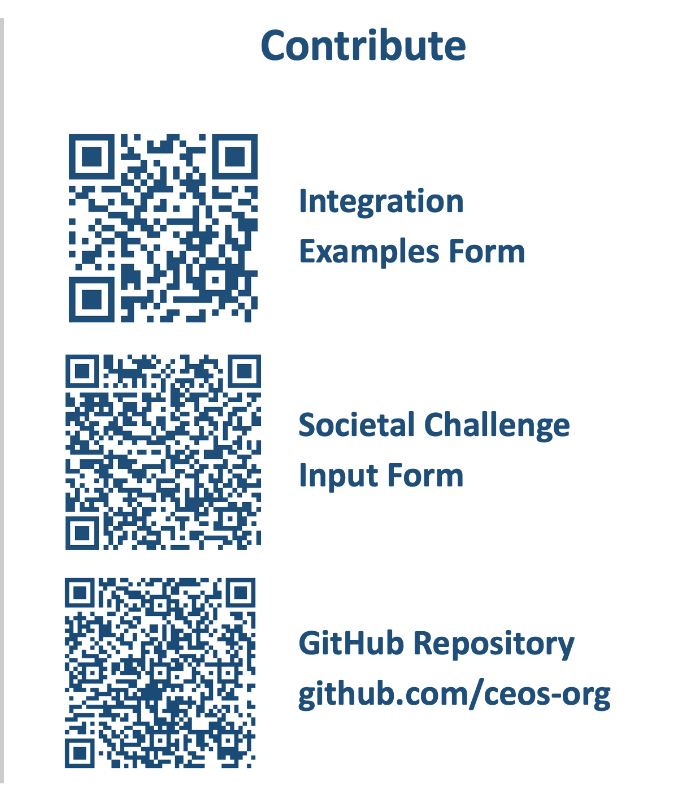
Progress Update Since SIT-41 (April 26)
What we have done
Drafted societal challenges section for Water Quality (Section 3C)
Created and distributed two Google Forms to the CEOS community: Integration Examples and Societal Challenge Input
Established GitHub repository at github.com/ceos-org/water-multisensor-best-practice
Received 6 integration examples from 5 organizations (NOAA, ISRO, NERSC, CSIRO, CNES, Geoscience Australia) across 4 countries
What We Still Need
Additional integration examples, especially for Water Use (0 submissions so far)
Complete societal challenges for Water Availability and Water Extremes
Community review of draft sections at SIT TW
Notes:
CEOS Water Best Practice Guidance Integration Example Submission
https://docs.google.com/forms/d/e/1FAIpQLSf0czZGMBwinCa1dmmo5dLVD1Db44Z200kYkZVQW3Y3su8LSA/viewform
Societal Challenge Input Form
https://docs.google.com/forms/d/e/1FAIpQLSdFng1FNCmwdV1SpsCKA1y0x19yxZMe7JiVsf35HwP32eFFcg/viewform
GitHub Repository – Multisensor Best Practice Guidance
https://github.com/ceos-org/water-multisensor-best-practice

Slide 36

Progress Since SIT-41 (April 2026)
What We Have Done
GitHub Repository
Drafted societal challenges section for Water Quality (Section 3D)
Created and distributed two Google Forms to the CEOS community: Integration Examples and Societal Challenge Input
Established GitHub repository at github.com/ceos-org/water-multisensor-best-practice
Received 6 integration examples from 5 organizations (NOAA, ISRO, NERSC, CSIRO, CNES, Geoscience Australia)
Created integration example template with submission requirements
github.com/ceos-org
What We Still Need
Additional integration examples, especially for Water Use (0 submissions so far)
Complete societal challenges for Water Availability and Water Extremes
Community review of draft sections at SIT TW

Slide 37
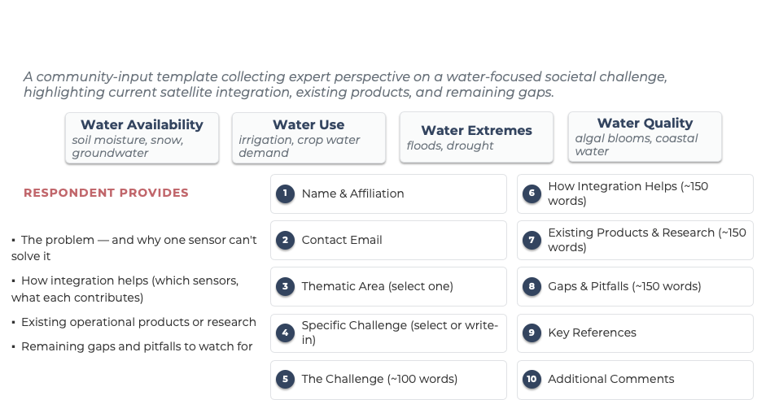

Notes:
CEOS Water Best Practice Guidance Integration Example Submission
https://docs.google.com/forms/d/e/1FAIpQLSf0czZGMBwinCa1dmmo5dLVD1Db44Z200kYkZVQW3Y3su8LSA/viewform
Societal Challenge Input Form
https://docs.google.com/forms/d/e/1FAIpQLSdFng1FNCmwdV1SpsCKA1y0x19yxZMe7JiVsf35HwP32eFFcg/viewform
GitHub Repository – Multisensor Best Practice Guidance
https://github.com/ceos-org/water-multisensor-best-practice

Slide 38
Harmful Algal Blooms: Early Warning for Public Health
Thematic Area: Water Quality | M. McKibben, C. Rousseaux (NASA GSFC)
THE CHALLENGE
CURRENT STATUS
HABs affect drinking water, fisheries, aquaculture, and public health globally
Response depends on which organism is present, not just whether chlorophyll is elevated
Heritage ocean-color sensors detect bloom presence but cannot distinguish toxic from non-toxic species
NOAA HAB forecasting (Gulf of Mexico) still relies on MODIS/VIIRS; PACE under evaluation
USGS/NOAA testing PACE for inland cyanobacterial retrieval against CyAN network
Validation and algorithm-refinement phase, not yet operational
HOW SATELLITE INTEGRATION ADDRESSES THIS
GAPS AND PITFALLS
PACE OCI: hyperspectral (~5 nm) detects accessory pigment signatures of specific phytoplankton types
Key advance: moves from 'presence/absence' toward 'what is actually blooming'
Improved sensitivity: in turbid, CDOM-rich estuaries and inland lakes
Algorithms trained on one region may not transfer to other water types
Atmospheric correction over turbid inland waters remains a leading error source
Spectral similarity between toxic and non-toxic taxa limits discrimination
Small inland waterbodies often below effective spatial resolution
2015 CEOS Water Strategy: C.10 Hyperspectral for water quality

Slide 39
Ocean Circulation Drives Biological Productivity
Thematic Area: Water Quality | M. McKibben, C. Rousseaux (NASA GSFC)
THE CHALLENGE
CURRENT STATUS
Mesoscale eddies and fronts pump nutrients into surface ocean, structuring productivity and fisheries
Ocean color sees surface chlorophyll but not sub-surface physical drivers
Heritage altimetry too coarse to resolve features at biologically relevant scales (10-100 km)
GO-SWACE (2024 PACE Hackweek): tracked Gulf Stream eddy with PACE + SWOT + BGC-Argo
Revealed community composition shifts as eddy propagated
Proof of concept, not yet repeatable at scale
HOW SATELLITE INTEGRATION ADDRESSES THIS
GAPS AND PITFALLS
Single-event results should not be assumed universal without replication
PACE/SWOT orbit mismatches limit matched observation frequency
Attribution confounded by co-occurring forcing (advection, grazing, atmospheric)
Without BGC-Argo, surface-only pairings risk misattributing subsurface processes
PACE OCI: phytoplankton community composition retrieval, distinguishing taxonomic shifts
SWOT: wide-swath altimetry resolves sea surface height ~10x finer than heritage nadir altimeters
Combined: connects physical mechanisms to phytoplankton community shifts, neither mission provides alone
2015 CEOS Water Strategy: C.10 Hyperspectral for water quality

Slide 40
Sargassum Inundation Events
Thematic Area: Water Quality | M. McKibben, C. Rousseaux (NASA GSFC)
THE CHALLENGE
CURRENT STATUS
Since 2011, mass Sargassum strandings across the Caribbean and Gulf of Mexico are a chronic hazard
Decomposing Sargassum releases H2S, closes beaches, fouls fishing gear, damages ecosystems
Timely forecasting essential for coastal managers to plan cleanup and protect tourism revenue
USF Sargassum Watch System (SaWS) operational with MODIS/VIIRS; OCI integration underway
Deep-learning detection fine-tuned per sensor to reduce uncertainty
GAPS AND PITFALLS
HOW SATELLITE INTEGRATION ADDRESSES THIS
Products exclude pixels within ~30 km of shore, precisely where societal impact is greatest
Sensor sensitivity differences complicate long-term trend analysis
Physiological indices more sensitive to atmospheric correction residuals than presence/absence
Spectral indicators vs Sargassum growth/decay relationship not yet established
PACE OCI: 47% more valid observations than MODIS; detected 51% more Sargassum pixels (Qi et al., 2026)
Improved detection: sun-glint avoidance, reduced cloud artifacts, band binning
New capability: hyperspectral can distinguish Sargassum from Trichodesmium and characterize physiological condition
2015 CEOS Water Strategy: C.10 Hyperspectral for water quality

Slide 41
Water Quality in Optically Complex Coastal Waters
Thematic Area: Water Quality | M. McKibben, C. Rousseaux (NASA GSFC)
THE CHALLENGE
CURRENT STATUS
Coastal waters where monitoring matters most are where satellite retrieval is most difficult
High sediment, CDOM, and bottom reflectance violate standard atmospheric correction assumptions
Highest societal need for reliable data coincides with lowest retrieval confidence
OCI UV/blue coverage has enabled new trace-gas measurements (NO2) demonstrating spectral sensitivity
Multi-Angle Aerosol Particle retrieval combining all three PACE instruments in development
Still in algorithm development and validation, not yet operational
HOW SATELLITE INTEGRATION ADDRESSES THIS
GAPS AND PITFALLS
PACE OCI: hyperspectral UV/NIR bands improve atmospheric correction in turbid and absorbing-aerosol conditions
SPEXone + HARP2: multi-angle polarimeters characterize aerosol type independently of ocean-leaving radiance
Combined: structurally new approach to atmospheric correction, not incremental refinement
SPEXone/HARP2 narrower swaths than OCI limit tri-sensor coverage
Absorbing-aerosol improvements don't necessarily transfer to sediment-dominated waters
Near-shore adjacency and shallow-water bottom reflectance unresolved by atmospheric correction
Trace-gas advances should not be conflated with water-quality validation
2015 CEOS Water Strategy: C.10 Hyperspectral for water quality

Slide 42
Snow Water Equivalent & Water Supply
Thematic Area: Water Availability | Terrestrial Water Cycle
THE CHALLENGE
CURRENT STATUS
Snowmelt is the primary water source for over a billion people worldwide
Water managers need SWE forecasts months in advance for reservoir releases and irrigation planning
Optical can map where snow is but not how much water it contains
Passive microwave SWE saturates above ~150 mm and fails under forest canopy
ASO (NASA JPL): lidar + spectrometer at 3-50 m, highest-accuracy SWE reference
AMSR2 daily SWE: operational global product at 25 km
NISAR SWE fusion: early algorithm development following July 2025 launch
Sierra Nevada and Swiss Alps: densest validation sites, recommended starting point
HOW SATELLITE INTEGRATION ADDRESSES THIS
GAPS AND PITFALLS
Optical (MODIS, Sentinel-2): maps snow cover extent and albedo under clear skies
Sentinel-1 C-band SAR: all-weather dry/wet snow discrimination, marks runoff onset
NISAR L-band SAR: penetrates forest canopy for forested SWE retrieval, first credible path
Passive microwave (AMSR2, SMAP): global SWE at 25 km with major limitations
Multi-freq SAR fusion: NISAR L-band + Sentinel-1 C-band + commercial X-band (ICEYE, Capella) could improve temporal sampling and canopy penetration Active/passive fusion: NISAR backscatter disaggregates coarse AMSR2/SMAP SWE spatially
Passive microwave saturates in the deepest, most critical snowpacks (>150 mm)
Dense boreal canopy: even NISAR L-band partially masked in mature closed canopy
Multi-frequency SAR fusion complicated by different revisit times, incidence angles, and sensitivities
No operational near-real-time SWE at < 1 km exists for any region
Methods validated at Sierra Nevada/Alps must transfer to data-sparse Hindu Kush-Himalaya

Slide 43
Groundwater Depletion & Aquifer Monitoring
Thematic Area: Water Availability | Terrestrial Water Cycle
THE CHALLENGE
CURRENT STATUS
Groundwater provides drinking water for over 2 billion people and supports global food production
In many regions, withdrawal far exceeds recharge; aquifers are being mined, not borrowed
Unlike surface water, depletion is invisible until wells run dry
Early warning requires detecting storage changes before they become supply crises
Ogallala Aquifer: GRACE-FO shows 8-12 km³/year loss; InSAR reveals localized subsidence 5-15 mm/year
Indo-Gangetic Plain: strongest depletion signal globally; NISAR will improve subsidence mapping
JPL GRACE Mascon solutions recommended for regional applications
ESA CCI Soil Moisture: 25 km, daily, 1978-present (for decomposition input)
HOW SATELLITE INTEGRATION ADDRESSES THIS
GAPS AND PITFALLS
GRACE-FO: measures gravity changes to derive total terrestrial water storage anomalies, the only sensor that sees groundwater at 300 km
Isolating groundwater: requires subtracting soil moisture (SMAP), snow (AMSR2), and surface water (OPERA DSWx) from total storage
InSAR (Sentinel-1, NISAR): detects land subsidence from aquifer compaction at mm precision, 10-30 m resolution
Complementary scales: GRACE-FO sees volume change at 300 km; InSAR reveals spatial pattern at sub-km
GRACE-FO 300 km resolution is a fundamental physical limit, cannot improve without a constellation
Decomposition uncertainty largest in humid tropics where groundwater residual is smaller than error
No confirmed GRACE-FO successor; a gap in the only 20-year groundwater record from space
In-situ well networks critically sparse in Sub-Saharan Africa, Central Asia, South Asia
Managed aquifer recharge monitoring from space remains unvalidated

Slide 44
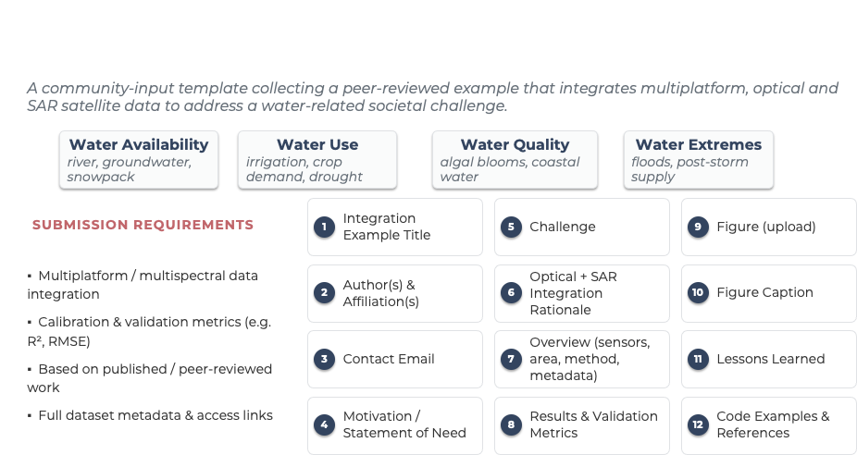

Notes:
CEOS Water Best Practice Guidance Integration Example Submission
https://docs.google.com/forms/d/e/1FAIpQLSf0czZGMBwinCa1dmmo5dLVD1Db44Z200kYkZVQW3Y3su8LSA/viewform
Societal Challenge Input Form
https://docs.google.com/forms/d/e/1FAIpQLSdFng1FNCmwdV1SpsCKA1y0x19yxZMe7JiVsf35HwP32eFFcg/viewform
GitHub Repository – Multisensor Best Practice Guidance
https://github.com/ceos-org/water-multisensor-best-practice

Slide 45
Integration Examples Received
6 submissions from 5 organizations across 4 countries
Organization | Country | Thematic Area | Integration Example
NOAA Fisheries | USA | Water Quality | Sensor-Agnostic Water Quality Diagnostic
IIRS / ISRO | India | Availability + Extremes | Flood Mapping: SWOT + Sentinel-2 + Gauge Data
NERSC | Norway | Water Quality | SAR + OLCI for Sub-mesoscale Eddies
CSIRO | Australia | Water Extremes | Flood Mapping: Sentinel-2, Sentinel-1, NovaSAR-1
CNES | France | Multiple | Hydroweb.next, FloodDAM-DT, OPHYSE, XTremQuality
Geoscience Australia | Australia | Water Availability | Groundwater-Dependent Vegetation: Optical + InSAR
Water Availability
Water Use
Water Quality
Water Extremes
3 submissions
0 - GAP
3 submissions
3 submissions

Slide 46
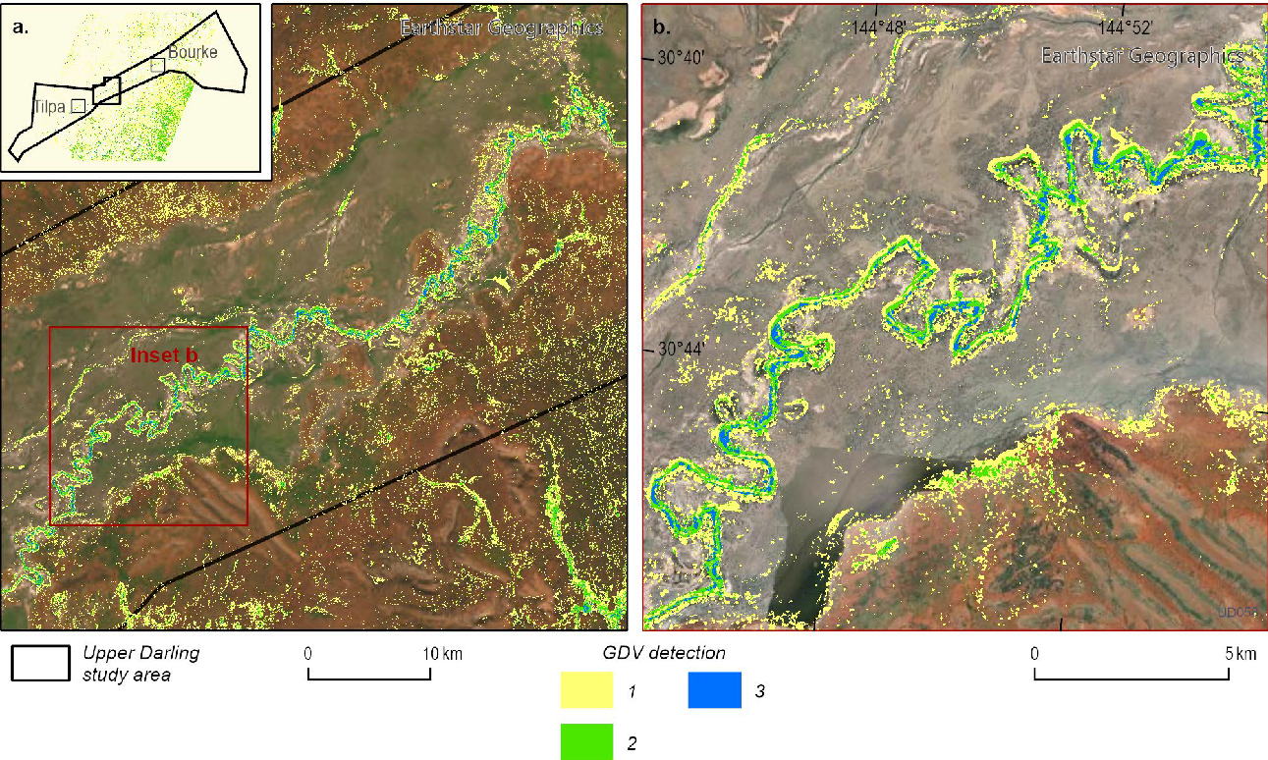
Use Case: Mapping Groundwater-Dependent Vegetation
Geoscience Australia (Australia), by S. Buckerfield et al. (2023).
CHALLENGE
[ Insert GDV map figure here ]
Groundwater-dependent vegetation indicates aquifer health in dryland ecosystems
Traditional mapping requires costly, limited field surveys
Optical alone cannot distinguish levels of groundwater dependence
SATELLITE INTEGRATION
Landsat (30 m): greenness and wetness percentiles over 35 years
Sentinel-1 InSAR (15 m): coherence separates woody vegetation from grass/bare soil
GRACE-FO: guides wet/dry period selection for InSAR pairs
Combined: confidence-layered GDV map (1-3 indices agreeing)
Map of groundwater-dependent vegetation (GDV) in the Upper Darling River floodplain study area of western NSW
IMPACT
Strong agreement with Bureau of Meteorology Groundwater-Dependent Ecosystem Atlas
Improved discrimination between high and moderate groundwater-dependent vegetation
Scalable approach for regions lacking GDE mapping globally
Study area: Upper Darling River floodplain, NSW, Australia (31,500 km²)
Sensors: Landsat (30 m), Sentinel-1 InSAR (15 m), GRACE-FO
Code: github.com/GeoscienceAustralia/GWB-GDE-DEA
DOI: dx.doi.org/10.26186/148545
Notes:
Groundwater-Dependent Vegetation map (GDV map)

Slide 47
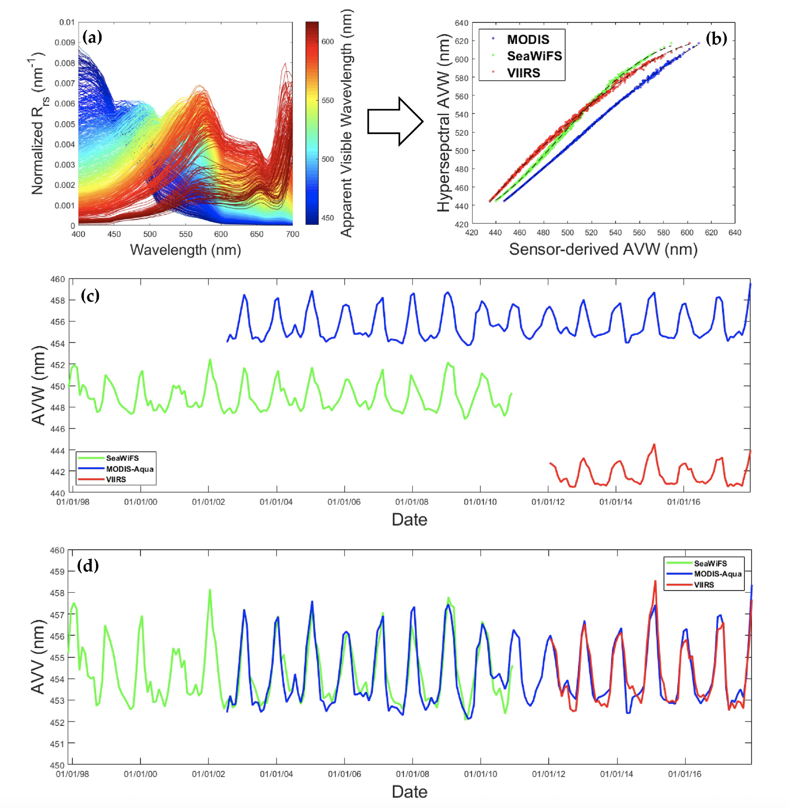
Use Case: Sensor-Agnostic Water Quality Diagnostic
NOAA Fisheries (USA), by Ryan Vandermeulen
CHALLENGE
Satellite water quality products rely on empirical algorithms tuned to specific sensors and spectral bands, which don't fully exploit the visible reflectance spectrum.
Performance degrades in optically complex coastal waters, and inconsistencies arise across sensors with different spectral response functions.
SATELLITE INTEGRATION
Multi-sensor: SeaWiFS, MODIS, MERIS, OLCI, VIIRS, Sentinel-2, Landsat, PACE OCI, and others
Approach: Apparent Visible Wavelength (AVW), a sensor-agnostic spectral indicator derived from the full visible reflectance spectrum
Combined: sensor-specific coefficients harmonize all missions to a common metric, enabling a 22-year global record
IMPACT
Mean absolute errors of 0.37 to 1.4 nm across missions
Substantial agreement (κ = 0.51-0.62) between overlapping satellite records
Fewer than 2% of pixels show significantly different trends across sensors
Sensor-specific AVW conversion from reflectance spectra (a), multi-mission validation for MODIS, SeaWiFS, and VIIRS (b), and regional time series before (c) and after (d) cross-sensor harmonization in the North Pacific (Vandermeulen et al., 2020).

Slide 48
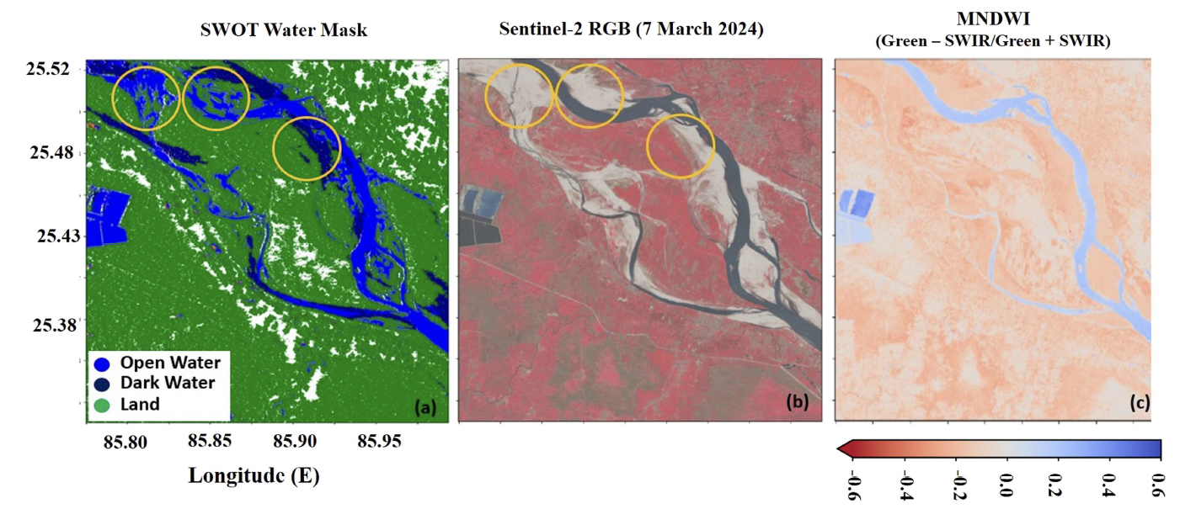
Use Case: High-Resolution Flood Mapping and Water Surface Elevation
IIRS / ISRO (India), by C. M. Bhatt, N. Rana, R. P. Singh, D. Singh, P. Chauhan, A. Pandey
CHALLENGE
Optical sensors are obstructed by persistent monsoon cloud cover
River gauges and conventional altimeters provide only one-dimensional water level measurements
No existing approach captures flood extent and two-dimensional water surface elevation simultaneously
SATELLITE INTEGRATION
SWOT KaRIN: wide-swath altimetry providing 2D water surface elevation and extent at 50-100 m resolution
Sentinel-2: optical imagery (10-20 m) for water mask generation and comparison
Sentinel-3A: along-track altimetry for independent WSE validation
Gauge data: Hatidah gauge, Central Water Commission (CWC), Bihar
SWOT-derived water mask (a), Sentinel-2 optical imagery (b), and MNDWI water classification (c) over the Ganga River floodplain, March 2024. Yellow circles highlight areas of disagreement between SWOT and optical classification (Bhatt et al., 2026).
Study area:
Ganga River floodplain, North Bihar, India (2024 monsoon)
IMPACT
Sensors:
SWOT, Sentinel-2, Sentinel-3A, gauge data
Captured three major flood waves inundating ~1,660 km² of floodplain
R² = 0.97, RMSE = 0.59 m against in-situ gauge
R² = 0.90, RMSE = 1.03 m against Sentinel-3A
DOI:
doi:10.1080/19475705.2026.2634200

Slide 49
Discussion: Input from the CEOS Community
We'd like your input on:
1
Scope and Coverage
Are the four thematic areas (Availability, Use, Extremes, Quality) the right framing? What's missing?
2
Integration Examples
Does your agency have a demonstrated multi-sensor integration example for water? We have a gap in Water Use. Can you help fill it?
3
Societal Challenges
For your thematic area: what are the biggest gaps and pitfalls when combining sensors? What has worked and what hasn't?
4
Contributors and Timeline
Who from your agency can contribute text, code, or review? We target a draft for Plenary review and final deliverable for SIT-42.

Slide 50


Get Involved
Scan the QR codes to contribute. All submissions welcome through December 2026.
Integration Examples
Submission Form
Societal Challenge
Input Form
GitHub Repository
Share a demonstrated example of multi-sensor integration for water applications
Provide input on challenges, current status, gaps, and pitfalls for your thematic area
Access the living document, notebooks, and code at github.com/ceos-org
Notes:
CEOS Water Best Practice Guidance Integration Example Submission
https://docs.google.com/forms/d/e/1FAIpQLSf0czZGMBwinCa1dmmo5dLVD1Db44Z200kYkZVQW3Y3su8LSA/viewform
Societal Challenge Input Form
https://docs.google.com/forms/d/e/1FAIpQLSdFng1FNCmwdV1SpsCKA1y0x19yxZMe7JiVsf35HwP32eFFcg/viewform
GitHub Repository – Multisensor Best Practice Guidance
https://github.com/ceos-org/water-multisensor-best-practice

Slide 51
NOSA 2027 CEOS Chair Theme: True Blue
Ole Morten Olsen
NOSA, 2027 CEOS Chair
Agenda Item W2.3
SIT TW 2026
Washington DC, USA
8-10 September, 2026

Slide 52

2027 CEOS Chair Theme:
Trusted Satellite Data for a Better Future

Slide 53
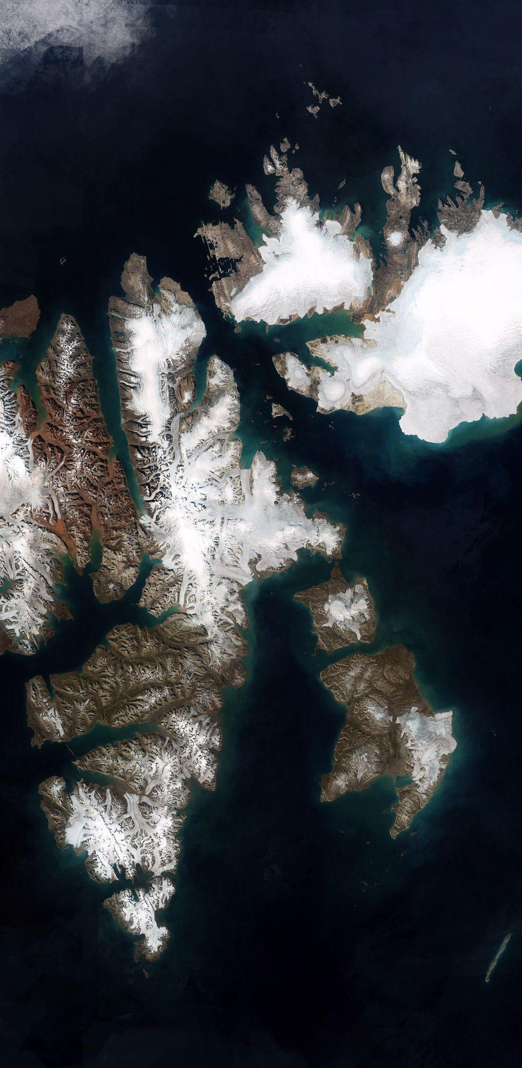
Focus Activity #2: True Blue
Highlighting the importance of the oceans and polar regions, and working towards building a resilient and comprehensive ocean observing system through enhanced international cooperation, harmonised approaches and improved access to data.
Image: Copernicus Sentinel-2

Slide 54


Ocean-Eye International Alliance
Part of the EU’s OceanEye initiative
Supports the Global Ocean Observing System (GOOS)
Objectives:
  build long-term resilience for ocean observing and its global coordination
  address critical gaps in under-monitored regions in the Southern Hemisphere, the Arctic, deep sea, and coastal areas.
Notes:
OceanEye is ECs flagship for ocean observations. Norway has significantly contributed to support.

Slide 55
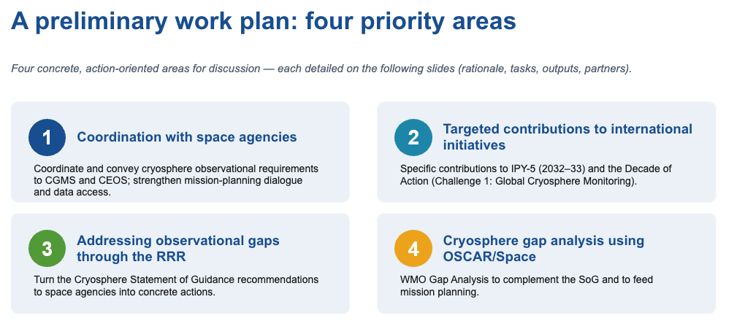
Partner: WMO TT-CPOS
TT-CPOS Priorities
Task Team on the Cryosphere and Polar Observation from Space (TT-CPOS)
  Evolution of the former Polar Space Task Group
Supporting Priority #1:
Coordination with space agencies on mission planning, acquisition & product development
Notes:
Norway will work with WMOs task team via dialogue and support for its priorities.

Slide 56

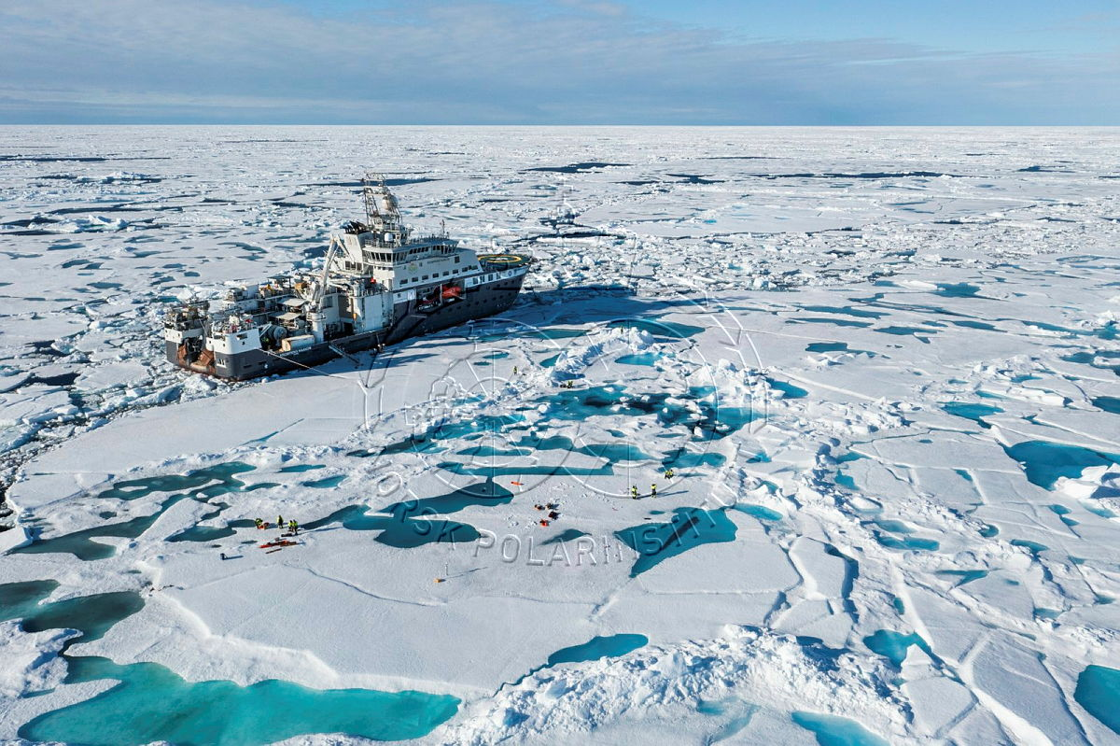
5th International Polar Year(2032-33)
Aims to address urgent global challenges by advancing polar research
The IPY secretariat will be hosted in Tromsø, Norway
NOSA will promote the value of sustained space-based observations for the polar regions and facilitate early engagement between IPY and the global space agency community
Credit: Trine Lise Sviggum Helgerud,
Norwegian Polar Institute
Image: Copernicus Sentinel-2
Notes:
The International Polar Year Secretariat will be hosted in Tromsø, Norway, strengthening Norway's role as a global hub for polar research and international cooperation. Lead consortium Norway, Chile and South-Korea.
Work to align future satellite observations with polar science needs.

Slide 57
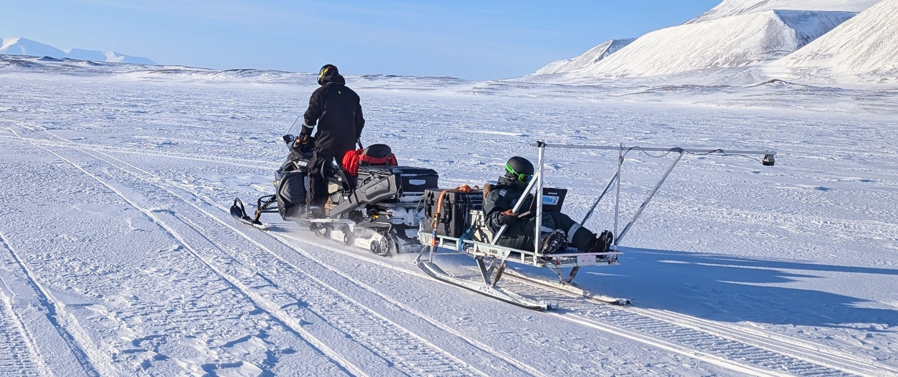
Polar Cal/Val Supersites
Enhance in situ and ground-based observation networks in polar regions
  Reinforcing the trustworthiness and accuracy of satellite measurements
Credit: Brigitte Lefevire, EC
Work with WGCV to define Cal/Val supersites in polar areas
Credit: Eero Rinne, UNIS.
Notes:
Active involvement in the WGCV and dialogue with Subgroup Chairs to make sure consistent definitions of “Super site(s)” also cover polar and ocean areas.
Connected to the WGCV-56-04 action item WGCV Subgroup Chairs to convene a meeting to discuss a consistent definition for Super site(s) within WGCV. To be followed up at WGCV-57.

Slide 58
Discussion
Are there ongoing/upcoming activities within CEOS which align with this theme?
Welcome interest in collaborating with the 2027 CEOS Chair Team to work on these activities

