Slide 1
2026 CEOS-ARD Strategy
SIT TW 2026 - WS #3
Earth Observation for Everyone

Slide 2
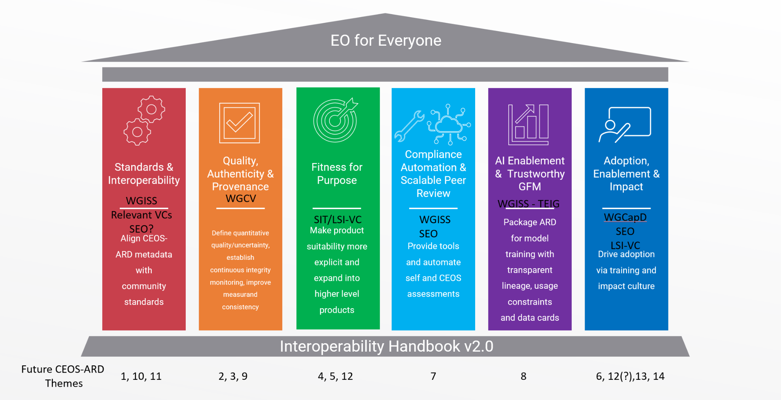
CEOS-ARD Strategy Pillars
WGCapD
SEO
Underpinned by CEOS Interoperability Handbook conventions

Slide 3
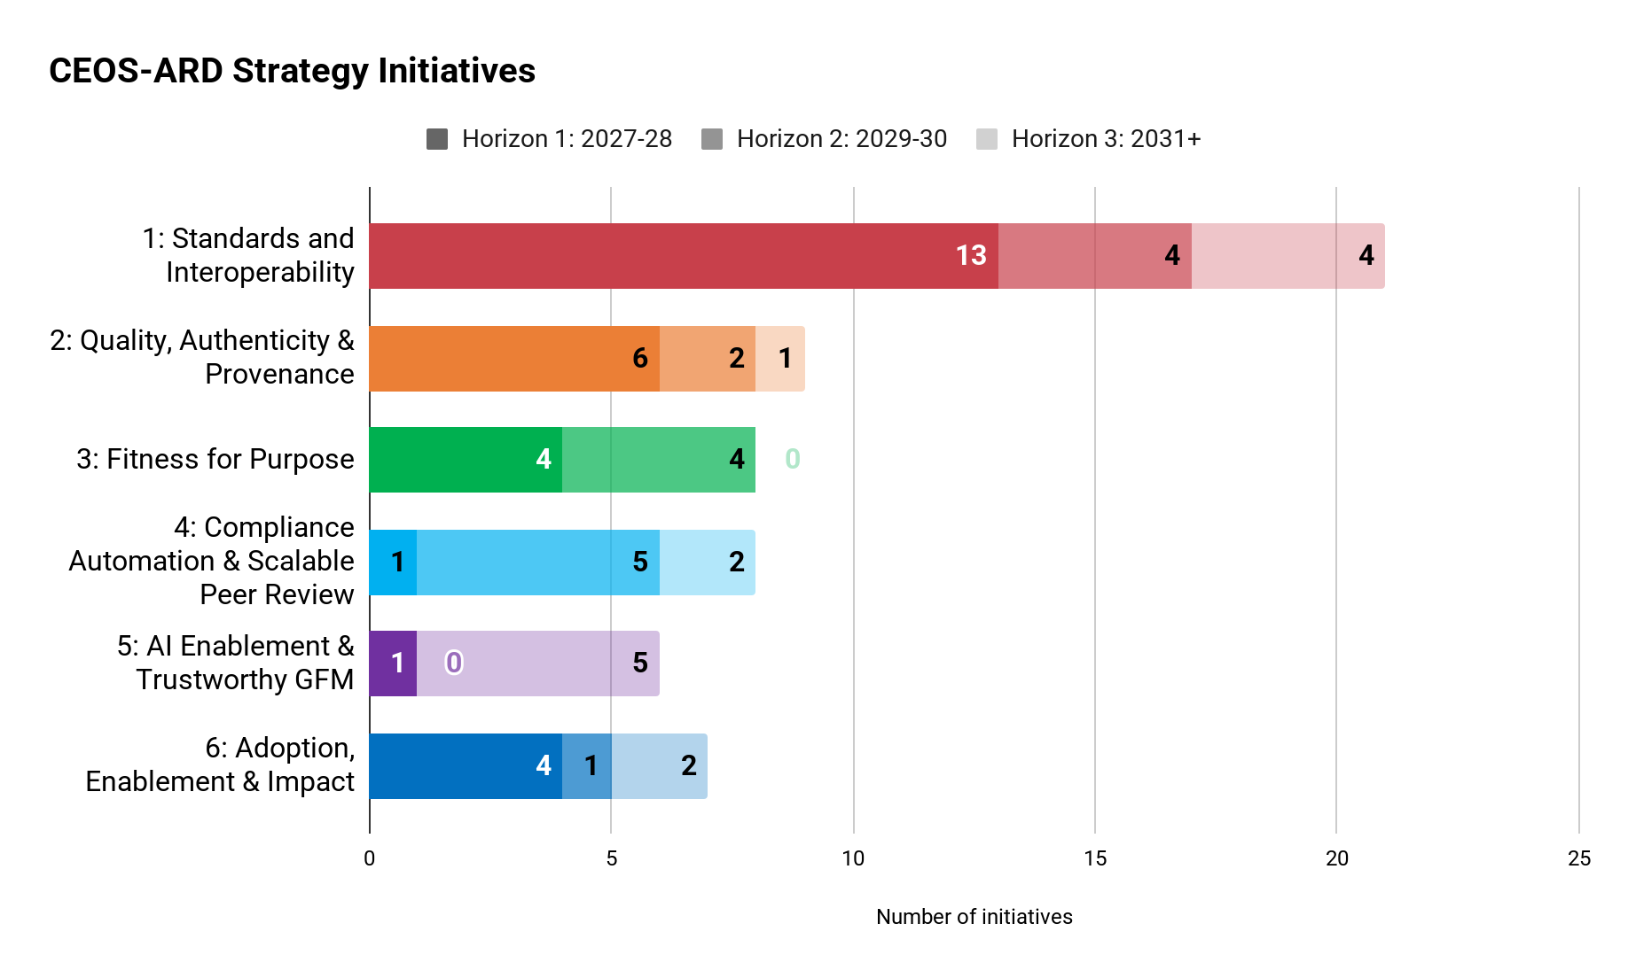
Initiatives and Time Horizons
Horizon 1 (2027-2028): Establishing the Standards
Horizon 2 (2029-2030): Scaling the Ecosystem
Horizon 3 (2031+): Operationalisation and Mainstream Integration

Slide 4
Work Themes
Pillar 1: Standards and Interoperability
Alignment with broader geospatial standards and conventions Robust and consistent ARD specifications and framework Discoverability and accessibility
Pillar 2: Quality, Authenticity & Provenance
Continuous integrity monitoring Consistency and downstream quality Quality assessment frameworks
Pillar 3: Fitness for Purpose
Refined assessments and product characterisation User guidance and suitability assessment
Pillar 4: Compliance Automation & Scalable Peer Review
Improved product assessments and supporting tools Data provider support
Pillar 5: AI Enablement & Trustworthy GFM
AI community engagement and support AI support via improved formats and data packaging
Pillar 6: Adoption, Enablement & Impact
Supporting the commercial sector Demonstrating value Meeting thematic and higher level needs Data procurement Capacity building and training

Slide 5
Objective: Reviewing the initiatives and tasks and establishing the foundation for an implementation-focused resource assignment discussion at the CEOS Plenary

Slide 6
How does your agency identify areas of alignment and potential contribution to such a statement of requirements?
How can we best facilitate a discussion at Plenary that might see specific commitments from CEOS Principals?

Slide 7
Implementation of the new CEOS-ARD Building Blocks concept and envisioned future automation of self-assessments and peer review tools requires software developer expertise
This expertise is limited in the traditional CEOS-ARD focused entities in CEOS.
Are CEOS agencies able to provide additional developer expertise to complement and provide redundancy?

Slide 8
Pillar #5: AI Enablement and Trustworthy GFM

Slide 9
NASA Earth Science Data Systems (ESDS) Program AI Strategy
Katie Baynes

Slide 10

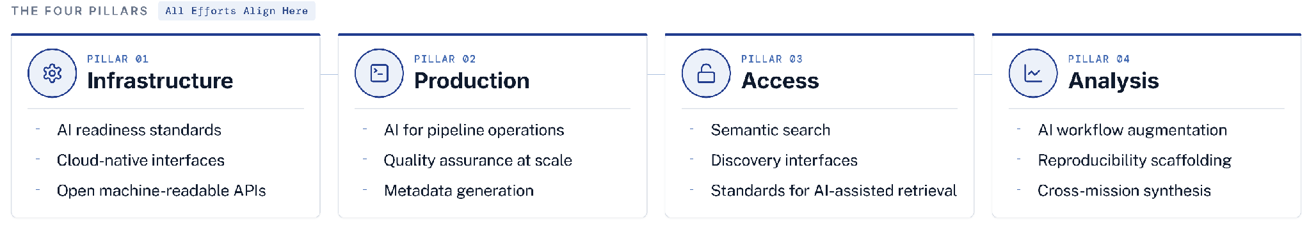
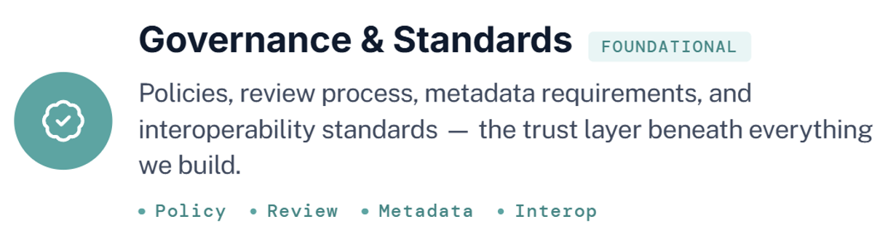
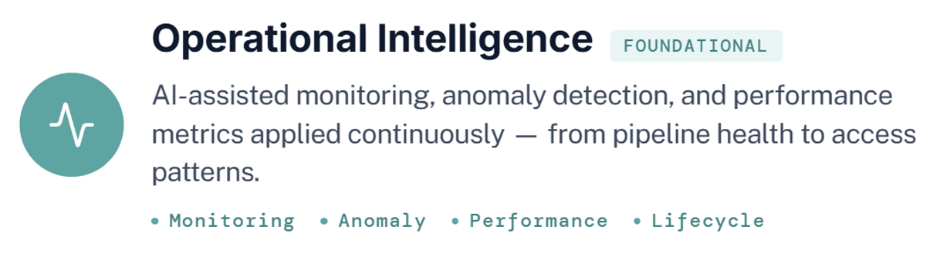
EARTH SCIENCE DATA SYSTEMS
Notes:
"NASA's Earth Science Data Systems program — the team behind Earthdata and the DAAC network — is executing an AI strategy called Earth Data Intelligence.
The organizing idea: AI as interface amplifier, getting Earth science data to science faster.
The strategy has four pillars: AI-assisted production pipelines, scalable AI-ready infrastructure, intelligent access and discovery, and reproducible analysis workflows.
Running underneath all four are two cross-cutting capabilities: governance and standards, ensuring outputs meet scientific and policy requirements, and operational intelligence, giving the data systems real-time awareness of their own health and performance.
Together, these position NASA's Earth science data infrastructure to meet the demands of the foundation model era."

Slide 11

EARTH DATA INTELLIGENCE
AI Strategy Tactics
Five complementary tracks, pursued in parallel — not sequentially
Innovation
Collaboration
Governance
Partnerships
Workforce
AI Augmentation Call
Embedded collaboration
Governance and standards
External partnerships
Training and workforce
Open competitive call for proposals from researchers, mission teams, and DAAC staff — written proposal, then funded prototype.
ESDS expertise assigned directly to mission teams early in the data lifecycle. Work alongside — not deliver to.
Define AI-ready data standards, provenance requirements, and output auditability across the full ESDS portfolio.
Deliberate relationships with AI providers, cloud platforms, federal agencies, and international partners. Data rights resolved at acquisition.
AI literacy across the ESDS workforce and Earth science community. Embedded collaboration is the primary delivery mechanism — learning by doing.
OUTCOME
OUTCOME
OUTCOME
OUTCOME
OUTCOME
Surface best ideas from people closest to the work; absorb proven prototypes into operational systems.
AI-readiness built in from mission start, not retrofitted after products reach the archive.
No AI output reaches users without a provenance trail. Consistent, trustworthy integration across the portfolio.
NASA data as a native participant in the AI ecosystem. Open access not blocked at distribution.
Capability lives in the community, not the program office. ESDS is the catalyst, not the bottleneck.

Slide 12
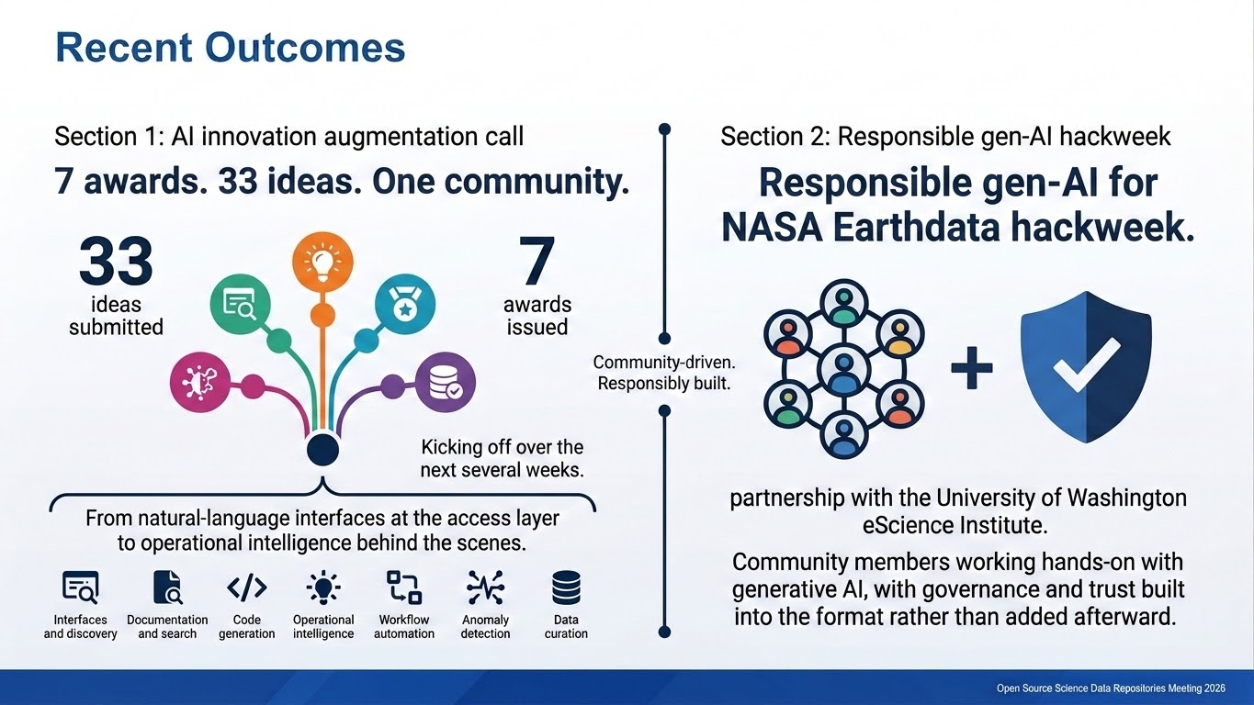



Slide 13
Does your agency have its own EO AI strategy?
  What are the headlines and directions for your agency with regard to EO and AI?
  Who wrote these strategies?
  Is there anyone or anything related to those that we can leverage in CEOS-ARD? Lessons learned?

Slide 14
Gaps in AI Pillar
ID | Work Theme | What | CEOS Lead | Time Horizon
5: AI Enablement & Trustworthy GFM
2026-0050 | AI support via improved formats and data packaging | Enable scalable AI training with CEOS-ARD by making recommendations for chunkable, cloud-optimized formats (e.g., Zarr, COG) and other related requirements related to metadata, APIs, etc. |  | 3
2026-0051 | AI support via improved formats and data packaging | Implement increased traceability and versioning in the CEOS-ARD Framework and PFS to support reproducibility and explainability. |  | 3
2026-0053 | AI support via improved formats and data packaging | Improve packaging of CEOS-ARD datasets for AI model training with consistent tiling, splits, and licensing clarity. |  | 3
2026-0054 | AI support via improved formats and data packaging | Implement Data and Model Cards to provide structured documentation on provenance, limitations, biases, and permissible uses to mitigate risks in AI workflows. |  | 3
2026-0055 | AI community engagement and support | Publish benchmark tasks and evaluation protocols to guide AI developers and ensure robust performance. |  | 3
2026-0056 | AI community engagement and support | Engage with AI research communities and platform providers to promote adoption of CEOS-ARD and understand best practices/requirements. | CEOS-ARD Oversight Group | 1

Slide 15
Regarding the assignment gaps in the AI Enablement and Trustworthy GFM Pillar:
Is this unique to CEOS-ARD or do we think CEOS has an underrepresentation of expertise in AI/ML?
Do we perhaps need a specific subgroup with new representation under WGISS?

Slide 16
Discussion: Adoption of the CEOS-ARD Framework by CEOS agencies

Slide 17
What prevents wider adoption of CEOS-ARD within your agency?
Is adoption of the CEOS-ARD framework a top-down directive from CEOS Principals/agency heads or a grassroots effort?

Slide 18
What would drive more engagement in CEOS-ARD at your agency?
What evidence / information would you need to enable your agency to justify the investment of meeting the CEOS-ARD specifications?
How can we better communicate the value and business case for CEOS-ARD to CEOS Principals?

Slide 19
Are there similar ARD activities in your agencies? Are they aligned with CEOS-ARD?

Slide 20
Pillar #2: Quality, Authenticity & Provenance

Slide 21

slido.com, code 2006080
Do you think it would make sense to explore, through CEOS, broader agency adoption of the Joint NASA-ESA-USGS Quality Assessment Framework (QAF)?

Slide 22
What is your reaction to the likely adoption of the Joint NASA-ESA-USGS Quality Assessment Framework (QAF) by the CEOS-ARD Framework?
Does it make sense for space agencies to converge on a common QAF? Could CEOS be the mechanism for achieving that?

Slide 23
Thank you!
Next steps:
Further discussion at LSI-VC-20 next week
Feedback on the strategy and initiatives requested by Friday 9 October
2026 CEOS-ARD Strategy to be presented for endorsement at the 2026 CEOS Plenary
Expressions of interest in contributing to the initiatives and tasks

Slide 24
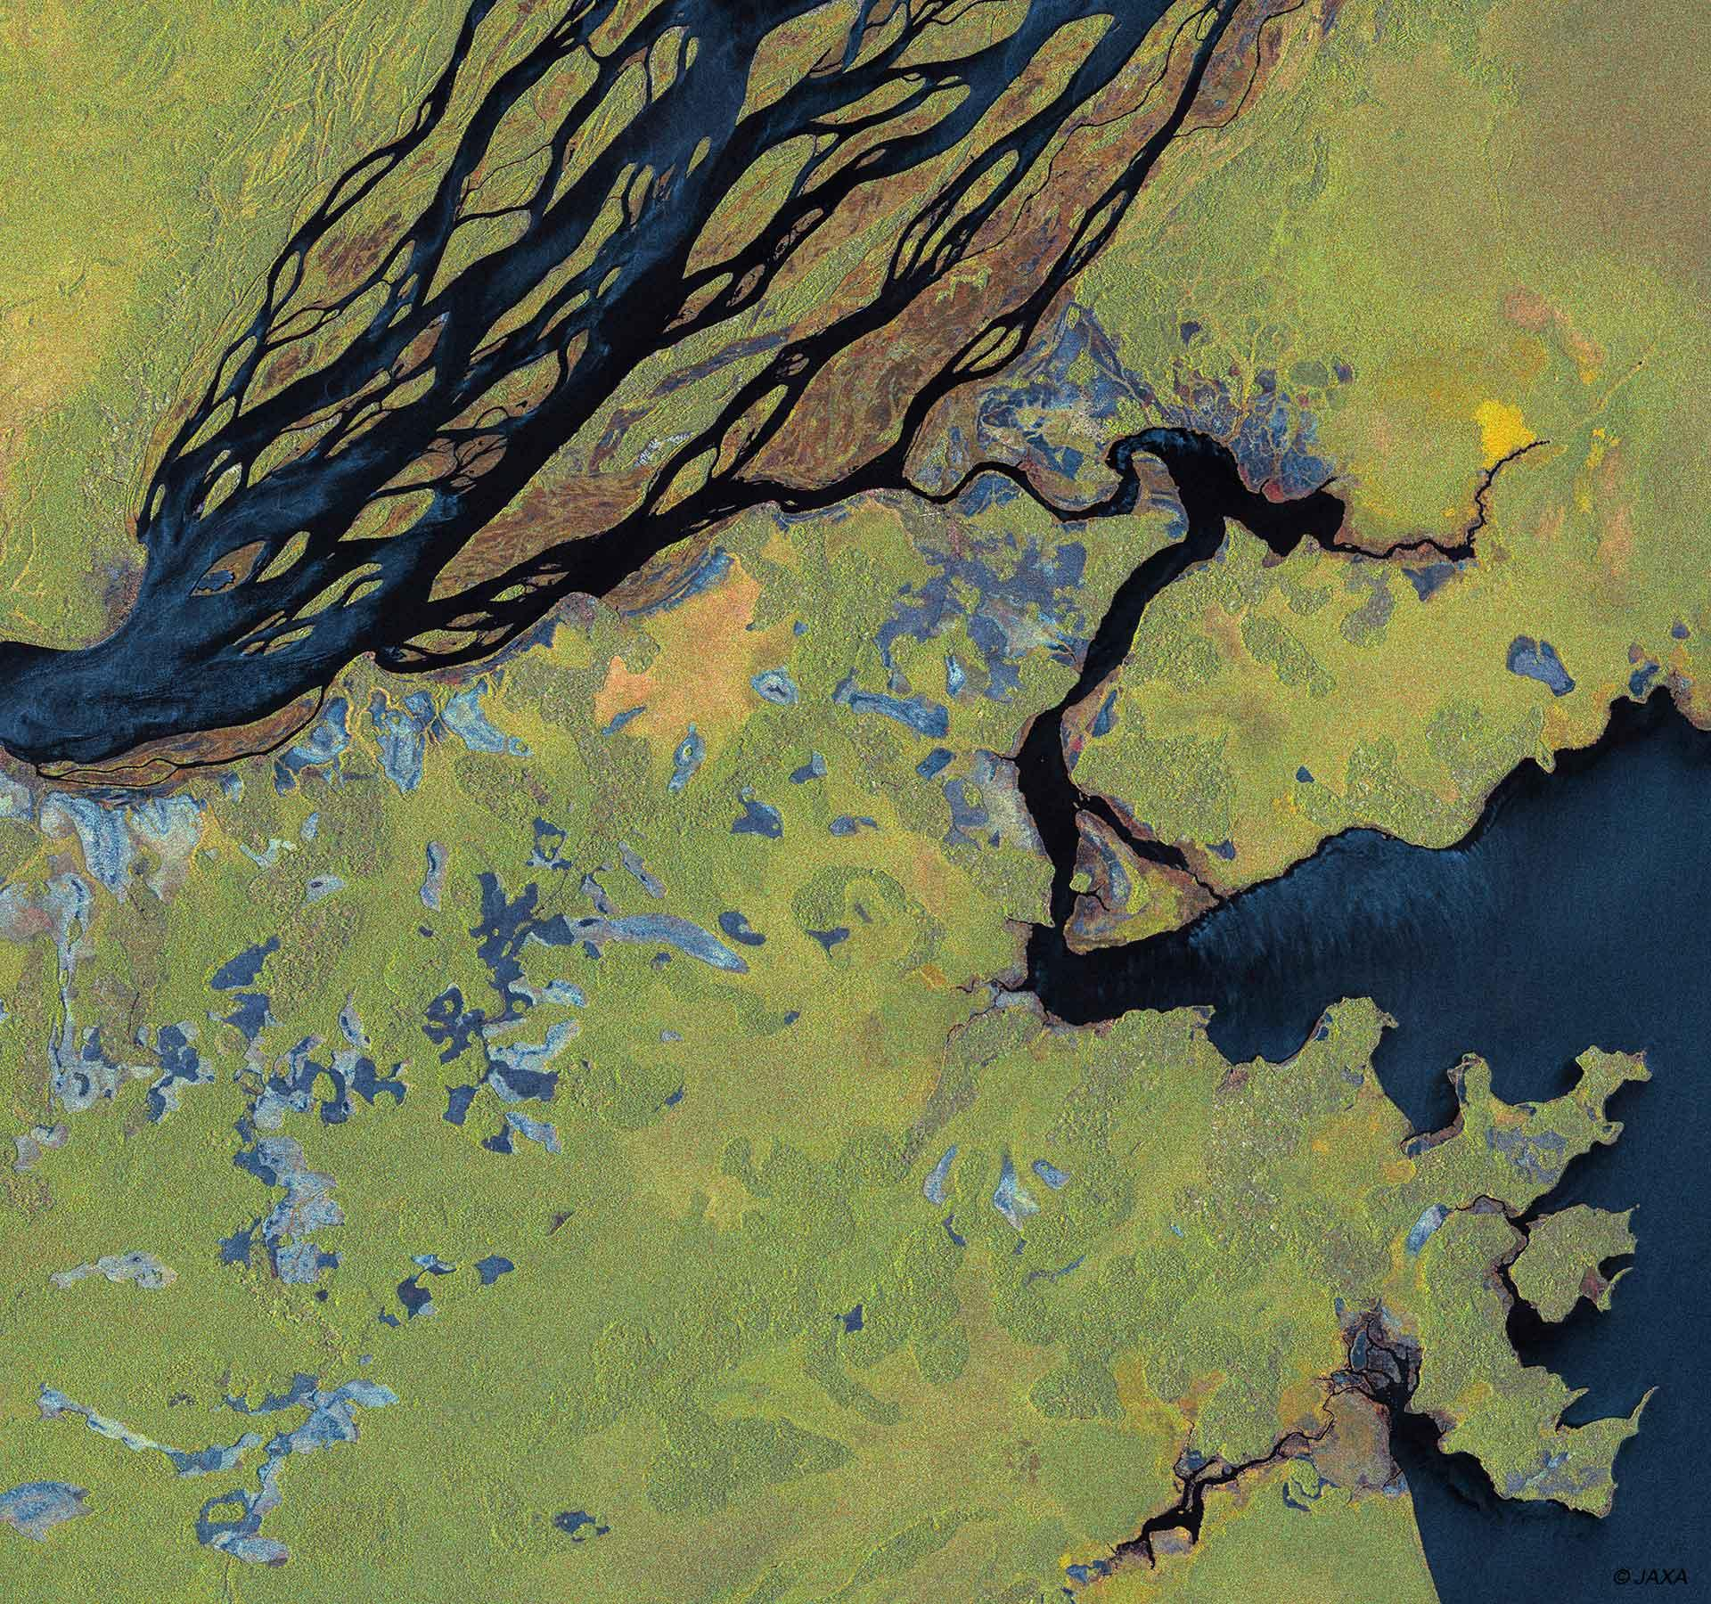

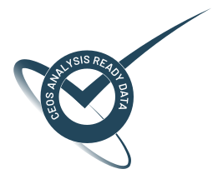
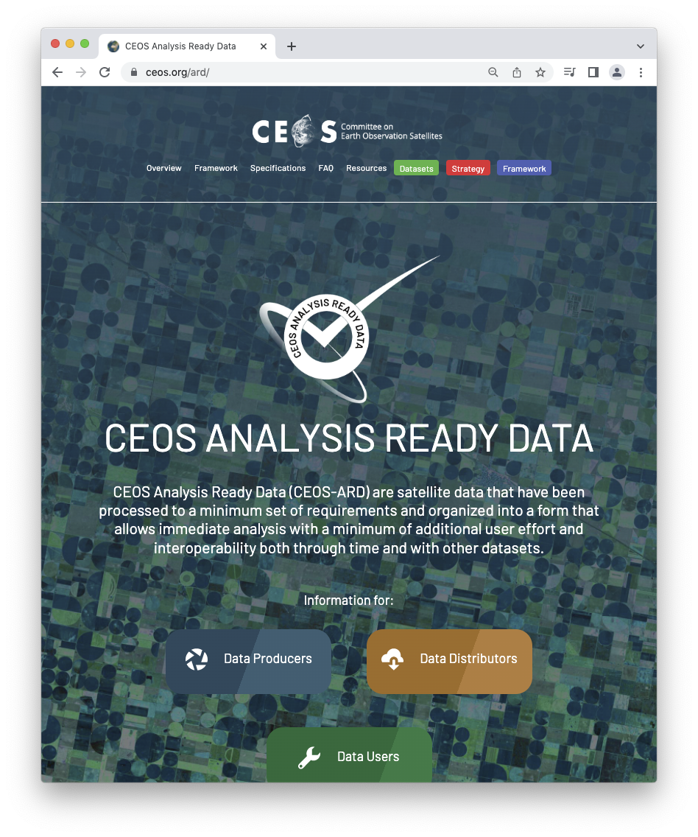
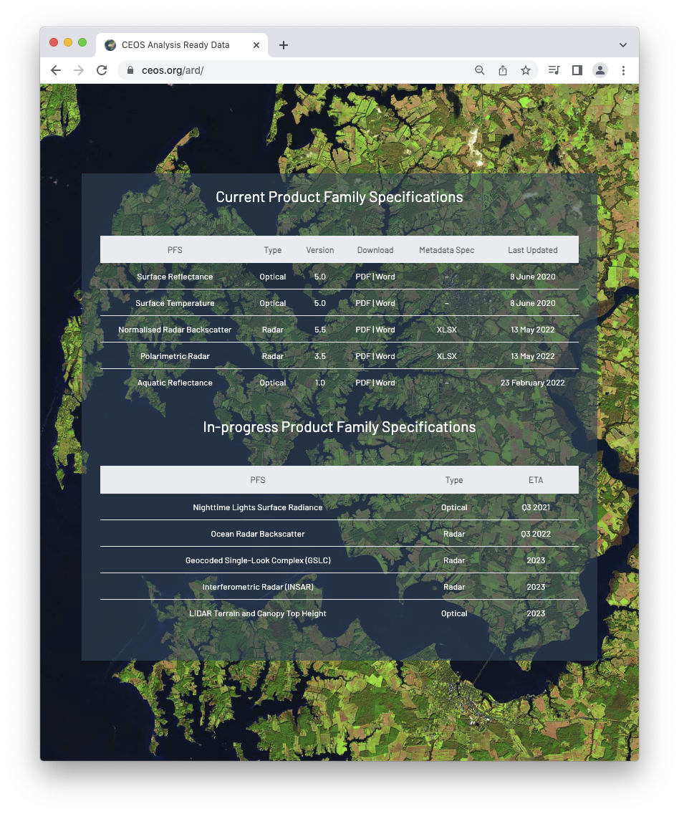
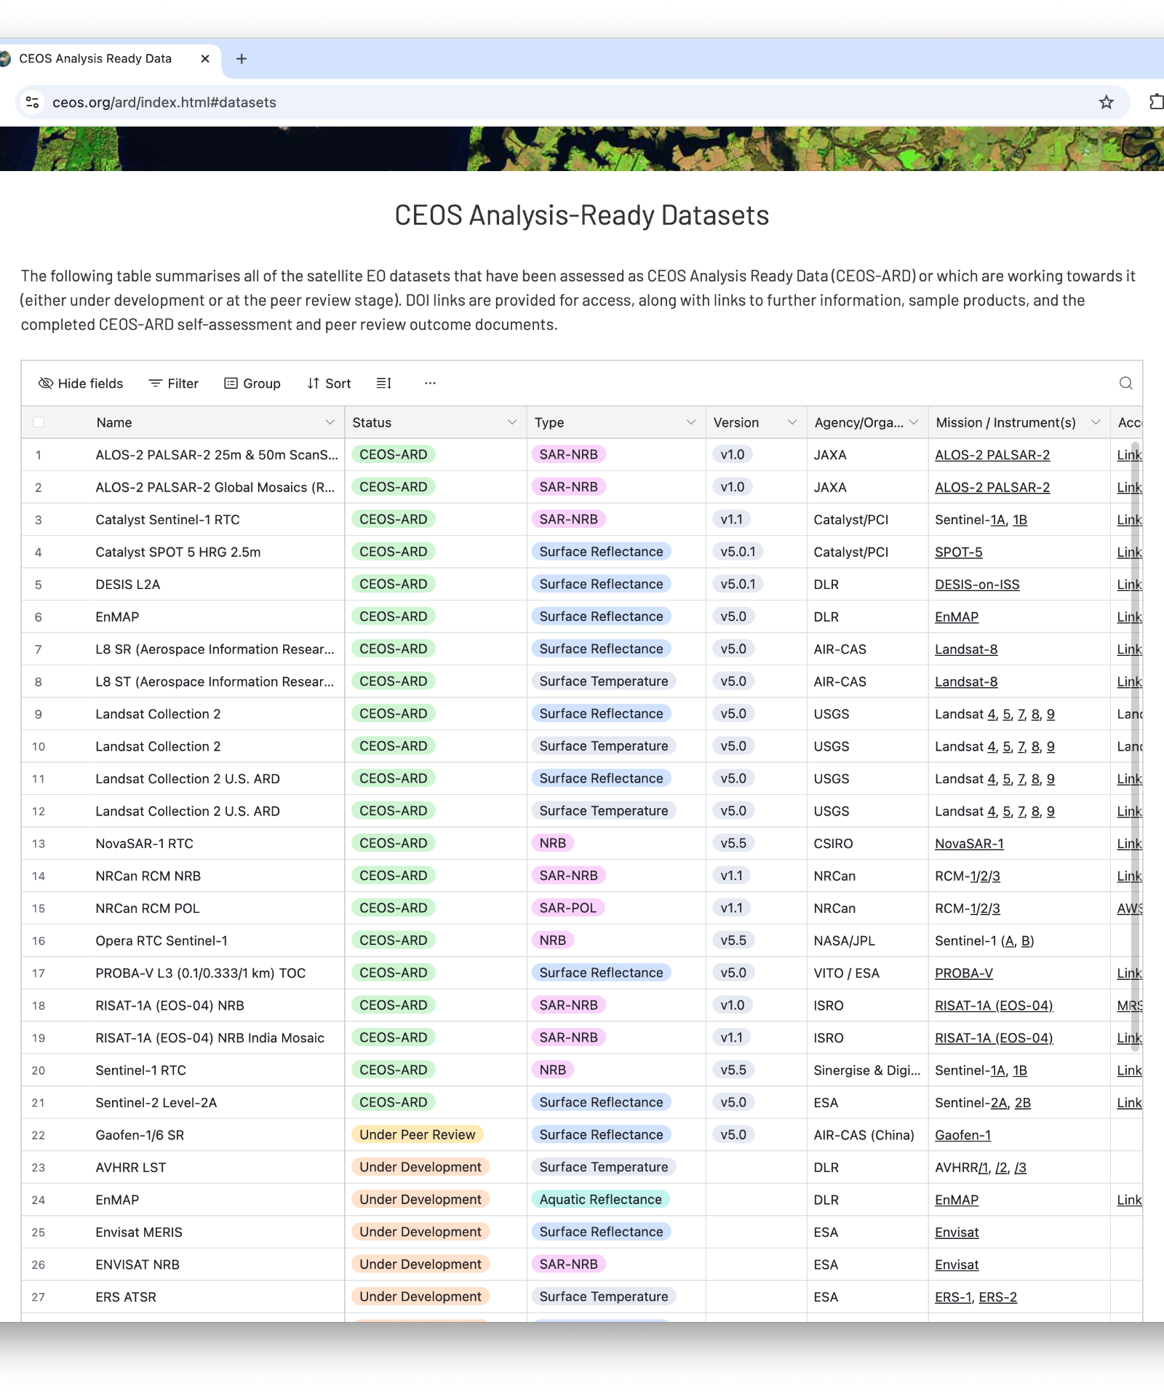
Connect
ceos.org/ard
Email: matt@symbios.space
ard-contact@lists.ceos.org

