Slide 1
Recovery Observatory
Steven Hosford (CNES)
CEOS Action 27-9 CEOS SIT-29 Meeting
CNES, Toulouse, France 9th-10th April 2014

Slide 2
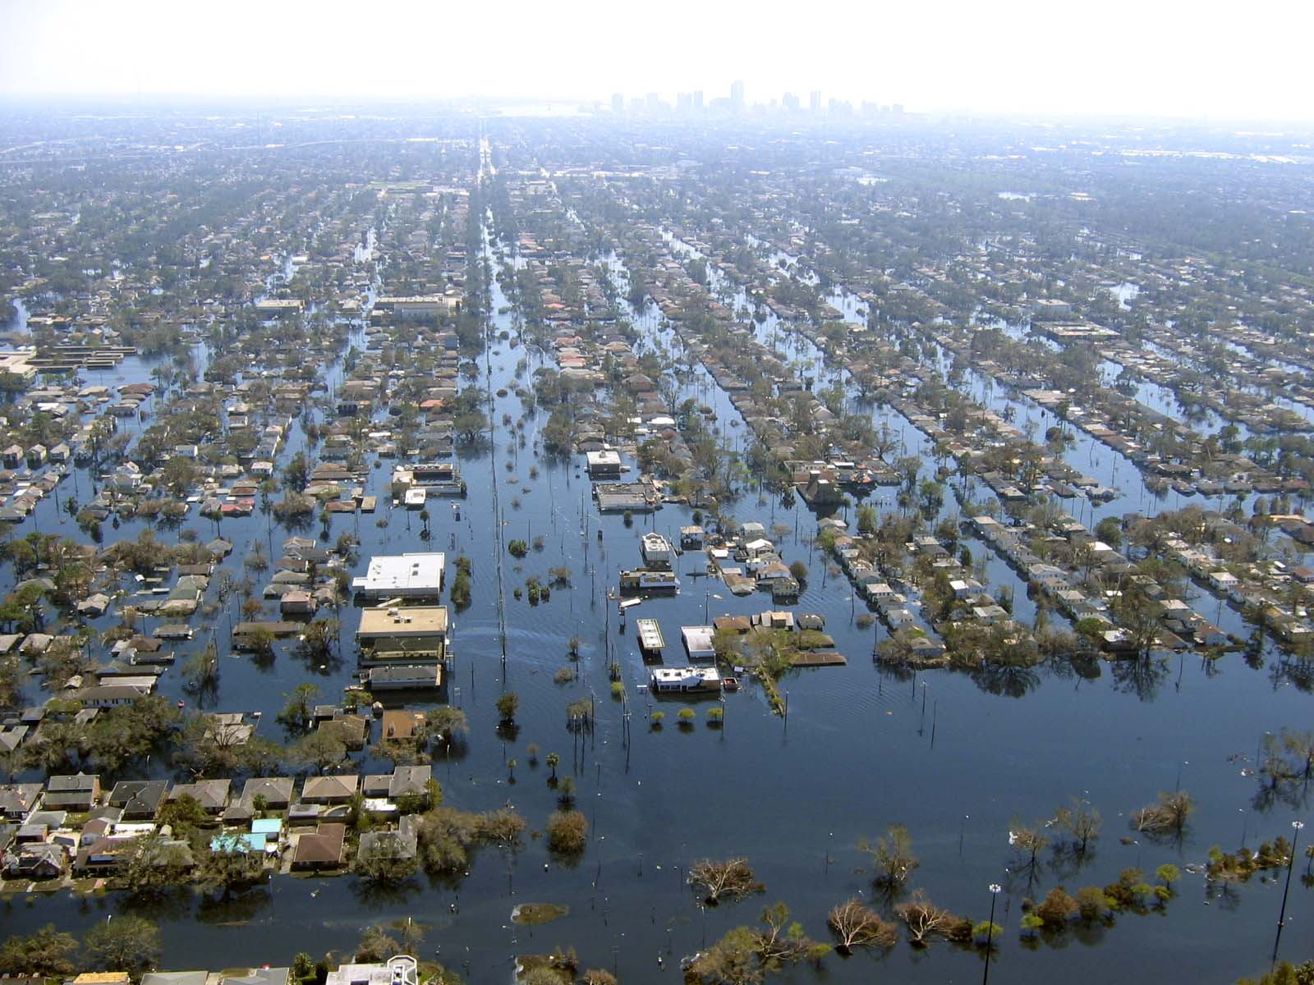
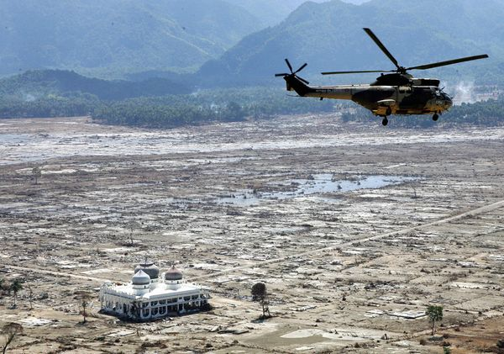
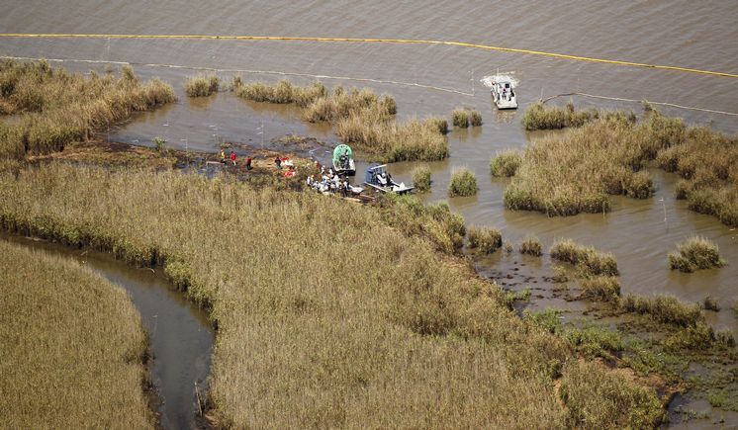
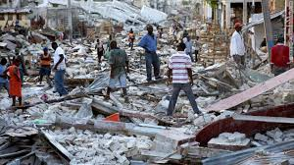
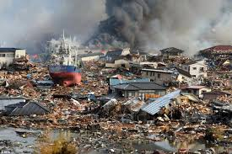
Recovery Observatory – the need
Indonesian Tsunami
2004
Hurricane Katrina
2005
Deepwater Horizon
2009
Haiti Earthquake
2010
Tohoku Tsunami
2011
Photo credits: www.nationalgeographic.com; www.mediamythalert.com; www.tampabay.com; www.manongeo.wordpress.com; www.japansociety.org.uk.
Notes:
Certain disasters occur on a scale that puts them in a category of their own. In particular, the damage they cause requires an enormous effort over several years ot foster full recovery. Satellite EO can play a major role supporting this recovery.

Slide 3
Recovery Observatory – the idea
Response
(weeks)
Recovery
(years)
Recovery Observatory (3-5 yrs)
Organise EO data from response phase and pre-disaster in repository
Plan coordinated acquisitions to support:
Built area damage assessment (initial and later detailed);
Natural resource and environment assessment;
Reconstruction planning;
Reconstruction monitoring; and
Change monitoring.
International Charter
Sentinel-Asia
EO data from National Agencies
Commercial providers
Copernicus/GMES
Coordination
Effective Resource Allocation
Clear Institutional Links
Ad Hoc Approach
Lack of Coordination and Cooperation
Lack of Institutional Links
Lack of Awareness of Role of EO
Notes:
Space agencies already
organise the “response” part of the cycle (International Charter, Sentinel-Asia)
propose an “ad-hoc” approach on scientific requirements for a specific zone or disaster/theme (better understanding of hazard phenomena, modelling, etc.)
After the initial response, space agencies have little or no coordination for the post-crisis part of the disaster management cycle
What is a “Recovery Observatory”?
Infrastructure(s) providing access to EO data of use in the Recovery phase (non profit activities)
Data should include that acquired during the response and a regular (every several months) acquisition during Recovery
Links to local users and to international organisations

Slide 4
Recovery Observatory – the proposal
Recovery Observatory Implementation:
Oversight Team (CNES, ESA, JAXA, NASA, ASI) created summer 2013
Proposes ONE Observatory as part of Observation Strategy 2014-2016
Builds on success of Charter, Sentinel-Asia and KalHaiti project
Detailed analysis completed
Next steps:
Preparation (conditions for triggering, infrastructure establishment, liaison with DRR stakeholders, generic planning) – begins now!
Cold storage
Triggering
Operations (3-5 years)
Closing
Recovery Observatory ready for triggering by 28th Plenary (November 2014)
Preparation Phase completed April 2015
Notes:
Proposal
set-up and agree all organisational aspects (including procedure to decide on the creation of an RO following a major event)
create ONE pilot RO following a major event during the CEOS DRM activities
Example of “Kalhaiti” RO established by CNES following Haiti earthquake, Jan 2010
integration of large quantity of EO data acquired during the Charter activation (approx. 3Tb – 69000 files)
regular acquisitions during Recovery period (<150 images since 2010)
large community of local and international users
HOWEVER:
Kal Haiti is effort driven by one agency (although some data from other agencies has now been contributed)
Kal Haiti was established well after the event
Opportunities to support early recovery not fully exploited
For these reasons, Kal Haiti is not a true showcase of what is possible with satellite EO during major recovery effort

Slide 5
Recovery Observatory – EO data requirement (I)
Recovery Observatory Data Requirement Overview:
EO data requirement limited because area of interest is small – only concerns affected area
EO data during response would be covered by International Charter – agreement with providers required to place data and Charter products in Observatory
Data for recovery limited to monitoring at regular intervals – weeks or months initially, then quarterly
Effort from Agencies can be on best effort basis after initial “critical mass” is secured
Critical mass refers to key data sets over affected area to establish situational awareness (during response) and track change over time:
High resolution optical and radar data before and after event, and at regular intervals (weekly or monthly, then quarterly)
IT infrastructure required to organise data (linkages to distributed storage, meta data, related products archive, forum for users)

Slide 6
Recovery Observatory – EO Data Early Estimate
(after response)
Type | Frequency | Total images (4 yrs) | Products
HR/VHR SAR | Quarterly over large areas; asc and desc passes over highly affected area for detailed InSAR assessment | 400 images | Products developed quarterly; initial damage assessment, dedicated change detection products (InSAR)
HR/VHR Optical | Mosaic coverage before and after event; updates quarterly only over critical areas | Depends on area affected – 400 images? | Situational awareness, change detection, damage mapping, recovery monitoring, rehabilitation monitoring (environment)
General comment: difficult to predict exact volume but area will be limited; frequency less than for response;
Likely total volume during recovery (monthly/quarterly for 3 – 5 years) not to exceed total volume during initial response (daily for weeks); best effort commitment.
Total volume expected is much lower (x100) than the total volume of data delivered by space agencies in support to FCT/GFOI or Supersites

Slide 7
Recovery Observatory – focus of current effort
Recovery Observatory Oversight Team – Issues Being Addressed:
IT Infrastructure and related planning
Working through WGISS, CEOS to propose solid IT approach to organise access to data and support usage
Outreach to stakeholders (Red Cross, UNISDR) and involvement in partnership (triggering)
Key DRR partners to support triggering process by recommending appropriate event and coordinating relationship with national end user
EO data licensing – moving from ad hoc, diverse licensing to standard approach. Eventual use by RO contributors:
Propose new “open” licence tailored to image data which would be adopted by data providers
Considerably simplify the requirements on the IT infrastructure (management of one licence/set of access constraints)
Contributions under different licenses still welcome

Slide 8
Recovery Observatory – Preparation Phase
Preparation Phase 1 (now til November 2014):
WGISS begins consultations on IT infrastructure, canvasses potential contributions; architecture defined. Basic IT architecture put in place.
Recovery Observatory Oversight Team to initiate dialogue with international DRM stakeholders. Synergy with 2015 WCDRR activities for the selection of the stakeholders.
Initial RO activation plan to be in place by November 2014
Preparation Phase 2 (November 2014 – Mid 2015):
Long-term IT architecture established; transfer to new architecture of RO already triggered. Otherwise, beginning of cold storage.
Data licensing discussions

Slide 9
Decision
CEOS SIT is asked to endorse the set up of ONE CEOS Recovery Observatory. The following steps will be undertaken:
Initiate the Preparation Phase which will work out key implementation issues (triggering, infrastructure, partnerships, …)
Enable a triggering of the Observatory from November 2014 Plenary, if a major disaster occurs and CEOS decides to trigger Recovery Observatory.
Note that:
After presentation at last 2013 Plenary, a SIT endorsement constitutes approval in principle for ONE CEOS RO in the 2014-2016 period (running for 3 to 5 years).
“In principle” contributions of data sets from agencies for the Recovery Observatory will be sought during the preparation phase and will only be confirmed at triggering (a quick decision will be required)

