Slide 1
Craig Donlon
Sentinel-3 Mission Scientist, ESA/ESTEC
Bojan R. Bojkov
Head Sensor Performance, Products and Algorithms, ESA/ESRIN

Slide 2
SST/LST Comparison Campaign Introduction and Background
Cal/Val sensor comparison campaign in support of SST and LST measurements from space (support action for VC-SST and WGC)
(follows similar highly successful Tuz Golu campaign for surface reflectance and
Miami 3 (2009) for SST (10 global participants) using QA4EO guidelines
Proposal
4th of ~5 yearly (‘Miami’ 1,2,3) WGCV comparisons for radiometers including black bodies
Phase1 (2014-2015): Laboratory based vs. SI traceable standards (radiometers and black bodies) (Land and Ocean applications)
Phase 2A (2014 – 2018): Series of ship/ocean based radiometer campaigns
Phase 2B (2015 – 2017): Field-based calibration of radiometers
Participation open to all
Background
Essential Climate Variables Sea Surface Temperature (SST) and Land Surface Temperature (LST) are both dependent on global satellite observations of surface emitted thermal radiation
Heritage long-time series of data from multiple sensors exists
New sensors soon to be launched e.g. Sentinel 3, JPSS-1
International comparisons are essential to provide confidence in data, test innovation and facilitate capacity building and training

Slide 3
Project 1: SST/LST Comparison Campaign Introduction and Background (continued)
ESA has agreed to provide funding to support the organisation, logistics and analysis of the comparison (For all phases 1 through to 2B)
It will require:
CEOS member agencies to support the participation (travel/subsistence ~2-3 wks to UK) and instruments transport of appropriate Cal/Val teams from their region of influence.
For Phase 2A, this will require radiometers to be deployed on ships for a few months (no cost for ship but for radiometer transport).
For Phase 2B, this will require support for radiometers and personnel (travel/subsistence ~2 wks) for appropriate teams from their region of influence to be deployed) to a field-site potentially in Namibia.
Benefits to CEOS agencies:
Knowledge to remove and correct instrument biases enabling harmonised global satellite Cal/Val
Potential to learn and improve from peer interactions
Establishment of best-practises for instrument and product Cal & Val

Slide 4
Project 2: SST (pilot) ‘Operational Validation Project’ Proposal
Background:
For SST validation (Operational and Climate) require network of high performance drifting Ocean Buoys for continuous monitoring of Ocean Temps, in addition to Ship borne radiometers analogous to ‘test-sites’ such as Aeronet and new LandNET
Key part of strategy to bridge ‘data gaps’ between sensors for climate
White paper drafted by VC-SST, GHRSST, WGCV-IVOS detailing background available
Existing networks not sufficient in number for necessary coverage
Perform a study, funded by ESA, to evaluate what is achievable in terms of accuracy and relative benefits of both improved Ocean Buoys: performance and number and similarly for Ship borne radiometers in the context of Satellite derived SST products and CDRs
Lead to a potential future proposal to CEOS agencies based on an update of the existing white paper with more rigorous cost-benefit analysis.

Slide 5
Background
The Copernicus Programme is developing four Sentinel-3 satellites that all carry an Sea and Land Surface Temperature Radiometer (SLSTR) instrument
For the Sentinel-3/SLSTR instruments, we will need to:
Verify the radiance responsivity, the radiometric uncertainty and the long-term stability of each instrument
Maintain the traceability of the instruments throughout the lifetime of the missions following GEO/CEOS QA4EO principles
Quantify discrepancies between instruments within multi-mission time-series (i.e. maintain interoperability)
Verify the atmospheric models and algorithms used to transform the satellite measured radiances into water leaving radiances

Slide 6
Background (ii)
To properly address the tasks on the previous slide, we will:
Verify the performances of the Level-1 products globally and temporally using CEOS endorsed calibration and inter-comparison techniques and follow the principles outlined in the GEO/CEOS QA4EO
Use select land, ocean and atmosphere Level-2 products to diagnose by proxy the Level-1 performance (but no tuning!)
Within the frame of the EU-ESA “Copernicus delegation agreement”, ESA is responsible for the following tasks:
The maintenance and evolution of the Sentinel-3 optical instruments Level-1 products (section 6.1.2)
The Cal/Val infrastructure necessary to meet the Sentinel mission requirements (section 3.2.2.3)
In the case of Sea Surface Temperature, FRM required for validation are provided by (a) ship mounted infrared radiometers and (b) ocean moorings. In an operational context, drifting buoy and Argo floats complement the FRM for validation.
For Land Surface Temperature, FRM are provided by infrared radiometers

Slide 7
Background (iii) – the Sentinel-3 Validation Team (S3VT)
To support independent Sentinel-3 validation efforts (Level-1, land, ocean, atmosphere), ESA and EUMETSAT jointly formed the Sentinel-3 Validation Team (S3VT) in 2012 - Including a dedicated SST sub-group representing 14 specific projects
S3VT ToR relevant to Fiducial Reference Measurements (FRMs):
Provision of expertise and activities to scientifically validate SLSTR products utilising both offline and NRT data streams and analyses
Provision of fiducial reference measurements that can be regarded and employed as a standard reference and characterized by detailed instrument uncertainty budgets with SI traceability as well as detailed quantification of measurement uncertainties, including environmental observation conditions
Maintenance, update and implementation of optical measurement protocols, methodologies and guidelines for field instrument calibration and characterization, for in situ measurements, measurement processing, and validation procedures. Cooperation on protocols with organizations such as GHRSST and CEOS SST-VC/WGCV
Characterization and calibration of field instruments, participation in inter-calibration round robins, aiming at establishing SI traceability of instrument calibration
Sharing of information and results through S3VT web portal, wiki, blogs, e-mails
Coordination of activities
Notes:
Fiducial reference measurements are those measurements regarded or employed as a standard reference that are essential to independently verify and monitor the performance of SLSTR measurements.

Slide 8
24 Months/500K€
Establish and maintain SI. traceability of Fiducial Reference Measurements (FRM) for satellite derived surface temperature product validation.
OBJ-1: Design and implement a laboratory-based comparison of the calibration processes for FRM TIR radiometers (SST, LST, IST and others)
OBJ-2: Design and implement a laboratory-based comparison to verify TIR blackbody sources used to maintain calibration of FRM TIR radiometers.
OBJ-3: Design and implement field inter-comparisons using pairs of FRM TIR radiometers to build a database of knowledge over a several years.
OBJ-4: Conduct field-campaigns for TIR FRM in collaboration with CEOS and the international community.
OBJ-5: Conduct a full data analysis, derivation and specification of uncertainties, following agreed NMI protocols on all data collected as part of FRM4-CEOS.
OBJ-6: Publish all outcomes and results in an open and transparent manner using peer reviewed and other grey literature. The activity is also open to other thermal infrared radiometers used as FRM over other surfaces such as lakes.
OBJ-7: Develop a route to traceability for not-recoverable in situ infrastructure (e.g. drifting buoys, Argo floats)

Slide 9
Implementing Consortium

Slide 10
Tasks
Task 1: Outreach, Communication and Promotion,
Task-2: Requirements Review and Preparation for Technical Implementation (Definition of protocols and procedures)
Task 3: CEOS SI. inter-comparison experiment for TIR Fiducial Reference Measurement SST/LST/IST Radiometers and Reference Blackbody calibrators.
Task 4: CEOS TIR FRM Field Inter-comparison Experiment (FICE) and Framework and Pilot Study (SST and LST)
Task 5: Study of SI Traceability for SST, LST and IST measurements collected using instruments other than FRM TIR radiometers.
Task 6: International Workshop and Final Reporting.

Slide 11
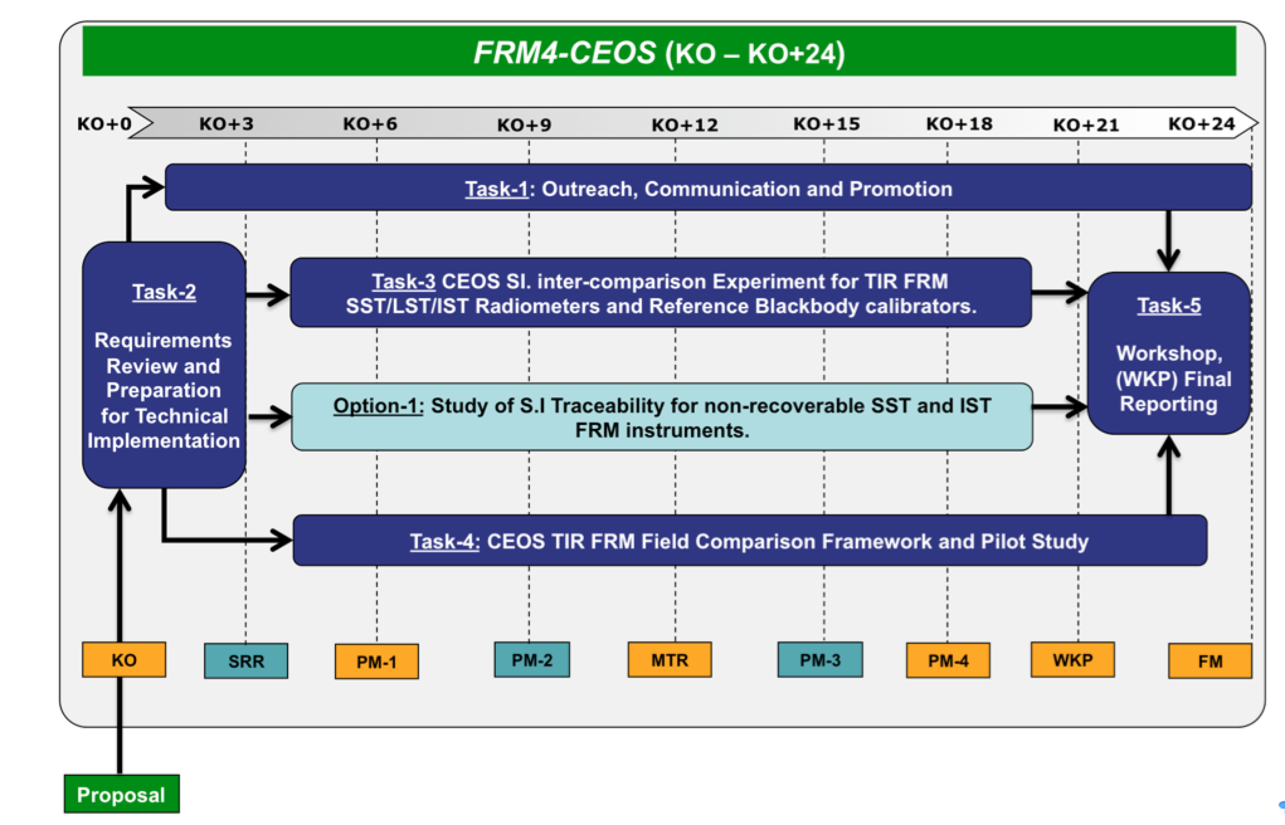
Schedule
KO 30th April 2015

Slide 12
Participation
ESA will support the cost of radiometer inter-calibration work via the FRM4TIR (CEOS) project
CEOS Agencies are requested to provide support to their national teams to participate in the radiometer and black body calibration exercise in 2016
Cost of T&S for national teams, shipping of gear etc.
This approach has worked well in the past for previous activities held in the USA.
Looking forwards to a useful outcome.

