Slide 1
P-VC Status and Issues
Committee on Earth Observation Satellites
Riko Oki, Steven Neeck, P-VC Co-Leads
SIT-30 Agenda Item #8
CEOS Action / Work Plan Reference
30th CEOS SIT Meeting
CNES Headquarters, Paris, France
31st March – 1st April 2015

Slide 2
Status
Reminder of 3-year outcomes (per P-VC ToR v1.0, Nov 2013)
P-VC Data Portal and links to CEOS Water Portal
WA-01-C1_3 Phase 1 – “link only” interface
WA-01-C1_4 Phase 2 – “query/results/order based” interface
Precipitation ECV support – Response to Action A-8 of GCOS IP- Ensure continuity of satellite precipitation products (Deliverables #1, #2, #3, #4, #5 )
Deployment of GPM phase constellation satellites and maintaining continuity with TRMM
Advocacy of post-GPM phase P-VC

Slide 3
Status (cont.)
Accomplishments since SIT-29
P-VC Data Portal
Phase 1 of P-VC Data Portal (WA-01-C1_3) - Completed
Phase 2 of P-VC Data Portal implementation (WA-01-C1_4 and CEOS 2015-2017 Work Plan v0.5 Outcome VC-16)
Data Portal Phase 2 study (function and architecture) completed and submitted to P-VC agencies.
Substantial progress made in validating the Data Portal Phase 2 architecture. Completed the prototype linking the PPS and JAXA G Portal with an interconnected common interface. Working with NOAA on adding IR-based rain estimate products.
Remaining work planned to be completed by July 2015 (details in CEOS Work Plan Deliverables status update).
Precipitation ECV support – Response to GCOS IP Action A8
DMSP F19 launched and commissioned (Deliverable #1)
Megha-Tropiques mission was extended for two years following completion of its three year baseline mission. (Deliverable #1)
7th GPM International GV Workshop is scheduled for May 12-14 in Seoul, Korea hosted by KMA (Deliverable #2)

Slide 4
Status (cont.)
Accomplishments since SIT-29 (cont.)
Precipitation ECV support – Response to GCOS IP Action A8 (cont.)
X-Cal WG meetings held at NOAA ESSIC (USA) and UCF Orlando (USA) with focus on GMI characterization as well as weekly videocons (Deliverables #2, #3, #4, and #5).
PPS/MOS are producing and distributing all GPM Standard Data Products to public users. The NASA IMERG multisatellite product is publicly available as a research product. The NRT version is to be available in April (Deliverables #2, #3, #4, and #5).
Deployment of GPM phase constellation satellites and maintaining continuity with TRMM
GPM Core Observatory launched and commissioned with all GPM Standard Products are publicly available at http://pmm.nasa.gov/data-access
After +17 years of operations, TRMM has fully expended its fuel and is nearing the end of its operational life - passivation and reentry are expected in April and June, respectively

Slide 5
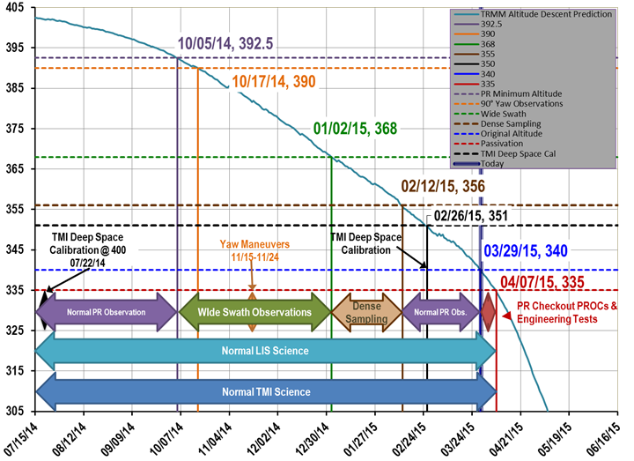
Status (cont.)
TRMM descent profile (passivation ~April 8-15, reentry ~ June 23)

Slide 6
Status (cont.)
Accomplishments since SIT-29 (cont.)
Advocacy of post-GPM phase P-VC
GPM FO meeting held on sidelines of 2014 PMM Science Team meeting as well as Integrated Global Precipitation and Clouds mission concept workshops at NASA GSFC
A pair of letters coordinated between the P-VC and the IPWG addressing concern over absence of plans for sustainment of the JAXA AMSR2 and DPR measurements was discussed at the 5th P-VC Workshop
5th P-VC Workshop
Held November 21, 2014, Tsukuba, Japan (on sidelines of 7th IPWG Workshop)
Productive strategic engagement with CGMS IPWG
Planning for 6th P-VC Workshop
July 16-17, 2015, Baltimore (USA) (on sidelines of next PMM Science Team Meeting)
Will address additional input for 2015-2017 Work Plan v0.5 Outcomes VC-17, Support to ECV precipitation parameters, and VC-18, Programs for improvement of global precipitation products

Slide 7
Status (cont.)
Accomplishments since SIT-29 (cont.)
P-VC engagement with WGs
WGCV-38
WGISS-37

Slide 8
GPM NRT Data Products
Multi-satellite precipitation estimates
NASA IMERG (global, 4 hour latency with 30 minute updates)
To be publicly available in April 2015
http://pmm.nasa.gov/data-access/downloads/gpm
JAXA GSMaP NRT (global, 4 hour latency with 60 minute updates)
Publicly available http://sharaku.eorc.jaxa.jp/GSMaP/
JAXA GSMaP NOW (MTSAT area, 1 hour latency with 60 minute updates)
To be publicly available in May 2015 http://sharaku.eorc.jaxa.jp/GSMaP/
NOAA bRR (global, 12 hour latency with 30 minute updates)
To be available in FY2015 with GPM added http://www.ospo.noaa.gov/Products/atmosphere/brr/
GPM Core Observatory precipitation estimates
L2 GMI (1 hour latency), L2 DPR (3 hour latency), and L2 GMI/DPR combined (3 hour latency)
Publicly available
http://pmm.nasa.gov/data-access/downloads/gpm

Slide 9
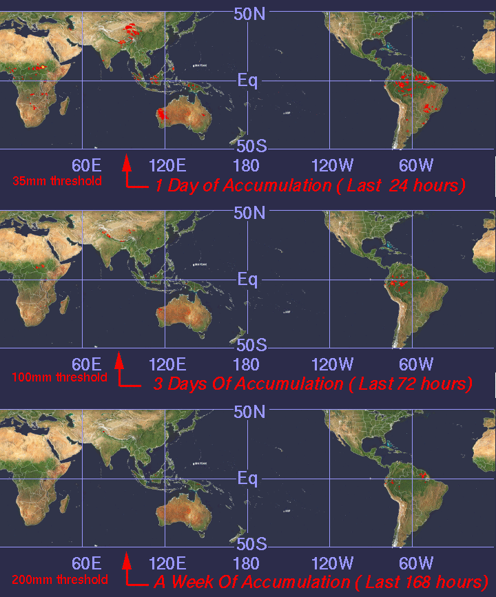
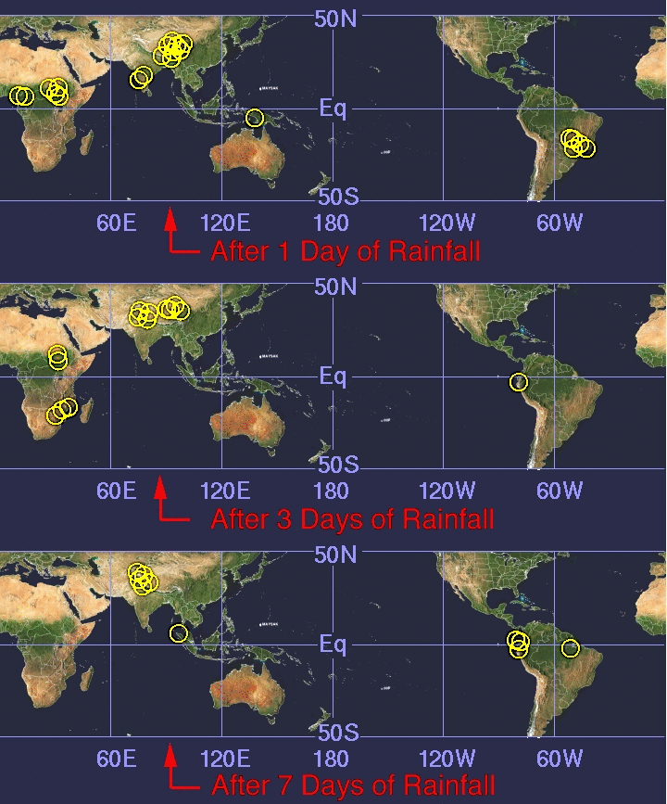
GPM NRT Data Products
Multi-satellite flood and landslide predictions
UMD Global Flood Monitoring System (GFMS) (TMPA RT evolving to IMERG)
Publicly available
http://trmm.gsfc.nasa.gov/publications_dir/potential_flood_hydro.html

Slide 10
Multi-Satellite Precipitation Data (30 min, 10km x 10km)
IMERG: Integrated Multi-satellitE Retrievals for GPM

Slide 11
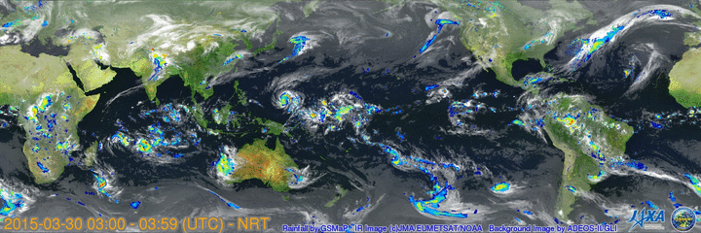
JAXA GSMaP NRT (hourly, 0.1 deg lat/lon)

Slide 12
JAXA Global Rainfall Watch NOWCAST
Called as GSMaP NOW (GSMaP nowcast version)
Developing to fulfill requirements from users to reduce data latency
Using data that is available within 1-hour (GMI, AMSR2 direct receiving data, AMSU direct receiving data (from JMA), MTSAT (from JMA)).
Also applying 1-hour forward (future) extrapolation by cloud moving vector.
X-1 UTC
X UTC
X+1 UTC
time
microwave imager observation at X-1
GSMaP at X-1
GSMaP at X
Extrapolation by MV
Specification | GSMaP_NOW | GSMaP_NRT
Latency | within 1-hour | 4-hour
Grid | 0.1 degree lat/lon | 0.1 degree lat/lon
Frequency | 1-hour | 1-hour
Coverage | MTSAT area | Global (60N-60S)
Web site and image will be available in May 2015.
Binary and text data will be released later after evaluation of accuracy.

Slide 13
Issues
Systemic lack of participation by some countries, such as Russia and China
Potential Microwave Imager coverage gaps (e.g. post-GCOM-W1 and post DMSP)
Potential Precipitation Radar coverage gap (post-GPM)
No SIT action is requested

Slide 14
Backup

Slide 15
Response to GCOS Action A8 - Ensure continuity of satellite precipitation products
Deliverables
Sustainment and enhancement of constellation of satellites carrying microwave radiometers (both imagers and sounders) and moderate inclination satellite carrying microwave imager and precipitation radar.
Well characterized and stable Level 1B calibrated, geolocated brightness temperature (Tb) products from each PC radiometer.
Inter-calibrated brightness temperature (Tc) products by applying the GPM core observatory reference standard.
Precipitation retrievals using physically based a-priori database constructed from combined radiometer/radar measurement.
Global monthly PDF of precipitation intensity based on the above.

Slide 16
2015-2017 Work Plan v0.5 Outcomes
VC-1: Action was reviewed by P-VC agencies at November 5th P-VC WS. The 2013 Data Discovery table was used as a starting point and distributed and for updating. Input still being collected. Coordinating with IPWG to leverage datasets.
VC-16: The revised Data Portal Phase 2 Study (function and architecture) document was reviewed by JAXA, updated, and delivered to the P-VC agencies for comment and review. The study document was updated from comments. Implementation details were reviewed with JAXA at the 25th GSIM in December. Substantial progress has been made in validating the Data Portal Phase 2 architecture. Completed the prototype linking the PPS and JAXA G Portal with an interconnected common interface. Working with NOAA on adding IR-based rain estimate products. Remaining work is planned to be completed by July 2015.
VC-17: The Megha-Tropiques mission was extended for two years following completion of its three year baseline mission. (Deliverable #1); Cross-Calibration WG meeting was held at UCF Orlando (USA) as well as weekly videocons (Deliverables #2, #3, #4, and #5); PPS/MOS are producing and distributing all GPM Standard Data Products to public users through NASA and JAXA sites. The NASA IMERG multisatellite product is publicly available as a research product. The plan is for the NRT version to be available (half-hourly frequency or even more frequent) by the early April (Deliverables #2, #3, #4, and #5); the 7th GPM International GV Workshop is scheduled for May in Seoul, Korea hosted by KMA (Deliverable #2).
VC-18: The P-VC is looking at its plans to address this action in the context of updating its strategic direction. This will be a topic of the 6th P-VC Workshop scheduled for July in Baltimore (USA). An area of increasing interest aside from improving the quality of multi-satellite and multi-agency derived products is improving product support, discovery, and utility.
16

Slide 17
2015-2017 Work Plan VC-16 Status
March 2015: Made substantial progress in validating the Data Portal Phase 2 architecture. With JAXA's participation completed the prototype linking the PPS and JAXA G Portal in an interconnected common interface. This demonstrated the viability of the query and search part of a CEOS P-VC Data Portal. Working with NOAA on adding IR-based rain estimate products. Remaining work planned to be completed by July 2015 is to complete integrated system testing and correct bugs, identify and incorporate additional P-VC member data contributions, complete user authentication/authorization, and complete a template for ‘P-VC Mediatator’ to be deployed on a data partner’s side, serving as a common access gateway for data downloading where user authentication is checked and verified against SSO.
17

Slide 18
X-Cal Working Group
X-Calibration Working Group (X-Cal WG)
International working group (in coordination with WMO CGMS/GSICS) to develop a consensus reference standard for cross-calibration of microwave radiometers to produce uniform global precipitation products within a consistent framework.
Sixteen WG meetings held since 2007
16th WG meeting, January 28-29, 2015, UCF, Orlando, FL USA
NASA, JAXA, CNES, ISRO, INPE, CONAE, NOAA, NRL, EUMETSAT, JMA, UKMET, Universities from the U.S. and Asia participate
Discovered/Fixed Problem in TMI (ca. 2K p-p), implemented fix in V7 algorithm
TRMM intercalibration with GMI
Implementation of L1C intercalibration processing (conical imagers and sounders) including calibration constants for pre-launch PPS
Instrument liaisons for 9 contemporary passive microwave instruments
http://www.gpm-x-cal.info/
18

Slide 19
Participation
Lead Agencies:
Japan – JAXA: Riko Oki, oki.riko@jaxa.jp & USA – NASA: Steven Neeck, steven.neeck@nasa.gov
Space Agency Participants:
France - CNES: Philippe Veyre, veyre.phillipe@cnes.fr
India - ISRO: K. Kumar, director@sac.isro.gov.in
Brazil - INPE: Carlos Frederico Angelis, angelis@cptec.inpe.br
Europe - ESA: Michael Rast, michael.rast@esa.int
China – NSMC/CMA: Lu Naimeng, lunaimeng@nsmc.cma.gov
Russia – ROSHYDROMET: Vasily Asmus, asmus@planet.ittp.ru
USA - NOAA: Ralph Ferraro, ralph.r.ferraro@noaa.gov
USA - Naval Research Laboratory: Ian Adams, ian.adams@nrl.navy.mil
Europe - EUMETSAT: Johannes Schmetz, Johannes.Schmetz@eumetsat.int
Germany - DLR: Martin Hagen, martin.hagen@dlr.de
Canada - Canadian Space Agency: Éric Laliberté, Eric.Laliberte@asc-csa.gc.ca

Slide 20
Participation (cont.)
Other Agency Participants:
France – LEGOS-OMP/CNRS: Remy Roca, Remy.Roca@legos.obs-mip.fr
Canada – Environment Canada: Paul Joe, paul.joe@ec.gc.ca
User Community Representatives:
CGMS-IPWG: Remy Roca, Remy.Roca@legos.obs-mip.fr, Nai-Yu Wang, nai-yu.wang@noaa.gov
GEWEX: Chris Kummerow, kummerow@atmos.colostate.edu
WCRP/IGWCO: Rick Lawford, lawford@morgan.edu
GCOS: Stephen Briggs, stephen.briggs@esa.int
Peter Bauer, Peter.Bauer@ecmwf.int
Phil Arkin, parkin@essic.umd.edu

Slide 21
U.S. P-VC Co-Lead Team
Steven Neeck/NASA HQ
Ramesh Kakar/NASA HQ
Gail Jackson/NASA GSFC
Erich Stocker/NASA GSFC (SEO POC, Data Systems)
Scott Braun/NASA GSFC (Visualization POC)
Xiaopeng Hu/NASA GSFC (V-PC Data Portal)
George Huffman/NASA GSFC
Chris Kidd/NASA GSFC/University of Maryland
Bob Adler/ University of Maryland Baltimore County
Ralph Ferraro/NOAA
Joe Turk/JPL
Ian Adams/NRL
Chris Kummerow/Colorado State University

Slide 22
Japan P-VC Co-Lead Team
Riko Oki, JAXA
Masahiro Kojima, JAXA
Kinji Furukawa, JAXA (SEO POC, Data Systems)
Keizo Nakagawa, JAXA
Misako Kachi, JAXA (Visualization POC)
Toshiaki Takeshima, JAXA
Kengo Aizawa, JAXA
Keiji Imaoka, JAXA
Kazuo Umezawa, JAXA
Yukari Takayabu, University of Tokyo
Toshio Iguchi, NICT
Ken’ichi Okamoto, Osaka Prefecture University
Toshio Koike, University of Tokyo
Jun Matsumoto, Tokyo Metropolitan University
Kazuhiko Fukami Public Works Research Institute
Yoshiaki Takeuichi, Japan Meteorological Agency
Yoshiyuki Chihara, Ministry of Education, Culture, Sports, Science and Technology

