Slide 1

WG Disasters Report
Committee on Earth Observation Satellites
Ivan PETITEVILLE, ESA
SIT-30 Agenda Item # 11
CEOS Action DIS-9, DIS-10
30th CEOS SIT Meeting
CNES Headquarters, Paris, France
31st March – 1st April 2015

Slide 2
Actions & Decisions
No actions open
No decision for SIT-30

Slide 3
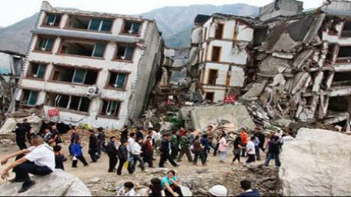
CEOS Activities in
Support to DRR
Single Hazard:
  Floods, Seismic Hazards & Volcanoes Pilots
Multi-Hazard:
  Geohazards Supersites
  Recovery Observatory Pilot

Slide 4
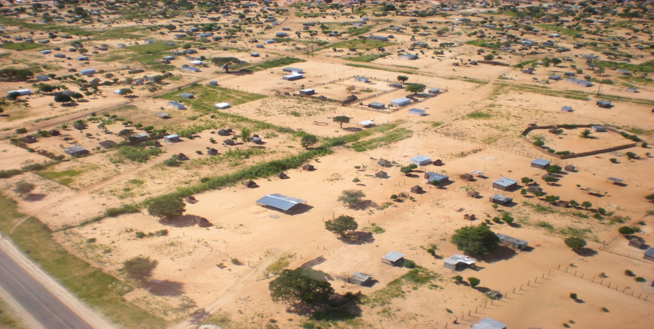
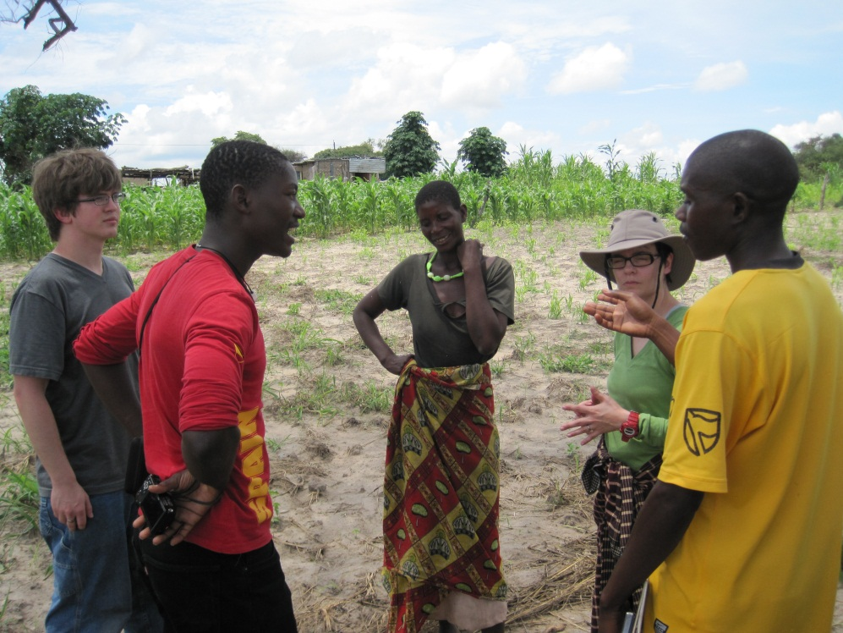
Single Hazard Pilot Projects
4-year end-to end-projects to demonstrate benefits of satellite EO to ALL DRM phases, with strong user involvement
Floods, Seismic Hazards and Volcanoes are progressing very well
ESA with NASA are exploring the value of a multi-hazard landslide pilot
NASA staff with two Namibian agents (Namibian Department of Water Affairs and Forestry) and one villager
Courtesy NASA.
Notes:
ESA with NASA are exploring the value of a multi-hazard landslide pilot, which includes
- Primary triggers from other hazards (wildfires, rainstorms, earthquakes, volcanoes, permafrost degradation, sedimentation, high stream flows, and inundation) and man-made development activity;
- Secondary cascading hazards from slope failures, mudslides, diverted or blocked streams, dam burst floods, debris flow, displacement waves and tsunamis; and
- Infrastructure impacts such as damaged roads-rail lines and utilities

Slide 5
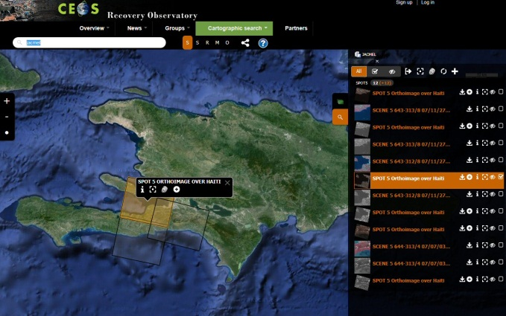
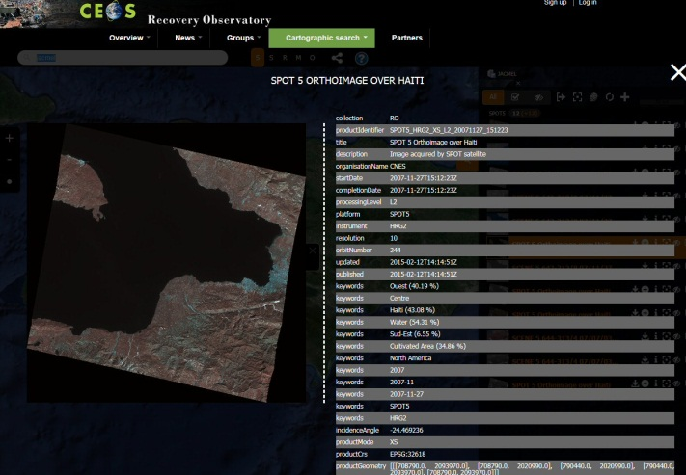
Multi Hazard Pilot Projects
Satellite data regularly delivered to all Supersites except last 2 endorsed by CEOS: Ecuador and NZ
  Licenses agreements in preparation with CEOS Agencies.
Recovery Observatory progressing as planned:
  Infrastructure v1 ready, v2 in July.
  Key international stakeholders and Value-added entities have joined
Notes:
Stakeholders actively engaged or being engaged
GFDRR/World Bank and UNDP have joined RO Oversight Team. Discussion with Red Cross.
EC being approached through “Copernicus EMS”

Slide 6
Stakeholders and
Value-added partners in RO
Stakeholders actively engaged or being engaged in Recovery Observatory (RO)
  GFDRR/World Bank and UNDP have joined RO Oversight Team
  EC being approached through “Copernicus EMS”
Value-adding approach being established
  UNOSAT has joined Oversight Team
  JRC prepared to contribute after WCDRR side discussions
  CNES arranging for VA company contribution – others would be welcome

Slide 7
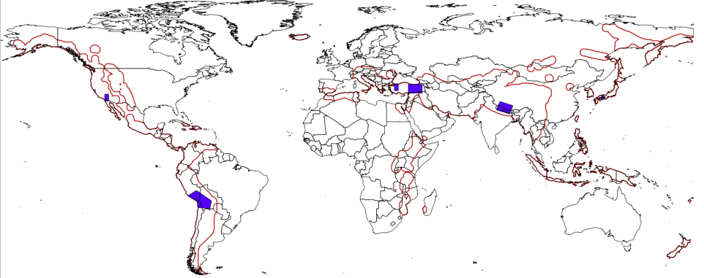
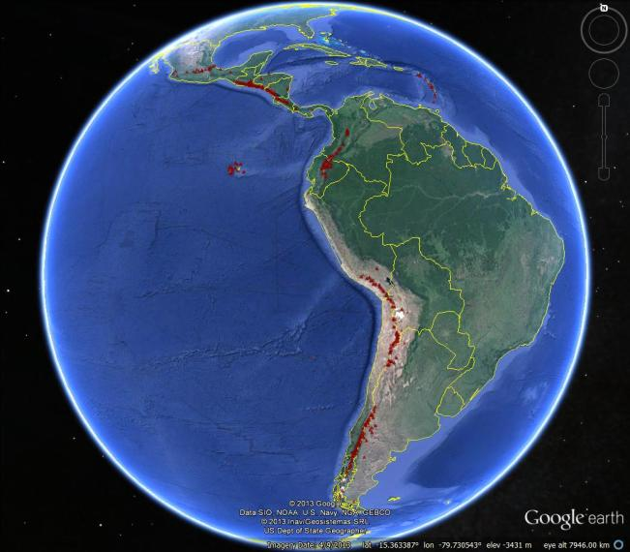
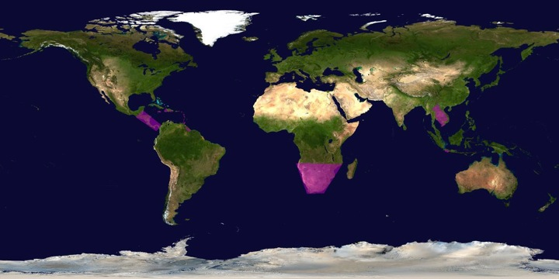
Pilots’ Coverage
Both global and regional activities.
SEISMIC HAZARDS
VOLCANOES
FLOODS

Slide 8
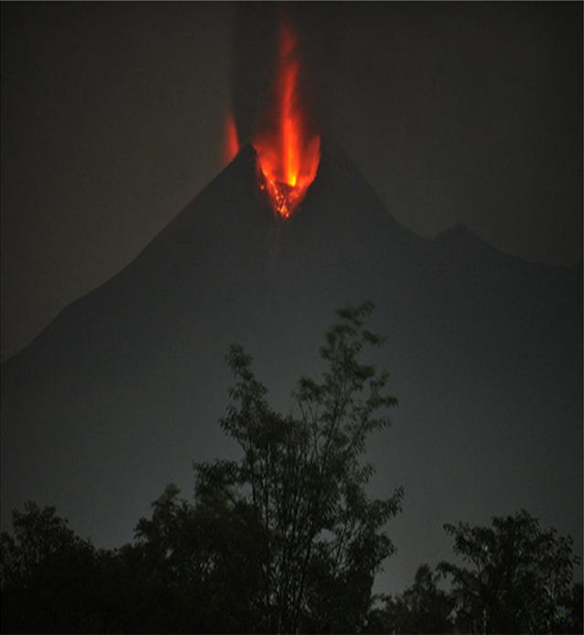
WHY?
Volcano Pilot
Hundreds of millions live within 20 km of an active volcano today.
In 2010, the Eyjafjallajökull eruption brought losses of $200m/day, and 100,000 cancelled flights.
Merapi, Indonesia, erupting in 2010. From Pallister and others, 2013

Slide 9
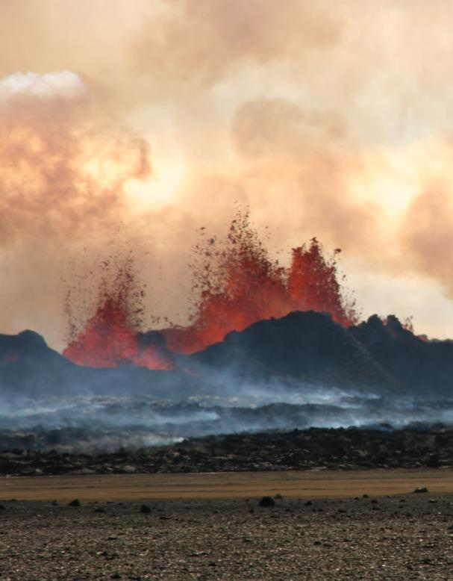
WHAT IS MISSING?
Volcano Pilot
Only ~10% of the ~1500 active volcanoes in the world are being monitored in some way
Satellite observations are not coordinated for volcano monitoring
Need systematic observations before, during, and after volcanic events
Bardarbunga, Iceland, erupting in 2014.
Photo credit: M Parks

Slide 10
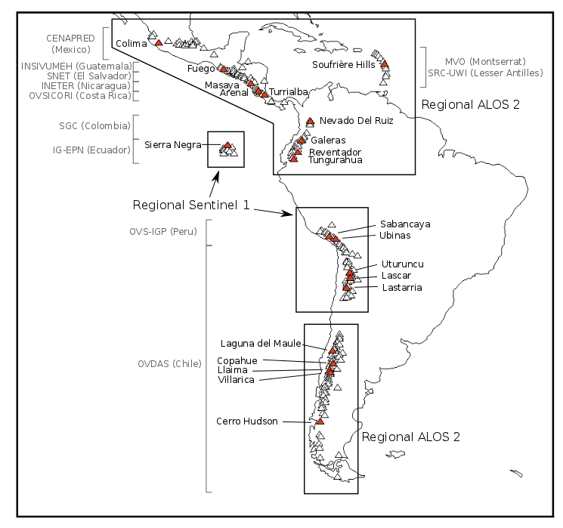
Pilot Region:
Latin America
Notes:
Triangles are all volcanoes in Latin America. Red triangles are target volcanoes from the CEOS pilot plan. Black boxes and text show regions for planned quarterly monitoring with C-Band (Sentinel-1) and L-Band (ALOS 2) InSAR. Grey text shows the local end users (monitoring agency).

Slide 11
User Communities
in South America
Instituto Geofisico, Escuela Politechnia Nacional (IG-EPN), Ecuador
Servicio Geologico Colombiano, Colombia
SERNAGEOMIN-OVDAS (Observatorio Volcanológico de los Andes del Sur), Chile
Observatorio Vulcanologico del Sur, Instituto Geofisico del Perù (OVS-IGP), Perù
Risk Products provided to Local Authorities

Slide 12
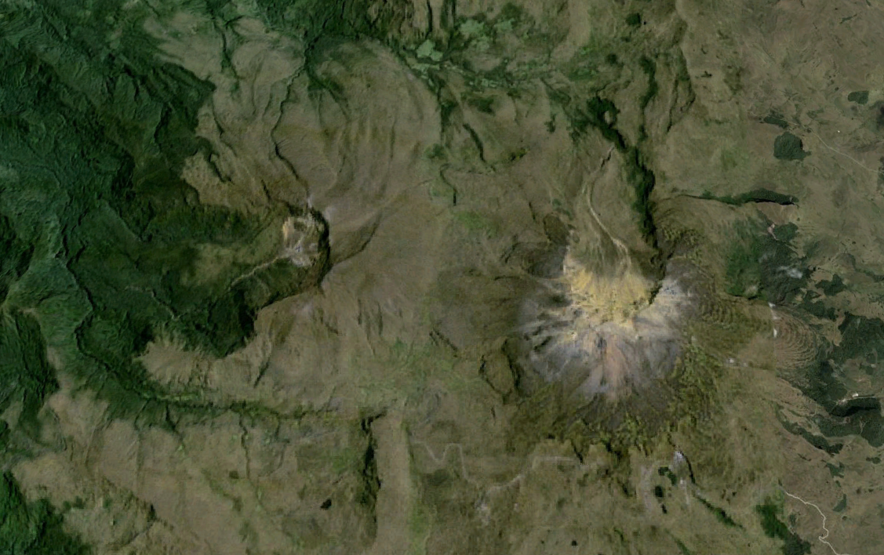
Unrest at Chiles - Cerro Negro de Mayasquer,
Ecuador-Colombian border

Slide 13
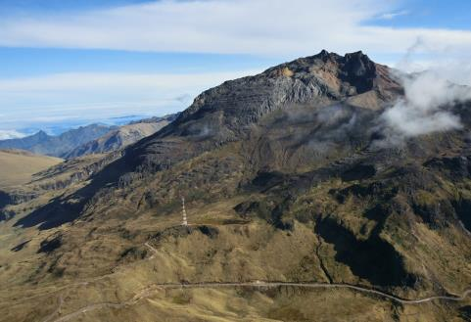
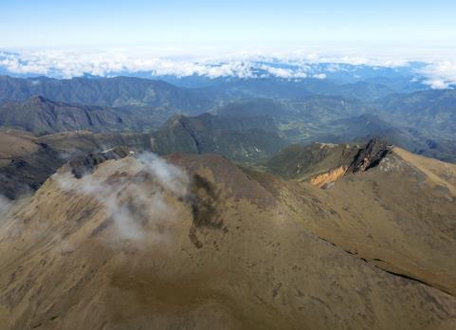
Chiles –
Cerro Negro de Mayasquer
Unrest at Chiles-Cerro Negro Volcano
Chiles- Cerro Negro are volcanoes on the Ecuador-Colombian border, with no historical activity
Since September 2014, thousands of small earthquakes every day – but no changes at the surface.
As there have been no historical eruptions, ground based monitoring is limited:
-> satellite data are critical
Chiles
Cerro-Negro
photos: Instituto Geofisico, Ecuador

Slide 14


Chiles –
Cerro Negro de Mayasquer
CEOS
data
Ebmeier, Bristol
Ebmeier, Bristol
TSX, 14th -29th Oct 2014
CSK, 24th May -27th Oct 2014
CEOS data have been used to find fault geometries and constrain location of magmatic intrusion
regular processing of CSK and TSX data since October 2014 to help volcano observatories
Notes:
Scientists at the University of Bristol have processed and analysed CosmoSkyMed and TerraSAR imagery provided by the CEOS Volcano DRM Pilot and shared with Volcano Observatories Instituto Geofisico (Ecuador) and Servicio (Colombia)

Slide 15
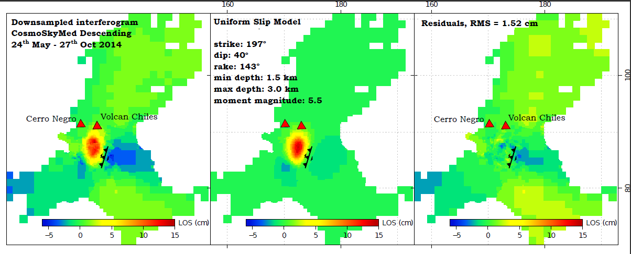
Chiles –
Cerro Negro de Mayasquer
Deformation Best-fit fault plane solution Residuals
The deformation detected using InSAR has so far been primarily associated with a larger (M5.6w) earthquake on the 22nd October 2014. This earthquake result in maximum displacements of 15 cm towards the satellite in a region SW of Chiles volcano.
The majority of deformation can be explained by oblique slip on a fault at depths ~1.5-3 km dipping WNW. The orientation of this fault aligns well with faults mapped from regional topographic structures.

Slide 16
Chiles –
Cerro Negro de Mayasquer
Evolving unrest at Chiles-Cerro Negro:
larger earthquake swarm in Feb 2014
~10,000 small VT type events in March 2014
~1000 similar events per day to May 2014; rapid increase in Oct.
- 5.6 Mw EQ, (thrust) on 20th Oct; 22nd Oct, 7,700 events in 1 day.
Neither Chiles or Cerro Negro have erupted for a long time; USGS believes either could produce a very large eruption
Civil Defense in Colombia ordered the evacuation of 12,000 people.

Slide 17
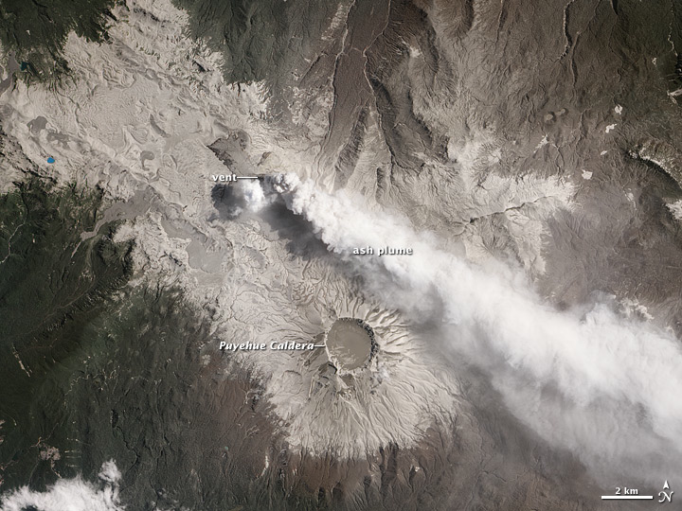
Cordon Caulle volcano, Chile
Volcano with three rhyo-dacite eruptions in the last century (total volume erupted ~2 km³)
Large plinian eruption in 2011-2012 produced widespread damage and disrupted air travel.
Limited in situ monitoring.

Slide 18
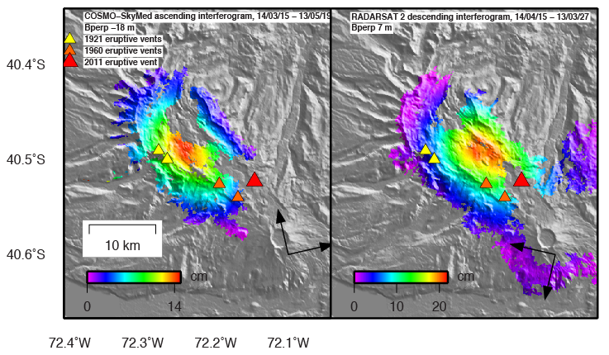
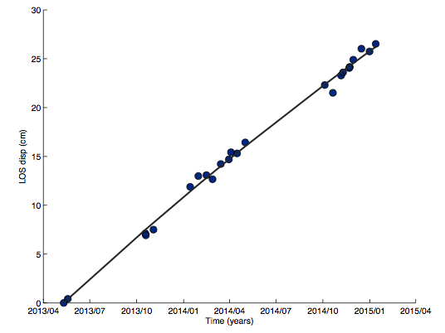
Cordon Caulle Volcano, Chile
CEOS RADARSAT-2 and COSMO-SkyMed SAR data processed by Cornell Univ. has discovered widespread volcano inflation (~20 cm/yr) ongoing until mid Jan. 2015.
No increase in seismicity above background.
Met in person with OVDAS (Observatorio Volcanológico de los Andes del Sur, Chile) in Jan. 2015. Results led them to deploy GPS stations during March 2015.

Slide 19
Cooperation with
Other CEOS WGs and VCs
WGCapD:
  Distance Education Course Remote Sensing Technology for Disaster Risk Management.
  140 registered to 8 Webinars (April-May)
WGISS:
  Developer of the Recovery Observatory Infrastructure
VCs (future):
  e.g. Hydromet events (PC), Volcanic eruption (AC). Cooperation to be further defined.
Notes:
140 registered to Webinars but room only for 95.

Slide 20
Post-Sendai …
Encouraging results from CEOS DRR-related activities with positive feedback from the intermediate and end-user communities.
→ Proposal to extend the concept at larger scale for the post-2015 era ….
Through CEOS, Space Agencies seek partnership with major DRM stakeholders and end user community, to bring concrete, sustainable solutions to high level priorities in line with post-2015 framework for DRR

Slide 21
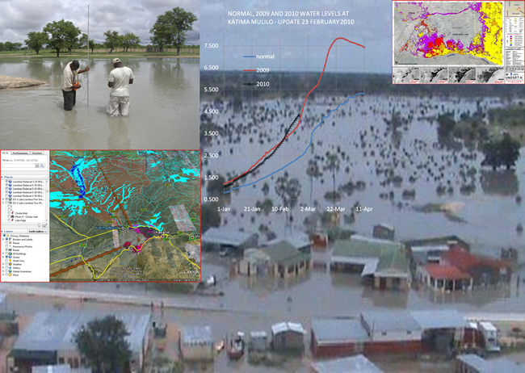
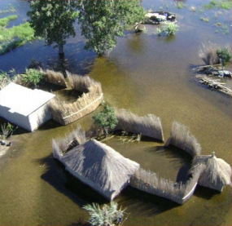
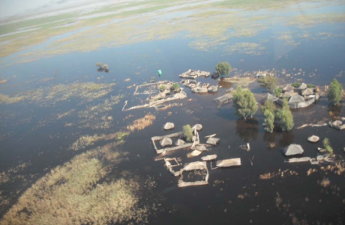
QUESTIONS ?
THANK YOU …
Ivan.Petiteville@esa.int
Floods in Namibia (2009). 50,000 people displaced, 102 died. Courtesy NASA

