Slide 1
GFOI Status & Issues
Committee on Earth Observation Satellites
CEOS Lead & SDCG EXEC
SIT-31 Agenda Item 5
CEOS Strategic Implementation Team
ESA/ESRIN, Frascati, Italy
19th-20th April 2016

Slide 2
Brief Status Report
Reinforcement in 2016 thanks to:
Enthusiastic GFOI Plenary in February in Frascati
New FAO lead and interest in GFOI
Formal establishment of GFOI Office within FAO
Increasing donor interest (including GNU countries)
MGD version 2.0 another tangible with great promise
R&D component reactivated by ESA through GOFC-GOLD
Coordination of capacity building with SilvaCarbon, UN-REDD, and World Bank FCPF
Better integration and coordination of components
Importance of REDD+ & MRV in the Paris Agreement (COP21)
Notes:
GNU = Germany, Norway, UK

Slide 3
Brief Status Report
SDCG
New CEOS Lead (Prof Shimada, JAXA)
Active & productive
GFOI Space Data Strategy progressing routinely
New Space Data Portal: http://www.gfoi.org/space-data/space-data-portal/
Global Data Flows Study
Copernicus REDD+ input
Updated Work Plan
Intensified cooperation with FAO and UN-REDD
Data Cube pilots progressing (Kenya and Colombia)
UK host in Sept, with UK Govt briefing on GFOI
Notes:
New CEOS Lead participated at GFOI side event at COP-21 in Paris

Slide 4
Documents provided to SIT
Element-3 (support to GFOI R&D activities) Update: FOR ENDORSEMENT
Global Data Flows – Progress Report: FOR INFORMATION
2015 Acquisition Implementation Report: FOR INFORMATION
SDCG 2016-2018 Work Plan Draft: FOR INFORMATION (will seek endorsement at 2016 Plenary & renewal of SDCG)
GFOI Strategy Document: FOR INFORMATION

Slide 5
For endorsement by SIT
SDCG Element 3 Strategy: Satellite Data in support of GFOI R&D Programme. First endorsed by SIT-30. Complement to SDCG Global Baseline (El-1) and National Space Data Services (El-2) Strategies.
GFOI R&D Programme – activities re-started in 2016
GFOI R&D component coordination supported by ESA
15 R&D teams from REDD countries and int’l research organisations
Multi-disciplinary sites, addressing several GFOI Priority R&D topics
Element-3 implementation progressing with strong engagement by CEOS agencies with commercial missions (ASI, CNES, CSA, DLR, JAXA). Satellite tasking and data provision to selected R&D groups on-going.
Implementation plan for 2016 ready for execution; plans for 2017-2018 scoped in SDCG 3YWP. 3-year duration proposed.
Seeking endorsement of CEOS SIT (@ SIT-31) for the Strategy

Slide 6
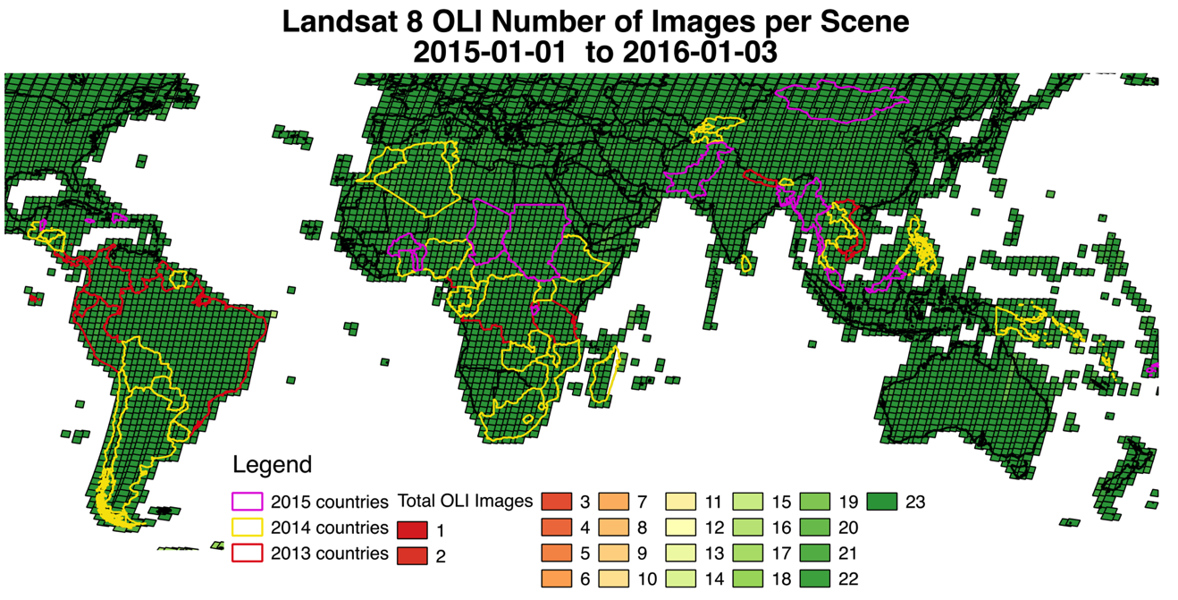
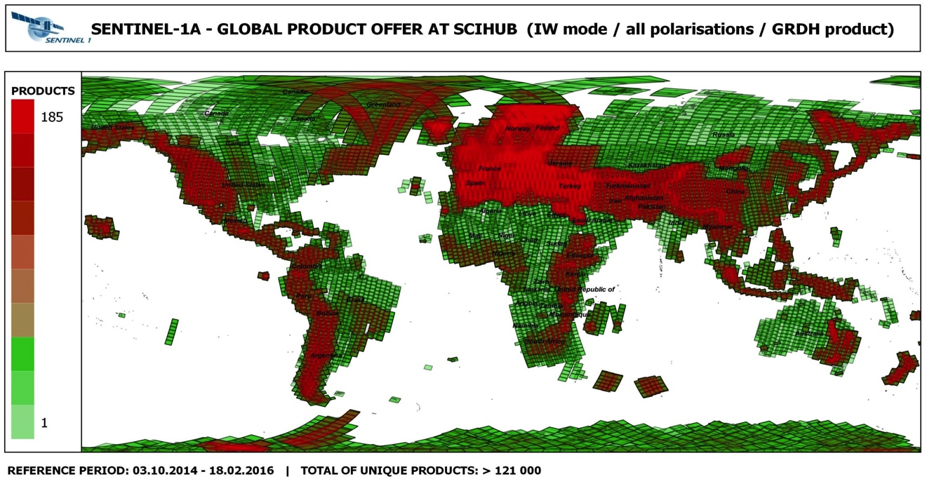
SDCG Implementation Report
Landsat 7 and 8
Again main work horses for GFOI Landsat acquired systematically in 2015 over all GFOI countries
Sentinel-2
launched on 23 June opened its data flow on 3 December 2015.
Sentinel-1
in ramp-up phase until June 2015, acquired specifically over heavily clouded areas and and areas with a high risk of illegal logging
ALOS-2 PALSAR-2
Annual mosaics are provided by JAXA

Slide 7
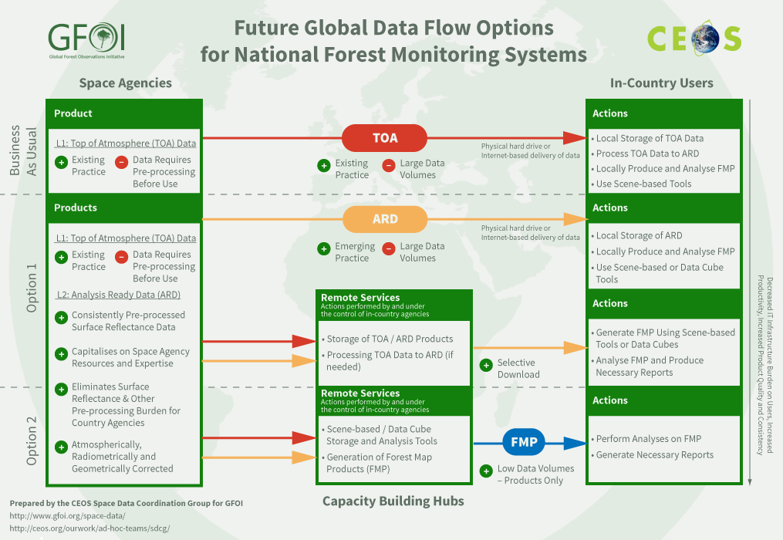
Issues for attention of SIT
Global Data Flows Study not complete but very promising feedback from countries, FAO, World Bank on the obstacles to uptake of space data and possible solutions.

Slide 8
Issues for attention of SIT
SDCG sees significant strategic value in the working level initiatives in relation to ARD and the Data Cube first explored for GFOI Pilots. These have significant potential to assist govt EO programmes to remain competitive and in removing obstacles to data uptake. Top-down support encouraged for SEO-led efforts:
ARD description
CEOS Data Cube 3-Year Work Plan

Slide 9
Issues for attention of SIT
Australian funding cycle for GFOI ends around 31 December 2016 and potentially impacts all aspects of their engagement and support:
Lead
Office (31 January 2017)
MGD (30 June 2016)
SDCG SEC (30 November 2016)
Creative solutions to SDCG SEC being brainstormed to achieve continuity through end 2017
SIT should be aware of the risks to GFOI
Australian DOTE exploring options for renewal – unlikely to include Space Data

Slide 10
Issues for attention of SIT
2016 emphasis on end-to-end GFOI demo with 1-2 countries in association with FAO and GFOI Office
Demonstrate practical benefits for governments
Integration of all components – esp Space Data & MGD
Supports evaluation study of GFOI effectiveness by the GFOI Office for the Australian and Norwegian Governments
Highlights many SIT-31 issues in relation to strategic partnerships and data architectures (UN, donors, countries..)

Slide 11
Issues for attention of SIT
For Global Baseline Acquisition Strategy, more dual-pol observations over world’s forested areas are needed for C-band data sources to make effective contribution
Message input to EC Copernicus REDD+ Service process
No time to waste in building a systematic archive of Sentinel-1 dual-polarisation data over the pan-tropics

Slide 12
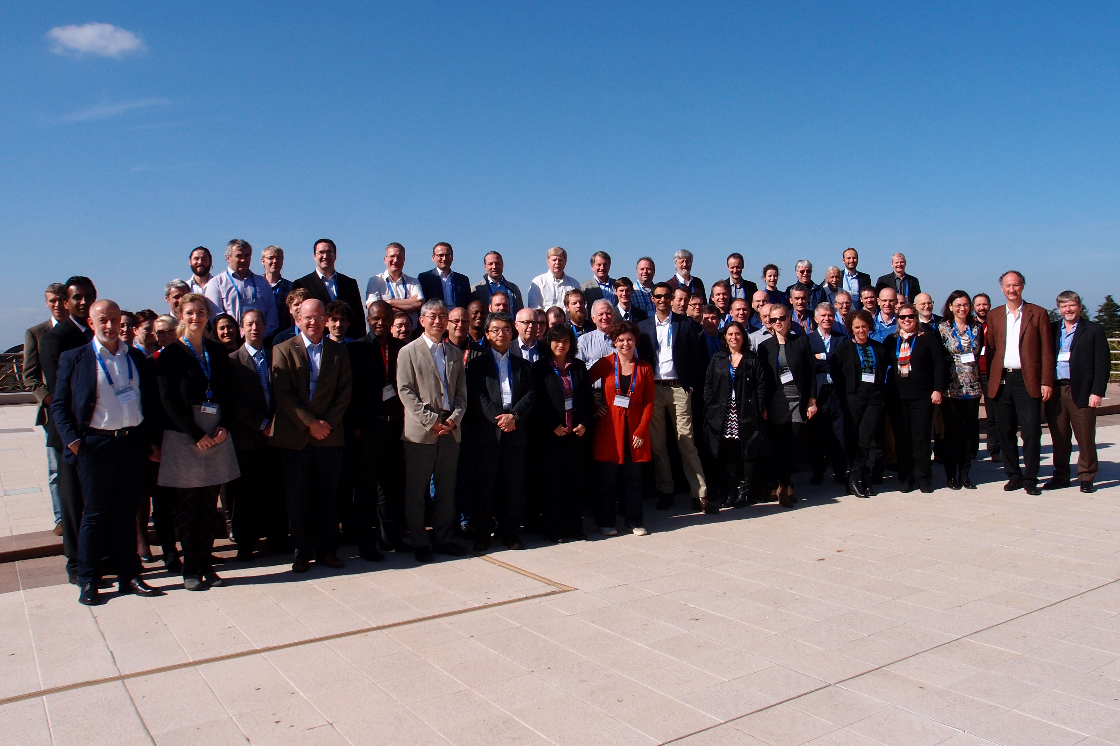
Growing, but still a lot to do ... …
GFOI Open Forum in Frascati, 22-26 February 2016

