Slide 1
Status of Sentinel-3 activities at EUMETSAT
Committee on Earth Observation Satellites
SIT-31 Agenda Item # 13
ESA/ESRIN, Frascati, Italy
19th-20th April 2016

Slide 2
EUMETSAT role in Sentinel – 3 in orbit commissioning and operations
Support to ESA during the in-orbit commissioning phase
After the IOC Review, operations, maintenance and evolution of :
the Flight Operations Segment, including mission planning, with ESOC serving as a backup
the Sentinel-3 Marine Data Centre, including one instance of the Payload Data Ground Segment and EUMETSAT’s multi-mission facilities

Slide 3
EUMETSAT role in Sentinel – 3 in orbit commissioning
ESA responsible for commissioning phase activities
Flight Operations Segment
EUMETSAT shadows ESOC for S-band passes
Payload Data Ground Segment/Marine Data Centre
Acquisition of Sentinel-3A data from ESA Core Ground Station
Testing functionalities & capacities of full Marine Data Centre
Testing processing to Level 0, Level 1 and Level 2
Delivering products to ESA in support to satellite commissioning
Preparing for taking over operations of S3A satellite and Marine Data Centre according to joint plan agreed with ESA

Slide 4
Current status and next steps at EUMETSAT
Payload Data Ground Segment
Data successfully acquired, pre-processed and transferred to EUMETSAT by the ESA Core Ground Station in Svalbard
L0 products successfully generated by the Marine PDGS in EUMETSAT
L1 production is being incrementally enabled, starting with OLCI
Data flowing to commissioning partners
First data planned to be released to S3 Validation Team following each successful MTR
Next Steps
EUMETSAT support to ESA IOCR in July
Handover of operations of spacecraft & Marine Centre from ESA
Operations ramp up phase in cooperation with ESA

Slide 5
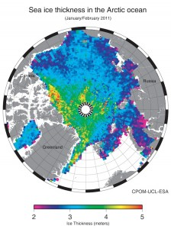
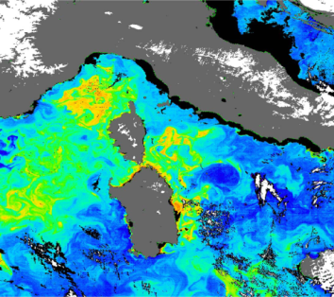
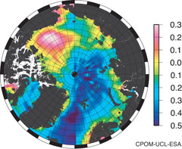
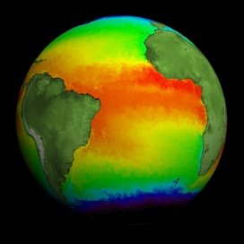
Sentinel-3 marine products from EUMETSAT
Level 1 data generated and distributed both by ESA and EUMETSAT.
Split of responsibility at Level 2 : Marine (EUMETSAT), Land (ESA)
Level 2 OLCI
Normalised water surface reflectance
Algal pigment concentration for open and for coastal waters
Total suspended matter concentration
Diffuse attenuation coefficient
Coloured dissolved matter absorption
Photosynthetically active radiation
Integrated water vapour
Aerosol optical depth
Aerosol Angström exponent
Level 2 SRAL
Sea/coastal zone surface height
Significant wave height
Wind speed
Backscatter coefficient s₀
Sea ice height, freeboard
Total water, liquid water (from MWR)
Level 2 SLTSR
Sea surface temperature
(L2P GHRSST standard)

Slide 6
Plans for release of products
Joint objective of ESA and EUMETSAT :
Release L1 operational products after IOCR – Mid July 2016
Implementation of joint CAL/VAL plan, release of increasingly mature L2 products
Release of L2 operational products after RORR – Feb. – April 2017

Slide 7
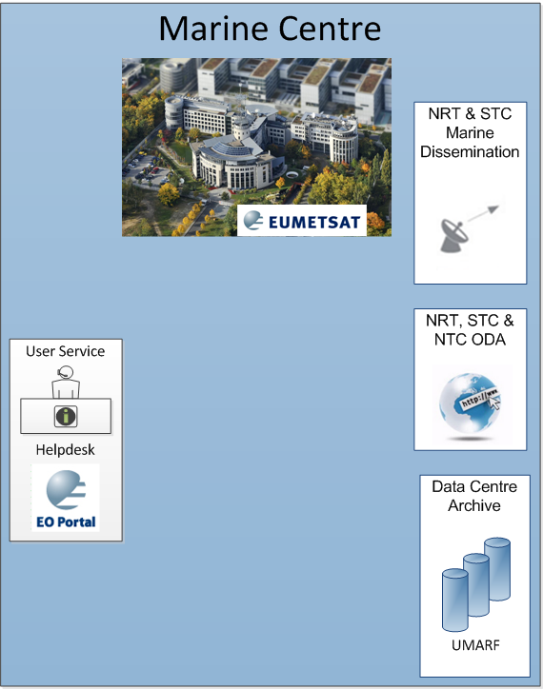
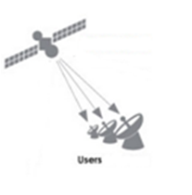
EUMETSAT Sentinel-3 Services and Data Access
User Support Services
User Registration,
Product Discovery,
Subscription & Ordering,
Helpdesk,
Training, etc.
EUMETCast
Operational dissemination NRT data in EUMETSAT. Can involve satellite and terrestrial methods.
Online Data Access (ODA)
Rolling archive of 1 month of products supporting ftp/http access
EUMETSAT Data Centre
Complete historical archive of all EUMETSAT data including S-3 marine products
Notes:
TO BE REMOVED- In S3 Ops Concept slideshow

Slide 8
On-line Data Archive (ODA)
All Sentinel-3 data and
products accessible via ODA
ODA comprises one-month rolling buffer of data – Target 1 year
Users subscribe via the EOP to the products & dataset they wish to download
The product ID corresponds to the files on the ODA
Access to the ODA is through the user’s EOP account credentials
ODA accessed through an ftp address

Slide 9
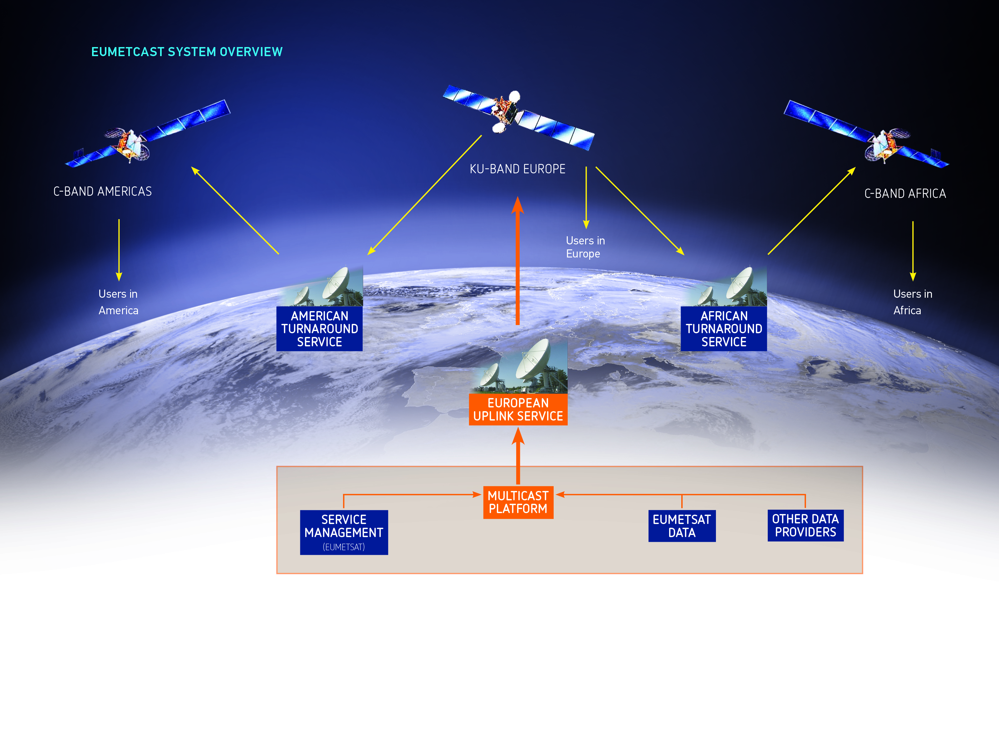
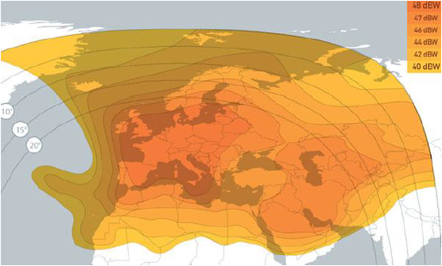
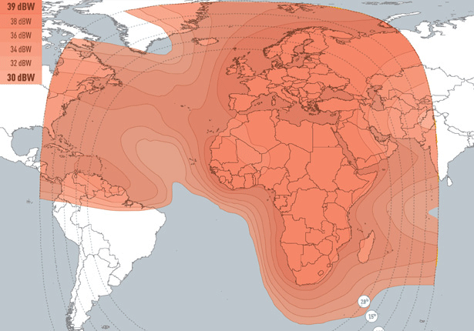
NRT products : EUMETCast Satellite
EUMETCast Satellite
Broadcasting over commercial telecommunication satellites
Many users
Big data volumes
Full coverage of Europe and
Africa (S3 in Africa)
Cheap receiving station valid
for both satellite and terrestrial

Slide 10
NRT products : EUMETCast Terrestrial
EUMETCast Terrestrial
Multicasting over Internet
Big data volumes for fewer users
EUMETSAT baseline for distribution of Copernicus data to partners having signed a Cooperation
Arrangements with EC
TOAs with NOAA and
Geoscience Australia focusing on NRT users of marine products

Slide 11
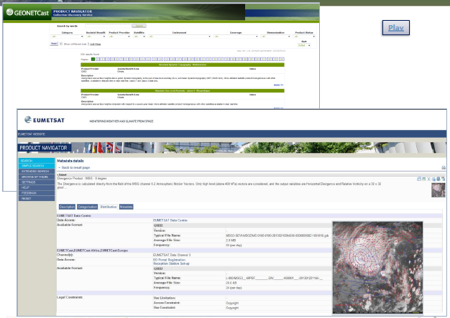
EUMETSAT Data Centre – Off line archive
Metadata descriptions, data provider and data access information
Links to resource information (e.g. user documentation)
Includes all EUMETSAT and Third-party products, including those delivered through EUMETCast
All Sentinel-3 marine products are included
Uses open standards (e.g. OGC, Inspire) for catalogue interoperability with other organisations

Slide 12
Any question on accessing S3 data from EUMETSAT ?
OPS@eumetsat.int

