Slide 1

CEOS Ocean Variables Enabling Research and Applications for GEO (COVERAGE):
Committee on Earth Observation Satellites
An Initiative Proposal to CEOS
Drs. E. Lindstrom, V. Tsontos & J. Vazquez
NASA
SIT 32 Agenda Item #3
CEOS Strategic Implementation Team
ESA Headquarters, Paris, France
26th-27th April 2017

Slide 2

COVERAGE Overview (1/2)
CEOS Ocean Variables Enabling Research and Applications for GEO
Vision:
  International collaboration via CEOS and diverse stakeholder engagement for a global COVERAGE “portal product” developed around a priority set of community-driven themes and use cases
  3 year Pilot (“R&D”) project –Not proposing a new CEOS VC, WG or operational capability
Build a project to:
  Enhance complementarity among 4 CEOS Ocean Constellations
  Utilize established earth science data standards/protocols & emerging data management/cloud capabilities where necessary
  Assemble and present satellite and in situ ocean data in a compelling web-based format
  Demonstrate the value-added of multivariate ocean data integration in support of GEO, science, applications, and public engagement

Slide 3
COVERAGE Milestones
from Pasadena to Paris
Sept.2013
COVERAGE concept conceived at Pasadena SIT-TWG
NASA Sargasso COVERAGE pilot with SSC
SSC COVERAGE stakeholder workshop (Key West, FL.)
2015/16
Aug.2016
COVERAGE initiative paper developed by NASA
Sept.2016
COVERAGE initiative submitted to CEOS and presented at SIT Technical Workshop (Oxford) per the formal CEOS initiative process
Approval deferred to SIT32 pending consultative process
Actions: - Ocean VCs & interested WGs to review/comment COVERAGE initiative paper
- COVERAGE to engage VC’s, GEO-Blue Planet & MBON, interested Agencies
Consultative process with Stakeholders (telecons, presentations)
GEO-Blue Planet & GEO-MBON endorsement
Ocean VCs supportive: SST-VC, OCR-VC, OST-VC, OVW-VC endorsement
Agency engagement: NASA (PO-program, EOSDIS), NOAA (P. DiGiacomo)
SSC Commission meeting (Azores)
7 months
April 2017
SIT-32 Meeting (Paris)
- COVERAGE presentation & side meeting
- Resolution to adopt

Slide 4
COVERAGE Motivation
COVERAGE is a response to:
Need for improved, unified access to data from the 4 CEOS ocean virtual constellations (VCs) for GEO (SSH, SST, Color, OVW, but also potentially SSS and Ocean Currents)
Need for improved access/integration of multivariate, multi-platform ocean observations, thematically organized and in a common frame (including those from the Ocean VCs), available in near real-time where possible in support of GEO-Blue Planet & MBON initiatives in particular.
Proposed COVERAGE initiative for CEOS
Low Footprint Pilot Project! - no new VC or WG.
Provide a coherent, focal point activity and mechanism promoting the advancement of the aforementioned needs consistent with CEOS programmatic objectives.
Invite interest and participation of other CEOS agencies in this effort.
Collaborative Opportunities: data sharing, technical exchange
Stakeholder Beneficiaries
Internal CEOS : Ocean VCs, WGISS, FDA
External: GEO-Blue Planet, GEO-MBON, UN/IOC GOOS

Slide 5
COVERAGE Overview (2/2)
CEOS Ocean Variables Enabling Research and Applications for GEO
Develop a data rich platform for delivery and access to integrated, analysis ready ocean data:
  Multi-parameter observations, easily discoverable and usable, thematically organized, available in near real-time (where possible), collocated to a common grid and including climatologies.
  Complemented by a set of value-added data services available via the COVERAGE portal including:
    an advanced Web-based visualization interface
    data discovery
    subsetting/extraction
    data collocation/matchup
    other potentially relevant on demand processing capabilities
    (eg. trend analysis, anomaly detection, dynamic regridding).
  Establish technical interfaces and data delivery and aggregation pipelines
  Community & Use Case Driven
Leverage relevant existing/emerging technologies (several open source) and successful program & project implementation models (eg. GHRSST, NASA Sea Level Change Portal)

Slide 6
COVERAGE Alignment with CEOS Strategic Objectives & Work Elements
CEOS Goals ¹:
Achieve better integration across the full range of Earth observations (space-based->in situ)
Facilitate open & easy access to CEOS agency data for maximal societal benefit CEOS via improved discovery, interoperability, coordinated data access portals in specific topical areas, promoting use of open-source tools
CEOS 2016-19 Work Plan² :
3.6. Capacity Building, Data Access, Availability and Quality:
II. Future Data Architectures: Address data access/usage obstacles & “Big Data” challenge
3.8 Support to Other Key Stakeholder Initiatives:
Commitment to priority actions identified by GEO Blue Planet Initiative:
    CEOS ocean VCs role in sustainment/continuation/harmonization of essential ocean variables
    develop experimental & operational coordinated, multi-sensor ocean products & services to explore optimal utility of developing a collocated, readily accessible dataset package with fit-for-purpose latency for applied, industrial, and research uses.
1.CEOS Strategic Guidance, Nov. 2013 2. CEOS 2016-2018 Work Plan, Mar. 2016 & CEOS 2017-2019 Work Plan, Mar. 2017
3. http://geoblueplanet.com 4. http://www.marinebon.org

Slide 7
Status of COVERAGE Stakeholder Engagement since Oxford
Multiple consultations with VCs, GEO-MBON, GEO-Blue Planet, CEOS agency reps
All 4 Ocean VCs supportive (SST, OCR, OST, OVW)
SST-VC (3/29): "this is an important initiative and it should be supported….
we would like to confirm that the SST-VC supports this initiative”
MBON consultations & formal letter of endorsement
“… The COVERAGE concept is something that the research and resource management practitioners have needed for a long time.”
Blue Planet & NOAA consultations
- BP includes COVERAGE in Draft 3-year CEOS Workplan 2017
- potential application (nested regional, sub-regional app. Sargasso & Caribbean “4M”: Multi-purpose marine monitoring concept to support to Marine Habitat Monitoring in Barbados & Grenada)
Agency outreach: NASA (PO-program, EOSDIS), NOAA, JAXA, EMETSAT, CNES,CMA
Consultations planned to continue in coming months
1.CEOS Strategic Guidance, Nov. 2013 2. CEOS 2016-2018 Work Plan, Mar. 2016
3. http://geoblueplanet.com 4. http://www.marinebon.org

Slide 8
COVERAGE Draft Implementation Plan Approach for CEOS
Advancement of the CEOS Virtual Constellations: 2017-2019
Objective/Deliverable | Projected Completion Date | Background Information | Responsible CEOS Entity
COV-1: Collaborative agreements for COVERAGE | Q3 2017 | Establish collaborative agreements with agency and stakeholder groups (VCs, GEO-MBON, GEO-Blue Planet) partnering in COVERAGE | COVERAGE group
COV-2: COVERAGE use cases & focal pilot application | Q4 2017 | Determine priority application for COVERAGE via stakeholders engagement and compile use cases/requirements | COVERAGE group
COV-3: COVERAGE Project Implementation Plan | Q1 2018 | Develop detailed project implementation plan and schedule | COVERAGE group
COV-4: COVERAGE Phase I prototype system | Q1 2019 | Development of prototype COVERAGE system demonstrating core functionality for limited datasets | COVERAGE group
COV-5: COVERAGE Phase II system | Q1 2020 | Develop COVERAGE system demonstrating full functionality for suite of datasets | COVERAGE group
COV-5: Operational COVERAGE portal & system | Q3 2020 | Tested and operationally deployed COVERAGE thematic data portal & associated data services | COVERAGE group
4 part development concept for COVERAGE :
Preliminary arrangements & detailed scoping (6 months)
Phase 1 implementation for limited COVERAGE prototype system (1 year)
Phase 2 development of full COVERAGE system (1 year)
Integration & testing, deployment and evaluation of finalized COVERAGE system (6 months).

Slide 9
COVERAGE SIT32 Side-meeting
A Very Productive & Positive Dialogue with CEOS Stakeholders
Discussion Points:
Phased development (“the Onion”) and rapid prototyping
Importance of Metrics to quantify success/impact
Synergies with WGISS & FDA activities (potential FDA pilot) + GOOS & IMOS interest
Importance of continuing stakeholder consultations (VCs, agencies)
Resource implications to VCs? Business as usual, consultative role
Care & coordination to ensure:
  - leverage existing capability/expertise within CEOS agencies
  - limit unnecessary/non-useful duplication of effort
  Scheduling, Implementation plan, Steering Committee
  Sustainability beyond the 3-year pilot

Slide 10
COVERAGE Initiative
BACKUP SLIDES

Slide 11
COVERAGE Draft Implementation Plan Approach for CEOS
Establish MOUs with agency & stakeholder groups partnering in COVERAGE
Development of COVERAGE Project management infrastructure (including steering committee and team/collaborators)
Development of integrated project implementation plan and schedule
Use case gathering and prioritization at both the COVERAGE system and component level (visualization, data discovery, subsetting, and other desirable value-added data services)
Inventory of data sources and associated data access interfaces necessary to support priority use cases
Development of COVERAGE system and component functional requirements
Technical design specification/review/refinement
Iterative Development & Review
Periodic reporting (agency and CEOS)
By 2017 SIT-Tech.
WG Meeting

Slide 12
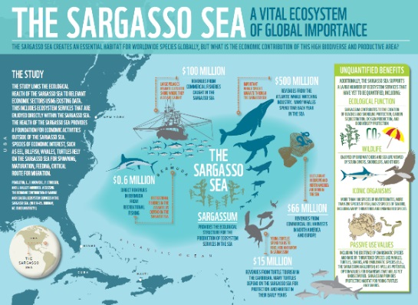

Sargasso Sea Pilot Project (1/2)
Use the Sargasso Sea and NASA as a regional pilot application for Sargasso Sea Commission to ensure that the development is user-driven and effective.
Collaboration with the Sargasso Sea Commission (SSC)
  SSC:
  - Network of international partners led by the Government of Bermuda, including UK, USA and intergovernmental agencies (IUCN, ISA)
  - advance the recognition of the importance of the Sargasso Sea and promote its protection in accordance with UNCLOS
  Interactions with SSC over a 2 year period, including a joint workshop in Key West, FL. with stakeholders, to define the scope and contents of a pilot COVERAGE application for the Sargasso region
  Development of a demo COVERAGE application for the Sargasso
Value of COVERAGE for SSC
  Platform providing integrated data access to data for data poor high seas area
  Illuminate the relationship between oceanographic conditions and uses of the Sargasso Sea
  Identify ocean use by marine species and humans & highlight areas of conflicting usage
  Tool supporting future measures resulting from ongoing UN negotiation of a new marine biodiversity treaty for areas beyond national jurisdiction (ABNJ) as an extension to UNCLOS.

Slide 13
Discussion Points for CEOS Partners
COVERAGE Side Meeting
Engage CEOS on any ocean surface data available in near real time for potential inclusion in COVERAGE (technical compatibility - one of SST, SSS, color, winds, height)
Identify high priority applications for which COVERAGE system would provide valuable new capability and data streams (use cases)
Resources to support CEOS partnering agency collaboration in COVERAGE (technical and coordination work)
Areas of possible technical exchange in the COVERAGE context (eg. technology contributions and coordinated/standards-oriented development for cross-system interoperability)
Approach to broader stakeholder engagement. eg. GOOS program.
Sustainability strategy (what could be the path to operationalization for a sustained COVERAGE beyond the 3 years of the R&D project assuming successful)

Slide 14
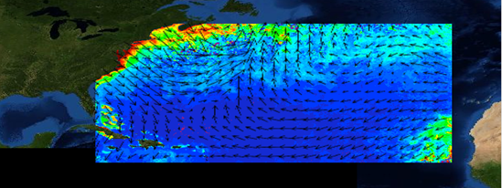
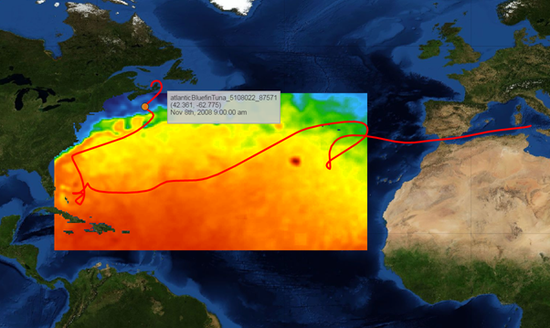
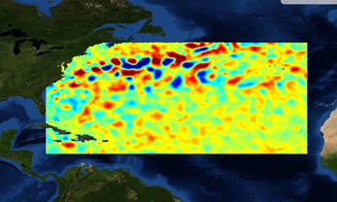
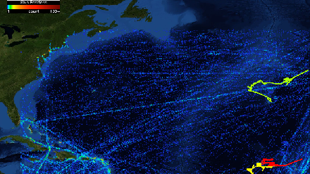
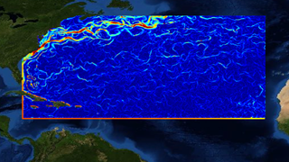
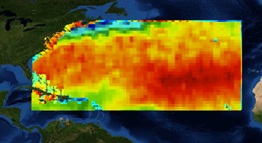
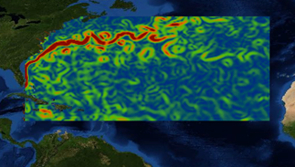
COVERAGE - Sargasso Sea Demo Web Application (2/2)
MODIS CHL-A +
ASCAT Ocean Surface Winds
Bluefin tuna archival tag track + Reynolds SST
AVISO Sea level anomaly
AIS Vessel Positions
Heat map + Tracks
MUR-SST Gradients
Aquarius Sea Surface Salinity
OSCAR Surface Currents

Slide 15
COVERAGE Alignment with GEO Ocean Initiatives
GEO-Blue Planet goals³
Advance/exploit synergies among observational programs for sustained development & use of ocean and coastal observations for the benefit of society
End-to-end information services providing increased integration of and access to in situ & remote sensing ocean observation data
GEO-MBON goals⁴
Enabling the description of relationships between biodiversity, organism abundance, system productivity, and ecosystem services
Providing biological and environmental data collected by multiple independent programs in a single integrated web-based tool that informs scientists, resource managers, educators, and all relevant stakeholders
1.CEOS Strategic Guidance, Nov. 2013 2. CEOS 2016-2018 Work Plan, Mar. 2016 & CEOS 2017-2019 Work Plan, Mar. 2017
3. http://geoblueplanet.com 4. http://www.marinebon.org

Slide 16
COVERAGE GEO-Community Endorsement

