Slide 1
Moderate Resolution Sensor Interoperability (MRI) Initiative
Committee on Earth Observation Satellites
Jenn Lacey, USGS (LSI-VC Co-Lead)
2017 CEOS Chair Initiative
SIT-32 Agenda Item #10
ESA Headquarters – Paris, France
25th-27th April 2017

Slide 2
Moderate Resolution Sensor Interoperability (MRI) Initiative
This initiative will include effort towards making optimal use of the increasing number of data streams available in the moderate resolution class, with a focus for 2017 on Landsat/Sentinel-2.
As higher level, multi-sensor, time series products are developed, the integration of these products requires verification and validation of their interoperability, such as
when are these products interoperable,
when are they not interoperable, and
under what conditions?

Slide 3
Organization & CEOS Interactions
The Moderate Resolution Sensor Interoperability (MRI) initiative is an activity under the Land Surface Imaging Virtual Constellation (LSI-VC)
In particular, MRI team is also working closely with the LSI-VC CEOS Analysis Ready Data for Land (CARD4L) team
CARD4L are satellite data that have been processed to a minimum set of requirements and organized into a form that allows immediate analysis with a minimum of additional user effort and interoperability both through time and with other datasets.
CARD4L provides the basis for ARD within a single dataset. MRI provides the basis for ARD combining multiple datasets.
LSI-VC is working in partnership with the Working Group on Calibration & Validation (WGCV) and the Working Group on Information Systems and Services (WGISS)

Slide 4
2017 Deliverables
Develop a MRI Framework paper for moderate (10-100m) resolution interoperability, identifying multi-sensor interoperability concepts that need to be addressed for successful implementation of multi-sensor interoperable time series
Address factors such as radiometry, geometry, data formats, browse, metadata, data access, metrics, and reporting
A Landsat/Sentinel-2 interoperability case study document utilizing the MRI Framework, including lessons learned and best practices identified through the implementation and use of the Harmonized Landsat Sentinel-2 (HLS) Surface Reflectance product

Slide 5
Deliverable #1: MRI Framework (Concept)
Component | Measure | Threshold (Minimum) | Target (Goal) | Verification Results | Next Steps
General Metadata | Product-specific metadata Image-specific metadata Meta-data aggregated from pixel data
Per Pixel Metadata | Cloud Cover and Shadow Land, water, snow/ice and vegetation masks DEM and Terrain Shadow Solar and View Angle Data Quality and Saturation Atmospheric model inputs
Radiometry | Within Sensor Calibration Spectral Band Adjustment
Geolocation | Within Sensor Between Sensor

Slide 6
Deliverable #2: Landsat/Sentinel-2
Interoperability Case Study
The NASA Harmonized Landsat 8 Sentinel-2 (HLS) product generation addresses many of the interoperability issues laid out in the MRI Framework.
The EC vegetation dynamics monitoring project using the HLS products in conjunction with the phenology algorithm will be the primary interoperability use case.
Case study evaluation will utilize the MRI Framework and address multi-sensor interoperability concepts.
Beyond HLS, agencies and users will be surveyed to obtain a more comprehensive list of ongoing efforts to use Landsat and Sentinel-2 data together.
These projects can provide a basis for understanding “lessons learned” and best practices.

Slide 7
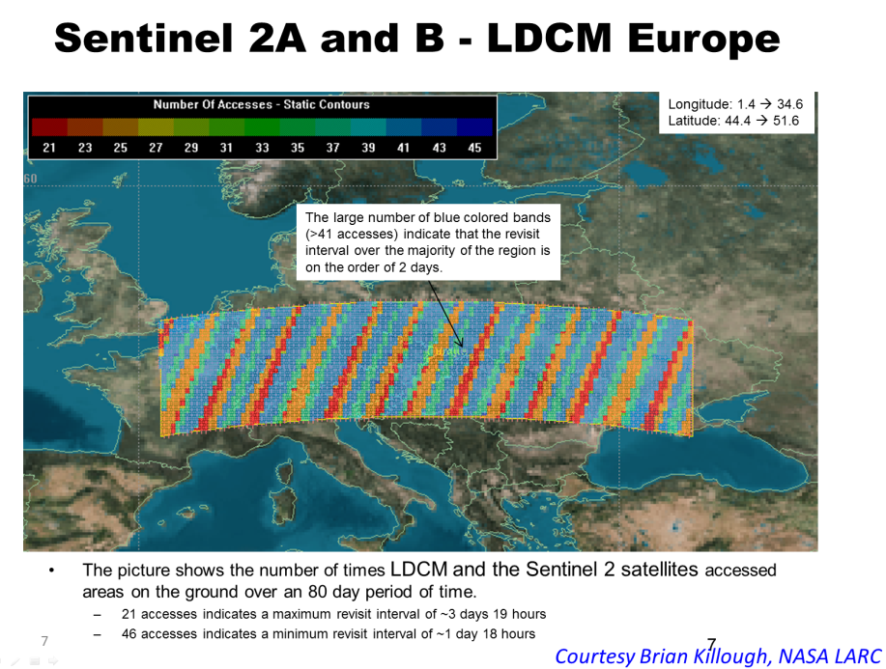
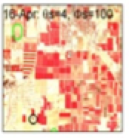
Harmonized Landsat Sentinel-2 (HLS) Project
Merging Sentinel-2 and Landsat data streams can provide 2-3 day global coverage
Goal is “seamless” near-daily 30m surface reflectance record including atmospheric corrections, spectral and BRDF adjustments, regridding
Project initiated as collaboration among GSFC, UMD, NASA Ames

Slide 8
Deliverable #2: Landsat/Sentinel-2
Interoperability Case Study
HLS is a merged Landsat 8 Sentinel-2 Surface Reflectance product
Machine readable metadata
Resampled to 30-meter Sentinel-2 reference
Cloud masks
View and solar angle BRDF corrections
Atmospheric correction
Band pass adjustment
Products available for over 747 MGRS tiles and covering 63 regions
Document Best Practices and Lessons Learned through the HLS product generation and HLS Phenology Use Case

Slide 9
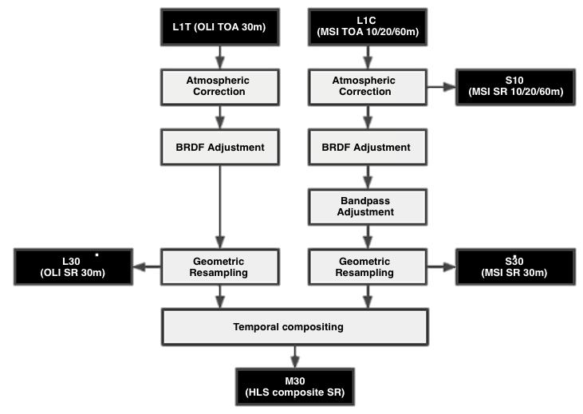
Interoperability Case Study
Where does CARD4L end and interoperability begin?
These steps standardise the data to be ‘analysis ready’. They are consistent with CARD4L but exceed the threshold specification (BRDF)
Subsequent steps are specifically blend these two data streams.
The method of blending is not unique; other approaches are also possible.

Slide 10
MRI Team
Co-leads
Team Members
Gene Fosnight | USGS | USGS chair team co-lead, Landsat, LSI-VC, SDCG
Cindy Ong | CSIRO | WGCV co-lead, imaging spectroscopy
Richard Moreno | CNES | WGISS co-lead, Copernicus
Jeff Masek | NASA | Landsat Sentinel-2 Case study, LSI-VC
Zoltan Szantoi | JRC | Landsat Sentinel-2 Case study, LSI-VC
Adam Lewis | GA | LSI-VC, FDA, CARD4L
Paul Briand | CSA | LSI-VC, GEOGLAM, SAR
Yves Crevier | CSA | SDCG, GEOGLAM, SAR
Brian Killough | NASA | SEO, LSI-VC, SDCG, FDA, CARD4L
Debajyoti Dhar | ISRO | Optical/SAR data fusion
Takeo Tadono | JAXA | LSI-VC, CARD4L, SAR
Amanda Regan | EC | User needs for satellite constellations
Nigel Fox | UKSA | WGCV IVOS
Kurt Thome | NASA | WGCV
Andy Mitchell | NASA | WGISS
Kerry Sawyer | NOAA | Represent SIT vice chair
Kevin Gallo | NOAA | LSI-VC, LPCS data integration
Eric Wood | USGS | Represent USGS Chair Team

Slide 11
Roadmap
Conduct Kickoff telecon (March 2017)
Discuss MRI at LSI-VC-3 (March 2017) and at WGISS (April 2017)
Identify Landsat/Sentinel-2 case study (early April 2017)
Present MRI at SIT-32 (April 2017 )
Distribute working copy of MRI Framework document (May 2017)
Discuss MRI at WGCV (May 2017)
Distribute final draft of MRI Framework document for review (late July 2017 )
Provide HLS product interoperability evaluation and phenology use case for review (late August 2017)
Present initial case study results at LSI-VC-4 and SIT TW (September 2017)
Present final MRI Framework and case study results at CEOS Plenary (October 2017)
Present proposed way forward at CEOS Plenary (October 2017)

