Slide 1
Copernicus Sentinels Space and Ground Segment Status
Committee on Earth Observation Satellites
I.Petiteville (ESA)
SIT-32 Agenda Item # 33
CEOS Strategic Implementation Team
ESA Headquarters, Paris, France
26th-27th April 2017

Slide 2
Copernicus Data Access and Dissemination

Slide 3
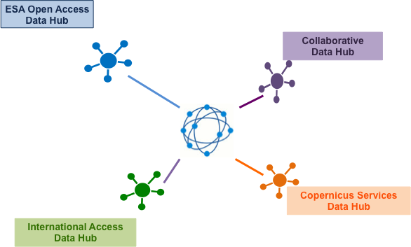
Sentinels Data Distribution - Configuration
Statistics: 5 April 2017

Slide 4
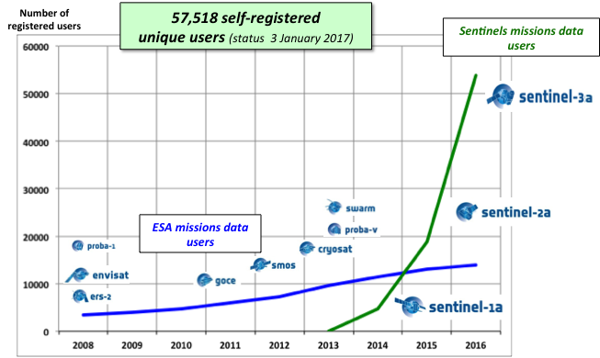
Sentinels Data Distribution – User Registration
73,179 self-registered
unique users (status 5 April 2017)

Slide 5
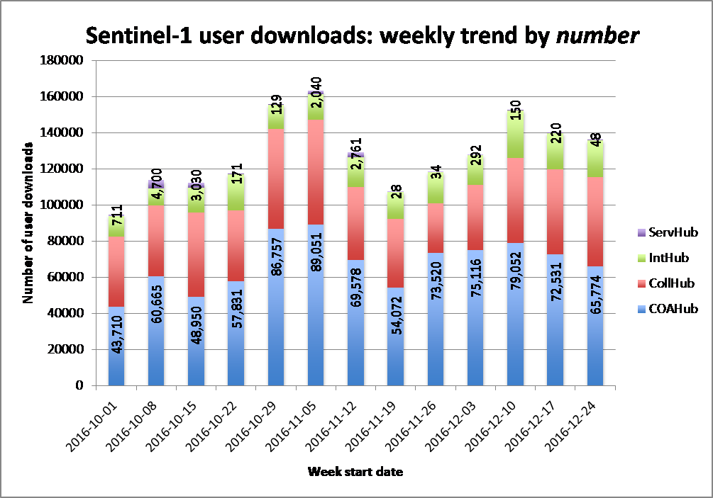
Sentinel-1: Data Distribution Statistics
Approx. 1.6 million products were downloaded during Q4-2016 (2.7 PB of data)
Exploitation ratio - 1:10
on average each product published has been
downloaded 10 times

Slide 6
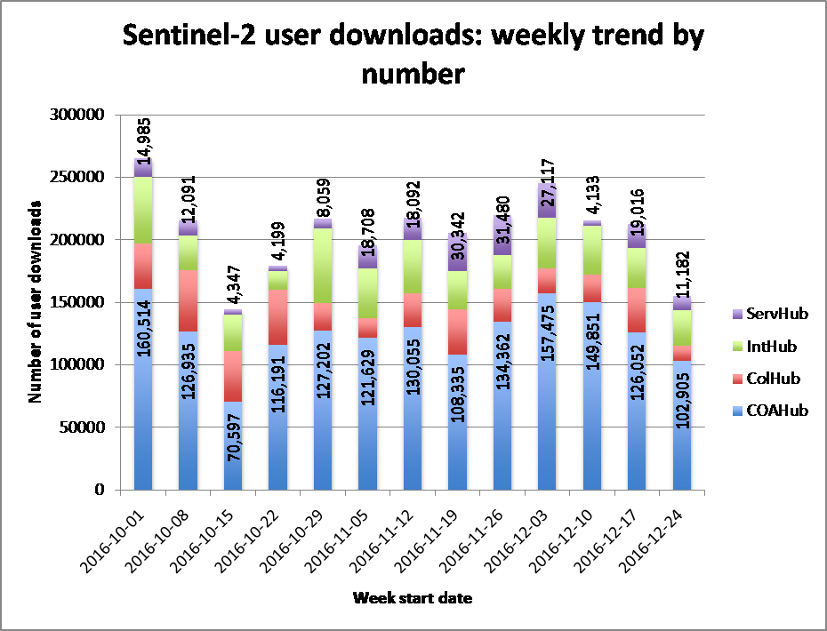
Sentinel-2: Data Distribution Statistics
Approx. 2,7 million products were downloaded during Q4-2016 (1,75PB of data)
Exploitation ratio - 1:10
on average each product published has been downloaded 10 times

Slide 7
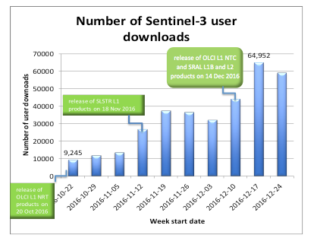
Sentinel-3: Data Distribution Statistics
Approx. 344,000 products were downloaded during Q4-2016 (175 TB of data)
Exploitation ratio - 1:6
on average each product published has been downloaded 6 times

Slide 8
Sentinels Data Distribution – Global View
11%
41%
North
America
20%
Europe
Asia
6%
20%
Africa
2%
South
America
Oceania

Slide 9
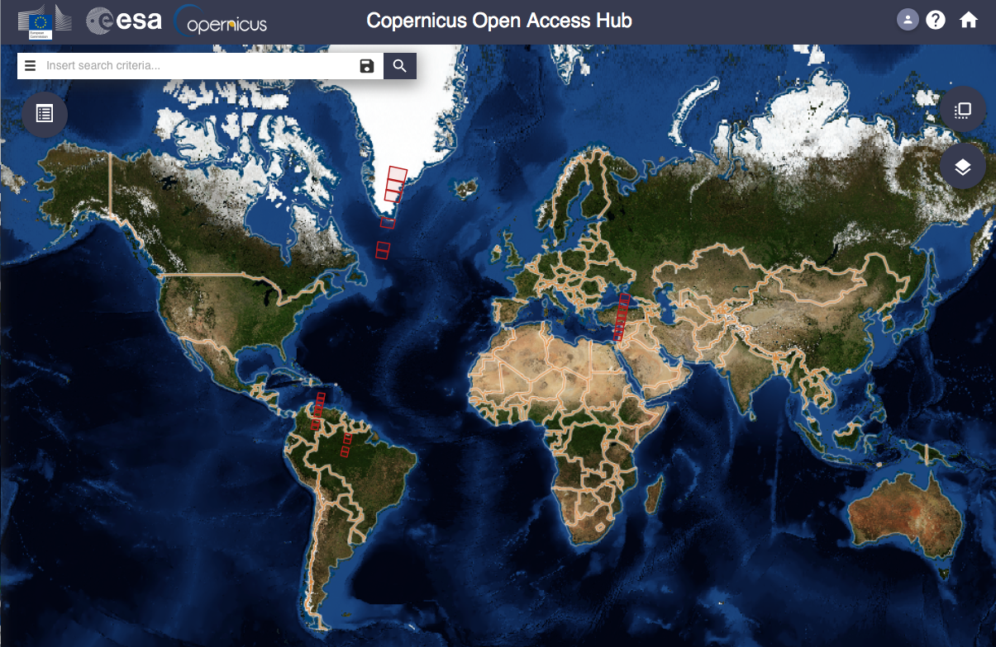
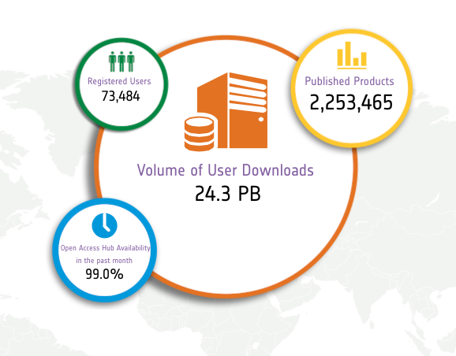
Sentinels Data Distribution – Overall Statistics
Statistics: 5 April 2017

Slide 10
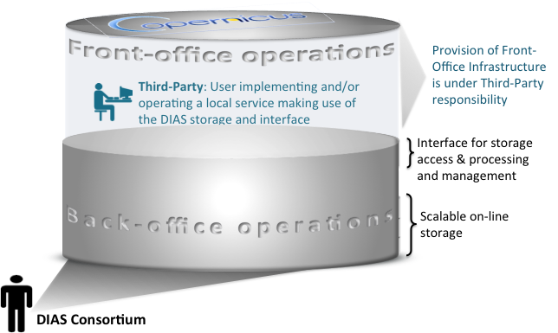
Copernicus Data and Information Access Services
ESA detailed implementation approach endorsed by European Commission and Copernicus Committee

Slide 11
Copernicus Data and Information Access Services
DIAS ITT issued: 27 January 2017
DIAS ITT Bidding period closeout: 24 April 2017
DIAS Contract(s) K.O. planned : July 2017
The procurement foresees a 4 years duration with possible yearly extension under same operational conditions (subject to the review process with the European Commission)
A 6-months phase-in is foreseen before starting the operations phase

Slide 12
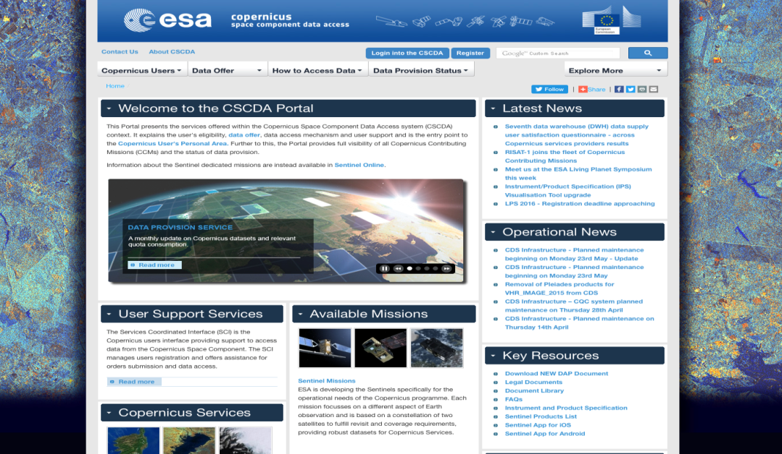
Copernicus Space Component Data Access : CSC-DA
Data Warehouse Phase 2 activities progressing
Major increase of emergency orders over last quarter
Ordering of additional datasets by eligible users remains very low with respect to the commission quota allocation
Regular technical coordination meetings held between ESA with all Copernicus Services
Open Invitation to Tender released for procurement of VHR_2018_Image and extension of emergency portfolio
spacedata.copernicus.eu
Almost 1000 user licences signed
(status 31.12.2016)
Copernicus Services are providing their higher level products/information to a community of more than 10,000 users (status Q1-2017)
Notes:
Upd – status (Veronique)

Slide 13
Copernicus Space Component (CSC) -
Mission Status

Slide 14
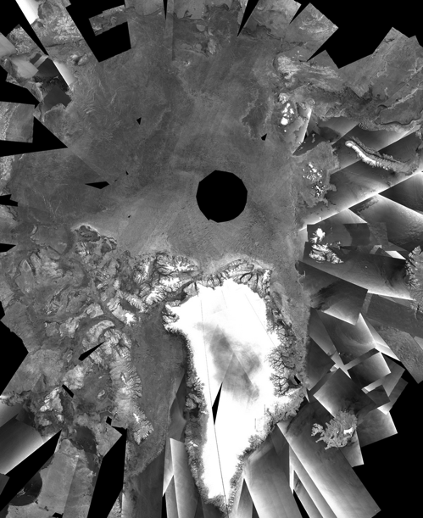
Sentinel-1Mission Status
Sentinel-1 nominal routine operations continue
Sentinel-1B core products distributed to all users since end September 2016
On-going support to various activations from the Copernicus Emergency Management Service and International Charter Space and Major Disasters
EDRS-A start of initial services to Sentinel-1A on 23 November 2016, focusing on end-to-end operational service validation
Sentinel-1 constellation generates now 8 TB of products daily (against a formal specification of 3 TB),
Expected to be further increased with EDRS and 4th core station
Upcoming Milestones
Start of gradual increase of QRT observations
Sentinel-1 mission yearly Routine Operations Review, Q1 2017
3-day S1 mosaic

Slide 15
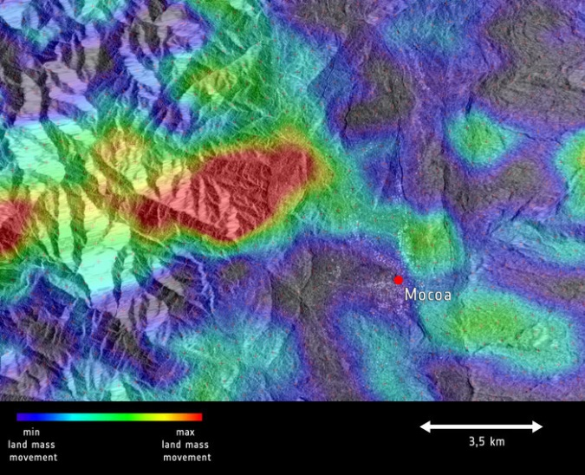
Sentinel-1Mission Status
Sentinel-1 nominal routine operations continue
Sentinel-1B core products distributed to all users since end September 2016
Data routinely provided to Copernicus Services
On-going support to various activations from the Copernicus Emergency Management Service and International Charter Space and Major Disasters
EDRS-A start of services to Sentinel-1A on 23 November 2016, focusing on end-to-end operational service validation. Start of EDRS-A services for Sentinel-1B on 23 March 2017. Use of EDRS service being progressively increased as part of routine operations
Sentinel-1 constellation generates now 10 TB of products daily (against a formal specification of 3 TB)
Expected to be further increased with the operational use of EDRS for Sentinel-1B and the 4th core X-band station
Upcoming Milestones
Gradual increase of QRT observations
Sentinel-1 Constellation Mission Operations Review: May 2017
Sentinel-1 sees Mocoa landslide

Slide 16
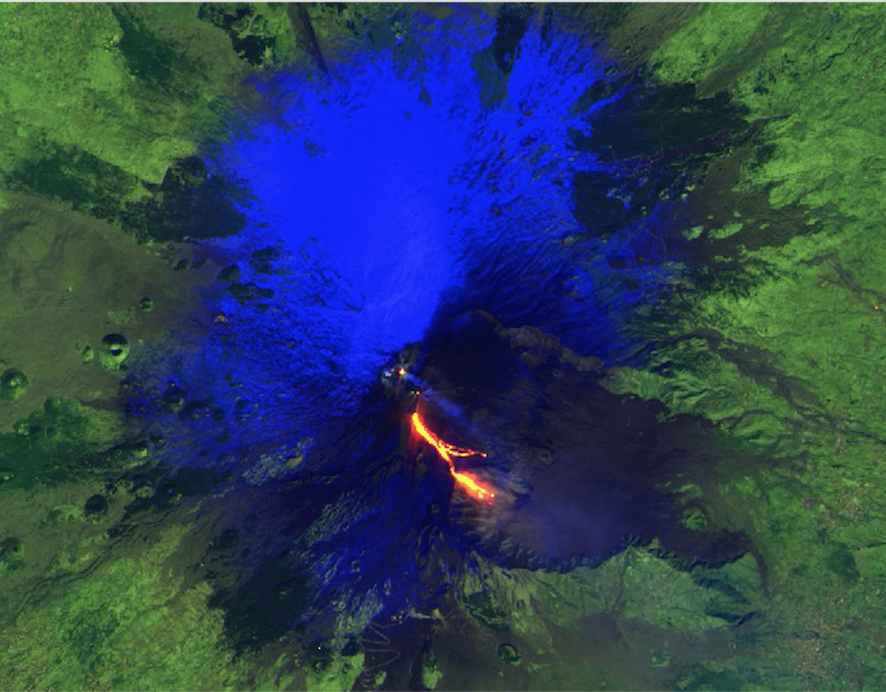
Sentinel-2Mission Status
Sentinel-2A nominal routine operations continue
Systematic coverage of Europe, Greenland and Africa every 10 days (at equator).
Till February 2017: Winter scenario for “Rest of the World” (due to reduced illumination at Northern latitudes): alternating 10-day revisit in Eastern and Western hemisphere, the latter including Antarctic rim.
Since March 2017 10-day revisit Europe, Africa, Greenland and 20-day rest of the world till additional station (Inuvik) and/or EDRS is introduced (~summer 2017
First Sentinel-2 Validation Team (S2VT) and 2nd Sentinel-2 Quality Working Group meeting held in November 2016 confirming excellent performance of S2A. Product evolution recommendations being analysed.
Improved mission planning check procedures have been introduced, based on in-orbit experience, to minimise outages
Sentinel-2B launch 6 March 2017, in-orbit commissioning phase proceeding nominally
Upcoming Milestones
Reprocessing of data acquired during Sentinel-2A commissioning phase and entire Sentinel-2 archive into new tile format
Release of sample Level-2A products as part of feasibility study, and pre-operational Level-2A production over Europe
Continued Sentinel-2B in-orbit commissioning, IOCR planned for mid June, followed by ramp-up (4 months)
Sentinel-2A sees Etna erupt March 2017

Slide 17
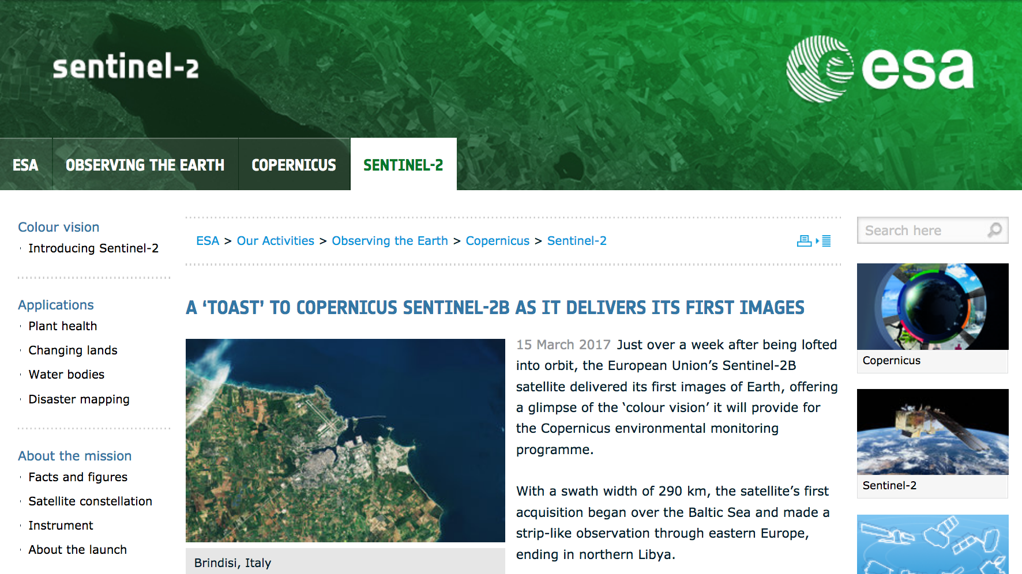
Sentinel-2B First Image

Slide 18
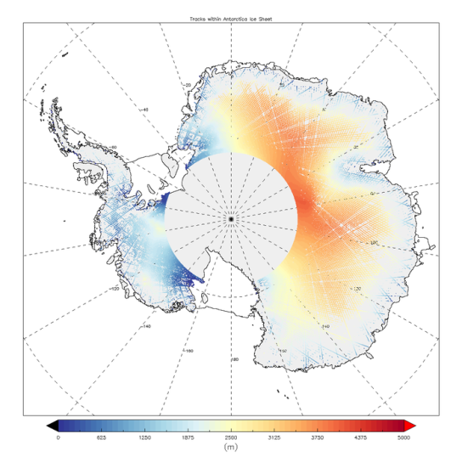
Sentinel-3Mission Status
Sentinel-3A ramp-up phase progressing nominally
All Level 1 core products have been released to all users (pending new SRAL L1B-S in April 2017)
Level 2 core products operational qualification on-going
Continuous interaction with user community: Sentinel-3 validation team meeting on 15-17 February 2017 in ESA-ESRIN, Italy, 2nd meetings of Quality Working Groups in Dec-Feb 2017.
Upcoming Milestones
Successfully complete the Sentinel-3A ramp-up phase and transition into routine operations – May 2017
Release remaining Level 2 core data products
Prepare for the Sentinel-3B launch, commissioning and ramp-up phase for Sentinel-3B, including also tandem flight between S3A and S3B
Sentinel-3A measures height of Antarctic ice sheet

Slide 19
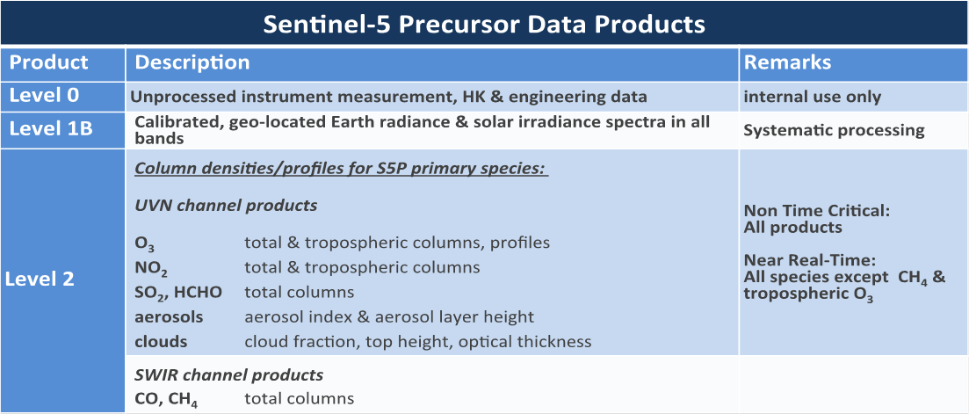
Sentinel-5 Precursor Mission Status
New launch date is 16 August 2017
S-5P Mission Management
Commissioning and ramp-up plans are being finalised
Sentinel-5P Mission Performance Centre service implementation is in-progress
Procurement of the Sentinel-5P X-band acquisition service for the routine phase are being finalised
S-5P Ground Segment
The Ground Segment is ready to support launch. Payload Data Ground Segment (PDGS) upgrade to support routine operations is being completed.
Access to the Sentinel-5P core products will be managed by ESA using the same approach as for the other Sentinels. All core products will be made available to all users in Near-Real Time and Non-Time Critical (Level 1 and Level 2).

Slide 20
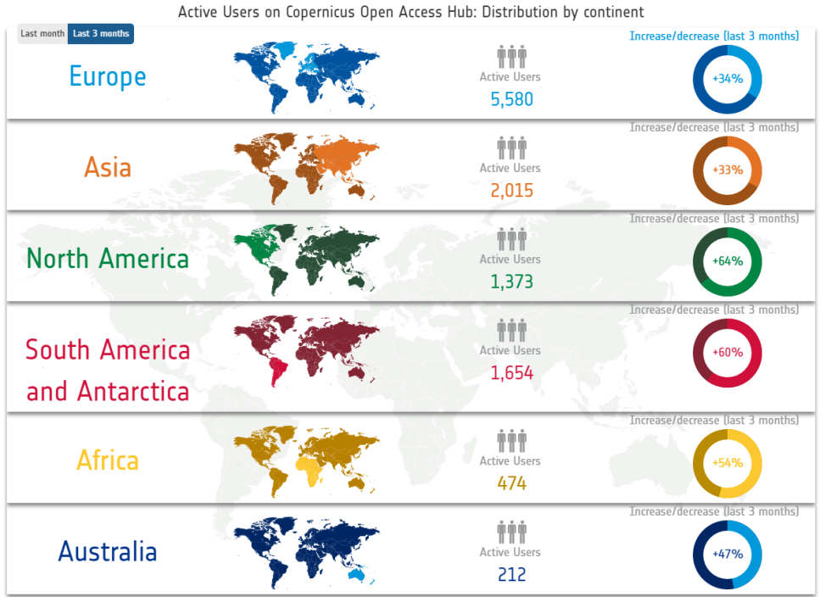
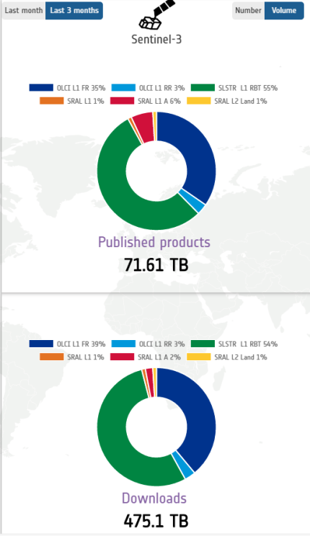
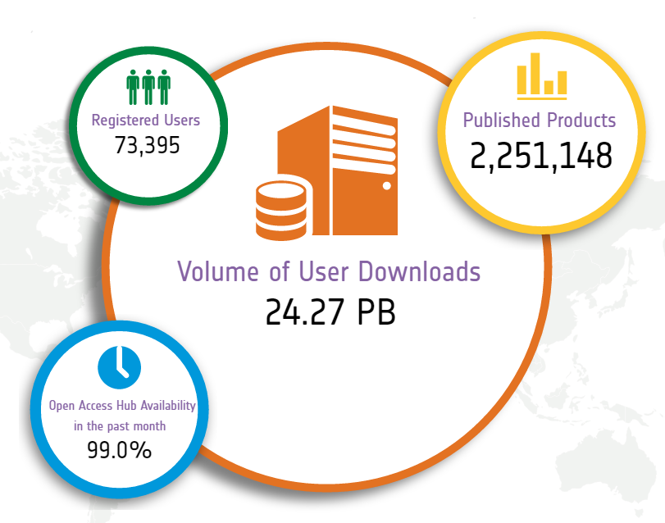
Sentinels Dashboard
The Sentinel Dashboard represents a novel concept to communicate with stakeholders the operations status of the Sentinel missions in real time
It includes provision of system availability, data access performance and user statistics. Easily accessible online and via mobile devices
First version released on 17 February 2017. Evolutions scheduled for Q3, introducing new features and responding to feedback.
Statistics from 5 April 2017

