Slide 1
Open Data Cube Side Meeting
April 25, 2017
Brian Killough
CEOS Systems Engineering Office
NASA Langley Research Center

Slide 2
Agenda
ODC White Paper draft - 20 minutes
Data Cube pilot projects - 20 minutes
Sentinel-1 ARD progress - 10 minutes
Vietnam Pilot Project Test Results – 20 minutes
EXTRA - 20 minutes open for extended discussions from above, or new topics

Slide 3
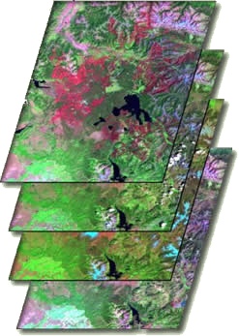
What are Data Cubes?
Data Cube = Time-series multi-dimensional (space, time, data type) stack of spatially aligned pixels ready for analysis
Proven concept by Geoscience Australia (GA) and the Australian Space Agency (CSIRO) and planned for the future USGS Landsat archive.
Analysis Ready Data (ARD) ... Dependent on processed products to reduce processing burden on users
Open source software approach allows free access, promotes expanded capabilities, and increases data usage.
Unique features: exploits time series, increases data interoperability, and supports many new applications.
TIME

Slide 4
ODC White Paper
Summarizes the purpose, vision and implementation steps required to achieve an Open Data Cube (ODC) architecture and community that provides value to global Earth observation (EO) satellite data users and increases the impact of EO satellite data.
We plan to use this paper as a resource for our website and for major international events … your feedback is welcome!
We desire increased participation to support data preparation, application algorithms and implementation of country prototypes.

Slide 5
Purpose: Why Data Cubes?
The primary user problems are data access, data preparation, and efficient analyses
Users want to minimize the time and knowledge required to obtain and prepare satellite data
Users want free and open source solutions that are advanced through community contributions
Users want to perform time series analyses for land change applications
Users want consistent data architectures that allow sharing of code, tools and algorithms
Users want to use multiple datasets (interoperability and complementarity)
Users want to use common GIS tools (ArcGIS and QGIS)
Users want local and regional solutions that avoid commercial and internet dependence
Users want sustained customer service and support

Slide 6
ODC Vision
A solution supporting CEOS objectives …
Build capability of users to apply CEOS satellite data
Supporting priority CEOS/GEO agendas (SDGs, Paris and Sendai)
CEOS Agencies wanting to participate …
Through provision of CEOS Analysis Ready Data (ARD) products
Contributing to development and uptake of solutions
Customers feel that they are the focus …
Training materials and easy installation/maintenance
A CEOS “Open Data Cube” brand that people know and trust
Users helping each other through an active Data Cube community
Scalable solution …
Supporting Data Cubes in 20 countries by 2022. Currently working in Australia, Colombia and Switzerland, and soon in Vietnam!
Key partners (e.g. FAO, World Bank) supporting data cube projects

Slide 7
What are the challenges?
Acceptance … Will EO satellite data providers and key global stakeholders agree that the ODC vision is achievable and worth their contribution?
CEOS has utilised prototype efforts to demonstrate the functionality and impact of the ODC and has reached out to global stakeholders (e.g. GEO, World Bank, SERVIR, AWS) to explore common objectives.
Global interest in the ODC initiative has been promising and CEOS is making progress toward “acceptance” of the ODC as a trusted solution with user value.
Scaleability … How does this solution scale to meet the demand of many global users given limited resources?
There are 3 national data cubes (e.g. Australia, Colombia, Switzerland) but many more countries with interest. In order to get 20 countries, it will take more than CEOS, such as World Bank, SERVIR and support from existing data cube countries.

Slide 8
Implementation: How do we get there?
Develop instructions and open source code to obtain and/or produce ARD
Create and manage an open source repository (e.g. GitHub) to host ODC content (https://github.com/opendatacube)
Develop an ODC installation package with sample inputs/outputs
Develop an ODC Learning Center with documentation and training
Create a user forum to share code and algorithms
Host common application algorithms desired by users (e.g. mosaics, water detection, change detection)
Engage stakeholder organizations (e.g. GEO, World Bank, SERVIR) to identify country needs and provide infrastructure and funds for implementation
Conduct pilot studies to test approaches and provide user feedback
Develop a group of globally distributed Python programmers who are able to support local deployment and customer support

Slide 9
Agenda
ODC White Paper draft - 20 minutes
Data Cube pilot projects - 20 minutes
Sentinel-1 ARD progress - 10 minutes
Vietnam Pilot Project Test Results – 20 minutes
EXTRA - 20 minutes open for extended discussions from above, or new topics

Slide 10
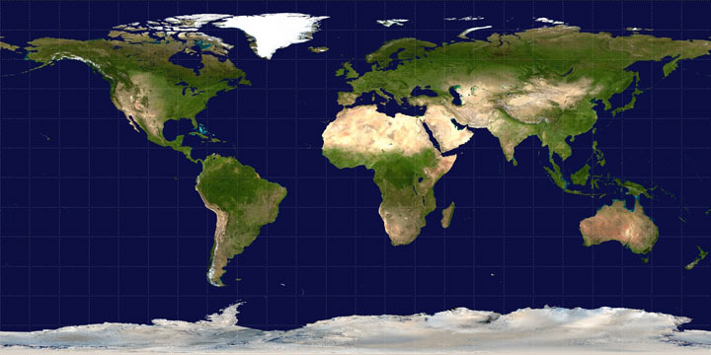
Growing a Global Network of Open DataCubes
AWS Demo
Fully Operational
Under Development
Planning Phase
Under Review
Expressed Interest

Slide 11
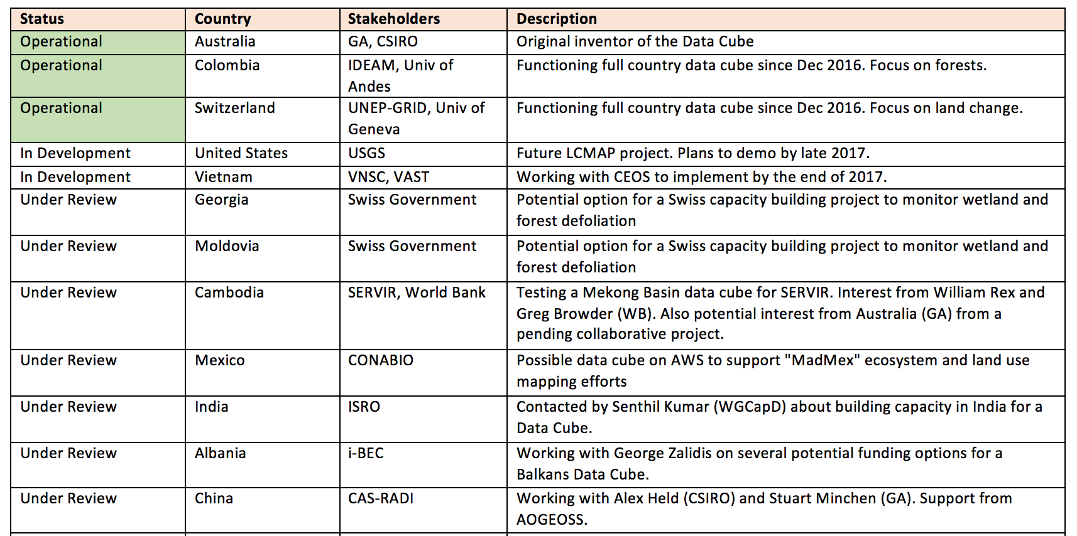
The “Road to 20” Data Cubes

Slide 12
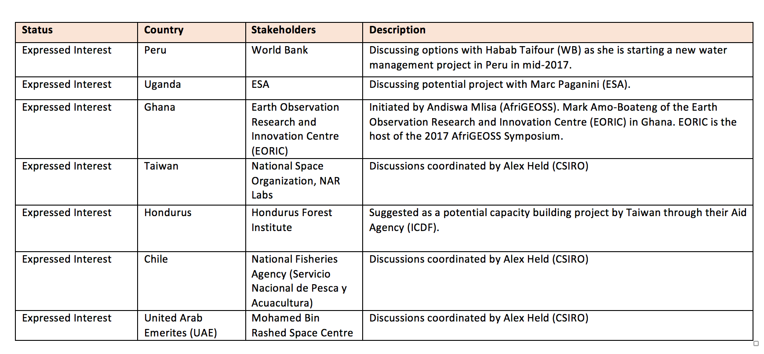
The “Road to 20” Data Cubes

Slide 13
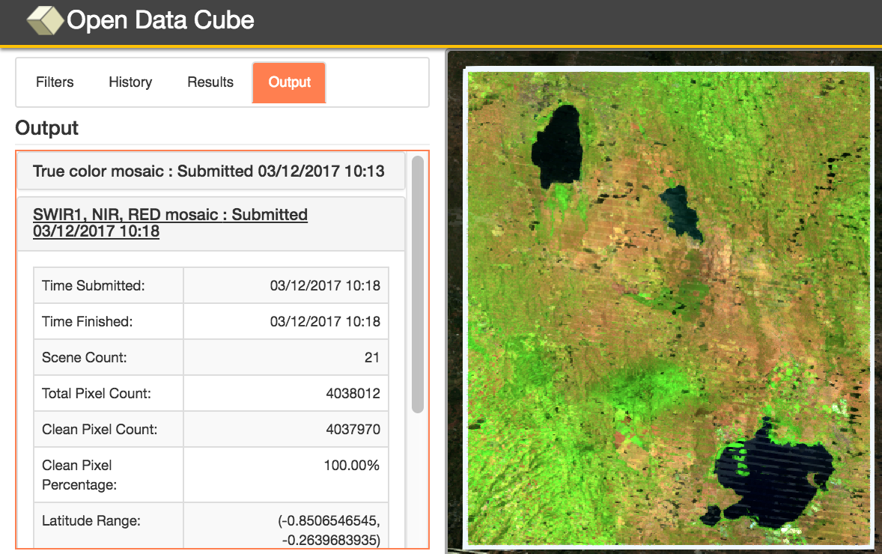
Amazon Cloud (AWS) Data Cube Demonstration Portal
Data Cubes
14 cubes with 10+ years each.
Kenya, Cameroon (Lake Chad), Togo (coastal Africa), Colombia, Tonga (Pacific Islands), Vietnam, Australia (Menindee Lakes), Bangladesh.
User Interface Features
User-selected spatial region and time
7 applications: custom cloud-free mosaics, NDVI anomaly, water detection, water quality (Total Suspended Matter), landslides (SLIP) and coastal change.
Outputs in GeoTIFF and GIF animation.
Free and open!
This is the first “hands-on” global demo of the Data Cube to show its potential for rapid time series analysis and diverse applications
User Interface: http://tinyurl.com/datacubeui
Email: info@ceos-cube.org
Web: www.ceos-cube.org

Slide 14
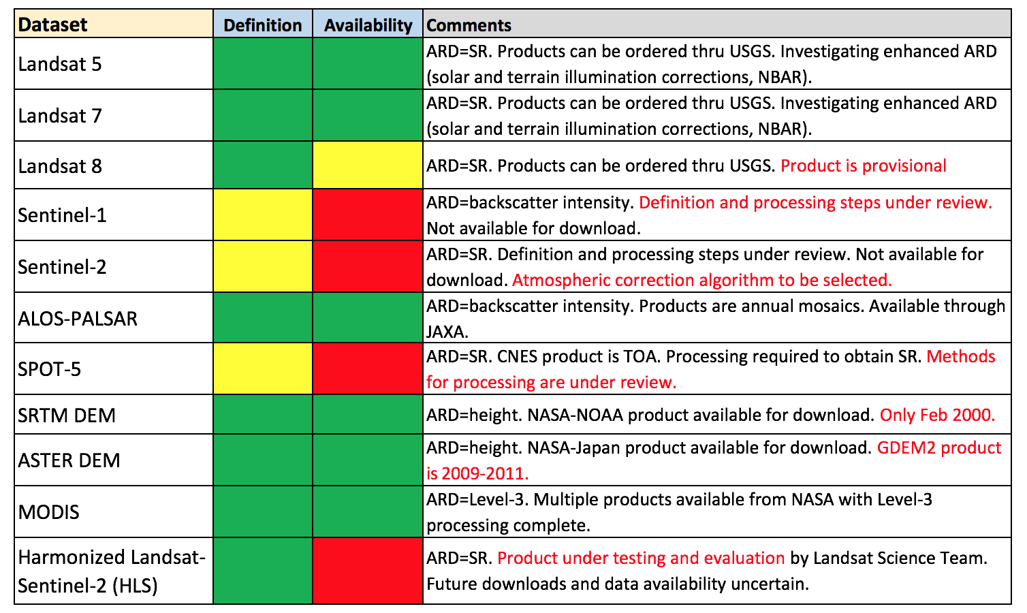
ARD Status

Slide 15
Agenda
ODC White Paper draft - 20 minutes
Data Cube pilot projects - 20 minutes
Sentinel-1 ARD progress - 10 minutes
Vietnam Pilot Project Test Results – 20 minutes
EXTRA - 20 minutes open for extended discussions from above, or new topics

Slide 16
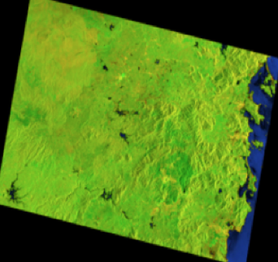
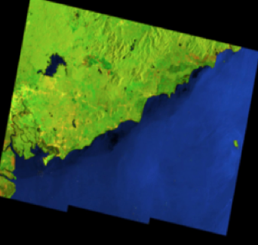
S1 ARD Background
The SEO has been working on Sentinel-1 processing toward ARD. This ARD is focused on land classification studies and time series analyses of land change. This ARD does NOT address In-SAR or the need for phase information.
The SEO has downloaded several S1 scenes over Vietnam (on right). These scenes were Interferometric Wide Swath (IW), GRD format. There are two methods for processing. Use the ESA SNAP tool, or use a Python script.
The SEO installed the ESA SNAP tool and consulted several other sources for processing support … SNAP Sentinel-1 User Forum, Ben Lewis (GA), Zheng-Shu Zhou (CSIRO), and Ake Rosenqvist (JAXA support).
The SEO has created a Python script that successfully processes GRD scenes into ARD. The key question is which steps should we use to get the ARD product?

Slide 17
Sentinel-1 Processing Steps
(1) Orbit Updates - Updates satellite ephemeris for improved geolocation (2) Remove GRD Border Noise - Removes processed artifacts at scene edges where non-zero noise values exist. (3) Remove Thermal Noise – Removes thermal noise using thresholds. Not a significant correction, but commonly used by most users. (4) Radiometric Calibration - Converts raw data to backscatter intensity (beta-0 output) (5) Radiometric Terrain Correction - Radiometric normalization (terrain flattening) using DEM data (gamma-0 output) (6) Speckle Filter – Removes noise but adds blurring to features and reduces resolution. This may be applied as an “advanced ARD” product for select users. (7) Geometric Terrain Correction - Orthorectification using DEM topography data (gamma-0 output in preferred grid projection) * Unit conversion from DN to decibels (dB) was not considered. Most applications apply algorithms to DN values and then use dB units for visual image products. * Assumes Interferometric Wide Swath (IW) mode and GRD data format

Slide 18
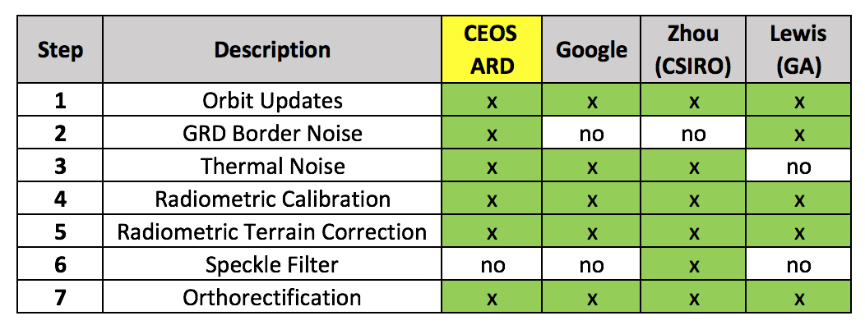
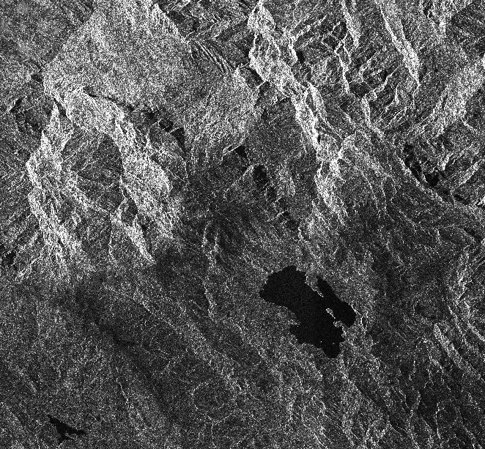
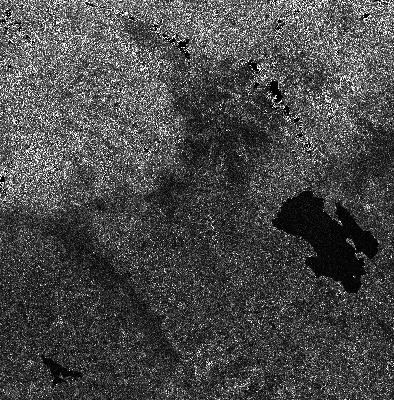
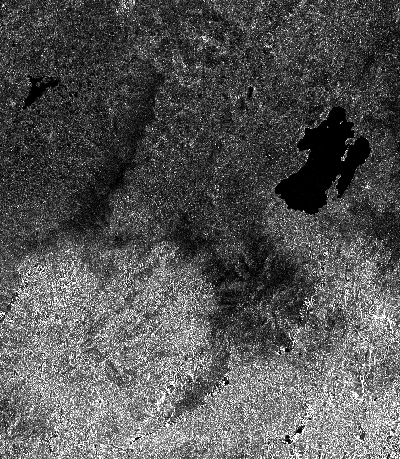
S1 CEOS ARD Summary
Unprocessed - VH Intensity Lake: Laguna de Tota Location: Sogamoso, Colombia
Steps 1 to 6 Gamma-0, VH Intensity
Step 7 - Orthorectification Gamma-0, VH, UTM-WRS84

Slide 19
S1 ARD Status
The goal is to reach a Sentinel-1 (S1) ARD definition that applies to the “majority” of global users focused on land classification and land change applications.
Phase information, or In-SAR data, is not needed by these user types.
It is proposed that the CEOS ARD for Land (CARD4L) definition for S1 include the 6 steps from the prior table, where speckle filtering is not included.
The SEO has developed a Python script that easily produces this CARD4L. Production of ARD could be done by the main data provider (Sentinel Toolbox on ESA Hub), mirror sites (e.g. ASF) or by the local users.
All of our Data Cube pilot countries want Sentinel-1 data. They are looking to us (CEOS) to define the ARD and help them produce that ARD and get the data into a cube format.
There is a strong desire to use this data independently and interoperably with optical data (e.g. Landsat, Sentinel-2) and other radar data (e.g. ALOS).
LSI-VC just released the first draft of S1 ARD.

Slide 20
Agenda
ODC White Paper draft - 20 minutes
Data Cube pilot projects - 20 minutes
Sentinel-1 ARD progress - 10 minutes
Vietnam Pilot Project Test Results – 20 minutes
EXTRA - 20 minutes open for extended discussions from above, or new topics

Slide 21
Vietnam Interoperability Test
Demonstrate Landsat 7, Landsat 8, Sentinel-1 and ALOS-PALSAR data interoperability in a Vietnam Data Cube.
Sentinel-1 data (10m) will remain in its native EPSG:4326 (WGS 84) projection.
Landsat 7/8 SR data (30m) will be resampled from UTM to EPSG:4326.
ALOS-PALSAR data (25m) will be resampled from 25m to 30m resolution and reprojected from Lat-Lon (GRS 80) to EPSG:4326 (WGS 84) projection.

Slide 22
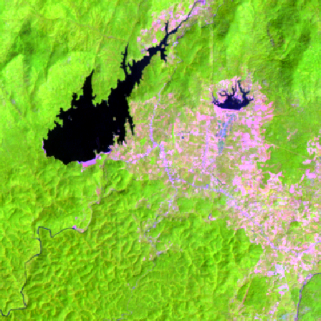
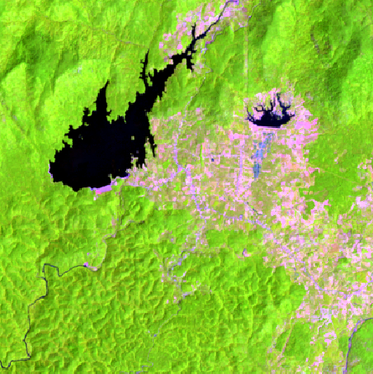
Vietnam Example - Optical
Landsat 7 Median Mosaic – Year 2015 RGB: Bands 5,4,3
Landsat 8 Median Mosaic – Year 2015 RGB: Bands 6,5,4

Slide 23
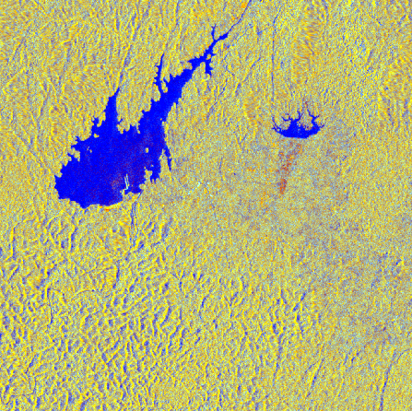
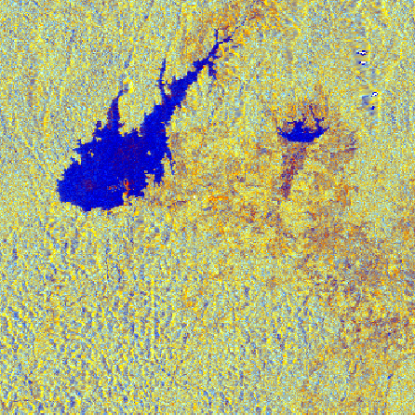
Vietnam Example - Radar
Sentinel-1 Median Mosaic - Year 2015 RGB: VV, VH, VV/VH
ALOS-PALSAR Median Mosaic – 2015 RGB: HH, HV, HH/HV

Slide 24
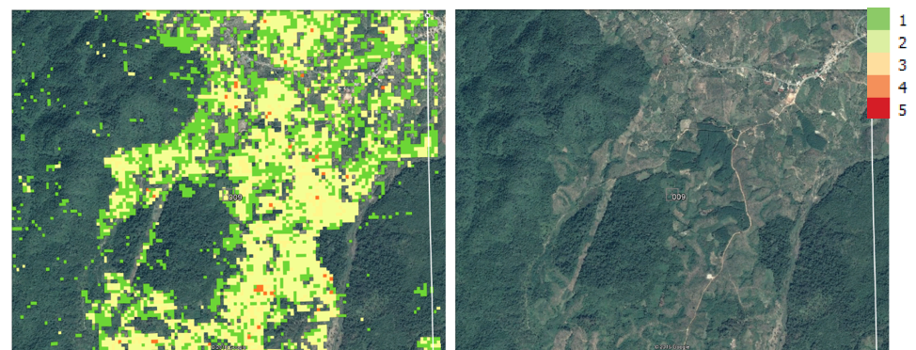
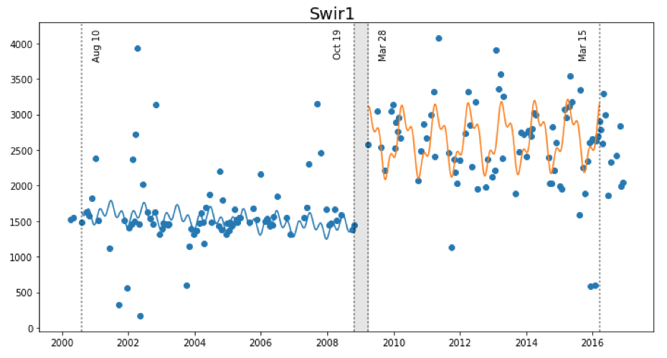
Land Change Detection
The SEO is investigating two approaches for change detection with Data Cubes … CCDC and BFAST
CCDC (Zhu and Woodcock, 2012) was converted to Python by USGS and recently tested by the SEO on the Vietnam Data Cube. We now call this“PyCCD”.
The SEO is also starting a task with Jan Verbesselt in June 2017 to convert BFAST from R-code to Python and to test on the Data Cube.
PyCCD time series model fits 7 bands to 6 weighted SIN and COS functions in order to find “breaks” that equate to potential land change.

Slide 25
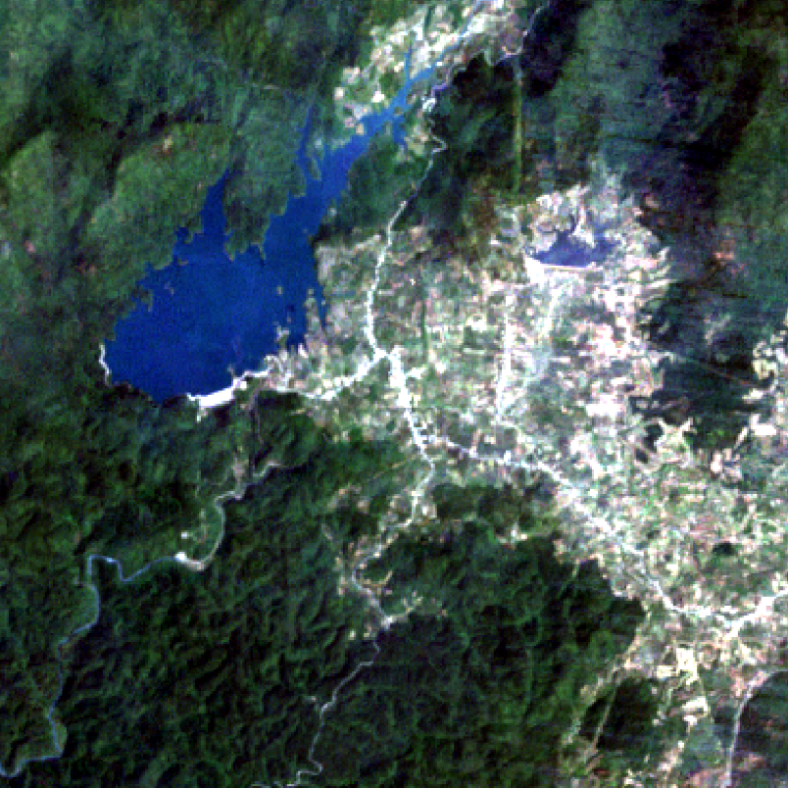
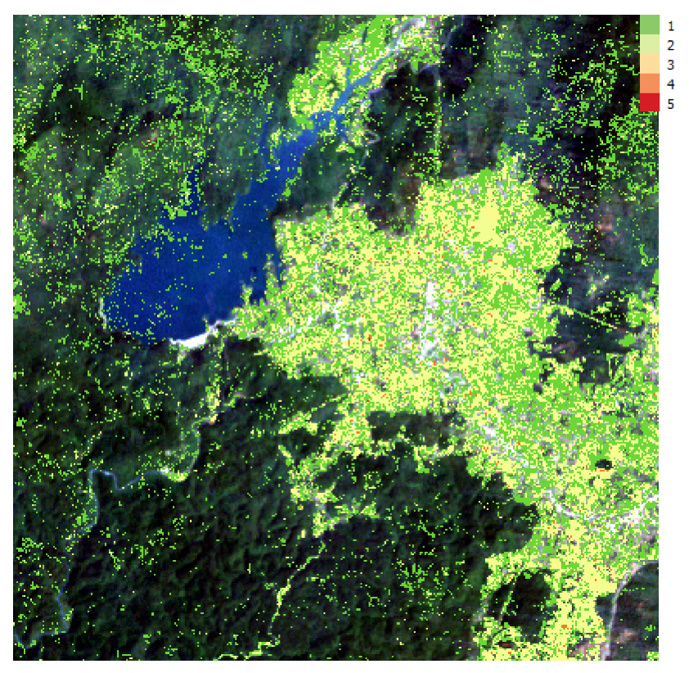
Vietnam Land Change
Bediaye, Vietnam – Data Cube Median Mosaic (left), PyCCD Results using QGIS (right)
2000 to 2016, 192 Landsat scenes, Lat = 11.19 to 11.29, Long = 107.81 to 107.91.

Slide 26
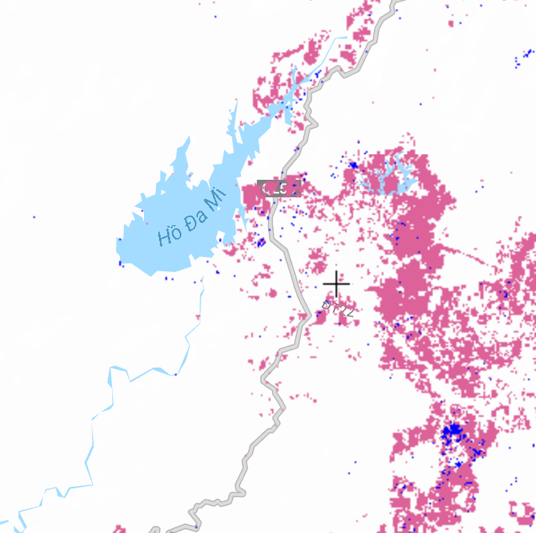
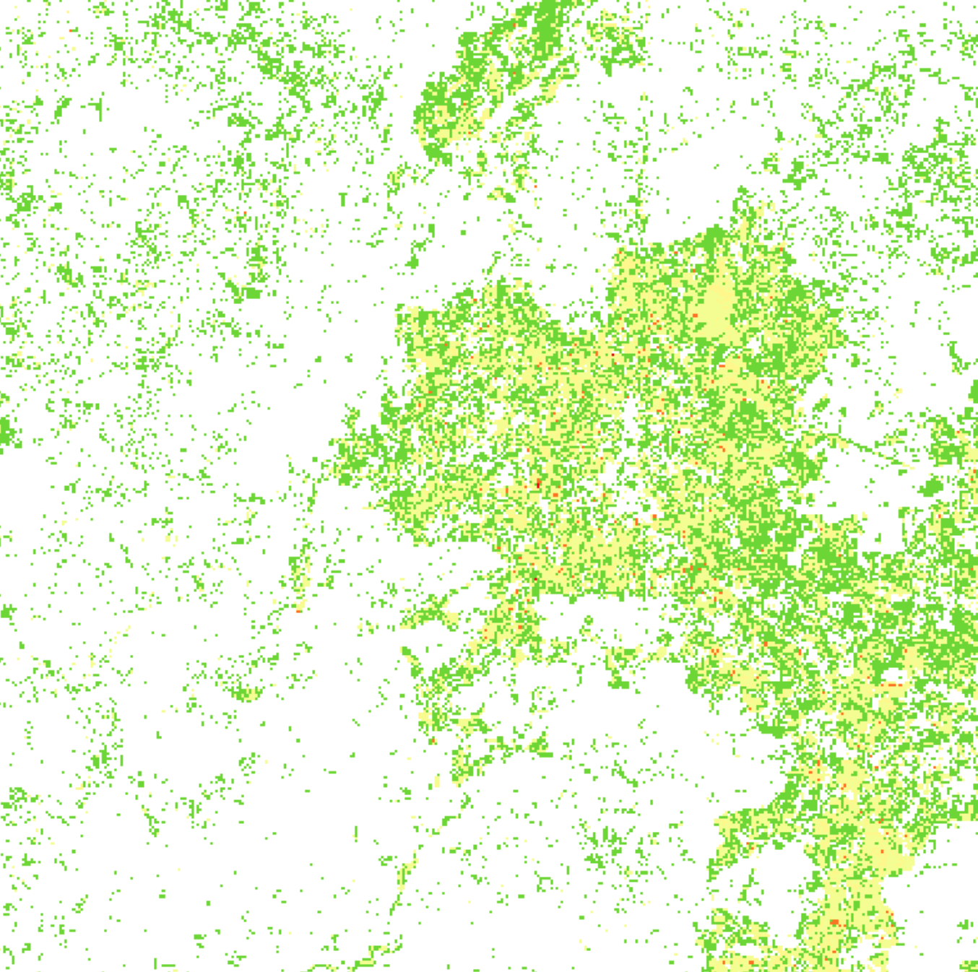
Global Forest Watch vs. PyCCD
Global Forest Watch – Forest Loss 2000 to 2015
PyCCD with a Data Cube – Land Change 2000 to 2016
PyCCD Execution: 372 x 372 pixels, 8 parallel cores, 2.3 hours (~1 msec / clear pixel) which equates to about 10 hours per clear Landsat scene.

Slide 27
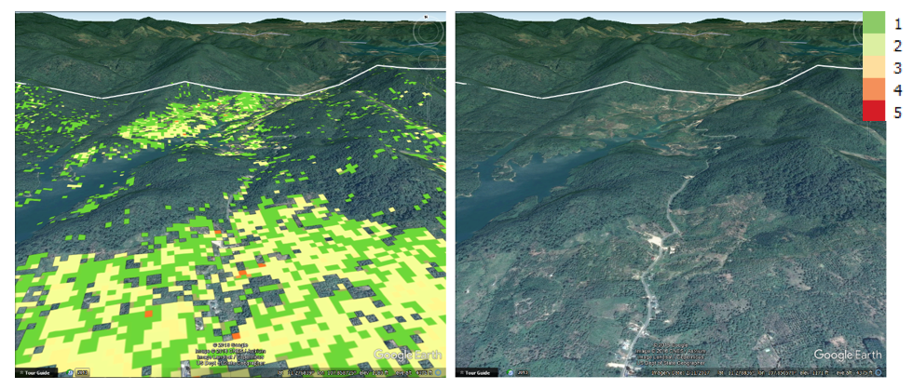
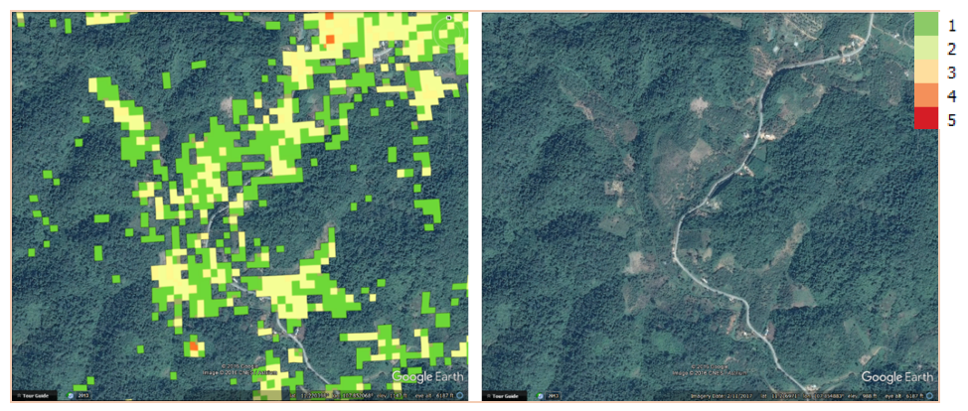
More PyCCD Examples
Deforestation
Roadside Clearing

Slide 28
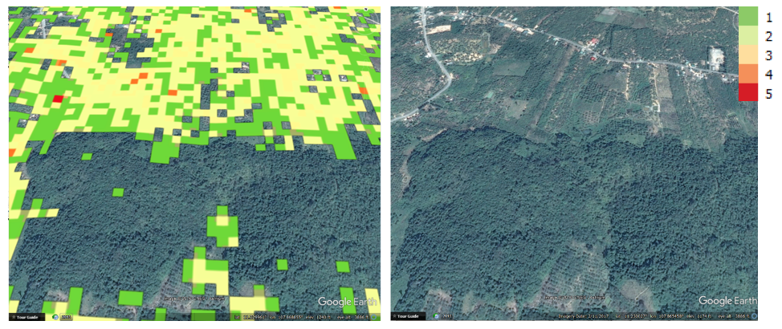
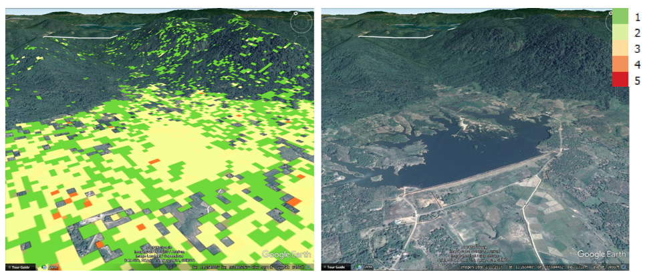
More PyCCD Examples
Possible Deforestation
Reservoir

Slide 29
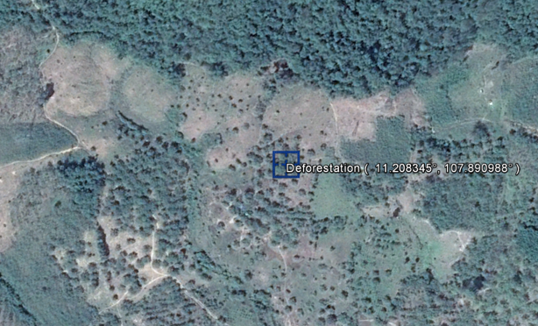
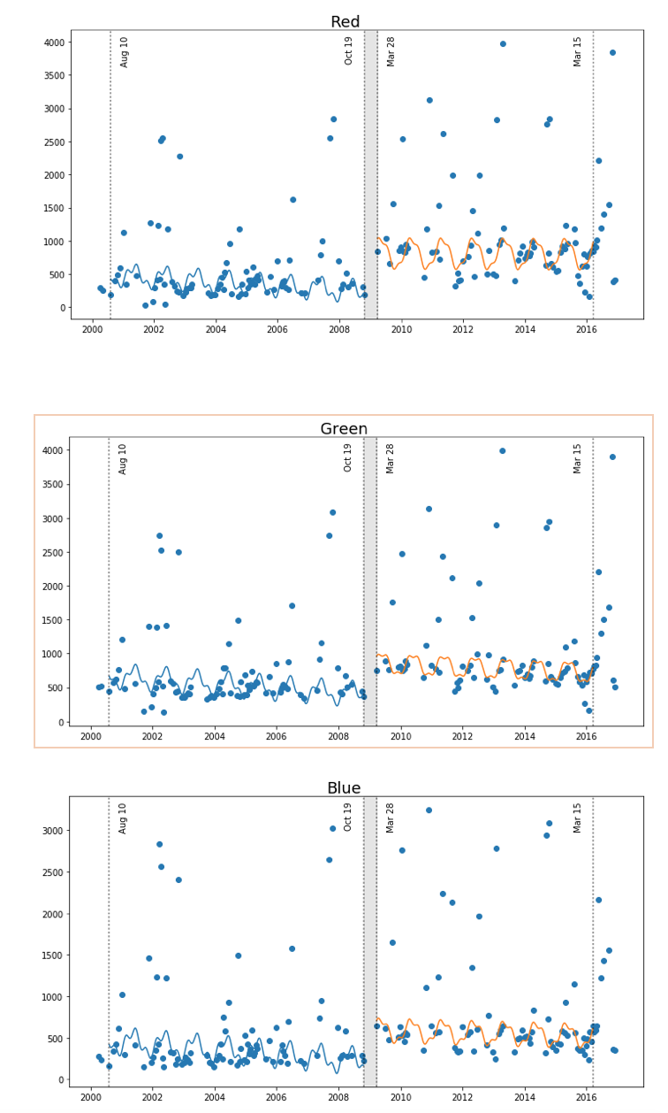
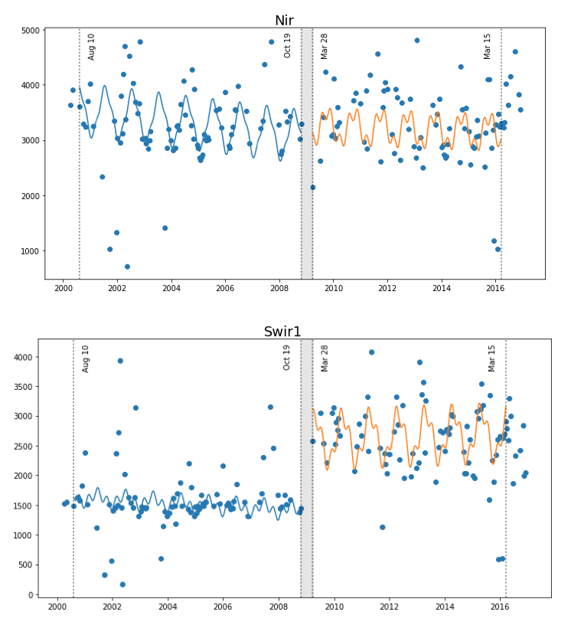
Time Series Models for Deforestation in Vietnam
Deforestation (single break)
Latitude: 11.208 Longitude: 107.89
Change is most evident in the SWIR bands

Slide 30
Vietnam Task Status
Data Cube team to provide face-to-face training in Hanoi and to deliver all scene data and sample data cubes – COMPLETE
SEO to put Vietnam sample cube on AWS - COMPLETE
SEO to develop the Mekong Basin data cube and work with the SERVIR team to investigate hosting
SEO will investigate the VN-2000 projection for data cube ingestion.
SEO to follow up with CSA on the potential for historic Radarsat data for the Vietnam data cube.
Vietnam will obtain a new computing system and install the data cube.
Vietnam will investigate putting their Sentinel-1 rice monitoring code into Python and release to the Data Cube open source community.
Vietnam (Dr. Nguyen) will visit SEO Data Cube team on May 11.

Slide 31
Miscellaneous Material

Slide 32
IGARSS 2017
The CEOS Open Data Cube team will be offering a free training/tutorial course at the 2017 IGARSS Conference on Sunday, July 23 from 8:30am to 12:30pm.
This course is meant to give attendees an in-depth understanding of how to build data cubes and run application analyses.
We welcome participation from new and current data cube users.

Slide 33
Contacts / Websites
User Interface: http://tinyurl.com/datacubeui
Email: info@ceos-cube.org
Data Cube Website: www.ceos-cube.org

