Slide 1
OST-VC Status
Committee on Earth Observation Satellites
Juliette Lambin, CNES, on behalf of OST-VC co-chairs
Remko Sharroo (EUMETSAT) & Amaury Larue (CNES)
CEOS SIT-33
Session and Agenda Item #
Boulder, CO, USA
24 – 25 April 2018

Slide 2
Altimetry, OST-VC and CEOS
OST-VC acts as a link between wider satellite altimetry and CEOS
Ocean Surface Topography Science Team
Side meeting of OST-VC at 2017 OSTST Meeting (Miami)
Inter-agency cooperation (bi+-lateral)
Jason-2: NASA, CNES, EUMETSAT, NOAA
SARAL: CNES, ISRO, EUMETSAT
Hy-2A: CNSA, CNES…
Sentinel-3: EU, ESA, CNES
Sentinel-6: ESA, EU, EUMETSAT, NASA, NOAA and CNES
SWOT: NASA, CNES, CSA, UKSA
OST-VC suited to discuss constellation-wide programmatic issues
From virtual to coordinated constellation...
Update of Constellation URD
OST-VC representative in COVERAGE initiative

Slide 3
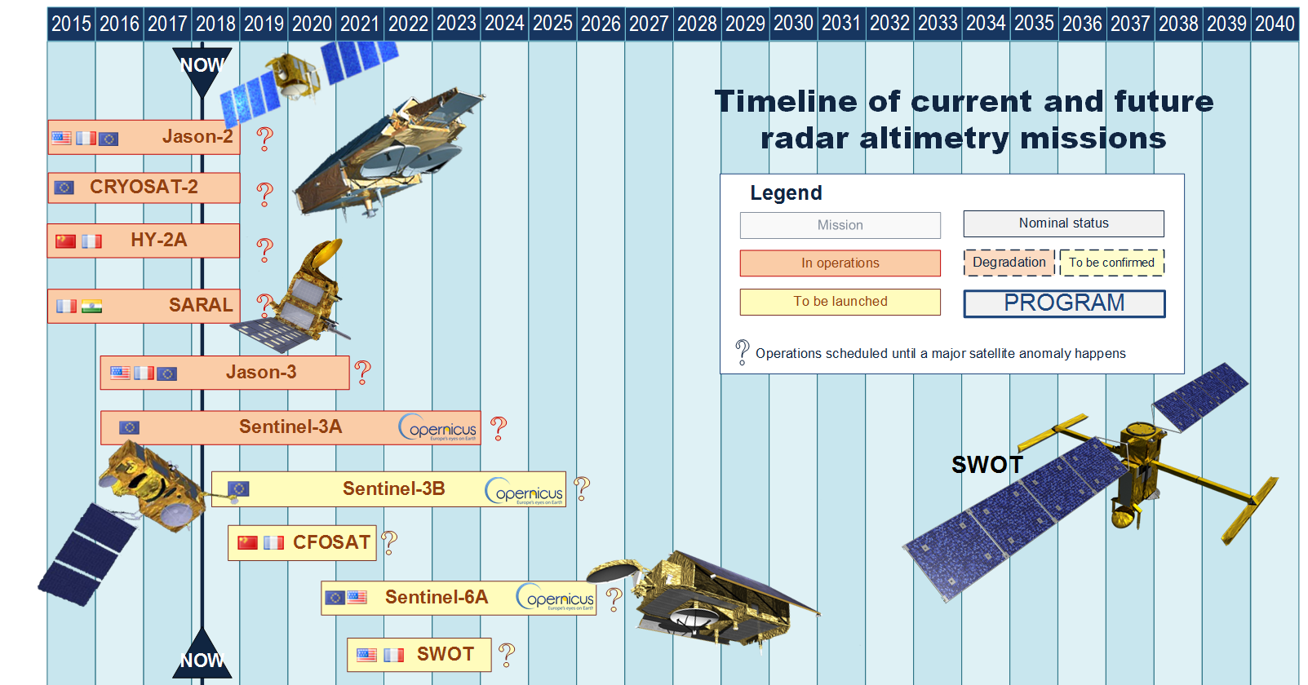
OST-VC timeline

Slide 4
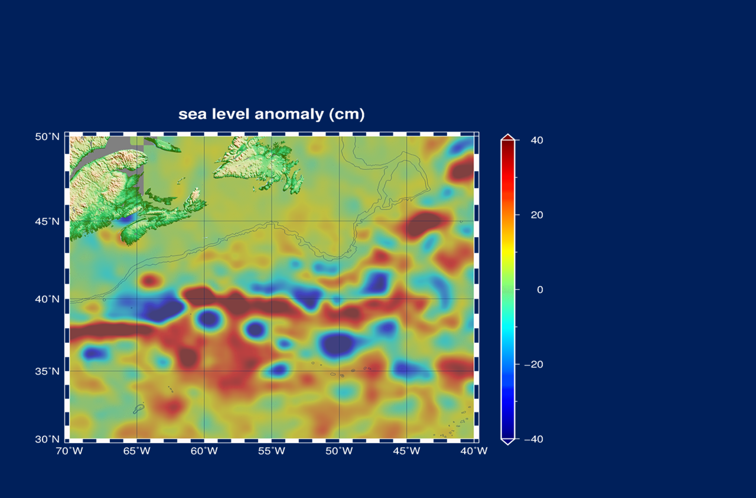
6 altimeters flying

Slide 5
Altimetry time serie

Slide 6
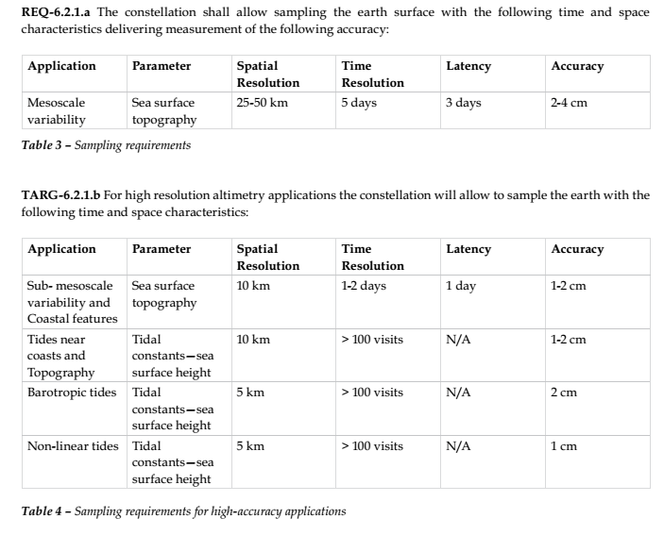
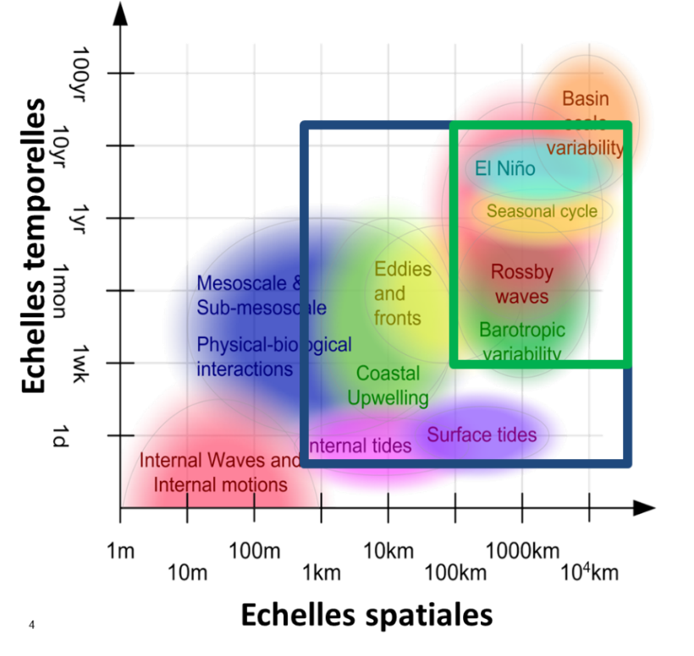
Current Constellation URD
« Next 15 years of altimetry », 2009: Constellation User Requirement Documents + Assmanhausen OST-VC meeting
Reference mission + complementing
Nadir altimetry only (swath altimetry mentionned)
Structured the current constellation (reference mission Jason + SARAL/S3/Hy-2/Cryosat)
Standards of products

Slide 7
Update of constellation URD
Objective 2018-2019: prepare a new URD
Discussed in OST-VC meeting 2016 and 2017
Early works through CNES phase 0 study (mix nadir/swath, global UR analysis)
Coordination CNES-ESA (swath altimeter for operational oceanography => URD SAOO)
What should be in it?
Analysis of user needs: systematic + exploratory
Swath altimetry + nadir altimetry : combined
Recommandation for an « operational constellation » (targets: copernicus NG, China altimetry programme)
Recommandation for additional science missions in complement
Links with other obervables

Slide 8
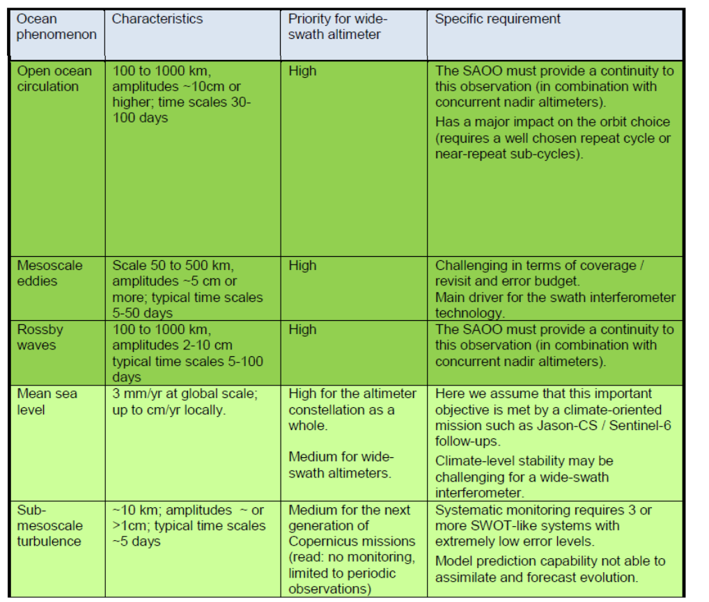
Example SAOO URD
50 km/5 days as effective resolution
Precision/accuracy set so that this effective resolution is met everywhere-everytime with an 80% probablility
Identify auxilliary information needed (tides, gravity field…)
Identify what is not considered in requirement (internal wave, submesoscale)

Slide 9
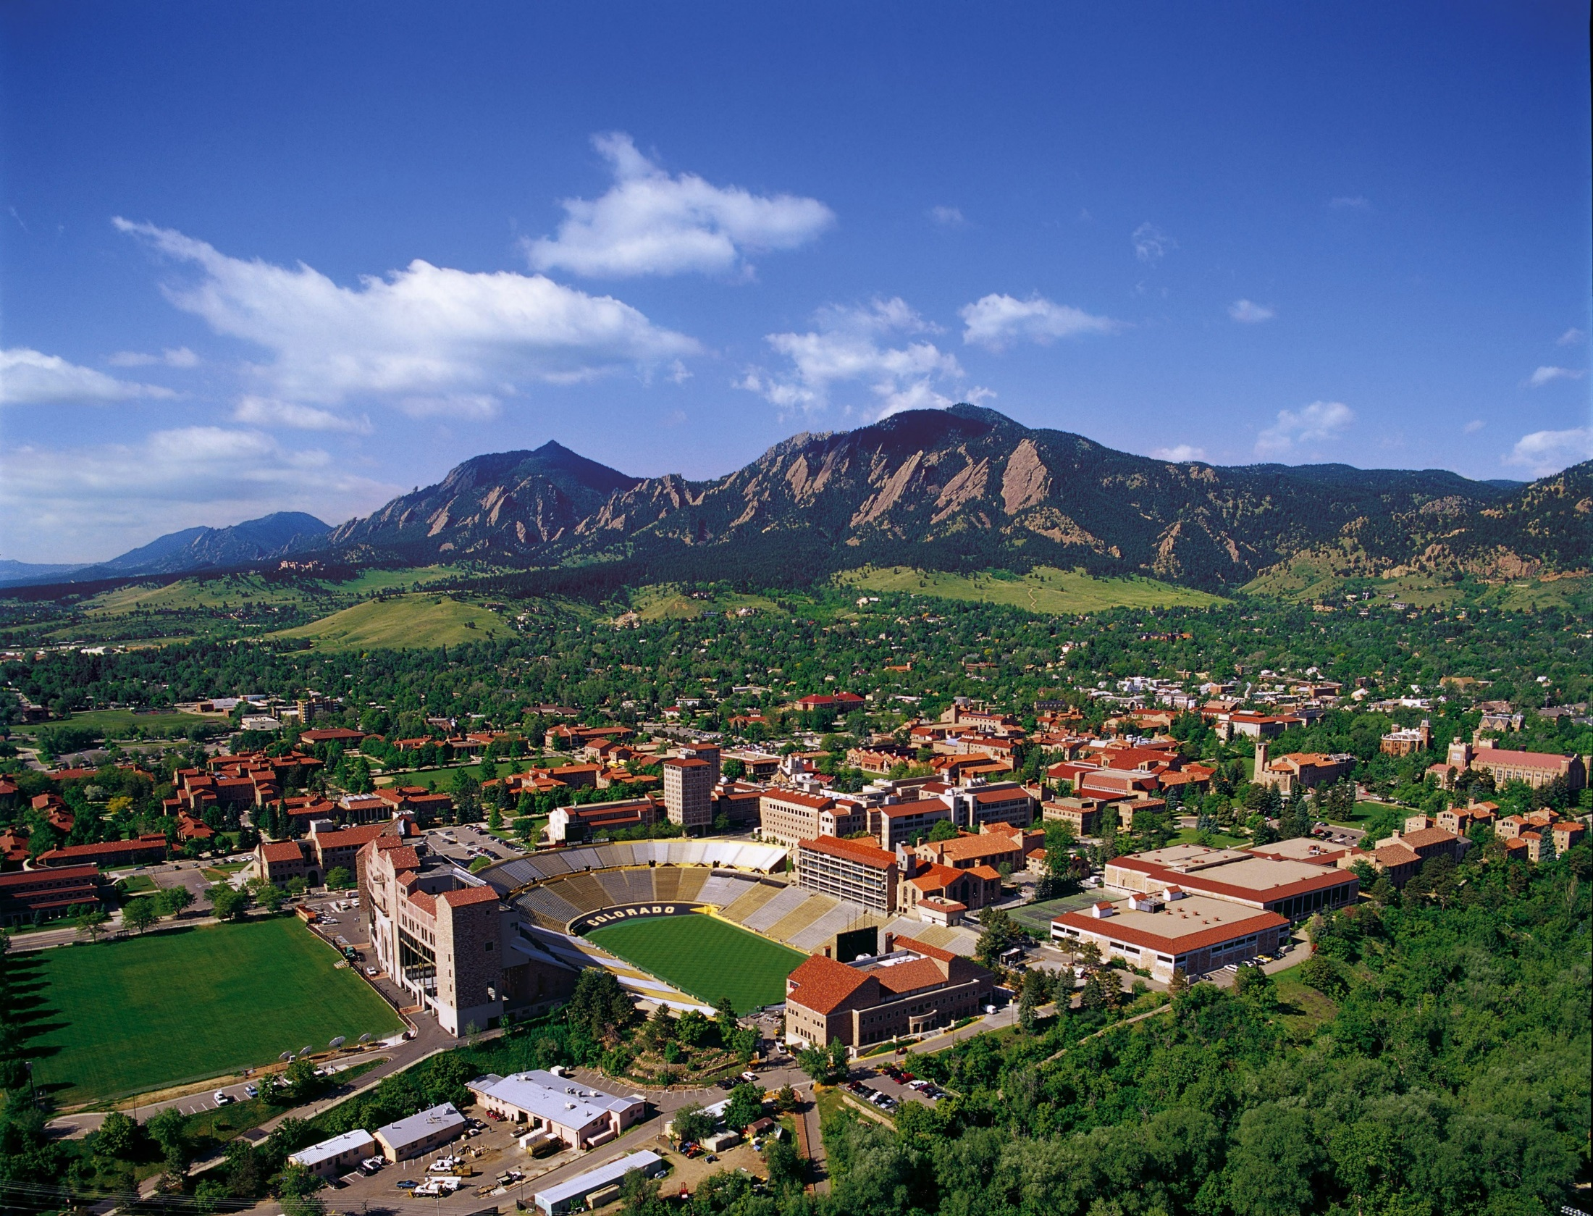
Thanks! See you in Boulder!
Questions?
Kerry.Sawyer@noaa.gov
george@symbioscomms.com

