Slide 1
Session 6: Ad hoc Teams Introduction
Committee on Earth Observation Satellites
Steve Volz, CEOS SIT Chair
National Oceanic and Atmospheric Administration (NOAA)
Mauro Facchini, CEOS Chair
European Commission (COM)
CEOS SIT-33
Session 6, Agenda Item 6.1
Boulder, CO, USA
24 – 25 April 2018

Slide 2
Session Objective and Questions
OBJECTIVE: To review progress and key issues being faced by CEOS Ad Hoc Teams (AHTs) and discussion on sustainability of the AHTs and plans for the future.
KEY SESSION QUESTIONS:
What concrete steps can be taken in support of FDA activities? And how does this related to existing Work Plans? What is required to promote and systematically generate ARD?
What are the next steps for CEOS in supporting the advancement of the SDGs?
How does CEOS sustain and progress its commitments to GEO Flagships such as GFOI (via SDCG), and GEOGLAM (via the AHT)? What resources and actions are required?

Slide 3
Strategic Directions - AHTs
Reflect and report on the group trajectory and lifecycle in relation to the thematic initiatives that they support
A clear understanding for SIT as to the outlook and evolution of those initiatives, including, if appropriate, long-term, sustained operations and the expectation for CEOS and CEOS Member Agency participation
Maximizing the value of their output for CEOS objectives (e.g., ECVs and SDGs) and for individual CEOS Agency objectives
Ensuring the necessary support for our existing thematic teams to flourish and to deliver
Clearer overall CEOS observing system assessment and desired observing strategies – and known contribution from each CEOS entity
STRATEGIC DIRECTIONS AND PARTNERSHIPS FOR CEOS
DISCUSSION PAPER – SIT-33

Slide 4
Preparation Process
Ad hoc teams are not part of the routine tag-ups with SIT Chair Team – which started with VCs and now includes WGs
Dedicated questionnaire
Analysis of 2018-2020 CEOS Work Plan for Tangible Outputs
Reporting Template for SIT-33

Slide 5
Group Health and Viability
SIT Assessment
FDA dormant until recently, since Rapid City Plenary
Other AHTs demonstrate vibrant activity, participation, and contributions to CEOS Work Plan
GEOGLAM and GFOI groups are considering how to foster better linkage with related agency activities

Slide 6
Group Health and Viability
SIT Assessment
Ages from 1.5 - 6.5 years, average 4 years +
FDA activity lately after dormant period
Other AHTs all very active and with strong participation
Stable leadership overall

Slide 7
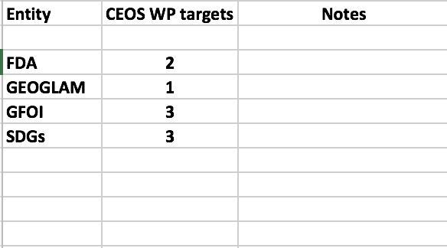
AHT Outputs Cited in 2018-2020 CEOS Work Plan
NOTE: not all targets are created equal – e.g. GEOGLAM has a ‘catch all’ output
AHTs have well established targets within CEOS WP

Slide 8
AHTs Asked to Provide Following Info to SIT (template)
Reflect and report on group trajectory and lifecycle in relation to the initiatives supported
Blockers, required decisions, and suggestions to resolve
Assessment of AHT trajectory and life cycle
Sustainment and expectations of CEOS and CEOS members
Provide status of activities, including an assessment of maturity and viability of supported initiatives, with consideration of a transition from ad hoc to standing CEOS support, if appropriate
Present a clear outlook and the expected evolution of those initiatives, including long-term, sustained activity
Tangible outcomes (outputs, products) your ad hoc Team adds beyond standing CEOS activity (e.g. VC and WG work)
Maturity and viability of supported initiative (e.g. outlook and anticipated evolution)
Unique and enabling support provided by CEOS via your AHT
Expectation for CEOS and CEOS member agency participation
Suggestions for CEOS around how a regularized transition process for ad hoc Teams might look
Highlight upcoming activities that uniquely require CEOS support to progress

Slide 9
2017 SIT TWS Action
SIT TWS Action 2017-21
Due Date

Slide 10
Discussion Seeds for Later
Do we need transition plans for some of the ad hoc activities?
Do we need a regularized process for ad hoc teams and such transitions?
For each team, what action is necessary to ensure the necessary leadership, engagement and connection to the CEOS objectives?

Slide 11
Session 6 Agenda
6.1, 20 min: Session Introduction (Steve Volz, Mauro Facchini)
6.2, 15 min: FDA (Nicolau Hanowski)
6.3, 15 min: SDG AHT (Alex Held, Eric Wood, Barb Ryan)
6.4, 15 min: SDCG (Osamu Ochiai)
6.5, 10 min: GEOGLAM AHT (Brad Doorn)
6.6, 15 min: Discussion

