Slide 1


Ad Hoc Team on Sustainable Development Goals (AHT SDG)
Committee on Earth Observation Satellites
Alex Held & Flora Kerblat, CSIRO, AHT SDG co-lead & SIT Vice Chair
Marc Paganini, ESA, AHT SDG co-lead
Eric Wood, USGS, AHT SDG co-lead
CEOS SIT-33
Session and Agenda Item #6.3
Boulder, CO, USA
24 – 25 April 2018

Slide 2
Background
AHT SDG History
  CEOS 30th Plenary, 2016: creation of the Ad Hoc Team on SDGs (AHT SDG) for a year
  CEOS 31st Plenary, Oct 2017: renewal for another year
  CEOS 32nd Plenary, Oct 2018: future of the AHT SDG to be decided ??
  (=> options to be provided by AHT SDG for discussion and decision)
AHT SDG Leadership
3 current co-leads : CSIRO (A. Held), ESA (M. Paganini), USGS (E. Wood)
+ support & coordination from CSIRO (F. Kerblat)
Interest for new co-leads ?
AHT SDG Membership
Today ~40 members (mailing list), including “associate members” e.g. UNOOSA
AHT SDG meetings since 31st CEOS Plenary:
Side-meeting in Rapid City, CEOS 31st Plenary, Oct 2017
Co-leads or team conference call meetings: 6th February & 21st March 2018
Side-meeting in Boulder, CEOS SIT-33, 23rd April 2018
Other key meetings with AHT SDG presence: GEO Plenary (Nov 2017, Washington);
49th Session of the United Nations Statistical Commission (6-9 March, NYC);
GPSDD Data for Development Festival (21-23 March, Bristol, UK)

Slide 3
AHT SDG
Implementation Plan and
Activity Report

Slide 4
AHT SDG Implementation Plan
Key elements (reminder)
Compile a compendium of CEOS Agencies’ engagement on SDGs
Define a coherent CEOS engagement plan on SDGs
Coordinate CEOS support to GEO-led SDG activities
Review and assess the contribution of EO to the SDG Targets and Indicators
Foster the added-value of EO data in the SDG monitoring and reporting process
Facilitate uptake of EO by SDG stakeholders
Conduct impactful communication & outreach activities on EO for SDGs

Slide 5


Tangible outputs since last Plenary
          CEOS Earth Observation Handbook on SDGs:
                Officially released in March 2018, at the 49th Session of the UN Statistical Commission 6-9 March 2018 (NYC) at a side-event “Statistical-Geospatial Integration Forum” (integrating statistical, geospatial, and other Big Data to leave no one behind)”
                Hard copies are being sent
                Electronic version to be found here
          Communication :
                Flyer to promote EO for the SDGs
                (related to the launch of the EOHB on SDG)
                List of key events compiled (internal work document shared with EO4SDG): basis of the calendar to be shown on EO4SDG website
          Compendium: stock of CEOS activities on SDGs:
          online survey, emailing, results compiling (ongoing) and first results shared in the “SDG Updates”
          “SDG Updates” produced and sent for information to CEOS (SEC principals, members, associates) in March 2018 (AHT SDG Updates_2018 Q1.pdf: also available here on the CEOS Doc Management)

Slide 6

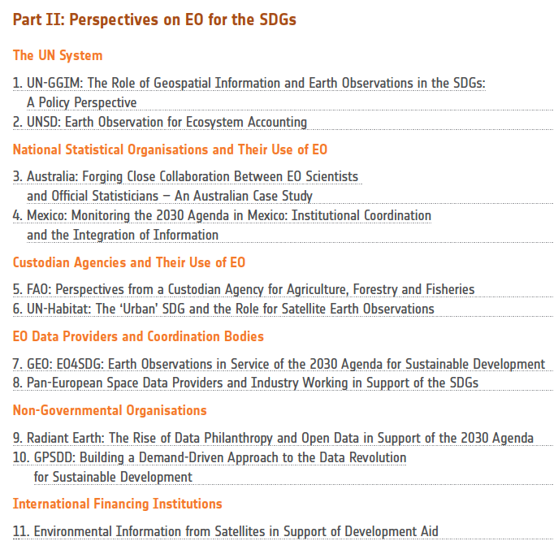






Part I role of EO data in support to the SDGs
CEOS EO Handbook on SDGs
Part II
Stakeholders’ perspectives
on EO for the SDGs
Part III
Examples of EO contribution to SDG Targets and Indicators

Slide 7
AHT SDG key achievements & lessons learnt (to be reviewed)
ACHIEVEMENTS (or key ongoing activities) | LESSONS LEARNT + -
Compendium | Good initial inputs from agencies | Need more responses (and more updated info) from Agencies
Engagement Plan | To be elaborated in the upcoming months, after more discussions with EO4SDG to clarify our respective roles | Roles to be clarified for more efficiency
EO Handbook on SDG | Outstanding team work (ESA, Symbios, CSIRO (Flora) and all contributors): tangible exercise including various stakeholders, with quality result, recognized by CEOS Agencies | More specific case studies to be developed
Support to various GEO activities (incl. EO4SDG) | Good reactivity & coordination from some key individuals to complete various tasks (training or communication material, participation in key meetings, etc.), relay of information to CEOS, etc. | Need more engagement from other AHT SDG members
Compilation of case studies (e.g. special issue of the RSE Journal) | Concrete inputs to the Compendium and EOHB, undertake new RSE edition on EO&SDG and other research contributions. | Need innovative and more specific (targeted) EO-space based data & examples to help SDG
Communication & outreach activities | Regular communications provided to CEOS (teleconferences, emails, “SDG Update”, & SEC written reports) & produced (SDG flyer) | Need more direct support from CEOS agencies to provide concrete inputs

Slide 8
Future outlook of the AHT SDG:
Options for discussion
Option 1: Continue as an AHT, requesting renewal for another year at Plenary, and continue to use Agencies’ best efforts to support UN and GEO mainstreaming EO in the SDG processes (new co-leads?);
Option 2: Continue as an AHT to ONLY act as a CEOS point of contact for external users, without undertaking new activities, and forward all specific requests to VC;
Option 3: ‘Graduate’ and become a CEOS Working Group with a more formal work plan, governance system and reporting mechanisms, and therefore more sustained efforts and support (= commitment) from CEOS and WG members to implement the work plan;
Option 4: Consider what the AHT SDG achieved, and still needs to be done from a CEOS perspective, and phase out the AHT with transfer of all AHT activities to GEO EO4SDG (including CEOS Agencies support)
Option 5: Transform the AHT into an “SDG Strategy” (given its cross-cutting essence, following the “Carbon Strategy” path), with a solid work plan and coordination body to map SDG activities to existing CEOS resources (VC, WG, etc) and continue being the “SDG space arm” focal point for GEO

Slide 9
Proposal
from AHT SDG team
Continue as AHT for 2018-2019 with following key achievables:
  Refine role of CEOS SDG activity vis-à-vis GEO EO4SDG activities and roles
  Support further showcasing and examples of role of EO in national SDG reporting
  If the option is given, prepare case for transition from AHT to CEOS Working Group on SDGs from late 2019, based on more tightly defined roles
  Form a sub-team to support UNCCD request to GEO for support for “Land Degradation Neutrality” EO-based monitoring methodology implementation and testing (co-leads to be confirmed)

Slide 10

Thanks!
Questions ?
SDG Co-leads: sdg-leads@lists.ceos.org currently including
  CSIRO: Alex.held@csiro.au and Flora.Kerblat@csiro.au
  ESA: Marc.paganini@esa.int
  USGS: woodec@usgs.gov
Communications: kim.e.holloway@nasa.gov

Slide 11
AHT SDG
Background and Context

Slide 12

CEOS AHT SDG:
Terms of Reference (ToR)
In the complex and evolving SDG environment, the AHT SDG shall:
take stock of the UN processes in place for the SDG implementation and of the existing SDG stakeholders (including GEO),
focus its activities around the unique role that CEOS should play as a coordination body of the Space community efforts to support the integration of satellite EO in support to the full realisation of the SDGs.
The AHT SDG can’t progress alone but shall rely on existing networks/partnerships:
AHT SDG aligns its engagement in the context of
(Programme Board, Engagement Strategy, GEO EO4SDG initiative)
AHT SDG builds on established relationships CEOS Agencies have with the UN agencies, individual countries (national statistics & line ministries), and other SDG stakeholders (including development banks & aid agencies).

Slide 13
CEOS AHT SDG:
Terms of Reference (ToR)
The AHT SDG shall assess, showcase and promote EO contribution
to SDG Targets and Indicators
CEOS AHT SDG – ToRs (summary):
Coordinate the efforts of CEOS agencies and channel CEOS support to the SDG process (EO showcases, promotion material, etc.) through GEO
Provide a forum for sharing/communicating EO best practices in support to the SDGs (in collaboration with GEO).
Analyse opportunities for better uptake of satellite-based EO in support to SDGs Targets and Indicators, in part via enhanced engagement of CEOS agencies within the GEO initiatives and flagships.
Engage with relevant authoritative SDG stakeholders inside (e.g., IAEG-SDGs & WGGI, UNSD, UN GGIM, Custodian agencies) and outside the UN system (e.g., GPSDD, IISD, WBG, Foundations).
Use CEOS assets and bodies (WGCapD, AHT FDA, SEO, etc.) to build and strengthen EO capacities at all levels of the SDGs implementation.

Slide 14
Implementation Plan – Status Updates (1)
IP main activities | Status
Compile and maintain a compendium of CEOS Agencies’ engagement on SDGs | Compendium compilation ongoing: see “SDG Updates” circulated in March => to be finalised and presented at CEOS Plenary
Define a coherent, flexible & adaptive CEOS engagement plan on SDGs | CEOS Engagement priorities to be discussed at SIT-33 - Engagement plan soon to be circulated for review at SIT TW => to be finalised and presented at CEOS Plenary
Coordinate CEOS support to GEO-led SDG activities (GEO EO4SDG initiative and GEO flagships/initiatives/communities active on SDGs) | Ongoing, various cooperative activities with GEO EO4SDGs: GEO/CEOS joint participation to UN GGIM side-meeting at UNSC 49thsession (NYC, March); GEO/CEOS joint communication (website content, including events calendar, training material…); GEO/CEOS co-authors on scientific publications (e.g. RSE issue on SDGs) => More coordination needed with other GEO Flagships/Initiatives working on SDG topics (Blue Planet, GEOGLAM, GEOBON, GEO Wetlands, etc.);
Review and assess the contribution of EO to the SDG Targets and Indicators | ESA’s EO4SDGs project: Kick-off on 20th April first task: perform an in-depth assessment of the EO contribution to the SDG targets and indicators with 2 outputs: Compendium + Policy brief. Both products will undertake an external review by EO4SDG & AHT SDG. => Draft expected for SIT TW and final for the CEOS Plenary

Slide 15
Implementation Plan – Status Updates (2)
IP main activities | Status
Demonstrate, showcase and foster the added-value of EO data in the SDG monitoring and reporting process | Compilation of EO best case practices for SDGs (ongoing) The Remote Sensing of Environment (RSE) Journal special Issue on EO and SDGs (in preparation) will provide good examples National/Regional SDG pilot projects (ongoing) List of pilot national/regional projects, including: CSIRO: EO Pacific Forum on SDG ESA: 2 SDG projects in Uganda (1 funded by GPSDD, 1 by ESA) Multi (CSIRO, NASA, …) & GEO: African Regional Data Cube => More to be added – finalised for the Plenary Training courses on EO for the SDGs (ongoing and to be discussed) “SDG Academy” (SDSN) – in discussion with Flora/Kim/Argie (GEO) CEOS AHT SDG role with capacity building to be discussed: provide only high-level content on EO and SDG to GEO? Links with CEOS WGCapD ?
Facilitate uptake of EO by SDG stakeholders | List of all activities related to infrastructures (e.g. EO platforms) and tools (e.g. Toolboxes and data cubes) (ongoing) e.g. Open Data Cube & SDG developments: the African Regional Data Cube project (with GPSDD), in the Pacific (Samoa) with CSIRO => Analysis to be finalised and presented at CEOS Plenary
Conduct impactful Communication & Outreach activities on EO for SDGs | “SDG updates”: first edition circulated within CEOS (completed) => Is it worth pursuing this? Or updates at SIT and Plenary enough? Release of the CEOS EOHB on SDG (completed): also available here: www.eohandbook.com/sdg Flyer to promote EO satellite data & SDG + launch of EOHB on SDG Internal communication (emailing and website updates) Contributions to GEO (EO4SDG): GEO EO4SDG portal (website content, including calendar) and GEO/CEOS primers/flyers (ongoing)

