Slide 1

GCOS – Update :
CEOS SIT-33
Boulder, CO, USA, 23-25 April 2018
Stephen Briggs,
Chairman, GCOS Steering Committee

Slide 2
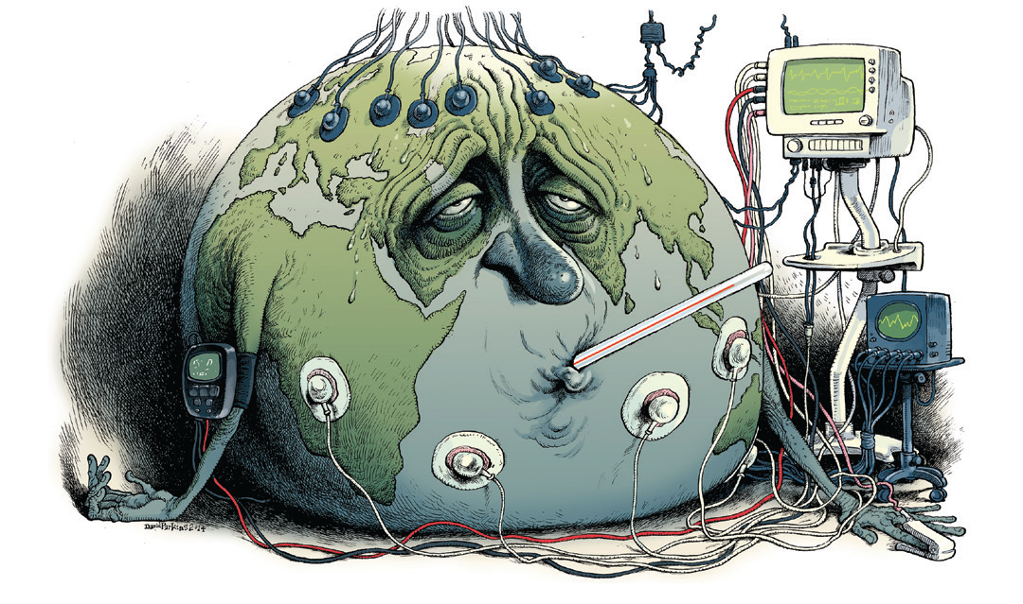
The importance of observations………
Credit: Victor & Kennel, Nature Climate Change, 2014.

Slide 3

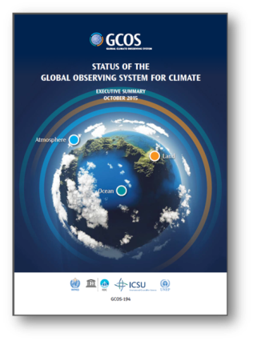
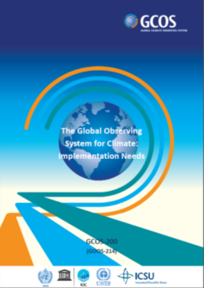

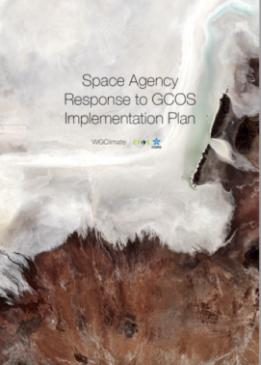
GCOS Progress: Improving global climate observations
COP-22, Marrakec
Decision 19/CP.22
SBSTA Conclusions
First Regional workshop held in Fiji for Pacific Island States
Working group in Lightning starts work
Working group on GCOS Reference Surface Network meets for first time
Support Adaptation
& Mitigation
Water, Energy and Carbon cycles
Additional Essential Climate Variables
More help for networks in developing countries
ECV Inventory: The Architecture for Climate Monitoring from Space in Action
Climate Indicators
2015
2016
2017
Notes:
3rd plan
And the news here is that…we are supporting adaptation&mitigation and ensuring that the cycles are being supported
Emphasis on the need to support developing countries and their observing networks
The Status Report which we have been delivered to COP21 in Paris last year showed that there has been improvement in the adequacy of the existing observing networks since 2010, but for the next decade we have to look into
1. Adaptation & Mitigation
2. Water, Energy and Carbon cycles
3. Additional Essential Climate Variables
4. Emphasis on more help for networks in developing countries

Slide 4
GCOS
Essential
Climate Variables –
ECVs
grouped by measurement domain and area covered.
The groups show how observations across all the measurement domains are needed to capture specific phenomena or issues.
 | Atmosphere | Terrestrial | Ocean
Energy & Temperature | Surface Radiation Budget, Earth Radiation Budget, Surface Temperature, Upper Air Temperature, Surface and Upper Air Wind Speed | Albedo, Latent and Sensible Heat fluxes, Land Surface Temperature | Ocean Surface Heat Flux, Sea Surface Temperature, Subsurface Temperature
Other Physical Properties | Surface Wind, Upper Air Wind, Pressure, Lightning, Aerosol Properties |  | Surface Currents, Subsurface Currents, Ocean Surface Stress, Sea State, Transient Traces
Carbon Cycle and other GHGs | Carbon Dioxide, Methane, Other long-lived GHG, Ozone, Precursors for Aerosol and Ozone | Soil Carbon, Above-ground Biomass | Inorganic Carbon, Nitrous Oxide
Hydrosphere | Precipitation, Cloud Properties, Water Vapour (Surface), Water Vapour (Upper Air), Surface Temperature, | Soil Moisture, River Discharge, Lakes, Groundwater, | Sea Surface Salinity, Subsurface Salinity, Sea Level, Sea Surface Temperature
Snow & Ice |  | Glaciers, Ice Sheets and ice shelves, Permafrost, Snow | Sea Ice
Biosphere |  | Land Cover, Leaf Area Index (LAI), Fraction of Absorbed Photosynthetically Active Radiation (FAPAR), Fire | Plankton, Oxygen, Nutrients, Ocean Colour, Marine Habitat Properties
Human Use of Natural Resources |  | Water Use, Greenhouse Gases (GHG) Fluxes | Marine Habitat Properties

Slide 5
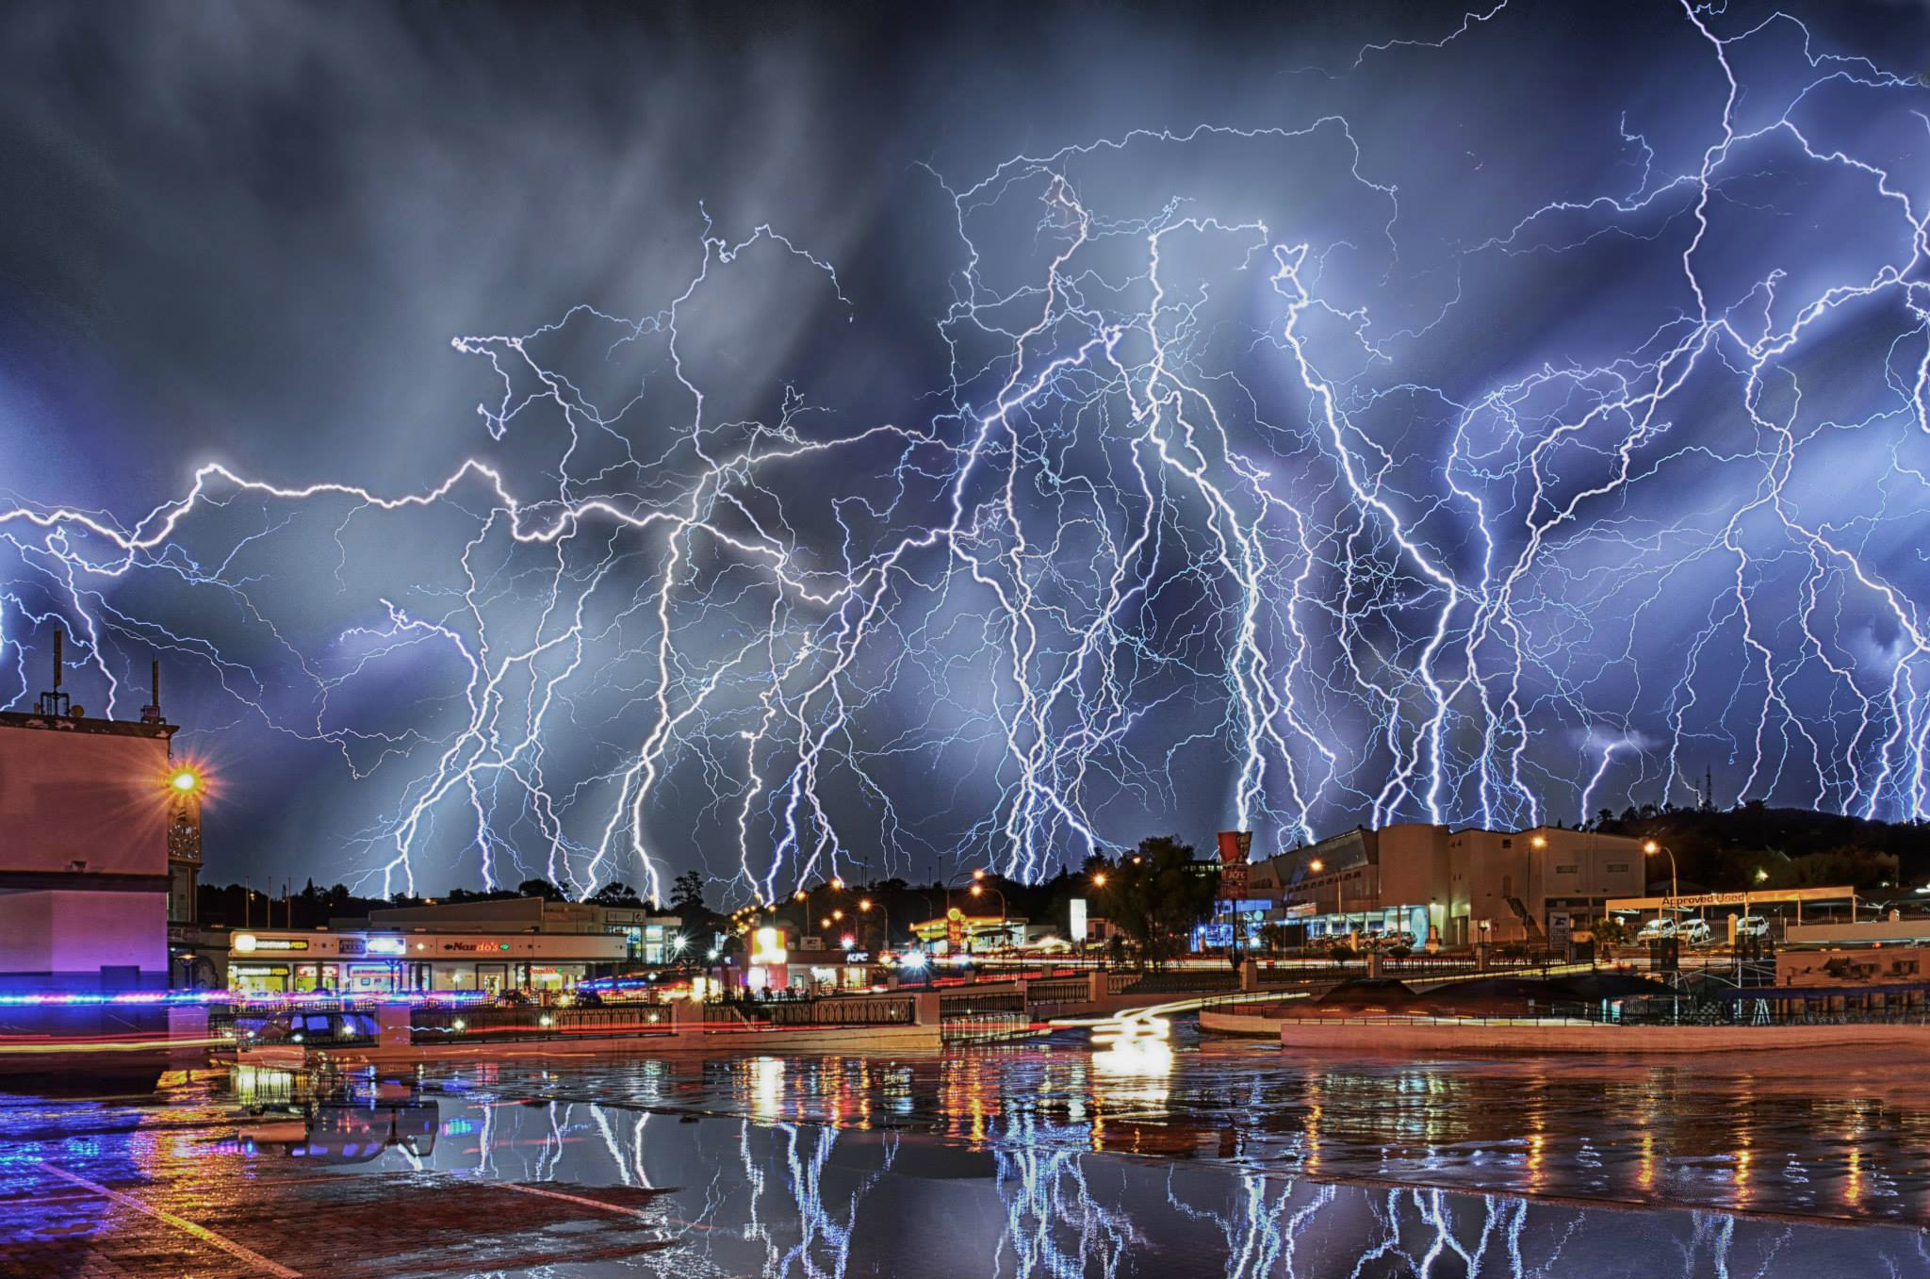
Wide scale monitoring of lightning is now possible and a proxy for severe weather events
Notes:
New Plan in now observing additional parameters. While most of the ECVs remain unchanged there are a few new ECVs that are now possible to observe and add to our understanding of climate change.
Example here:
Lightning. It is now possible to monitor lightning in a systematic and accurate way. This is important as the impact of increased storms are one topic that many countries are concerned about for adaptation planning. Systematic measurements will provide a baseline and monitoring changes in storminess.
Other new observations are:
GCOS has identified Anthropogenic Greenhouse Gas Fluxes and oceanic N2O as new ECVs. While a complete monitoring system for fluxes may take decades to develop and implement, atmospheric composition measurements (ground-based and satellite) are starting to be able to support existing emission estimates made for the UNFCCC.
Biology (marine habitat properties and adding Lake colour to the Lake ECV) – see following slide.
Land Surface Temperature (LST). This differs from surface temperature traditionally measured for weather prediction and used to track climate change (which is an air temperature about 2m above the ground). LST is measured by satellites: it is the radiant surface temperature and is important for vegetation and ecosystem modelling.
Two Ocean properties (ocean surface stress, ocean surface heat flux). These are needed to improve modelling of ocean systems, especially those that have a link to weather impacts such as El Niño and storms.

Slide 6


GCOS new Implementation Plan aims to improve monitoring of Global
Climate Cycles
Precipitation, Cloud Properties,
Water Vapour Surface Temperature
Ocean Acidification
Carbon Dioxide,
Methane
Deforestation
Mitigation
Ecosystem Loss
Sea Level Rise
Fisheries
Water
Carbon
Sea Surface
& Subsurface Salinity,
Sea Level,
Sea Surface Temperature
Soil Moisture,
River Discharge,
Lakes, Groundwater, Cryosphere, Water use
Inorganic Carbon
Soil Carbon,
Above-ground Biomass, Fire, GHG Fluxes
Coral Bleaching
Agriculture
Human Health
Floods
Droughts
Water Resources
Storms
Radiation Budgets, Temperature Wind speed & direction
Systemic Risks
Security
Slow Economic Development
Energy
Ocean Surface Heat Flux, Sea Surface & Subsurface Temperature,
Albedo,
Latent and Sensible Heat fluxes, Land Surface Temperature
Temperature
Heat waves

Slide 7
What’s new?
Adaptation & Mitigation
Monitoring Earth's climate cycles
New Technology
Urban Areas
Going beyond the traditional science base to support adaptation, mitigation, sustainable development, disasters and emergency response, and in responding overall to the Paris Agreement.
Including the Earth’s water and carbon cycles and energy balance in their entirety will improve understanding & prediction of the climate. This will guide mitigation and adaptation measures; assess risks and enable attribution of climatic events to underlying causes; and underpin climate services.
Observation technology is evolving and improving: e.g. ocean buoys and drifters, crowd sourced data
Over 50% of the world’s population now living in urban areas. observations are needed where people live, especially in the new urban megacities

Slide 8
Global Climate Indicators

Slide 9
Subsidiary Indicators
Temperature and Energy
Atmospheric Composition
Ocean and Water
Cryosphere
Top-of-Atmosphere Energy Balance
Methane
Heavy Precipitation
Snow Extent
N₂O
Heat Waves
Droughts
Fluorinated GHG

Slide 10
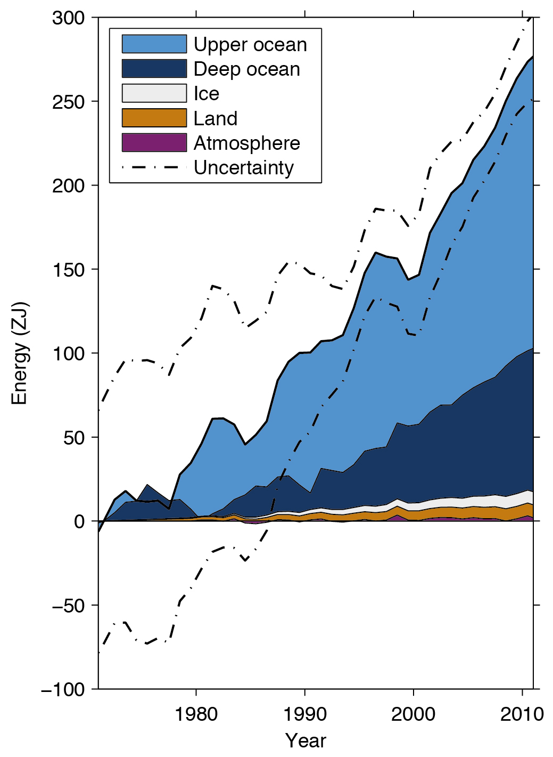
Ocean Heat Content (from IPCC AR5, 2013)

Slide 11
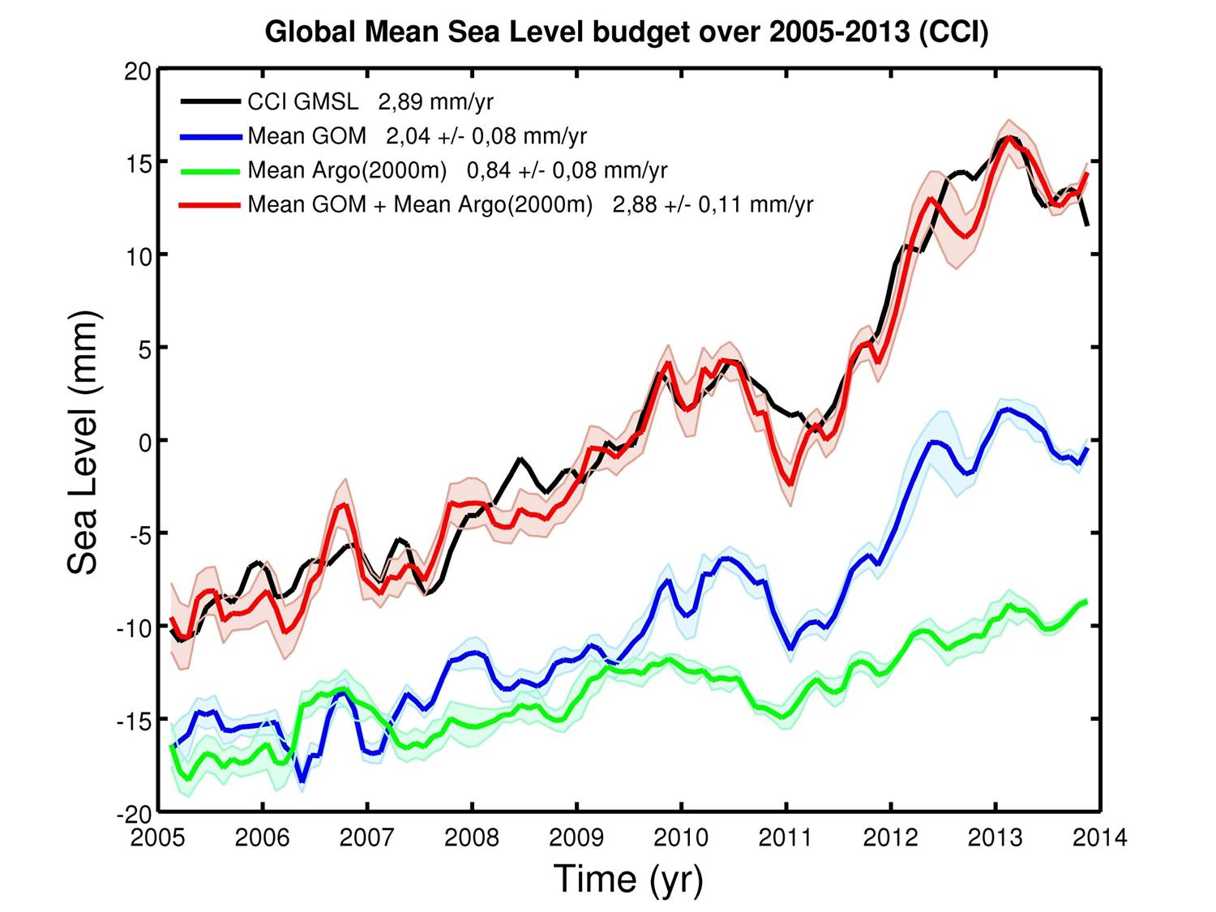
Global Sea-level Budget Workshop (ISSI Bern, Feb 2015)
– COMPONENTS OF SEA LEVEL RISE
MEASURED SEA LEVEL
SUM OF COMPONENTS
GLACIER AND ICE SHEET
RUNOFF
THERMAL EXPANSION

Slide 12
Reported to UNFCCC
Subsidiary Body for Scientific and Technological Advice (SBSTA),
FCCC/SBSTA/2017/7, VIII, 53 and 54:
The SBSTA noted the efforts undertaken by GCOS and the wider science community on the development of climate indicators, including global surface temperature, global atmospheric carbon dioxide and glacier change, and by WMO on the categorization of extreme events.
The SBSTA noted the importance of ocean-related climate indicators, including ocean heat content, ocean acidification, sea level rise, and Arctic and Antarctic sea ice extent, for informing on the state of the global climate.

Slide 13
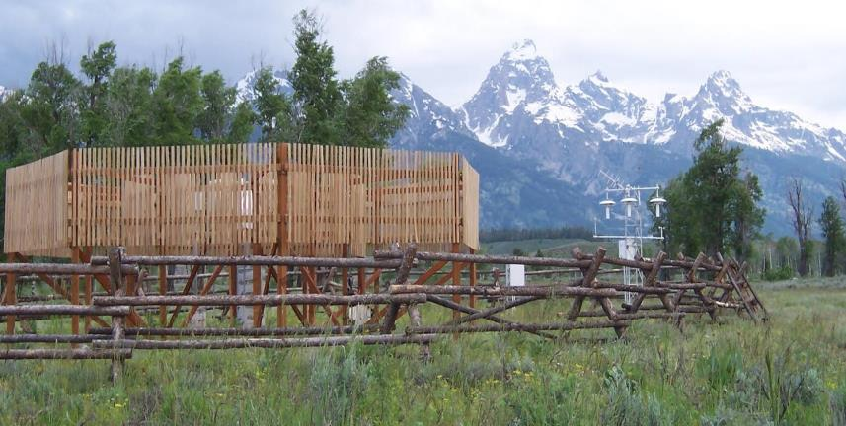
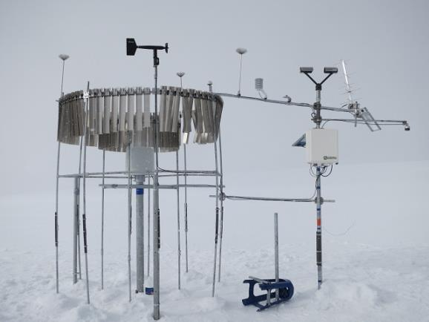
A GCOS Surface Reference Network
Improved long-term accuracy, stability and
comparability of observations.
Aims
  To achieve simultaneous high-quality observations of many ECVs
  Provide reference data to constrain and calibrate more spatially comprehensive observing systems.
A Reference Network
  Is traceable to an internationally accepted standard and has a comprehensive uncertainty analysis and is validated;
  Is documented in accessible literature and Includes complete metadata description
  Will measure temperature and precipitation and a range of other surface ECVs
  May be based on existing networks such as the US Climate Reference Network and the Cryonet sites from WMO GCW

Slide 14
Improved observations
lead to significant benefits
Successful adaptation and mitigation, reduced climate risks, enhanced livelihoods, and food & water security.
Climate Services, Risk Assessments, Early Warning & Disaster Risk Reduction Policies
Science, Assessments, Policy
Observations, Products, Open Data
ECV Requirements, Adequacy Reports, Plans
Notes:
GCOS produces ECV Requirements, Adequacy Reports, Plans
…. which lead to observations, products, open data
…. which inform science, assessments, policy
…..which are needed by climate services, risk assessments, early warning &disaster risk reduction policies
…..which lead to successful adaptation and mitigation, reduced climate risks, enhanced livelihoods, and food &water security.

Slide 15

Art 4
Art 5
Art 7
Art 8
Art 9
Art 10
Art 11
Art 12
Art 13
Art 14
NDCs
FINANCE
MITIGATION
TECH TRANSFER
COMMUNICATIONS
GLOBAL STOCKTAKE
LOSS & DAMAGE, EWS,..
CAPACITY BUILDING
ADAPTATION, EWS, RSO…
REPORTING/TRANSPARENCY
Art 7 (7c)
*Paris Agreement Article 7 (7c): Strengthening scientific knowledge on climate, including research, systemic observation of the climate system and early warning systems.
Notes:
COP-21: Paris Agreement Article 7 (7c)
Strengthening scientific knowledge on climate, including research, systematic observation of the climate
system and early warning systems, in a manner that informs climate services and supports decision- making
Developing the Transparency Framework (the need to promote transparency, accuracy, completeness, consistency, and comparability, and environmental integrity)
Short Keys:
Art. 4. Nationally Determined Contribution
Art. 5. Mitigation (REDD+)
Art. 7. Adaptation & Early Warning Systems. Systematic Observations, Adaption planning
Art. 8. Loss and damage: Early warning systems, emergency preparedness, slow onset events etc.
Art. 9 Provide finance
Art. 10 Technology Transfer
Art. 11 Capacity Development
Art. 12. Improve Public Communications
Art. 13: para. 7 & 8. Reporting and transparency framework
Art. 14 Global Stocktake

Slide 16
GCOS contribution to the Global Stocktake
Ad hoc Working Group on the Paris Agreement (APA), which consists of all 196 Parties to the UNFCCC, met for first time in May 2016, will discuss the details of the Paris Agreement.
One of the items on the agenda of the APA is to discuss “matters relating to the global stocktake,” the collective moment of review every five years, beginning in 2023.
The stocktake is at the heart of what has become known as the ambition mechanism of the Paris Agreement, which is an ongoing process, intended to inform successive Nationally Determined Contributions (NDCs) and strengthen action in a regular and timely way.
.
Notes:
Context to Global Stocktake

Slide 17
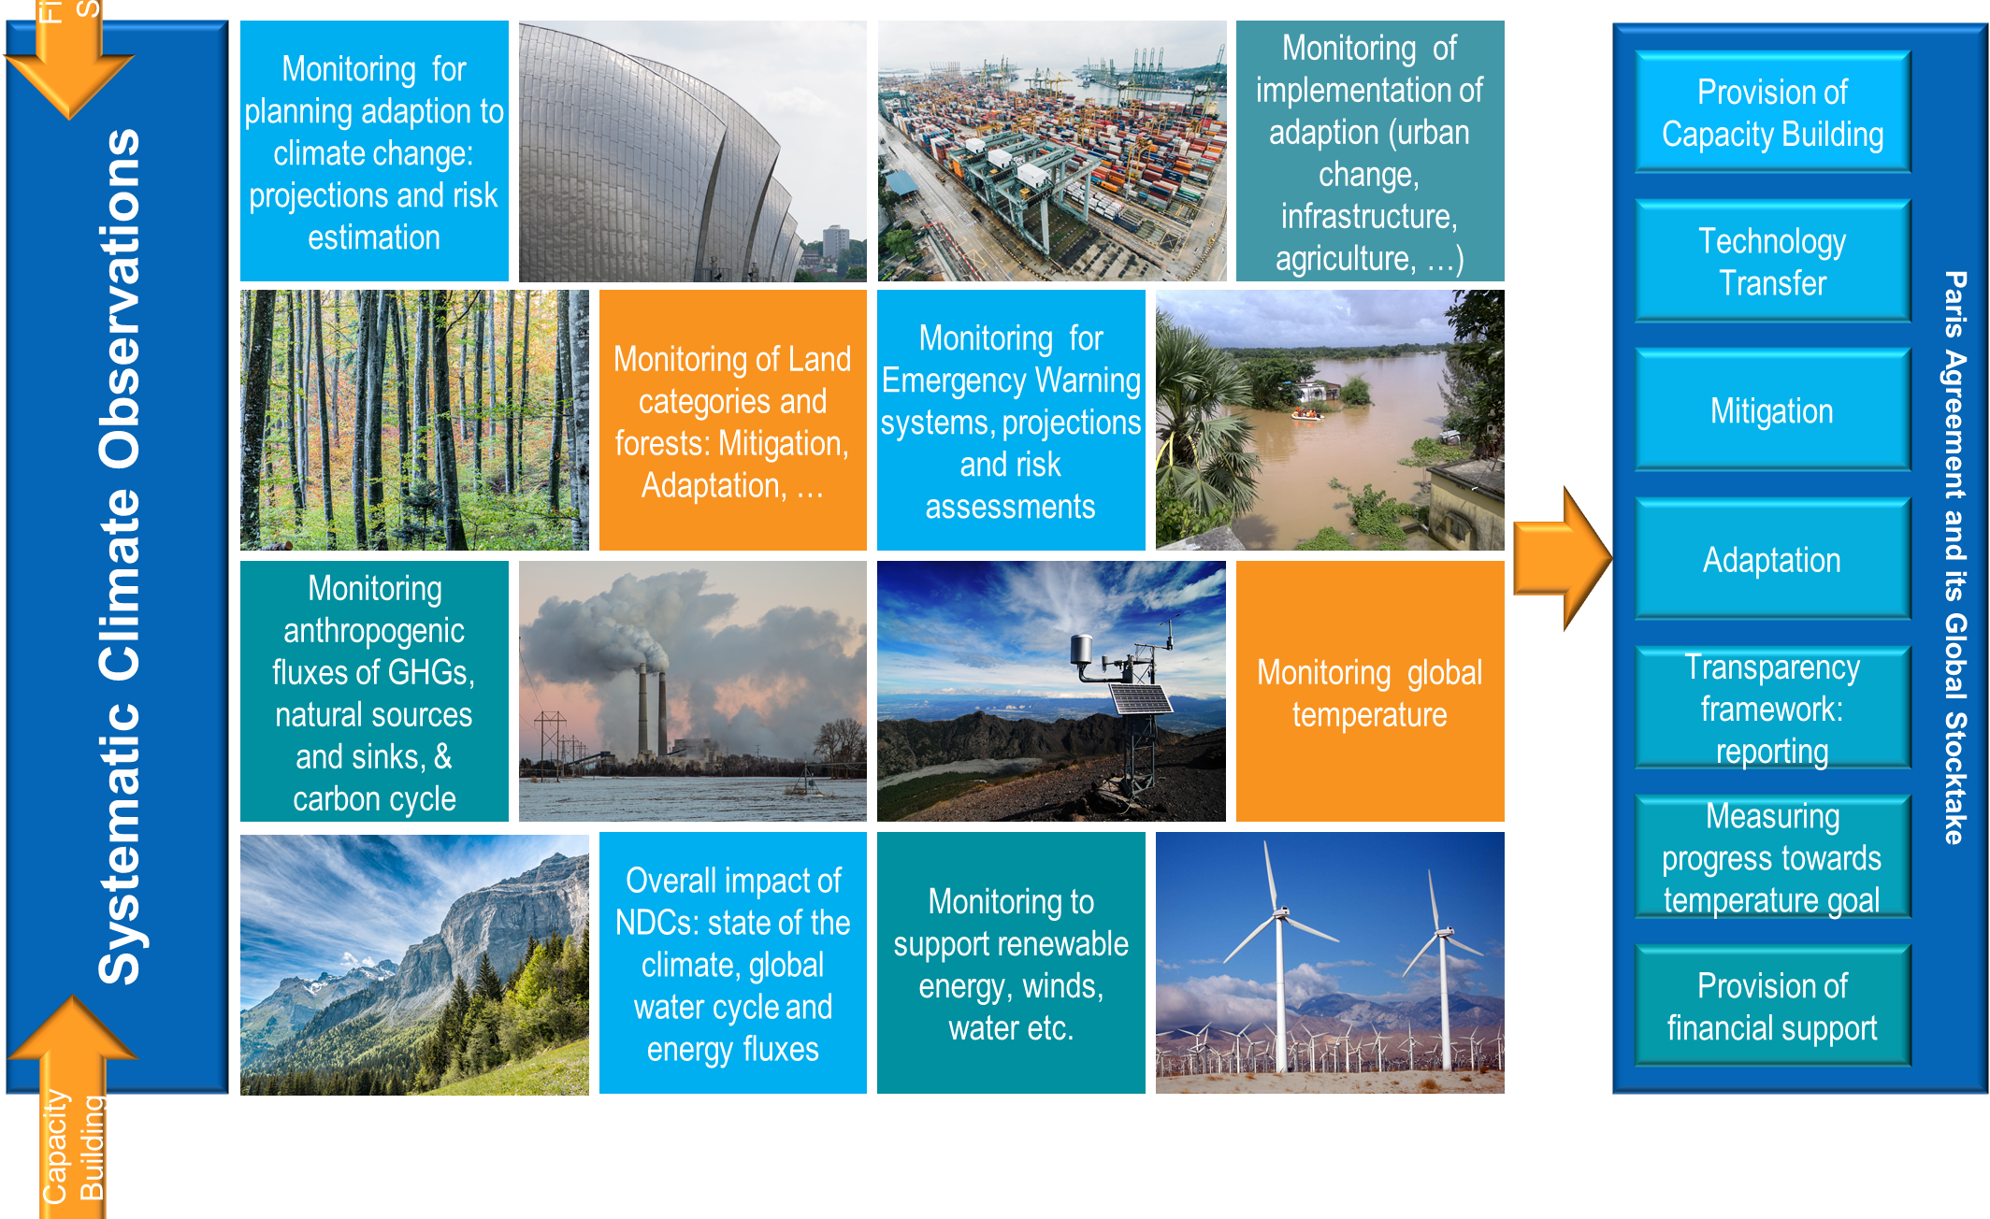
Systematic Observations are fundamental to implementing the Paris Agreement and monitoring its progress.

Slide 18


Climate observations also support:

Slide 19
Climate observations also support: support:

Slide 20
Climate observations also support:

Slide 21
Vision
a world where users have access to the climate-related information they need
Aim
to ensure the availability and quality of observations necessary to monitor, understand and predict the global climate system so that communities and nations can live successfully with climate variability and change
Free and Open
Principles
Transparent
Accurate
Useful
Timely
Best available science
Strategic Goals
Review Essential Climate Variables Monitoring the performance of the observational systems against these needs.
climate observations are enhanced and continued
Components
Support integrated observations, including the Earth’s water and carbon cycles and energy balance
Prepare plans and guidance. Assist with improving the observational infrastructure in countries with limited resources (the GCOS Cooperation Mechanism, GCM
Build on the climate-related components of the established observing systems
Advocate for, and facilitate of data repositories with open access to all climate data.
to meet identified user needs
Coordinate with the disparate observing systems.
adaptation and mitigation to climate change, support sustainable development, & the UNFCCC
Communicate with users, policy makers, funding agencies and the media
free and open access to relevant data

Slide 22
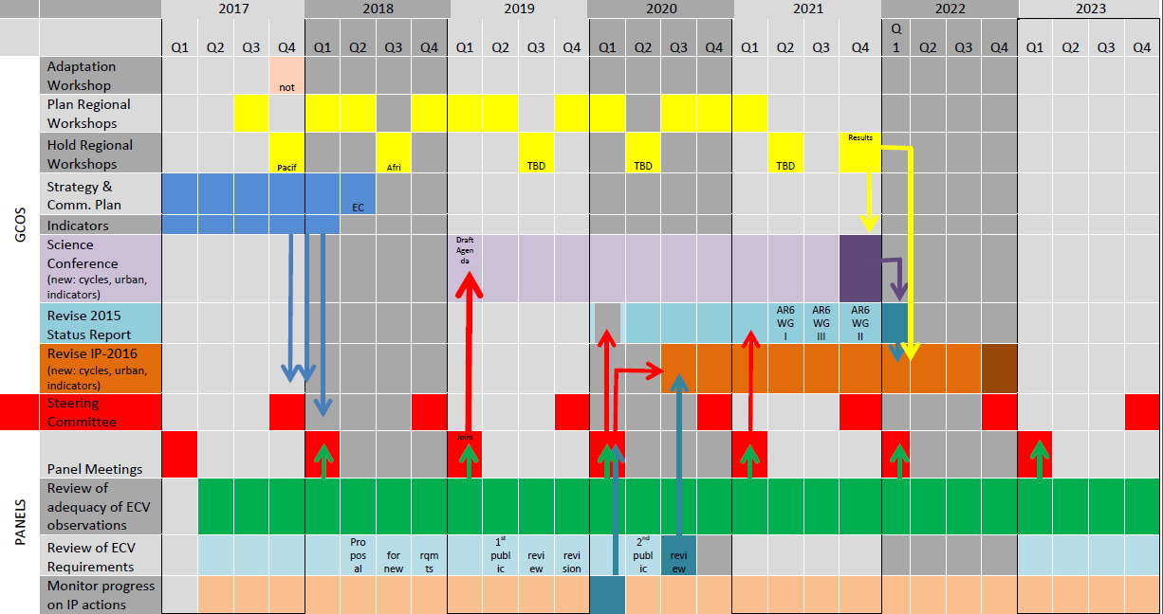
Time Plan
.

